Slide 1


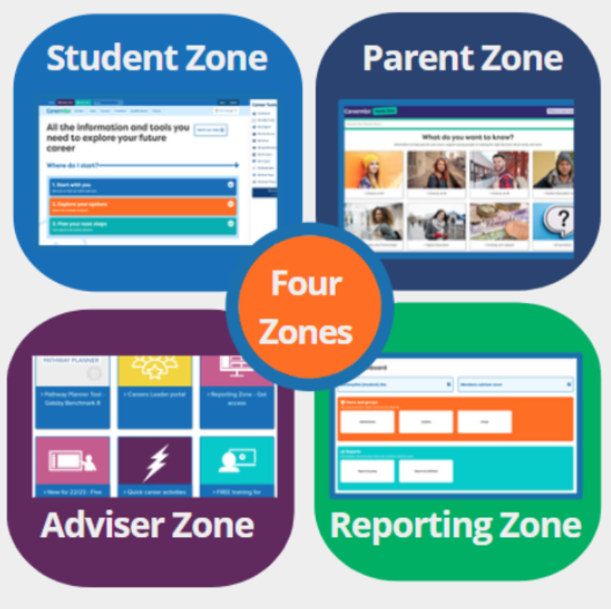


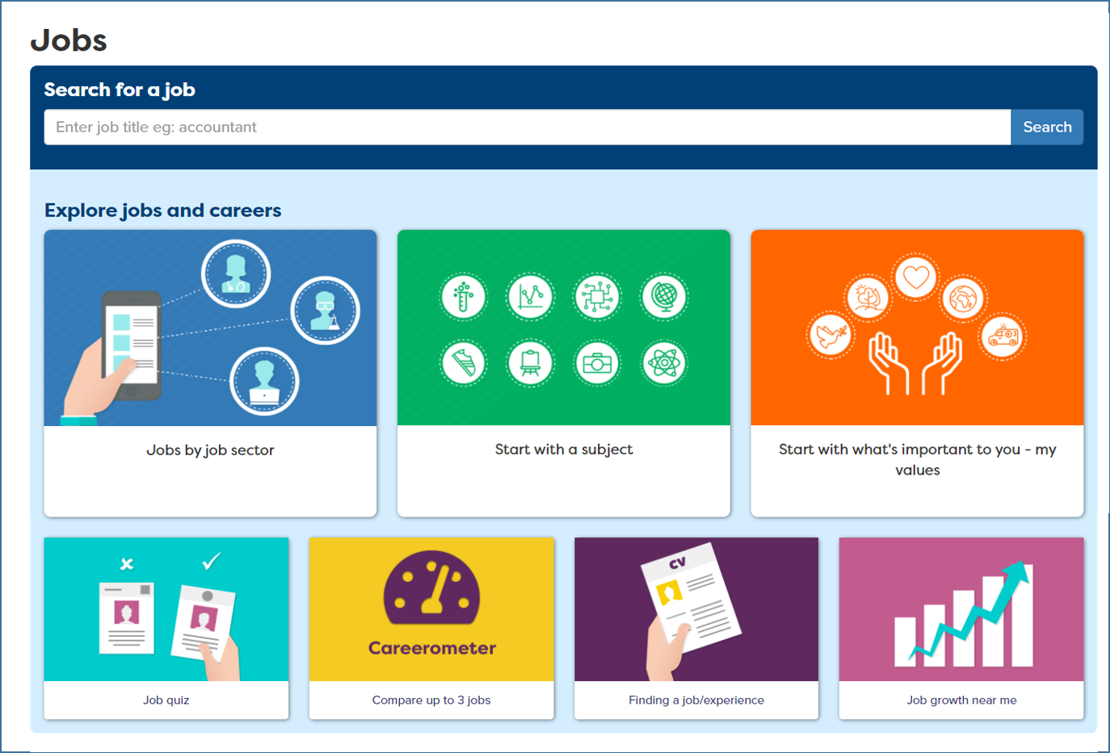


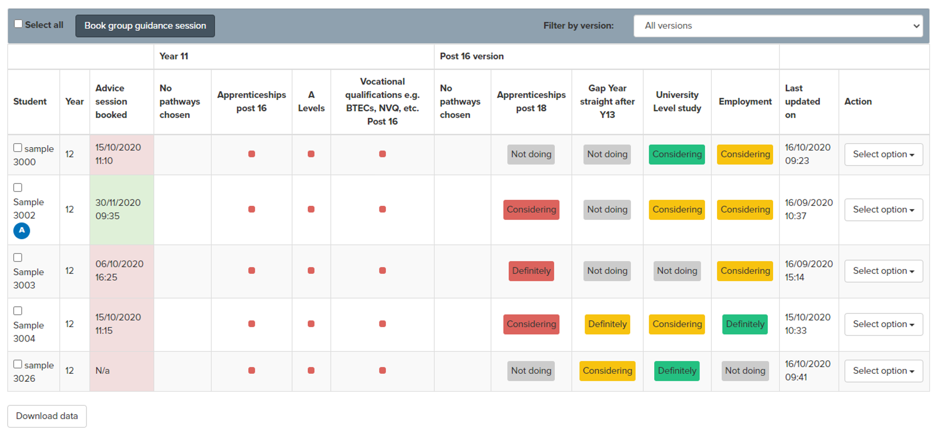

Mapped to Gatsby
Welcome Checklist
Schools
Mapped to reviewed BMs 2024-25
Gatsby Benchmark | Careerpilot sections | How Careerpilot helps schools meet the Gatsby Benchmarks
A stable careers programme |  | The Careerpilot website provides information and advice to young people at KS3-5, written by professional career advisers. The suite of Careerpilot tools can be central to implementing a stable whole school careers programme from year 7-13, with quizzes and activities to support students to explore themselves, their options and to plan their next steps. The Pathway Planner tool supports the personal guidance process through pre planning, triage and follow up. The Adviser Zone has lesson plans, videos and resources to help schools plan and deliver a progressive programme of careers education from year 7-13, including 5-week lessons with outcomes linked to CDI Framework, activities for tutor time, LMI Hot Job resources and support for subject teachers to make the link to careers.
Learning from career and labour market information |  | The Careerpilot site includes non-stereotypical videos and information on 19 job sectors - with over 800+ job profiles, which include regional and national labour market information. Students can also search for Green Jobs specifically. The Careerometer Tool enables young people to compare up to three jobs. The Course Search provides up to date LMI about degrees and the latest apprenticeship vacancies. The Careerpilot Hot Jobs section, in the Adviser Zone, offers posters, images and activities, that you can use to show students and parents the jobs that are predicted to grow, with key data. The Parent Zone supports the wider parent/carer school community to learn more about future careers and pathways.
Addressing the needs of each pupil |  | Career Tools enable registered students to manage their own careers and have access to their own records. Students can tag job sectors, qualifications, providers, etc. which create a Career Tools Report. Choices can be viewed by the student and by school staff through the Reporting Zone, enabling schools to plan encounters with FE/HE and employers. Advisers can record all reports and actions on Careerpilot, visible to the students. The Pathway Planner is an electronic triage system which allows schools to assess and prioritise individual student’s guidance needs at three levels. Tools enable all guidance to be recorded and provide a summary report showing all interventions and their impact, including planned destinations
See other maps: How Careerpilot can be mentioned for Compass

Slide 2
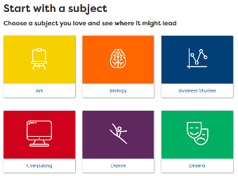

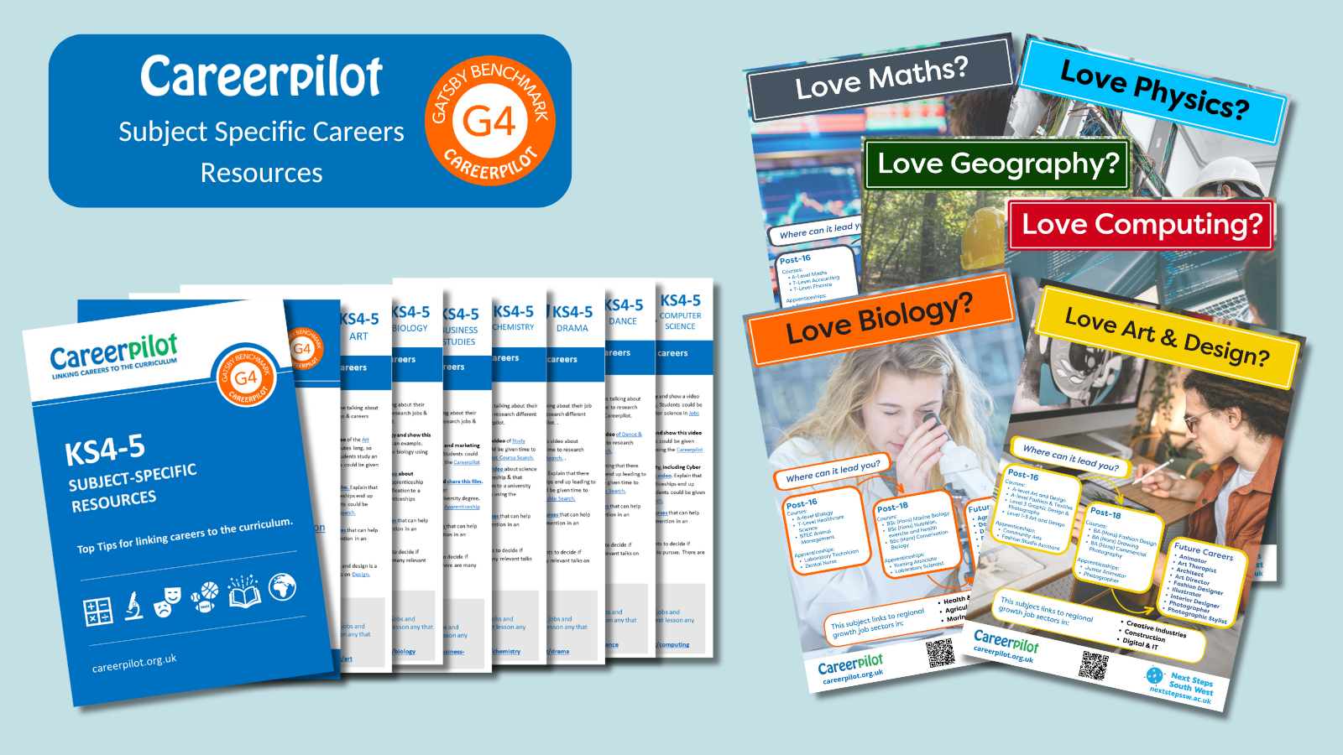
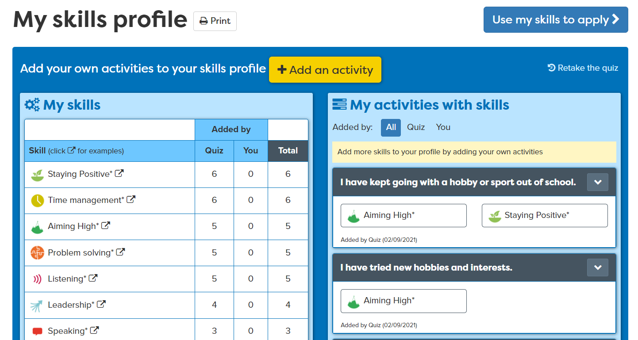

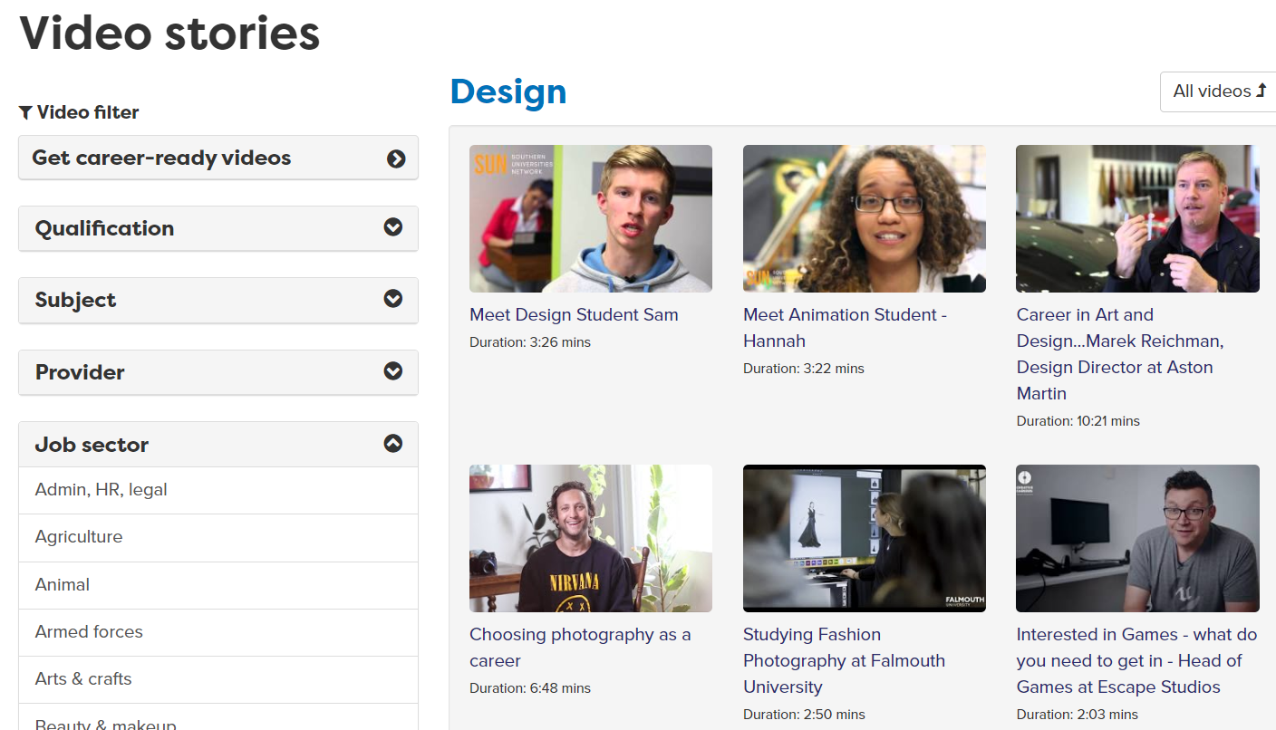
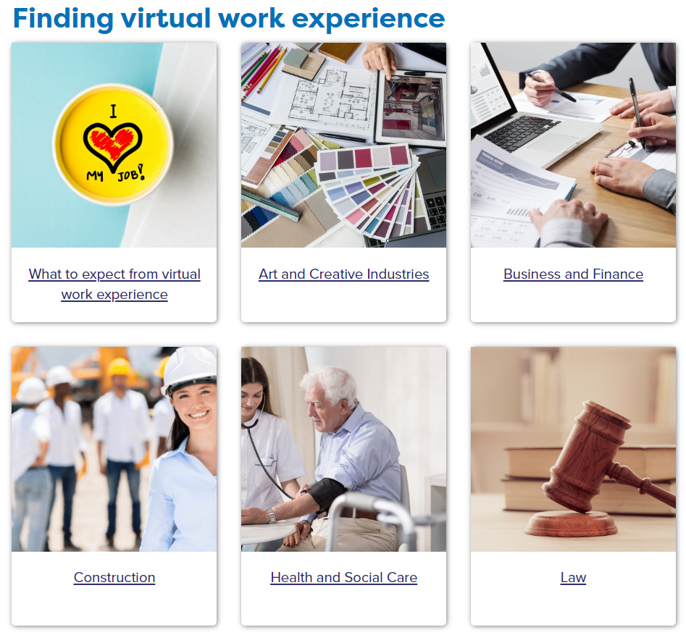



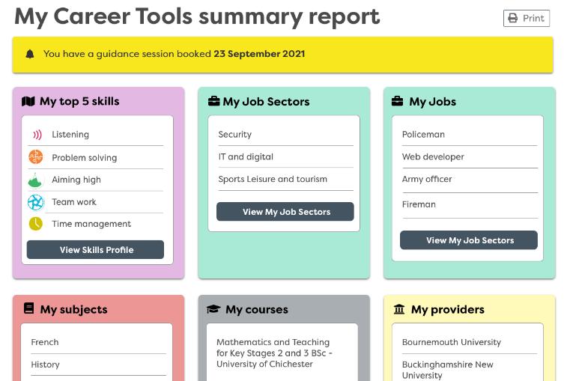


Gatsby Benchmark | Careerpilot sections | How Careerpilot helps schools meet the Gatsby Benchmarks
Linking curriculum learning to careers |  | ‘Start with a subject’ shows where a favourite subject could lead, giving sample jobs, apprenticeships, college and degree courses. The site has information on 19 job sectors, 57 sub-sectors and over 800+ job profiles, including Green Jobs. There are 1000 videos showing routes into a range of jobs, many of which are non-stereotypical and can be searched by subject. We also have Resources for Subject Teachers in the Adviser Zone including subject posters and top tips for linking to careers.
Learning from encounters with employers and employees |  | The site has over 1000 video stories of people talking about their job roles and routes. The Skills Profile enables students to record WEX, employer and FE/HE encounters and what skills they have learnt from these activities - which are added to their Skills Profile which they can use when applying or writing personal statements. Careers staff can use the Reporting Zone reports to plan encounters to meet students’ needs using information about students’ job sector interests.
Experiences of work |  | Careerpilot has a section to help students plan for work experience, which includes ideas for live virtual work experience. There are 800+ job profiles to help students get information about the role, expected skills, entry requirements and LMI. Students can complete the Skills Profile as part of planning for work experience so they have a list of their skills they can talk about at interview, and where they can record their experience and skills developed through work placements. Schools can access a recorded video lesson to help Y10 prepare for work experience.
Encounters with further and higher education |  | Careerpilot has detailed information about ALL study and training routes at age 13/14, 16 and 18. A Qualification Planner helps map a route through the levels. Students can use the Course Search to find courses and apprenticeship vacancies and Find a Provider has links to schools, colleges, universities and training providers. The site has lots of videos from FE/HE students talking about their study and our partner universities post free opportunities for students encounters in the South West.
Personal Guidance |  | Careerpilot can help students prepare for guidance. Guidance advisers can use the Career Tools report to start the session and record reports and actions at the end of the session. The Adviser Zone includes suggested pre-guidance activities for different key stages related to age, stage and decision point. The Pathway Planner triage tool prepares students for their options. Students complete a quiz to assess how ready they are for their chosen pathways. Data reports can be used by CLs and career advisers to target guidance to meet individual need.

