Slide 1


careerpilot.org.uk
Careerpilot is closing. This resource is only available to use until 23rd October 2026.
5 Week Careers Programme
Year 8 - Know Yourself, Know Your Skills

Slide 2
Teacher Overview: Year 8
This 5-week careers programme for Year 8 aims to support students to:
Develop their career skills for life, learning and work
Prepare them for the next career decisions they will have to make.
Lessons have been developed by the Careerpilot Team – all are qualified career advisers and teachers.
The programme contains all you need to deliver 5 x 50–60-minute lessons, or the first lesson can be delivered as a standalone session. All lessons use a PowerPoint presentation, with notes to explain screens. The first lesson has been pre-recorded as a video lesson with a member of the Careerpilot Team virtually delivering the session and providing instruction to the facilitating teacher should you wish to use this delivery option.
Lesson 1, 2 and 5 require all students to have individual access to Careerpilot to register and use the wealth of information and tools offered through the site to help build their career report.
Careerpilot can be accessed through a pc, tablet or phone at www.careerpilot.org.uk
Lesson 3-4 can either be delivered with or without student online access, using Careerpilot for online tasks where possible, or through use of adapted offline tasks if individual computer/phone access is not available.
To provide feedback or ask a question contact:
careerpilot@bath.ac.uk

Slide 3



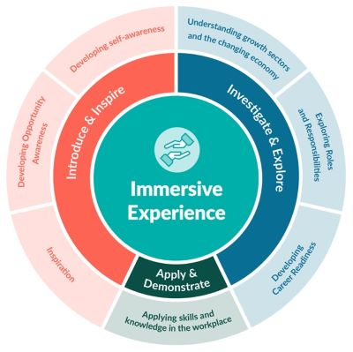



The Year 8 careers lessons are mapped to:
CDI Framework and career development skills
Gatsby Benchmarks
See the big picture by paying attention to how the economy, politics and society connect with your own life and career.
www.gatsbybenchmarks.org.uk/
The Equalex Framework to support preparation for Modern Work Experience
Manage your career actively, make the most of opportunities and learn from setbacks.
Explore the full range of possibilities open to you and learn about recruitment processes and the culture of different workplaces.
Grow throughout life by learning and reflecting on yourself, your background, and your strengths.
Introduce & Inspire
Investigate & Explore
www.thecdi.net/write/Framework/CDI_86-Framework-Guidance_in_Secondary_Schools-webFINAL.pdf
www.careersandenterprise.co.uk/modern-work-experience/equalex-for-educators/
https://www.careerpilot.org.uk/skills-profile/activities
Skills Builder Universal Framework 2.0
www.skillsbuilder.org/universal-framework
Notes:
These lessons have been developed to support students to build their career development skills, as identified by the CDI Career Development Famework. Each lesson identifies two outcomes linked to the CDI framework.
The lessons will support meeting Gatsby Benchmark 1, 2, 3, 4 and 6 and support the Equalex Framework for preparing students for Modern Work Experience as they ‘Introduce & Inspire’ students about the world of work and ‘Investigate & Explore’ jobs and careers.
The lessons provide opportunities for students to practice their essential skills as identified in the Skills Builder Framework 2.0 - www.skillsbuilder.org/universal-framework/
The relevant skills steps are identified in the teacher notes in relevant activities, with reflection questions and prompts for discussion with students as part of the plenary.

Slide 4
Lesson Overview – Year 8
Lesson 1: Know Yourself
Students complete Buzz Quiz to identify their animal personality and look at jobs that might suit them.
All students will need access to Careerpilot for this first lesson.
Lesson 2: Know Your Skills
Students explore what are skills and complete a skills profile online.
All students will need access to Careerpilot for this lesson.
Lesson 3: Skills for Work
Students use LMI on posters or on Careerpilot to look at what skills are needed for different jobs.
Alternative task options for students with or without individual access to Careerpilot. See slide 47-49.
All students need paper and pens.
Lesson 4: Selling Yourself
Students think about their own skills strengths and interests and share them with others.
Alternative task options for students with or without individual access to Careerpilot. See slide 57.
All students need paper and pens.
Lesson 5: Careerpilot quiz
Students take part in a quiz to reinforce the content of the last four lessons.
All students require paired online access to Careerpilot, paper and pens.
Notes:
Use this page to navigate directly to the relevant lesson.

Slide 5


Careerpilot is closing. This resource is only available to use until 23rd October 2026.
Know Yourself, Know Your Skills
Lesson 1: Know Yourself
This lesson can be delivered through a video recording
Notes:
The Career Development Institute have a new framework which shows that everybody, young and old, needs to have the skills to do these 6 things if they are going to be able to manage their future careers.
In this session we will be helping you develop the skills for these three.
This is what we will be doing.

Slide 6


Getting Career-ready
Introduction and warm up activity – 10-15 mins
You will complete a personality quiz to find out your personality type.
Careerpilot Activities 20-30 mins
You will use your personality profile to explore jobs and courses that may suit you.
Presentations
5-15 mins
Notes:
The Career Development Institute has developed a careers framework that shows the skills everybody needs to have to manage their future career.
This slide shows the students which of the career learning areas (CDI) that this lesson 1 links to.
You can also share the structure of the session with students.

Slide 7
What is a personality?
Your personality is what makes you special and different from everyone else. It's how you think, feel, and act. It's what makes you laugh, cry, or get excited. Everyone has a different personality, and that's what makes the world so interesting!
TASK:
Can you think of 10 words that describe how people may feel or act? These are called personality traits.
For example, people may be kind, thoughtful, funny…..
5 mins
Notes:
Help students to brainstorm different words that describe how they may feel or act. Explain that these words are like building blocks for our personalities. Everyone has a mix of these qualities and that is what makes us special and unique.

Slide 8

Personality types at work
A personality type is like a big group of people who share similar personality traits. They won’t be the same, but they may be more likely to act or feel in a certain way.
In work, some personality types love to be part of a busy team, while others prefer to work alone. Some prefer to detailed tasks, while others like to look at the bigger picture.
Our personality type can mean we are better suited to certain jobs or careers that will make the most of our personality and strengths.

Slide 9
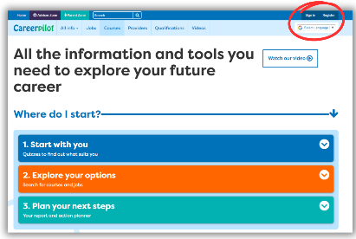
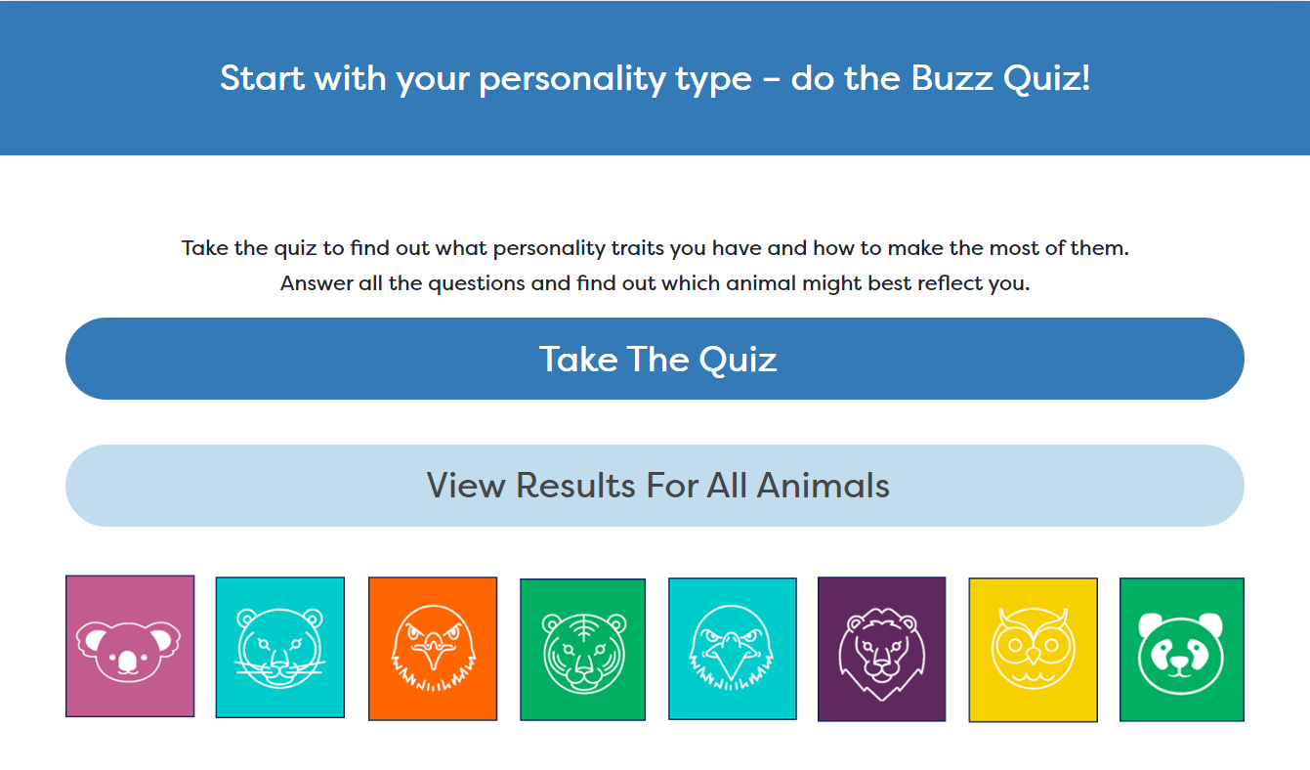

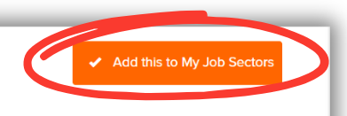
In today’s lesson you will…
Register or sign in to Careerpilot
2. Complete the Buzz Personality Quiz to discover your personality type. Make a note of your animal.
3. Explore job sectors that could be a good fit for your personality strengths
4. Save 2 job sectors that are of interest to your Career Tools.
Notes:
Explain to students what activities they will be doing shortly on Careerpilot.
Use the following slides 11-15 to explain how to complete these activities before getting started….

Slide 10
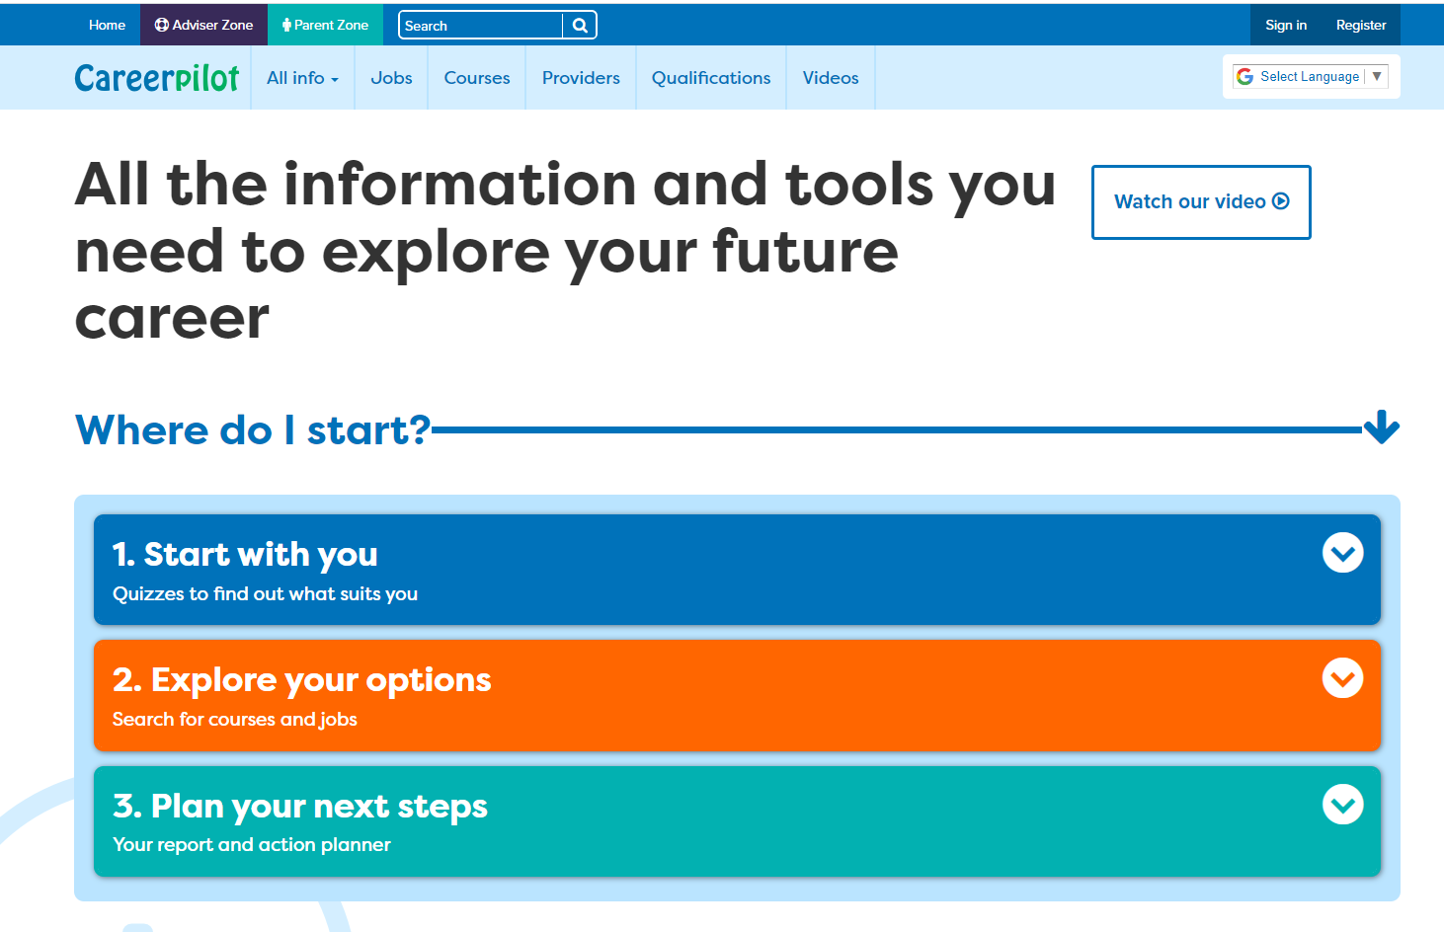
Introducing Careerpilot
Sign in to Careerpilot at school or any time at home to explore ideas for your future career.
You keep your Careerpilot account until you are 20!
Jobs, courses, qualification planner, videos
Quizzes, tools – 3 stages to help you decide
Future qualifications and pathways
careerpilot.org.uk
Notes:
Careerpilot is a website that you can use for free. It has lots of information and tools to help you to start to think about future career ideas and pathways and to get to know yourself, your skills, interests and strengths better.
The website is built around 3 stages:
Start with you – with quizzes to find out more about yourself and what jobs might suit you
Explore your options – where you can search for courses and jobs
Plan your next steps – where you can build a report and plan some actions.

Slide 11
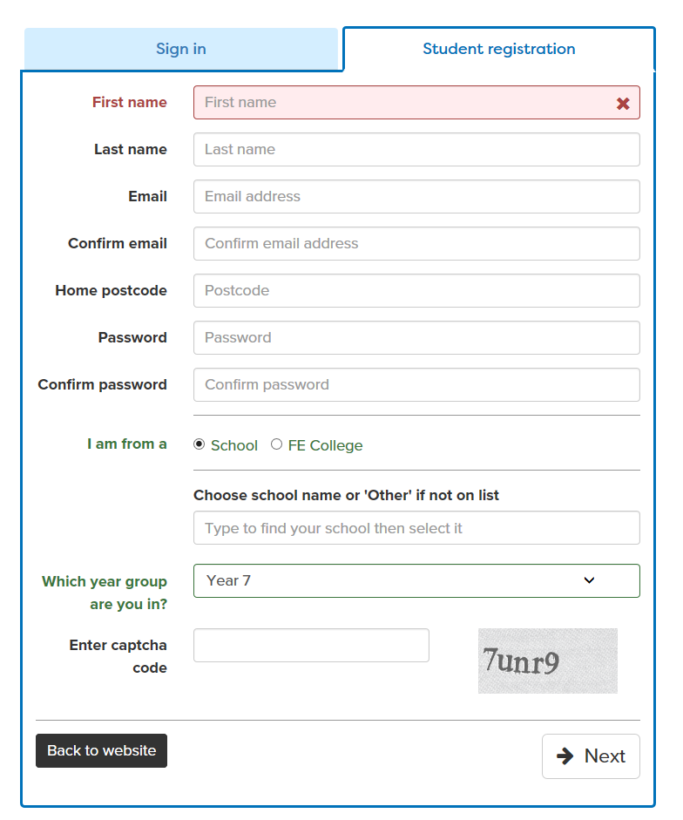

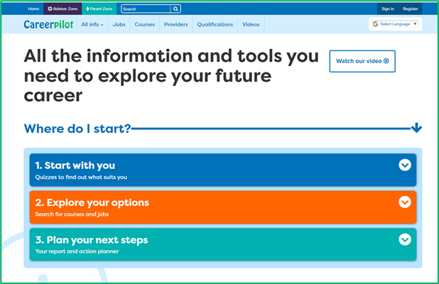
Register or sign in to Careerpilot
If you have registered before – sign in
Notes:
Show students that if they are new to Careerpilot, they need to register to use the website.
They must click on the ‘Register’ button in the top right corner to open up a short registration form that takes a few minutes to complete.
Remind students to use their school email address to register and to click on your school from the drop down list.
Students that have already registered just need to log in with their email and password.

Slide 12

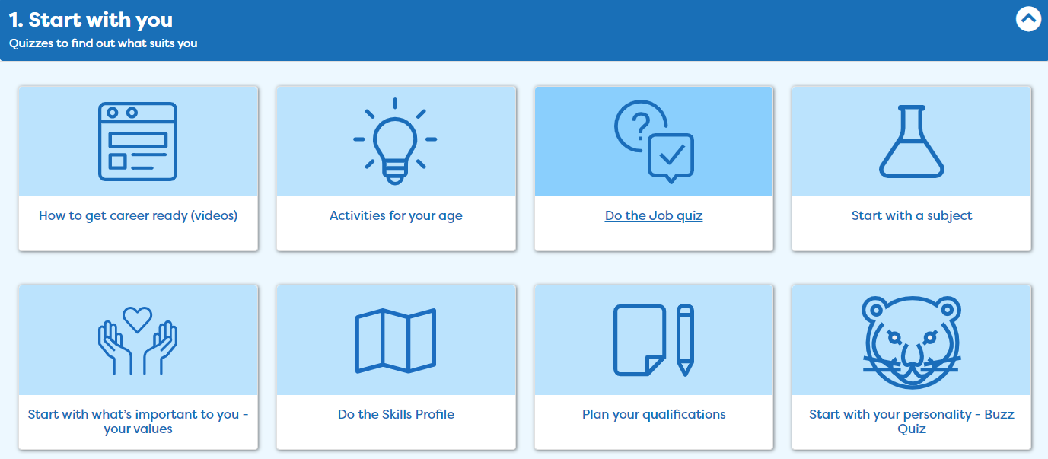
Complete the Buzz Quiz
Notes:
Once registered students need to go to ‘Start with you’ on the home page and click on ‘Start with your personality – Buzz Quiz’.

Slide 13
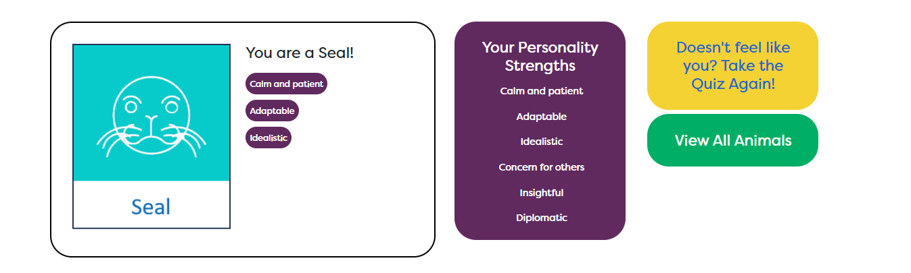
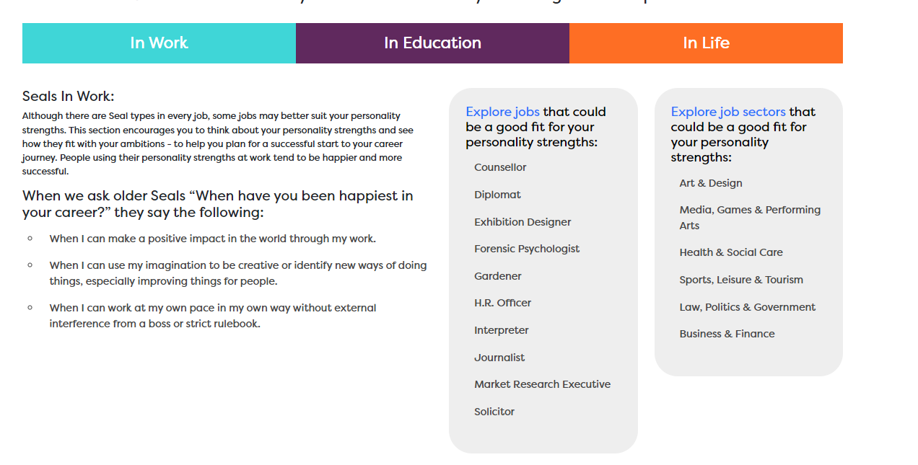
Find out what animal you are
Notes:
Find out what animal you are and explore job sectors that may suit you on Careerpilot.

Slide 14

Tag 2 job sectors you’re interested in
Notes:
Students can pick two job sectors they are interested in (they can have more) and click ‘Add this to My Job Sectors’ to save in their Career Tools.

Slide 15
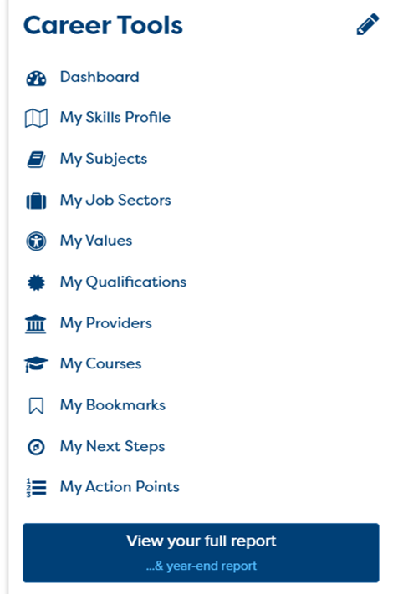
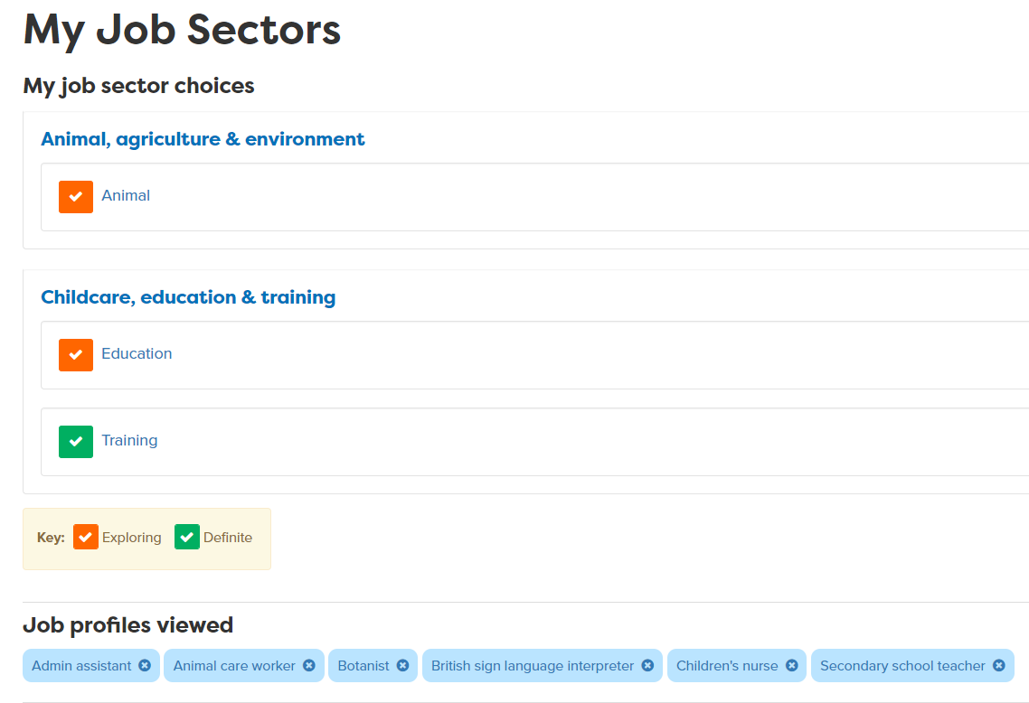
Use your Career Tools
Go to the home page and select Career Tools at top right of home page.
Click on My Job Sectors to see those you tagged and job profiles you viewed.
Notes:
Encourage students to go to their Career Tools via the home page and click on My Job Sectors to see their chosen sectors and the job profiles they have viewed.
Explain this will be saved for them to revisit at a later date and they can add more or change their choices as they go through school.

Slide 16

Careerpilot Task
20 mins
Register or sign in to Careerpilot
2. Go to Start with You. Then choose the Buzz Personality Quiz to discover your personality type. Make a note of your animal.
3. Explore job sectors that could be a good fit for your personality strengths
4. Save 2 job sectors that are of interest to your Career Tools.
Notes:
Explain to the students what activities they will be doing shortly on Careerpilot.

Slide 17


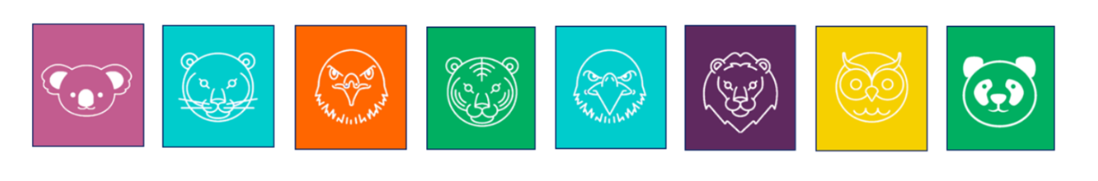
Sharing your personality type
With a partner, take it in turns to talk about your animal personality type and what jobs you found that were interesting to you.
Speak clearly
Show your partner you are paying attention while they speak
5 mins
Notes:
Give students time to talk in pairs about their skill strength.
This activity support students to develop the following skills:
Step 7 Speaking – Expressing self: I use tone, expression and gesture to be understood
Step 7 Listening – Active listening: I show I paying attention
Ask the students for feedback on how they feel they or a partner have demonstrated these skills steps.

Slide 18
Getting Career-ready
You completed a personality quiz to find out your personality type.
TODAY
You used your personality profile to explore jobs and courses that may suit you.
Notes:
The Career Development Institute has developed a careers framework that shows the skills everybody needs to have to manage their future career.
This slide shows the students which of the career learning areas (CDI) that this lesson 1 links to.
You can also share the structure of the session with students.

Slide 19
Careerpilot is closing. This resource is only available to use until 23rd October 2026.
Know Yourself, Know Your Skills
Lesson 2: Know Your Skills

Slide 20
Getting Career-ready
Introduction and warm up activity – 10-15 mins
You will complete a self assessment to create your own skills profile.
You will talk about your skills strengths with others in your class.
Careerpilot Activities 20-30 mins
You will recognise the skills needed for the world of work and how to build them.
Presentations
5-15 mins
Notes:
The Career Development Institute has developed a careers framework that shows the skills everybody needs to have to manage their future career.
This slide shows the students which of the career learning areas (CDI) that this lesson links to. You can also share the structure of the session with students.

Slide 21
What skills do we need for work?
Alongside your personality type, qualifications and work experience, you may also need to build certain skills for a successful career.
Some technical skills will be specific to a job, like computer skills to work in IT or food preparation skills to work in catering, but there are also some essential skills that are needed by everybody, for almost any job.

Slide 22



Skills Warm-up
Working in pairs, you have 5 minutes to try to think of as many different skills that you may need for the world of work.
Which skills do you think are essential skills that everyone needs for almost any job?
5 mins
Notes:
Students must work in pairs to write down as many skills as they can that may be needed for work.
They have 5 minutes to work together and to list, draw or create a mind map of skills on paper.
Ask them to circle skill they think are essential for every job.

Slide 23






The Essential Skills
Notes:
Class discussion – what skills did students come up with?
There are eight skills that have been identified by employers as being essential to any job. They are people skills, so are all about how you communicate with others, how you manage yourself and come up with new ideas.
Communication:
Listening - Receiving, retaining and processing of information
Speaking - Transmitting information or ideas
Creative Problem Solving:
Creativity – Using imagination and generating new ideas
Problem Solving – Finding solutions to problems
Self-management:
Planning – Setting goals and designing routes to achieve them
Adapting- overcoming challenges and setbacks to achieve goals
Collaboration:
Teamwork - Working cooperatively with others to achieve a shared goal
Leadership - Supporting, encouraging and motivating others to achieve a shared goal

Slide 24


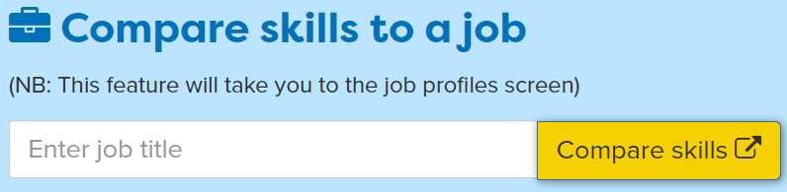
In today’s lesson you will…
Register or sign in to Careerpilot
2. Complete the Skills Profile
3. Add 2 new activities where you have developed your skills
4. Compare your skills with those needed for 3 different jobs
Notes:
Explain to students what activities they will be doing shortly on Careerpilot.
Use the following slides 11-15 to explain how to complete these activities before getting started….

Slide 25
Register or sign in to Careerpilot
If you have registered before – sign in
Notes:
Show students that if they are new to Careerpilot, they need to register to use the website.
They must click on the ‘Register’ button in the top right corner to open up a short registration form that takes a few minutes to complete.
Remind students to use their school email address to register and to click on your school from the drop down list.
Students that have already registered just need to log in with their email and password.

Slide 26
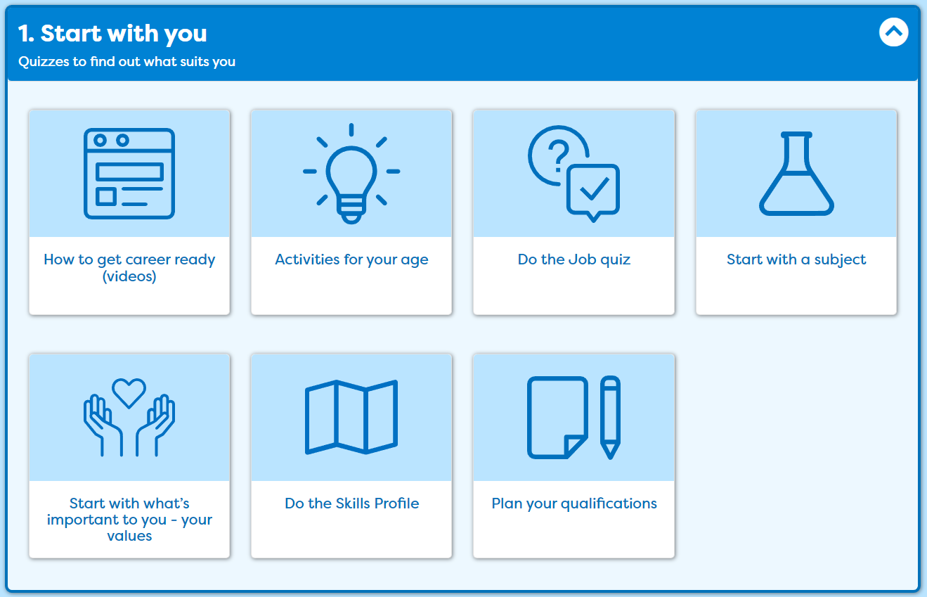
Complete the Skills Profile
Notes:
Once registered students need to go to ‘Start with you’ on the home page and click on ‘Do the Skills Quiz’.
Students will need to complete the skill profile quiz to identify skills they have already started to develop.

Slide 27
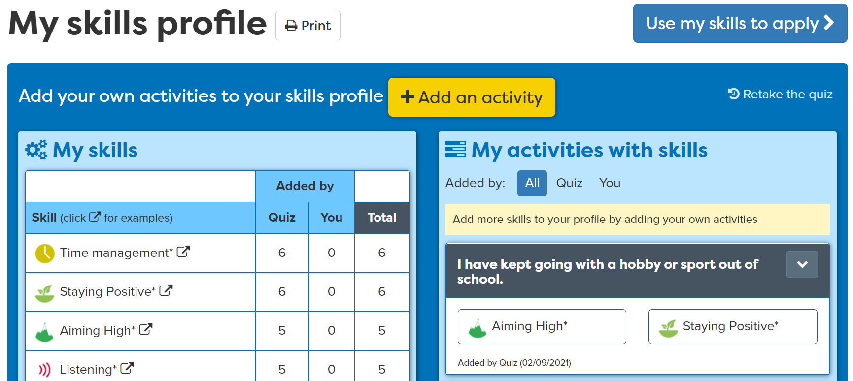
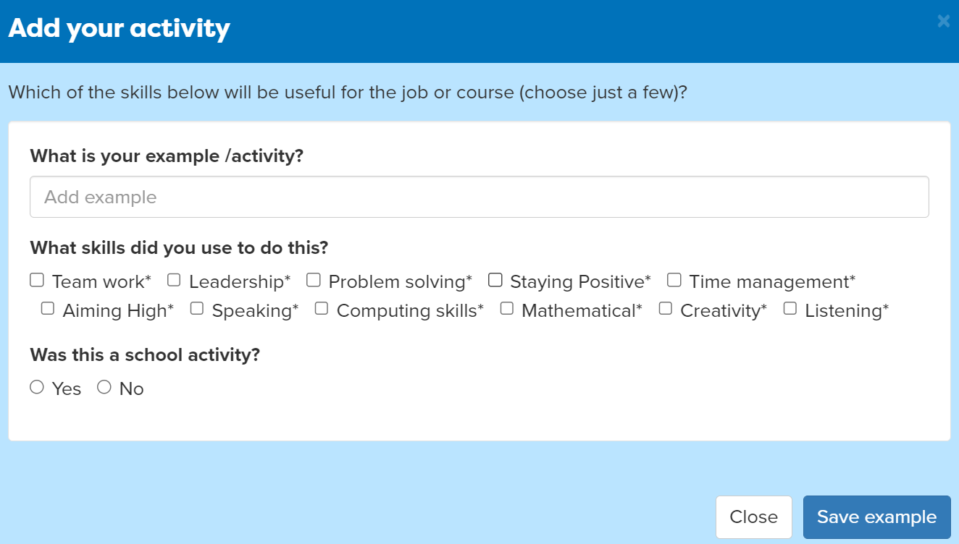
Add activities
Notes:
Students can add activities that they have completed where they have been building their skills.
For example, they may take part in a club outside of school where they use Teamwork skills.

Slide 28
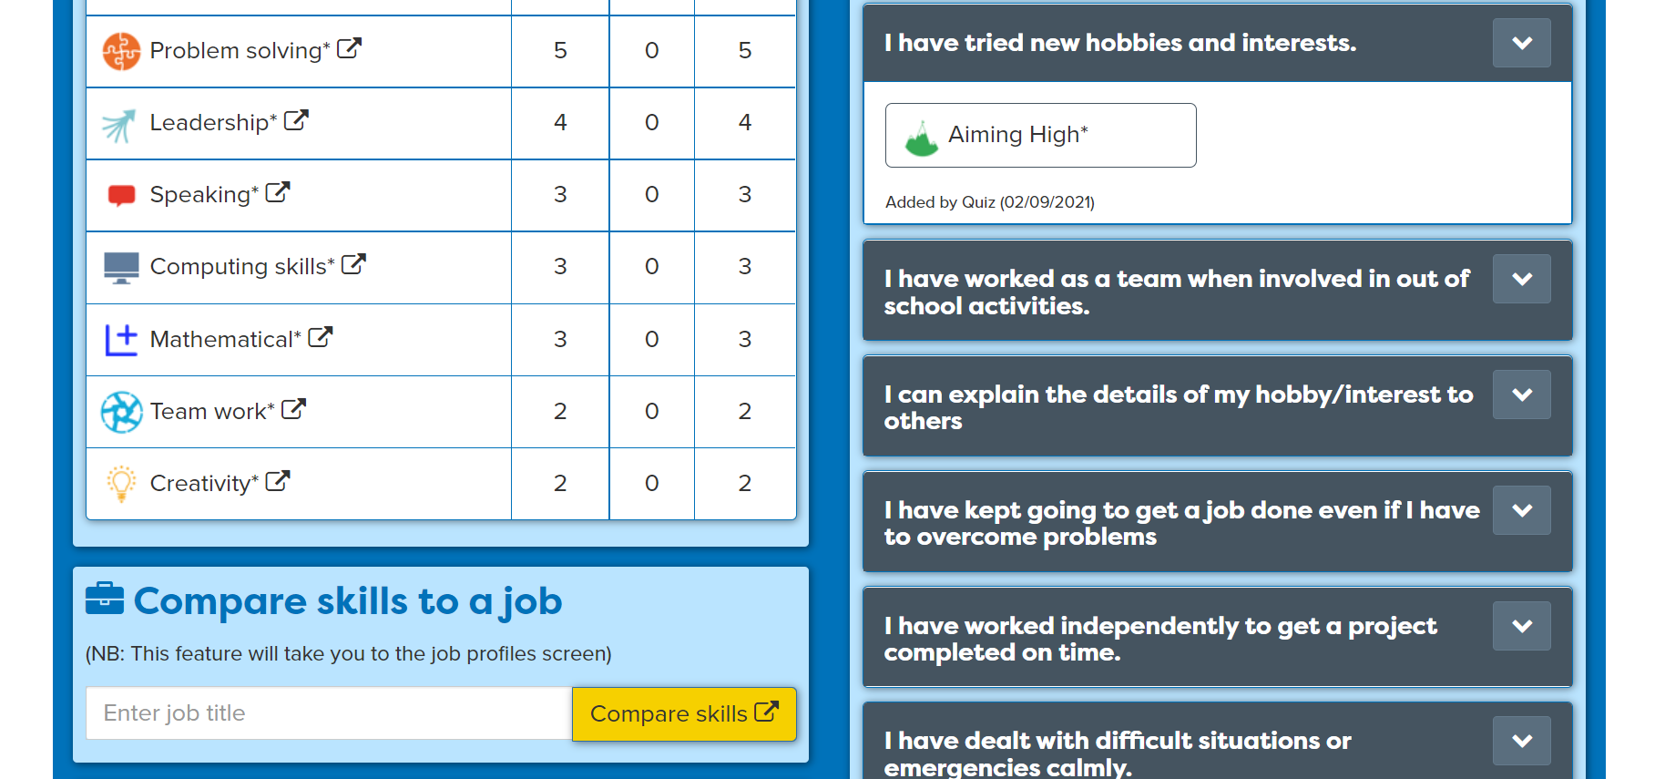
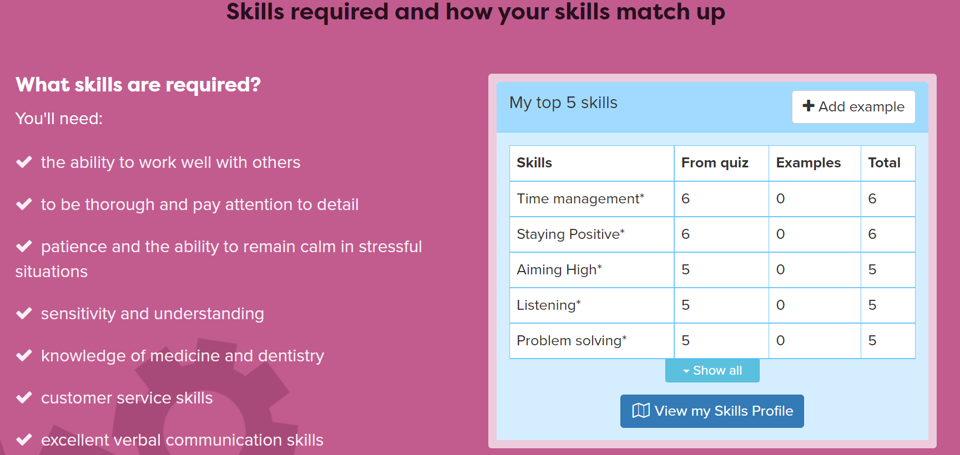
Compare your skills with a job
Notes:
Students can compare their own skills with those needed for 3 different jobs. Are there skills they need to develop further?
This will open the job profile so they can find out more about the job they’ve selected.
Extension: Students may wish to take notes about any jobs that are of interest, noting salary and day to day tasks.

Slide 29
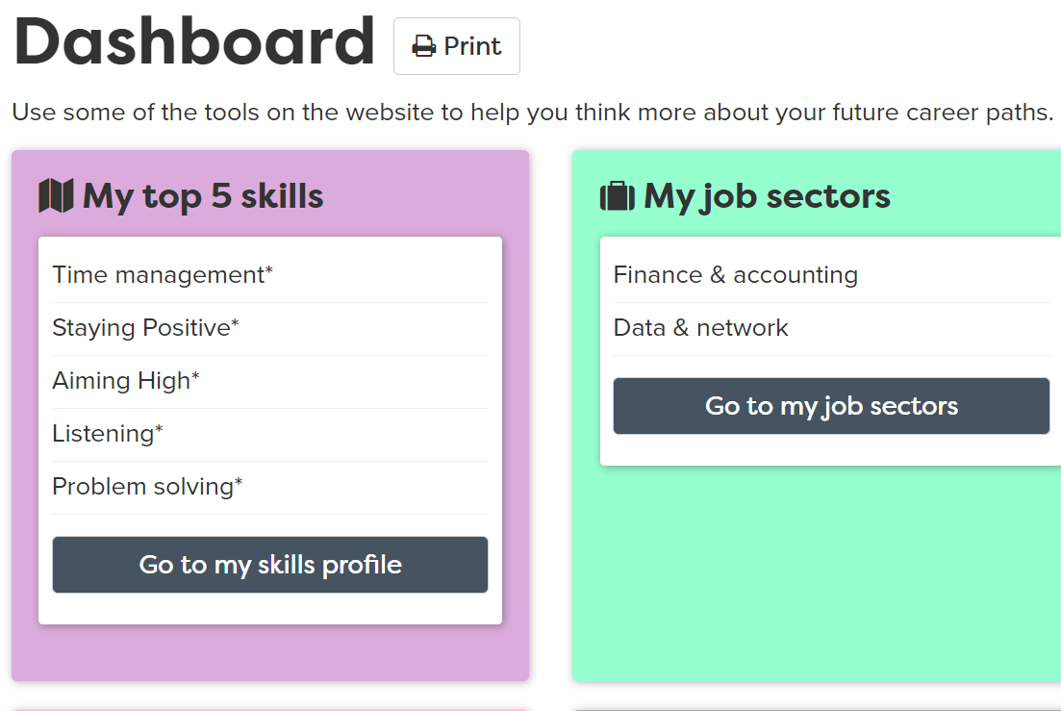
Using your Career Tools
Notes:
Encourage students to go to their Career Tools via the home page and select Career Tools at top right of home page.
Click on My Skills Profile to see your results or view your top 5 skills on the Dashboard.
Explain this will be saved for them to revisit at a later date and they can add more or change their choices as they go through school.

Slide 30
Careerpilot Task
20 mins
Register or sign in to Careerpilot
2. Complete the Skills Profile
3. Add 2 new activities where you have developed your skills
4. Compare your skills with those needed for 3 different jobs
Notes:
Explain to students what activities they will be doing shortly on Careerpilot.
Use the following slides 11-15 to explain how to complete these activities before getting started….

Slide 31
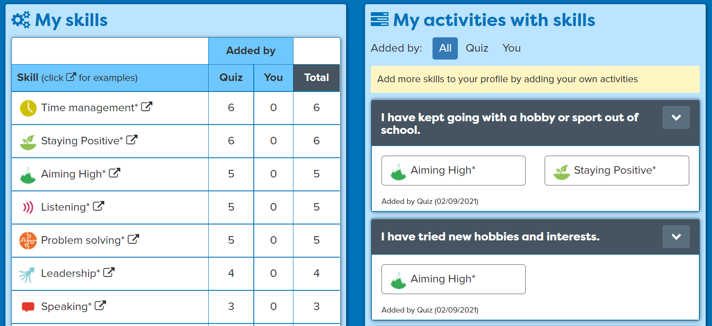
Sharing your skills
With a partner, take it in turns to talk about your skills and strengths.
Speak clearly and show some examples of where you
have been building skills.
Listen carefully while your partner speaks and show you are listening by asking questions to find out more
5 mins
Notes:
Give students time to talk in pairs about their skill strength.
This activity support students to develop the following skills:
Step 8 Speaking – Using facts: I use facts and examples to support my communication
Step 8 Listening – Questioning: I ask open questions to understand more
You may want to check students understanding of these skills steps.
Ask the students for feedback on how they feel they or a partner have demonstrated these skills steps.

Slide 32
Getting Career-ready
You have completed a skills profile and know your skills strengths and areas to develop.
You can talk about your skills strengths with others in your class.
TODAY
You recognise the skills needed for the world of work and know how to build them.
Notes:
Ask class to list the eight essential skills.
Communication - Listening and Speaking
Creative Problem Solving - Problem Solving and Creativity
Self-management – Adapting and Planning
Collaboration - Leadership and Teamwork
Ask class to put hands up if they have completed the skills profile and know their current skills strengths.

Slide 33

Careerpilot is closing. This resource is only available to use until 23rd October 2026.
Know Yourself, Know Your Skills
Lesson 3: Skills for Work

Slide 34
Getting Career-ready
Introduction and warm up activity – 10-15 mins
You will explore how developments in technology and science are changing jobs of the future and how skills are important.
Careerpilot Activities 20-30 mins
You will understand what Labour Market Intelligence (LMI) is and how it can be used to research different jobs and skills needed.
Presentations
5-15 mins
Notes:
The Career Development Institute has developed a careers framework that shows the skills everybody needs to have to manage their future career.
This slide shows the students which of the career learning areas (CDI) that this lesson links to. You can also share the structure of the session with students.

Slide 35

Changing job landscape
Technology and science are developing fast to improve our lives in so many ways. As the world changes, the types of jobs people do will change too.
Notes:
Technology is changing

Slide 36




The growth in automation
In some workplaces certain human tasks are being replaced by robots or computers. What human tasks do you think have been replaced by technology in the images below?
5 mins
Notes:
Students can discuss in pairs to as a class.
Examples in photos:
Amazon Go is a new kind of store featuring the world's most advanced shopping technology. No lines, no checkout – just grab and go!
Robotic production line in a factory
Drone delivery of parcels
Driverless cars

Slide 37


The skills we need
However, there are some skills that humans bring to the workplace that can’t easily be replaced by technology.
These are the skills that allow us to plan and organise, to work and communicate effectively with others, to come up with new ideas and ways of doing things.
Notes:
These eight skills have been identified by employers as being essential to any job. They are people skills, so are all about how you communicate with others, how you manage yourself and come up with new ideas.
You can see them as four pairs of skills:
Communication - Listening and Speaking
Creative Problem Solving - Problem Solving and Creativity
Self-management – Adapting and Planning
Collaboration - Leadership and Teamwork
You may ask students if they can give an example of where one of these skills might be used in the workplace.

Slide 38
What is LMI?
LMI stands for Labour Market Information - information about the jobs market. LMI can tell you about different jobs, what you might earn (salaries) and can show you the skills and qualifications needed for the job.

Slide 39
Student Tasks
If students have access to a computer each or in pairs continue with this presentation, looking at slides 40-44 and show slide 49 to end the session
If students DO NOT have access to a computer, go to slide 45.

Slide 40
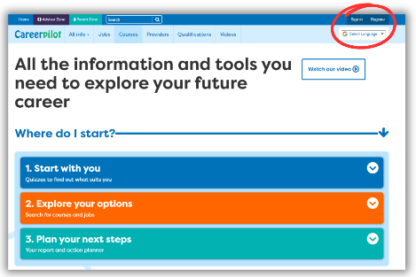

In today’s lesson you will….
Log in to Careerpilot
2. Go to Job Sectors and look at 3 different job profiles
3. Use the LMI on the job profile to look at:
What you’ll do – day to day tasks
Routes into this job
What skills are required and how do your skills match up
4. Create a table or poster to show what you find out about each job. Make a note of any skills you would need to develop further to do these jobs.
Notes:
Explain to students what activities they will be doing shortly on Careerpilot.
They have 30 minutes to complete these tasks.

Slide 41
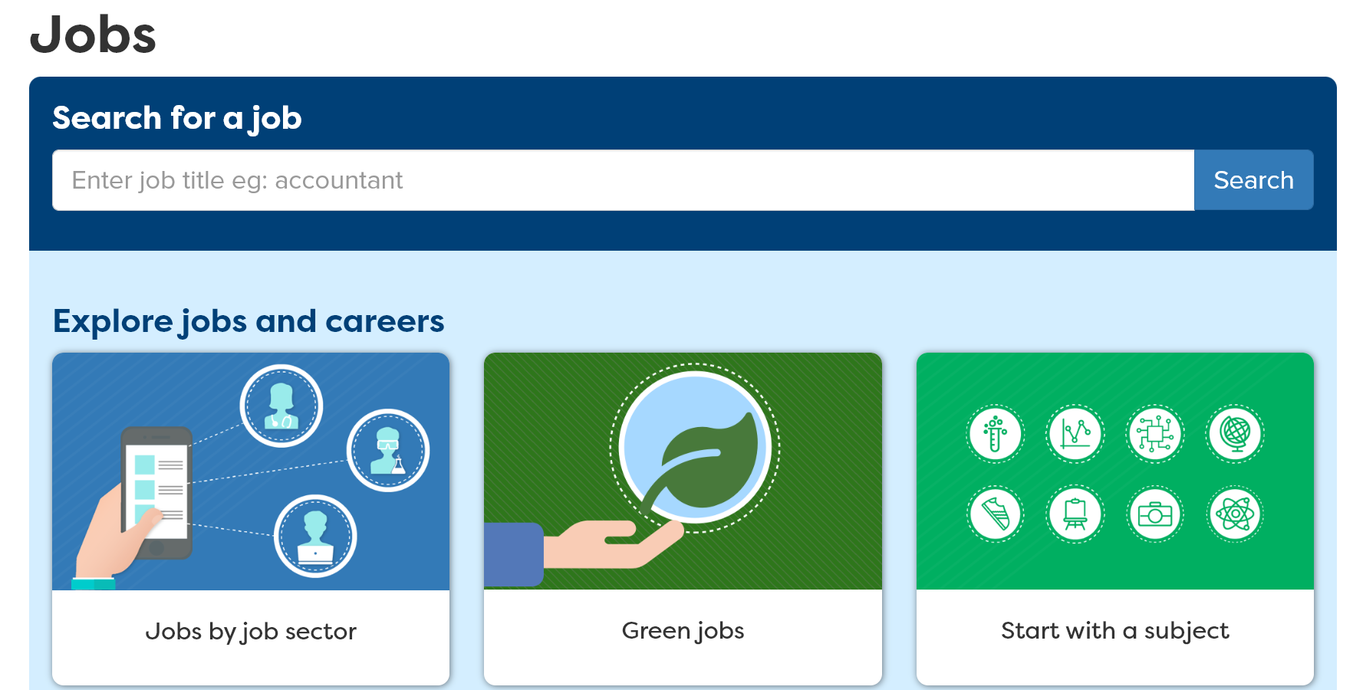

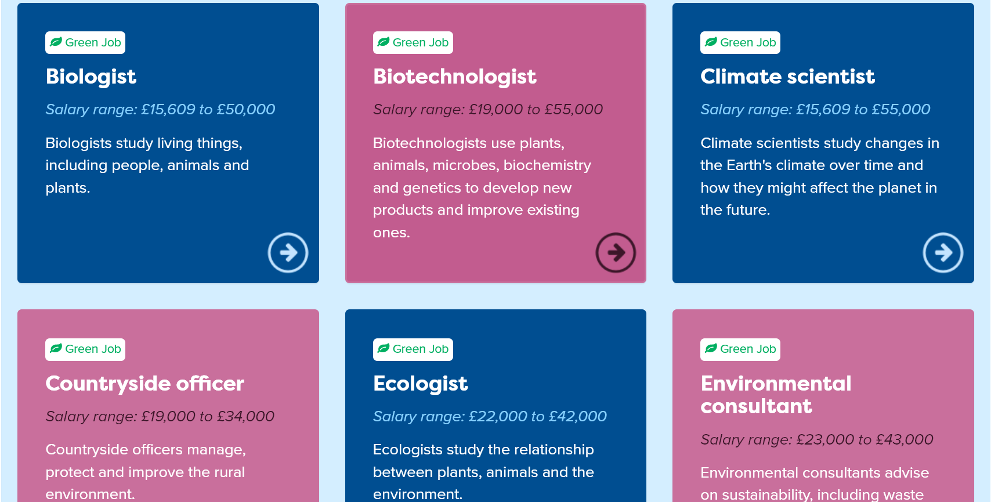
Use Careerpilot to explore 3 jobs

Slide 42
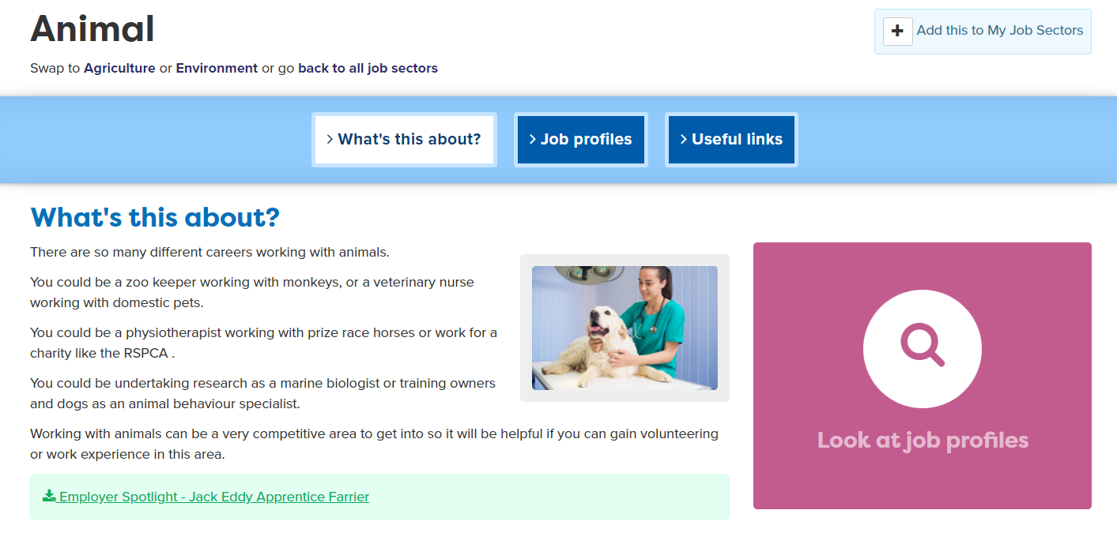
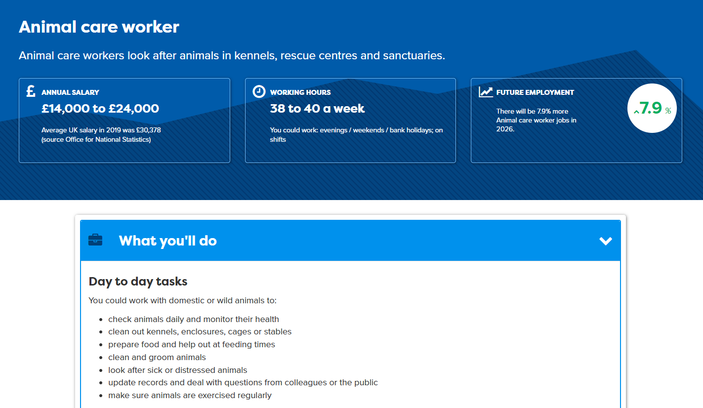
Use Careerpilot to look at LMI
Notes:
Students to can explore LMI using Careerpilot, as every job profile gives information about the salary, working hours and if the job is set to grow or decline over the next few years.

Slide 43
Careerpilot Task
30 mins
Log in to Careerpilot
2. Go to Job Sectors and look at 3 different job profiles
3. Use the LMI on the job profile to look at:
What you’ll do – day to day tasks
Routes into this job
What skills are required and how do your skills match up
4. Create a table or poster to show what you find out about each job. Make a note of any skills you would need to develop further to do these jobs.
Notes:
Explain to students what activities they will be doing shortly on Careerpilot.
They have 30 minutes to complete these tasks.

Slide 44
Sharing with others
With a partner, take it in turns to talk about the jobs you have researched, and the skills needed.
Speak clearly and show some examples of how your skills match up with those required.
Listen carefully while your partner speaks and show you are listening by asking questions to learn more.
5 mins
Click here for next slide
Notes:
Give students time to talk in pairs about jobs they have researched and skills needed.
This activity support students to develop the following skills:
Step 8 Speaking – Using facts: I use facts and examples to support my communication
Step 8 Listening – Questioning: I ask open questions to understand more
You may want to check students understanding of these skills steps.
Ask the students for feedback on how they feel they or a partner have demonstrated these skills steps.

Slide 45

Task 1
What labour market information can you find on this poster?
Discuss in pairs.
10 mins
Notes:
Print range of Hot Jobs posters to display in class or share out on to tables for students to look at in groups.
Careerpilot : Adviser Zone : Hot Jobs Resources - FREE - Gatsby Benchmark 2 : New - Digital and IT Hot Jobs resources
Prompts – What are the routes into this job? What subjects might be useful? What skills would be useful?

Slide 46
Task 2
1. Think about a job you would like to do one day and consider which of these skills you would need to be able to do the job.
2. Write down the job and three of the main skills you would need for the job and why.
3. Think about any examples of where you have demonstrated these skills in your life, both in school and outside of school.
20 mins
Notes:
You could give the example of a builder – this job would need good Problem-Solving skills to adapt or solve building issues, they would need good Teamwork skills to be able to work with others eg. from other trades, the architect, planners, engineers and the client, they would also need to Aim High as they create plans, work to deadlines and to a high standard.
Examples students might have for developing their own skills could include school projects, being part of a sports team, part time work, taking part in volunteering etc.

Slide 47
Sharing with others
With a partner, take it in turns to talk about the jobs you have researched and the skills needed.
Speak clearly and show some examples of how your skills match up with those required.
Listen carefully while your partner speaks and show you are listening by asking questions to learn more.
5 mins
Notes:
Give students time to talk in pairs about jobs they have researched and skills needed.
This activity support students to develop the following skills:
Step 8 Speaking – Using facts: I use facts and examples to support my communication
Step 8 Listening – Questioning: I ask open questions to understand more
You may want to check students understanding of these skills steps.
Ask the students for feedback on how they feel they or a partner have demonstrated these skills steps.

Slide 48
Sharing with others
With a partner, take it in turns to talk about the job you thought about and the three essential skills needed to do it.
Speak clearly and show some examples of how your skills match up with those required.
Listen carefully while your partner speaks and show you are listening by summarising or rephrasing what you have heard
5 mins
Notes:
This activity support students to develop the following skills:
Step 7 Speaking - I speak engagingly by using facts and examples to support my points
Step 8 - I show I am listening by summarising or rephrasing what I have heard
Ask the students for feedback on how they feel they or a partner have demonstrated these skills steps.

Slide 49
Getting Career-ready
You have explored how developments in technology and science are changing jobs of the future and how certain skills are important.
TODAY
You have used Labour Market Intelligence (LMI) to research different jobs and the skills required to do them.

Slide 50

Careerpilot is closing. This resource is only available to use until 23rd October 2026.
Knowing Yourself, Knowing Your Skills
Lesson 4: Selling Yourself

Slide 51
Getting Career-ready
Introduction and warm up activity – 10-15 mins
You will talk about your own personality and skills strengths with others in your class.
Careerpilot Activities 20-30 mins
You can recognise the skills needed for the world of work.
Presentations
5-15 mins
Notes:
The Career Development Institute has developed a careers framework that shows the skills everybody needs to have to manage their future career.
This slide shows the students which of the career learning areas (CDI) that this lesson links to. You can also share the structure of the session with students.

Slide 52
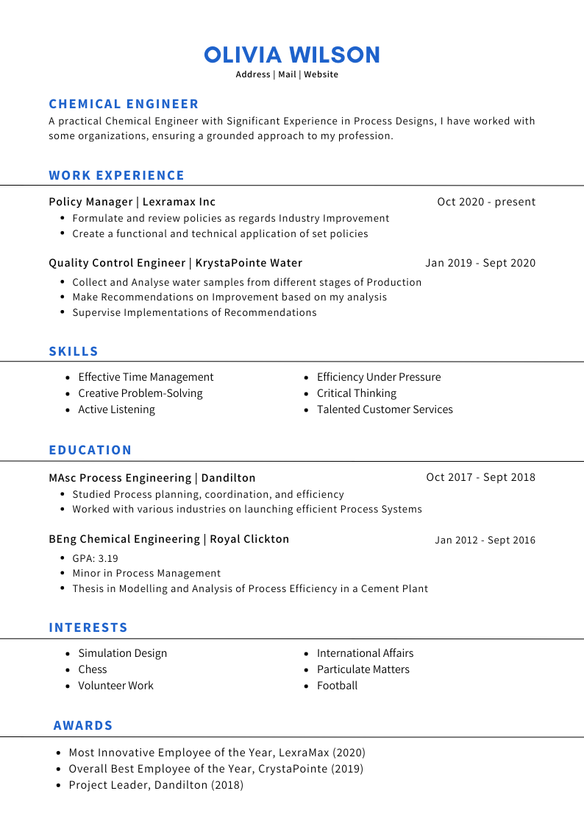
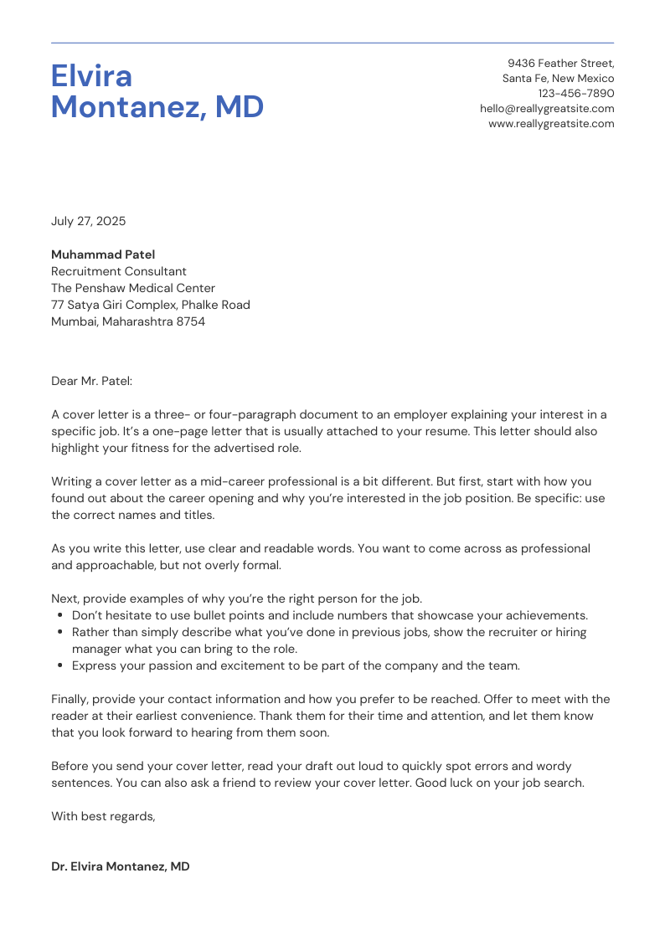
Applying for a Job
When you apply for a job you may be asked to send in your CV (Curriculum Vitae) or to fill in an application form.
A CV is a short, written summary of a person's career, qualifications, skills and education.
Notes:
Ask class what they think they would need to include in their CV.
Answer:
Your name, phone number, email
A short personal statement
Your skills and experience
Any jobs you’ve had which includes voluntary and work experience
Education and qualifications (most relevant stuff first)
Hobbies and interests (if you think they might help you get the job)

Slide 53

The Job Interview
If your job application is successful, you may be invited for a job interview.
You will need to talk confidently about yourself - your education, your skills strengths and work experience.
Notes:
Talk through the eight essential skills to recap.
Communication - Listening and Speaking
Creative Problem Solving - Problem Solving and Creativity
Self-management – Adapting and Planning
Collaboration - Leadership and Teamwork

Slide 54
Student Tasks
If students have access to a computer each or in pairs, continue with this presentation to the end of the session
If students DO NOT have access to a computer, go straight to slide 56.

Slide 55
Careerpilot Task
Log in to Careerpilot
2. Go to Career Tools on the home page and view your Skills Profile.
10 mins
3. Which three skills do you have most examples of? Remember them for the task on next slide.

Slide 56
Task
Create a poster to capture some information that you could use in your CV, a job application or a job interview. You could include your favourite subjects at school, your hobbies and interests, personality type (Buzz Quiz animal) and your skills strengths.
Your name
Favourite subjects
Hobbies and interests
Skills
Personality type
20-30 mins
Notes:
Explain to students what activities they will be doing shortly on Careerpilot.
Extension: Any students that finish early could be asked to look at another favourite subject and create a second diagram with related jobs around another subject.

Slide 57
Sharing your strengths
Working in pairs, take it in turns to talk through your poster, telling others about your strengths and interests.
Speak clearly to each other:
        What is your favourite subject?
        What hobbies or interests do you have?
        What are your skill strengths?
Use your diagram as a visual prompt to support your presentation.
While your partner is speaking, listen carefully and
be prepared to ask a question if you want to know more.
10 mins
Notes:
Alternatively, you could ask students to prepare a short presentation to share with the whole class if time allows.
This activity support students to develop the following skills:
Step 9 Speaking – Sharing visuals: I use images, charts or diagrams when it helps my communication
Step 8 Listening – Questioning: I ask open questions to understand more

Slide 58
Getting Career-ready
You have talked about your own strengths with others in your class.
TODAY
You can recognise the skills needed for the world of work.
Notes:
The Career Development Institute has developed a careers framework that shows the skills everybody needs to have to manage their future career.
This slide shows the students which of the career learning areas (CDI) that this lesson 1 links to.
You can also share the structure of the session with students.

Slide 59
Careerpilot is closing. This resource is only available to use until 23rd October 2026.
Exploring Jobs
Lesson 5: Careerpilot Quiz

Slide 60

Skills Warm-up
Working in pairs, can you remember the eight essential skills that everyone needs for any job?
Can you also name 3 technical skills that are needed for the jobs below?
5 mins
Notes:
Give students 5 minutes to discuss this task.
Remind them that essential skills are needed by everyone for any job.
Technical skills may be specific to certain job roles.

Slide 61
Skills for work
The Essential Skills – needed by everyone for any job
The Technical Skills – specific to certain jobs
Construction labourer
Physical skills
Practical skills
Barber
Hair cutting/scissor skills
Chef
Food preparation skills
Notes:
Class discussion – what skills did students come up with?
These eight skills have been identified by employers as being essential to any job:
Communication - Listening and Speaking
Creative Problem Solving - Problem Solving and Creativity
Self-management – Adapting and Planning
Collaboration - Leadership and Teamwork
Examples also given of technical skills that may be relevant to certain jobs in addition to the essential skills.

Slide 62

Careerpilot Quiz
Log in to Careerpilot and find the answer to the following questions:
1. What skills does a florist need?
2. What skills does a school nurse need?
15 mins
3. What skills does a computer developer need?
4. What skills does a firefighter need?
Notes:
Explain to students what activities they will be doing shortly on Careerpilot.
Students need to work individually to find the answers on their own computers, but may discuss in pairs as they work through the first 4 questions. Students to make a note of the answers.

Slide 63
Careerpilot Quiz
What skills does a florist need?
https://www.careerpilot.org.uk/job-sectors/arts-crafts/job-profile/florist
2. What skills does a school nurse need?
https://www.careerpilot.org.uk/job-sectors/childcare/job-profile/school-nurse
3. What skills does a computer games developer need?
https://www.careerpilot.org.uk/job-sectors/design/job-profile/computer-games-developer
4. What skills does a firefighter need?
https://www.careerpilot.org.uk/job-sectors/water-gas-oil-etc/job-profile/firefighter
Notes:
Help students to work through finding the answers using the links to the relevant pages on Careerpilot.
Discuss skills strengths and skills to develop further.
Show students how Careerpilot has information on how to develop your skills further and you can link to Skills Builder Launchpad to support you to independently build your own essential skills.

Slide 64
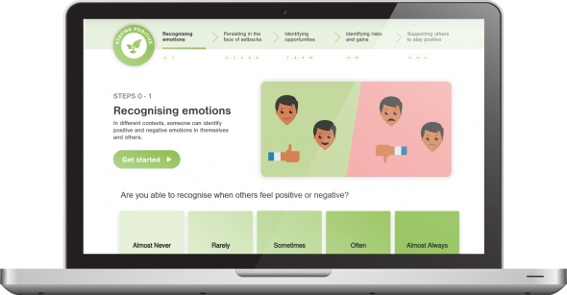
Building skills
Looking at your skills profile on Careerpilot, which 3 skills do you think are your strongest?
Pick 1 skill you would like to develop further.
Log on to Skills Builder Benchmark to complete a self assessment of your chosen skill and learn how to develop this skill further. www.skillsbuilder.org/programmes/skills-builder-benchmark
15 mins
Notes:
Discuss skills strengths and skills to develop further.
Show students how Careerpilot has information on how to develop your skills further
https://www.careerpilot.org.uk/information/help-and-support/building-essential-skills
Students can also use the Skills Builder self assessment tool to support students to independently benchmark their own essential skills against the Skills Builder Framework.
https://www.skillsbuilder.org/benchmark

Slide 65

Getting Career-ready
You have explored how developments in technology and science are changing jobs of the future and how certain skills are important.
Over the last 5 lessons
You recognise the skills needed for the world of work and know how to build them.
You have completed a personality quiz and a skills profile.
You have talked about your strengths with others in your class.
You have used Labour Market Intelligence (LMI) to research different jobs and the skills required to do them.
Notes:
The Career Development Institute has developed a careers framework that shows the skills everybody needs to have to manage their future career.
This slide shows the students which of the career learning areas (CDI) that this lesson 1 links to.
You can also share the structure of the session with students.

