Slide 1

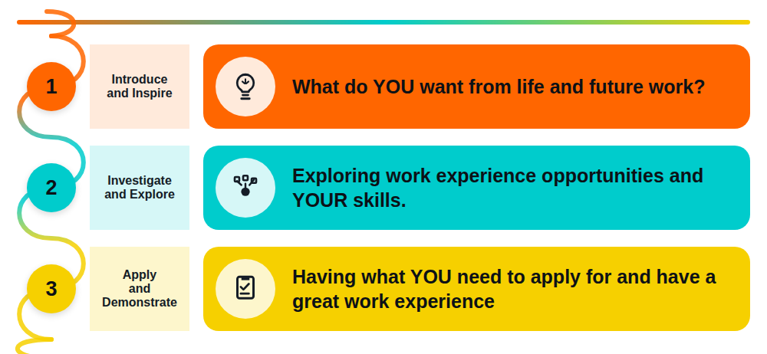


Save this template in your own folder on your school’s system.
Call it WEX or Next Steps Ready.
You will be using a different page in each lesson.
You will use it over three lessons
2026-27
nextstepsready.org.uk

Slide 2
Where are you now?
Do you have an idea of a work experience already? ____________________________________
Any ideas of a future job?
Start with a Subject
Subject you chose
Name of job you looked at
Salary: ______________________________
Two pathways into this job: _____________
____________________________________
____________________________________
Job Quiz Results
1
2
3
Job sector
%
Job sector
%
Job sector
%
Researching Jobs
Name of job_______________________
Pay____________ Hours ___________
Pathway 1:________________________
Pathway 2:________________________
Two skills this job needs:___________________________
________________________________
Name of job_______________________
Pay____________ Hours ___________
Pathway 1:________________________
Pathway 2:________________________
Two skills this job needs:___________________________
________________________________

Slide 3
What do you want from your work experience? Tick which apply
To find out about a company |  | To see what a working day is like
To learn/practice new skills |  | To see if I have the skills for the job
To try out a new role |  | To see what it is like talking to older people in a workplace
To be seen as a future worker |  | To find out what working conditions are like
To see if a like a job I am interested in |  | To find out how I can get into this job
Which job sectors are you interested in?_____________________________________________
Which jobs?__________________________________________________________________________
Researching local companies
Name of company:___________________________________________________________________
Address___________________________________________ Post code_________________________
A contact name/email:________________________________________________________________
What do they say about careers/work experience?
__________________________________________________________________________________
__________________________________________________________________________________
Use Google Maps to find out how you would get from school or home:
How would you get there?_____________________ How long would it take? ____________________
Finding company details
Top skills you have to offer
Your top skills on the Skills Profile

Slide 4
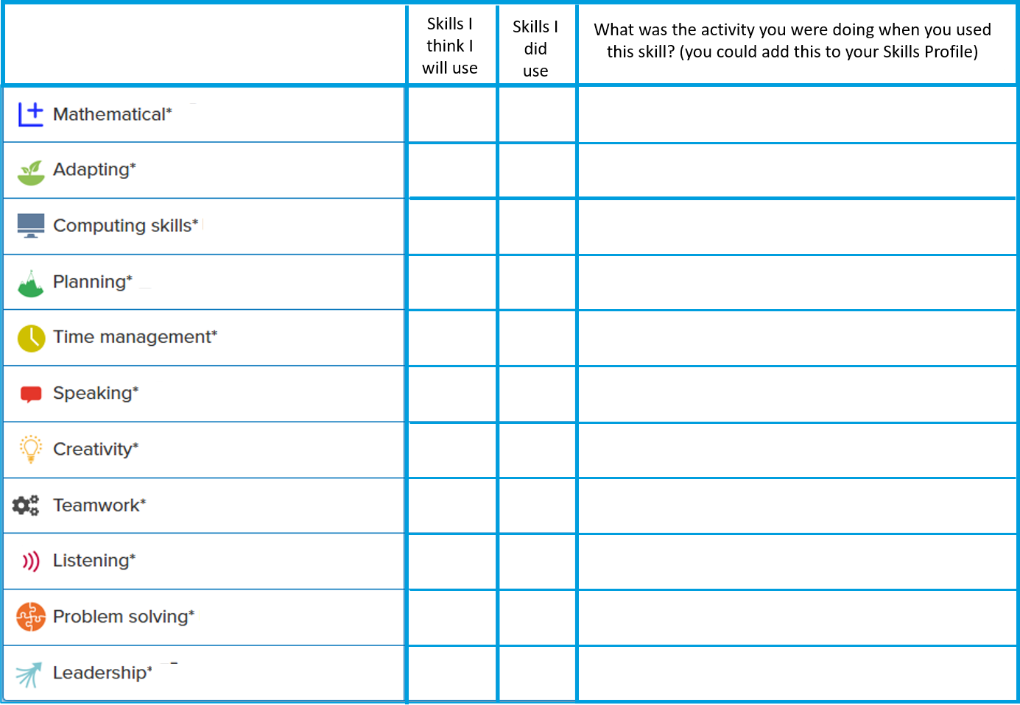
Using your Skills Map to apply for work experience
Name two or three skills that you have on your Skills Profile that are also mentioned on the job profile of the job you are interested in doing for work experience.
Job name__________________________________________________________________________
Skills job needs that I have:
________________________________________________________________________________
________________________________________________________________________________
________________________________________________________________________________
________________________________________________________________________________
Checklist – getting ready for work experience
Recognising Success on Work Experience
You could think about the skills you are likely to be able to practice on your placement.
Record what which skills you DO get a chance to use and add to the Skills Profile – and your CV.
You have been amazing – good luck!

