Slide 1




Quick Careers: Short lessons when time is tight!
2 x 20-minute sessions for every year group
Careerpilot is closing. This resource is only available to use until 23rd October 2026.
1
careerpilot.org.uk

Slide 2
Quick Careers: Explained
A Guide for Teachers
  There are two x 20 minute sessions for every year group, which could be done in a tutor time/PSHE sessions or given to students to do as homework.
  Each sessions starts with the students registering/signing into Careerpilot (top right of home page). When they are signed in, they can save and add their choices, quizzes, etc. in the Career Tools. This creates their report.
  Each session has appropriate suggested activities relevant to the age, stage and career exploration for that year group. There are facilitator’s questions that can be asked to summarise the session, check knowledge, hear student’s choices, etc.
  All activities are mapped to the Gatsby Benchmarks
  The data that the student collates about their career choices can be viewed in the Reporting Zone by staff in a school/college, if a Data Sharing Agreement has been completed. The ‘keeper of the password’ in each school can set up passwords for other staff (usually the Career Leader).
Students will need online access to: careerpilot.org.uk when doing the activities.
Help students keep their careers planning on track, even when time is limited
  Do in tutor time
  Or give as homework.
If you have more time for careers download 5 x lesson resources by Key Stage here.
2
careerpilot.org.uk

Slide 3
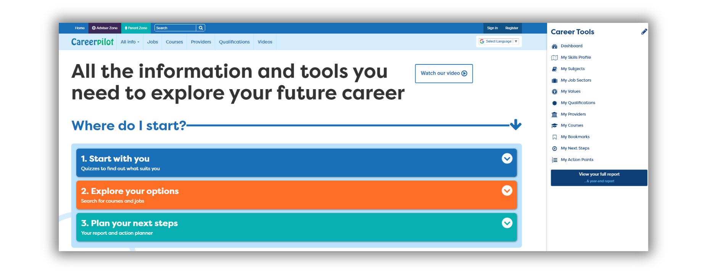
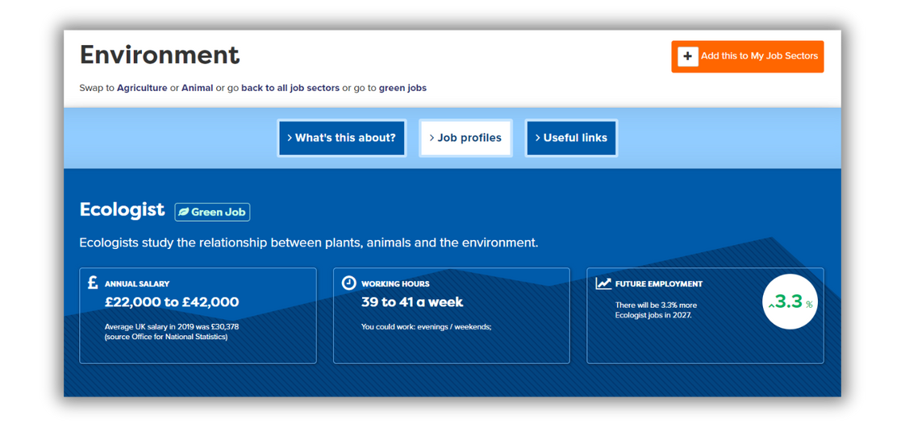
Careerpilot: Explained
A guide for students
Register or sign in to Careerpilot here
Save any jobs, courses or subjects you like to your Career Tools
Most of the activities can be found in these three sections
3
careerpilot.org.uk

Slide 4




Knowing yourself, knowing job sectors and jobs
2 x 20-minute sessions for every year group
Year 7
Session 1: Think about what you want from a job and explore details of jobs.
Session 2: Explore where jobs and subjects you like could lead on to.
  Register or log in to careerpilot.org.uk (top right).
  Go to ‘Start with you’ on home page, and choose ‘Do the Job Quiz’.
  Use your job sector quiz results to explore a job sector that comes up as a good match for you.
  Find two jobs that you like the look of. Add them to your Careerpilot Career Tools by clicking on the orange + (top right of job profile).
  Check on the job profile to see if these jobs will grow in the future?
  Register or log in to careerpilot.org.uk (top right).
  Go to ‘Start with You’ and choose ‘Start with a subject’, pick a subject you like and see what jobs it could lead on to.
  Click on one or two jobs that you like the look of. Add them to your Careerpilot Career Tools by clicking on + (top right of job profile).
  For each job look at ‘Employment by region’, which area of the country are there going to be most jobs?
Questions:
• Who found a job that would pay more than £40,000 a year?
• Who found a job that is predicted to grow more than 3% in the future?
• Did anybody find a job that is going to decline in the future?
Teachers: Reports you could view in the Careerpilot Reporting Zone*
  Tasks completed (Group report)
  Job sector report showing which the students are interested in (Group report)
*Password required to access Reporting Zone. Speak to your Careers Adviser/Careers Leader for help.
4
careerpilot.org.uk

Slide 5




Knowing your skills and personality type and what may suit you
2 x 20-minute sessions for every year group
Year 8
Session 1: Find out what skills you are already using, see how your skills compare to a job you like.
Session 2: Find out what personality type you are and explore some jobs that may suit you.
  Register or log in to careerpilot.org.uk (top right).
  Go to ‘Start with you’ on home page, and choose ‘Do the Skills Profile’ to see what skills you already have.
  Which are your top three from the quiz?
  On the Skills Profile results page (the grid of your skills), type in a job (bottom left) and see what skills you will need for the job.
  Register or log in to careerpilot.org.uk (top right).
  Go to ‘Start with You’ and choose ‘Start with your personality - Buzz Quiz’. Complete the quiz to see what animal you are.
  Look at the jobs that may suit your animal personality type and click on one or two jobs that you like the look of. Add them to your Careerpilot Career Tools by clicking on + (top right of job profile).
Questions:
Who had ‘speaking or team work’ as one of their top three skills?
Hands up who is which animal. Are there more of one particular animal personality type in this class?
Teachers: Reports you could view in the Careerpilot Reporting Zone*
  Tasks completed (Group report)
  My Skills (Individual report)
*Password required to access Reporting Zone. Speak to your Careers Adviser/Careers Leader for help.
5
careerpilot.org.uk

Slide 6



Knowing your skills, looking ahead
2 x 20-minute sessions for every year group
Year 9
Session 1: Explore subjects you are interested in and where they may lead.
Session 2: Explore your post 16 options
  Register or log in to careerpilot.org.uk (top right).
  Go to ‘Start with You’ and choose ‘Start with a subject’, pick a subject you like and see what jobs it could lead on to.
  Save any subjects and jobs you are interested to your Career Tools by clicking on the + in the top of the page..
  You can then view them in ‘My Subjects’ and ‘My Job Sectors’.
  Register or log in to careerpilot.org.uk (top right).
  Go to ‘Explore your options’ (orange section) and click on ‘Choices at 16’. Find out about the different choices you will get to choose when you are 16. Add the ones that you like best to your Career Tools by clicking on the + in the top of the page.
  Look at ‘Providers’ and find the ones near to you. See what courses they offer. In ‘list view’ add them to your Career Tools.
Questions:
Who had ‘leadership or problem solving’ as one of their top three skills?
What are the three pathways you can choose when you are 16?
Who is already thinking: A Levels, apprenticeships, vocational?
Teachers: Reports you could view in the Careerpilot Reporting Zone*
  Tasks completed (Group report)
  My Subjects (Individual report)
  My Bookmarks (Individual report)
*Password required to access Reporting Zone. Speak to your Careers Adviser/Careers Leader for help.
6
careerpilot.org.uk

Slide 7


Finding job sectors to suit you, looking towards
post 16 and different providers
2 x 20-minute sessions for every year group
Year 10
Session 1: Explore jobs and start to plan for work experience.
Session 2: Explore your post 16 options
  Register or log in to careerpilot.org.uk (top right).
  Go to ‘Start with you’ on home page, and choose ‘Do the Job Quiz’.
  Use your job sector quiz results to explore a job sector that comes up as a good match for you.
  Find two jobs that you like the look of. Add them to your Careerpilot Career Tools by clicking on the orange + (top right of job profile).
  Start to think about any opportunities for work experience.
  Look at some virtual work experience opportunities in ‘Finding a job/experience’.
  Register or log in to careerpilot.org.uk (top right).
  Go to ‘Explore your options’ (orange section) and click on ‘Choices at 16’. Find out about the different choices you will get to choose when you are 16. Add the ones that you like best to your Career Tools by clicking on the + in the top of the page.
  Look at ‘Providers’ and find the ones near to you. See what courses they offer. In ‘list view’ add them to your Career Tools.
Questions:
Who had either of the following job sectors come up as a match after doing the job quiz – business & finance, engineering?
Who is already thinking: A Levels, apprenticeships, vocational?
Teachers: Reports you could view in the Careerpilot Reporting Zone*
  Tasks completed (Group report)
  My Job Sectors (Group report)
  My Providers (Group report)
*Password required to access Reporting Zone. Speak to your Careers Adviser/Careers Leader for help.
7
careerpilot.org.uk

Slide 8


Planning for post 16 progression and options at 18
2 x 20-minute sessions for every year group
Year 11
Session 1: Get Ready for your Future Career.
Session 2: Explore your post 16 and post 18 options
  Go to careerpilot.org.uk and click on ‘Watch our video’
  Register or log in to Careerpilot (top right).
  Go to ‘Start with you’ and choose ‘Do the Skills Profile’.
  Add at least two activities you have done in the last 6 months by clicking on ‘Add an activity’.
  Go to ‘Use my skills to Apply’, add the course or job you are applying for to use your skills to apply.
  Register or log in to careerpilot.org.uk (top right).
  Look at jobs and the different routes are to get there.
  Go to ‘Courses’ (top of screen on blue background), look for courses/apprenticeships for after Year 11 or for the future. Add any you like to your Career Tools by clicking on the +.
  In ‘Explore your options’ (orange section) click on ‘Choices at 16’ and ‘Choices at 18’. Add useful pages to your bookmarks.
Questions:
What are the 4 things you need to do to manage your career?
What are the different options are 18?
Who found an interesting course or apprenticeship?
Teachers: Reports you could view in the Careerpilot Reporting Zone*
  Tasks completed (Group report)
  My Skills (Individual report)
  My Bookmarks (Individual report)
*Password required to access Reporting Zone. Speak to your Careers Adviser/Careers Leader for help.
8
careerpilot.org.uk

Slide 9

Skills for applications & personal statements,
exploring post 18 options
2 x 20-minute sessions for every year group
Year 12/13
Session 1: Know your options
Session 2: Use your skills to apply
  Go to careerpilot.org.uk and click on ‘Watch our video’
  Register or log in to Careerpilot (top right).
  Look at jobs you like and see what entry requirements you need.
  In ‘Explore your options’ click on ‘Choices at 18’. Find out about the different choices at 18. Add the ones that you are thinking of to your Career Tools by clicking on the + in the top of the page.
  Go to ‘Courses’, look for courses/apprenticeships and add any you like to your Career Tools by clicking on the +.
  Register or log in to careerpilot.org.uk (top right).
  Go to ‘Start with you’ and choose ‘Do the Skills Profile’.
  Add at least two activities you have done in the last 6 months by clicking on ‘Add an activity’.
  Go to ‘Use my skills to Apply’, add the course, etc. you are applying for and the skills you most need for that choice. Look at the examples you already have saved that you can use on applications or at interviews.
Questions:
  What are the 4 things you need to do to manage your career?
  What are the different options are 18?
Who found an interesting course or apprenticeship?
Teachers: Reports you could view in the Careerpilot Reporting Zone*
  Tasks completed (Group report)
  My Skills (Individual report)
  My Courses (Individual report)
*Password required to access Reporting Zone. Speak to your Careers Adviser/Careers Leader for help.
9
careerpilot.org.uk

