Slide 1


careerpilot.org.uk
Careerpilot is closing. This resource is only available to use until 23rd October 2026.
5 Week Careers Teaching Pack
Year 11 – Preparing for post 16

Slide 2
Teacher Overview
This 5-week careers programme aims to support students to:
Develop their career skills for life, learning and work
Prepare them for the next career decisions they will have to make.
Lessons have been developed by the Careerpilot Team – all are qualified career advisers and teachers.
The programme contains all you need to deliver 5 x 50-60 minute lessons, or the first lesson can be delivered as a standalone session. All lessons use a Power Point presentation, with notes to explain screens. The first lesson has been pre-recorded as a video lesson with a member of the Careerpilot Team virtually delivering the session and providing instruction to the facilitating teacher and the students should you wish to use this delivery option.
The lessons require students to have access to Careerpilot so they can use the wealth of information and tools offered through the site but also to help them build their career report. The report moves up annually with them, can be ‘ported’ by them to another provider e.g. a college and is owned by them until they are 20.
All student’s need is access to careerpilot.org.uk and paper/pen. Careerpilot can be accessed through pc, tablet or phone.
To provide feedback or ask a question contact careerpilot@bath.ac.uk

Slide 3



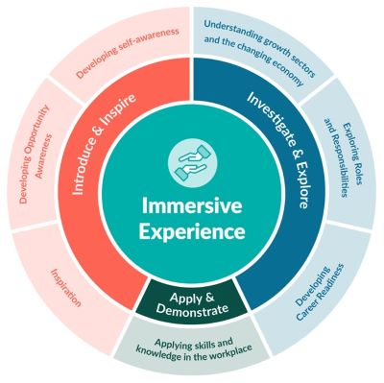



The Year 11 careers lessons are mapped to:
CDI Framework and career development skills
Gatsby Benchmarks
See the big picture by paying attention to how the economy, politics and society connect with your own life and career.
www.gatsbybenchmarks.org.uk/
The Equalex Framework to support preparation for Modern Work Experience
Manage your career actively, make the most of opportunities and learn from setbacks.
Explore the full range of possibilities open to you and learn about recruitment processes and the culture of different workplaces.
Grow throughout life by learning and reflecting on yourself, your background, and your strengths.
Investigate & Explore
Apply & Demonstrate
www.thecdi.net/write/Framework/CDI_86-Framework-Guidance_in_Secondary_Schools-webFINAL.pdf
www.careersandenterprise.co.uk/modern-work-experience/equalex-for-educators/
https://www.careerpilot.org.uk/skills-profile/activities
Skills Builder Universal Framework 2.0
www.skillsbuilder.org/universal-framework
Notes:
These lessons have been developed to support students to build their career development skills, as identified by the CDI Career Development Famework. Each lesson identifies two outcomes linked to the CDI framework.
The lessons will support meeting Gatsby Benchmark 1, 2, 3, 4 and 6 and support the Equalex Framework for preparing students for Modern Work Experience as they ‘Introduce & Inspire’ students about the world of work and ‘Investigate & Explore’ jobs and careers.
The lessons provide opportunities for students to practice their essential skills as identified in the Skills Builder Framework 2.0 - www.skillsbuilder.org/universal-framework/
The relevant skills steps are identified in the teacher notes in relevant activities, with reflection questions and prompts for discussion with students as part of the plenary.

Slide 4
Lesson Overview: Year 11
Lesson 1: Getting ready for post 16 options (recorded lesson available)
Students register/sign in on Careerpilot, understand LMI, research future job and qualification ideas.
Resources needed: Play video with sound. Individual online access to Careerpilot, paper and pens.
Lesson 2: The academic and vocational offer in schools and colleges
Students understand the different offers and explore college courses related to a job of interest.
Resources needed: Individual online access to Careerpilot, paper and pens.
Lesson 3: The apprenticeship pathway and how to find one
Students understand more about apprenticeships and try out three stage process to finding one.
Resources needed: Individual online access to Careerpilot, paper and pens.
Lesson 4: Applying for post 16 and looking ahead to post 18
Students complete a CV and start to consider and explore post 18 options.
Resources needed: Individual online access to Careerpilot, paper and pens.
Lesson 5: Careers Quiz and Reflection
Students reflect on what they have done. Review and update plans.
Resources needed: Online access to Careerpilot, paper and pens.
Notes:
Use this page to navigate directly to the relevant lesson.

Slide 5

Careerpilot is closing. This resource is only available to use until 23rd October 2026.
Preparing for Post 16
Lesson 1: Getting ready for post 16 options
This lesson can be delivered through a video recording

Slide 6


Getting Career-ready
Introduction and warm up activity – 20 mins
You will see how your post 16 choices fit with future jobs and you career
Careerpilot Activities 25 mins
You will make a plan and develop a pathway into your future
Wrap-up
5 mins
Notes:
The Career Development Institute has developed a careers framework that shows the skills everybody needs to have to manage their future career.
This slide shows the students which of the career learning areas (CDI) that this lesson links to.
You can also share the structure of the session with students.

Slide 7

Warm up activity
You have won the lottery!
The prize is….

Slide 8

A holiday in one of these places
Barbados
Australia
Which one will you choose?
South Africa
Belgium
England
Notes:
Think which one they want as their prize, they don’t have to say

Slide 9
Just found out more detail…
Explore ALL the information before you decide
Barbados
Beach ranger
Australia
Sheep-shearing
South Africa
Picking grapes
Which place do you want to go now?
Belgium
Testing chocolate
England
Glastonbury tickets
Notes:
Knowing the detail can make all the difference and that’s the same with choosing your career options, you need to know the detail, not just ‘I am going to go to college/sixth form’ but which course, where will it take you, etc.

Slide 10

What is a career?
A career is an individual's journey through life, learning and work.
A job is something you might do to earn money as part of your career journey. There are lots of different job sectors you could work in, from finance, to art and design, to working with animals.
Y11 – the big things
Explore all options and firm up what you will do at the end of Y11
Get the best GCSEs you can
Notes:
Explain what a career is and that jobs are part of their career journey (and they might have lots of them)
The key things related to careers that Y10 will be focusing on

Slide 11




Where are future jobs going to be?
Medical, Health Science and Care
IT and Digital Technology
Engineering and Construction
Environmental (Green Jobs)
This is Labour Market Information (LMI)
Be in the know to know where to go
Notes:
With new technology and science developments there will be a growth in jobs needed in many industry sectors including:
Medical and Health – we will continue to need more medical scientists, researchers, doctors, nurses and health care workers
IT and Digital – we will need more data analysts, technology researchers and AI developers
Engineering and construction - we will need more people to design and build the new buildings of the future – architects, electricians, energy engineers
Environmental jobs– we need lot of people to do jobs that help protect our planet like ecologists, foresters and environmental advisers

Slide 12





Get ready for your future career
https://www.youtube.com/watch?v=OWZxyyK6OuA
Notes:
Why is careers important and what can you do NOW!
Show video

Slide 13
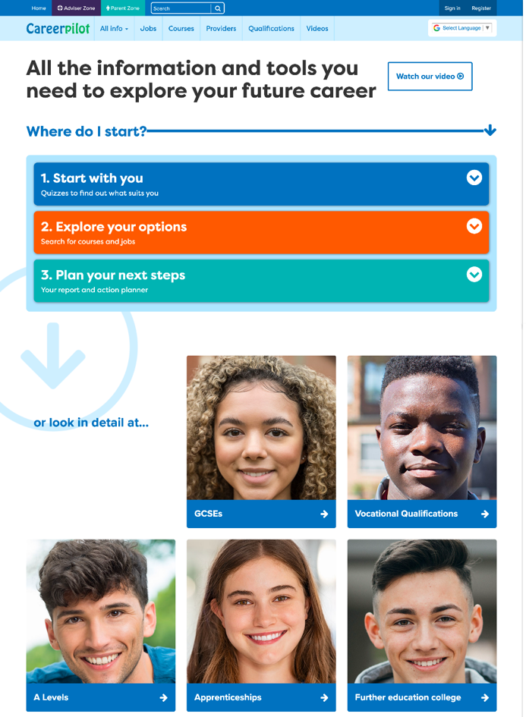
Introducing Careerpilot
Jobs, courses, qualification planner, videos
Quizzes, tools – 3 stages to help you decide
Future qualifications and pathways
careerpilot.org.uk
Notes:
Careerpilot is a website that you can use for free. It has lots of information and tools to help you to start to think about future career ideas and pathways.
The website is built around 3 stages:
Start with you – with quizzes to find out more about what might suit you
Explore your options – where you can search for courses and jobs
Plan your next steps – where you can build a report and plan some actions.

Slide 14

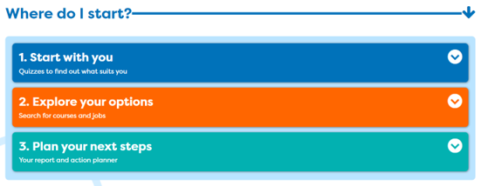
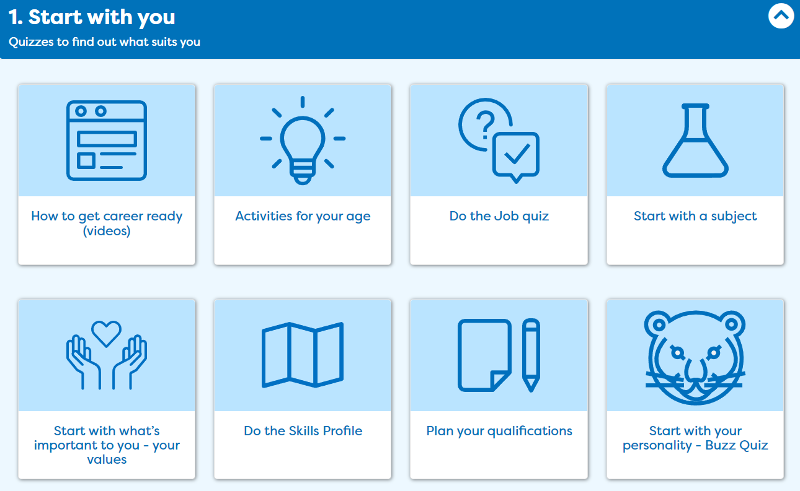
One place for all your careers information.
Get ready for your future career
Notes:
In this session you will be using ‘Start with you’ to get ideas of what jobs might suit you in the future

Slide 15

One place for all your careers information.
Get ready for your future career
Work Experience
Cadets
Duke of Edinburgh
GCSEs
Youth Groups
Don’t drop them!
Great for your CV
Sports Teams
Performing Arts
Notes:
Yes your number 1 priority needs to be your GCSE but don’t give up anything that will be useful for a future job/course/CV.

Slide 16

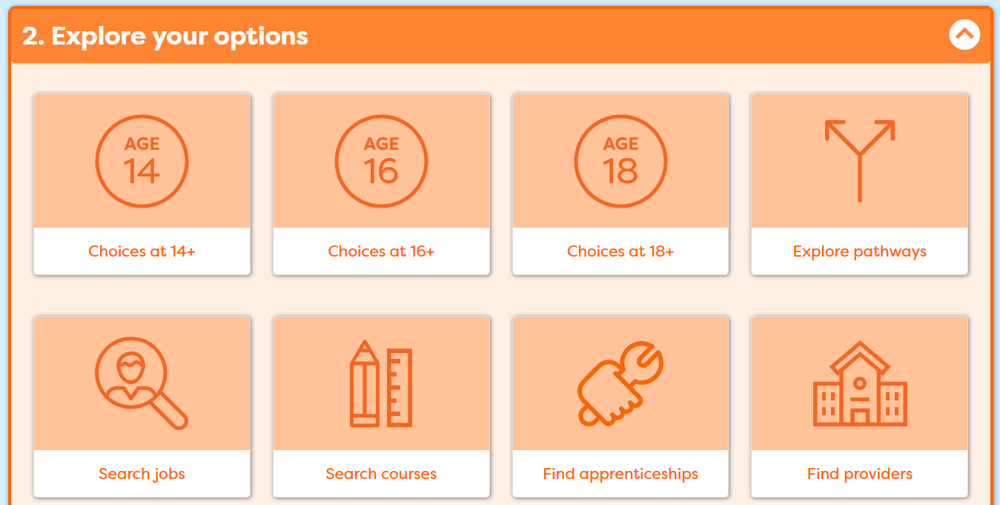
One place for all your careers information.
Get ready for your future career
Today
Notes:
Today focused on your options.

Slide 17


One place for all your careers information.
Get ready for your future career
Parents/family
Career advisers
Teachers
Careerpilot
Notes:
When they are back as a group. Talk about supporters and see if they can suggest any others. Tell them the name of the school careers adviser.

Slide 18
Pathways after Y11
What pathways can I choose at the end of Y11?
Academic
Vocational/Technical
Work-based - Apprenticeship
Mostly in a 6th Form or 6th Form College
Mostly in a
local college
Mostly in a workplace
Notes:
Ask them to say what pathways they can do at 16.

Slide 19






Different routes in
Academic
Technical/Vocational
Apprenticeship
Degree Achieved
Degree Year 2
HND
Foundation Degree Y2
Higher Apprenticeship
Degree Year 1
HNC
Foundation Degree Y1
Higher Apprenticeship
A levels
T LEVEL other Level 3 - BTEC/OCR
Advanced Apprenticeship
5 x GCSEs 4 - 9
T Level Foundation and other Level 2
Intermediate Apprenticeship
GCSEs 1 - 3
Notes:
Explain that there are three pathways but in all pathways there are levels of quals. Level 2 is getting 5 GCSEs grade 4-1.
Show them the other levels and make the point that all pathways can lead to a degree.
The bit of the qualification ladder we are mainly talking about today is their choices after GCSEs
There are many ways to achieve the same careers (although for some there are very set routes, like doctor, vet, etc. so they need to check)
Both Lucy and Leon are nurses
Lucy did a BTEC in health and Social Care after GCSEs and then did a degree.
Leon did A levels and then started work in a hospital as a porter. He was offered a health care apprenticeship and achieved his degree through this route.
A common pathway into nursing and paramedic is through working in a hospital and then being given the opportunity for further training.

Slide 20
One place for all your careers information.
Choosing options – what to think about
What grades are you likely to get at GCSE (esp. English and maths)?
How do you like to learn e.g. by doing, by studying?
Some people start with what they want to do in the future (course/job) and look at what they need to do to get there.
Some people start with a subject they like and focus in later.
There are lots of ways of getting to the same future job.
Notes:
What you need to think about

Slide 21
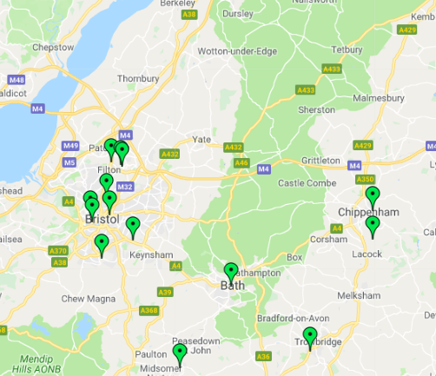
Vocational pathway
Vocational courses are about a job area
e.g General – Btec/OCR, Specific - Tech Levels
Colleges offer lots of vocational courses at lots of levels. Schools offer some too.
Some colleges offer A levels, some don’t. Students can resit their Maths & English GCSEs at college.
Many Level 3 vocational courses require 4 x GCSEs at Level 4+ (check this).
Example courses:
Level 2 - Accounts
Level 1 and 2 - Animal care and management
Level 1 and 2 – Health and Social Care
Level 1,2 and 3 – Plumbing
Level 3 T Level – Digital design
Level 1, 2 and 3 - Sports
Get UCAS points for each, which can get you onto a higher level course
Notes:
Key facts about vocational:
Colleges offer lots of vocational courses, some offer quite specialist courses like boat building, agriculture. Most do not offer GCSE resits, GCSEs or A Levels. However, in some areas of the South of England schools do not have 6th Forms and colleges are the providers for A levels (you might want to adapt this slide to suit your area). All colleges offer support for students who do not get Grade 4 or above in maths and English at GCSE.

Slide 22

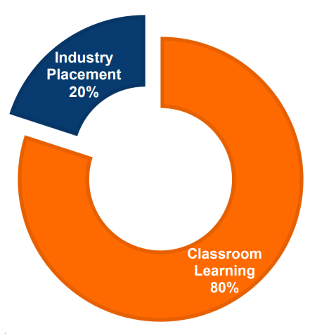
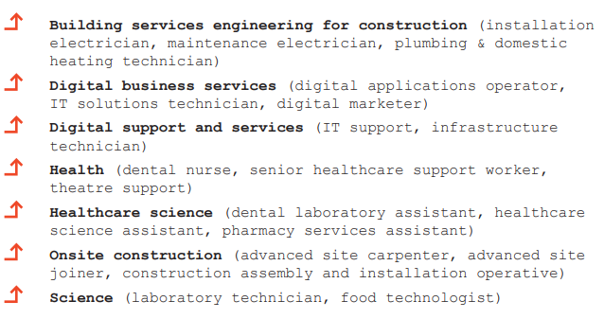
One place for all your careers information.
Vocational pathway: T Levels
Will train you to do a specific job
Mostly in colleges
1 T-Level equivalent to 3 A Levels
Get UCAS points which can get you onto a higher-level course
Notes:
T Levels are fairly new and are offered in colleges.
They are equivalent to 3 A Levels

Slide 23



Work-based Pathway – Apprenticeships
Higher/Degree Apprenticeship
£6.40 per hour – (but some employers pay more)
Higher/Degree Apprenticeship
Learn by doing the job, in the workplace
Higher/Degree Apprenticeship
Advanced Apprenticeship
Need to find one like finding a job
Intermediate Apprenticeship
Notes:
Explain will be looking at how to find an apprenticeship later in session

Slide 24

One place for all your careers information.
Academic pathway – A-levels
A Levels
Other Voc Quals
Usually take 3 or 4
Related to a job area
AS levels – in some schools
Small (=1 A Level)
Extended Project Qualification
Large (=2 or 3 A Levels)
L3 Core Maths
Get UCAS points for each, which can get you onto a higher level course
Notes:
A Levels – Key facts

Slide 25
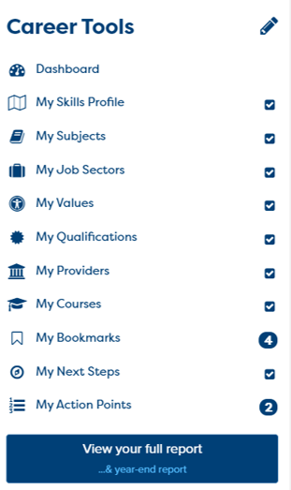

One place for all your careers information.
Now build your report in Career Tools
Register/sign in
Build your report
If you have registered before then sign in
Notes:
You will using Careerpilot to explore all your options, register (or sign in if you have used it before)
Then you can build your report and have a record of all your career choices and plans

Slide 26
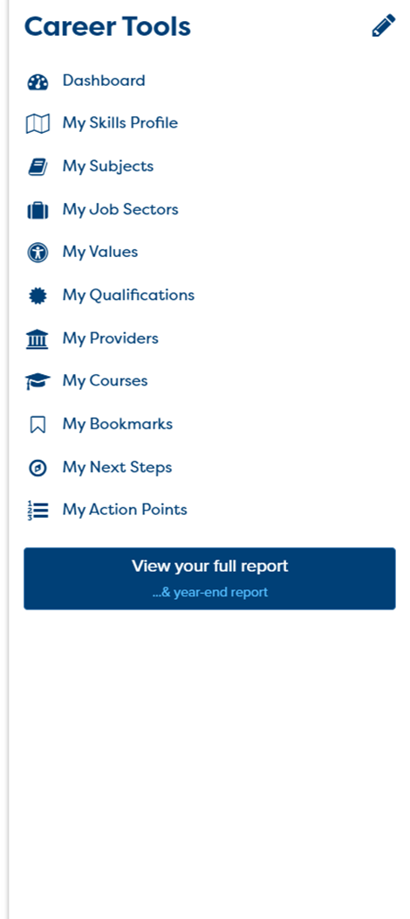
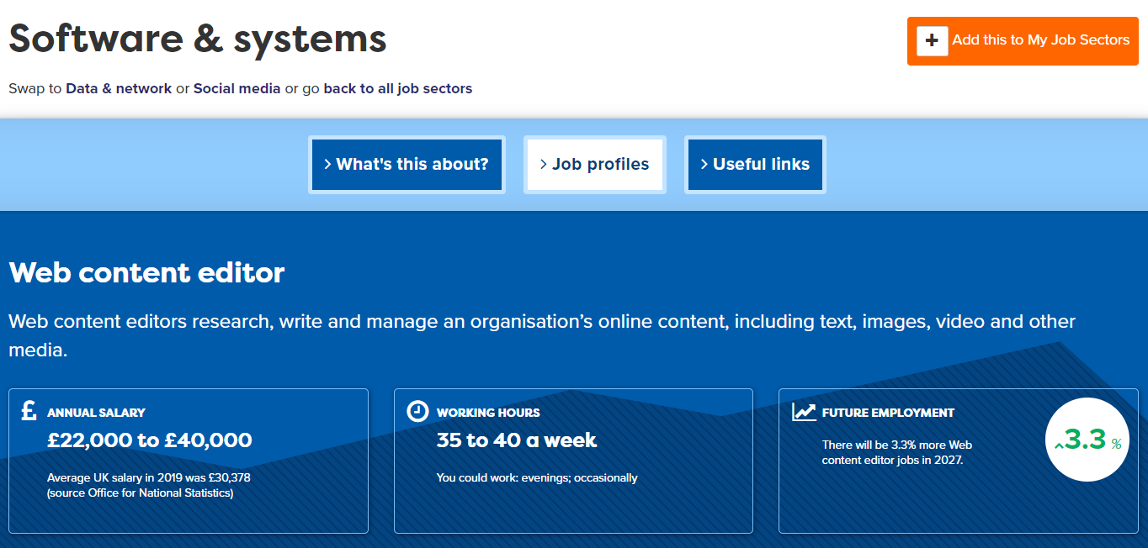
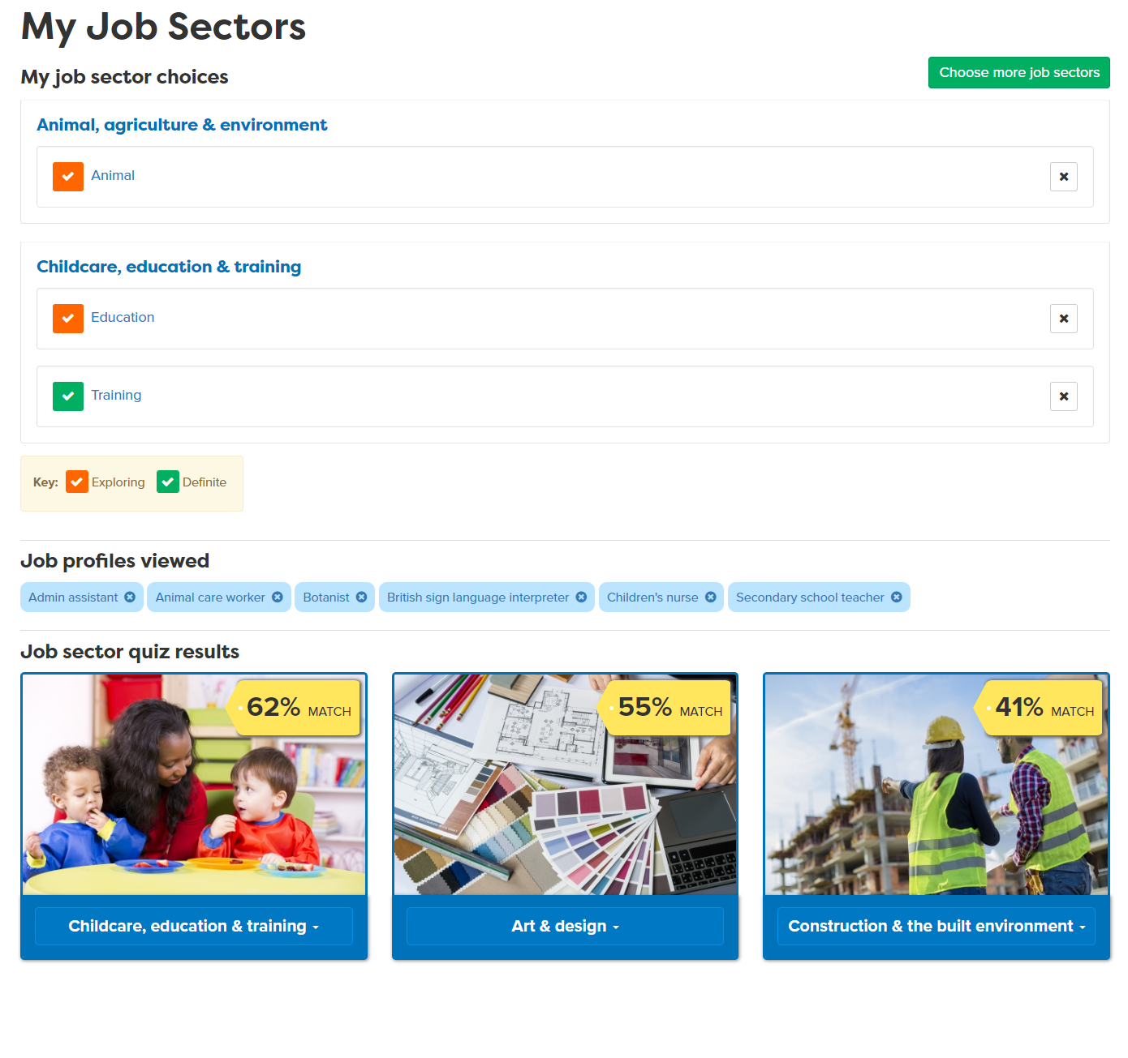
Use your Career Tools
Notes:
Encourage students to go to their Career Tools via the home page and click on My Job Sectors to see their chosen sectors and the job profiles they have viewed.
Explain this will be saved for them to revisit at a later date and they can add more or change their choices as they go through school.

Slide 27
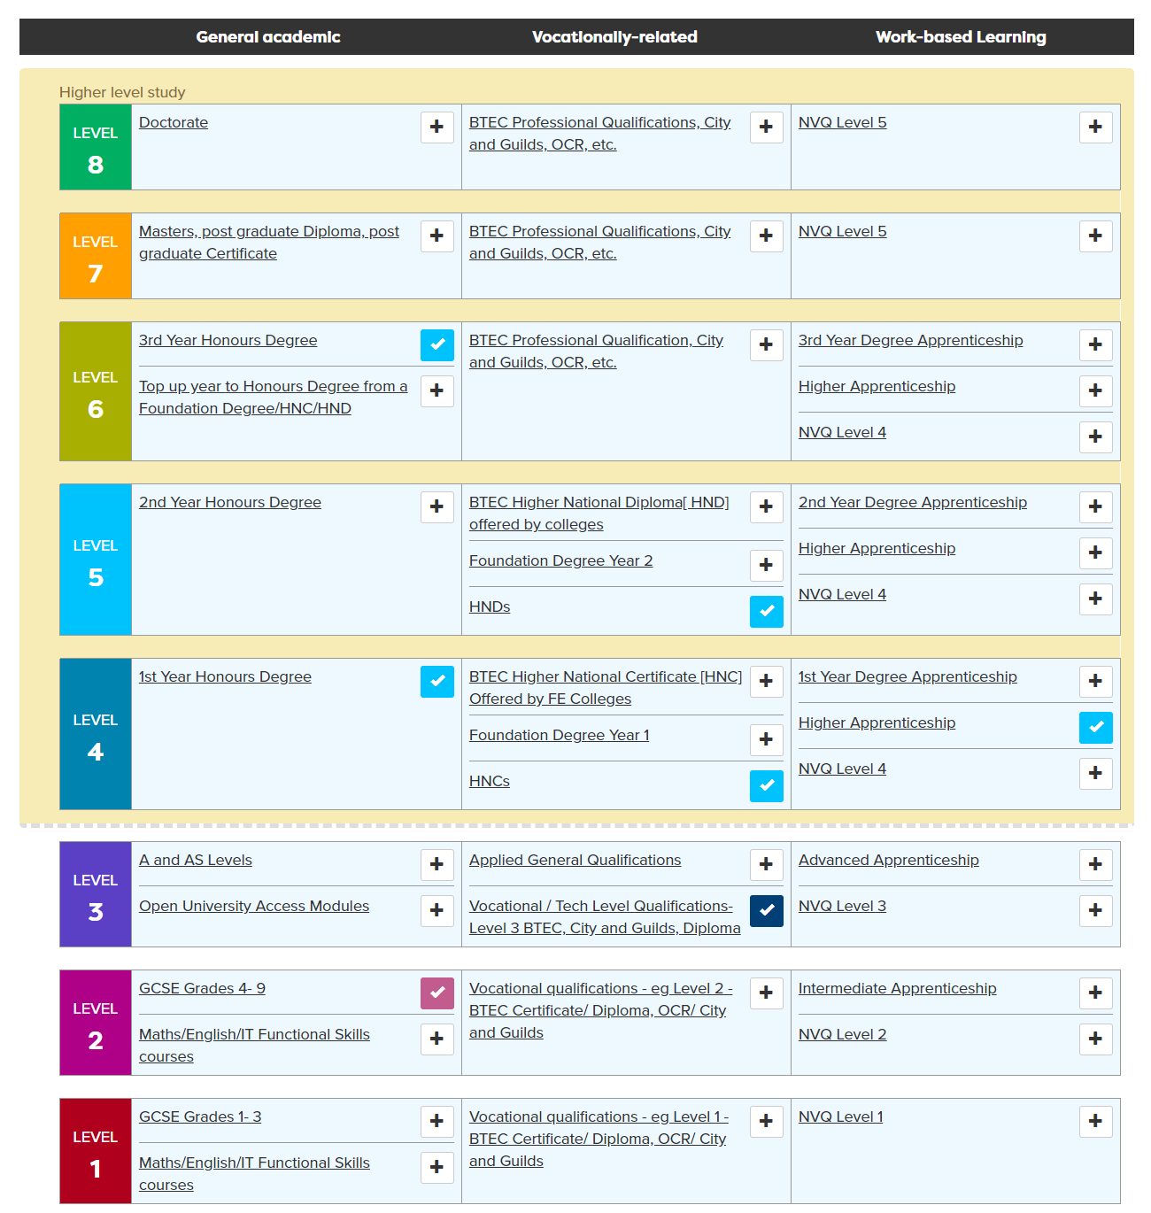
Add your present and future qualifications
Add/update your subjects and predicted grades
It is important to know your grades as this might affect your choices at 16 - but the good news is you have time to make them even better!
Notes:
Then they can add the qualifications they might be thinking of doing to the Qualifications planner. When they have added some on the ladder, in My Quals they can add their subjects and predicted grades. It is important to know grades as this might affect your choices at 16 but the good news is you have a whole year to make them even better!

Slide 28

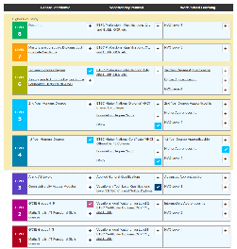
In today’s lesson you will…
25 mins
Register/sign in to Careerpilot
2. Know yourself use ‘Start with you’
3. Add/update your qualifications to ‘My qualifications’
4. Consider routes at 16 and explore options
careerpilot.org.uk
Notes:
Students can get started on the activities shown – flex the time to allow for the wrap up.

Slide 29


Pathways at 16: which are you interested in?
Academic
Technical/Vocational
Work-based
A levels
General
T Levels (L 3)
Apprenticeships
Studying subjects in detail
General about a sector e.g. Health and social care
Trained to do a job e.g. digital design
Trained to do a job in the workplace. Will get paid.
TASK: Working in pairs, discuss the pathways you are interested in and why you think they will suit you.
Speak clearly and in a way that is engaging for your audience
Listen carefully while your partner is talking
and ask questions to find out more
5 mins
Notes:
Who is thinking about XX as first choice, second choice?
Speaking Step 11 - Speaking engagingly: I communicate in a way that is engaging for my audience
Listening Step 8 – Questioning: I ask open questions to understand more

Slide 30
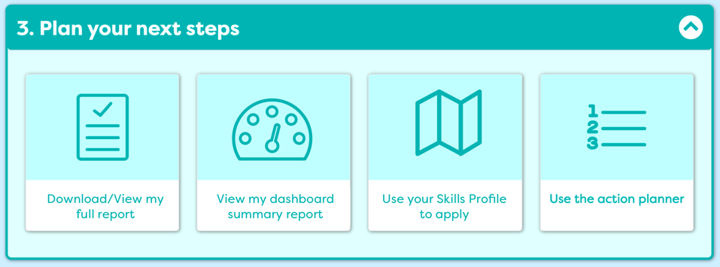
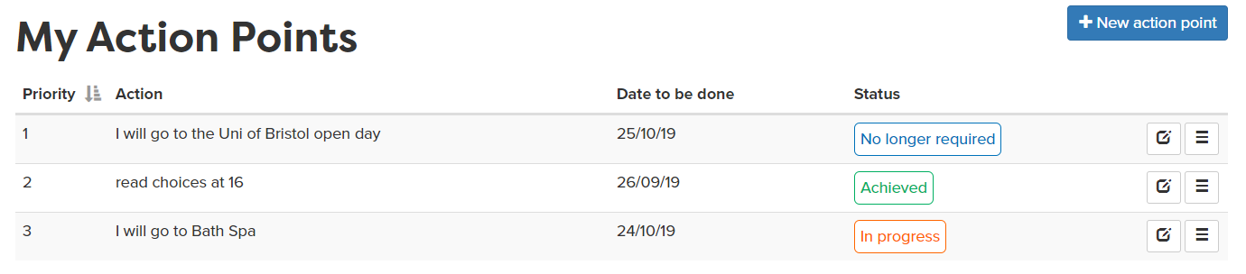
Plan your next steps
Notes:
They could, in their own time go back to Careerpilot and do any other activities, including setting an action point of something they could be doing to help them plan for the end of Y11.

Slide 31
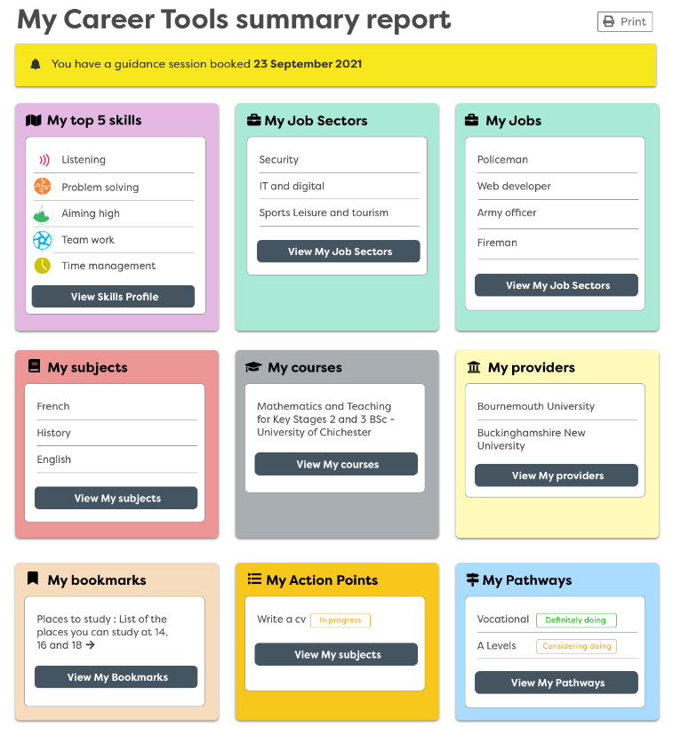
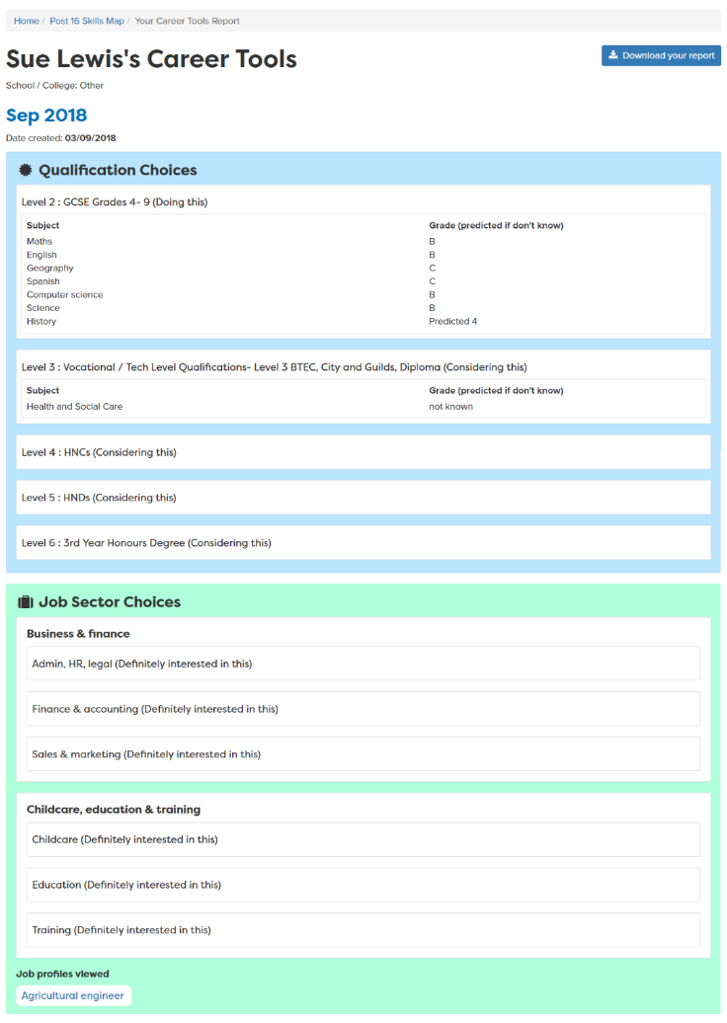
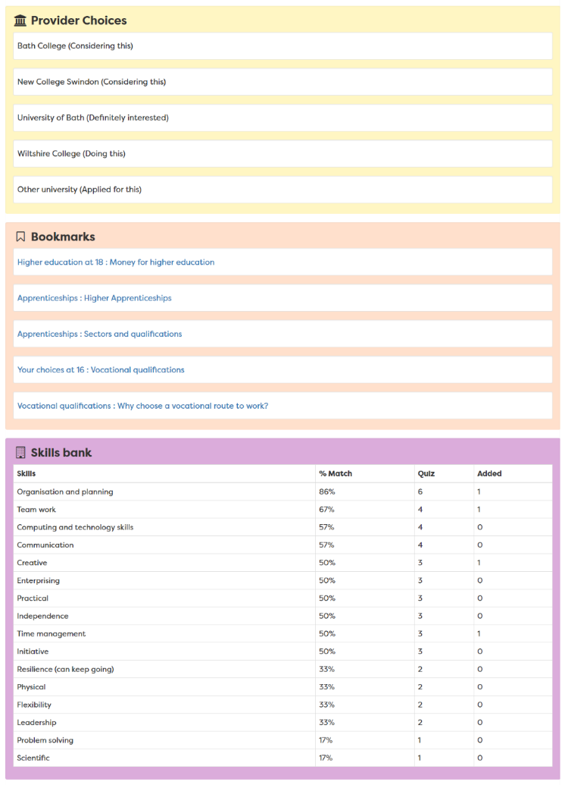
View your report
Report moves up each year
Notes:
A slide to show the report that is created once the career tools have been completed – moves up with them each year in school

Slide 32

Getting career-ready
You saw how your post 16 choices fit with future jobs and you career
You started to make a plan and develop a pathway into your future
Notes:
The Career Development Institute has developed a careers framework that shows the skills everybody needs to have to manage their future career.
This slide shows the students which of the career learning areas (CDI) that this lesson links to.
You can also share the structure of the session with students.

Slide 33

Careerpilot is closing. This resource is only available to use until 23rd October 2026.
Preparing for post 16
Lesson 2: The academic and vocational qualification offer in schools and colleges
Notes:
The Career Development Institute have a new framework which shows that everybody, young and old, needs to have the skills to do these 6 things if they are going to be able to manage their future careers.
In this session we will be helping you develop the skills for these three.
This is what we will be doing.

Slide 34
Getting career-ready
Introduction
10 mins
You will consider what learning pathway to do next
Careerpilot Activities 40 mins
You will make plans and developing a pathway into your future
Wrap-up
5 mins
Notes:
The Career Development Institute has developed a careers framework that shows the skills everybody needs to have to manage their future career.
This slide shows the students which of the career learning areas (CDI) that this lesson links to.
You can also share the structure of the session with students.

Slide 35

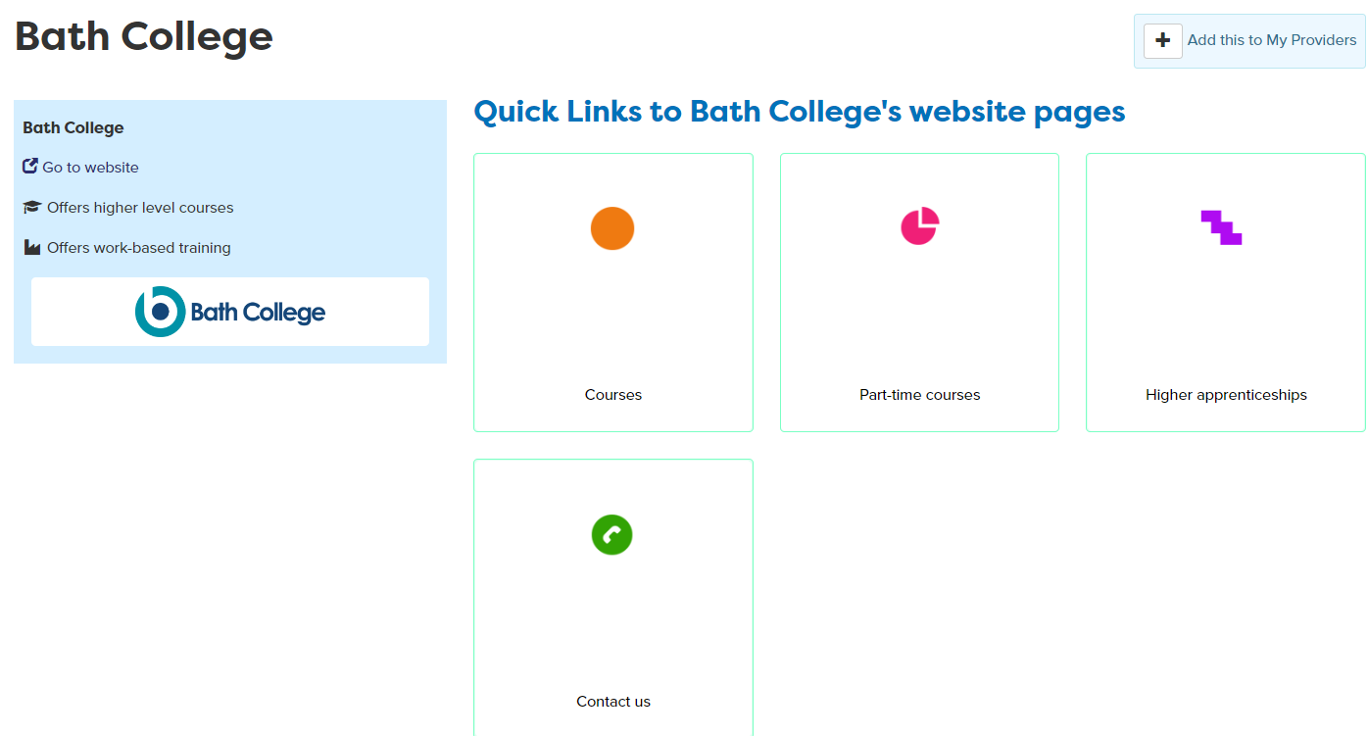
In today’s lesson you will…
Get a reminder of qualifications and levels
2. Focus on vocational qualifications
3. Look at different routes into jobs you like
4. Research what courses the local college offers that link to jobs you like
careerpilot.org.uk
Notes:
Explain to students what activities they will be doing shortly on Careerpilot.
Use the following slides to explain how to complete these activities before getting started….

Slide 36

4 things you can do now
Focus on vocational qualifications
Notes:
Remind the students of the video they saw last lesson. The focus today is drilling down in their options so they understand them in more detail.

Slide 37
Qualifications
Academic
Technical/Vocational
Apprenticeship
Degree Achieved
Degree Year 2
HND
Foundation Degree Y2
Higher Apprenticeship
Degree Year 1
HNC
Foundation Degree Y1
Higher Apprenticeship
A levels
BTEC/OCR NEW T LEVEL Level 3
Advanced Apprenticeship
5 x GCSEs 4 - 9
BTEC/OCR Level 2
Intermediate Apprenticeship
GCSEs 1 - 3
Notes:
Remind students of the pathways and options.
Today will focus on the offer in schools and colleges

Slide 38
Thinking ahead – what do you want?
Post 16 - after Year 11
What I want from life
Post 18 – after Year 13/college
Jobs I would like
5 mins
Notes:
Students draw the 4 circles as above and then write in their thoughts to date about each one. The last box is about what’s important to them – having a house, family, preventing climate change

Slide 39
Making career decisions
Choosing post 16 now
Where will this course lead?
You also want to know your choice at 16 will help you get to where you want to go in the future
Do people get good jobs after this course?
Am I choosing the right A Levels to get on the uni course I want?
What might I do post 18?
Remember: Free education only last until you are 19 (or get your first Level 3) so making an informed decision is important
Notes:
Need to be thinking ahead as well as to the decision now

Slide 40
Sixth Form/College offer
Academic Qualifications
Vocational Qualifications
Extra Curriculum:
Work experience
Medical Society
Volunteering
Duke of Edinburgh
School Council
Sports Leaders
A levels
BTEC
AS levels
Uni Arts London/OCR
Extended Project Qualification (EPQ)
Cambridge Technicals
L3 Core Maths
Find out more:
School websites
6th form evenings
Prospectus
Get UCAS points for each, which can get you onto a higher level course
Notes:
A summary of the typical 6th form offer
Schools might want to add a slide explaining their offer or tie this slide in with mentioning 6th Form open evening, etc.

Slide 41
Vocational qualifications offered at Sixth Form
Applied General Qualifications
BTEC level 3 National Certificate/ National Award
Each qualification equivalent to 1 or 2 A levels
Cambridge Technicals
Can be taken together or combined with A Level(s)
Leading to
Get UCAS points for each, which can get you onto a higher-level course
Apprenticeships, work or university.
Homework –
Find out what vocational courses your school offers
Notes:
A Levels – Key facts
Very popular in some schools as you can take individually eg HSC, Business, Sport or combine them eg HSC and Psychology, Sport and psychology.
Not all schools offer this route.
Note to school – you could add your own slides to show the school’s vocation offer at this point

Slide 42





Getting into the details: College
Level 3 –T Levels and other Level 3 qualifications
T Level Foundation (L2)
Level 1 and 2 Voc Quals
Notes:
Explain college has a large range of voc. Some colleges also do A Levels.

Slide 43

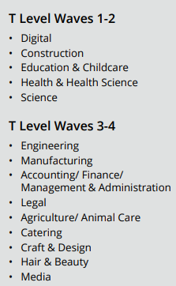

T Levels
Building Services Engineering for Construction
Construction: Design, Surveying and Planning
Created by business.
Train for a specific job.
2 years - equivalent to three A levels
Get UCAS points, which can get you onto a higher level course
Notes:
Remind students they need to check entry requirement for T Levels as some need 5 GCSEs at 4-9, some want 5 GCSEs at 5-9.

Slide 44
TASK: Sign into Careerpilot
1. Register/sign in
Notes:
You will using Careerpilot to explore all your options, register (or sign in if you have used it before)
Then you can build your report and have a record of all your career choices and plans

Slide 45
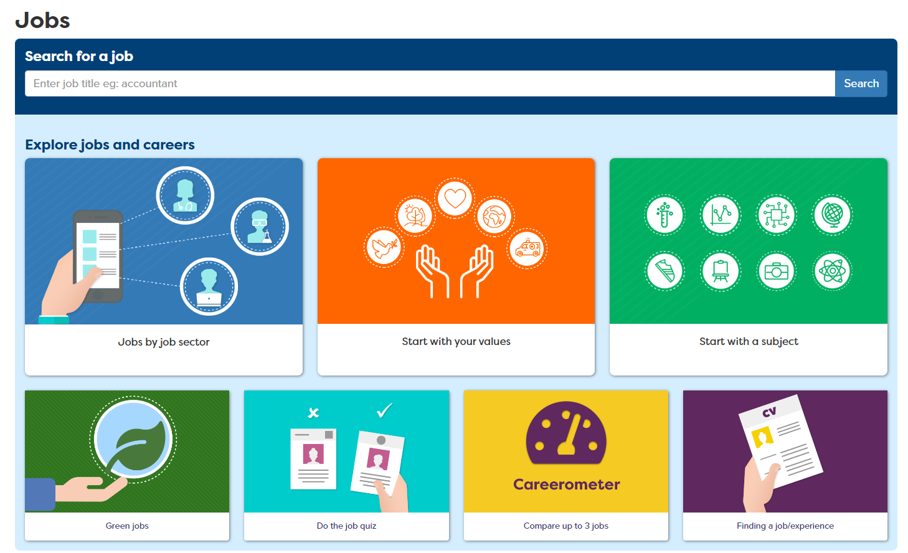
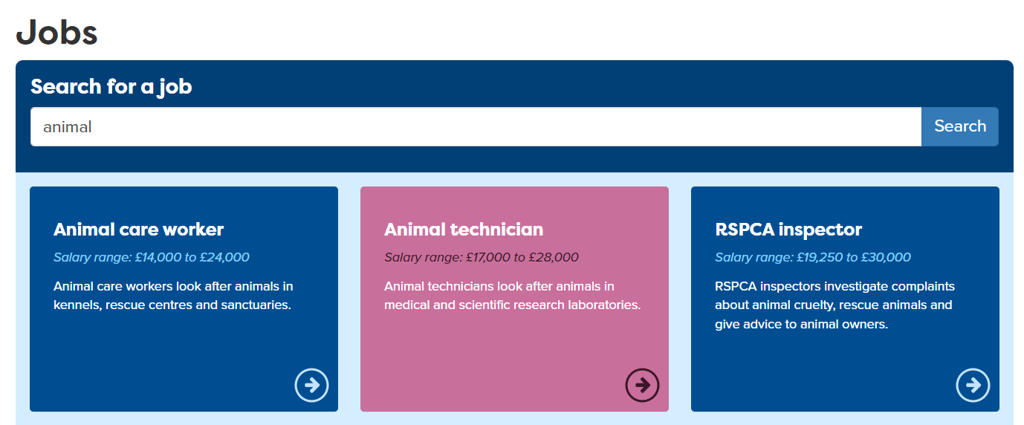
Find jobs you like in ‘My Job Sectors’
Notes:
You will use Careerpilot to explore all your options, register (or sign in if you have used it before)
Students might already have jobs they like saved in their Career Tools or they can go to ‘jobs’ and search in different ways from the Jobs page.
They can then look at job profiles to find the different routes in.

Slide 46
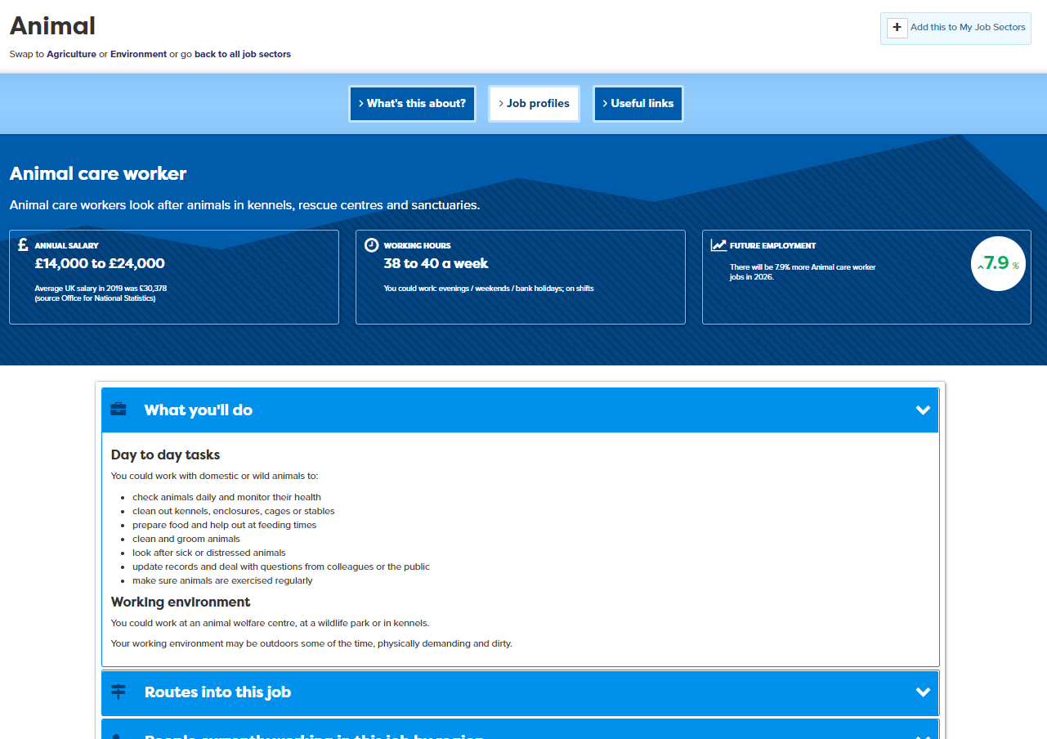
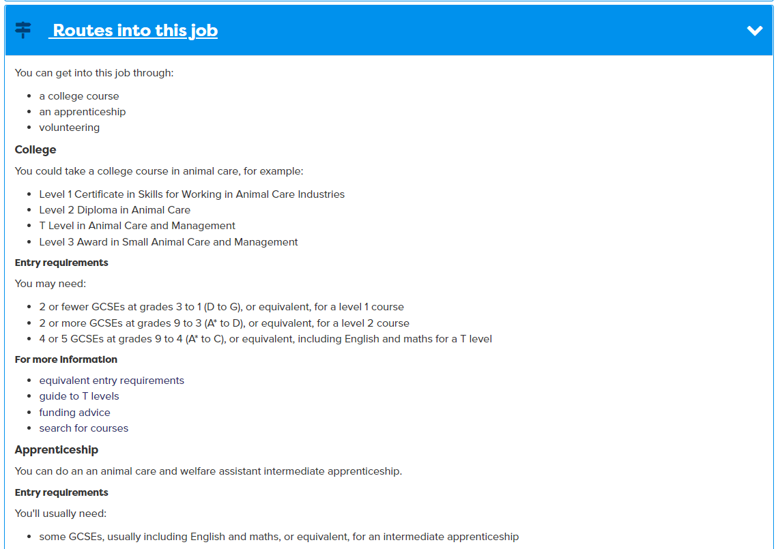
Look at job profiles to find routes in
Notes:
Every job profile has lots of information about the job, including Routes into. In this section any college routes will be mentioned

Slide 47
Task 1: Make a grid as below – don’t fill it in yet
 | Job I like - 1 | Job I like - 2
Name of job I like
College courses you could do to get into this job
Name of college I looked at
1. College course into this job I could do (and level)
2. College course into this job I could do (and level)
How keen on a scale of 1 to 10 are you in this course? (not at all interested and 10 really interested)
5 mins
Notes:
Students should do this in the career book or on paper. They should keep this for future reference.

Slide 48
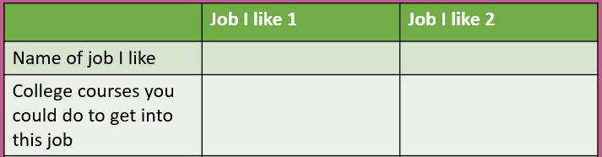
Task 1: Finding vocational routes into jobs
Do this for two jobs you are interested in
1. Look at the job profile for the job and see what routes there are into this through a college
2. Write down the names of any college courses (just 2 max) that are at Level 2 or 3
15 mins
Notes:
They find the job profile, see if there are college courses into it and write down one or two. They do this for two jobs.

Slide 49
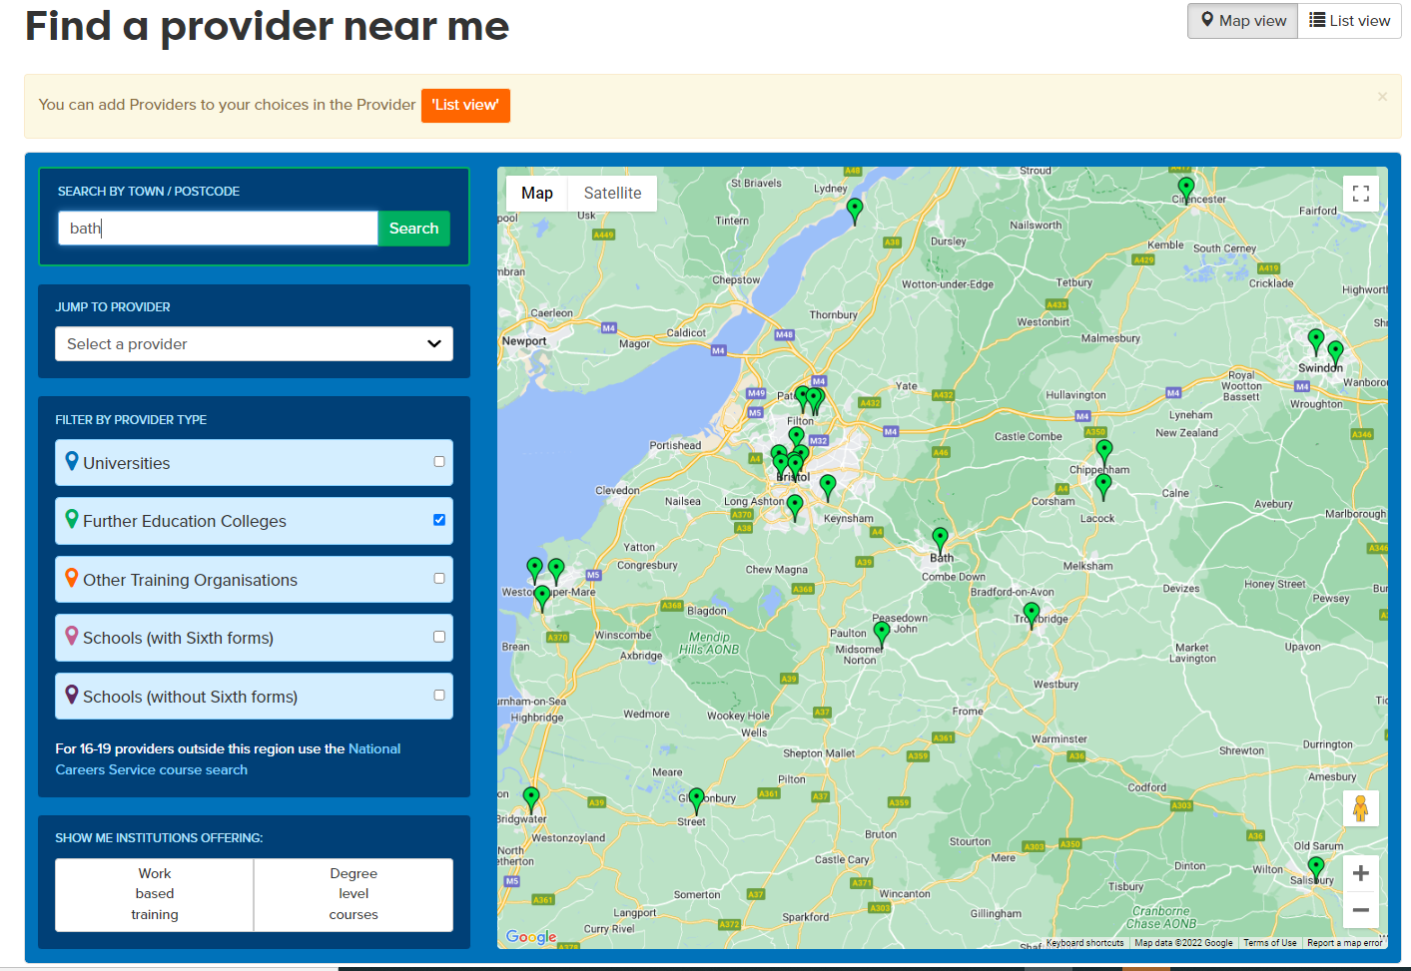
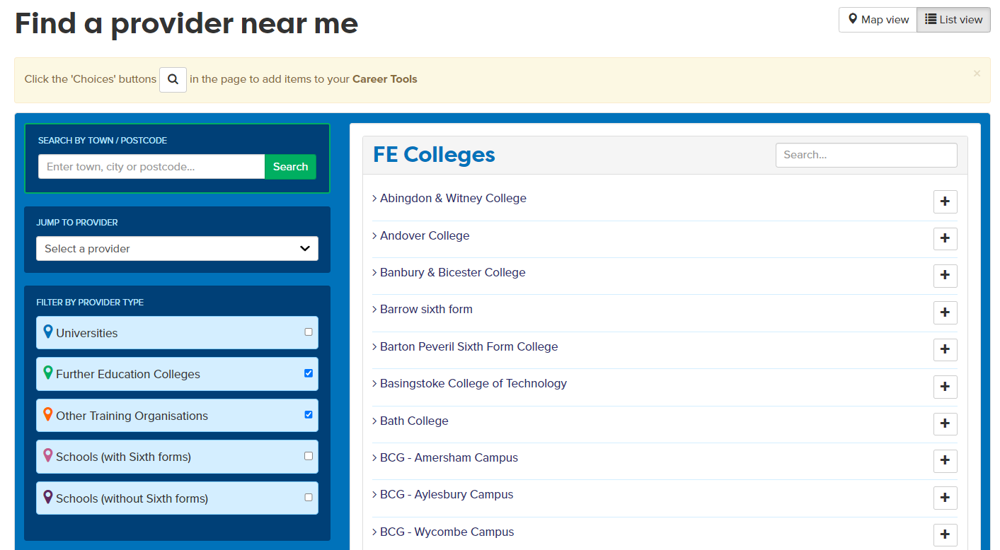
What vocational qualifications can I do at college?
In Providers – Choose ‘list view’ to tag
Notes:
Students should change to list view to see names of colleges, can then click to see their Careerpilot page and click through to the colleges online prospectus.
If they like the college they can add to ‘My Providers’ by clicking +

Slide 50
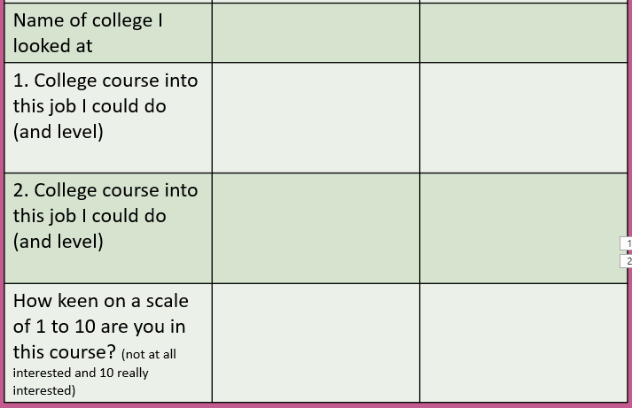
Task 2: Explore vocational qualifications
Using the names of the college courses that would get you into the jobs you are interested in - from Task 1
In ‘Providers’ on Careerpilot – find your local college, go to list view
Write down courses at your local college that fit with your job ideas - and what level the course is at
Rate the course on how interested your are in it.
15 mins
Notes:
Students should try to find one or two college courses for each of their chosen jobs.

Slide 51
Share with a partner
Share your grid – and see what is the same or different about what your partner looked at.
Use the chart to share what you found out.
Compare your own research with your partners –
discuss and compare how you rated the courses
5 mins
Notes:
Paired activity
Listening Step 12 – Comparing Views: I compare different points of view
Speaking Step 9 – Sharing Visuals: I use images, charts or diagrams when it helps my communication

Slide 52
Getting Career-ready – did you?
Considered what learning pathway to do next
Began to make plans and develop a pathway into your future
Notes:
The Career Development Institute has developed a careers framework that shows the skills everybody needs to have to manage their future career.
This slide shows the students which of the career learning areas (CDI) that this lesson links to. Ask if they achieved these things.

Slide 53

Careerpilot is closing. This resource is only available to use until 23rd October 2026.
Preparing for post 16
Lesson 3: The apprenticeship pathway and how to find one
Notes:
In this session students will be drilling down to find out more about apprenticeships and how to find one.

Slide 54
Getting Career-ready
Introduction and warm up activity – 10 mins
You will research the education and training system
Research task 1: 15 mins
You will start to take responsibility for making things happen in your career
Research task 2: 15 mins
Wrap-up
10 mins
Notes:
The Career Development Institute has developed a careers framework that shows the skills everybody needs to have to manage their future career.
This slide shows the students which of the career learning areas (CDI) that this lesson links to.
You can also share the structure of the session with students.

Slide 55
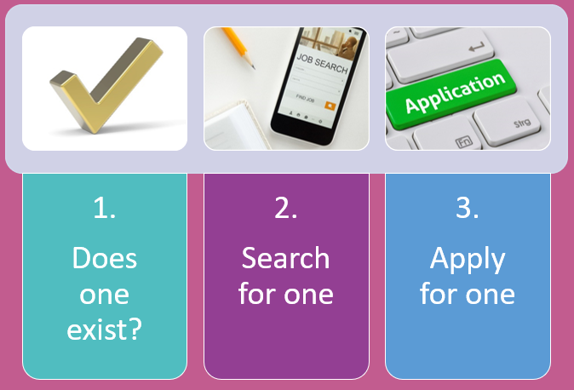

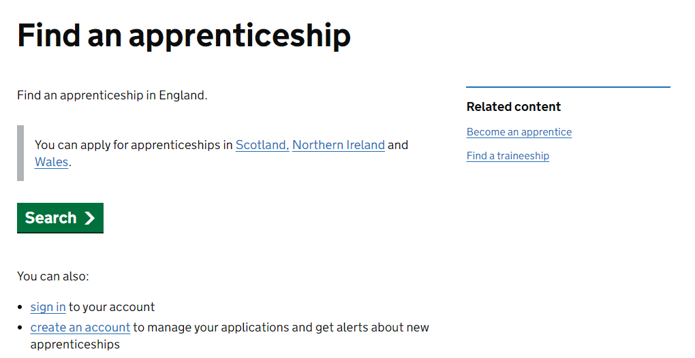
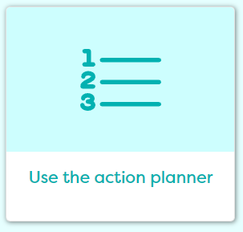
In today’s lesson you will…
1. Register/sign in to Careerpilot
2. Know more about apprenticeships
3. Know the three stages of finding an apprenticeship
4. Search for vacancies on Careerpilot
5. Search for vacancies in other places
6. Have action points to take your career forward
careerpilot.org.uk
Notes:
Explain to students what activities they will be doing shortly so they have an overview
The following slides will take them through what they need to do.
Students might choose an apprenticeship at 16 or after A levels, etc. So it is good to know how to find them even if they are thinking of something else at 16.

Slide 56
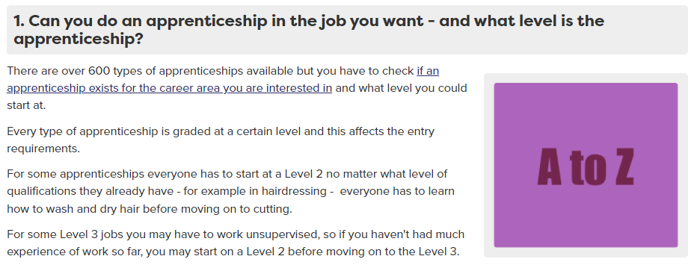
Degree or apprenticeship?
Quiz Question
Can be competitive –as anyone of any age can apply for an apprenticeship
Nurse
Dentist
Solicitor
Degree
Degree
Degree
Apprenticeship
Apprenticeship
Notes:
Ask what qualification do they need to become..
Is it a degree, apprenticeship or both.
See answers. Can also see an A-Z of available apprenticeships on Careerpilot. Make the point that even if one exists they still have to find a vacancy. Careerpilot has links to vacancy sites too.

Slide 57
T Levels
Will train you to do a specific job
Apprenticeships
Will train you to do a specific job
80% in workplace
20% in college
Notes:
T Levels and apprenticeships are training you to do a job but in different ways. One is more through classroom teaching and some WEX the other through work with some classroom teaching

Slide 58


Apprenticeships
Higher/Degree Apprenticeship
£6.40 per hour – for 37 hours £236 per week (but some employers pay more)
Might need to start at the same or lower level
Higher/Degree Apprenticeship
Learn by doing the job
Higher/Degree Apprenticeship
Advanced Apprenticeship
Need to find one like finding a job
Intermediate Apprenticeship
Notes:
Apprenticeships Key facts
You can progress on to an apprenticeship at any point in your career – as a young person starting out, as a graduate or as a career changer.
Are good if you know what job you want to do and you are ready to enter the workplace at 16 and the apprenticeship you want is available.
Sometime you have to start at a lower level to build up the job knowledge e.g hairdresser.
Sometimes you have to stay in education and do a level 3 course before you can progress on to a specific apprenticeship. T levels are created to fit with apprenticeship standards and allow progression to higher and degree apps.

Slide 59
Finding an Apprenticeships
What do you want to be trained to do through an apprenticeship?
1.
Does one exist?
2.
Search for a vacancy
3.
Apply
Notes:
An apprenticeship is training you to do a job so you do have to think what job role you are looking for.
Then there are three stages to follow

Slide 60
Task 1: Make a grid – don’t fill it in yet
 | Apprenticeship 1 | Apprenticeship 2 | Apprenticeship 3
Name of apprenticeship
Town/location
Starting date
Employer
Level
One more fact
How keen on a scale of 1 to 10 are you in this course? (not at all interested and 10 really interested)
5 mins
Notes:
Students can do this in their career book or on paper. They should keep the page for future reference.
THEY DO NOT FILL IT IN YET

Slide 61
Start by looking at a job
Notes:
Another way to think what apprenticeship might suit them is to look for a job they like and see if there is an apprenticeship route. This will give the name of the apprenticeship.

Slide 62
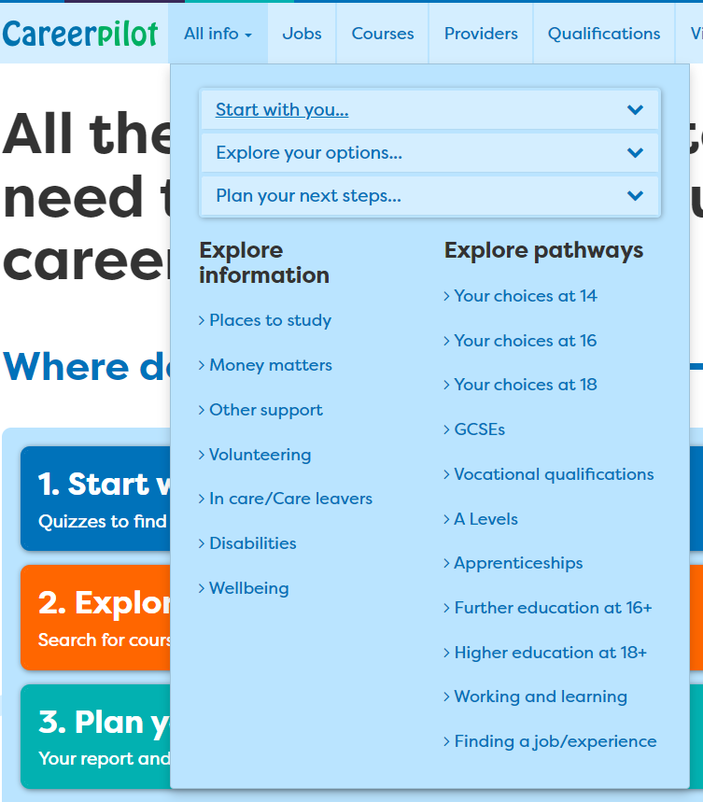
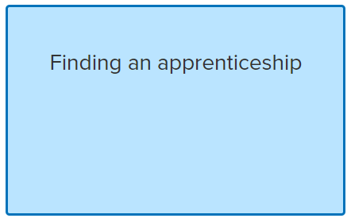
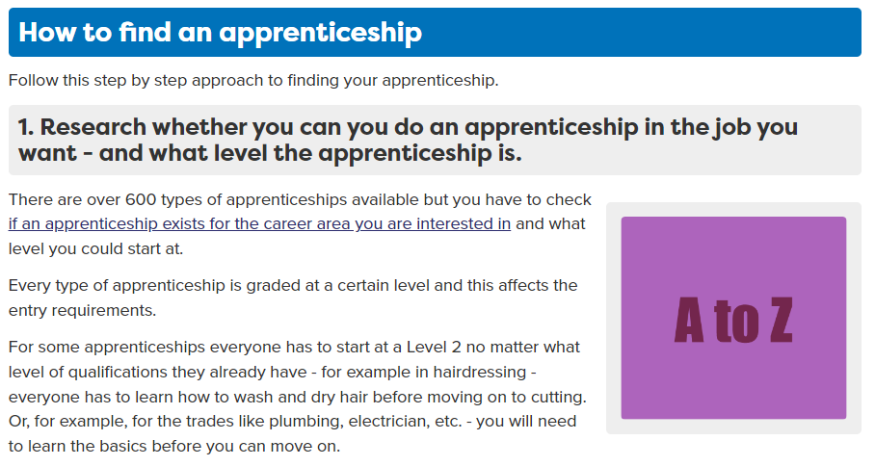
Is there an apprenticeship for what you want to do?
Notes:
They could also just search for something they are interested in already. First they need to see that a standard has been written for this job. That will tell them an apprenticeship exists. They still need to see if there are any vacancies.

Slide 63
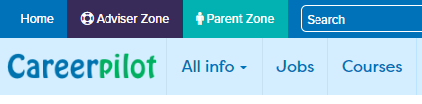
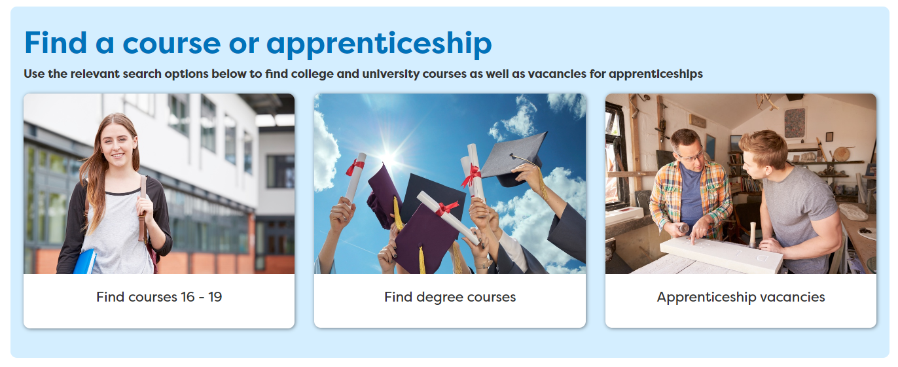
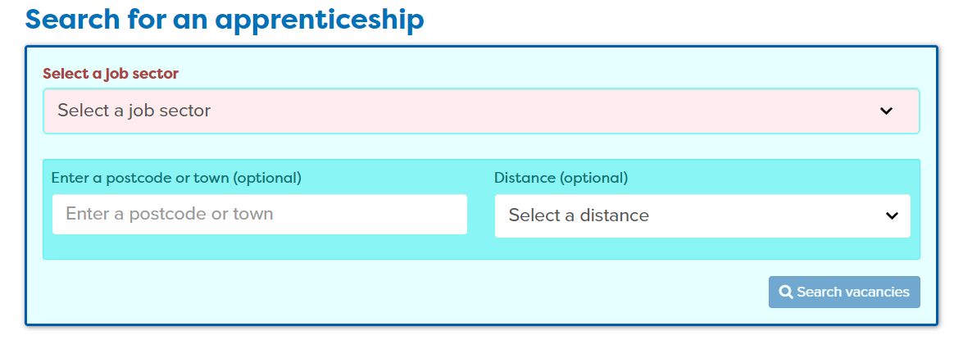
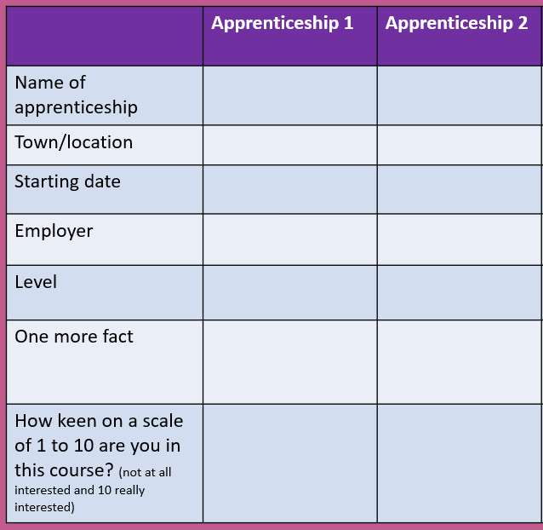
Task – Look at vacancies
Find two vacancies less than 30 miles from where you live.
For each one, fill in the information on the grid
15 mins
Notes:
Task – they are going to use the Careerpilot apprenticeship vacancy search. If they know a job title they want to search by they can use that or they can look at a job profile for something of interest to them and see if there is an apprenticeship. They can then look for that specific one by name.
They should record information for TWO on their grid

Slide 64


Other places to search apprenticeships
Notes:
There are other good places to search for an apprenticeship – through gov.uk – where they can set up an account and get alerts and through Amazing Apprenticeships where they can see what employers are offering what apprenticeships.

Slide 65


Wrap-up: In pairs
Share your grid with a partner – and explain what you searched for and what you found.
Take it in turns to speak clearly and in a way that is engaging for your audience.
Listen carefully to your partner and summarise what they tell you.
 | Apprenticeship 1 | Apprenticeship 2 | Apprenticeship 3
Name of apprenticeship
Town/location
Starting date
Employer
5 mins
Notes:
This activity support students to practice the following skills steps:
Speaking Step 11 – Speaking Engagingly: I communicate in a way that is engaging for my audience
Listening Step 9 – Summarising: I summarise or rephrase what I learnt

Slide 66
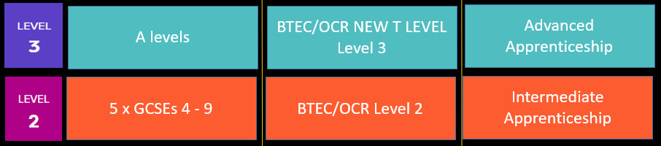
Firming up plans and managing your career
Write down what you are thinking of post 16 – like this
Order | Choice | Details
1st | A levels | Art, history, English
2nd | Apprenticeship | Design
3rd | T Level | Digital design
10 mins
Notes:
The students should now be firming up plans. Explain that anything can be changed but be good to get their ideas of what they are thinking of now.

Slide 67
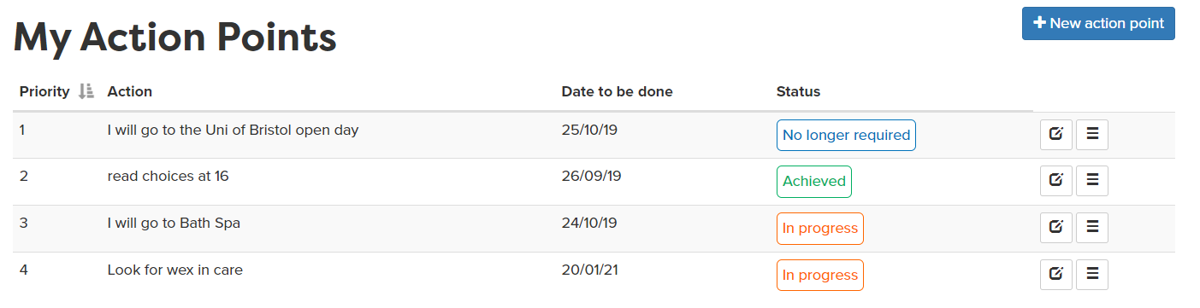
Set action points
Set an action point for something you need to do to take your plans forward.
Notes:
Students can use the action planning tool to do at least one action point of something they are going to do to take forward their career if there is time.

Slide 68
Getting Career-ready – did you?
You researched the education and training system
You started to take responsibility for making things happen in your career
Next lesson: Applying
Notes:
The Career Development Institute has developed a careers framework that shows the skills everybody needs to have to manage their future career.
This slide shows the students which of the career learning areas (CDI) that this lesson links to.

Slide 69

Careerpilot is closing. This resource is only available to use until 23rd October 2026.
Preparing for post 16
Lesson 4: Applying for post 16 and looking ahead to Post 18
Notes:
In this session we will look at ways to apply for any post 16 option and how to do it and also looking ahead to post 18

Slide 70
Getting Career-ready
Introduction
5 mins
You will start making plans for post 18
CV Building : 30 mins
You will start to take responsibility for making things happen in your career
Looking ahead to post 18: 15 mins
Wrap-up
5 mins
Notes:
The Career Development Institute has developed a careers framework that shows the skills everybody needs to have to manage their future career.
This slide shows the students which of the career learning areas (CDI) that this lesson links to.
You can also share the structure of the session with students.

Slide 71

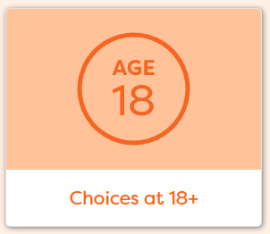
In today’s lesson you will…
Register/sign in to Careerpilot
2. Consider different ways to apply
3. Start or review a CV
4. Explore post 18 options
5. Have action points to take your career forward
careerpilot.org.uk
Notes:
Explain to students what activities they will be doing shortly so they have an overview
The following slides will take them through what they need to do.
Students might choose an apprenticeship at 16 or after A levels, etc. So it is good to know how to find them even if they are thinking of something else at 16.

Slide 72
Applying (for any post 16 route)
Different courses/employers will require different things:
A ‘covering letter’
A CV, which stands for curriculum vitae, is a document used when applying for jobs. It allows you to summarise your education, skills and experience
Application form (often online)
Find out: What are you being asked to do?
Notes:
It is important to find out what is the expected way to apply for a course they want to do.
Having an up-to-date CV is always useful because the information on it can be cut and paste into an application, letter, etc. The CV can also be used to get a part time job.

Slide 73
A CV: What should you include?
As a class group, come up with some ideas
Personal details - phone/email NOT address
Education and any pending or achieved quals.
5 mins
A CV should include
Skills
Any work experiences/
interests
Notes:
Here are some of the key things that should be included on a CV

Slide 74

Hot Tips
It does not need to be a fancy design, people read from top to bottom
DO NOT add address, town should be enough
Write the ‘personal profile’ at the end.
Put ‘pending’ and the date you will be doing exams.
This is the most important bit – give examples
If you do not have work experience already just take this out
Notes:
Students should already have information they could include on their CV in the Careerpilot Career Tools

Slide 75
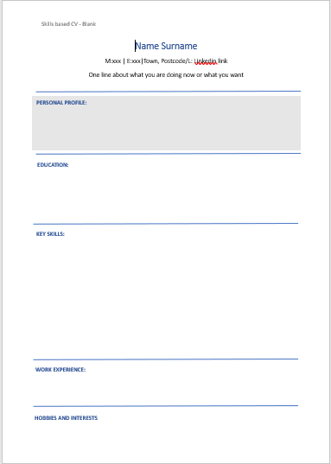
You already have a lot of information
Notes:
They should already have some info that will help them get started from the Careerpilot Career Tools

Slide 76


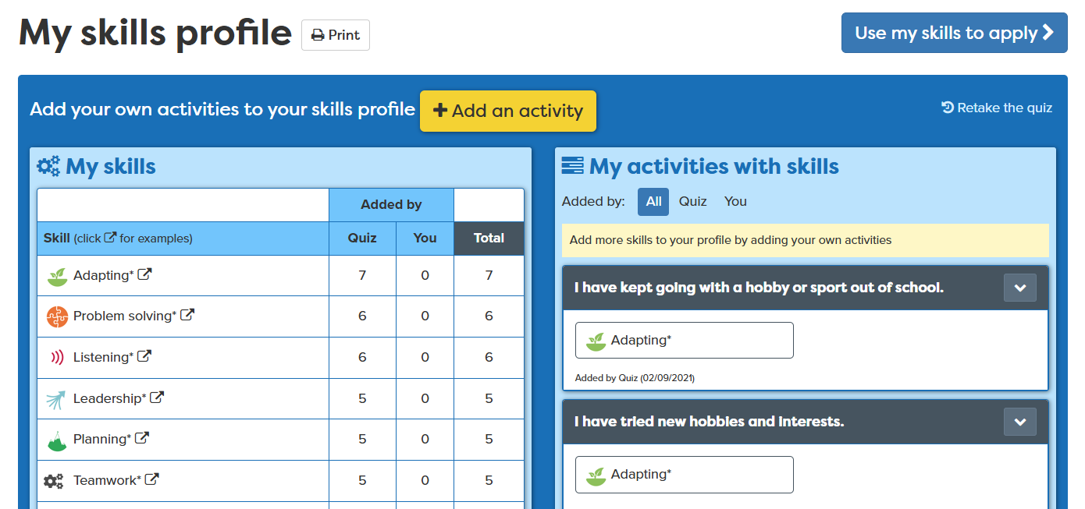
Use a template and get started
Finding a job/experience
CV
30 mins
Notes:
Students should be directed to which template they should use. The word download is probably the easiest for Y10.
Explain they should say what GCSEs they are doing and add’ pending’ if they haven’t done them yet.
If they have any work experience or part time work e.g babysitting, paper round, helping dad in his building company, they can include this. If not then take out this section.
Students may at this point review their skills profile and use to apply if helpful.

Slide 77
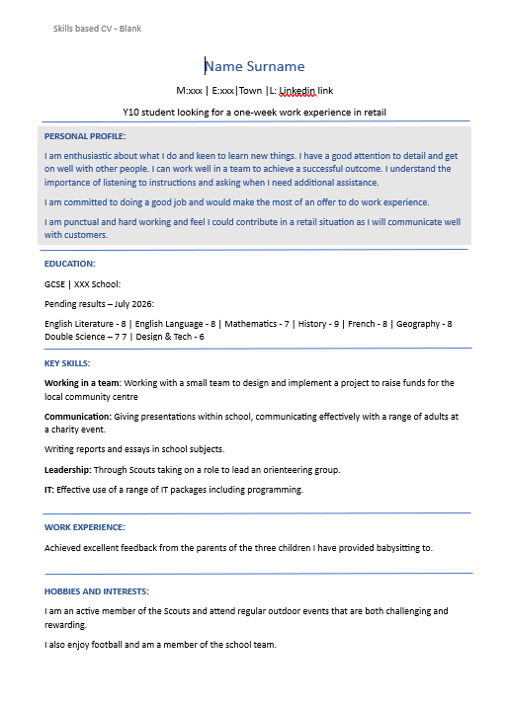
Provide feedback to a partner
In pairs look at each other’s draft CVs and help each other improve or give constructive feedback.
You may ask questions to understand more.
You may use facts and examples to support support your feedback.
5 mins
Notes:
Ask students to now take it in turns to show and tell a partner about the job sectors they have saved, including about any jobs they viewed that sounded interesting.
Students can compare the salaries of the jobs they found and talk about what aspects of the day to day tasks they think looked interesting and why.
If time, ask students to feed back on their partner’s chosen jobs or job sectors to the whole class.
Students will have opportunity to practice speaking and listening skills:
Listening Step 8 – Questioning: I ask open questions to understand more

Slide 78
Covering letter – letter of introduction
Why are you writing
I am writing to apply for XXX
Where are you now?
I have just finished doing my GCSEs at xx school.
I’ve always been interested in working with children and have babysat since I was 14. I would love the opportunity to do a nursery assistant apprenticeship.
Give some info about yourself
Include CV
I am attaching my CV.
Include contact details
My telephone number/email address is…
Notes:
Explain what should be included in a covering letter but students will do in own time.

Slide 79
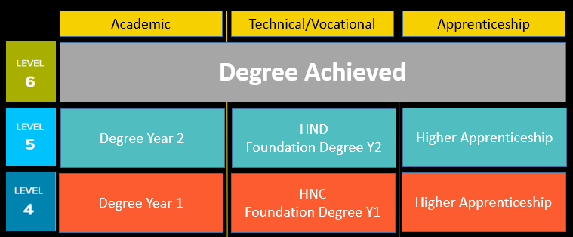
Looking ahead to post 18
Notes:
What come next in quals ladder – Level 4 and above – they should be thinking of these things too

Slide 80
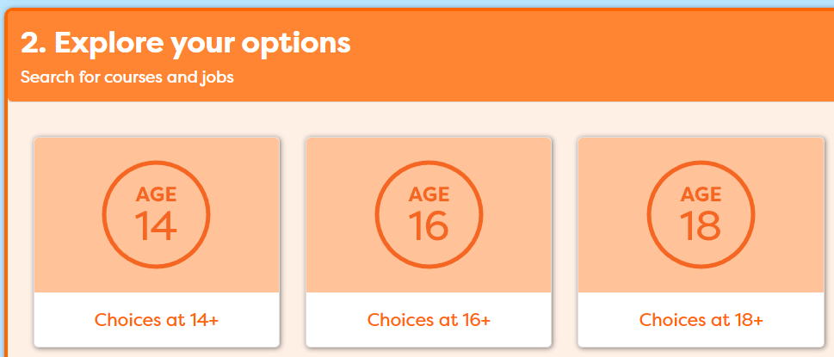
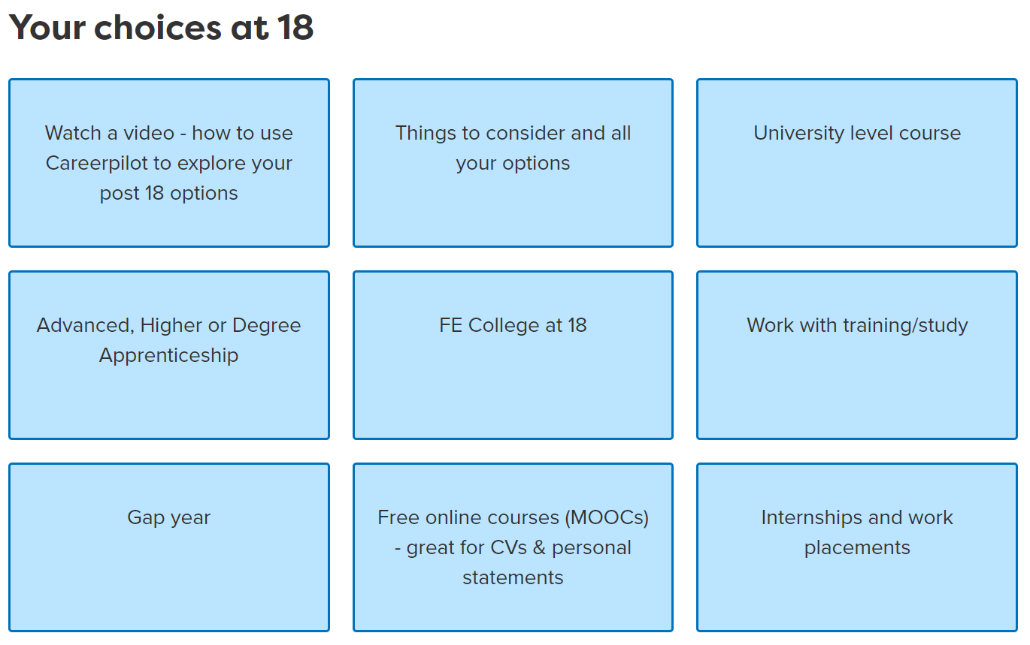
One place for all your careers information.
Task: Explore post 18 options
15 mins
Notes:
Explain that Careerpilot has the details to help them think about post 18. Give them time to explore their choices at 18.

Slide 81
Careerpilot is closing. This resource is only available to use until 23rd October 2026.
Preparing for post 16
Lesson 5: Careers Quiz and Reflection

Slide 82
Getting Career-ready
What is a career?
What does LMI stand for and why is it useful?
How and why are jobs changing?
What three pathways can you take at 16?
What level have you achieved when you have a degree?
10 mins
Notes:
A career is an individual's journey through life, learning and work.
A job is something you might do to earn money as part of your career journey. There are lots of different job sectors you could work in, from finance, to art and design, to working with animals.
LMI stands for labour market information – the more you know about where the jobs are the more likely you are to know where to align yourself for the future
Jobs are changing because of tech, AI, climate change.
The three pathways are academic, vocational and work based
Level 6 is when you get your degree

Slide 83
Academic
Technical/Vocational
Apprenticeship
Degree Achieved
Degree Year 2
HND
Foundation Degree Y2
HNC
Foundation Degree Y1
A levels
Advanced Apprenticeship
BTEC/OCR Level 2
Intermediate Apprenticeship
GCSEs 1 - 3
Fill in the gaps – what qualifications should be in the blanks
Notes:
As a group see if students can say what qualifications should be in the blanks

Slide 84
Academic
Technical/Vocational
Apprenticeship
Degree Achieved
Degree Year 2
HND
Foundation Degree Y2
Higher Apprenticeship
Degree Year 1
HNC
Foundation Degree Y1
Higher Apprenticeship
A levels
BTEC/OCR and T LEVEL Level 3
Advanced Apprenticeship
5 x GCSEs 4 - 9
BTEC/OCR Level 2
Intermediate Apprenticeship
GCSEs 1 - 3
Notes:
The answers

Slide 85
Review your plans and discuss with a partner
Post 16 – After Y11
What I want from life
Post 18 – After Y13/college
Jobs I would like
5 mins
Notes:
Students should have this from lesson 2. Ask them to change or update and then in pairs share what their plans are and discuss

Slide 86



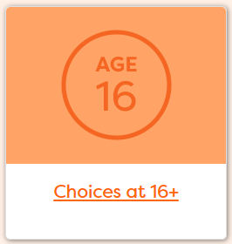


Y11 lessons – what has been most useful to you?
Write down your top three most useful and why
5 mins
Notes:
These are some of the things that have been covered over the 5 week programme. Which have been the most useful and why? Students should write this down.
As a class group after individual recordings - Ask the class to put up their hands if they found the job quiz useful, etc to gauge class views.

Slide 87
Over the last 5 lessons you have….
Seen how your post 16 choices fit with future jobs & your career
Made a plan to develop a pathway into your future
Considered what learning pathway to do next
Researched the education and training system
Started making a plan for post 18
Started to take responsibility for making things happen in your career
Promoted your skills and interest
Notes:
Summary of which aspects of the CDI framework students have covered.
Should be proud they have done these things which will take forward their career – clap!

