Slide 1
careerpilot.org.uk
What inspires you?
Look at Jobs and courses
Make a plan
Options already chosen

Slide 2
What you will get from this lesson
You will:
See why it is important to manage your career;
Consider the next career steps you need to take;
Think about what you like and your skills;
Share your ideas with someone.

Slide 3
What is a career?
A career is an individual's journey through life, learning and work.
It is all about YOU!
Throughout your career you will have many jobs

Slide 4
How can you manage your career?
https://www.youtube.com/watch?v=OWZxyyK6OuA

Slide 5
Getting to know you
Tell the group one thing about your e.g favourite food, music, hobby, etc.

Slide 6
What’s next on your career journey?
Y8 or 9
Y10
Y11
Y12/Y13
Trying out work
Choosing post 16 courses
Choosing post 18 options
Chosen GCSE exam subjects
In the UK you have to be in education or training until you are 18

Slide 7
The bigger picture - Qualification Pathways
Academic
Vocational
Work-based
Degree Achieved
Degree Year 2
HND
Foundation Degree Y2
Higher Apprenticeship
Degree Year 1
HNC
Foundation Degree Y1
Higher Apprenticeship
A levels
BTEC/OCR NEW T LEVEL Level 3
Advanced Apprenticeship
5 x GCSEs 4 - 9
BTEC/OCR Level 2
Intermediate Apprenticeship
GCSEs 1 - 3
Notes:
Explain that there are three pathways but in all pathways there are levels of quals. Level 2 is getting 5 GCSEs grade 4-1.
Show them the other levels and make the point that all pathways can lead to a degree.
The bit of the qualification ladder we are mainly talking about today is their choices after GCSEs

Slide 8
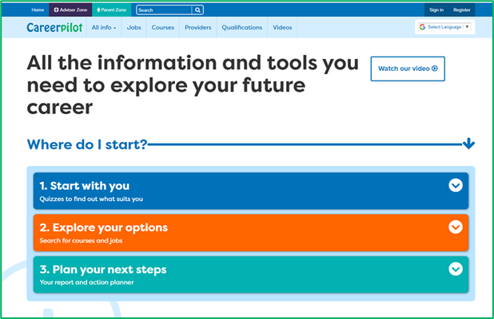
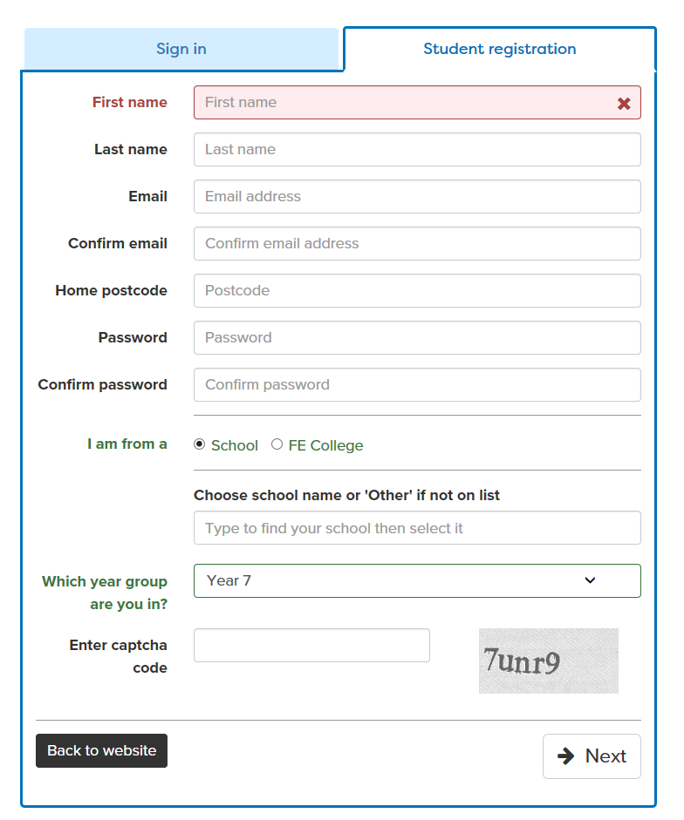
Register or sign in to Careerpilot
careerpilot.org.uk
If you have registered before – sign in
Notes:
Show students that if they are new to Careerpilot, they need to register to use the website.
They must click on the ‘Register’ button in the top right corner to open up a short registration form that takes a few minutes to complete.
Remind students to use their school email address to register and to click on your school from the drop down list.
Students that have already registered just need to log in with their email and password.

Slide 9
Starting Points

Slide 10
Starting Points

Slide 11
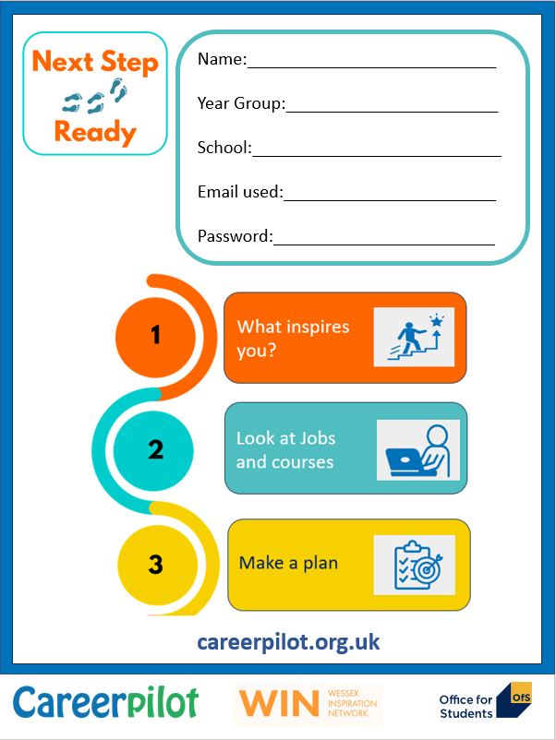
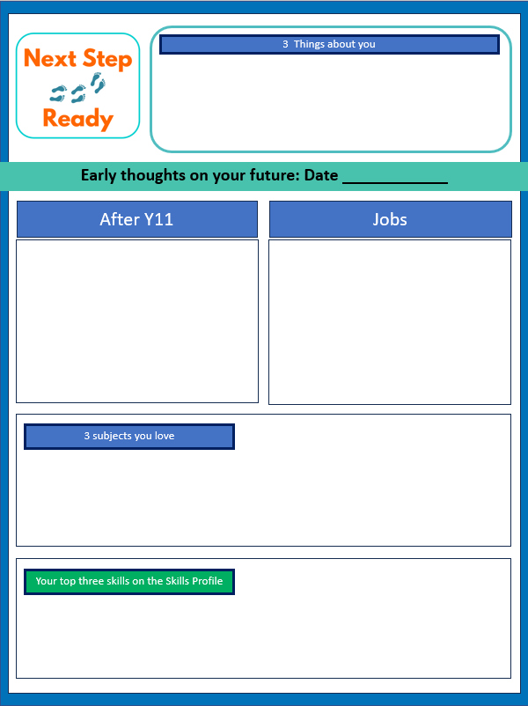
Workbook

Slide 12
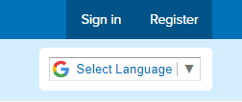
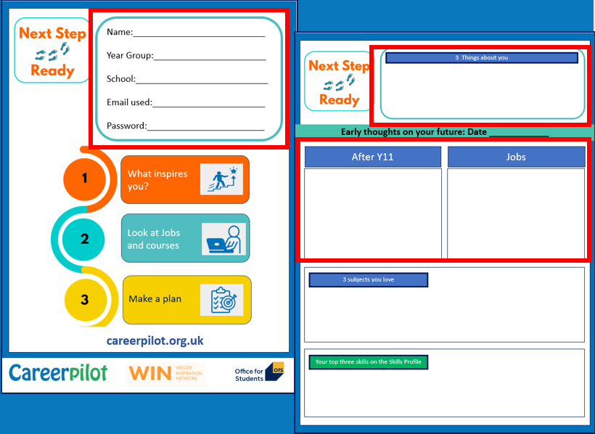
Getting started
1. Register or sign in
careerpilot.org.uk.
2. Do the starter quiz
3. Add your details to your workbook
10 mins
Notes:
Students can use their list subjects and those they are interested in as a starting point for exploring where they might lead.

Slide 13
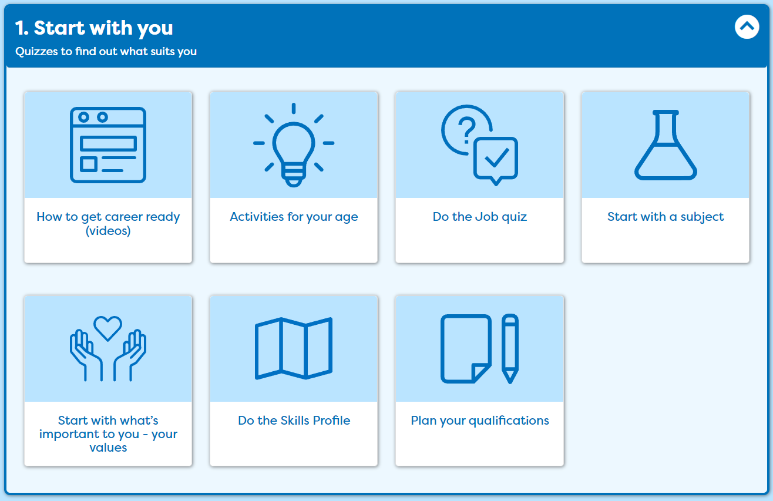
See where some of the subjects you like can take you

Slide 14
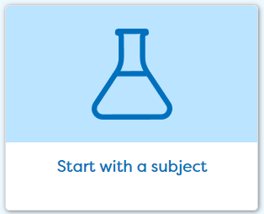
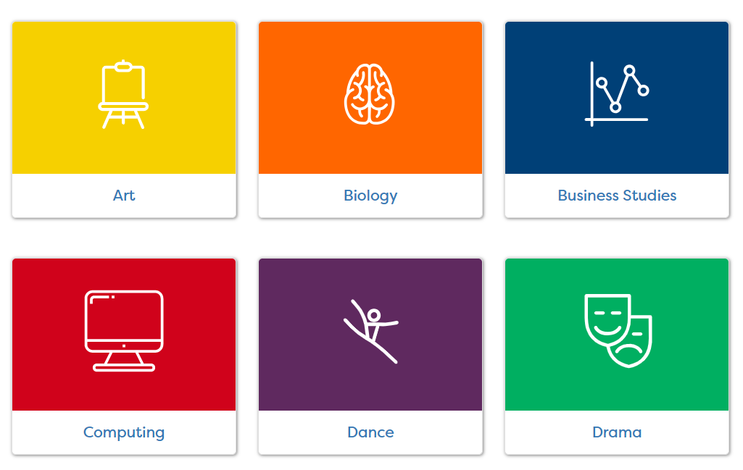
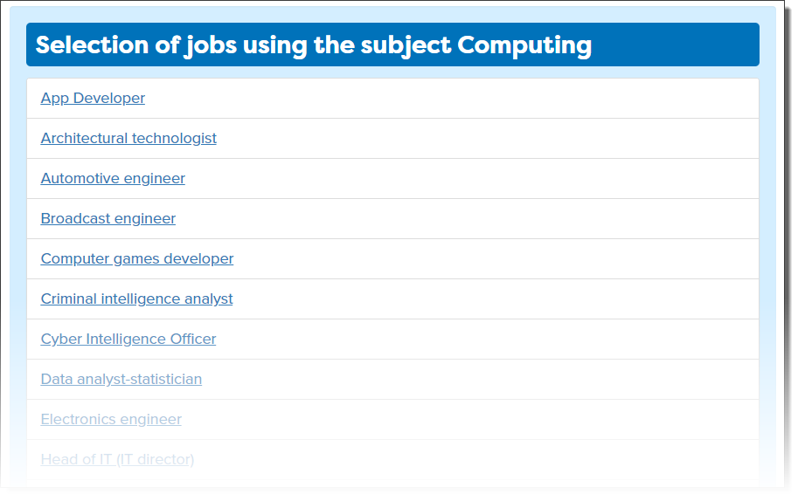
See where they lead
Notes:
Aside from the skills profile, Careerpilot also links to the curriculum and links courses and jobs through ‘Start with a subject’ . In this section students can pick subjects they are interested in and read more about jobs, courses and online activities they can take part in which are related to the subject. A direct way of Achieving Gatsby Benchmark 4

Slide 15
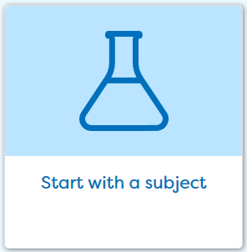
Choosing subjects
Click on ‘Start With You’ then ‘Start with Subject’ .
Tag at least three subjects that you love
10 mins
Notes:
Students can use their list subjects and those they are interested in as a starting point for exploring where they might lead.

Slide 16
Explore your skills

Slide 17
The Essential Skills
Other skills some jobs need
IT Skills
Practical
Scientific
Physical
Notes:
Class discussion – what skills did students come up with?
These eight skills have been identified by employers as being essential to any job. They are people skills, so are all about how you communicate with others, how you manage yourself and come up with new ideas.
You can see them as four pairs of skills:
Communication skills - Listening and Speaking
Creative Problem Solving skills - Problem Solving and Creativity
Self-management skills - Staying Positive and Aiming High
Inter-personal skills - Leadership and Teamwork

Slide 18
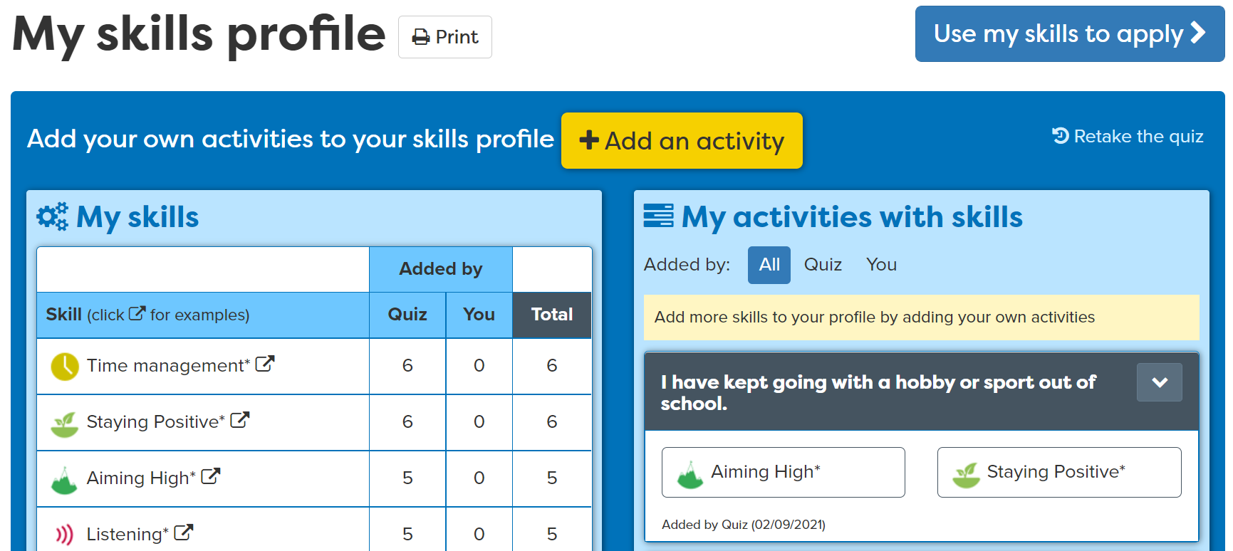
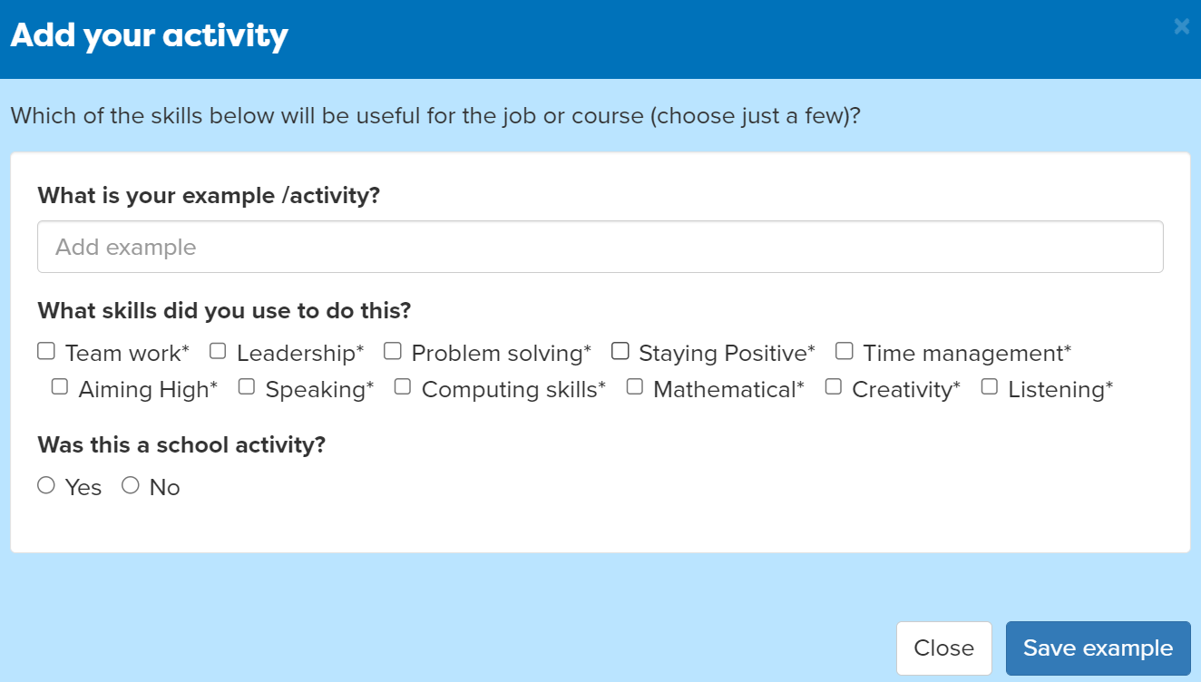
Add activities
Answer the questions
Notes:
Students can add activities that they have completed where they have been building their skills.
For example, they may take part in a club outside of school where they use Teamwork skills.

Slide 19
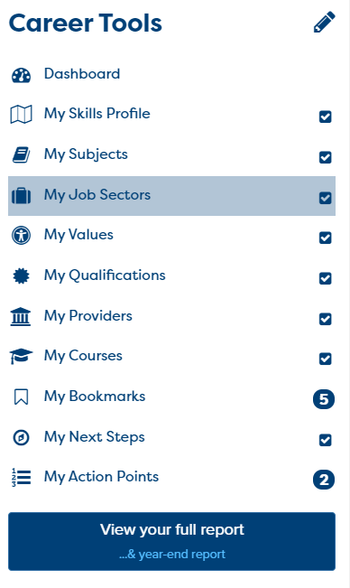
Your Skills Tasks
Click on ‘Start With You’ then ‘Do the Skills Profile’. Add an example of your own.
10 mins
Go to your Career Tools report and see what you have already – should be skills and 3 subjects you love
Notes:
Explain to students what activities they will be doing shortly on Careerpilot.
Use the following slides 11-16 to explain how to complete these activities before getting started….

Slide 20
Discussing your interests
Tell the group one thing you looked at that was interesting to you

Slide 21
Feedback on lesson
Secret Feedback: Head on table, eyes closed put hand up if agree with the question
Hands up:
Do you now know the 4 things you can do to manage your career?
Do you know more about the subjects you could do?
Do you know more about the skills you already have?
Digital Postcard:
What we did and what you could do now
careerpilot.org.uk

Slide 22
careerpilot.org.uk
What inspires you?
Look at Jobs and courses
Make a plan

Slide 23
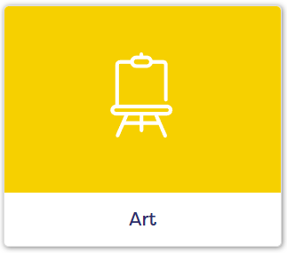
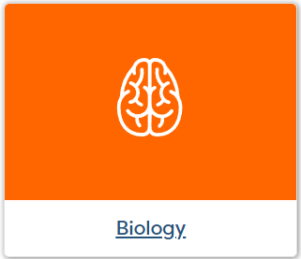
Which subjects would be useful in this job
Nurse
Architect
Use the subject cards to find subjects that would be useful
Notes:
Can leave out of short of time

Slide 24
Pick out the subjects you are doing for GCSE
The subjects you love
The subjects you don’t mind
The subjects you are not keen on
Sort your subjects in three piles
Notes:
Can leave out if short of time

