Slide 1


careerpilot.org.uk
Careerpilot is closing. This resource is only available to use until 23rd October 2026.
5 Week Careers Teaching Pack
Year 10 - Post 16 options and Work Experience

Slide 2
Teacher Overview: Year 10
This 5-week careers programme aims to support students to:
Develop their career skills for life, learning and work
Prepare them for the next career decisions they will have to make.
Lessons have been developed by the Careerpilot Team – all are qualified career advisers and teachers.
The programme contains all you need to deliver 5 x 50-60 minute lessons. All lessons use a Power Point presentation, with notes to explain screens.
Lesson 1 – about post 16 choices and lesson 2 – about why work experience both could be delivered as standalone sessions. The first lesson and second lessons have been pre-recorded as video lessons with a member of the Careerpilot Team virtually delivering the session and providing instruction to the facilitating teacher and the students should you wish to use this delivery option.
All Year 10 lessons will require students to have online access to careerpilot.org.uk and paper/pen.
Careerpilot can be accessed through pc, tablet or phone.
To provide feedback or ask a question contact:
careerpilot@bath.ac.uk

Slide 3



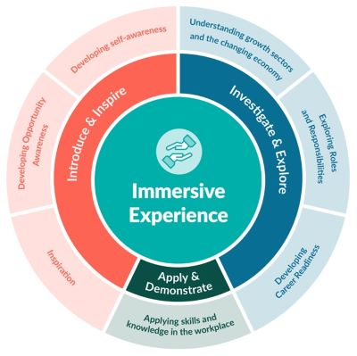



The Year 10 careers lessons are mapped to:
CDI Framework and career development skills
Gatsby Benchmarks
Create opportunities by being proactive and building positive relationships with others.
www.gatsbybenchmarks.org.uk/
The Equalex Framework to support preparation for Modern Work Experience
Manage your career actively, make the most of opportunities and learn from setbacks.
Introduce and Inspire
Explore the full range of possibilities open to you and learn about recruitment processes and the culture of different workplaces.
Investigate & Explore
Apply & Demonstrate
Grow throughout life by learning and reflecting on yourself, your background, and your strengths.
www.thecdi.net/write/Framework/CDI_86-Framework-Guidance_in_Secondary_Schools-webFINAL.pdf
www.careersandenterprise.co.uk/modern-work-experience/equalex-for-educators/
https://www.careerpilot.org.uk/skills-profile/activities
Skills Builder Universal Framework 2.0
www.skillsbuilder.org/universal-framework
Notes:
These lessons have been developed to support students to build their career development skills, as identified by the CDI Career Development Famework. Each lesson identifies two outcomes linked to the CDI framework.
The lessons will support meeting Gatsby Benchmark 1, 2, 3, 4 and 6 and support the Equalex Framework for preparing students for Modern Work Experience as they ‘Introduce & Inspire’ students about the world of work and ‘Investigate & Explore’ jobs and careers.
The lessons provide opportunities for students to practice their essential skills as identified in the Skills Builder Framework 2.0 - www.skillsbuilder.org/universal-framework/
The relevant skills steps are identified in the teacher notes in relevant activities, with reflection questions and prompts for discussion with students as part of the plenary.

Slide 4
Lesson Overview
Lesson 1: Getting ready for post 16
Students will consider working life and be introduced to Labour Market Information, and how people get into jobs, they will have an overview of post 16 options, complete the Job Sector and Buzz Quiz then
use their results to research jobs and routes in.
Resources needed: Individual online access to Careerpilot, paper and pens.
Lesson 2: Work Experience – why do it, what to think about
Students consider their interests, values and skills and how work experience can support them.
Resources needed: Individual online access to Careerpilot, paper and pens.
Lesson 3: How to find a placement
Students research work experience opportunities and make an action plan.
Resources needed: Play video with sound, paired online access, paper and pens
Lesson 4: Writing a CV
Students learn how to apply for work experience and create a CV.
Resources needed: Individual online access to Careerpilot & CV template, paper and pens.
Lesson 5: Reflection and Reviewing
Students reflect on what they have learnt in the last four lessons and complete a feedback survey.
Resources needed: Individual online access to Careerpilot, paper and pens.
Notes:
Use this page to navigate directly to the relevant lesson.

Slide 5

Careerpilot is closing. This resource is only available to use until 23rd October 2026.
Post 16 options and Work Experience
Lesson 1: Getting ready for post 16 options
This lesson can be delivered through a video recording
Notes:
This is lesson 1 of a series of 5 lessons – it can be shown as a stand-alone.
It has been recorded by a member of the Careerpilot Team delivering the session with directions for the teacher and students in what to do and timings.
If time is short cut back the main 30 minute activity and/or change the ‘wrap-up’ to a whole group activity.

Slide 6


Getting Career-ready
Introduction and warm up activity – 10 mins
You will consider what learning pathways you could take at 16
Careerpilot Activities 35 mins
You will research the job market and the education system
Wrap-up
5 mins
Notes:
The Career Development Institute has developed a careers framework that shows the skills everybody needs to have to manage their future career.
This slide shows the students which of the career learning areas (CDI) that this lesson links to.
You can also share the structure of the session with students.

Slide 7
What is a career?
A career is an individual's journey through life, learning and work.
It is all about YOU!
Throughout your career you may have many jobs.
Notes:
Ask students if they know what a career means?
Encourage students to explain what is meant by the word career then reveal the answer.
Ask students to share it they have any idea about what sort of job or work they might like to do one day?

Slide 8
Year 10 – the big things for your career
Start thinking about what you will do at the end of Y11
Have a chance to try out work experience
Get the best GCSEs you can
Notes:
Summary of the big career things for Y10

Slide 9
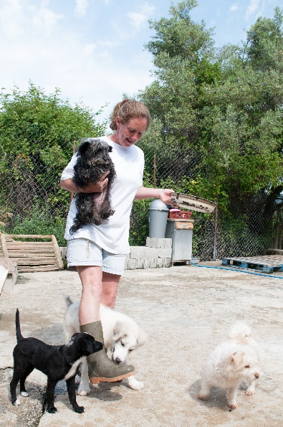









What does the future look like for you?
You could live until over 100 and have lots of different jobs in your lifetime!
Notes:
Lots of jobs are changing or disappearing, an example is libraries, which has changed a lot over the last 10 years or postal services where most people send messages now rather than letters.
Lots of new jobs are coming on board particularly linked to tech or the environment.
Important for young people to keep up with what is happening and how things are changing.
Research shows young people born in 2002, are likely to live to 100 and have 1 different jobs!

Slide 10



Where are the jobs?
Working in pairs, think of:
2 jobs there might be less of now than 10 years ago,
2 jobs that will always be needed into the future,
2 jobs that have been or are beginning to be replaced by technology.
5 mins
This is Labour Market Information (LMI)
Be in the know, to know where to go
Notes:
When they have finished ask for answers to the questions:
Here are a few examples to feed into the discussion:
Decline – carpenters (because things will be cut to size off site by machines),
Always needed – nurses, hairdressers, energy engineers, soldiers (through nature of role changing)
Replaced by tech – interview selection (algorithms used by some to select for interviews depending on answers) , banking (now online so not people at counters), some farming roles (now using drones to look at crops)

Slide 11




Where are future jobs going to be?
Medical, Health Science and Care
IT and Digital Technology
Engineering and Construction
Environmental (Green Jobs)
There will be other sectors growing too
Notes:
With new technology and science developments there will be a growth in jobs needed in many industry sectors including:
Medical and Health – we will continue to need more medical scientists, researchers, doctors, nurses and health care workers
IT and Digital – we will need more data analysts, technology researchers and AI developers
Engineering and construction - we will need more people to design and build the new buildings of the future – architects, electricians, energy engineers
Environmental jobs– we need lot of people to do jobs that help protect our planet like ecologists, foresters and environmental advisers

Slide 12
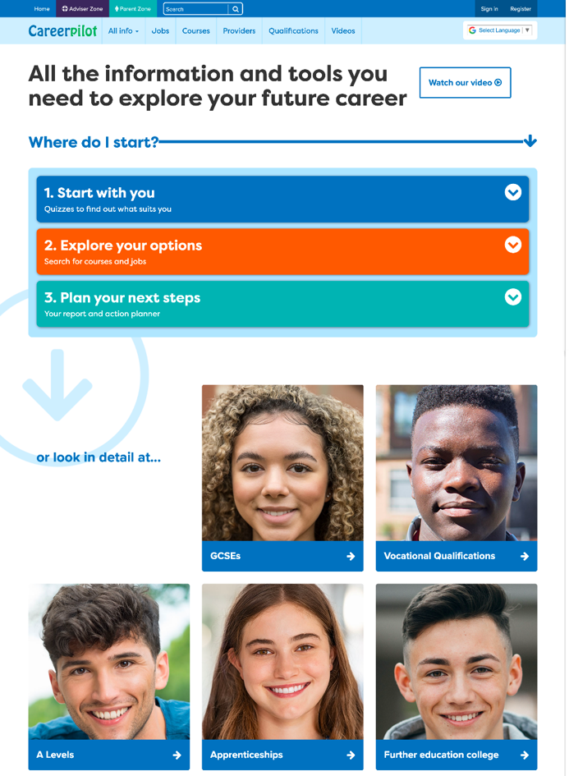
Careerpilot – all you need in one place
Jobs, courses, qualification planner, videos
Quizzes, tools – 3 stages to help you decide
Future qualifications and pathways
careerpilot.org.uk
Notes:
Careerpilot is a website that you can use for free. It has lots of information and tools to help you to start to think about future career ideas and pathways.
The website is built around 3 stages:
Start with you – with quizzes to find out more about what might suit you
Explore your options – where you can search for courses and jobs
Plan your next steps – where you can build a report and plan some actions.

Slide 13
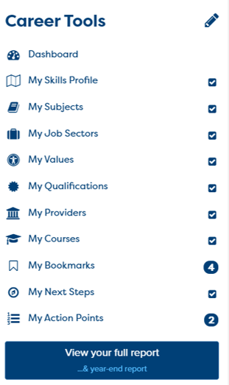

One place for all your careers information.
Build your report in Career Tools
Register/sign in
Build your report
Notes:
You will using Careerpilot to explore all your options, register (or sign in if you have used it before)
Then you can build your report and have a record of all your career choices and plans

Slide 14
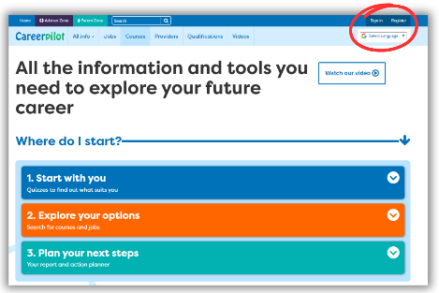
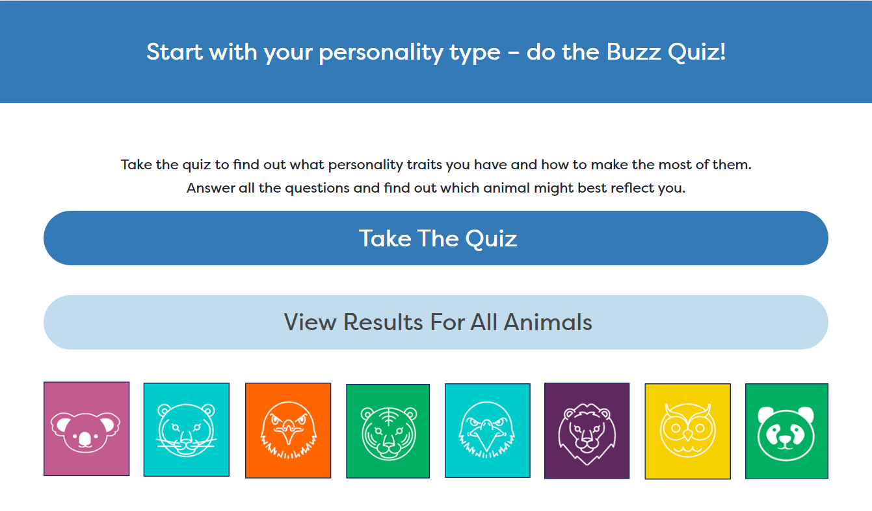

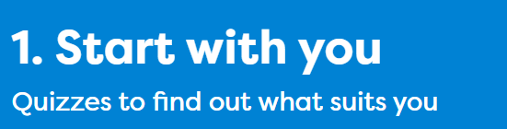
Let’s get going… First you will:
Register/sign in to Careerpilot
2. Complete the Buzz Personality Quiz to discover your personality type. Make a note of your animal.
3. Complete the Job Quiz
Notes:
Explain to students what activities they will be doing shortly on Careerpilot.
Use the following slides to explain how to complete these activities before getting started….

Slide 15
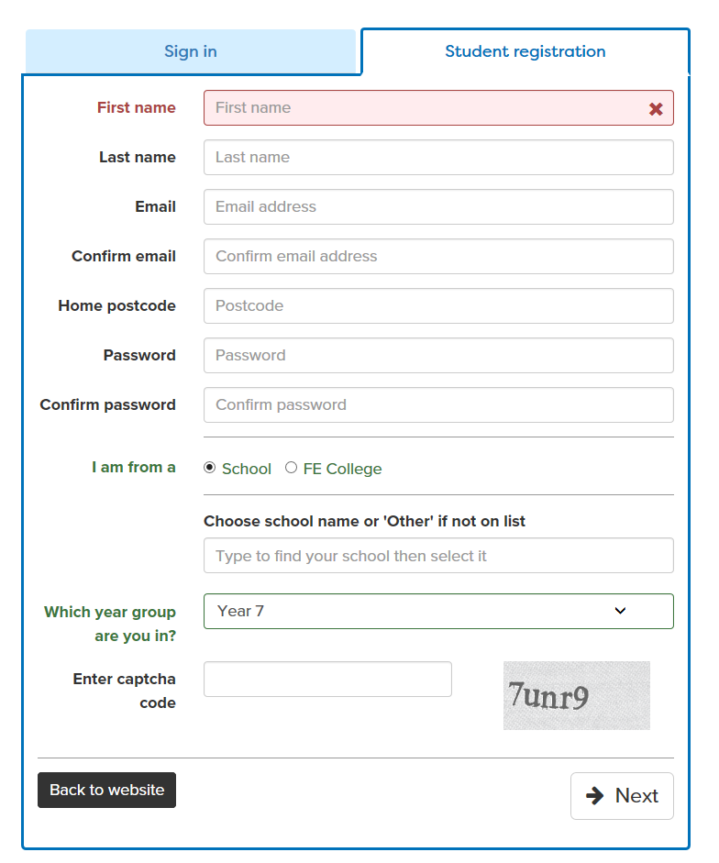
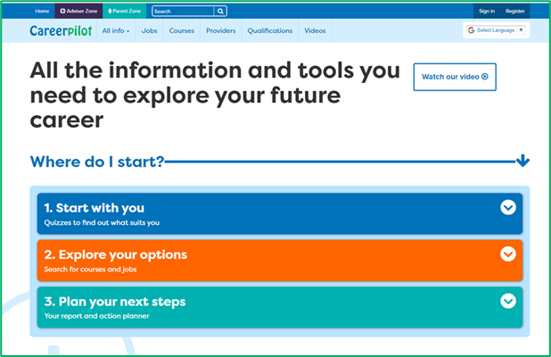
Register or sign in to Careerpilot
If you have registered before – sign in
Notes:
Show students that if they are new to Careerpilot, they need to register to use the website.
They must click on the ‘Register’ button in the top right corner to open up a short registration form that takes a few minutes to complete.
Remind students to use their school email address to register and to click on your school from the drop down list.
Students that have already registered just need to log in with their email and password – or use forgotten password

Slide 16
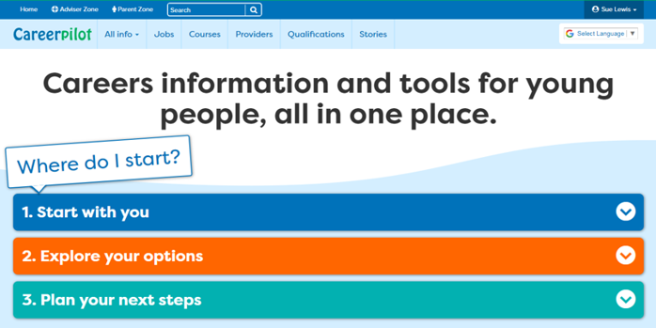
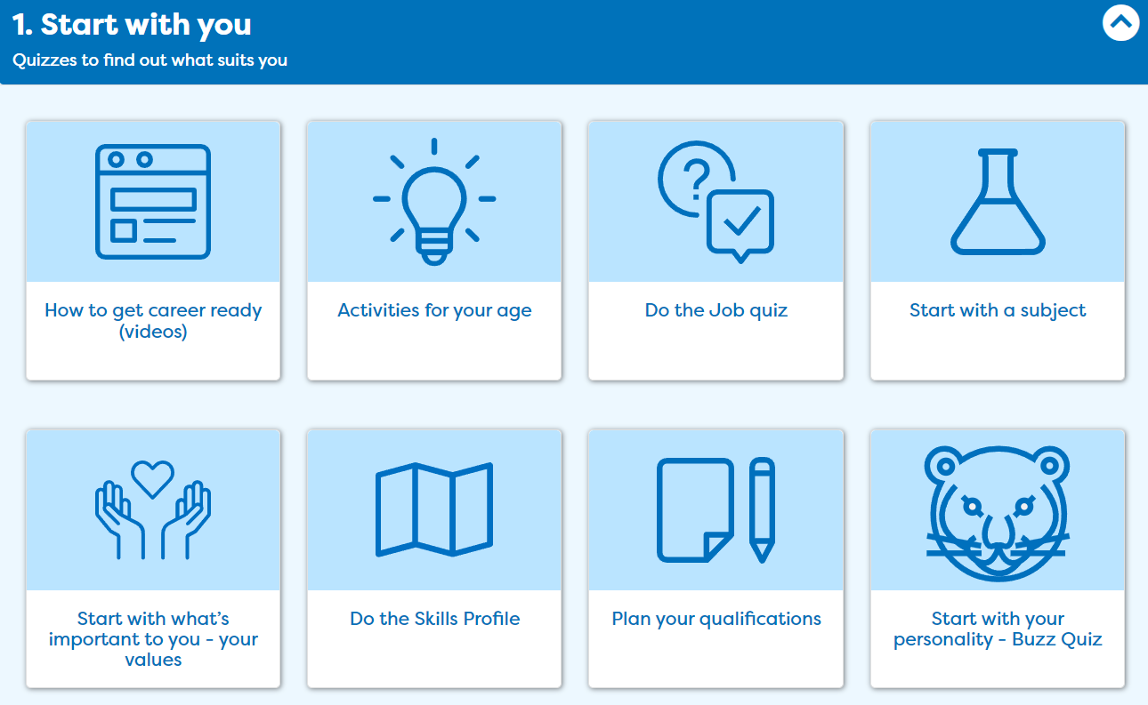
Discover your personality type
Notes:
Once registered students need to go to ‘Start with you’ on the home page and click on ‘Start with your personality – Buzz Quiz’.

Slide 17
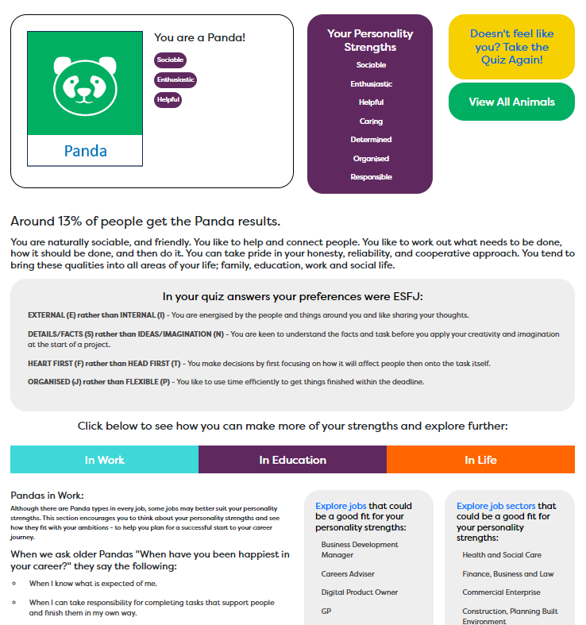
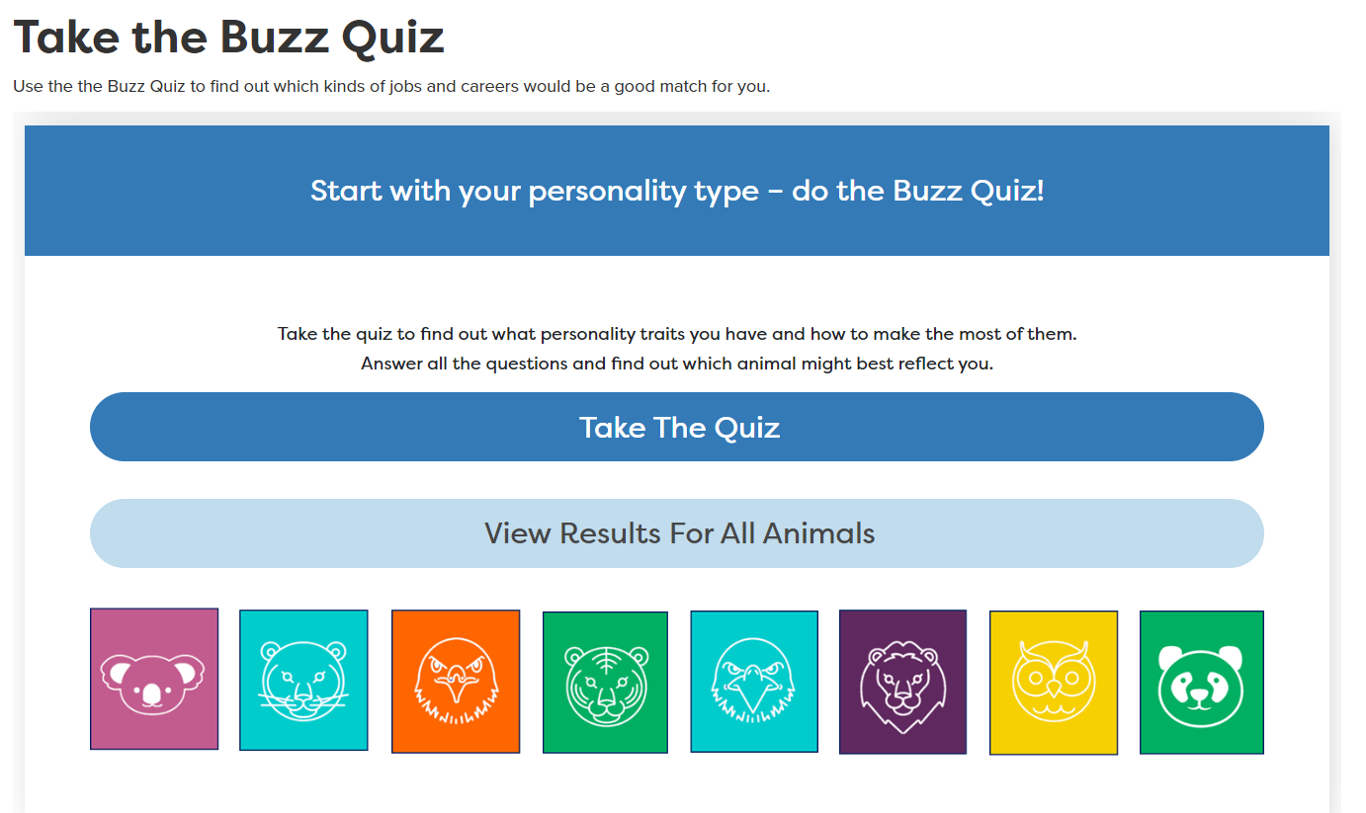
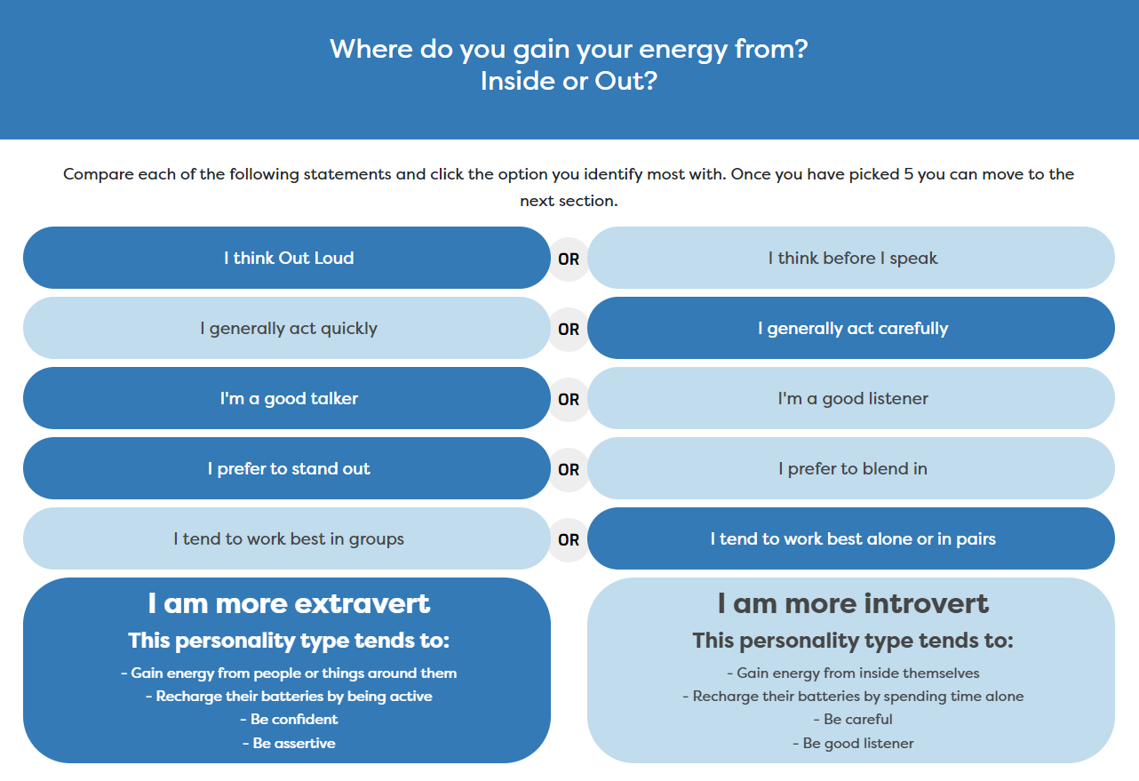
Buzz Personality Quiz
We all have different types of personality traits, do you know what yours are?

Slide 18
Explore future jobs
Notes:
Once registered students need to go to ‘Start with you’ on the home page and click on ‘Start with your personality – Buzz Quiz’.

Slide 19
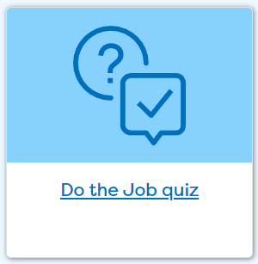
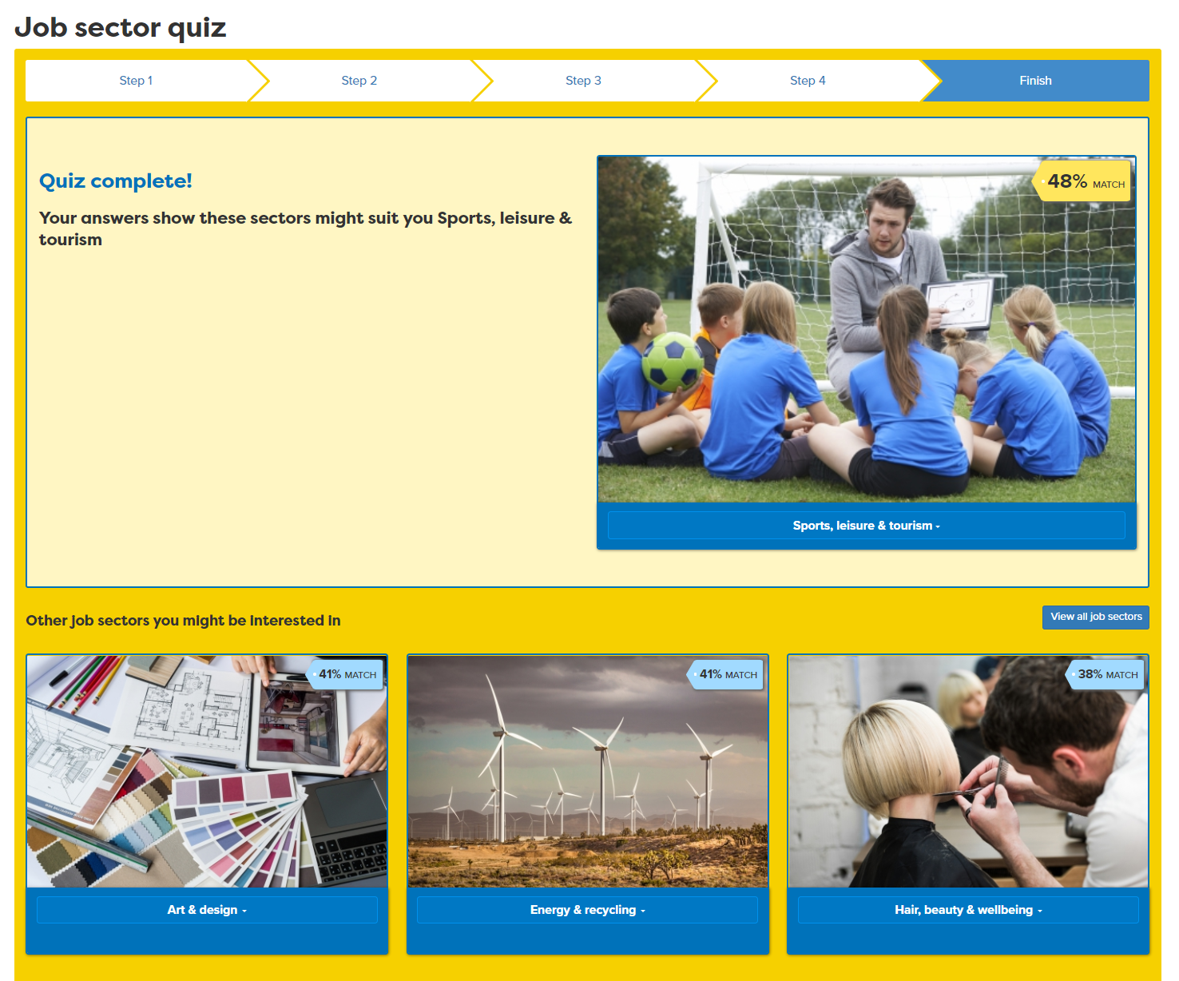
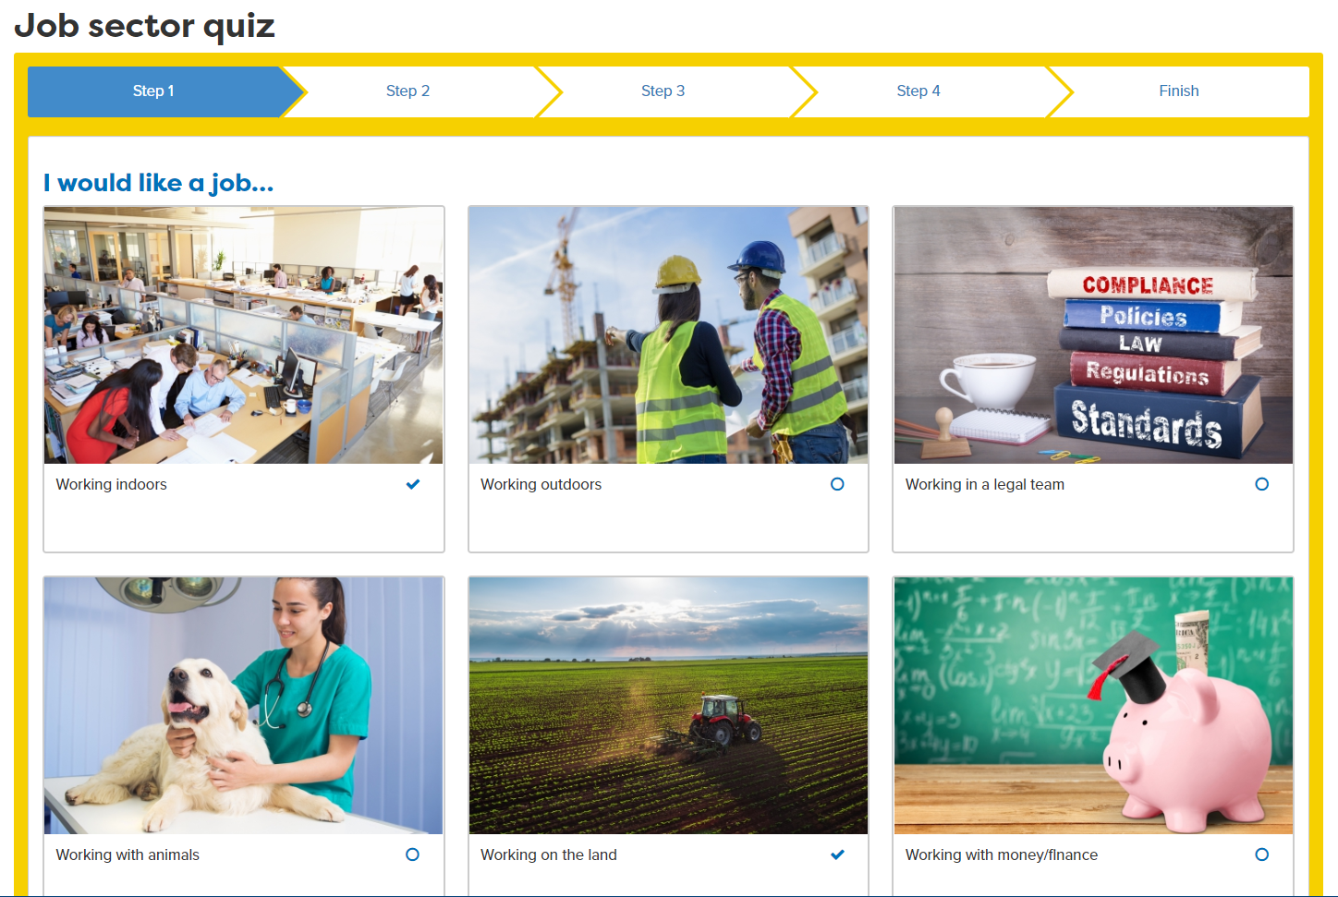
Job Sector Quiz
Notes:
Students can explore some of the job sectors the quiz matches them with and drill down to look at job profiles in those sectors
They can also click on ‘View all job sectors’ to explore other job sectors not in their quiz results.
Knowing what sectors they might like will help when planning a WEX

Slide 20
Let’s get going… First you will:
Register/sign in to Careerpilot
2. Complete the Buzz Personality Quiz to discover your personality type. Make a note of your animal.
3. Complete the Job Quiz
10 mins
Notes:
Explain to students what activities they will be doing shortly on Careerpilot.
Use the following slides to explain how to complete these activities before getting started….

Slide 21
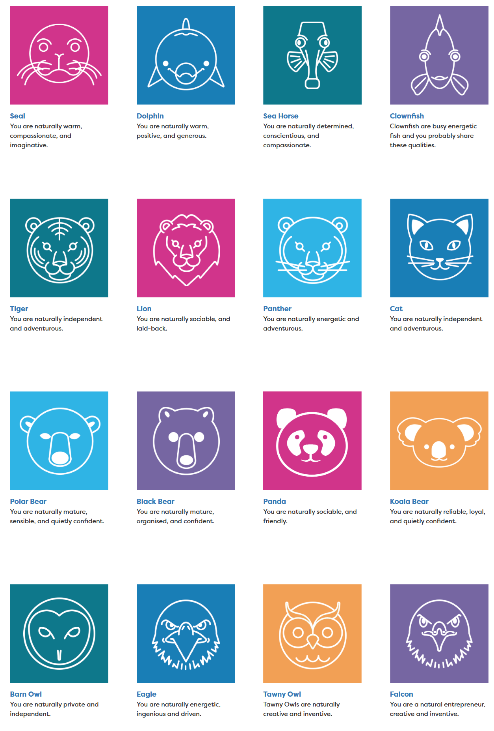

Quick Feedback: Who had this animal, any of these job sectors?
Your community/country/the world needs people of all types and people interested in all job sectors.
Notes:
Just a few minutes of feedback, click to show three animals and ask if anybody had those, click to show 6 job sectors and ask if anybody had one of these recommended to explore.
Click to show speech bubble making point that all types of people with all types of job interests are required.

Slide 22
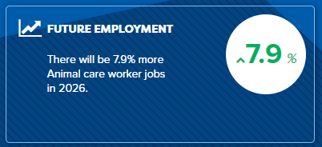

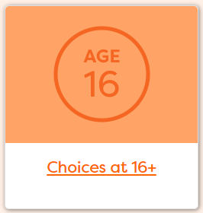
Next task
Use your results. Look at job profiles and see what jobs are growing/declining and the routes into jobs
2. Add jobs you like to My Job Sectors
3. Consider routes at 16
Notes:
Explain to students what activities they will be doing shortly on Careerpilot.
Use the following slides to explain how to complete these activities before getting started….

Slide 23
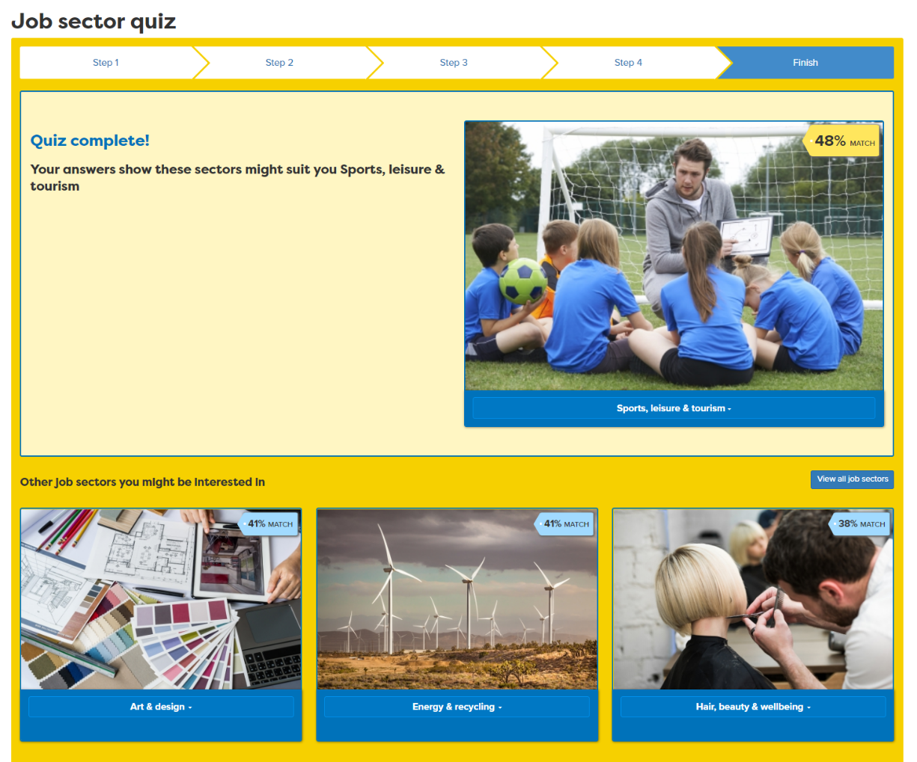
Use your results to start exploring
Notes:
Students use their results to start exploring sectors and jobs

Slide 24
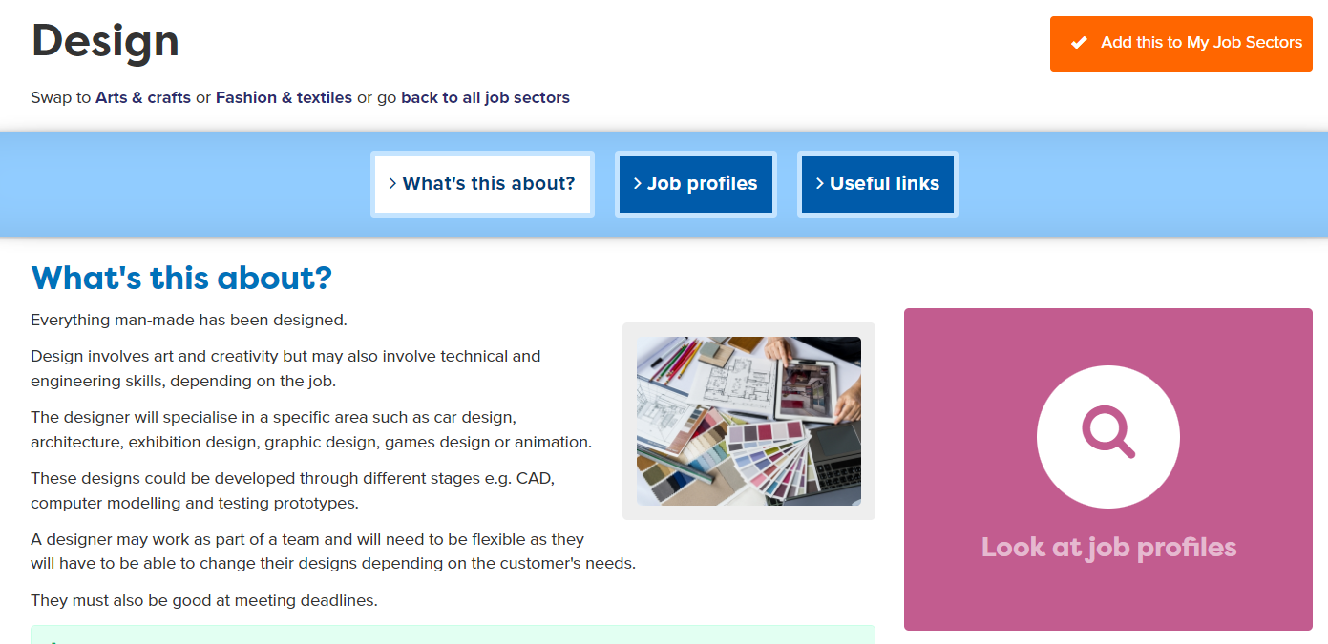
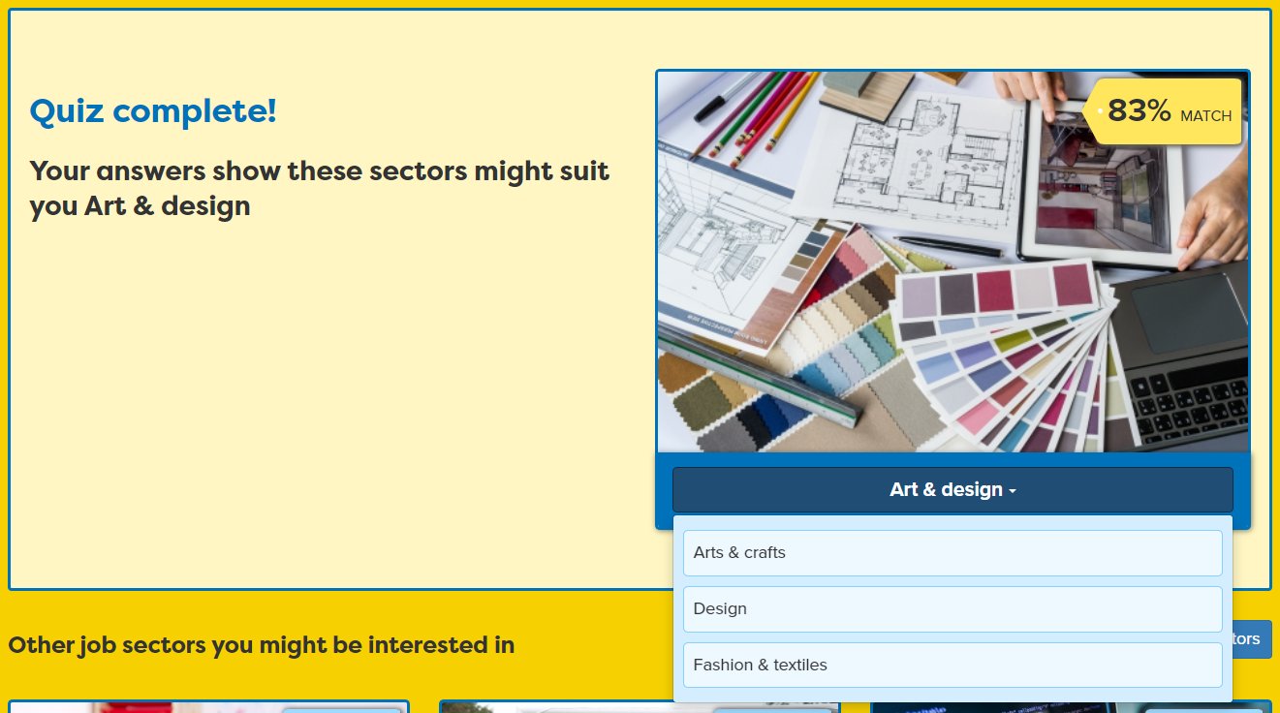
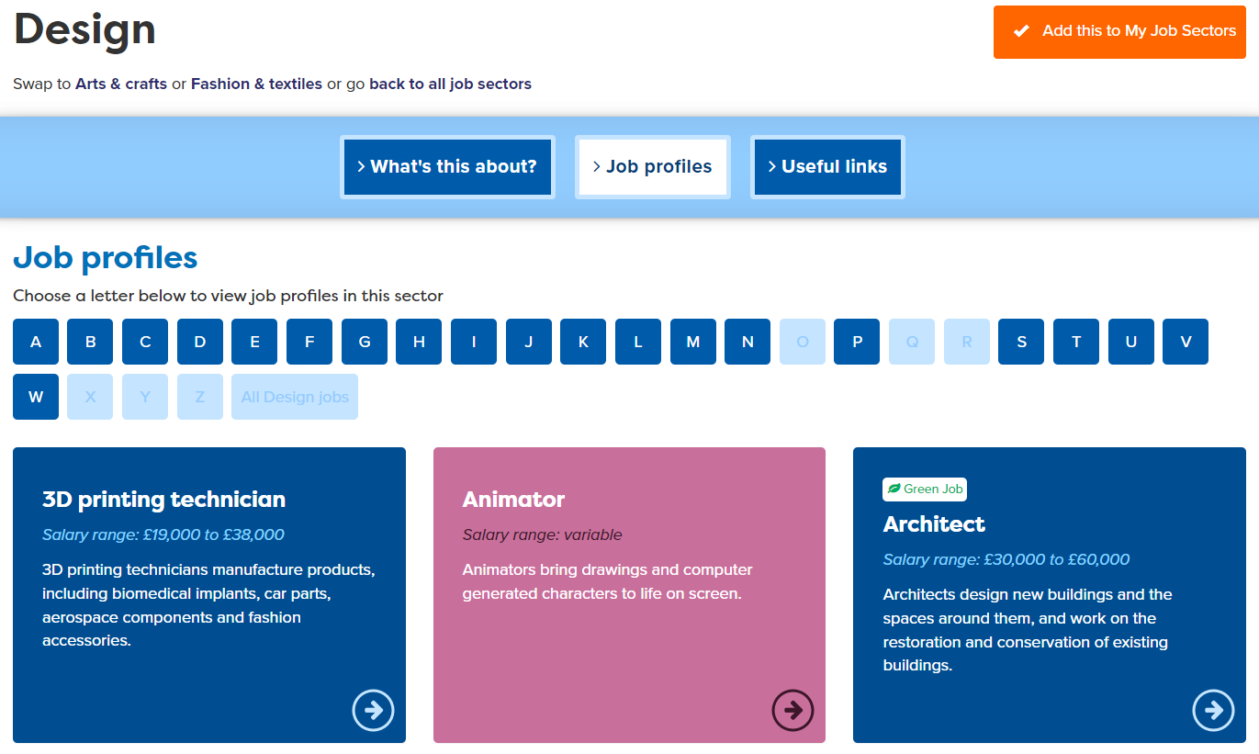
Exploring Jobs
Notes:
You are going to use your Buzz Quiz and Job Quiz results to start exploring jobs and finding out how you get into them. You can see detailed job profiles which will also show you pathways into the jobs. Let’s focus on the pathways choices you will have at the end of Y11 and going forward.

Slide 25
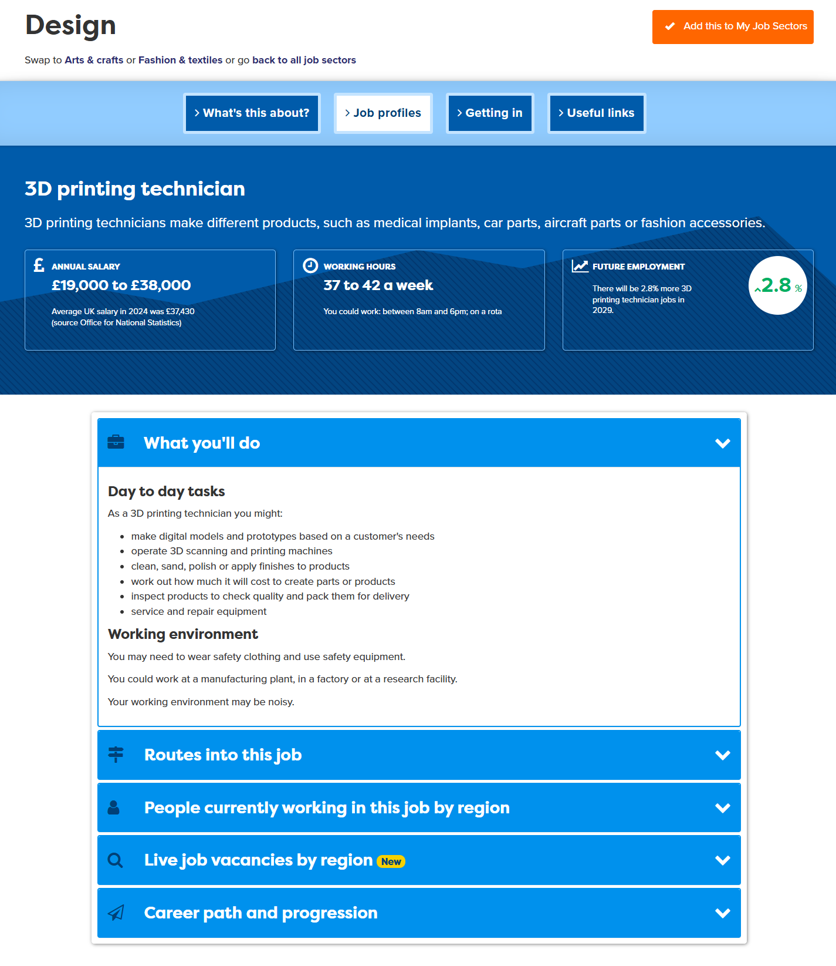
Research the Job
Notes:
When students find jobs of interest, encourage them to tag the job sector to add to their Career Tools.

Slide 26
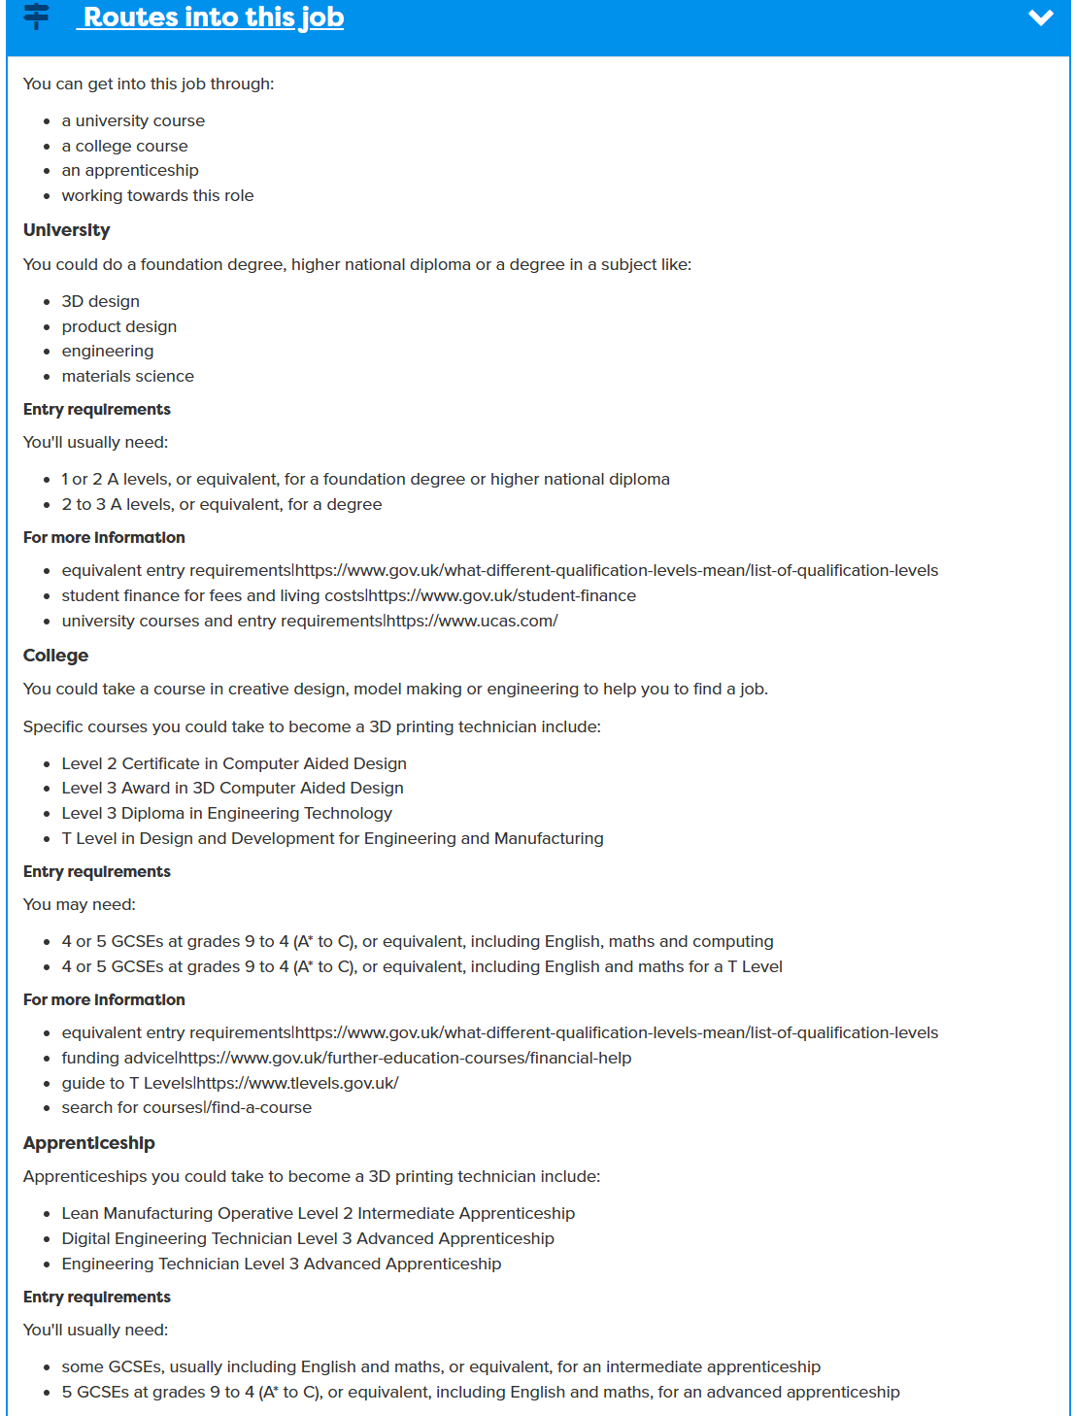
Research the Job
Look at 2 jobs
Notes:
When students find jobs of interest, encourage them to tag the job sector to add to their Career Tools.

Slide 27
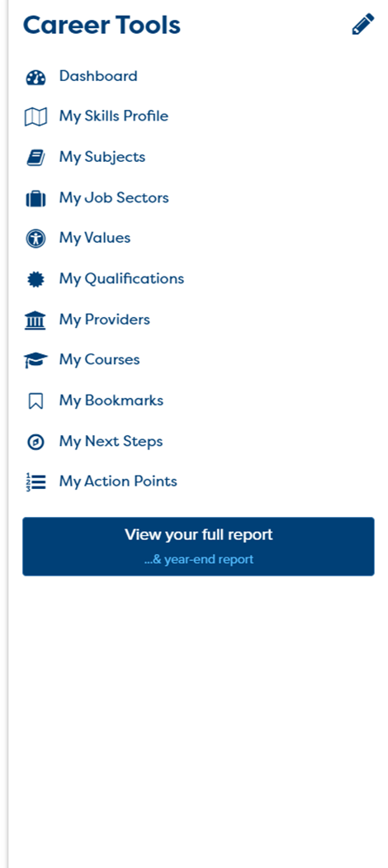
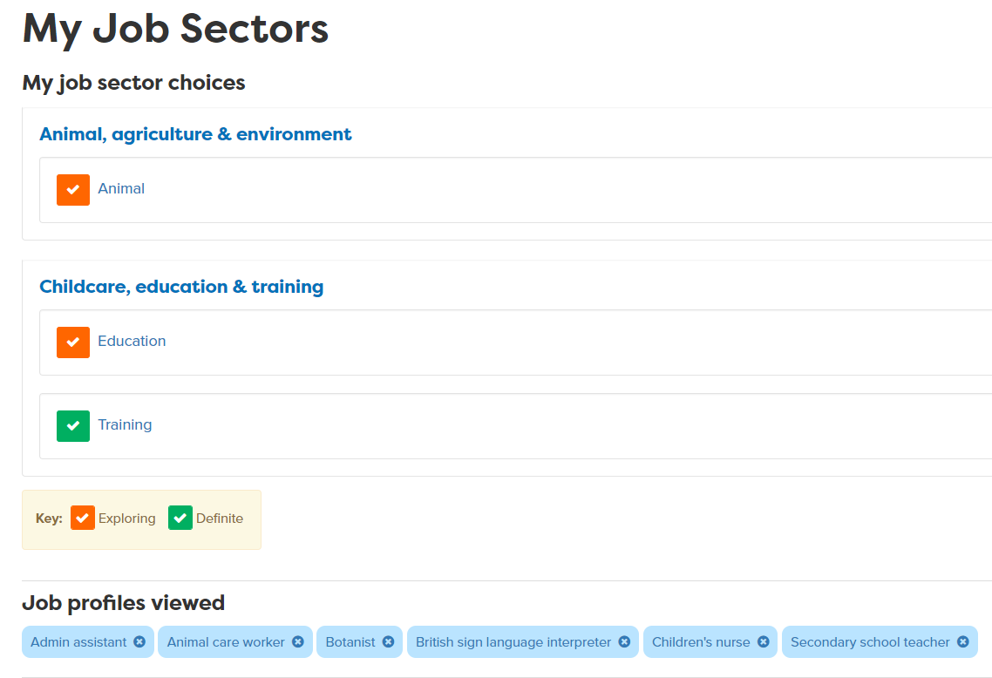
Add what you like to your Career Tools
Notes:
Encourage students to go to their Career Tools via the home page and click on My Job Sectors to see their chosen sectors and the job profiles they have viewed.
Explain this will be saved for them to revisit at a later date and they can add more or change their choices as they go through school.

Slide 28
Explore post 16 pathways
What pathways can I choose at the end of Y11?
Academic
Vocational/Technical
Apprenticeship
Mostly in a 6th Form or 6th Form College
Mostly in a
local college but some also in schools
Mostly in a workplace
Notes:
Ask them to say what pathways they can do at 16.

Slide 29
One place for all your careers information.
What pathway may suit me?
Academic
Technical/Vocational
Work-based
A levels
General
T Levels (L 3)
Apprenticeships
Mostly in school, Sixth Forms and some colleges.
Lots in college some in school
Mostly in colleges, some in schools
Trained in the workplace. Will get paid.
Need to: have enjoyed GCSE subject,
like independent study,
Related to a job area e.g health & social care
Trained to do a named job e.g digital design
Trained to do a specific job e.g carpentry, assistant accountant.
Exam assessment at the end of two years
Course work, some final assessment and work placement
Learning through doing the job, some time learning at a college, some written assessment.
Notes:
Run through the key differences between the different pathways available at 16

Slide 30






One place for all your careers information.
Qualification choices
Academic
Technical/Vocational
Apprenticeship
Degree Achieved
Degree Year 2
HND
Foundation Degree Y2
Higher Apprenticeship
Degree Year 1
HNC
Foundation Degree Y1
Higher Apprenticeship
A levels
T LEVEL other Level 3 - BTEC/OCR
Advanced Apprenticeship
5 x GCSEs 4 - 9
T Level Foundation and other Level 2
Intermediate Apprenticeship
GCSEs 1 - 3
Notes:
Explain that there are three pathways but in all pathways there are levels of quals. Level 2 is getting 5 GCSEs grade 4-1.
Show them the other levels and make the point that all pathways can lead to a degree.
The bit of the qualification ladder we are mainly talking about today is their choices after GCSEs

Slide 31
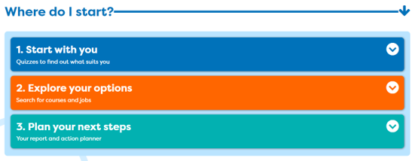
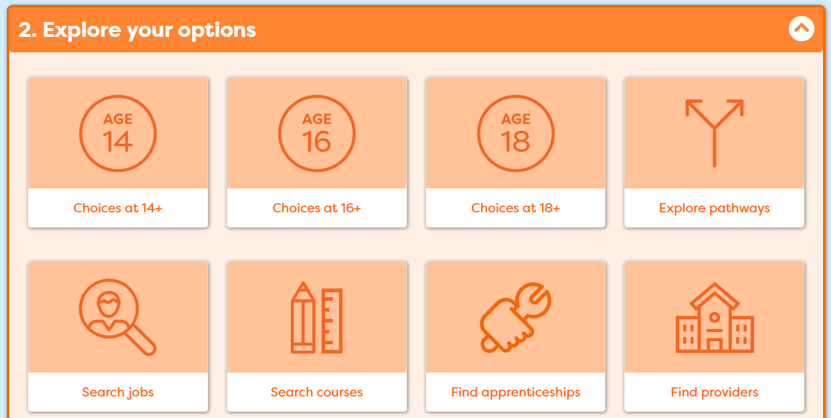
One place for all your careers information.
Explore your post 16 options
Notes:
Now move on to Explore your options and these are the sections that would be good for you to look at.

Slide 32
Next task
Use your results. Look at job profiles and see what jobs are growing/declining and the routes into jobs
2. Add jobs you like to My Job Sectors
3. Consider post 16 pathways
Make a few notes about each of the jobs you look at
15 - 20 mins
Notes:
Explain to students what activities they will be doing shortly on Careerpilot.
Use the following slides to explain how to complete these activities before getting started….

Slide 33



What did you find out?
In pairs discuss which job sectors the quiz matched you to, what animal you came out as.
Tell your partner which jobs you looked at and what routes you could take into them e.g. Can you do an apprenticeship? Do you need a degree?
Listen carefully while your partner speaks and show you are listening by summarising what you heard.
5 mins
Notes:
Ask students to now take it in turns to show and tell a partner about the job sectors they have saved, including about any jobs they viewed that sounded interesting.
Students can compare the salaries of the jobs they found and talk about what aspects of the day to day tasks they think looked interesting and why.
Step 8 Listening - Summarising: I show I am listening by summarising or rephrasing what I have heard
Step 8 Speaking - Using facts: I use facts and examples to support my communication
If time, ask students to feed back on their partner’s chosen jobs or job sectors to the whole class.

Slide 34
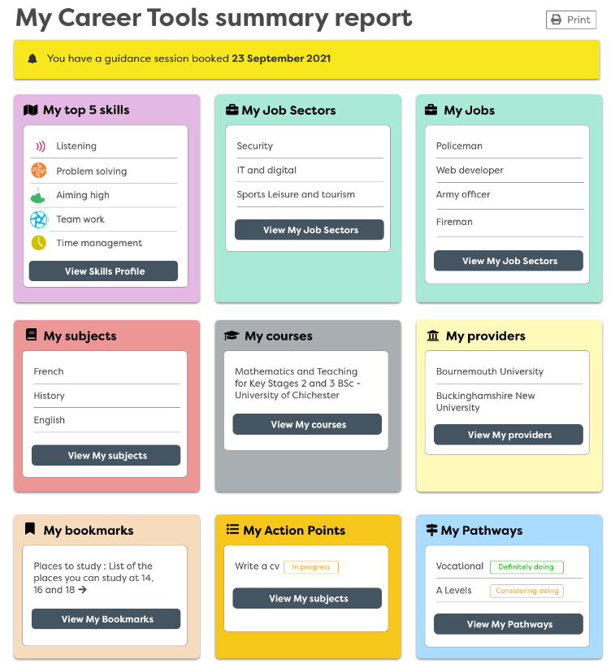
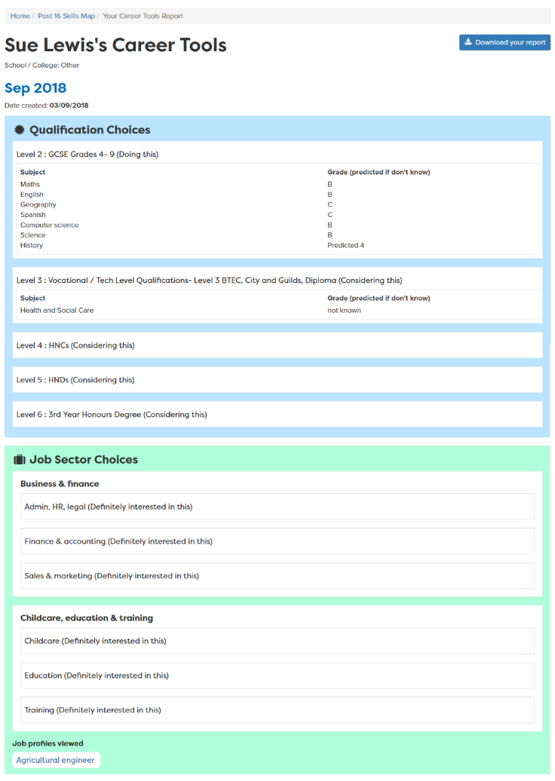
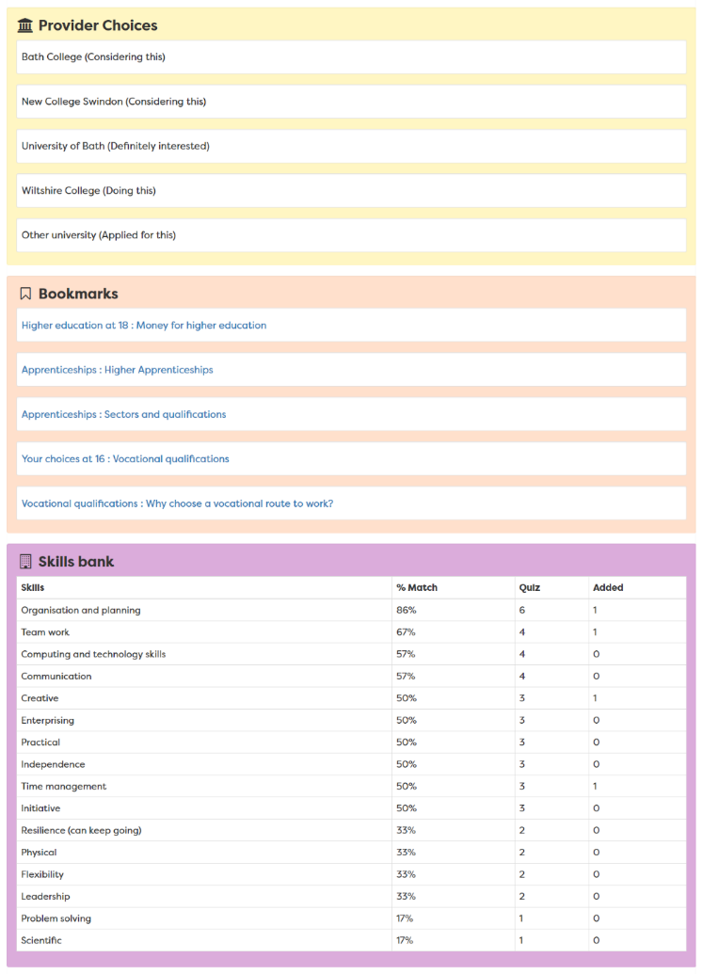
Report moves up each year
Notes:
A slide to show the report that is created once the career tools have been completed – moves up with them each year in school

Slide 35

Getting Career-ready – did you?
Consider what learning pathways you could take at 16?
Research the job market and the education system
Next session: Work experience – why do it, what have you got to offer?
Notes:
The Career Development Institute has developed a careers framework that shows the skills everybody needs to have to manage their future career.
This slide shows the students which of the career learning areas (CDI) that this lesson 1 links to.
You can also share the structure of the session with students.

Slide 36

Careerpilot is closing. This resource is only available to use until 23rd October 2026.
Post 16 options and Work Experience
Lesson 2: Work experience - why do it, what to think about and what have you got to offer?

Slide 37
Getting Career-ready
Introduction and warm up activity – 15 mins
You will recognise the value of trying new things
Careerpilot Activities 25 mins
You will reflect on the meaning of work
Wrap-up
10 mins
Notes:
The Career Development Institute has developed a careers framework that shows the skills everybody needs to have to manage their future career.
This slide shows the students which of the career learning areas (CDI) that this lesson links to.
You can also share the structure of the session with students.

Slide 38



What was their first job?
Taylor Swift: Singer, songwriter, musician
Beyonce – Singer
Harry Styles – Singer
Christmas Tree Farm
Hair salon floor sweeper
Worked in a bakery
Where you start your working life is not always where you end up!
Notes:
Quick starter activity to show that you are likely do a range of different jobs in your lifetime. Work experience helps students to find out what work is like and to try out something which interests them.
Ask students if they know who each celebrity is and what job they are famous for, then click to reveal.
Ask students to guess a job they did before they were famous then click to reveal one at a time.
Taylor Swift worked on a Christmas Tree Farm picking bugs off plants

Slide 39
Why do people work?
Working in pairs, come up with some ideas about why people go to work. To get paid is only one reason for working!
Share your ideas and listen to your partner’s contributions.
You may want to make notes of your ideas.
Why do people work?
5 mins
Notes:
Students have 5 mins to work in pairs to think about what different people get from work
Ideas to feed into discussion:
Satisfaction
Challenge
Power
Money
Reason to get up in morning
This activity supports students to practice Step 7 Teamworking – Contributing: I contribute to a group activity

Slide 40





Work experience can help career choices
Y10 Work Experience
Choosing post 16
Choosing post 18
Notes:
WEX can help you make decisions about your future courses and work

Slide 41
One place for all your careers information.
Why do Work Experience?
To find out about a company
To learn/practice skills
To try out a job role
To be seen as a future worker
Notes:
Ask the class – why WEX is important?

Slide 42
Work Experience can help answer….
Is this the sort of job I like?
What skills will I need to do it?
What is the best way to talk to a boss?
Do I like the working conditions?
Could I do this job every day?
How could I get into this job?
Write down a few things you want to get from YOUR work experience
Notes:
Pause the video for students to write down what they want to get from their WEX

Slide 43

Work experience – reality check
What jobs can I realistically do at 16?
Nursery worker
Supermarket
Engineer
Office worker
Doctor
Computer programmer
Whatever work experience you get it will help you practice and develop your skills
Notes:
Ask the students to identify which are likely to be offered to a 16 year old. Explain there are lots of great opportunities but because of rules/H&S some might not be available for a 16 year old. They could work in a place that does that job role but they might not be actually doing at as a 16 year old.
They will be developing skills wherever they go and be in a work role for maybe the first time.

Slide 44





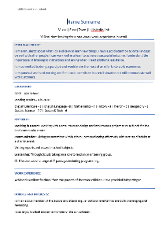
Get the most out of work experience
Think about a job sector or job you would like to try
Think about what you have to offer – your skills and interests
Look for a placement
Have a CV ready to show your employer or talk about
Notes:
Lesson 1 you did the job quiz to see sectors that might suit you.

Slide 45
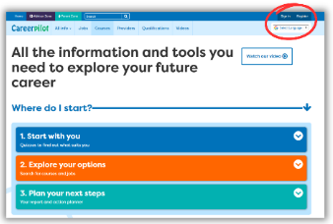
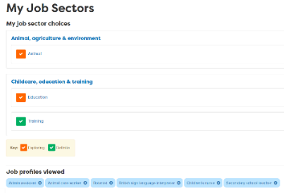


In today’s lesson you will…
Register/sign in to Careerpilot
2. Go to ‘My Job sectors’ and remind yourself
of the ones you liked – any good for work experience?
3. Complete the values task and think about what’s
important to you in a job (add to My Values)
4. Assess/update your skills using the ‘Skills Profile’.
Add your own examples
careerpilot.org.uk
Notes:
Explain to students what activities they will be doing shortly on Careerpilot.
Use the following slides to explain how to complete these activities before getting started….

Slide 46
One place for all your careers information.
Log in to Careerpilot
Register/sign in
Notes:
You will using Careerpilot to explore all your options, register (or sign in if you have used it before)
Then you can build your report and have a record of all your career choices and plans

Slide 47
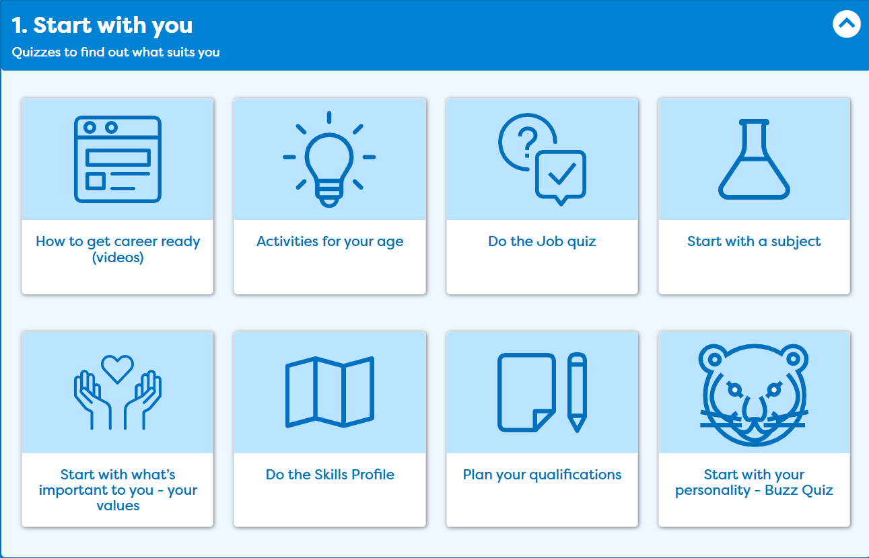
One place for all your careers information.
Think about what you have to offer
Notes:
In ‘Start with you’ these are the activities will be doing today. I am going to show you what you need to do.

Slide 48

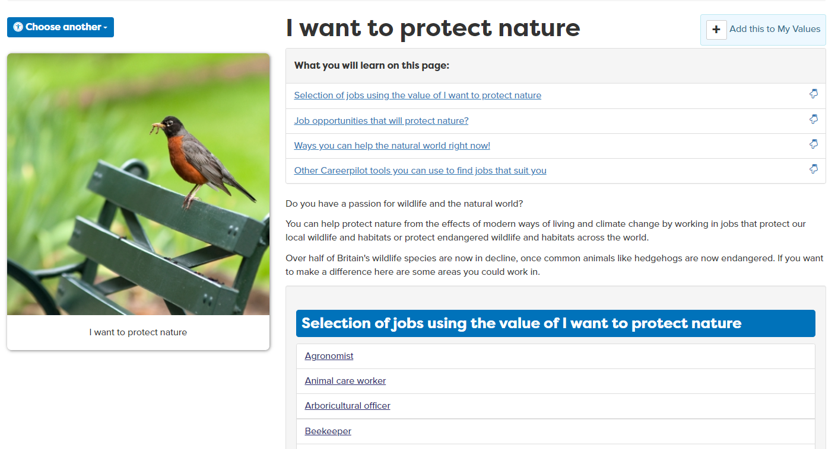
What’s important to you in future work?
Notes:
In ‘Start with you’ these are the activities will be doing today. I am going to show you what you need to do.

Slide 49

The Essential Skills
Other skills some jobs need
IT Skills
Practical
Scientific
Physical
Notes:
Reminder
These eight skills have been identified by employers as being essential to any job. They are people skills, so are all about how you communicate with others, how you manage yourself and come up with new ideas.
You can see them as four pairs of skills:
Communication skills - Listening and Speaking
Creative Problem Solving skills - Problem Solving and Creativity
Self-management skills – Adapting and Planning
Collaboration skills - Leadership and Teamwork

Slide 50
One place for all your careers information.
Think about what you have to offer
Notes:
In ‘Start with you’ these are the activities will be doing today. I am going to show you what you need to do.

Slide 51
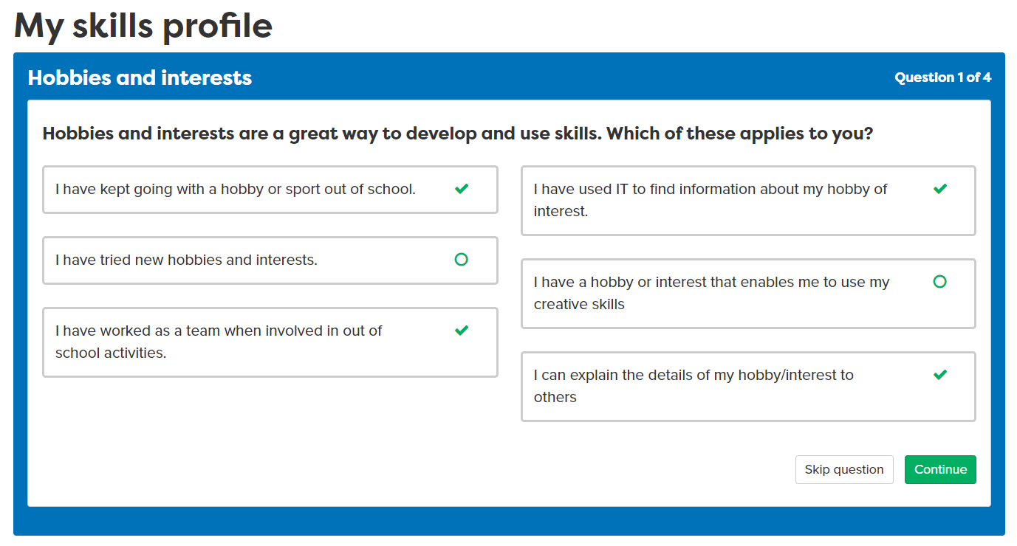
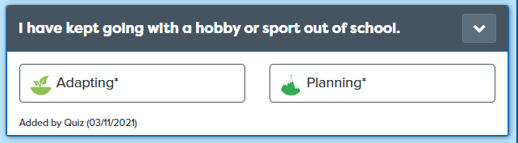
What are your skill strengths?
Notes:
First we will do the Skills Profile, if you have done it before retake the quiz to see if things have changed.

Slide 52
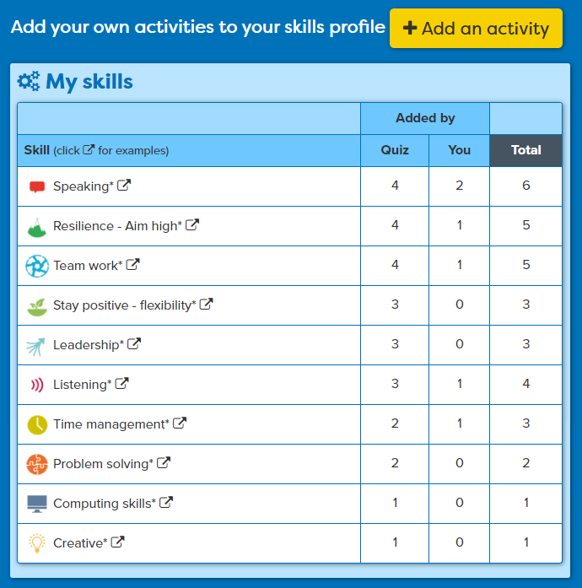
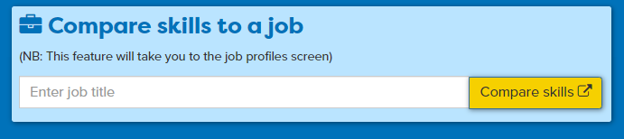
Add your own examples
Today: Add at least 2 examples
Useful for work experience
All your skills are ‘banked’ for later when you want to apply
See how YOUR skills compare to a job
Notes:
All their skills will be put in the Skills Bank, they should add at least two examples of their own in the lesson but keep going back to add things over time. The Skills Banks can then be used when they come to apply.
Useful when you are applying for WEX to mention your skills.

Slide 53
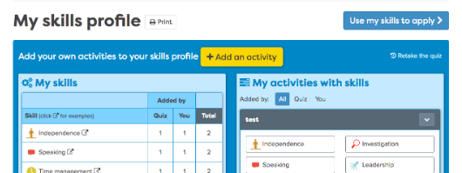
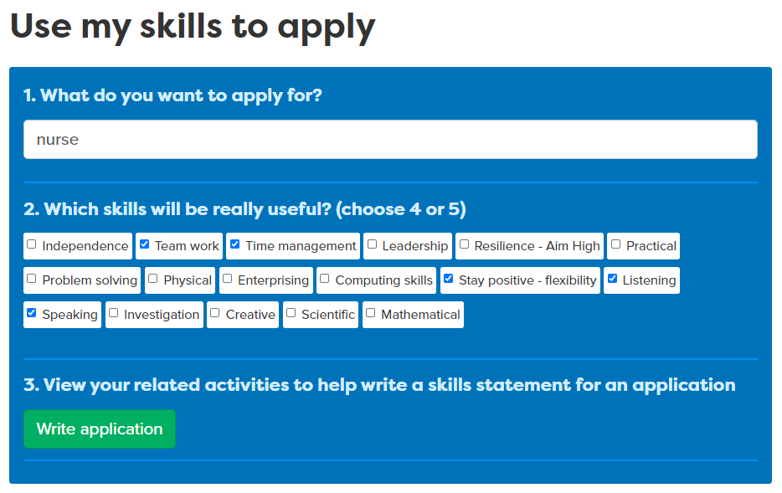
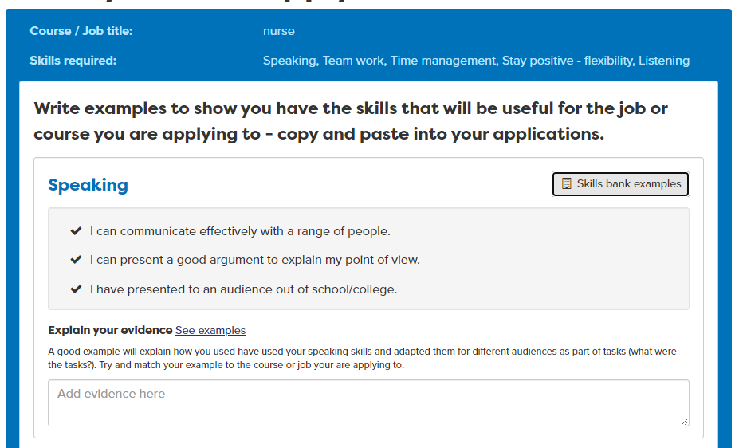
Use your skills when you apply
Notes:
Students can use the skills profile to apply for jobs but adding the information to their CVS and personal statement using our tool above. You can use this in employer CV work shops – B5, applying for work experience BM6 and college or university places – BM7.

Slide 54
Task to complete on Careerpilot
25 mins
Register/sign in to Careerpilot
2. Go to ‘My Job sectors’ and remind yourself
of the ones you liked – any good for work experience?
3. Complete the values task and think about what’s
important to you in a job (add to My Values)
4. Assess/update your skills using the ‘Skills Profile’.
Add your own examples
careerpilot.org.uk
Notes:
Pause video for students to complete tasks on Careerpilot – use the previous slides as needed to guide them through the activities

Slide 55




Wrap-up
Working in pairs – tell your partner:
A job sector you would like to do work experience in
A value that is important to you
A job or qualification you might like to do in the future
    Speak clearly and use facts and examples to explain your choices
  Listen carefully and summarise what you’ve heard to show your understanding.
5 mins
Notes:
Students have 5 mins to work in pairs to share their research and ideas.
If time could ask the class to put hands up about which job sectors/quals they are interested in.
This activity supports students to practice:
Step 8 Speaking – Using Facts: I use facts and examples to support my communication
Step 8 Listening – Summarising: I summarise or rephrase what I learnt

Slide 56
Getting Career-ready – did you?
Recognise the value of trying new things
Reflect on the meaning of work
Next session: Work experience – how to find one
Notes:
The Career Development Institute has developed a careers framework that shows the skills everybody needs to have to manage their future career.
This slide shows the students which of the career learning areas (CDI) that this lesson links to.
You can also share the structure of the session with students.

Slide 57

Careerpilot is closing. This resource is only available to use until 23rd October 2026.
Post 16 options and Work Experience
Lesson 3: Work experience – how to find a placement

Slide 58
Getting Career-ready
Introduction and warm up activity – 10 mins
You will research workplaces and what it is like to work there
Research task 1:
20 mins
You will start to take responsibility for making things happen in your career
Research task 2:
15 mins
Wrap-up
10 mins
Notes:
The Career Development Institute has developed a careers framework that shows the skills everybody needs to have to manage their future career.
This slide shows the students which of the career learning areas (CDI) that this lesson links to.
You can also share the structure of the session with students.

Slide 59



One place for all your careers information.
Get the most out of work experience
Think about a job sector or job you would like to try
Think about what you have to offer – your skills and interests
Look for a placement
Have a CV ready to show your employer or talk about
Notes:
Summary of how to prepare for WEX.
Today is finding a placement – CV building will be next session

Slide 60
Things to think about
Some sectors/jobs are more likely than others to offer work experience to a 16 year old
Notes:
Ask students which sectors/jobs are most likely to offer WEX

Slide 61
Things to think about
There are different types of work experience
1 week block
Virtual work experience
Work shadowing
Check with your teachers to see what sort of work experience you are expected to do and for how long
Notes:
Virtual has become much more popular since Covid

Slide 62


Finding work experience
As a class, come up with ideas of how or where you could look for a work placement?
Share your ideas and listen to other’s contributions.
5 mins
Notes:
Could ask family for contacts, career teacher might have a list, ask employers locally, look online, etc.
This activity supports students to practice Step 7 Teamwork – Contributing: I contribute to a group activity.

Slide 63

Tips for finding work experience
Play the video
Notes:
Show the video which summarises key points about WEX. CV building will be next session.

Slide 64
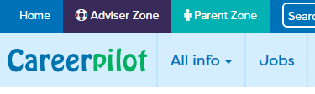
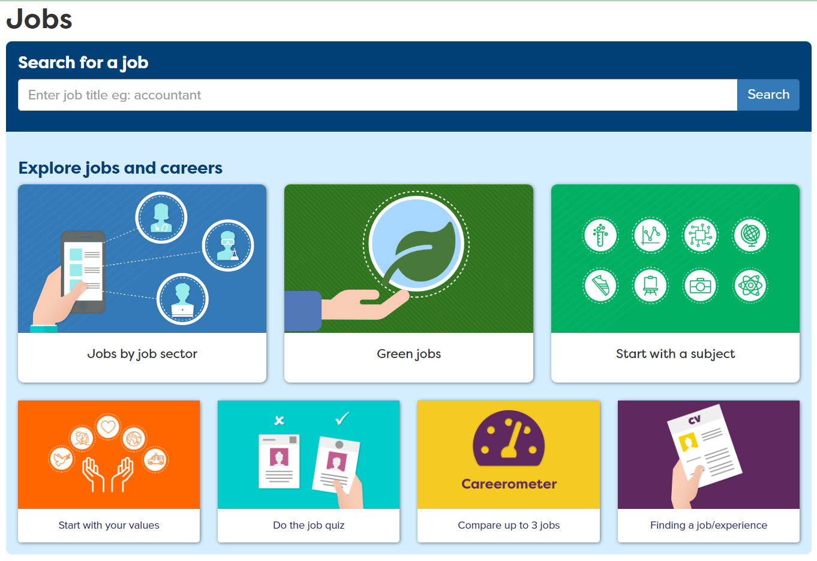
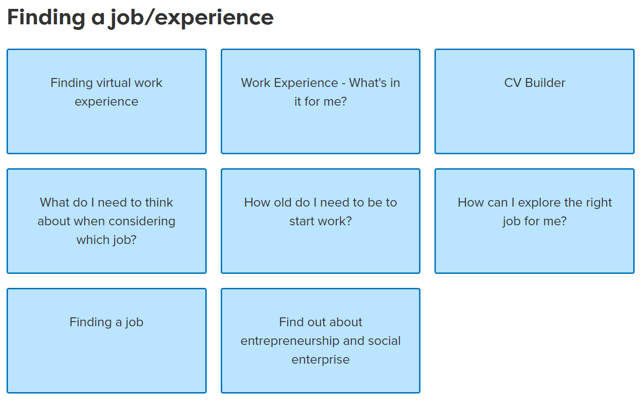
How Careerpilot could help
Notes:
Show students how Careerpilot can help

Slide 65
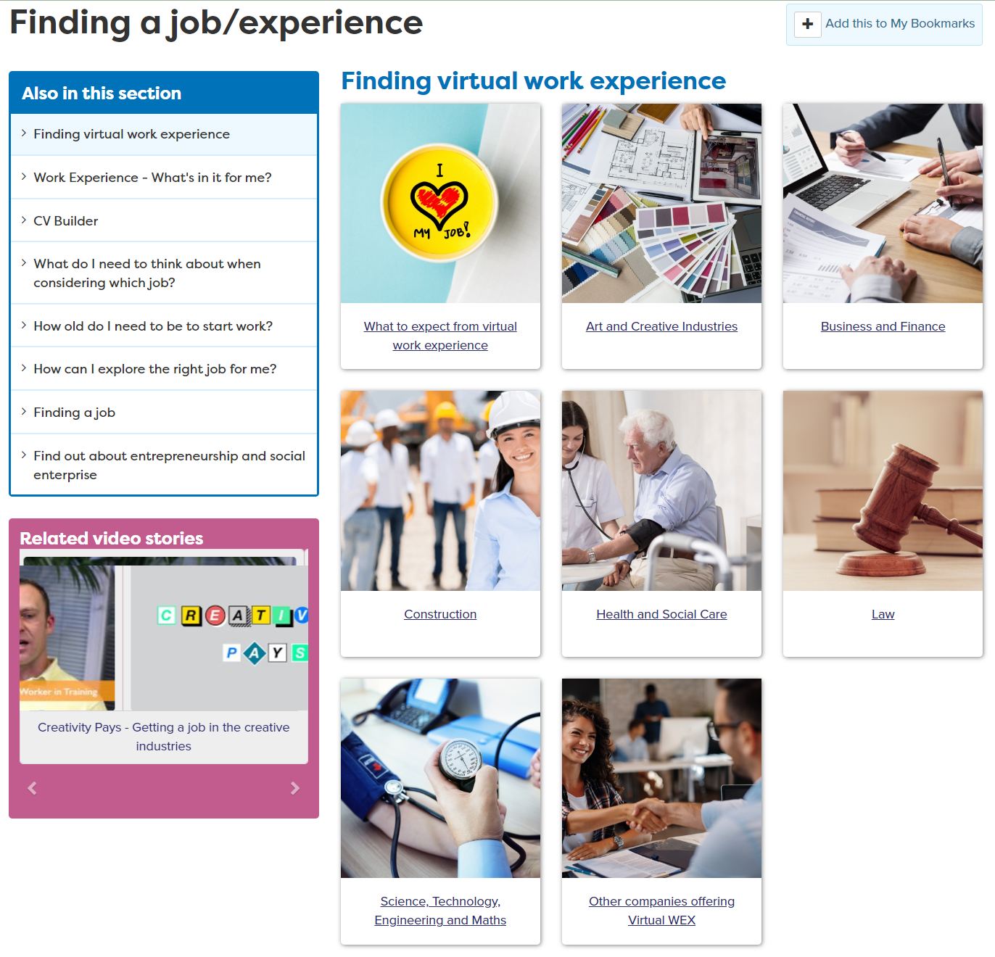
How Careerpilot could help
Virtual Work Experience
Could be anywhere in world!
Flexible
Employers can take more people
Notes:
Students use Careerpilot – the Finding a job/experience section to explore Virtual opportunities

Slide 66

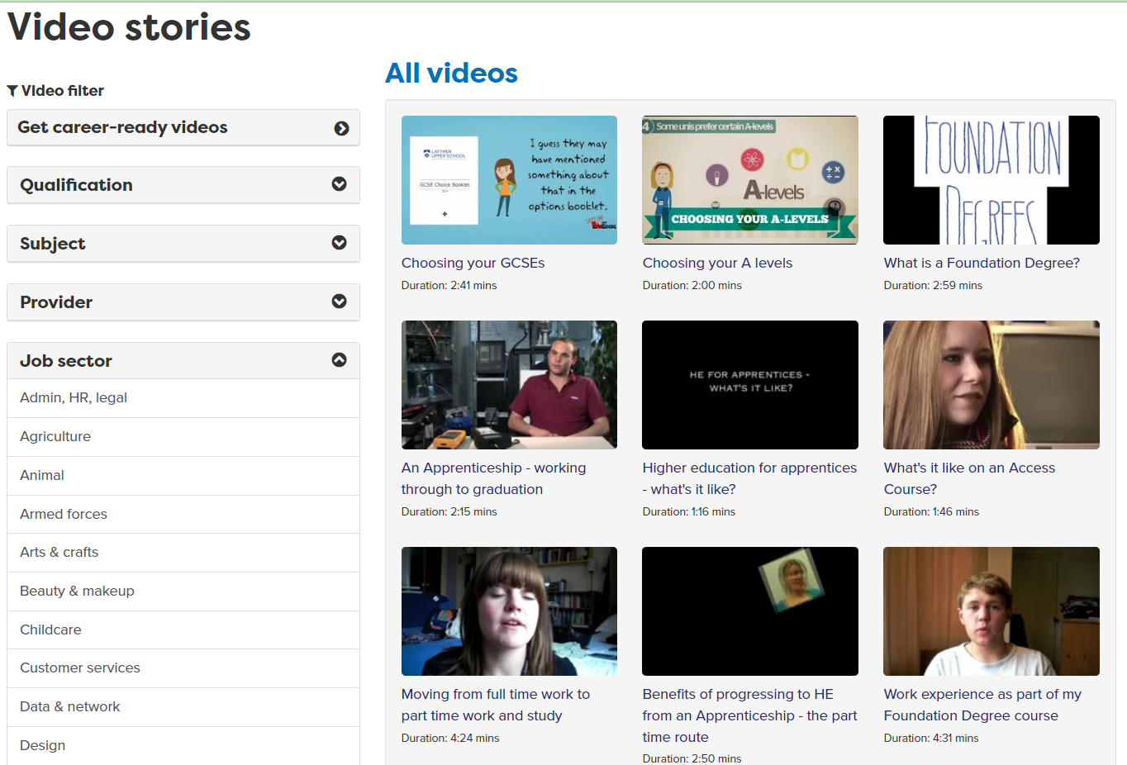
How Careerpilot could help
Notes:
Students use Careerpilot – the video stories section to look at clips related to jobs they are interested in – if they can’t view videos in school but the teacher can – if there is time could see which is the most popular sector for WEX and show a video or two of jobs in that sector to whole class.

Slide 67
Task 1 – My Work Experience
20 mins
What do YOU want to get from YOUR work experience?
Try out a particular job
Practice or learn skills
Try out being a worker
See whether the job I am thinking of is really for me
Who could help you find a placement?
My career teacher
My family
My friends
Other
Which job sectors are you interested in doing a work experience in?
e.g. hospitality
Find workplaces that are easy to get to that fit with what you want?
1. Do a Google map search and see what is around you
2. Look at the companies’ website and check out WEX/contacts
Notes:
Each students should start making their own notes following this process:
Title is ‘My Work experience and then they should answer each of the above.
They can use Careerpilot to remind them of the job sector titles.
They should do some internet research to find employers they could ask for a placement. They should try and find contact details.

Slide 68
Task 2 – Work Experience Research
Finding a job/experience
15 mins
Explore the ‘Finding an experience/job’ section and click on ‘virtual work experiences’
If you can watch videos have a look at some video stories related to jobs you are interested in (if you can’t you can do this at home)
If you find a virtual experience you want to apply to add the link to your ‘My work experience’ notes and bookmark the page using ‘+ My Bookmarks’
Notes:
The task explained

Slide 69


Setting actions
5 mins
Notes:
Students should write at least one action point to help them move their WEX forward

Slide 70
Wrap-up
Working in pairs – share your plan for work experience
What you want to get from it?
Which job sectors do you want an experience in?
Local companies that you want to contact
Virtual opportunities that seem interesting
    Speak clearly and use facts and examples to explain your plan
  Listen carefully and summarise what you’ve heard to show your understanding.
5 mins
Notes:
Students have 5 mins to work in pairs to share their research and ideas.
This activity supports students to practice:
Step 8 Speaking – Using Facts: I use facts and examples to support my communication
Step 8 Listening – Summarising: I summarise or rephrase what I learnt

Slide 71
Getting Career-ready – did you?
You will research workplaces and what it is like to work there
You will start to take responsibility for making things happen in your career
Next session: Work experience – Preparing a CV
Notes:
The Career Development Institute has developed a careers framework that shows the skills everybody needs to have to manage their future career.
This slide shows the students which of the career learning areas (CDI) that this lesson links to.
Ask students to indicate by a show of hand if the set outcomes have been achieved.

Slide 72
Careerpilot is closing. This resource is only available to use until 23rd October 2026.
Post 16 options and Work Experience
Lesson 4: Work experience – Writing a CV

Slide 73
Getting Career-ready
Introduction
10 mins
You will promote your skills and interest
CV writing
35 mins
You will be able to apply for a work experience
Covering letter:
10 min
Notes:
The Career Development Institute has developed a careers framework that shows the skills everybody needs to have to manage their future career.
This slide shows the students which of the career learning areas (CDI) that this lesson links to.
You can also share the structure of the session with students.

Slide 74
One place for all your careers information.
Get the most out of work experience
Think about a job sector or job you would like to try
Think about what you have to offer – your skills and interests
Look for a placement
Have a CV ready to show your employer or talk about
Notes:
Summary of how to prepare for WEX.
Today is finding a placement – CV building will be next session

Slide 75

In today’s lesson you will…
Register/sign in to Careerpilot
2. Find out about CV writing
3. Write a basic CV
4. Understand about covering letters
careerpilot.org.uk
Notes:
Explain to students what activities they will be doing shortly so they have an overview
Use the following slides to explain how to complete these activities before getting started….

Slide 76
Applying for work experience
A ‘covering letter’
A CV, which stands for curriculum vitae, is a document used when applying for jobs. It allows you to summarise your education, skills and experience
Application form
All these things are likely to be the first time the employer has even heard of you
Notes:
Explain there are a range of ways they might need to apply for WEX and having a CV, etc. ready will be usefull for WEX but also when they apply for jobs.

Slide 77

What information should you put on a CV?
As a class group, come up with some ideas about what you should add to a CV
Share your ideas and listen to each other’s contributions. You may want to make notes of your ideas.
Some personal details like email NOT address
Education and any pending qualifications
A CV should include
5 mins
Skills
Any work experiences/
interests
Notes:
Ask students for ideas of what should be on CV
These are the main things that young people can focus on.
This activity support students to practice Step 7 Teamwork – Contributing: I can contribute to group activity

Slide 78

Video: how to create a CV – press play
If you are in Y10 and haven’t had any work experience, then focus on:
Personal details
Education
Skills
Work experience/
Interests
Notes:
Show the video and see if the things they mentioned came up on video.
Explain Y10s focus on skills and interest – but should add any work they have already done – e.g. babysitting

Slide 79






Hot Tips
DO NOT add address, town should be enough
It does not need to be a fancy design, people read from top to bottom
Write the ‘personal profile’ at the end.
Put ‘pending’ and the date you will be doing exams.
This is the most important bit – give examples
If you do not have work experience already just take this out
Notes:
Students should already have information they could include on their CV in the Careerpilot Career Tools

Slide 80

You already have a lot of information
Notes:
Students should already have information they could include on their CV in the Careerpilot Career Tools

Slide 81

Use a template and get started
Finding a job/experience
CV
There are others too
Say ‘Pending’
30 mins
Take this section out
Notes:
Students should be directed to which template they should use. The word download is probably the easiest for Y10.
Explain they should say what GCSEs they are doing and add’ pending’ if they haven’t done them yet.
If they have any experience of work e.g babysitting, paper round, helping dad in his building company, they can include this. If not then take out this section.

Slide 82

Provide feedback to a partner
In pairs look at each other’s draft CVs and help each other improve or give constructive feedback.
You may ask questions to understand more.
You may use facts and examples to support support your feedback.
5 mins
Notes:
Ask students to now take it in turns to show and tell a partner about the job sectors they have saved, including about any jobs they viewed that sounded interesting.
Students can compare the salaries of the jobs they found and talk about what aspects of the day to day tasks they think looked interesting and why.
If time, ask students to feed back on their partner’s chosen jobs or job sectors to the whole class.
Students will have opportunity to practice speaking and listening skills:
Listening Step 8 – Questioning: I ask open questions to understand more

Slide 83
Covering letter – letter of introduction
Why are you writing
I am writing to ask if I could do a work experience at your company
This would be for one week from July 5th – 10th
Give important dates
I am Year 10 at XX school and will be doing my GCSEs next year. I am very interested in finding out what it is like to work in XXX
Give some info about yourself
Include contact details
My email address is
Homework
Notes:
Run through why a covering letter/email is often used and what should be in it.

Slide 84

Getting Career-ready – did you?
You promoted your skills and interests
You got ready to apply for work experience
Notes:
The Career Development Institute has developed a careers framework that shows the skills everybody needs to have to manage their future career.
This slide shows the students which of the career learning areas (CDI) that this lesson links to.
You can also share the structure of the session with students.

Slide 85
Careerpilot is closing. This resource is only available to use until 23rd October 2026.
Post 16 options and Work Experience
Lesson 5: Reflection and Reviewing

Slide 86

Getting Career-ready
Class Discussion
What is a career?
What does LMI stand for and why is it useful?
How and why are jobs changing?
Name 4 things you can get out of Work experience.
10 mins
Notes:
A career is an individual's journey through life, learning and work.
A job is something you might do to earn money as part of your career journey. There are lots of different job sectors you could work in, from finance, to art and design, to working with animals.
LMI stands for labour market information – the more you know about where the jobs are the more likely you are to know where to align yourself for the future
Jobs are changing because of tech, AI, climate change
WEX – can get – new skills, experience of a job, see what talking to a boss is like, see if a job is for you, or not.

Slide 87
Make a list of the things below you have now done.
Then write what is left to do and write action points on Careerpilot of how and when you will do them
You have:
An understanding of the three main pathways you can choose at 16.
Thought about what you want from work experience
Explored different places you could do work experience, including virtual opportunities
Found a work experience placement to suit you
10 mins
Written a CV (even if it is a draft)
Written a draft covering letter
Notes:
Each student should do this

Slide 88


What has been most useful to you?
10 mins
Write down your top three most useful and why
Notes:
Can do as individual and then discuss with a partner.
These are some of the things that have been covered over the 5 week programme. Which have been the most useful and why? Students should write this down.
As a class group after individual recordings - Ask the class to put up their hands if they found the job quiz useful, etc to gauge class views.

Slide 89
Get Career Ready
You have:
considered what learning pathways you could take at 16
researched the job market and the education system
recognised the value of trying new things
reflected on the meaning of work
researched workplaces and what it is like to work there
started to take responsibility for making things happen in your career
promoted your skills and interest
got ready to apply for a work experience
Notes:
Summary of which aspects of the CDI framework students have covered.
Should be proud they have done these things which will take forward their career – clap!

