Slide 1


careerpilot.org.uk
Careerpilot is closing. This resource is only available to use until 23rd October 2026.
5 Week Careers Teaching Pack
Year 12/13 – Preparing for post 18

Slide 2
Teacher Overview
This 5-week careers programme aims to support students to:
Develop their career skills for life, learning and work
Prepare them for the next career decisions they will have to make.
Lessons have been developed by the Careerpilot Team – all are qualified career advisers and teachers.
The programme contains all you need to deliver 5 x 50-60 minute lessons, or the first lesson can be delivered as a standalone session. All lessons use a Power Point presentation, with notes to explain screens. The first lesson has been pre-recorded as a video lesson with a member of the Careerpilot Team virtually delivering the session and providing instruction to the facilitating teacher and the students should you wish to use this delivery option.
The lessons require students to have access to Careerpilot so they can use the wealth of information and tools offered through the site but also to help them build their career report. The report moves up annually with them, can be ‘ported’ by them to another provider e.g. a college and is owned by them until they are 20.
All student’s need is access to careerpilot.org.uk and paper/pen. Careerpilot can be accessed through pc, tablet or phone.
To provide feedback or ask a question contact careerpilot@bath.ac.uk

Slide 3




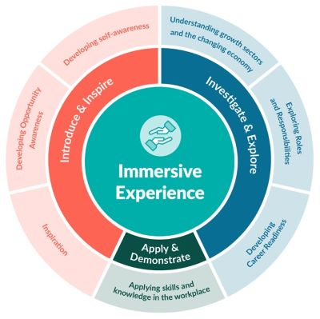




The Year 12/13 careers lessons are mapped to:
CDI Framework and career development skills
Gatsby Benchmarks
Grow throughout life by learning and reflecting on yourself, your background, and your strengths.
www.gatsbybenchmarks.org.uk/
Explore the full range of possibilities open to you and learn about recruitment processes and the culture of different workplaces.
The Equalex Framework to support preparation for Modern Work Experience
Manage your career actively, make the most of opportunities and learn from setbacks.
Create opportunities by being proactive and building positive relationships with others.
Balance life as a worker with other interests and your involvement in family and community
See the big picture by paying attention to how the economy, politics and society connect with own life and career.
Investigate & Explore
Apply & Demonstrate
www.thecdi.net/write/Framework/CDI_86-Framework-Guidance_in_Secondary_Schools-webFINAL.pdf
www.careersandenterprise.co.uk/modern-work-experience/equalex-for-educators/
https://www.careerpilot.org.uk/skills-profile/activities
Skills Builder Universal Framework 2.0
www.skillsbuilder.org/universal-framework
Notes:
These lessons have been developed to support students to build their career development skills, as identified by the CDI Career Development Famework. Each lesson identifies two outcomes linked to the CDI framework.
The lessons will support meeting Gatsby Benchmark 1, 2, 3, 4 and 6 and support the Equalex Framework for preparing students for Modern Work Experience as they ‘Introduce & Inspire’ students about the world of work and ‘Investigate & Explore’ jobs and careers.
The lessons provide opportunities for students to practice their essential skills as identified in the Skills Builder Framework 2.0 - www.skillsbuilder.org/universal-framework/
The relevant skills steps are identified in the teacher notes in relevant activities, with reflection questions and prompts for discussion with students as part of the plenary.

Slide 4
Lesson Overview – Year 12/13
Lesson 1: Getting ready for post 18 options (recorded lesson available)
Students register/sign in on Careerpilot, understand post 18 options in overview, explore themselves and options
Resources needed: Play video with sound. Individual online access to Careerpilot, paper and pens.
Lesson 2: Alternatives to university
Students understand the alternatives and explore whether there are pathways to suit them.
Resources needed: Individual online access to Careerpilot, paper and pens.
Lesson 3: Choosing a university course
Students understand more about the process of choosing and comparing courses.
Resources needed: Individual online access to Careerpilot, paper and pens.
Lesson 4: Funding future study and getting ready to apply
Students explore key points about funding their study, assess their skills & get ready to apply. Resources needed: Individual online access to Careerpilot, paper and pens.
Lesson 5: Reflection and reviewing
Students reflect on what they have done and what has been useful. Review and update plans
Resources needed: Online access to Careerpilot, paper and pens.
Notes:
Use this page to navigate directly to the relevant lesson.

Slide 5

careerpilot.org.uk
Careerpilot is closing. This resource is only available to use until 23rd October 2026.
This lesson can be delivered through a video recording
Preparing for post 18 options
Lesson 1: Getting ready for post 18 options
Notes:
A video recording of this lesson is available to play from the front with prompts to pause for students to complete activities. This is available as a separate file with links to the recording.

Slide 6
Getting Career-ready
Introduction
25 mins
You will see how your post 18 choices fit with future jobs and your career
Careerpilot Activities 25 mins
You will actively be planning, prioritising and setting targets for your future
Wrap up
10 mins
Notes:
The Career Development Institute has developed a careers framework that shows the skills everybody needs to have to manage their future career.
This slide shows the students which of the career learning areas (CDI) that this lesson links to.
You can also share the structure of the session with students.

Slide 7

What is a career?
A career is an individual's journey through life, learning and work.
A job is something you might do to earn money as part of your career journey. There are lots of different job sectors you could work in, from finance, to art and design, to working with animals.
Y12/13 – the big things
Explore all post 18 options in detail
See what options align with your future plans
Get the best qualifications you can
Notes:
Explain what a career is and that jobs are part of their career journey (and they might have lots of them).
Emphasis the big career things that Y12/13 will need to be considering

Slide 8

Exploring motivations
What do you want from a future job?
What drives you?
Write down your top 3, here are a few ideas or use your own
You can use what drives you (your values) to help you find a course/career.
Notes:
They can write down their top three (recognize it is sometimes hard to have just three). They don’t need to tell you what they have chosen but make the point that what drives you (your values) can help you look for courses and careers.

Slide 9
Career planning is changing
Careers in the past
Careers in the future?
Notes:
In the past there was more of a staircase approach to jobs, start at one step and move up. Now careers are ‘squiggly’ as we don’t know for sure where jobs will be as tech advances and people might have to retrain, etc.

Slide 10




Where are future jobs going to be?
Medical, Health Science and Care
IT and Digital Technology
Engineering and Construction
Environmental (Green Jobs)
This is Labour Market Information (LMI)
Be in the know to know where to go
Notes:
With new technology and science developments there will be lots of brand-new jobs for people to do and a growth in jobs in many industry sectors including these sectors.

Slide 11

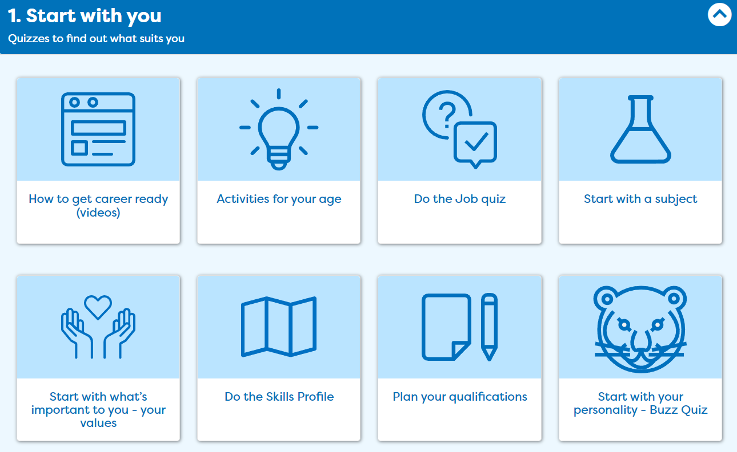
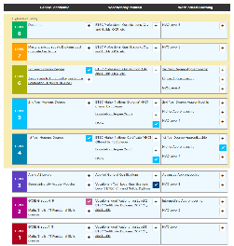

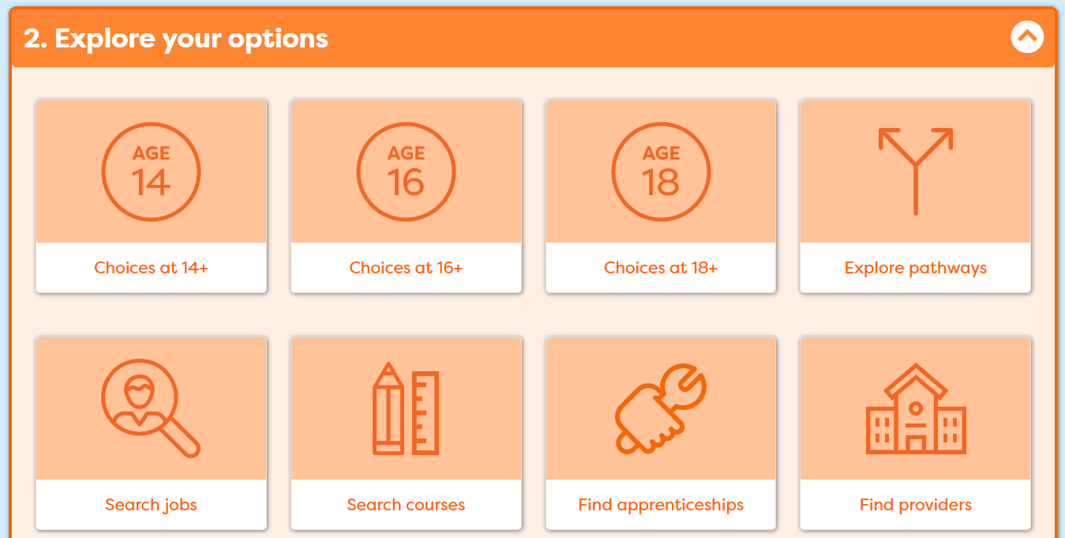
In today’s lesson you will…
Register/sign in to Careerpilot
2. Confirm what drives you ‘Start with you’
3. Add your qualifications to ‘My qualifications’
4. Consider routes at 18 and explore options
Notes:
Explain to students what activities they will be doing shortly on Careerpilot.
Use the following slides to explain how to complete these activities before getting started….

Slide 12





Get ready for your future career
https://www.youtube.com/watch?v=OWZxyyK6OuA
Notes:
Show the video (3 mins). If they have seen it before set them a challenge to remember the 4 thing the video recommends they can do now to manage their career

Slide 13
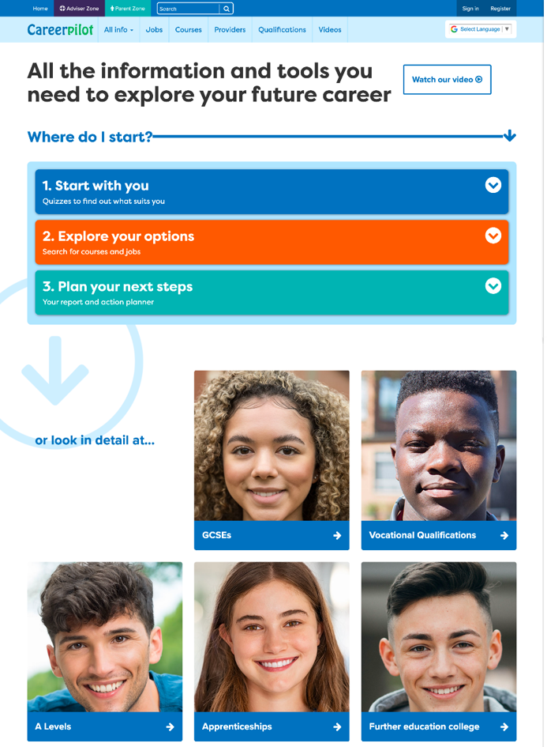
Careerpilot – all you need in one place
Jobs, courses, qualification planner, videos
Quizzes, tools – 3 stages to help you decide
Future qualifications and pathways
careerpilot.org.uk
Notes:
Careerpilot is a website that you can use for free. It has lots of information and tools to help you to start to think about future career ideas and pathways.
The website is built around 3 stages:
Start with you – with quizzes to find out more about what might suit you
Explore your options – where you can search for courses and jobs
Plan your next steps – where you can build a report and plan some actions.
They might well have used it before in KS3 and 4

Slide 14
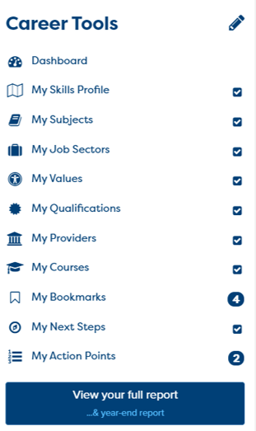
One place for all your careers information.
Build your report in the Career Tools
1. Register/sign in 2. Build you report
Notes:
You will be using Careerpilot to explore all your options, register (or sign in if you have used it before)
Then you can build your report and have a record of all your career choices and plans

Slide 15

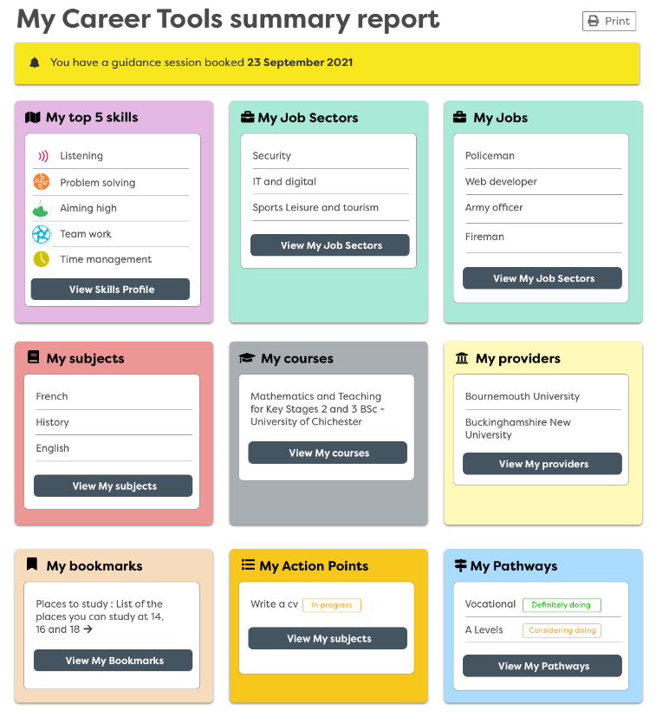
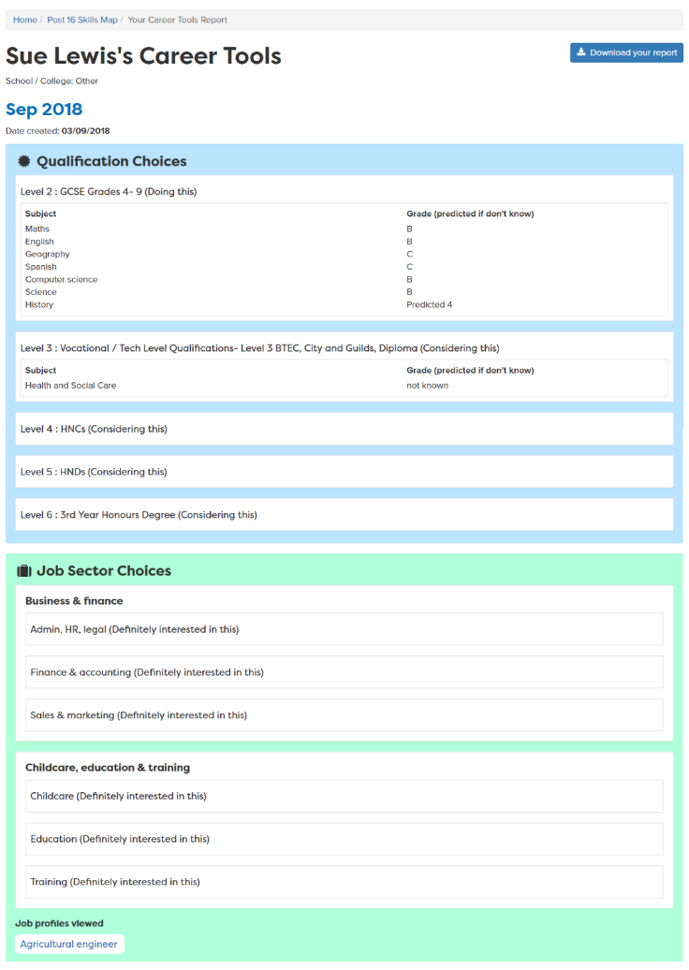
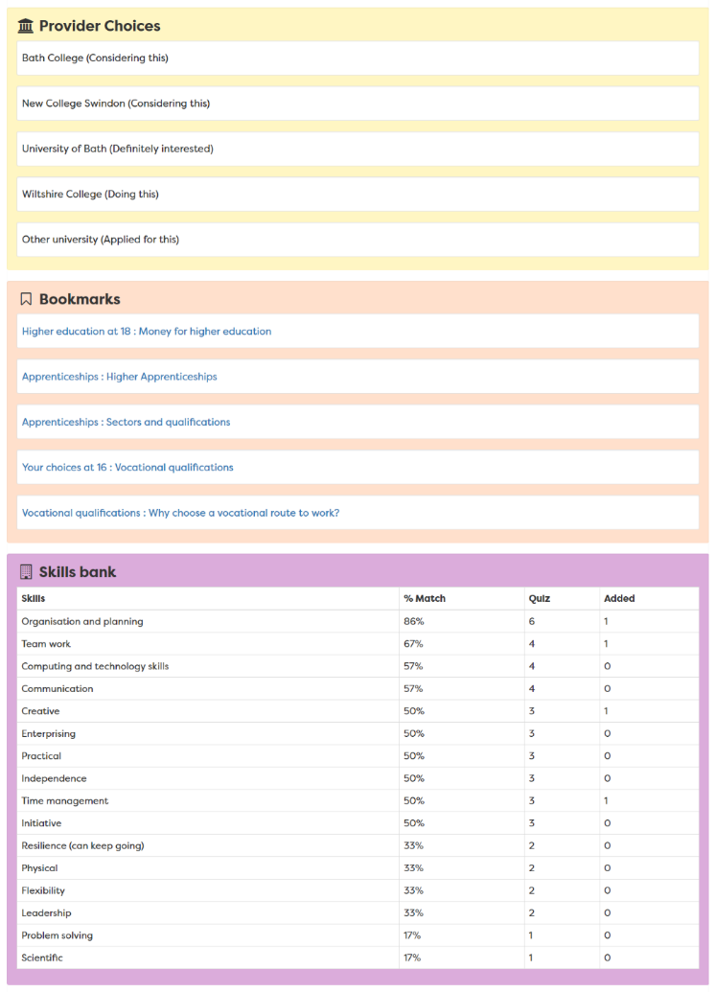
Report moves up each year
Notes:
A slide to show the report that is created once the career tools have been completed – moves up with them each year in school
Students can access their report until they are 20

Slide 16

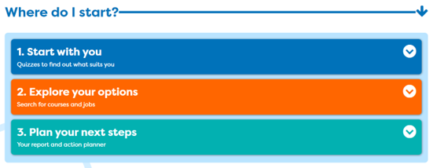
One place for all your careers information.
Notes:
Start by exploring ‘Start with you’ or redoing things you did previously to see what has changed.
You will add you post Y12 subjects to ‘My quals’ and make sure you added your GCSE actual results.

Slide 17
One place for all your careers information.
Future Planning
What I want from life
Post 18 – After Y13/college
Jobs I would like
5 mins
Notes:
It is important to tie career decisions into what you want from life.
Students draw the 3 circles as above and then write in their thought to date about each one. The last box is about what’s important to them – Kids, having a house, preventing climate change

Slide 18

One place for all your careers information.
Get ready for your future career
Work Experience
Cadets
Duke of Edinburgh
A Levels/
T Levels/BTECs
Youth Groups
Don’t drop them!
Great for your CV
Sports Teams
Performing Arts
Notes:
Yes your number 1 priority needs to be you’re A Levels or other Level 3 Qualification but don’t give up anything that will be useful for a future job/course/CV.

Slide 19

Today
Notes:
Today focused on your options.

Slide 20
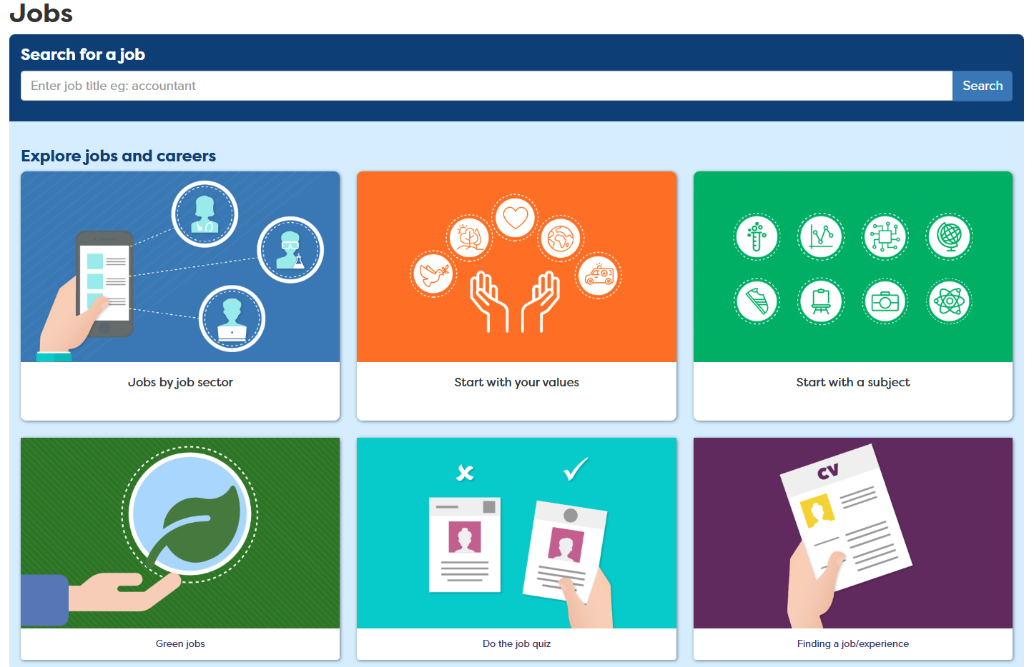
One place for all your careers information.
What will get you to where you want to go?
Notes:
If you know what job you want to do in the future you can see what routes you can take into it.
Choose a job

Slide 21
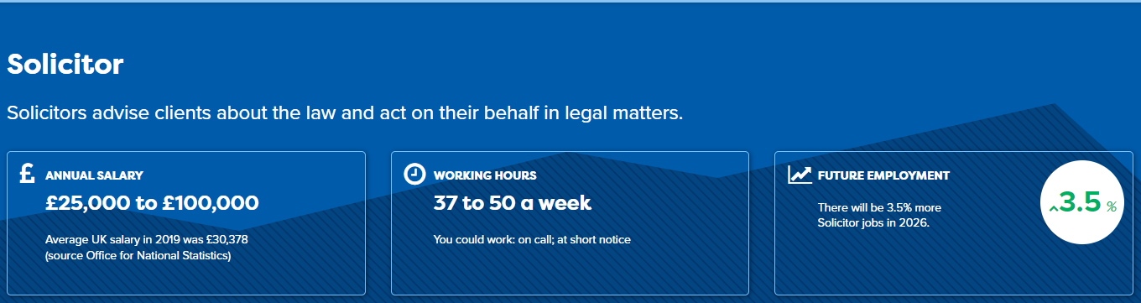
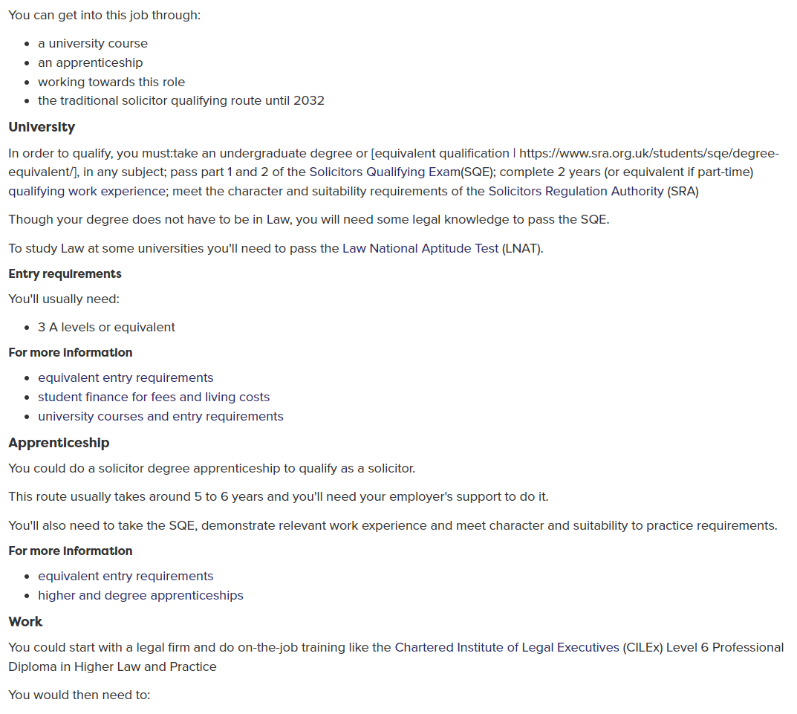
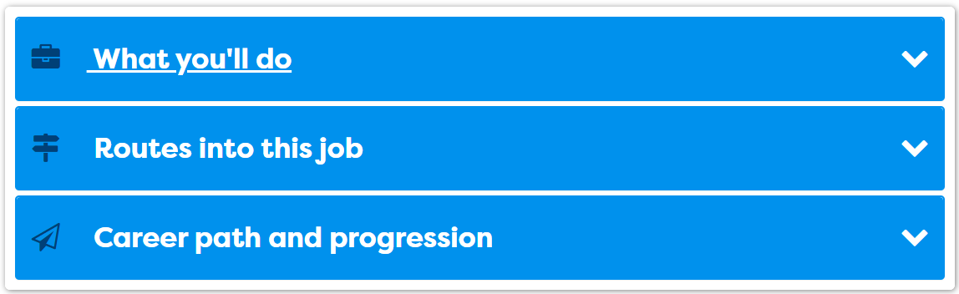
One place for all your careers information.
What will get you to where you want to go?
Notes:
Every profile has lots of details about the job – LMI and what routes can be taken.

Slide 22






Gap Year
Get a job
Academic
Technical/Vocational
Apprenticeship
Degree Achieved
Degree Year 2
HND
Foundation Degree Y2
Higher Apprenticeship
Degree Year 1
HNC
Foundation Degree Y1
Higher Apprenticeship
A levels
BTEC/OCR General or T Level
Advanced Apprenticeship
5 x GCSEs 4 - 9
BTEC/OCR Level 2
Intermediate Apprenticeship
GCSEs 1 - 3
Notes:
Need also to consider the next qual you will do.
Explain that there are three pathways but in all pathways there are levels of quals.
Make the point that all pathways can lead to a degree.
The bit of the qualification ladder we are mainly talking about today is their choices after Level 2 or 3

Slide 23
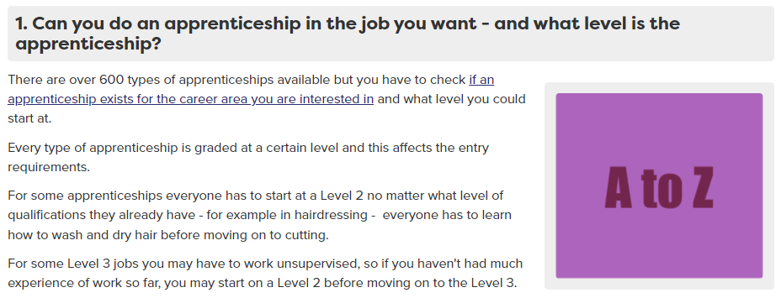
Degree or apprenticeship?
Nurse
Dentist
Medical Doctor
Can be competitive –as anyone of any age can apply for an apprenticeship
Degree
Degree
Degree
Apprenticeship
Apprenticeship – new 2023
Notes:
Ask what qualification do they need to become….
Is it a degree, apprenticeship or both?
See answers. The Medical doctor is a bit of a trick question as this will be a new apprenticeship in 2023.
Can see an A-Z of available apprenticeships on Careerpilot – in the ‘finding an apprenticeship’ section. Make the point that even if one exists they still have to find a vacancy. Careerpilot has links to vacancy sites too.

Slide 24



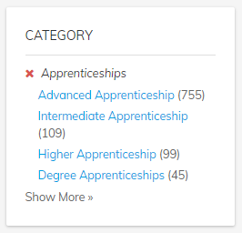

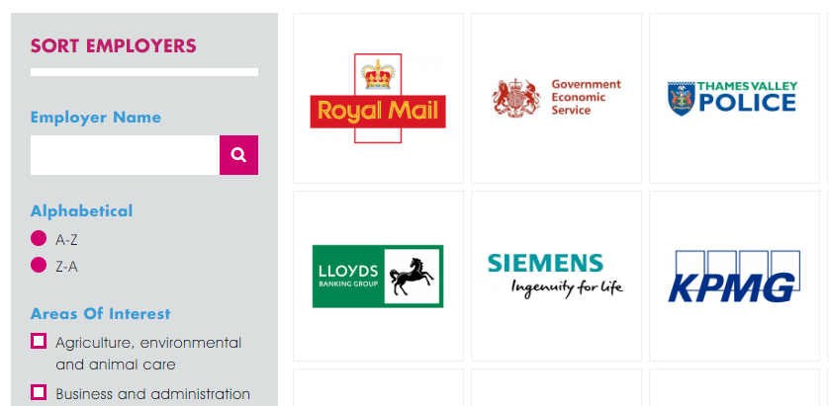
One place for all your careers information.
Interested in apprenticeships?
Higher/Degree Apprenticeship
You might have to start at a lower level or go sideways
Higher/Degree Apprenticeship
Higher/Degree Apprenticeship
Advanced Apprenticeship
Intermediate Apprenticeship
Notes:
Make point that Higher and Degree apps are great but they are competitive. Need sometimes to start at level lower than you have. There are other places to look, like Not Going to Uni.
There are a lot more Advanced Apps available
Search for vacancies on Careerpilot

Slide 25
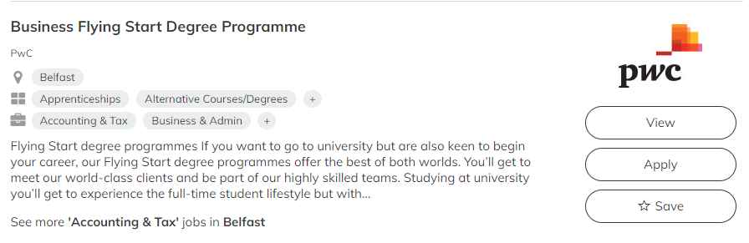


One place for all your careers information.
Interested in employer sponsored degree?
Check the small print and what you are committing to!
Notes:
There are also employers who will sponsor you as you do your degree.

Slide 26


Interested in Higher Education in a college?
Often lower grades needed.
Degree in 3rd year
Business
Computing
Design
Education
Engineering
Environment
Social care
Construction
Law
Media
Finance
Psychology
Science
Social Sciences
HND
Foundation Degree Y2
HNC
Foundation Degree Y1
Often lower fees than a university.
A Foundation Degree is a degree combining both academic and vocational qualifications.
Notes:
Another option you can consider is to do higher level qualifications through your local college.
They offer a range of qualifications at level 4 and above depending on the college and the courses will vary depending on their specialisms and the local demand.
They either offer HNC/HNDs – which are higher level BTEC courses or Foundation degrees which combine academic and vocational qualifications.
It is possible after a level 5 to top up one of these qualifications to get a full degree either at college or a university. All of the courses that are offered by a college are vocational – so job related.
The fees can be less than university and the course may suit you if you know what you want to do and would like to stay close to home.
Some HNC/Ds and FD are now also badged as Higher Technical Quals, providing good progression routes from T Levels

Slide 27

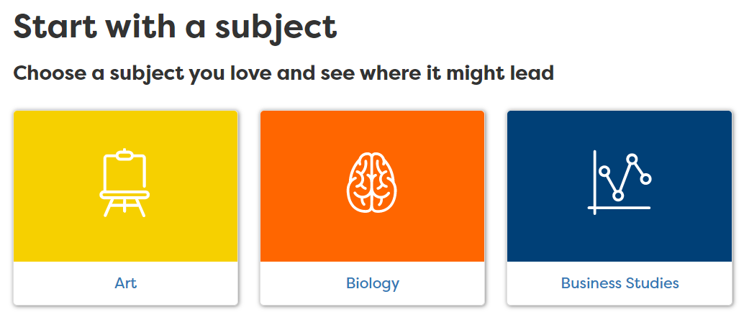
Thinking Uni? 1000s of courses, 130 unis
1. Decide which course
2. Find and compare
Values/interests can help you choose
Courses with the same name can be quite different
Start with a job and work back
What UCAS tariff points will you have? (56 = A*, 48 =A, B =40)
Accommodation costs, student satisfaction, etc.
Go to a local Uni and save costs or consider college/ Open University.
Notes:
Who is thinking about uni?
Here are a few key things when deciding.
Can start with a job or start with a subject as employers are keen for people with any sort of degree subject.

Slide 28
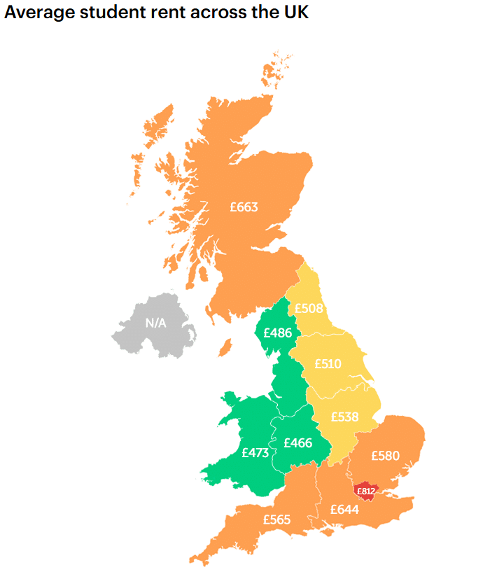

Explore the details
Average student rent across the UK
What is the average
student rent?
Does the rent include bills, WIFI?
Notes:
Ask students to write down what they think the average rent is.
Put hands up if think:
Under £500
Over £500
Need to know more than just about the course costs.
Rent varies across the UK with London being the most expensive region (though maintenance loans are higher in London)

Slide 29
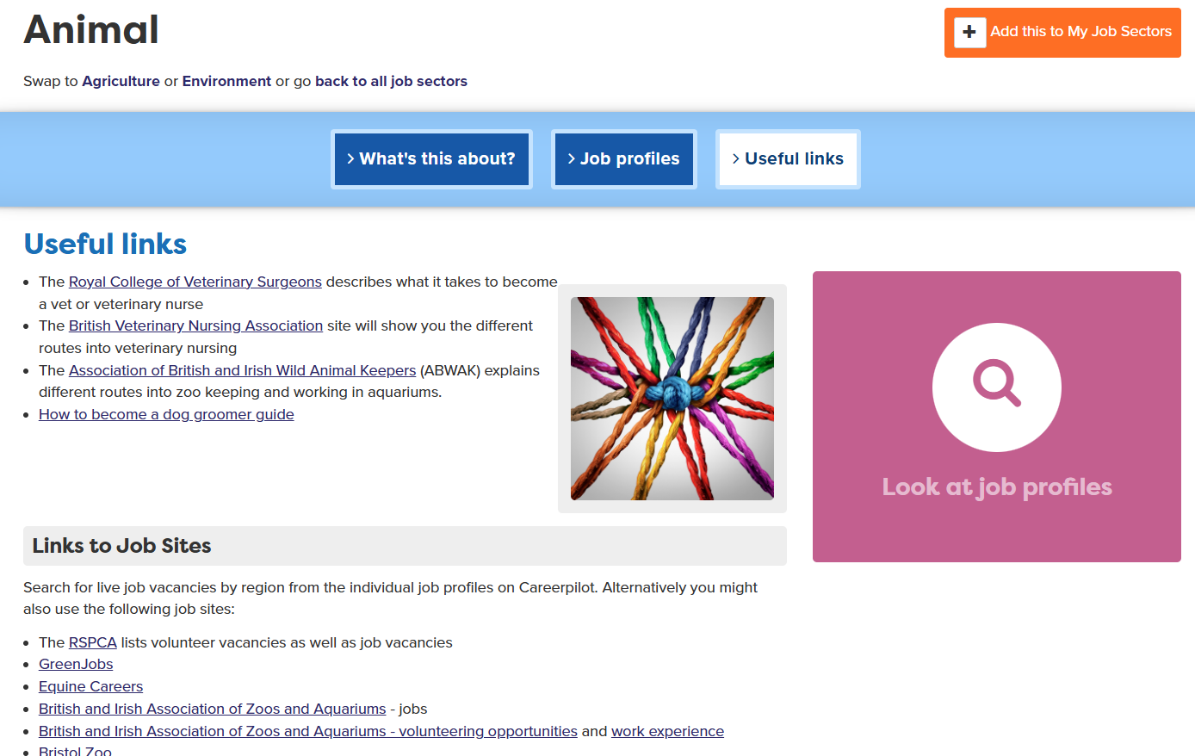
Thinking about work and training?
Notes:
Careerpilot has info on these pathways and every job sector has links to employer websites to find out more and also to search vacancies.

Slide 30
One place for all your careers information.
Top Tips
If you are thinking of applying for an apprenticeship:
Plan A
Apply for Uni by January
Plan B
Look for an apprenticeship as vacancies for September often come out after January
Notes:
They can always decline their uni place later if they get a great apprenticeship opportunity.

Slide 31
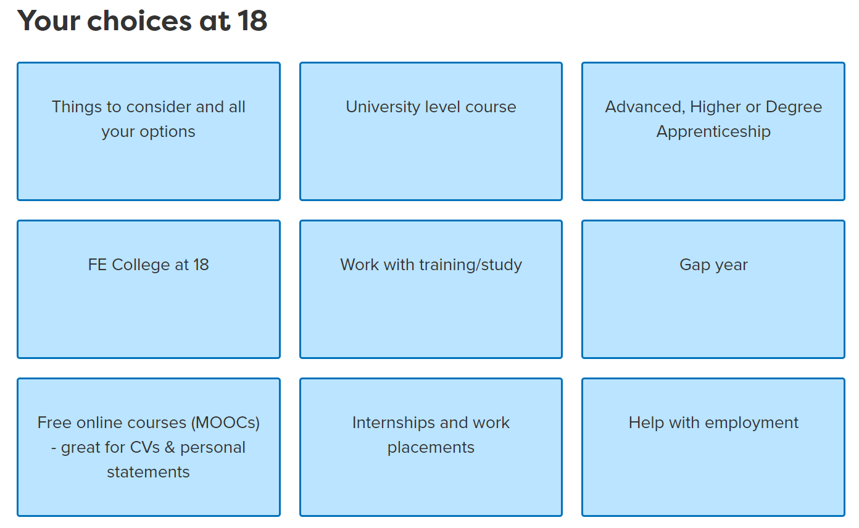
One place for all your careers information.
Careerpilot has all the information
Notes:
Careerpilot has lots of information about options, including links to other sites which offer good information.
MOOC – Massive Open Online Courses are free and are a short, online intro to subjects – looks great on your CV or personal statement but also great way to find out more about a subject.

Slide 32

Now it about you – explore your options
1
3
careerpilot.org.uk
2
4
20 mins
Notes:
Give the students 20 – 25 minutes exploring Careerpilot after explaining task. Make sure they sign into Careerpilot.
These are the sections we will be focusing on today. Use any of these sections to help you get an idea of yourself and your options and to help you think about what you will do after Y13 and into the future. Remember to tag things you like as you find them.

Slide 33


One place for all your careers information.
Get ready for your future career
Parents/family
Career advisers
Teachers Head of 6th Form
Careerpilot
Notes:
When they are back as a group. Talk about supporters and see if they can suggest any others. Tell them the name of the school careers adviser.

Slide 34
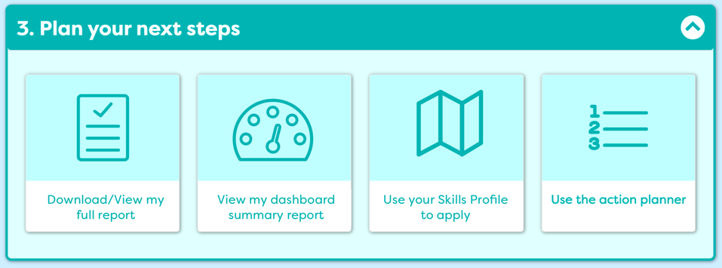
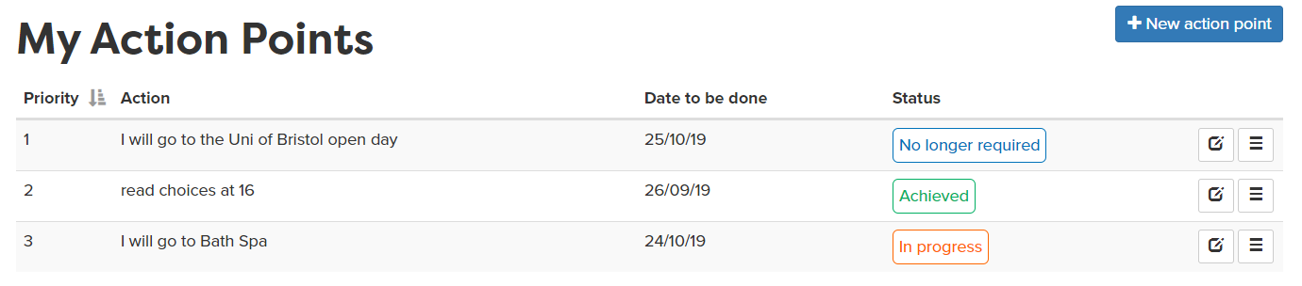
Write an action point
5 mins
Notes:
They should write one or two action points of things they will do now to move on their career.

Slide 35
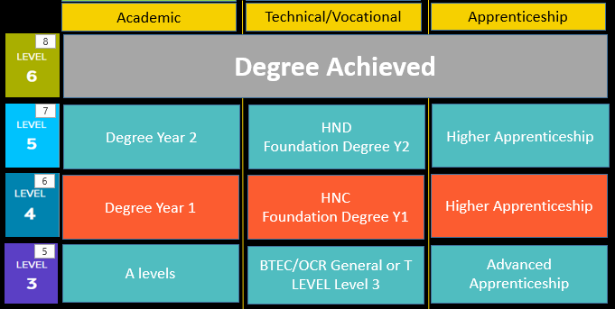
Wrap-up – In pairs
Pathways at 18: Which are you interested in?
5 mins
Notes:
Ask who is interested in Academic, Voc, work based.
Get students to write down their chosen pathways as A, B C
Ask who wants to stay in the area, who wants to go further
In pairs share what they looked at and what they are thinking of

Slide 36
Getting Career-ready – did you?
Seen how your post 18 choices fit with future jobs and your career
Started to make a plan and develop a pathway for your future
Notes:
The Career Development Institute has developed a careers framework that shows the skills everybody needs to have to manage their future career.
This slide shows the students which of the career learning areas (CDI) that this lesson links to.
You can also share the structure of the session with students.

Slide 37


Careerpilot is closing. This resource is only available to use until 23rd October 2026.
Preparing for post 18
Lesson 2: Alternatives to university

Slide 38
Getting Career-ready
Introduction
5 mins
You will start planning your next steps in learning and work
Careerpilot planning task
10 mins
Explore alternative routes
20 mins
You will seek out information on the education and training system
Wrap-up
15 mins
Notes:
The Career Development Institute has developed a careers framework that shows the skills everybody needs to have to manage their future career.
This slide shows the students which of the career learning areas (CDI) that this lesson links to.
You can also share the structure of the session with students.

Slide 39
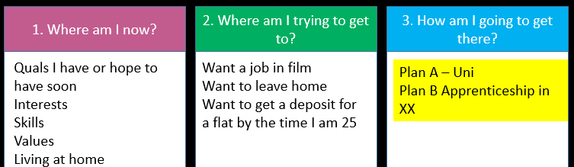
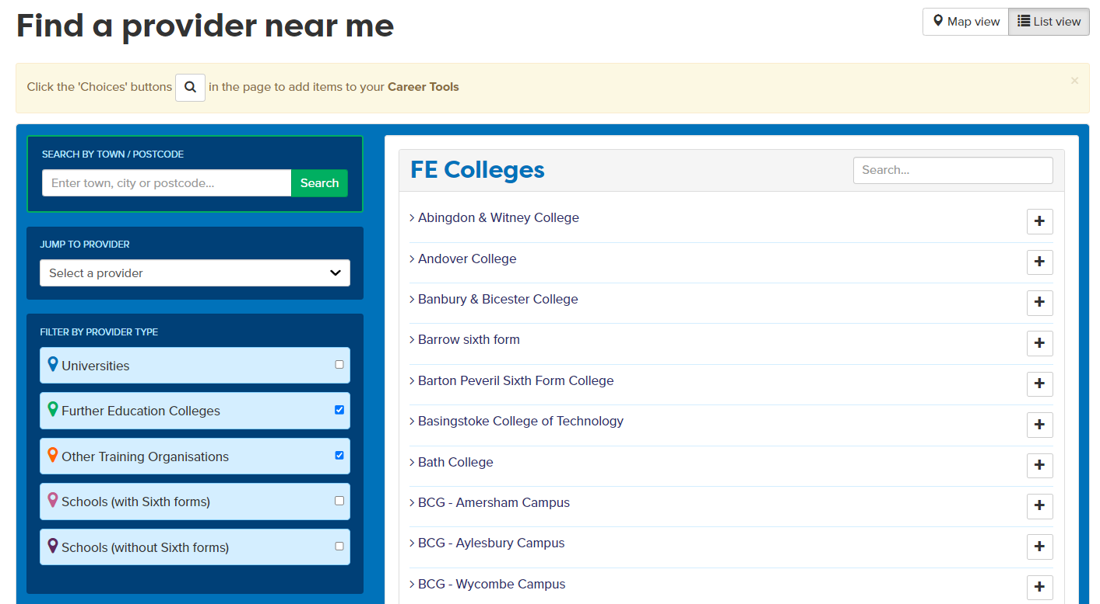

In today’s lesson you will…
Use a process for managing your career
2. Look at college courses that could suit you
3. Search for an apprenticeship
4. Think of pathways for you - Plan A, Plan B
careerpilot.org.uk
Notes:
Explain to students what activities they will be doing shortly on Careerpilot.
Use the following slides to explain how to complete these activities before getting started….

Slide 40






Managing your own career
Focus on alternatives to uni.
Notes:
Remind the students of the video they saw last lesson. The focus today is drilling down in their options so they understand them in more detail.

Slide 41
One place for all your careers information.
Managing your career
1. Where am I now?
2. Where am I trying to get to?
3. How am I going to get there?
Quals I have or hope to have soon
Interests
Skills
Values
Living at home
Have a relationship
Sports
Want a job in film
Want to leave home
Want to get a deposit for a flat by the time I am 25
Want to get a job after 6th Form
Decide whether stay at home for uni
Improve my grades
Search for film courses within 10 miles of home
Check out employment after the course
Happenstance
10 mins
Notes:
There is a process for career decision making you can follow
Start with ‘where am I now’ which is a reflection of what you have to offer, what you are doing, quals, etc.
Then think about ‘Where am I trying to get to?’ and thing about where you want to be - in 1 years time or 5/10 years time – it’s about what you want to achieve/do
Then think about the steps you need to take to get there in ‘How am I going to get there?’
Ask students to draw this grid and then spend 10 minutes doing the three stages.
Fly in Happenstance after they have completed the task – there is a newish career development theory that now talks about the importance of ‘happenstance’ when you take every opportunity open to you as they present themselves and see where it goes, on the basis that it might lead to something that is really interesting, exciting.

Slide 42
Making career decisions that fit with you
Choosing post 18 now
Where will this course lead?
Do people get good jobs after this course?
But also want to know your choice at 18 will help you get to where you want to go in the future
Am I choosing the right degree to get into the job I want?
Will it make me happy?
What might I do for a job
Employers want people with degrees of any subject so doing a degree in a subject your love is fine – you can focus on a job later
Notes:
Need to be thinking ahead as well as to the decision now, and asking questions
But also need to feel it is okay for you and will make you happy, links with your passions
It is fine to do a degree in a subject you love even if you don’t know what job you want to do right now.

Slide 43
Academic
Technical/Vocational
Apprenticeship
Degree Achieved
Degree Year 2
HND
Foundation Degree Y2
Higher Apprenticeship
Degree Year 1
HNC
Foundation Degree Y1
Higher Apprenticeship
A levels
BTEC/OCR general or T Level
Advanced Apprenticeship
5 x GCSEs 4 - 9
BTEC/OCR Level 2
Intermediate Apprenticeship
GCSEs 1 - 3
Notes:
Remind students of the pathways and options.
Although the next decision is about what they will do after Y13 that needs to tie in with an idea of future plans and that it is taking you where you want to go
Today will focus on the alternative pathways to uni.

Slide 44
Interested in Higher Education in a college?
Business
Computing
Design
Education
Engineering
Environment
Social care
Construction
Law
Media
Finance
Psychology
Science
Social Sciences
Degree in 3rd year
Often lower grades needed
HND
Foundation Degree Y2
HNC
Foundation Degree Y1
Often lower fees than a university
A Foundation Degree is a degree combining both academic and vocational qualifications.
Notes:
Another option you can consider is to do higher level qualifications through your local college.
They offer a range of qualifications at level 4 and above depending on the college and the courses will vary depending on their specialisms and the local demand.
They either offer HNC/HNDs – which are higher level BTEC courses or Foundation degrees which combine academic and vocational qualifications.
It is possible after a level 5 to top up one of these qualifications to get a full degree either at college or a university. All of the courses that are offered by a college are vocational – so job related.
The fees can be less than university and the course may suit you if you know what you want to do and would like to stay close to home.
Some HNC/Ds and FD are now also badged as Higher Technical Quals, providing good progression routes from T Levels

Slide 45

What is a Foundation Degree?
https://www.careerpilot.org.uk/stories/what-is-a-foundation-degree
Notes:
Show the video if there is interest in the group of this pathway

Slide 46


Interested in apprenticeships?
Higher/Degree Apprenticeship
£7.55 per hour (some employers pay more)
You might have to start at a lower level or go sideways
Higher/Degree Apprenticeship
Learn by doing the job 80% work 20% college
Higher/Degree Apprenticeship
Advanced Apprenticeship
Need to find one like finding a job
Intermediate Apprenticeship
Notes:
Remind them that Higher and Degree apps are great but they are competitive. Need sometimes to start at level lower than you have. There are other places to look, like Not Going to Uni.
There are a lot more Advanced Apps available
Search for vacancies on Careerpilot

Slide 47
Finding an Apprenticeships
What do you want to be trained to do through an apprenticeship?
1.
Does one exist?
2.
Search for a vacancy
3.
Apply
Notes:
An apprenticeship is training you to do a job so you do have to think what job role you are looking for.
Then there are three stages to follow

Slide 48
Higher and Degree Apprenticeships - sectors
Higher apprenticeships are available in a wide range of industries and job roles – there are over 40 higher apprenticeship frameworks, including in these industries (those in bold have most opportunities)
construction, planning and the built environment
agriculture, horticulture and animal care
arts, media and publishing
business, administration and law
engineering and manufacturing technologies
education and training
information and communication technology
science and mathematics
retail and commercial enterprise
health, public services and care
They are competitive
Might not be available locally
Notes:
Here is a list of the apprenticeships with that often have the most vacancies.
As anyone of any age can apply for an apprenticeship sometimes it is difficult to get into these from 18 – such as Police Constables – maybe competing with people already in the force or had more work experience.
Also you can see that just because an apprenticeship might exist for a specific job such as graphic design it doesn’t necessarily mean there will be any vacancies – it depends on employer demand.
You can search for these on Careerpilot and there is also a specific area on UCAS website for these.
Some of the deadlines for these opportunities mirror the deadlines for applying to university.
You may end up doing part of the degree apprenticeship at a university or on site depending on the employer. You maybe working towards professional examinations too. Although it maybe slightly longer than a degree you are gaining work experience and earning money.

Slide 49
One place for all your careers information.
Sign into Careerpilot
1. Register/sign in
careerpilot.org.uk
Notes:
You will using Careerpilot to explore all your options, register (or sign in if you have used it before)
Then you can build your report and have a record of all your career choices and plans

Slide 50
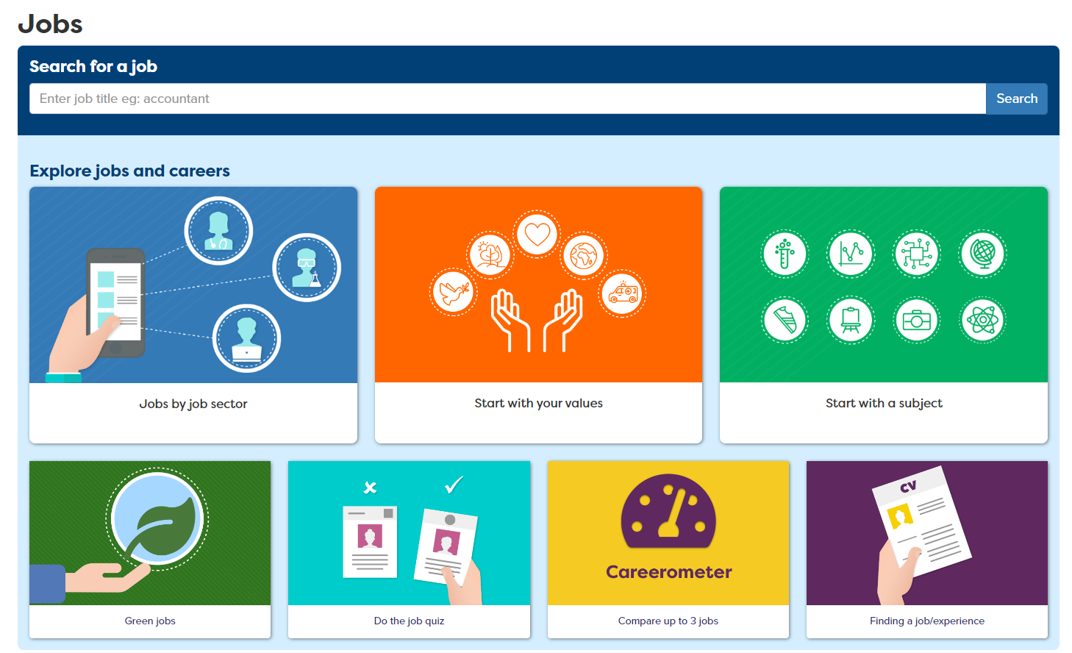
If you have a job in mind already
Notes:
You will using Careerpilot to explore all your options, register (or sign in if you have used it before)
They might already have jobs they like saved in their Career Tools or they can go to ‘jobs’ and search in different ways
Add the job of interest of the Career Tools

Slide 51
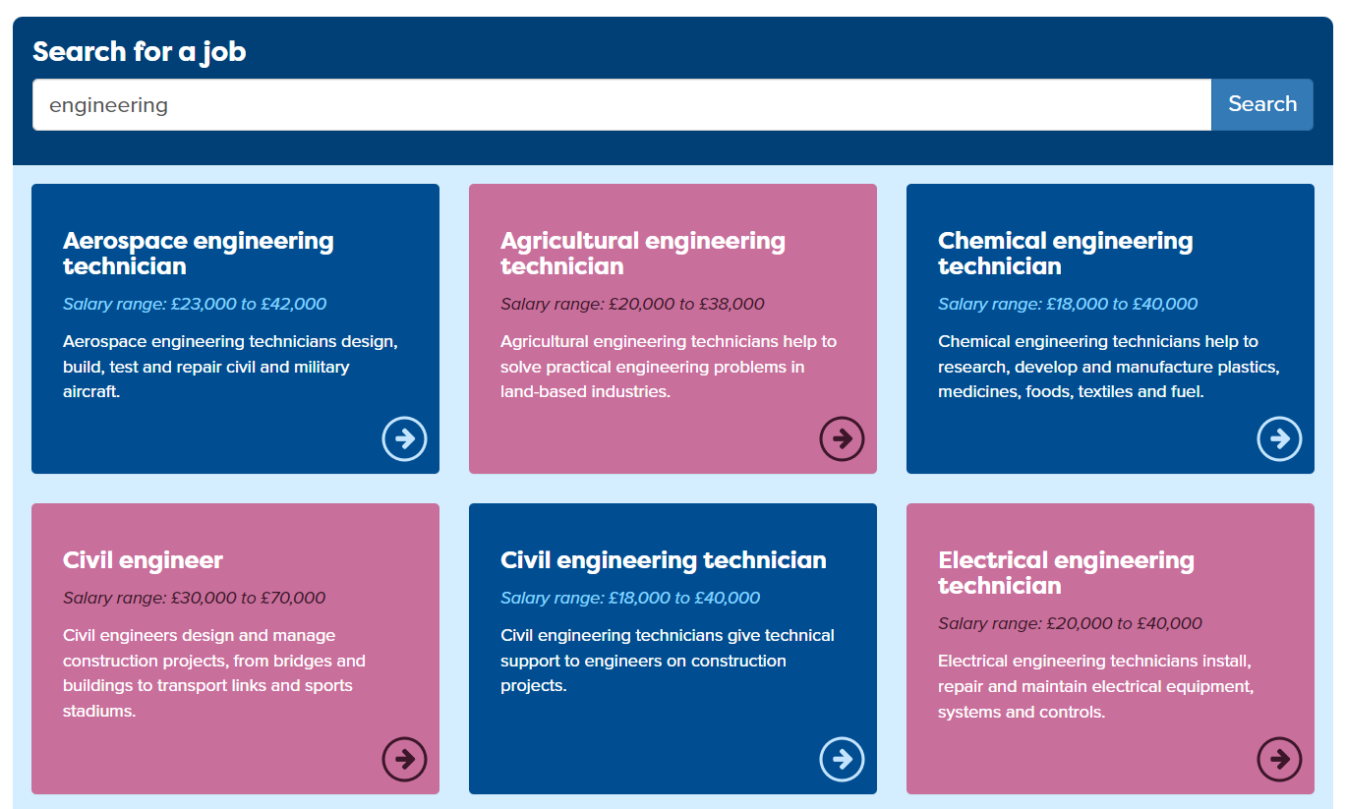
Look at job profiles to research careers
Notes:
Students can choose a job to see the whole job profile

Slide 52
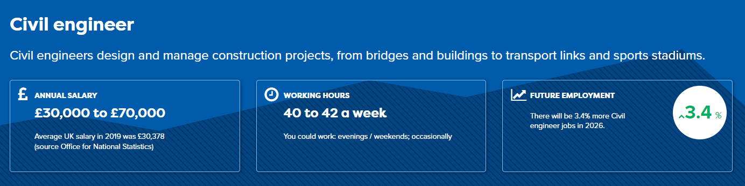
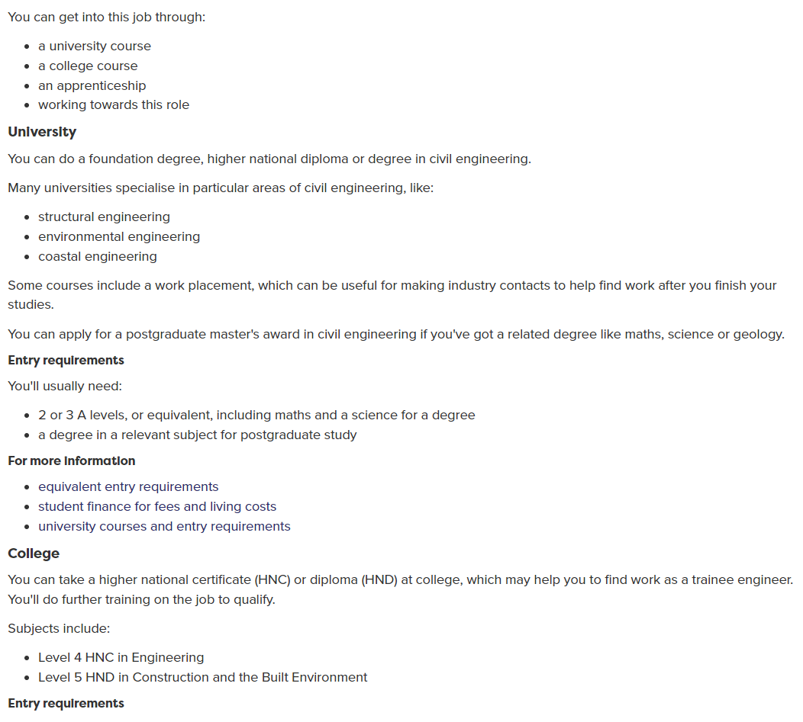
Will show routes into the job
Notes:
Every profile has details on the routes in – look to see if there are any college or apprenticeship routes or what degree routes.

Slide 53
Task 1: Make a grid as below– don’t fill it in yet
 | Job I like 1 | Job I like 2
Name of job I am interested in
College course the job profiles says I could do
Apprenticeship I could do
College I looked at
What the college offers linked to my job choice
Apprenticeship I looked for
What vacancies are available (less than 30 miles from home post code)
How keen on a scale of 1 to 10 are you in this course? (not at all interested and 10 really interested)
5 mins
Notes:
Students should do this in the career book or on paper. They should keep this for future reference.

Slide 54
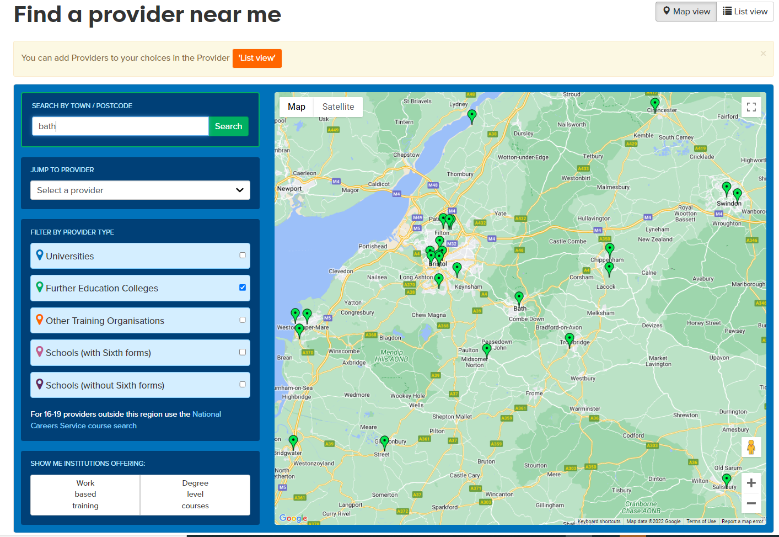
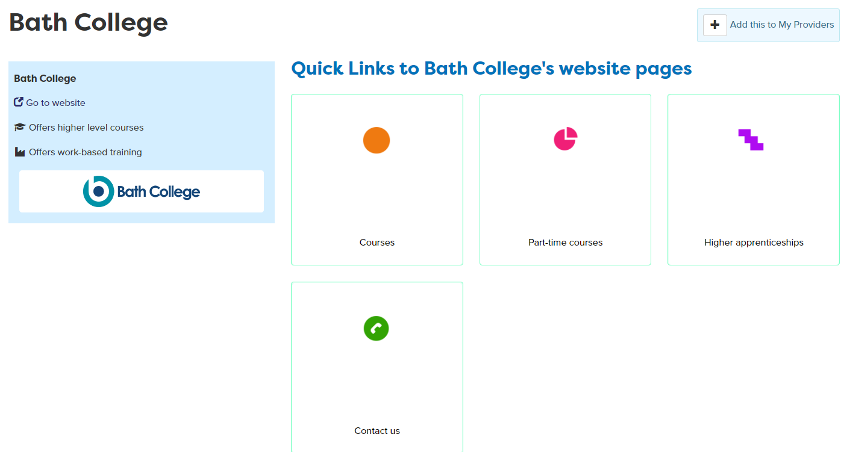
Explore college providers
Notes:
Students should change to ‘list view’ to see names of colleges, can then click to see their page in Careerpilot and click through to the colleges online prospectus.
If they like the college they can add to ‘My Providers’ by clicking ‘+Add this to my providers’

Slide 55
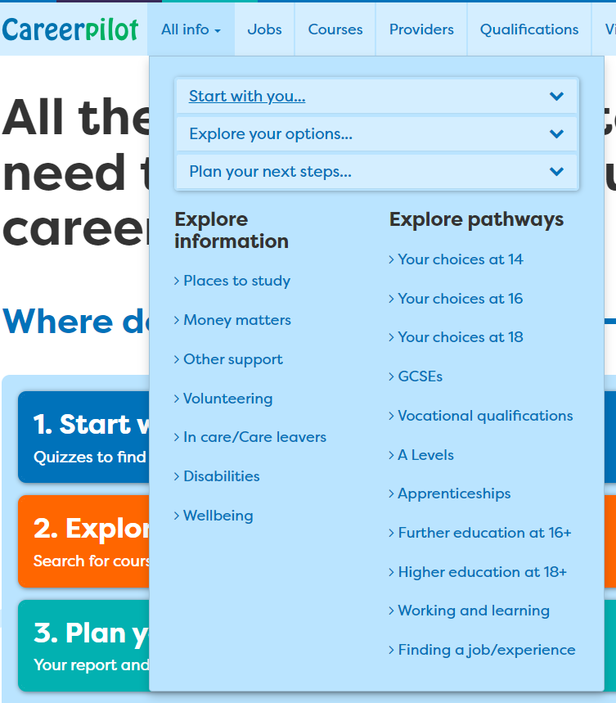
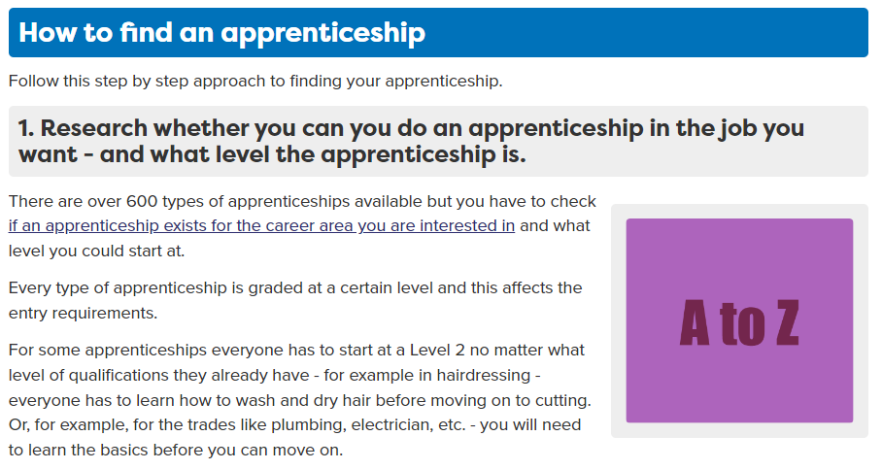
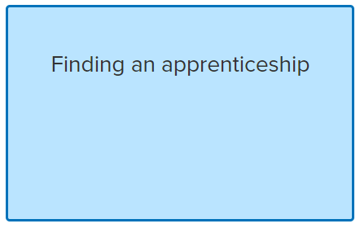
Researching apprenticeships
1.
Does one exist?
Notes:
They could also just search for something they are interested in already. First they need to see that a standard has been written for this job. That will tell them an apprenticeship exists. They still need to see if there are any vacancies.

Slide 56

Searching what’s available on Careerpilot
2.
Search for a vacancy
Notes:
Through the Careerpilot course search they can find apprenticeship vacancies.

Slide 57
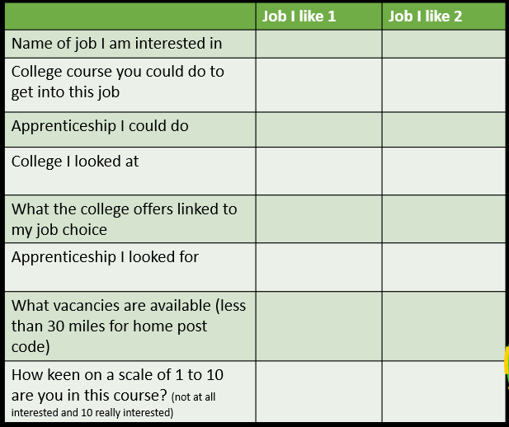
Task : Explore courses and apprenticeships
1. Look at two job profiles and see what college and apprenticeship routes you could take
2. Search local college sites and apprenticeship vacancy sites to see what’s on offer
20
mins
Notes:
Students should try to find one or two college courses for each of their chosen jobs.

Slide 58
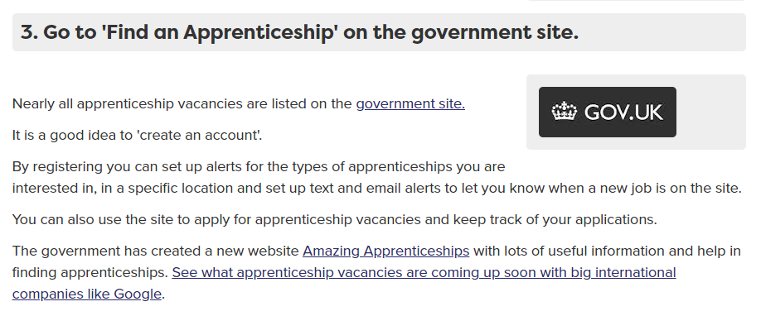
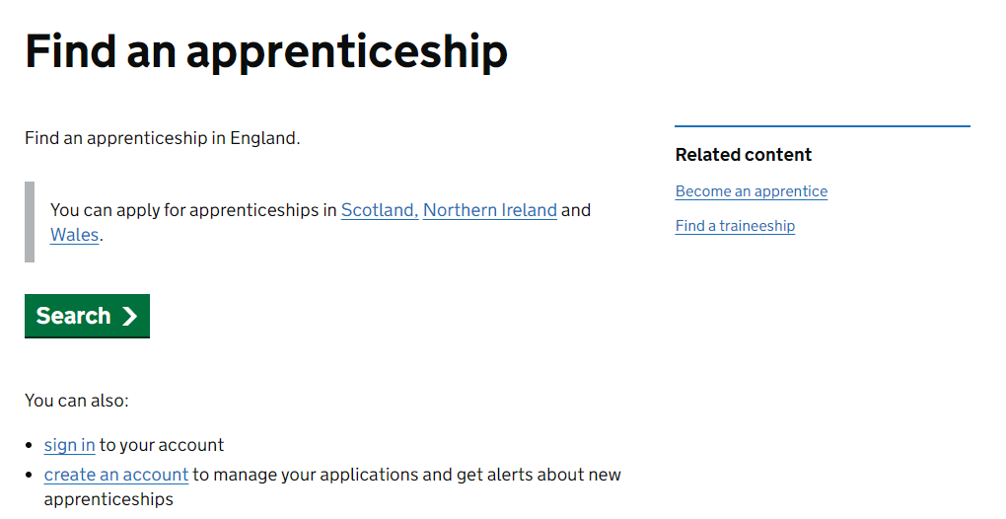

Other places to research apprenticeships
Amazing Apprenticeships
Notes:
There are other good places to search for an apprenticeship – through gov.uk – where they can set up an account and get alerts and through Amazing Apprenticeships where they can see what employers are offering what apprenticeships.

Slide 59
Managing your career
Where am I now?
Where am I trying to get to?
How am I going to get there?
Qualifications I have or hope to have soon
Interests
Skills
Values
Living at home
Sports
Want a job in film
Want to leave home
Want to get a deposit for a flat by the time I am 25
Plan A – Uni
Plan B Apprenticeship in XX
5 mins
Notes:
Update your three stage career planning process. Add Plan A and Plan B.

Slide 60


Share with a partner
Share your grid of the college courses and apprenticeships you looked at with a partner – discuss the routes you could take and why you have come up with your Plan A and B
Take in turns to speak clearly and listen carefully to your partner.
Speak clearly and in a way that is engaging for your audience
Listen carefully while your partner is talking
and ask questions to find out more
10 mins
Notes:
Paired activity
Speaking Step 11 - Speaking engagingly: I communicate in a way that is engaging for my audience
Listening Step 8 – Questioning: I ask open questions to understand more

Slide 61
Getting career-ready – did you?
Started planning your next steps in learning and work
Started to have a clearer understanding of the learning pathways you need to take
Notes:
The Career Development Institute has developed a careers framework that shows the skills everybody needs to have to manage their future career.
This slide shows the students which of the career learning areas (CDI) that this lesson links to.
You can also share the structure of the session with students.

Slide 62

Careerpilot is closing. This resource is only available to use until 23rd October 2026.
Preparing for post 18
Lesson 3: Choosing a course and university
Notes:
In this session students will be drilling down to find out more about how to choose a course at uni

Slide 63
Getting Career-ready
Introduction and warm up activity – 15 mins
You will plan your next step in learning and work
Research task courses : 20 mins
You will be proactive about your life, learning and career
Compare courses and unis: 10 mins
Wrap-up
10 mins
Notes:
The Career Development Institute has developed a careers framework that shows the skills everybody needs to have to manage their future career.
This slide shows the students which of the career learning areas (CDI) that this lesson links to.
You can also share the structure of the session with students.

Slide 64


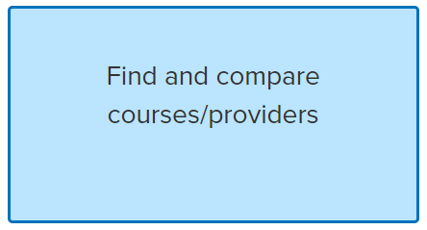
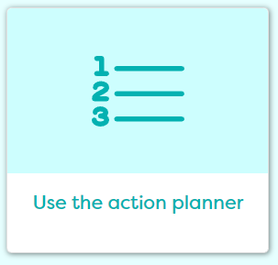
In today’s lesson you will…
Know more about how to choose a university
course
2. Research courses in detail
3. Compare courses and unis
4. Review plans and set actions
careerpilot.org.uk
Notes:
Explain to students what activities they will be doing shortly so they have an overview
The following slides will take them through what they need to do.
Students might choose an apprenticeship at 16 or after A levels, etc. So it is good to know how to find them even if they are thinking of something else at 16.

Slide 65

How to choose a university course
www.careerpilot.org.uk/stories/how-to-choose-the-right-university-course

Slide 66
Mind map – key points
How to choose a course
5 mins
Notes:
As a group pull out the key points from the video of how to choose a course and any others they can think of

Slide 67
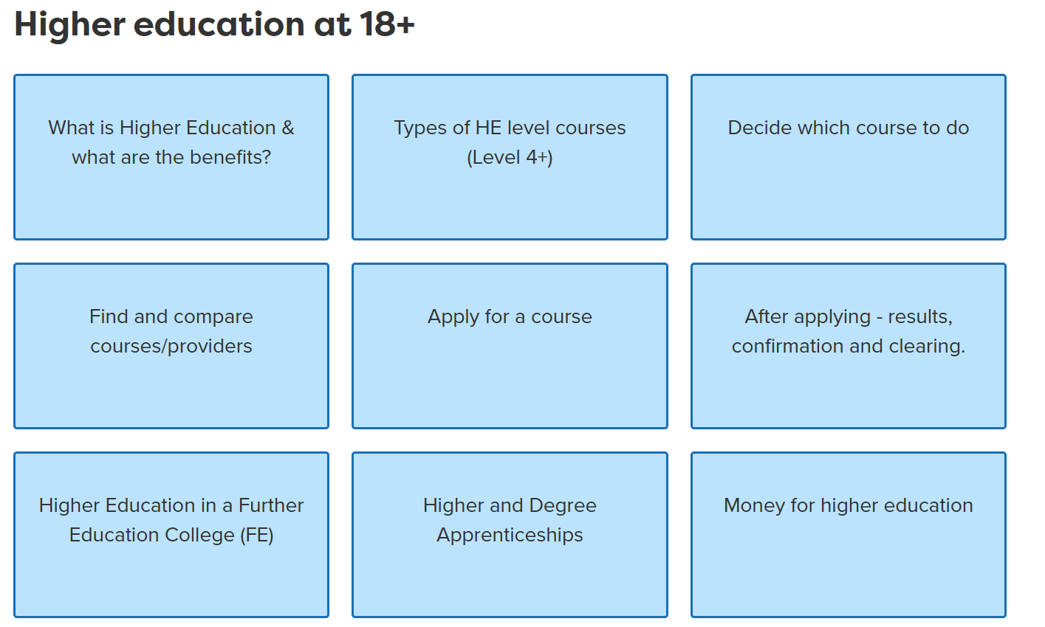
Finding information on Careerpilot
Notes:
Careerpilot has lots of information about HE at 18

Slide 68
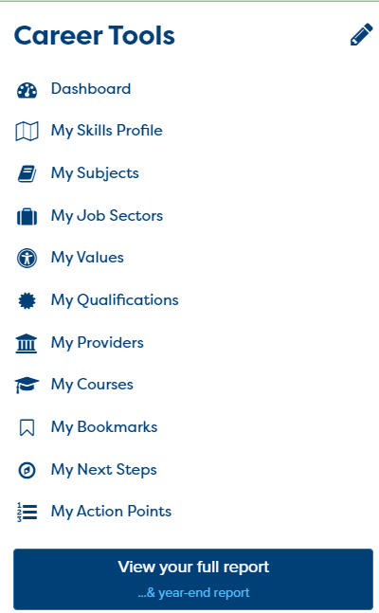
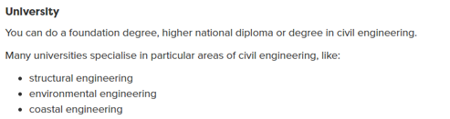
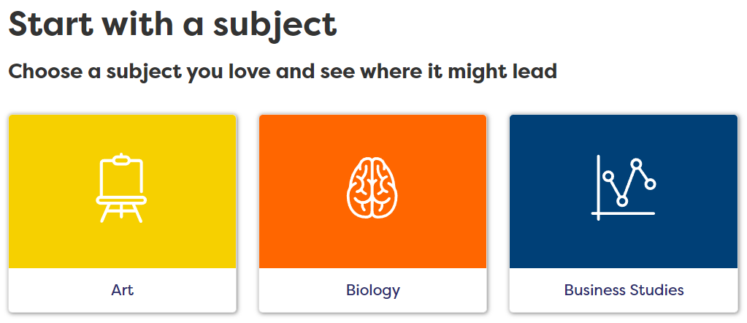

Careerpilot can help you decide what course
Leads to a job I like
10 mins
Develops a subject I love
Will help me get this from life
Notes:
The work they have already been doing using Careerpilot will help them and they can do these activities again.
The job profiles will have the details of routes into this job
The ‘Start with a subject’ tool will help them see where a subject could lead e.g to jobs and some sample degree and apprenticeship courses
The values tool will help them think about where something that is important to them could lead.

Slide 69
Task: What do you want from a course/uni?
Course ideas you already have
What do you want to get from doing a uni course?
Leads to a job I like
Develops a subject I love
Will help me get this from life
Pathways I am most thinking of
Academic – focus on a subject e.g history
Applied – linked to a future job
Combined – covering two or more subjects
10 mins
Other things that are important to me
Industry placement?
Extra curricular?
Location – home or away?
Notes:
Students now create the pink boxes above and write into them what they are currently thinking, it doesn’t matter if they leave some of the spaces blank. They can put a X if not interested in an industry placement, etc. Even if they are thinking about college or an apprenticeship they can still explore uni routes.

Slide 70
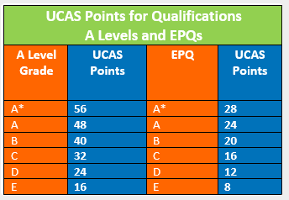
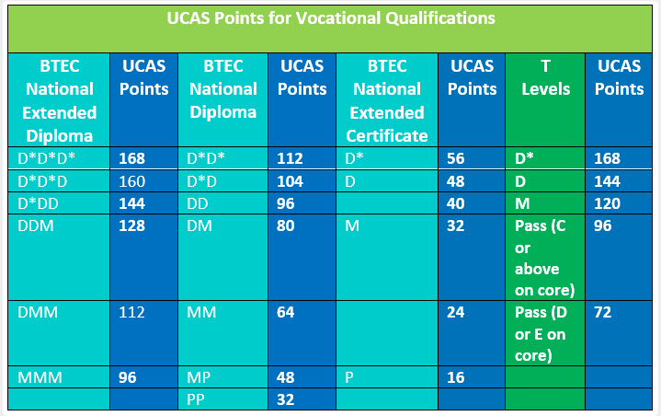
Research the courses
Courses with the same name can be very different at different unis
Look at the modules on offer in different years
Check out specialisms at the university
Know what grades/UCAS points you have to offer
Notes:
Tips when choosing a course – drill down to the details.
Know what you bring in terms of UCAS points/grades.

Slide 71

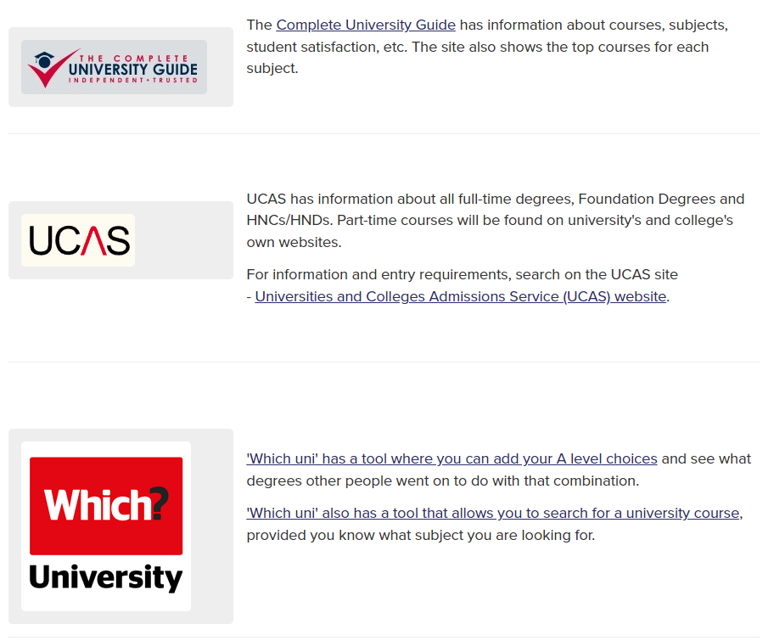


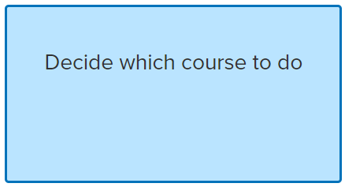
Where to look
Notes:
Where to look on Careerpilot

Slide 72
One place for all your careers information.
Task: Getting into the details
Find a university course you are thinking of at two different unis and see what pathways, courses, modules they offer?
Check out what grades/UCAS tariff points they want.
Check out whether the course/uni offers the other things you are looking for e.g. placements, night life, etc.
Record summarised information and give each a ‘best match for you rating’ from 1-10 (10 best match)
20
mins
Notes:
Research task using Careerpilot and other websites or can go straight to uni’s website

Slide 73
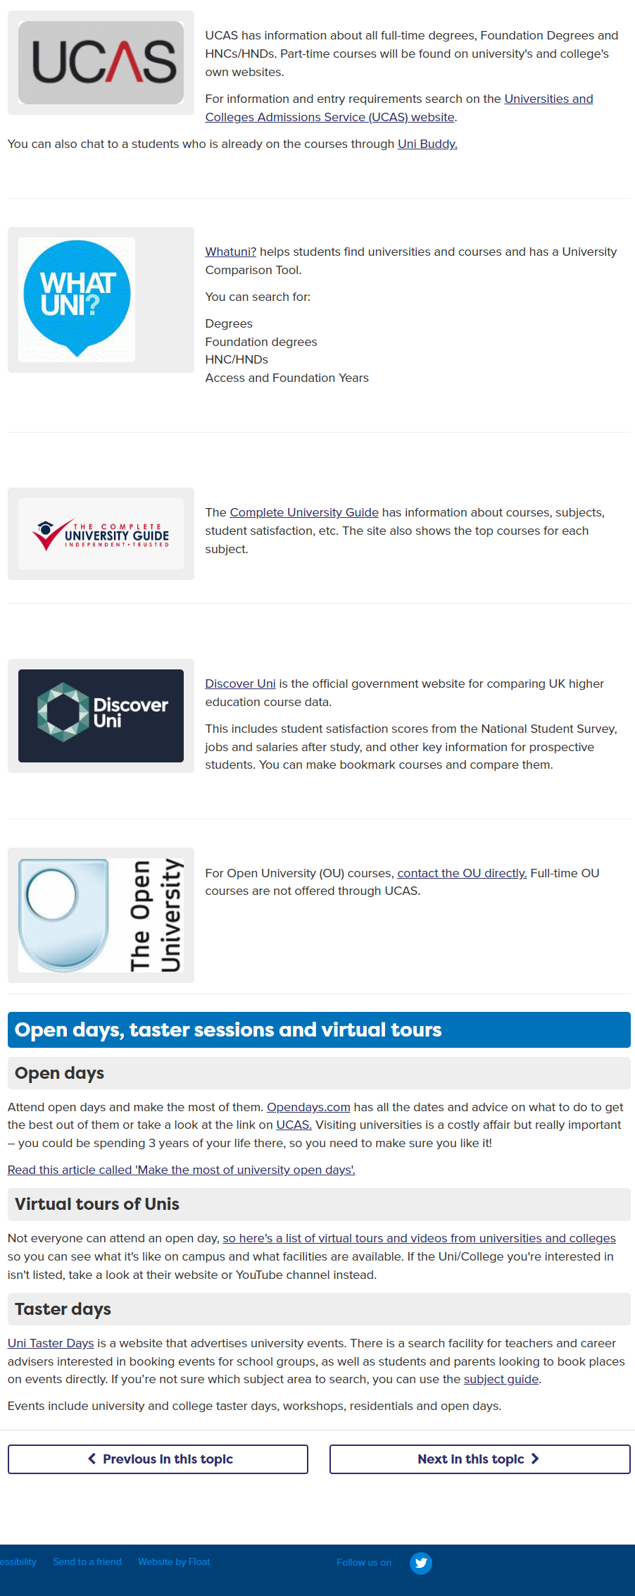
Comparing courses and unis
Notes:
When students know what course they want to do they can start comparing courses and unis to narrow down to the 5 they need to put on their application through UCAS.
There are links to comparison sites on Careerpilot

Slide 74
What’s it really like?
There is no substitute for going to see a place to see if it feels right for you. However, many universities offer virtual open days too.
Notes:
Students should also go and see a uni or watch virtual tours.

Slide 75
Task: Comparing and checking out
Look at league tables and data to compare courses and unis. Summarise the data.
Decide what’s important to you
How easy is it to travel home?
What’s the accommodation like?
Book open days
Is the night life for me?
10 mins
Prepare questions
Notes:
Who is thinking about uni?
Here are a few key things when deciding.
Can start with a job or start with a subject as employers are keen for people with any sort of degree subject.

Slide 76


Task: Updating plans and setting actions
Review and update your plan from lesson 2
Review and update your action points on Careerpilot
10 mins
Notes:
Students should review and update their three stage career plan and also review and add action points to Careerpilot – in Career Tools

Slide 77
Getting Career-ready – did you?
Planned your next step in learning and work
Been proactive about your life, learning and career
Notes:
The Career Development Institute has developed a careers framework that shows the skills everybody needs to have to manage their future career.
This slide shows the students which of the career learning areas (CDI) that this lesson links to.
You can also share the structure of the session with students.

Slide 78

Careerpilot is closing. This resource is only available to use until 23rd October 2026.
Preparing for post 18
Lesson 4: Funding future study and getting ready to apply
Notes:
In this session we will look at funding in summary and ways to apply for any post 16 option and how to do it and also looking ahead to post 18

Slide 79
Getting Career-ready
Introduction
5 mins
You will begin to manage your own money and plan finances
Explore finance:
20 mins
Selling your skills/applying:
30 mins
You will represent yourself through CVs/applications
Wrap-up
5 mins
Notes:
The Career Development Institute has developed a careers framework that shows the skills everybody needs to have to manage their future career.
This slide shows the students which of the career learning areas (CDI) that this lesson links to.
You can also share the structure of the session with students.

Slide 80




In today’s lesson you will…
1. Explore benefits of higher education
2. Explore funding
3. Know your skills
4. Write a CV
careerpilot.org.uk
Notes:
Explain to students what activities they will be doing shortly so they have an overview
The following slides will take them through what they need to do.

Slide 81


Let’s say higher education – not uni!
Higher education is any course from Level 4 upwards
You graduate with a degree at Level 6
Notes:
Higher education happens in all sorts of contexts – not just uni.
You are a graduate with a degree when you reach Level 6
Level 7 is post graduate/masters
Level 7 is doctorate

Slide 82
Is Higher education worth it?
Employment Benefits
Financial Benefits:
Personal Benefits:
Graduates have higher employment rates, with a greater proportion in high-skilled employment.
Graduates will earn on average 20% more over their working life than those who did not go to university.
Learning to live and study independently
Building professional connections

Slide 83
Funding for study – summary (England)
Apprenticeship
Sponsored degree
£7.55 per hour
(but some employers pay more)
Costs paid by employer
Notes:
If you are choose these pathways then you will get paid – but good to check out what you will get and to know your costs.

Slide 84
What do you need funding for?
What do you need to pay for?
5 mins
Notes:
Can either do as group or in pairs – quick list of the things you need to pay for. Can do this if choosing any pathway

Slide 85
What do you need funding for?
Tuition fees for uni
£9,535 per year
Loan from government
Accommodation
Means tested maintenance loan from government
Getting a job
Help from family
Bursaries
Living costs – food, mobile, etc.
Food
Going out
Transport
Mobile
Course materials
Notes:
These are the main costs lines if you are thinking uni.
These are rough costs.
The living costs will be down to your lifestyle.
Here are some ways you can access funding

Slide 86
Funding summary (England)
Highter Education at a College
Higher Education at a University
Tuition fees – paid direct to uni by government – apply to SLC
Vary from £2500 to £6000 per year
Most unis charge £9250 a year
Maintenance loan for living costs from government – paid to you
Depends on what your family earns
How do I pay this back?
Through your tax deductions when you are earning a certain amount
Notes:
Different costs depending on where you study
Who gets the money and where it comes from
How it is paid back

Slide 87


Other Funding and how to find out more
Bursaries from unis
Scholarships
Educational Grants and awards
10 mins
Task: Explore Careerpilot’s Money Matters section and use links to find out more
Notes:
Sources of info about funding.
10 mins to explore either funding for uni or an apprenticeship

Slide 88
Are you ready to apply?
I know what course I want to do
I am ready to apply
I know where I want to do it
I have an idea how I will fund it
10 mins

Slide 89
How to apply?
Apprenticeship
HE in College
HE at Uni
Online through vacancy site
Often through UCAS
Through UCAS
Might want CV
Could be direct to college
Complete online application
Might need to write covering letter
Could be online application
Complete personal statement
Notes:
Applying is different depending on what you are thinking of doing
In 2026 there will be no personal statement but instead a set of questions to answer.

Slide 90
Knowing what skills you have to offer
Do the post 16 version
Notes:
Whatever you are applying for you need to know what you have to offer – your skills.
Complete the post 16 Skills Profile

Slide 91

Knowing what skills you have to offer
Notes:
Add two examples of things you have done that have enabled you to use your skills (things not in the quiz).
Click on ‘Use my skills to apply’

Slide 92


Matching your skills to courses/training
Task:
Complete post 16 Skills Profile (Career Tools)
Add two of your own examples to your Skills Profile
Go to ‘Use my skills to apply’ – add what are you applying for/ choose what skills would be most useful?
Write your evidence relating it to what you are applying for
15 mins
Notes:
Task as above

Slide 93

Writing a CV - What should you include?
Notes:
CV useful to have for jobs, applications, even if not needed for uni.
What should be included in CV (this is also often required in applications.)

Slide 94



Building your CV
Finding a job/experience
CV
There are others too
Say ‘Pending’
20 mins
Notes:
Students should be directed to which template they should use. The Word download is probably the easiest.
Explain they should say what quals they are doing and add’ pending’ for their post 16 quals if they haven’t got results yet.

Slide 95

Provide feedback to a partner
In pairs look at each other’s draft CVs and help each other improve or give constructive feedback.
You may ask questions to understand more.
You may use facts and examples to support support your feedback.
5 mins
Notes:
Ask students to now take it in turns to show and tell a partner about the job sectors they have saved, including about any jobs they viewed that sounded interesting.
Students can compare the salaries of the jobs they found and talk about what aspects of the day to day tasks they think looked interesting and why.
If time, ask students to feed back on their partner’s chosen jobs or job sectors to the whole class.
Students will have opportunity to practice speaking and listening skills:
Listening Step 8 – Questioning: I ask open questions to understand more

Slide 96
Getting Career-ready
You began to manage your own money and plan finances?
You started to represent yourself through CVs/applications?
Notes:
The Career Development Institute has developed a careers framework that shows the skills everybody needs to have to manage their future career.
This slide shows the students which of the career learning areas (CDI) that this lesson links to.
You can also share the structure of the session with students.

Slide 97
Careerpilot is closing. This resource is only available to use until 23rd October 2026.
Preparing for post 18
Lesson 5: Review Career Planning and Reflection

Slide 98
Getting Career-ready
In Pairs
What is a career?
What does LMI stand for and why is it useful?
How and why are jobs changing?
What are the main pathway choices at 18?
What level have you achieved when you have a degree?
10 mins
Notes:
A point for each correct answer
A career is an individual's journey through life, learning and work.
A job is something you might do to earn money as part of your career journey. There are lots of different job sectors you could work in, from finance, to art and design, to working with animals.
LMI stands for labour market information – the more you know about where the jobs are the more likely you are to know where to align yourself for the future
Jobs are changing because of tech, AI, climate change.
The pathway choices at 18 are – apprenticeship, gap year, HE in college, HE in Uni, work
Level 6 is when you get your degree

Slide 99
What you have learnt over the 5 weeks
What I have learnt in the career lessons
10 mins
Notes:
A summary of what they have covered:
The range of post 18 options
About their skills, values, jobs.
About LMI
About alternatives to uni through apprenticeships and college
How to choose a HE course
About money for study
How to start writing a CV.
Could ask what has been most useful?
Do they feel they have a strong plan for their future?

Slide 100
One place for all your careers information.
Review your career plan
Where am I now?
Where am I trying to get to?
How am I going to get there?
Quals I have or hope to have soon
Interests
Skills
Values
Living at home
Sports
Want a job in film
Want to leave home
Want to get a deposit for a flat by the time I am 25
Want to get a job after 6th Form
Decide whether stay at home for uni
Improve my grades
Search for film courses within 10 miles of home
Check out employment after the course
Happenstance
(taking any opportunity that presents itself)
10 mins
Notes:
Review your three stage plan and add any examples of when you have used happenstance (if you have any)

Slide 101
Review your career plan
10 mins
Review your plan with a partner discuss:
How confident are you with your plan?
What do you see at potential barriers to achieving your plan?
What plans have you got to overcome these barriers?
Is your Plan B still a good contingency?
Take in turns to speak clearly and listen carefully to your partner.
Speak clearly and in a way that is engaging for your audience
Listen carefully while your partner is talking
and ask questions to find out more
Notes:
Review your three stage plan and add any examples of when you have used happenstance (if you have any)
Speaking Step 11 - Speaking engagingly: I communicate in a way that is engaging for my audience
Listening Step 8 – Questioning: I ask open questions to understand more

Slide 102
Over the last 5 lessons you have…
seen how your post 18 choices fit with future jobs & your career
actively planned and prioritised for your future
started planning your next steps in learning and work
actively sought out info on the education system and your career
been proactive about your life, learning and career
planned next steps in learning and work
begun to manage your own money and finances
started to represent yourself on CVs and applications
Notes:
Summary of which aspects of the CDI framework students have covered.
Should be proud they have done these things which will take forward their career – clap!

