Slide 1



Post 16 options and Work Experience
Lesson 1: Getting ready for post 16 options
This lesson can be delivered through a video recording
Notes:
This is lesson 1 of a series of 5 lessons – it can be shown as a stand-alone.
It has been recorded by a member of the Careerpilot Team delivering the session with directions for the teacher and students in what to do and timings.
If time is short cut back the main 30 minute activity and/or change the ‘wrap-up’ to a whole group activity.

Slide 2
Recorded video of lesson 1
https://youtu.be/O0ETOqVICn4
Right click to play the video above or copy and paste in a new tab to view:

Slide 3






Getting Career-ready
Introduction and warm up activity – 10 mins
You will consider what learning pathways you could take at 16
Careerpilot Activities 35 mins
You will research the job market and the education system
Wrap-up
5 mins
Notes:
The Career Development Institute has developed a careers framework that shows the skills everybody needs to have to manage their future career.
This slide shows the students which of the career learning areas (CDI) that this lesson links to.
You can also share the structure of the session with students.

Slide 4

What is a career?
A career is an individual's journey through life, learning and work.
It is all about YOU!
Throughout your career you may have many jobs.
Notes:
Ask students if they know what a career means?
Encourage students to explain what is meant by the word career then reveal the answer.
Ask students to share it they have any idea about what sort of job or work they might like to do one day?

Slide 5
Year 10 – the big things for your career
Start thinking about what you will do at the end of Y11
Have a chance to try out work experience
Get the best GCSEs you can
Notes:
Summary of the big career things for Y10

Slide 6
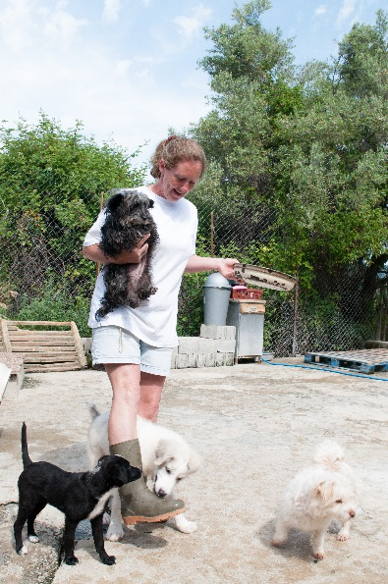









What does the future look like for you?
You could live until over 100 and have lots of different jobs in your lifetime!
Notes:
Lots of jobs are changing or disappearing, an example is libraries, which has changed a lot over the last 10 years or postal services where most people send messages now rather than letters.
Lots of new jobs are coming on board particularly linked to tech or the environment.
Important for young people to keep up with what is happening and how things are changing.
Research shows young people born in 2002, are likely to live to 100 and have 1 different jobs!

Slide 7



Where are the jobs?
Working in pairs, think of:
2 jobs there might be less of now than 10 years ago,
2 jobs that will always be needed into the future,
2 jobs that have been or are beginning to be replaced by technology.
5 mins
This is Labour Market Information (LMI)
Be in the know, to know where to go
Notes:
When they have finished ask for answers to the questions:
Here are a few examples to feed into the discussion:
Decline – carpenters (because things will be cut to size off site by machines),
Always needed – nurses, hairdressers, energy engineers, soldiers (through nature of role changing)
Replaced by tech – interview selection (algorithms used by some to select for interviews depending on answers) , banking (now online so not people at counters), some farming roles (now using drones to look at crops)

Slide 8




Where are future jobs going to be?
Medical, Health Science and Care
IT and Digital Technology
Engineering and Construction
Environmental (Green Jobs)
There will be other sectors growing too
Notes:
With new technology and science developments there will be a growth in jobs needed in many industry sectors including:
Medical and Health – we will continue to need more medical scientists, researchers, doctors, nurses and health care workers
IT and Digital – we will need more data analysts, technology researchers and AI developers
Engineering and construction - we will need more people to design and build the new buildings of the future – architects, electricians, energy engineers
Environmental jobs– we need lot of people to do jobs that help protect our planet like ecologists, foresters and environmental advisers

Slide 9
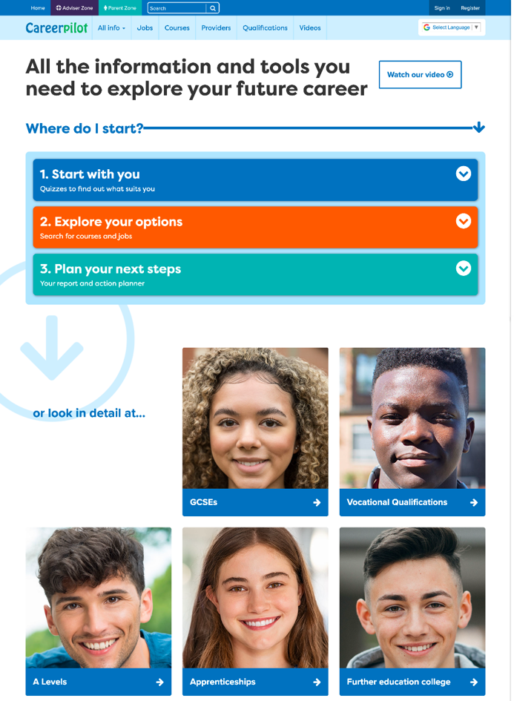
Careerpilot – all you need in one place
Jobs, courses, qualification planner, videos
Quizzes, tools – 3 stages to help you decide
Future qualifications and pathways
careerpilot.org.uk
Notes:
Careerpilot is a website that you can use for free. It has lots of information and tools to help you to start to think about future career ideas and pathways.
The website is built around 3 stages:
Start with you – with quizzes to find out more about what might suit you
Explore your options – where you can search for courses and jobs
Plan your next steps – where you can build a report and plan some actions.

Slide 10
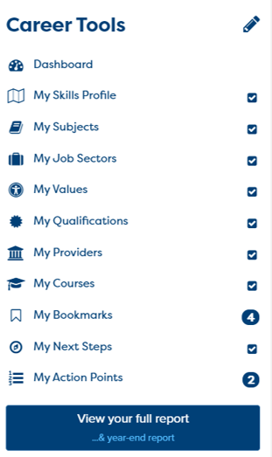

One place for all your careers information.
Build your report in Career Tools
Register/sign in
Build your report
Notes:
You will using Careerpilot to explore all your options, register (or sign in if you have used it before)
Then you can build your report and have a record of all your career choices and plans

Slide 11
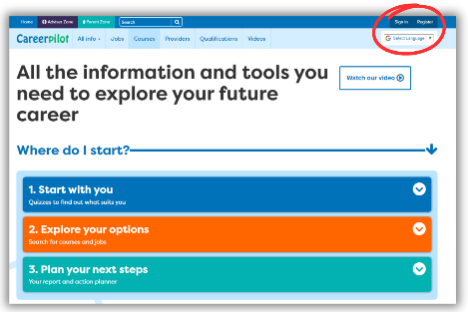
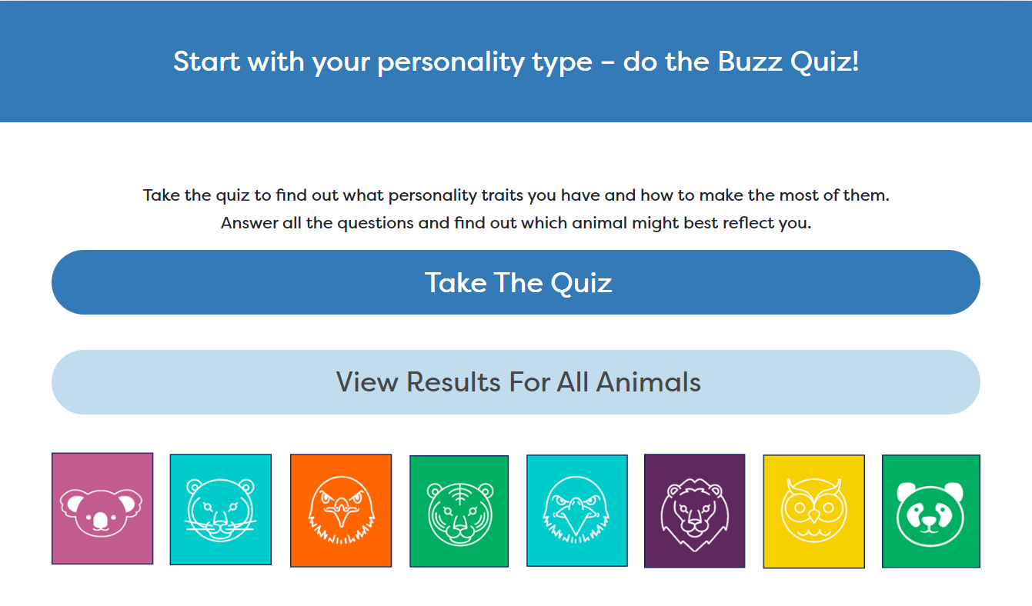

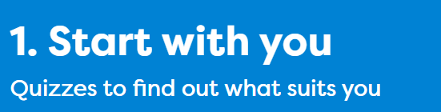
Let’s get going… First you will:
Register/sign in to Careerpilot
2. Complete the Buzz Personality Quiz to discover your personality type. Make a note of your animal.
3. Complete the Job Quiz
Notes:
Explain to students what activities they will be doing shortly on Careerpilot.
Use the following slides to explain how to complete these activities before getting started….

Slide 12
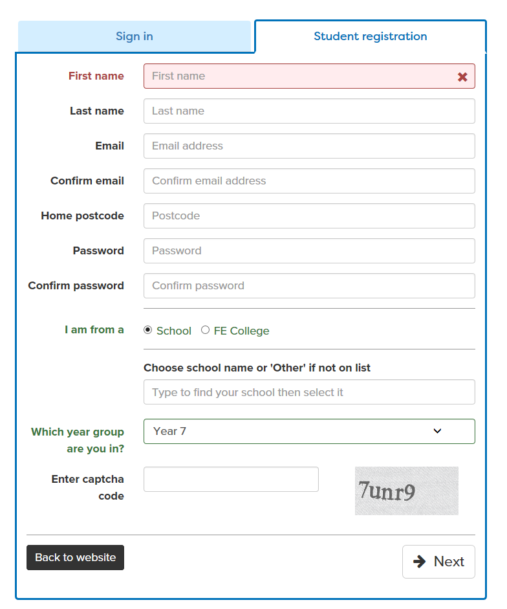
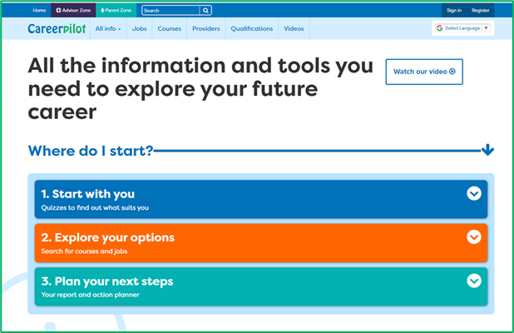
Register or sign in to Careerpilot
If you have registered before – sign in
Notes:
Show students that if they are new to Careerpilot, they need to register to use the website.
They must click on the ‘Register’ button in the top right corner to open up a short registration form that takes a few minutes to complete.
Remind students to use their school email address to register and to click on your school from the drop down list.
Students that have already registered just need to log in with their email and password – or use forgotten password

Slide 13
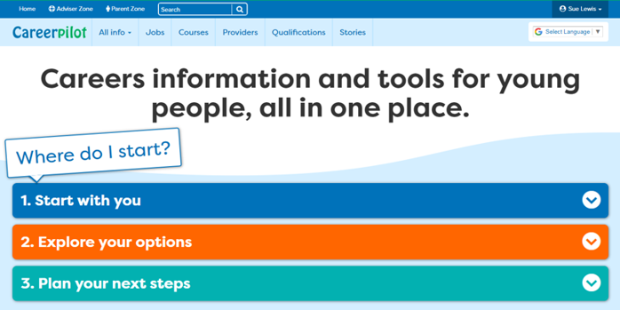
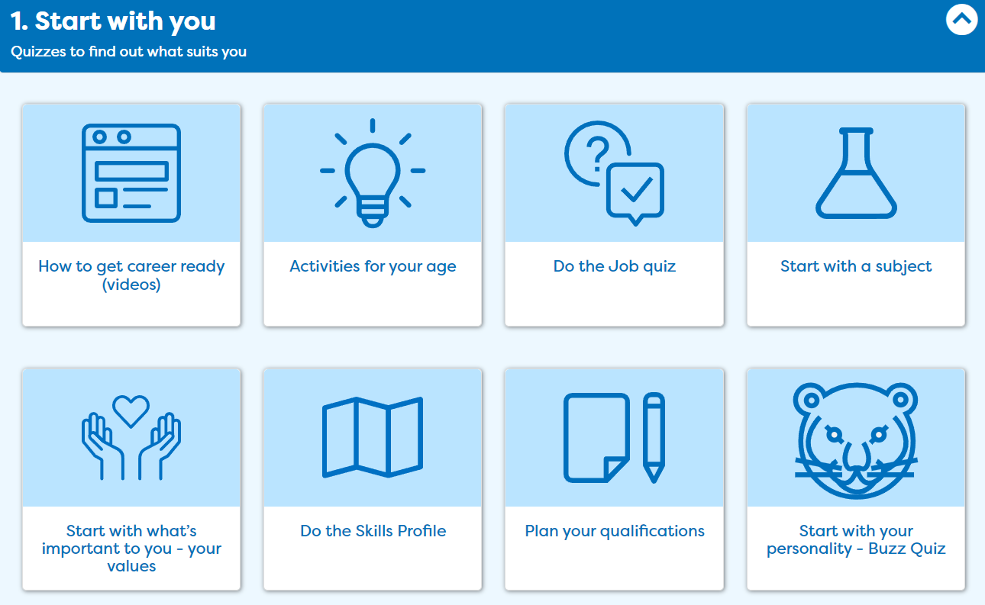
Discover your personality type
Notes:
Once registered students need to go to ‘Start with you’ on the home page and click on ‘Start with your personality – Buzz Quiz’.

Slide 14
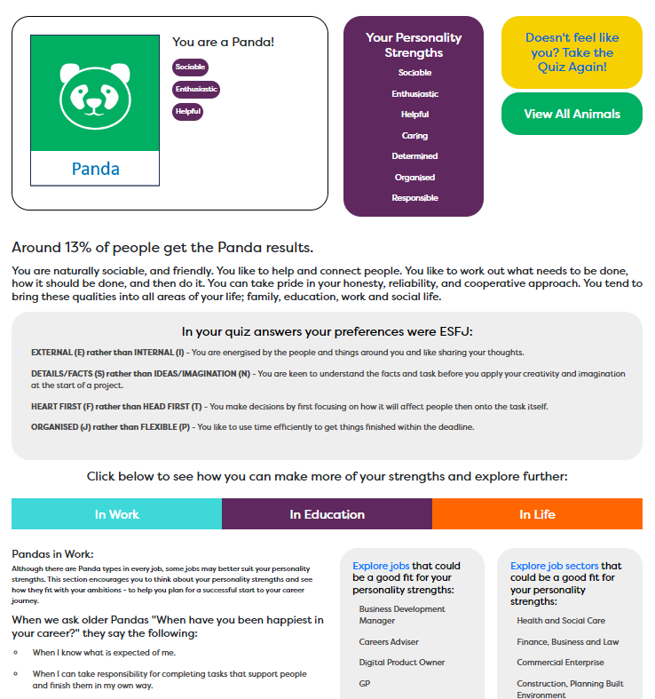
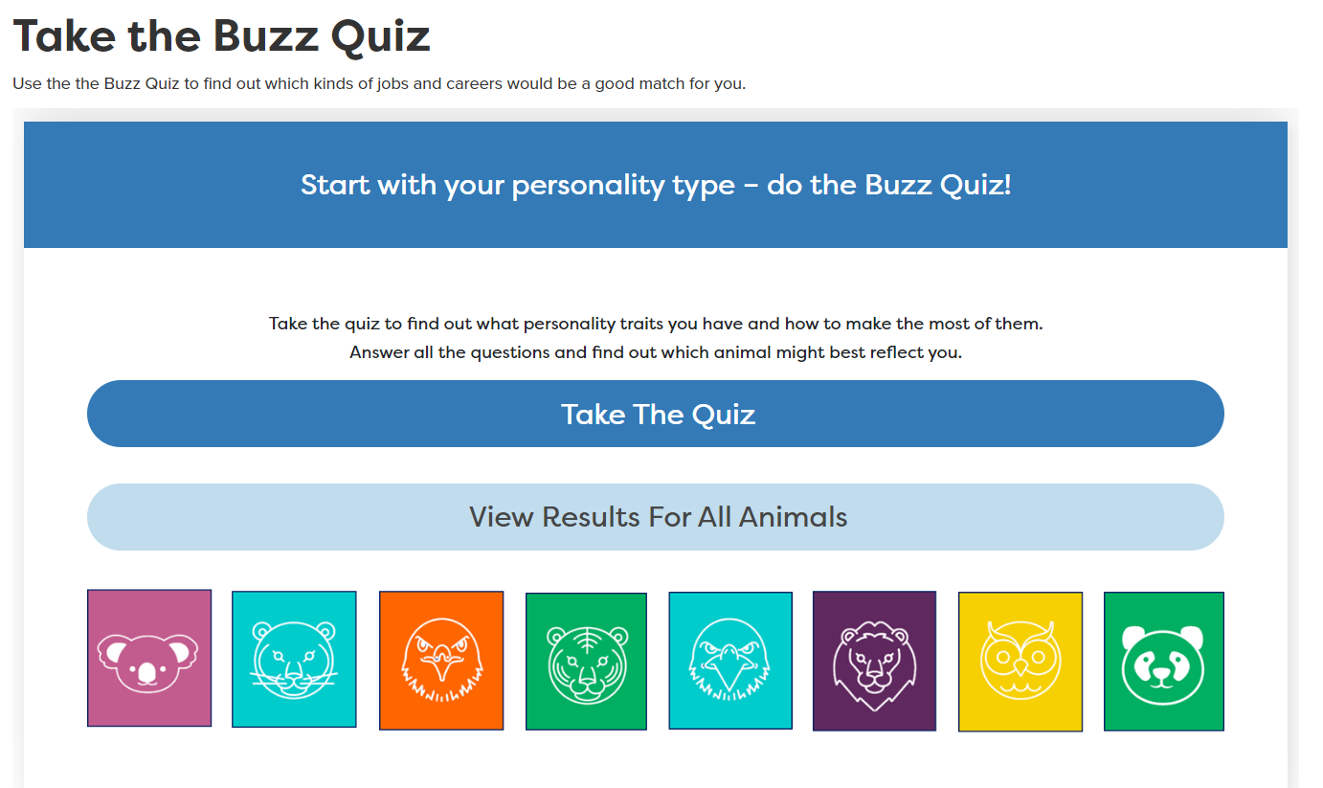
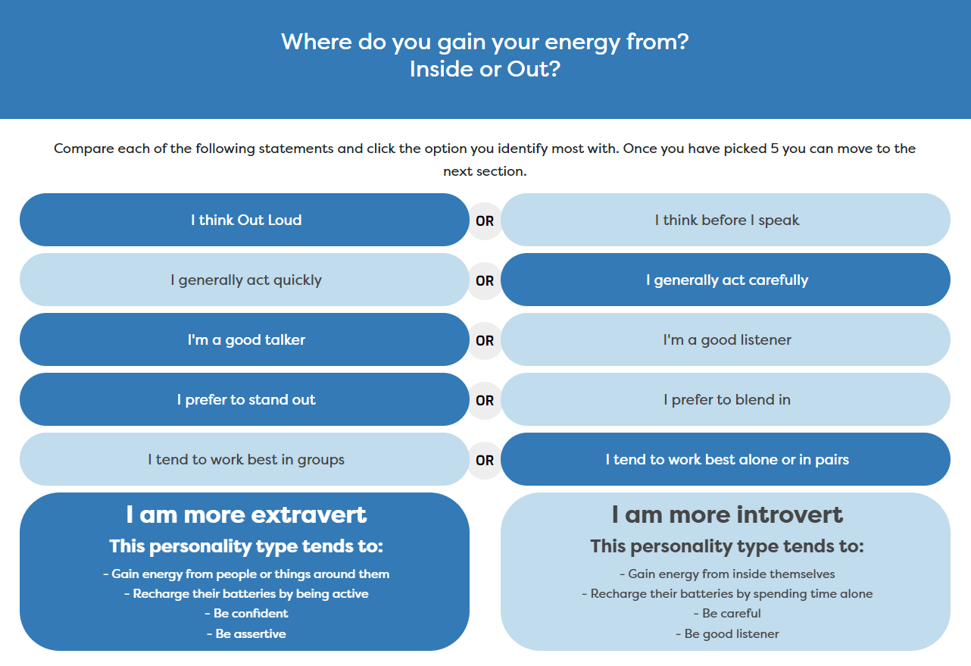
Buzz Personality Quiz
We all have different types of personality traits, do you know what yours are?

Slide 15
Explore future jobs
Notes:
Once registered students need to go to ‘Start with you’ on the home page and click on ‘Start with your personality – Buzz Quiz’.

Slide 16
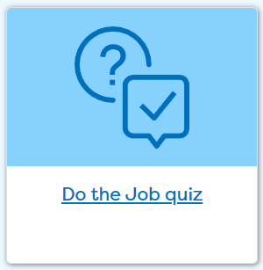
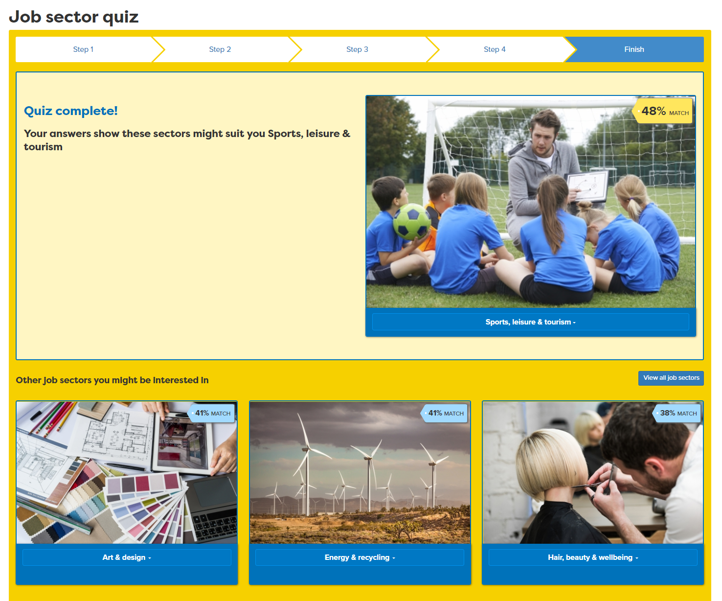
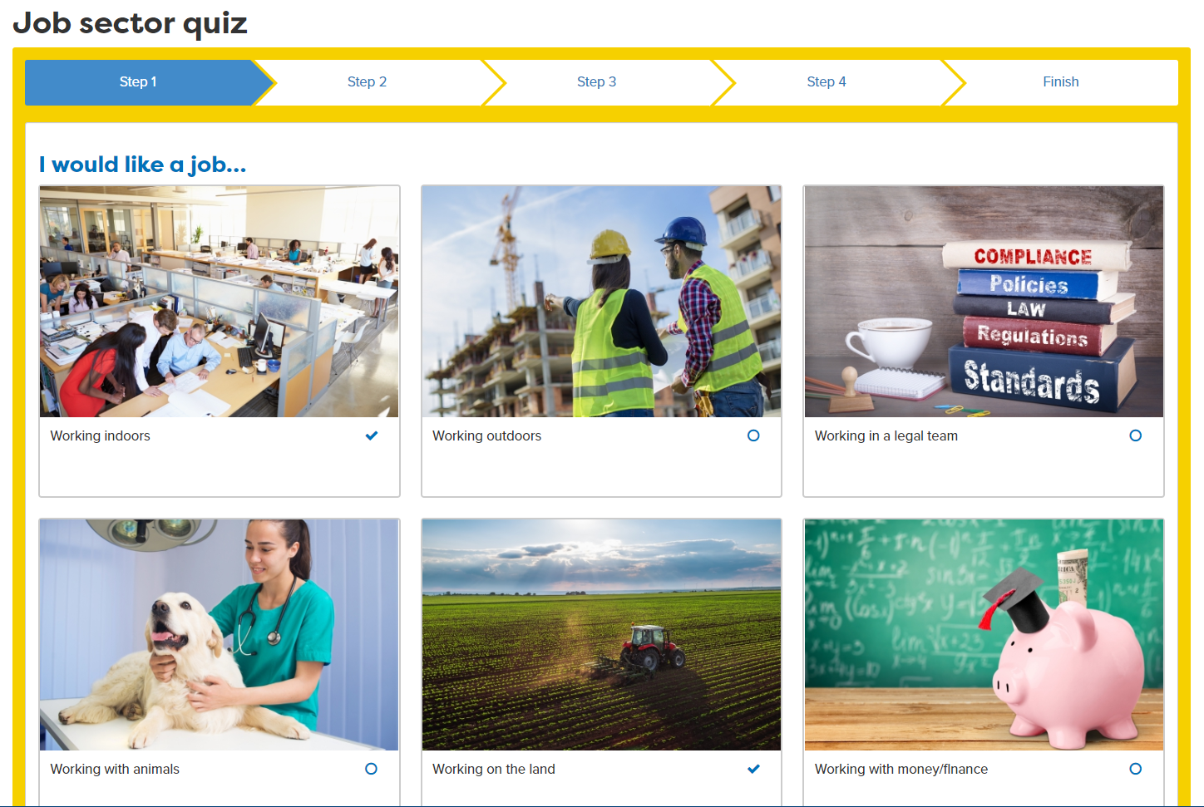
Job Sector Quiz
Notes:
Students can explore some of the job sectors the quiz matches them with and drill down to look at job profiles in those sectors
They can also click on ‘View all job sectors’ to explore other job sectors not in their quiz results.
Knowing what sectors they might like will help when planning a WEX

Slide 17
Let’s get going… First you will:
Register/sign in to Careerpilot
2. Complete the Buzz Personality Quiz to discover your personality type. Make a note of your animal.
3. Complete the Job Quiz
10 mins
Notes:
Explain to students what activities they will be doing shortly on Careerpilot.
Use the following slides to explain how to complete these activities before getting started….

Slide 18
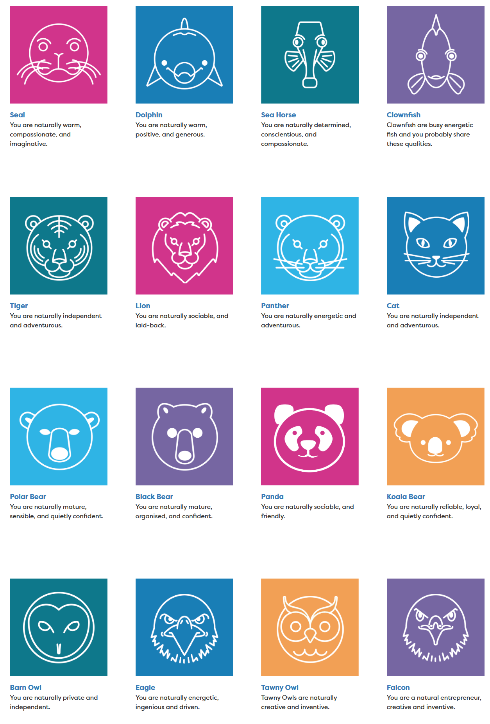

Quick Feedback: Who had this animal, any of these job sectors?
Your community/country/the world needs people of all types and people interested in all job sectors.
Notes:
Just a few minutes of feedback, click to show three animals and ask if anybody had those, click to show 6 job sectors and ask if anybody had one of these recommended to explore.
Click to show speech bubble making point that all types of people with all types of job interests are required.

Slide 19
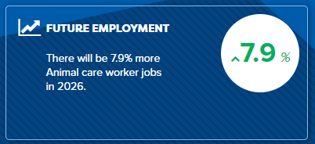

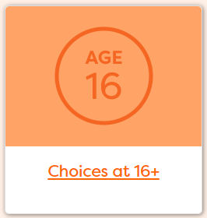
Next task
Use your results. Look at job profiles and see what jobs are growing/declining and the routes into jobs
2. Add jobs you like to My Job Sectors
3. Consider routes at 16
Notes:
Explain to students what activities they will be doing shortly on Careerpilot.
Use the following slides to explain how to complete these activities before getting started….

Slide 20
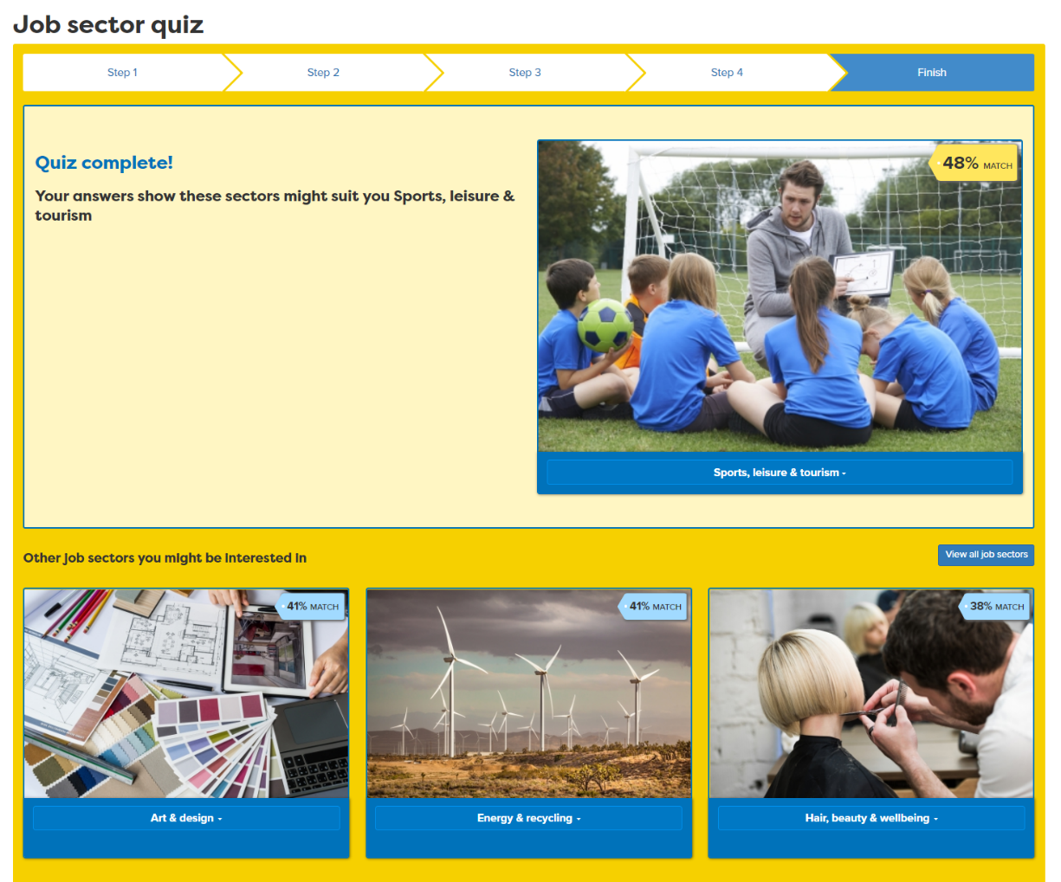
Use your results to start exploring
Notes:
Students use their results to start exploring sectors and jobs

Slide 21
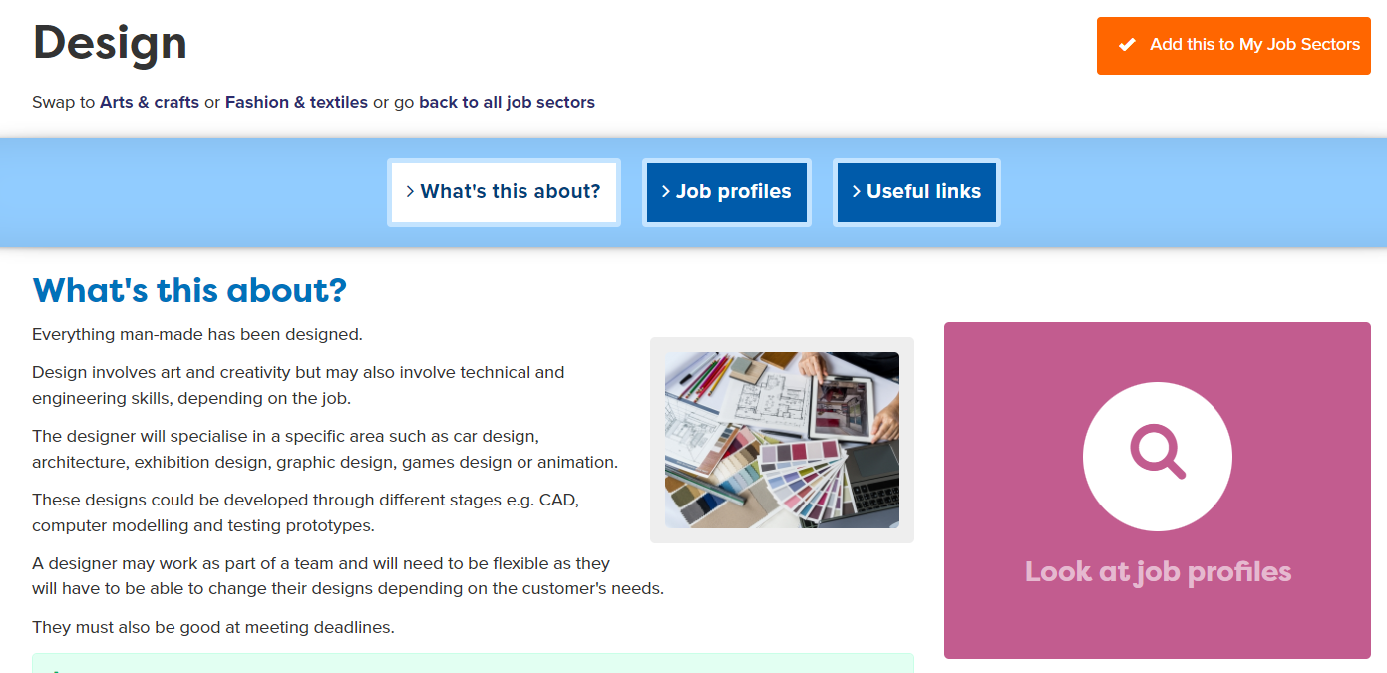
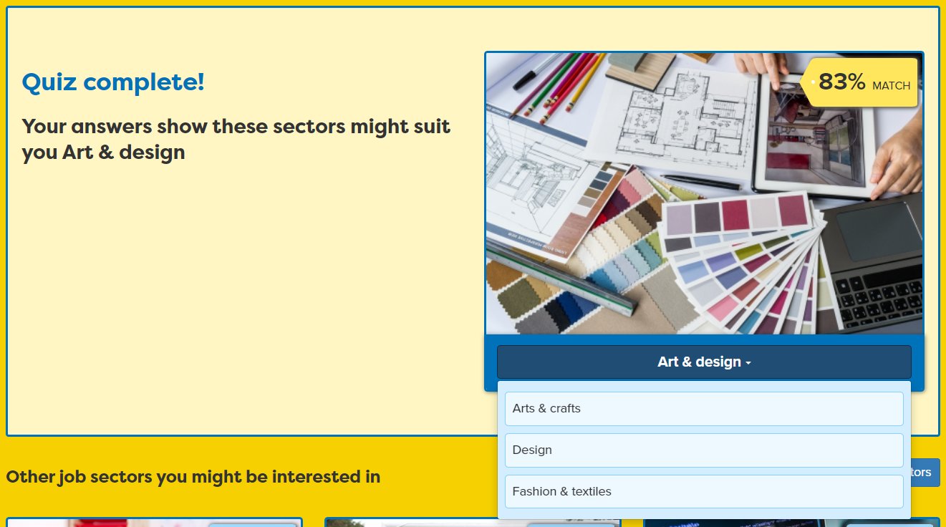
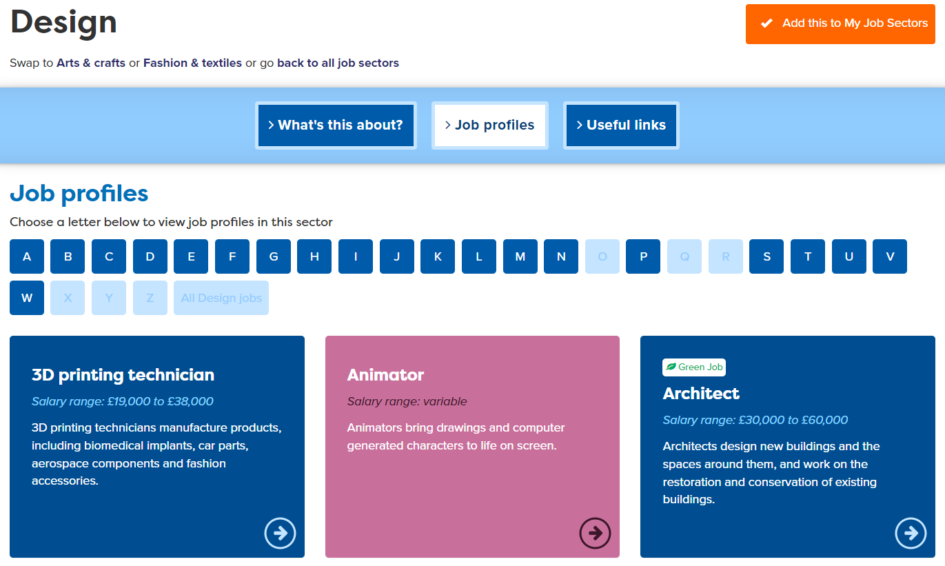
Exploring Jobs
Notes:
You are going to use your Buzz Quiz and Job Quiz results to start exploring jobs and finding out how you get into them. You can see detailed job profiles which will also show you pathways into the jobs. Let’s focus on the pathways choices you will have at the end of Y11 and going forward.

Slide 22
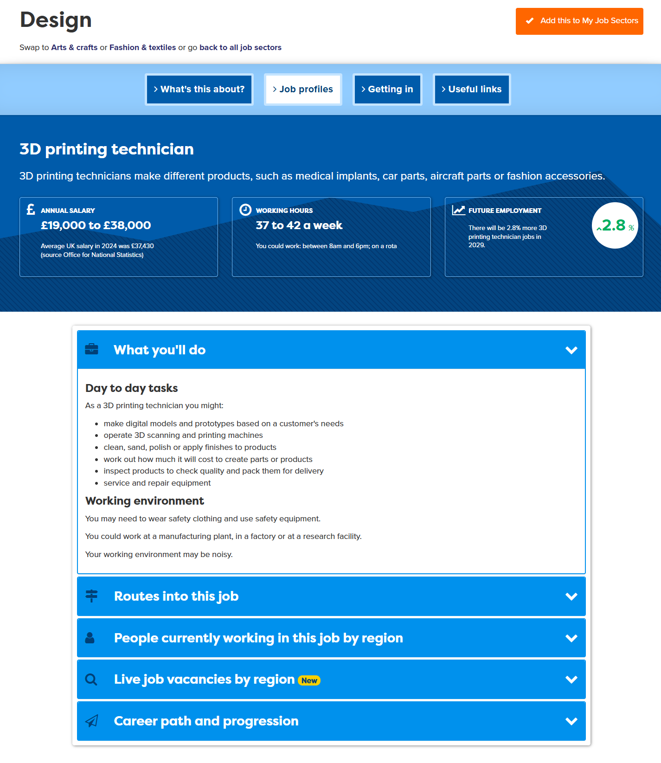
Research the Job
Notes:
When students find jobs of interest, encourage them to tag the job sector to add to their Career Tools.

Slide 23
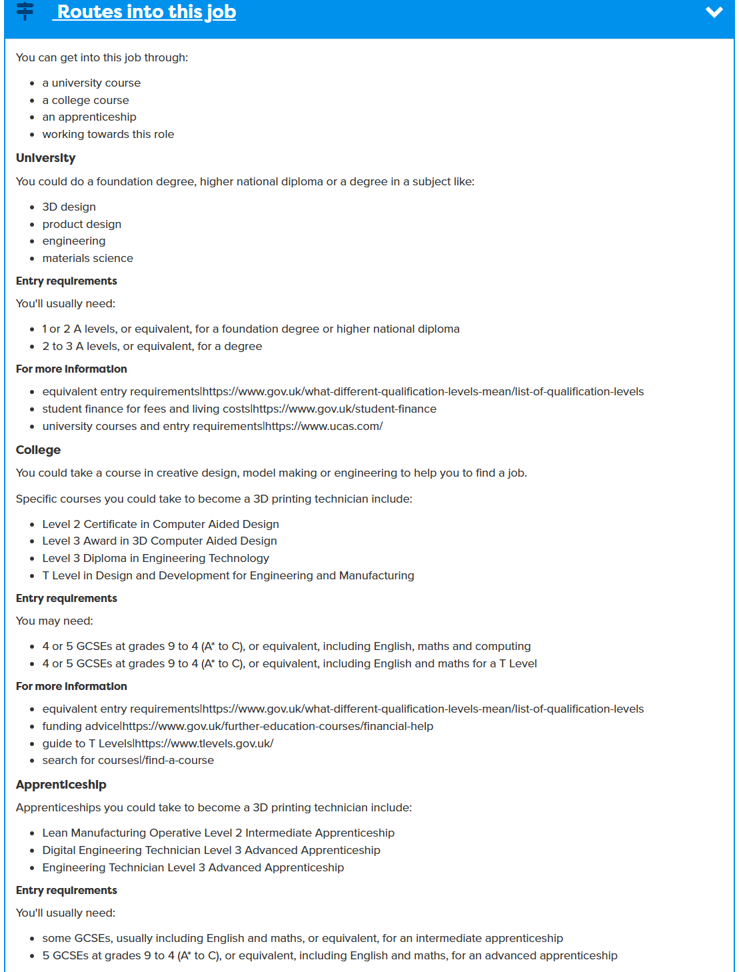
Research the Job
Look at 2 jobs
Notes:
When students find jobs of interest, encourage them to tag the job sector to add to their Career Tools.

Slide 24
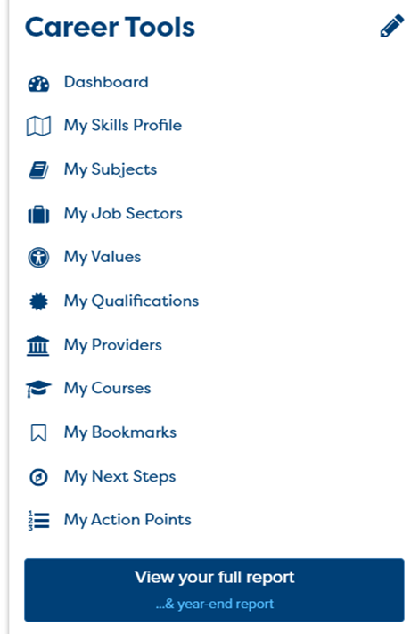
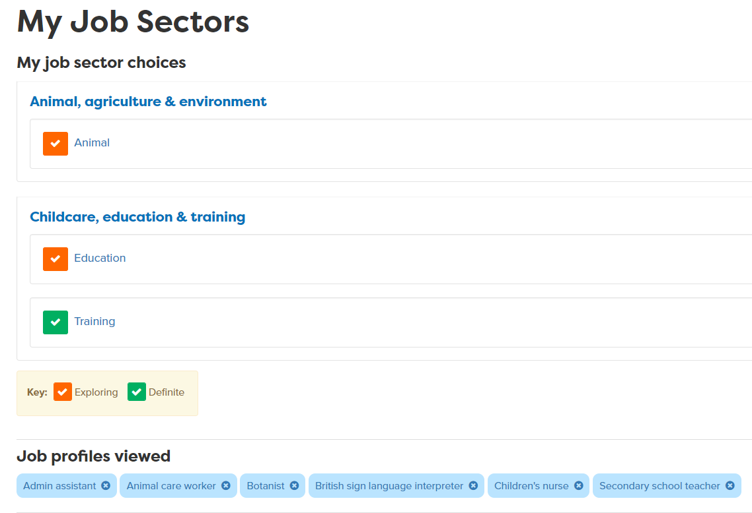
Add what you like to your Career Tools
Notes:
Encourage students to go to their Career Tools via the home page and click on My Job Sectors to see their chosen sectors and the job profiles they have viewed.
Explain this will be saved for them to revisit at a later date and they can add more or change their choices as they go through school.

Slide 25
Explore post 16 pathways
What pathways can I choose at the end of Y11?
Academic
Vocational/Technical
Apprenticeship
Mostly in a 6th Form or 6th Form College
Mostly in a
local college but some also in schools
Mostly in a workplace
Notes:
Ask them to say what pathways they can do at 16.

Slide 26
One place for all your careers information.
What pathway may suit me?
Academic
Technical/Vocational
Work-based
A levels
General
T Levels (L 3)
Apprenticeships
Mostly in school, Sixth Forms and some colleges.
Lots in college some in school
Mostly in colleges, some in schools
Trained in the workplace. Will get paid.
Need to: have enjoyed GCSE subject,
like independent study,
Related to a job area e.g health & social care
Trained to do a named job e.g digital design
Trained to do a specific job e.g carpentry, assistant accountant.
Exam assessment at the end of two years
Course work, some final assessment and work placement
Learning through doing the job, some time learning at a college, some written assessment.
Notes:
Run through the key differences between the different pathways available at 16

Slide 27






One place for all your careers information.
Qualification choices
Academic
Technical/Vocational
Apprenticeship
Degree Achieved
Degree Year 2
HND
Foundation Degree Y2
Higher Apprenticeship
Degree Year 1
HNC
Foundation Degree Y1
Higher Apprenticeship
A levels
T LEVEL other Level 3 - BTEC/OCR
Advanced Apprenticeship
5 x GCSEs 4 - 9
T Level Foundation and other Level 2
Intermediate Apprenticeship
GCSEs 1 - 3
Notes:
Explain that there are three pathways but in all pathways there are levels of quals. Level 2 is getting 5 GCSEs grade 4-1.
Show them the other levels and make the point that all pathways can lead to a degree.
The bit of the qualification ladder we are mainly talking about today is their choices after GCSEs

Slide 28
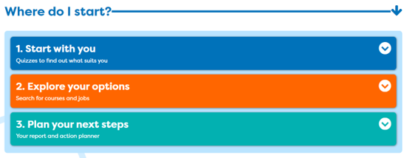
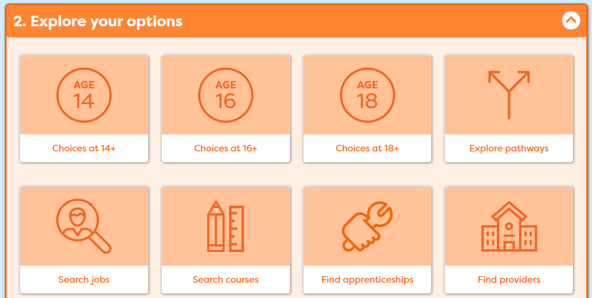
One place for all your careers information.
Explore your post 16 options
Notes:
Now move on to Explore your options and these are the sections that would be good for you to look at.

Slide 29
Next task
Use your results. Look at job profiles and see what jobs are growing/declining and the routes into jobs
2. Add jobs you like to My Job Sectors
3. Consider post 16 pathways
Make a few notes about each of the jobs you look at
15 - 20 mins
Notes:
Explain to students what activities they will be doing shortly on Careerpilot.
Use the following slides to explain how to complete these activities before getting started….

Slide 30



What did you find out?
In pairs discuss which job sectors the quiz matched you to, what animal you came out as.
Tell your partner which jobs you looked at and what routes you could take into them e.g. Can you do an apprenticeship? Do you need a degree?
Listen carefully while your partner speaks and show you are listening by summarising what you heard.
5 mins
Notes:
Ask students to now take it in turns to show and tell a partner about the job sectors they have saved, including about any jobs they viewed that sounded interesting.
Students can compare the salaries of the jobs they found and talk about what aspects of the day to day tasks they think looked interesting and why.
Step 8 Listening - Summarising: I show I am listening by summarising or rephrasing what I have heard
Step 8 Speaking - Using facts: I use facts and examples to support my communication
If time, ask students to feed back on their partner’s chosen jobs or job sectors to the whole class.

Slide 31
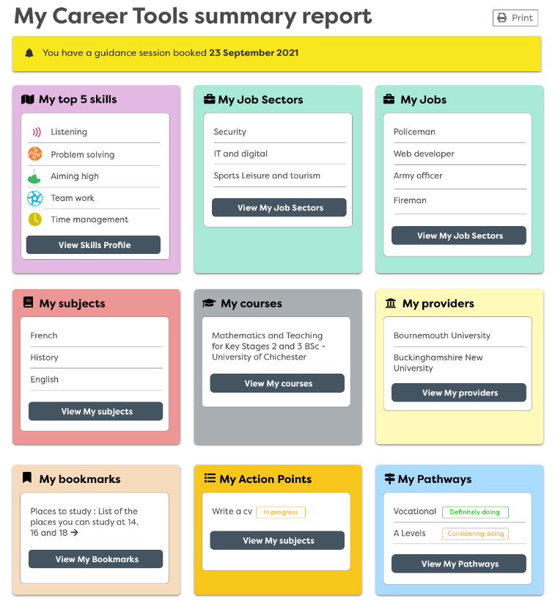
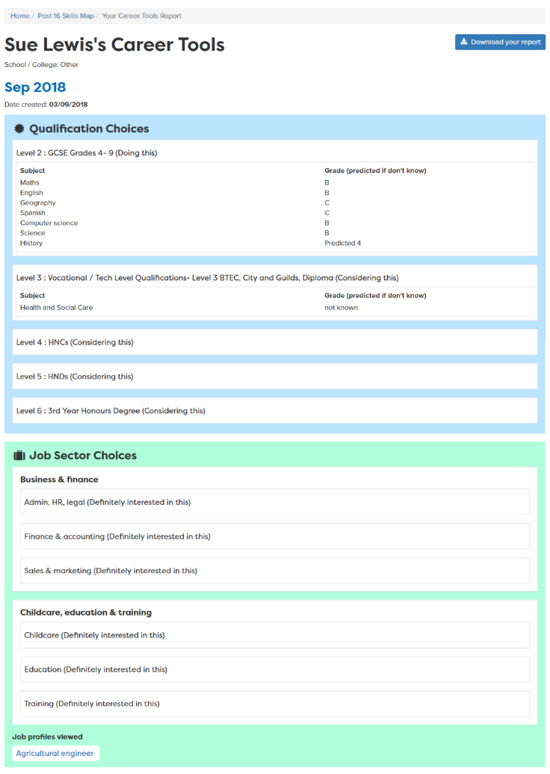
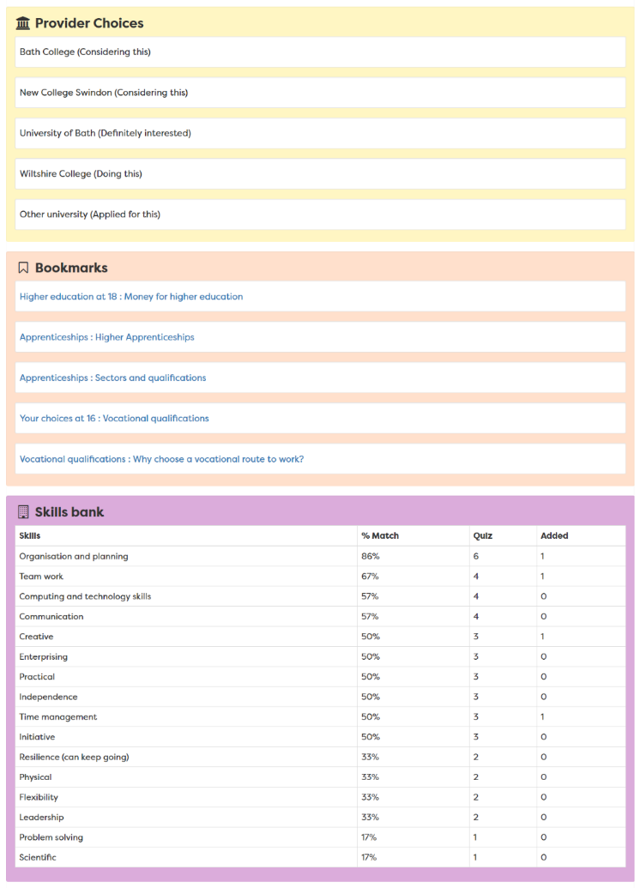
Report moves up each year
Notes:
A slide to show the report that is created once the career tools have been completed – moves up with them each year in school

Slide 32

Getting Career-ready – did you?
Consider what learning pathways you could take at 16?
Research the job market and the education system
Next session: Work experience – why do it, what have you got to offer?
Notes:
The Career Development Institute has developed a careers framework that shows the skills everybody needs to have to manage their future career.
This slide shows the students which of the career learning areas (CDI) that this lesson 1 links to.
You can also share the structure of the session with students.

