Slide 1


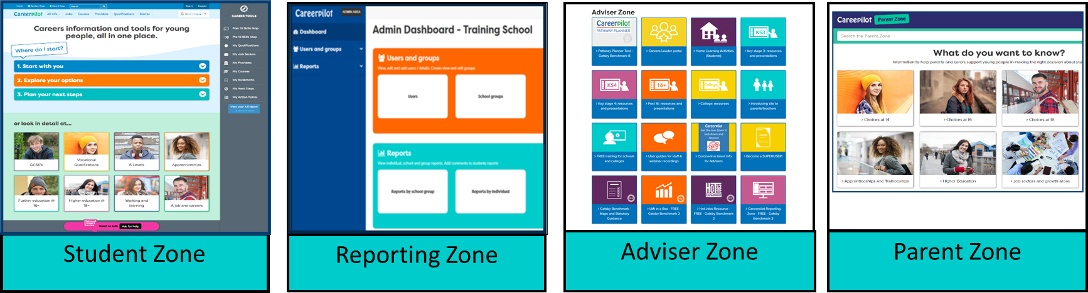


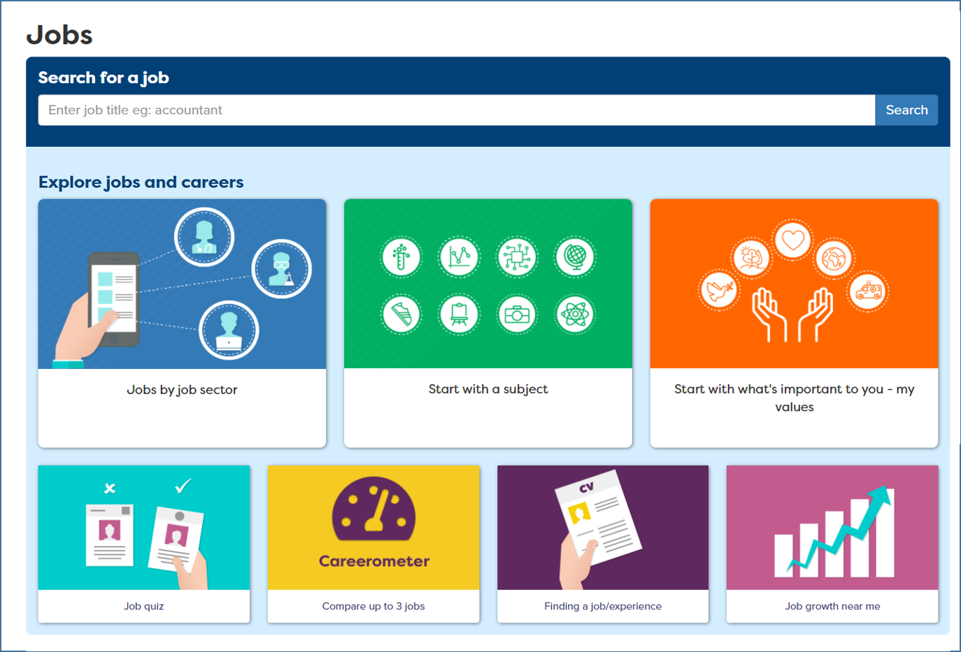
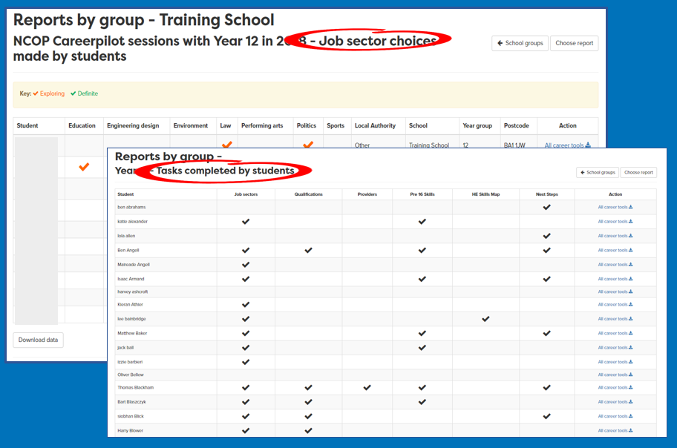


Mapped to Gatsby
Welcome Checklist
Colleges
2023-24
Benchmark | Careerpilot sections that map to Gatsby | How Careerpilot helps schools meet the Gatsby Benchmarks
 |  | The Careerpilot website provides information and advice to college students, written by professional career advisers. The suite of Careerpilot tools can be central to implementing a stable whole college careers programme. The Adviser Zone has lesson plans, videos and resources to help schools plan and deliver a progressive programme of careers education including 5 week programmes for post 16 students. The Careers Leader portal will support Careers Leaders in accessing tools that support them in meeting the Gatsby Benchmarks and in adopting the new CDI Framework. Finally, the Parent Zone helps parents and carers get answers to career-related questions.
 |  | The Careerpilot site includes non-stereotypical videos and information on 19 job sectors - linked to 57 sub sectors and over 800+ job profiles, which include labour market information, nationally and locally. Our job profiles also show where the jobs are regionally. Students can now also search for Green Jobs specifically. The Careerometer Tool enables young people to compare up to three jobs. The Course Search provides up to date LMI about degrees.
 |  | In the Adviser Zone you will find suggested activities to do with each year group. Career Tools enable registered students to manage their own careers and have access to their own records. Students can explore and choose job sectors, qualifications, etc. which create a Career Tools Report. Choices can be viewed by the student and also by school staff through the Reporting Zone. Reports can be used to target employer/FE/HE experiences to meet individual needs. Each year the student’s record is saved and moves with them. The Pathway Planner can be added to your site (small cost). It is an electronic triage system which allows you to assess and prioritise individual student’s guidance needs at three levels. Tools enable all guidance to be recorded and provide a summary report showing your interventions and their impact.
See other maps: How Careerpilot can be mentioned for Compass

Slide 2

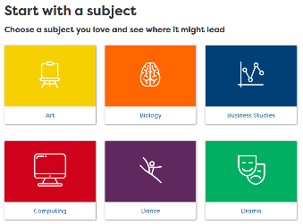

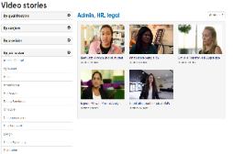

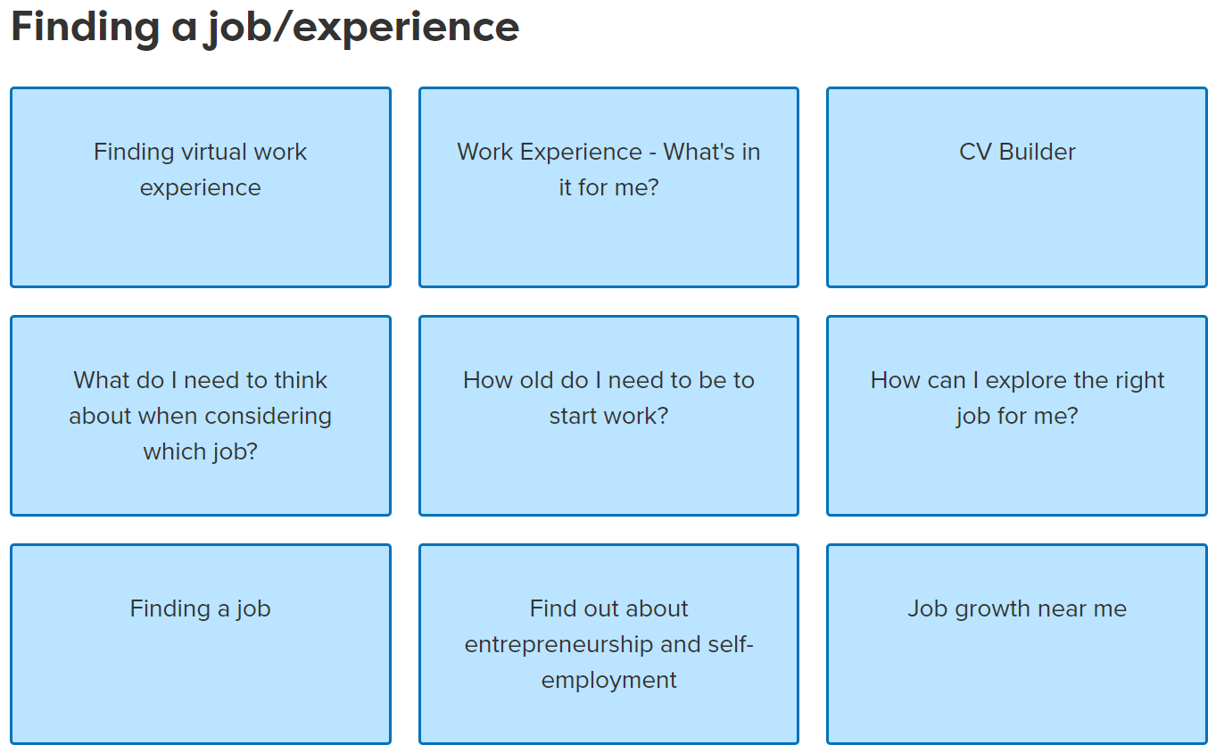


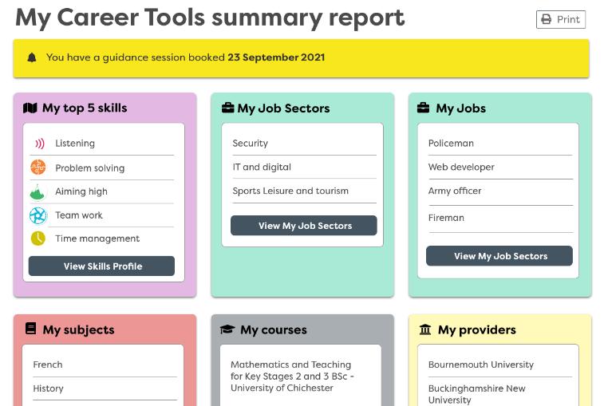

Benchmark | The Careerpilot sections that map to Gatsby | How Careerpilot helps schools meet the Gatsby Benchmarks
 |  | ‘Start with a subject’ shows where a favourite subject could lead, giving sample jobs, apprenticeships, college and degree courses and useful free online courses. The site has information on 19 job sectors, 57 sub-sectors (one is STEM) and over 800+ job profiles, including a number of Green Jobs. There is a bank of over 1000 videos showing routes into a range of jobs, many which are non-stereotypical and which can be searched by subject. This section is great for subject teachers to use in class. We also have 23 KS5 subject specific resources for subject teachers to make the link to careers from their subject teaching.
 |  | The site has over 1000 video stories of people talking about their job roles and routes. The Skills Profile enables students to record WEX, employer and FE/HE encounters and what skills they have learnt from these activities - which are added to their Skills Profile which they can use when applying or writing personal statements. Careers staff can use the Reporting Zone reports to plan encounters to meet students’ needs using information about students’ job sector interests.
 |  | Careerpilot has a section to help students plan their work experience, which includes ideas for virtual WEX. There are 800+ job profiles to help students get detailed information about the role, expected skills, entry requirements and LMI. They can do the Skills Profile as part of planning for WEX so they have a list of their skills they can talk about at interview, and where they can record their WEX experience and the skills they developed through WEX after it has taken place.
 |  | Careerpilot has detailed information about ALL study and training routes at age 16 and 18. A Qualification Planner helps map a route through the levels. Students can use the Course Search to find courses and apprenticeship vacancies and Find a Provider has links to colleges, universities and training providers. The site has lots of videos from FE/HE students talking about their study and links to open days. Our partner universities post free opportunities for students in the South West.
 |  | Careerpilot can help students prepare for guidance interviews if they complete the Career Tools. Guidance advisers can use the report to start the session and record reports and actions at the end of the session. The Adviser Zone includes suggested pre-guidance activities for different key stages related to age, stage and decision point. The Pathway Planner triage model and tool prepares students for their options. Students complete a quiz to assess how ready they are for their chosen pathways. The quiz data can be used by CLs and career advisers to target guidance to meet individual needs at three levels using a RAG rating. You can book appointments, write up guidance sessions, record planned destinations and view a timeline showing how students are progressing towards preparedness for their pathway choices.

