Slide 1


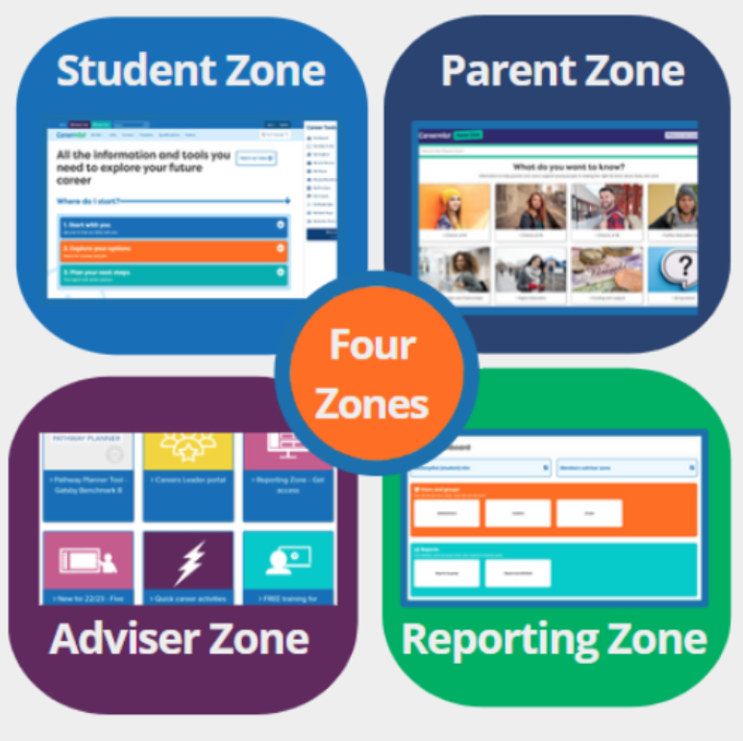

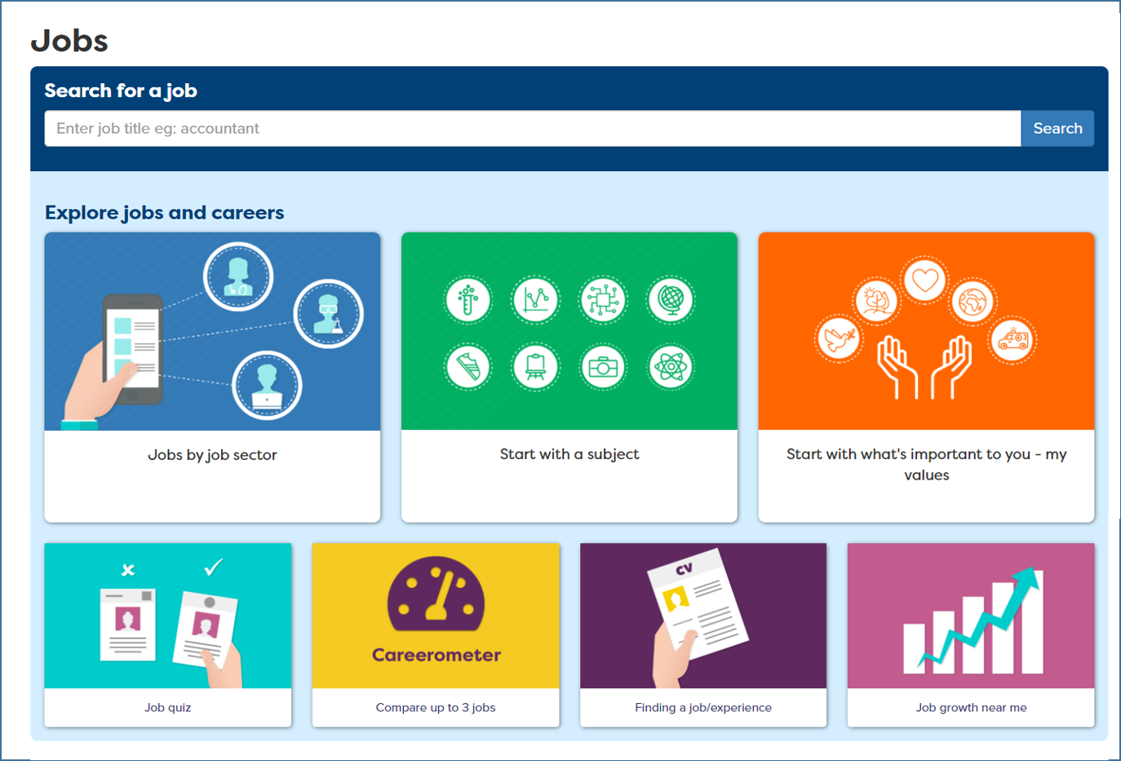

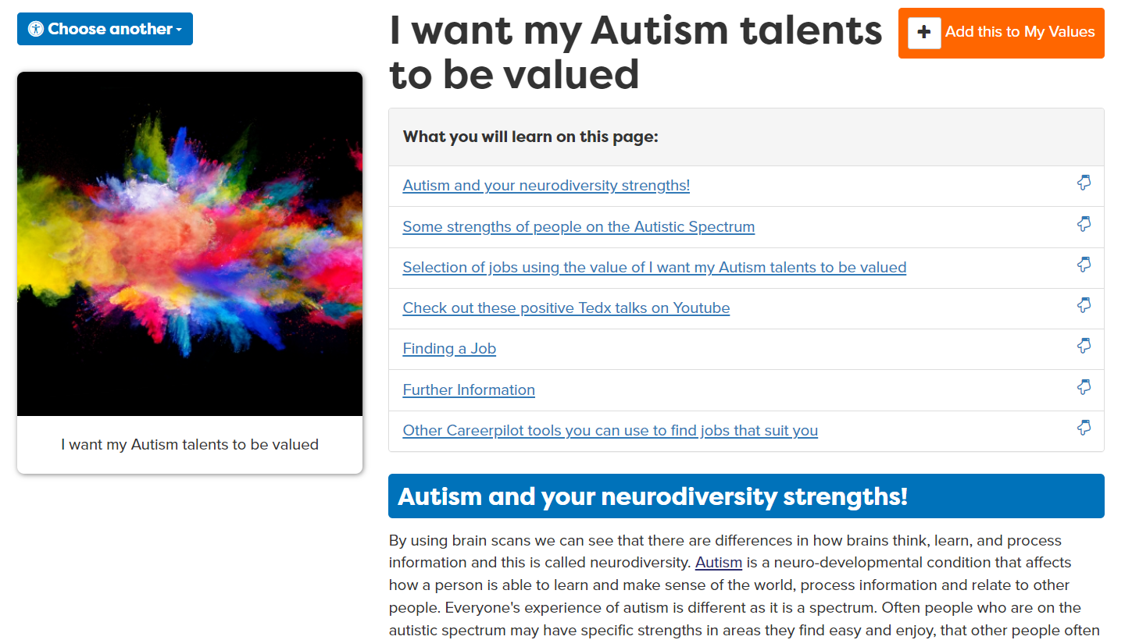
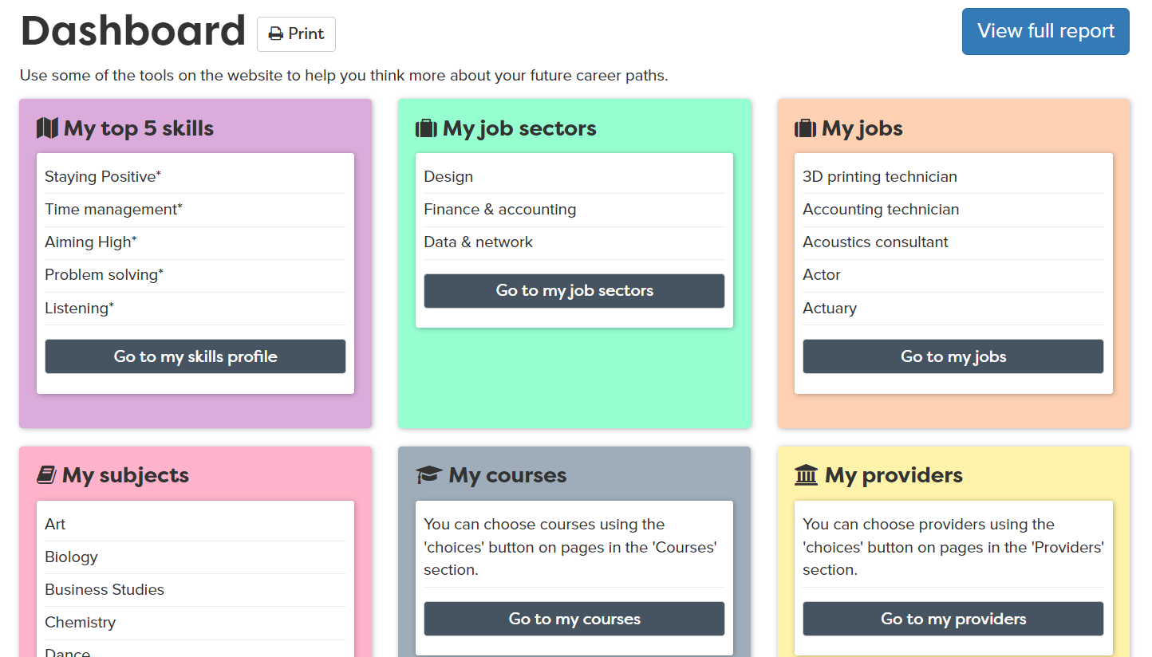

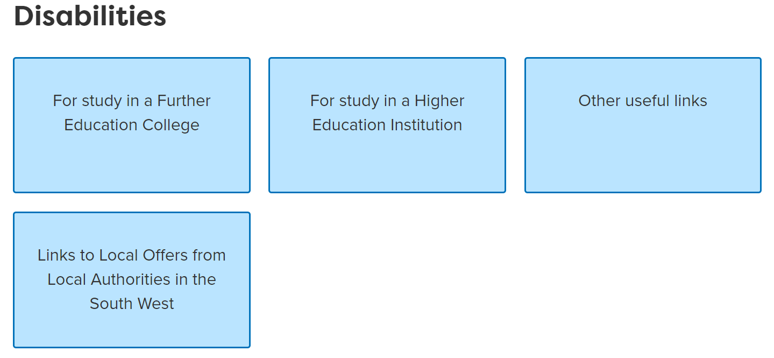
Mapped to Gatsby
Welcome Checklist
SEND – Group 2
2023-24
Benchmark | The Careerpilot sections that maps | How Careerpilot helps schools meet the Gatsby Benchmarks
 |  | The suite of Careerpilot tools can help implement a stable careers programme for SEND students. The Careerpilot website provides information and advice to young people about all the different pathways, written by professional career advisers. The Adviser Zone has lesson plans, videos and resources to help schools plan and deliver a programme of careers education including 5 week careers programmes for every year group and 20 minute activities for tutor time. Some may need to be adapted for the SEND audience. Many Careerpilot resources are presented visually e.g the job quiz, and there are over 1000 videos about jobs and qualifications. The Parent Zone helps parents and carers get answers to career-related questions.
 |  | The Careerpilot site includes non-stereotypical videos and information on 19 job sectors - linked to 57 sub sectors and over 800+ job profiles, which include labour market information, nationally and locally. Our job profiles also show where the jobs are regionally. The Careerometer Tool enables young people to compare up to three jobs. The Course Search provides up to date access to LMI about degrees and apprenticeship vacancies. The ‘Hot Jobs’ in the Adviser Zone, offer sets of posters and images, some with activities, that you can use to show students and parents the jobs that are predicted to grow, with key data. Students can start looking for jobs from different starting points, by completing a job quiz, by their strengths and values, or through a subject they love. The values section has entry points for people with some SEND needs showing job sectors and companies which are looking for their specific talents.
 |  | Career Tools enable registered students to complete a range of activities which will help them learn more about themselves and their choices. Students can explore and choose job sectors, qualifications, etc. and create a Career Tools Report, useful preparation for an EHCP meeting, especially at key points of progression. The site has links to all SEND local offers in the SW and in some of the SE. A section on ‘Disabilities’ provides key information about progression for students with a disability moving to college or uni.

Slide 2
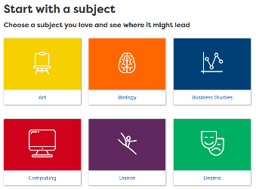


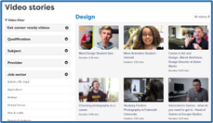


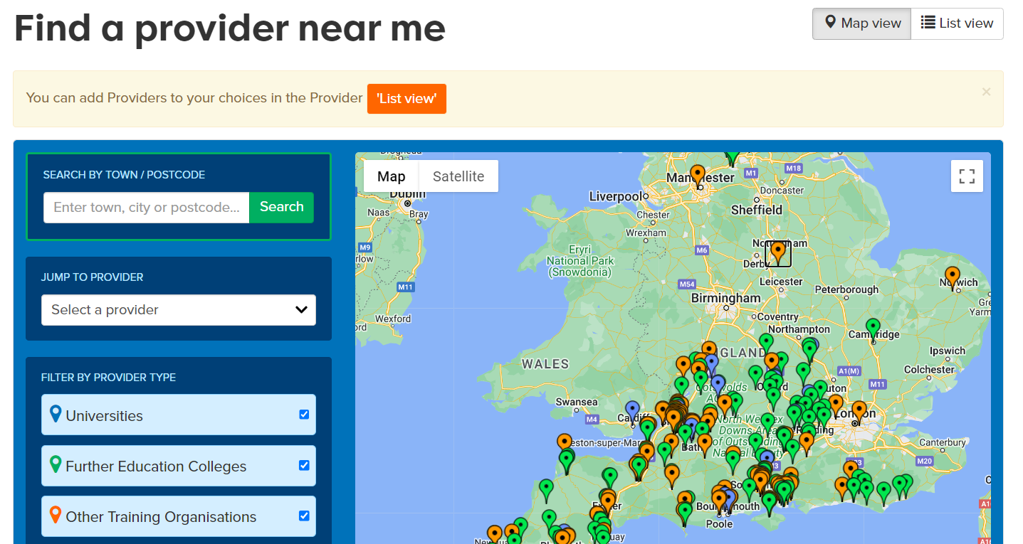

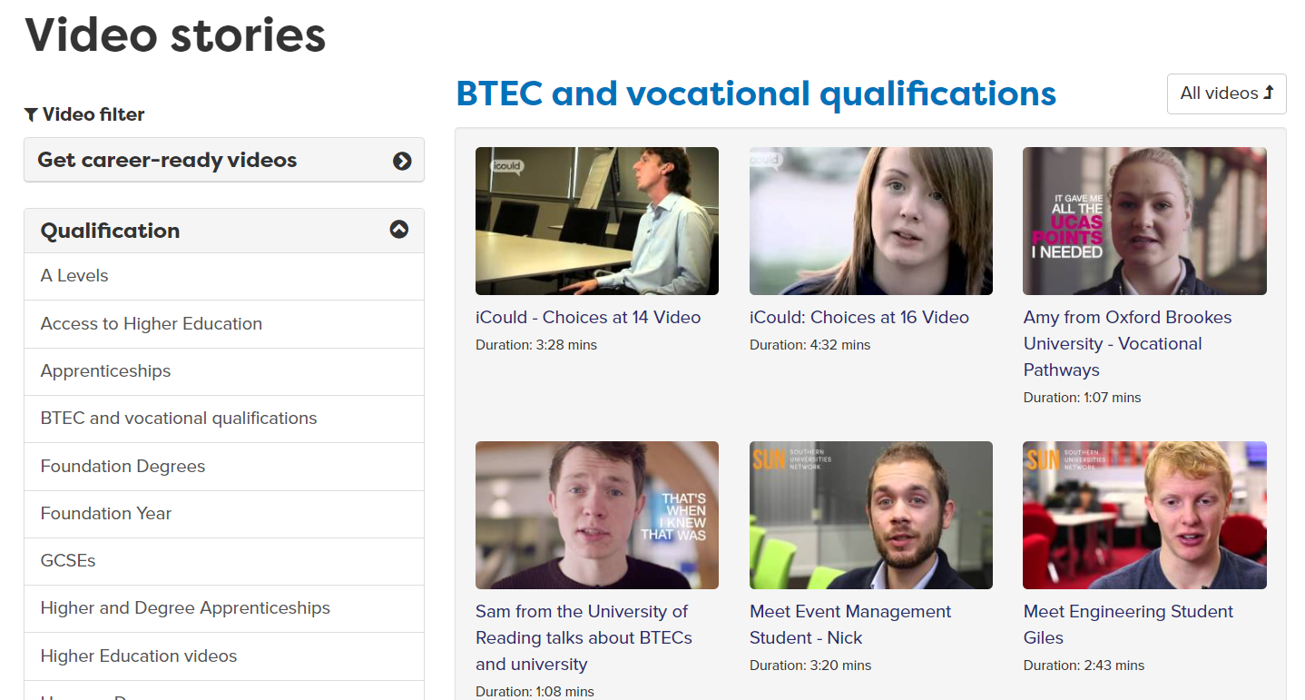
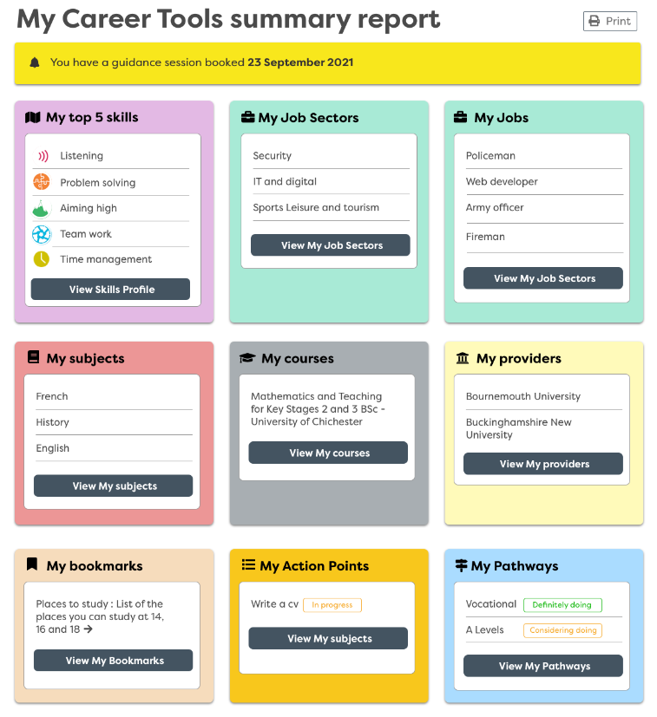


Benchmark | The Careerpilot sections that maps | How Careerpilot helps schools meet the Gatsby Benchmarks
 |  | Careerpilot has a ‘start with a subject’ tool which shows how each of 21 subjects can lead to sample jobs, apprenticeships, college and degree courses and useful free online courses. The site has information on 19 job sectors, 57 sub-sectors and over 800+ job profiles. There are over 1000 video case studies showing routes into a range of jobs, many which are non-stereotypical.
 |  | Careerpilot has over 1000 video stories of people talking about their job roles and routes. The Skills Profile enable students to record any work experience, employer and FE/HE encounters they complete and what skills they have learnt from these activities - which are added to their Skills Profile and they can then use them when applying.
 |  | Careerpilot has a section to help students plan their work experience, there are 800+ job profiles to help students get detailed information about the role, expected skills, entry requirements and LMI. Students can do the Skills Profile as part of planning for work experience so they have a list of their skills they can talk about at interview, and where they can record their work experience and the skills they developed after it has taken place.
 |  | Careerpilot has detailed information about ALL the study and training routes at age 13/14, 16 and 18. A Qualification Planner helps them map their route through the levels. Students can use the Course Search to find courses and apprenticeship vacancies and Find a Provider has links to all schools, colleges, universities and many training providers in the South of England region. The site has lots of videos from FE/HE students talking about their study.
 |  | Careerpilot can help students prepare for guidance interviews and for EHCP meetings if they complete the Career Tools. This will create their personalised career report which they can choose to share with parents and other supporting professionals. Guidance advisers can use the report to learn about the students interests and plans and the adviser can record reports and actions at the end of the session.

