Slide 1

Careerpilot is closing. This resource is only available to use until 23rd October 2026.
Year 7 - Exploring Jobs
Lesson 1:
Introducing Careerpilot
This lesson can be delivered through a video recording – see next slide for link
Notes:
Lesson 1 – Introducing Year 7 to Careerpilot to explore jobs.

Slide 2
Play video lesson or use link
Right click on the image above, or copy and paste the link below to open the video recording in a new tab:
https://youtu.be/LBUZpqQf4-Y
Notes:
Lesson 1 – Introducing Year 7 to Careerpilot to explore jobs.
You can deliver this lesson using the following PowerPoint slides or can use this pre-recorded lesson and pause the video when prompted for students to complete tasks.

Slide 3






Getting Career-ready
Introduction and warm up activity – 10-15 mins
You will understand that a career is a journey and will start looking towards what you might like to do in the future.
Careerpilot Activities 20-30 mins
You will explore different job sectors and start to think about what aspects of a job you might be interested in.
Presentations
10-15 mins
Notes:
The Career Development Institute has developed a careers framework that shows the skills everybody needs to have to manage their future career.
This slide shows the students which of the career learning areas (CDI) that this lesson 1 links to.
You can also share the structure of the session with students.

Slide 4

What is a career?
A career is an individual's journey through life, learning and work.
A job is something you might do to earn money as part of your career journey. There are lots of different job sectors you could work in, from finance, to art and design, to working with animals.
Notes:
Ask students if they know what a career means?
Encourage students to explain what is meant by the word career then reveal the answer.
Ask students to share if they have any idea about what sort of job they might like to do one day?

Slide 5




Exploring jobs
Working in groups or pairs, you have 5 minutes to try to think of a different job for every letter of the alphabet.
Write the job titles down in order...
A – Actor
B – Banker
C – Chef
5 mins
Notes:
Students must work in pairs to write down job titles for each letter of the alphabet.
They have 5 minutes to work together.
When the time is up, work as a class to quickly go through the letters of the alphabet getting students to contribute ideas for each letter.
Use the following slide to help with any letters that are missing.
Students can build their Teamwork skill at Step 4: I work well with others by supporting them if I can do so

Slide 6
Jobs you might have picked….
A - Actor
B - Baker
C - Chef
D - Dancer
E - Electrician
F - Farmer
G - Gardener
H - Hotel Manager
I - Insurance Salesperson
J - Jewellery Designer-Maker
K - Kitchen Fitter
L - Librarian
M - Musician
N - Nurse
O - Optician
P - Paramedic
Q - Quantity Surveyor
R – Recycled Metals Worker
S – Sports Coach
T - Teacher
U – User Researcher
V - Vlogger
W – Web designer
X - X-Ray Technician
Y - Youth Worker
Z - Zookeeper
Notes:
Extension:
Class discussion opportunities around what the job title means, what would people do if they did this job? Does anyone know anyone who does the different jobs listed?
Use Careerpilot to research the jobs further as a class: https://www.careerpilot.org.uk/job-sectors

Slide 7
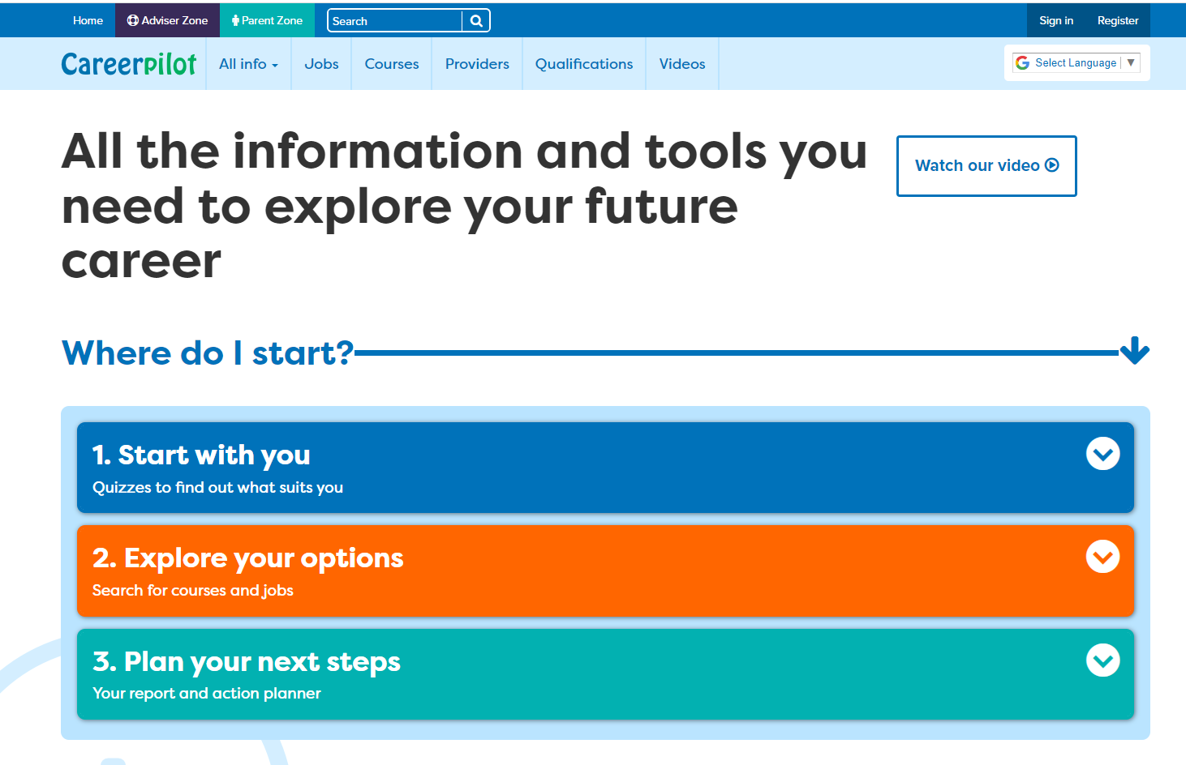
Introducing Careerpilot
Jobs, courses, qualification planner, videos
Quizzes, tools
Future qualifications and pathways
careerpilot.org.uk
Notes:
Careerpilot is a website that you can use for free. It has lots of information and tools to help you to start to think about future career ideas and pathways.
The website is built around 3 stages:
Start with you – with quizzes to find out more about what might suit you
Explore your options – where you can search for courses and jobs
Plan your next steps – where you can build a report and plan some actions.

Slide 8
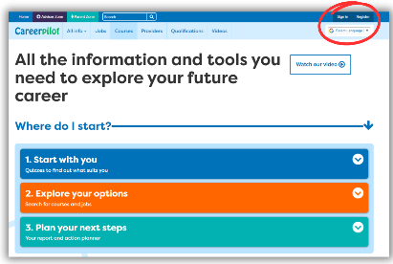


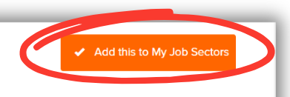
In today’s lesson you will…
Register on Careerpilot
2. Complete the Job Sector Quiz
3. Explore some Job Sectors and look at job profiles
4. Tag 2 Job Sectors you are interested in
Notes:
Explain to students what activities they will be doing shortly on Careerpilot.
Use the following slides 13-19 to explain how to complete these activities before getting started….

Slide 9
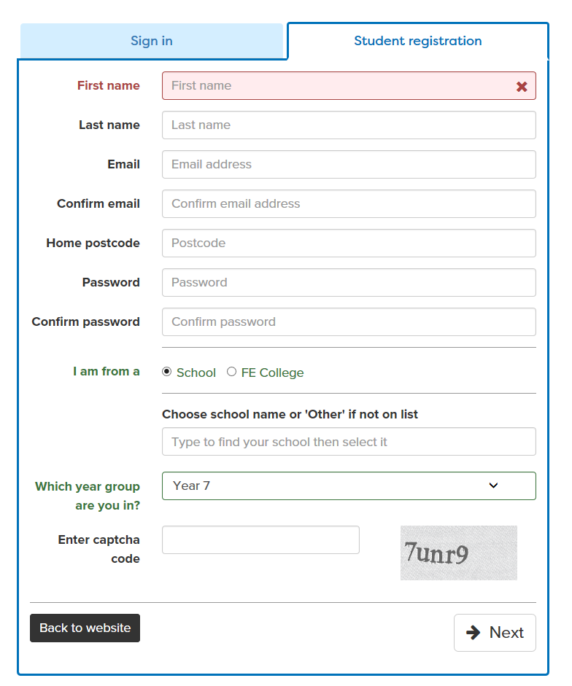

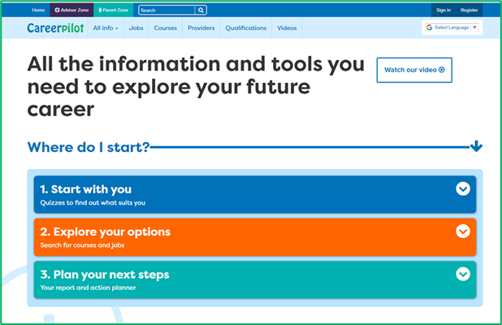
Register or sign in to Careerpilot
If you have registered before – sign in
Notes:
Show students that if they are new to Careerpilot, they need to register to use the website.
They must click on the ‘Register’ button in the top right corner to open up a short registration form that takes a few minutes to complete.
Remind students to use their school email address to register and to click on your school from the drop down list.
Students that have already registered just need to log in with their email and password.

Slide 10
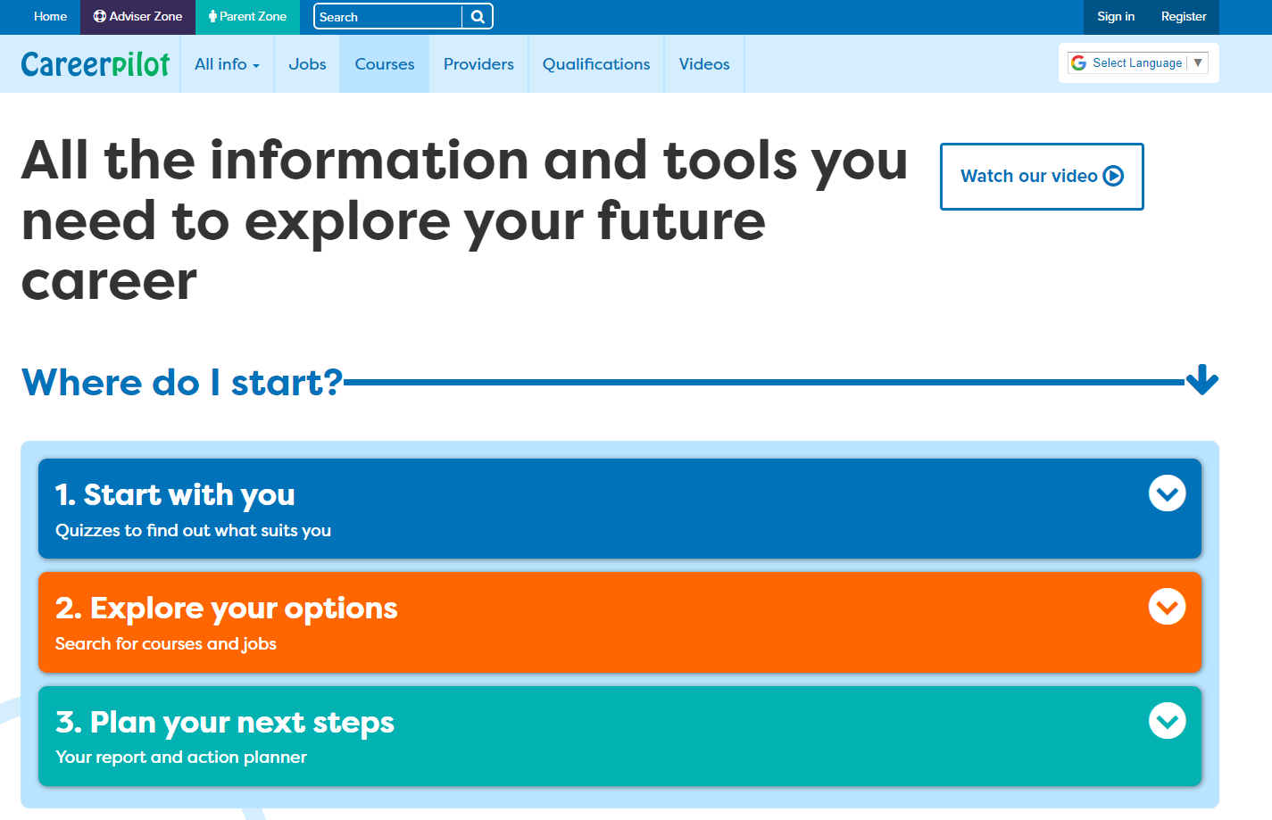
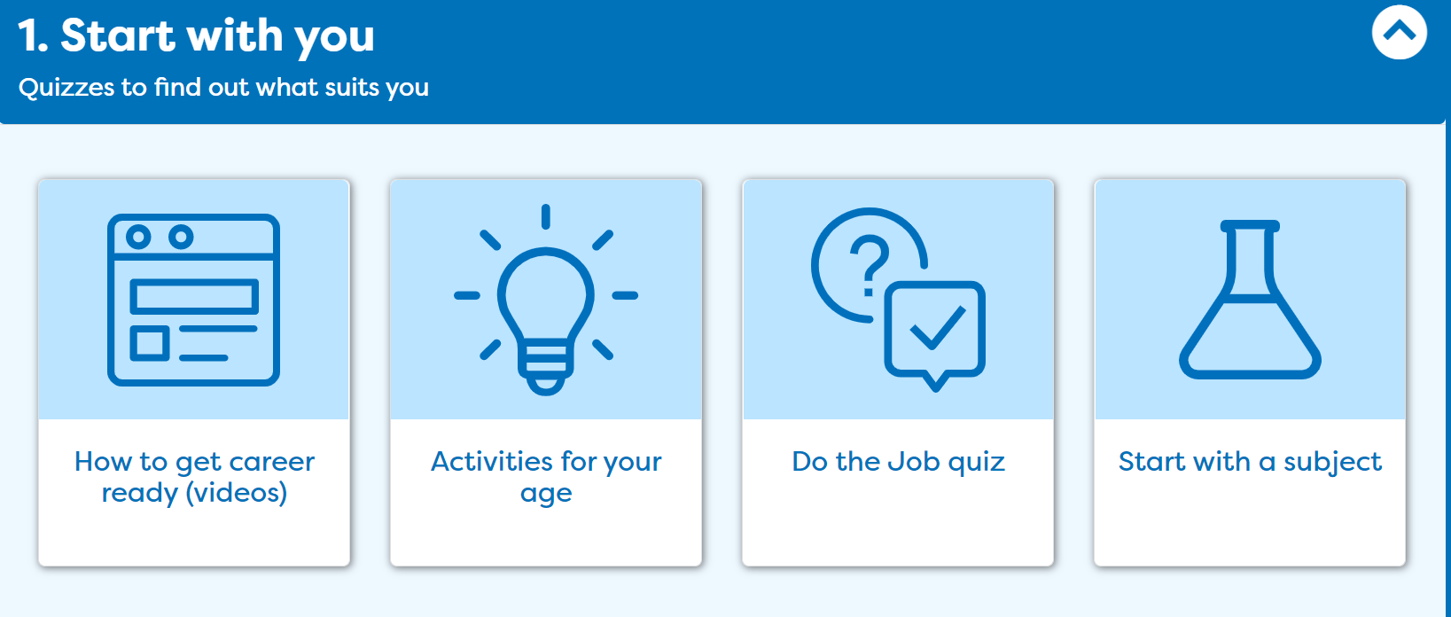
Complete the Job Sector Quiz.
Notes:
Once registered students need to go to ‘Start with you’ on the home page and click on ‘Quizzes to get started’ then click on the Careerpilot Job Sector Quiz.

Slide 11
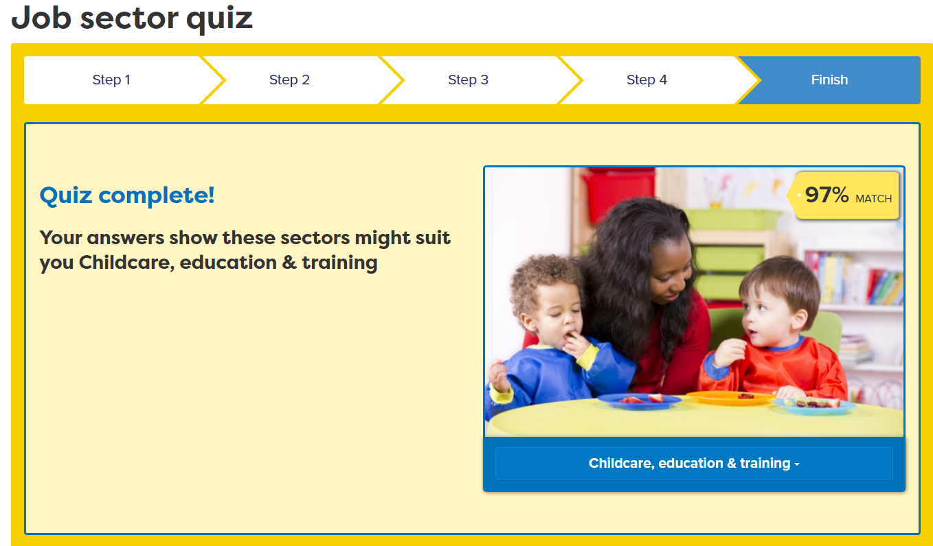

Explore Job Sectors and Job Profiles
Notes:
Students can explore some of the job sectors the quiz matches them with.
They can also click on ‘View all job sectors’ to explore other job sectors not in their quiz results.

Slide 12
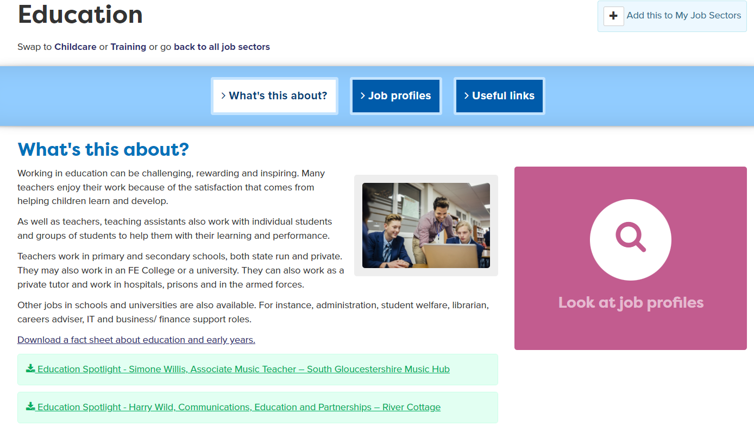
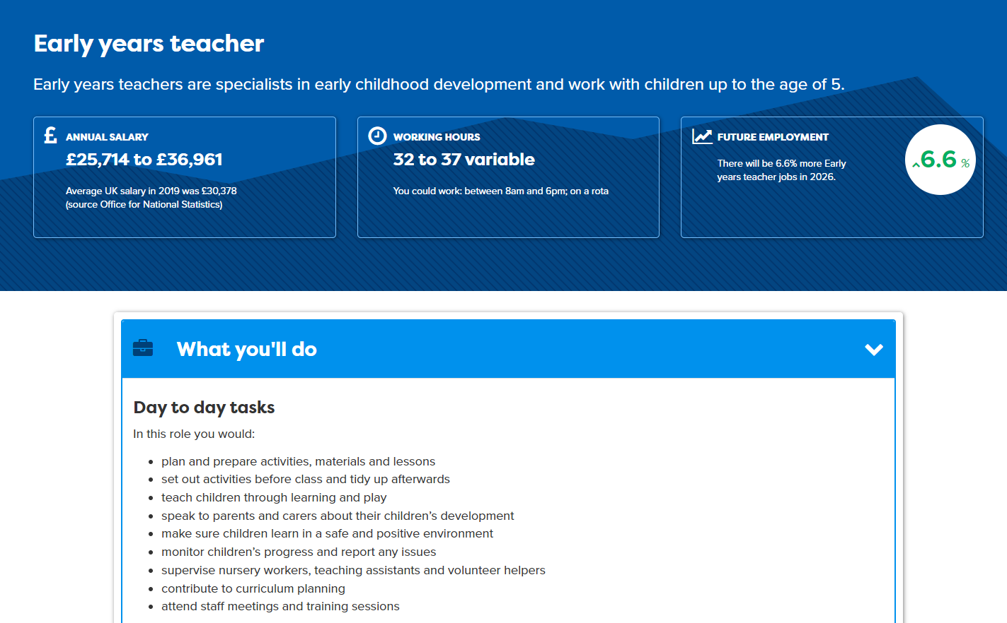
Notes:
In every sector students can look at ‘what’s this about’ and also see lots of ‘job profiles’.
Each job profile shows information about the job, including salaries and day to day tasks.
Check understanding about ‘salary’. Explain to students that the annual salary is the amount of money you could earn in a year doing this job if you work full time (5 days a week). Students can compare the job salary to the ‘Average UK Salary’ of approximately £30,000.
Day to day tasks shows what you would actually be doing for this job.
Students should explore some jobs and look at what’s involved, comparing salaries of different jobs.
Extension: Students may wish to take notes about any jobs that are of interest, noting salary and day to day tasks.

Slide 13
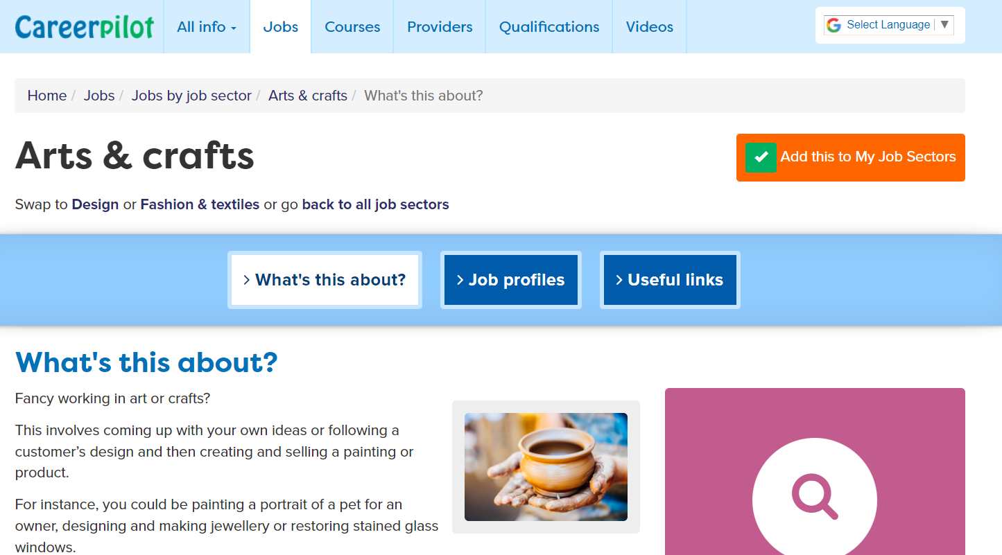
Tag 2 job sectors you’re interested in
Notes:
Their task is to pick two job sectors they are interested in (they can have more) and click ‘Add this to My Job Sectors’ to save in their Career Tools.

Slide 14
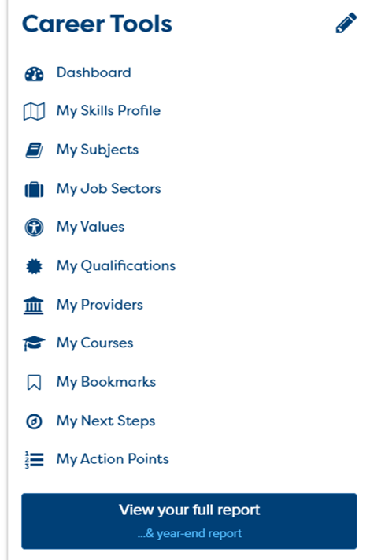
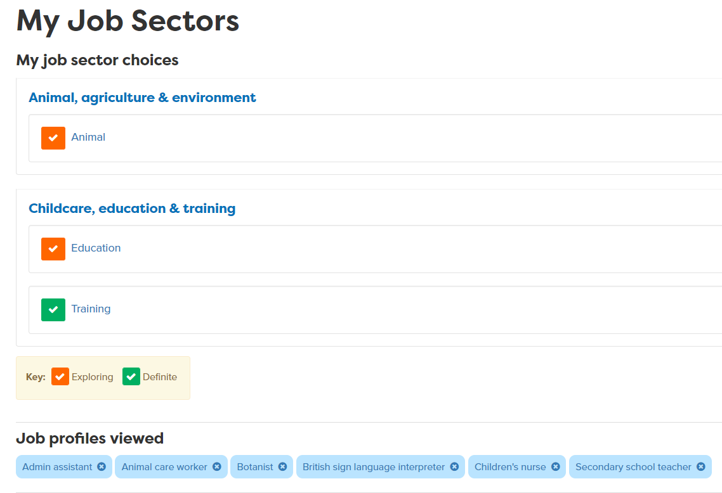
Using your Career Tools
Go to the home page and select Career Tools at top right of home page.
Click on My Job Sectors to see those you tagged and job profiles you viewed.
Notes:
Encourage students to go to their Career Tools via the home page and click on My Job Sectors to see their chosen sectors and the job profiles they have viewed.
Explain this will be saved for them to revisit at a later date and they can add more or change their choices as they go through school.

Slide 15
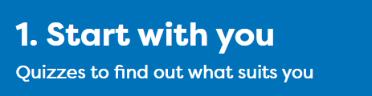
Careerpilot Task
20 mins
Register on Careerpilot
2. Complete the Job Sector Quiz
3. Explore some Job Sectors and look at job profiles
4. Tag 2 Job Sectors you are interested in
Notes:
Explain to students what activities they will be doing shortly on Careerpilot.
Use the following slides 13-19 to explain how to complete these activities before getting started….

Slide 16


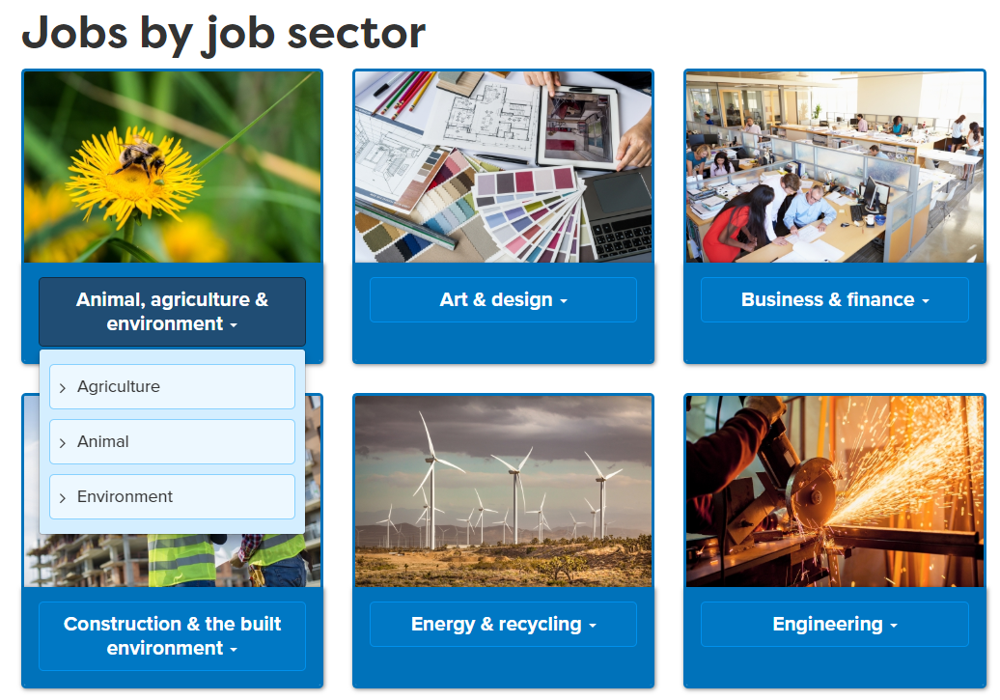
Sharing what you found out
Take it in turns to tell each other about the Job Sectors you explored and any Job Profiles you found that interest you and why.
When you speak, talk clearly so everyone can hear you. When listening to someone else is talking, show you are listening by looking at them.
5 mins
Notes:
Ask students to now take it in turns to show and tell a partner about the job sectors they have saved, including about any jobs they viewed that sounded interesting. Students can compare the salaries of the jobs they found and talk about what aspects of the day to day tasks they think looked interesting and why.
This activity will support students to practice the following essential skills:
Step 6 Listening: I show I am listening by how I use eye contact and body language
Step 6 Speaking: I speak effectively by using appropriate tone, expression and gesture
Reflection questions:
What is tone, and how can it vary?
What is meant by your expression and gesture? How can it impact on your communication?
Why do you think eye contact is important to show you are listening?
How do you feel when someone is not making eye contact when you are speaking?
What does positive body language look like?
Ask students if they feel they have demonstrated these skill steps as part of this activity.
If time, ask students to feed back on their partner’s chosen jobs or job sectors to the whole class.

Slide 17
Getting Career-ready
TODAY
You understand that a career is a journey and have started to look towards what you might like to do in the future.
You explored different job sectors and started to think about what aspects of a job you might be interested in.
Notes:
LAST SLIDE OF LESSON 1
Reflect on the aims of the session and how they can help students to start to get Career-ready.
Check understanding of what ‘career’ means with class.
Ask for hands up from students if they feel they have started to think about some job sectors they might be interested in.

