Slide 1


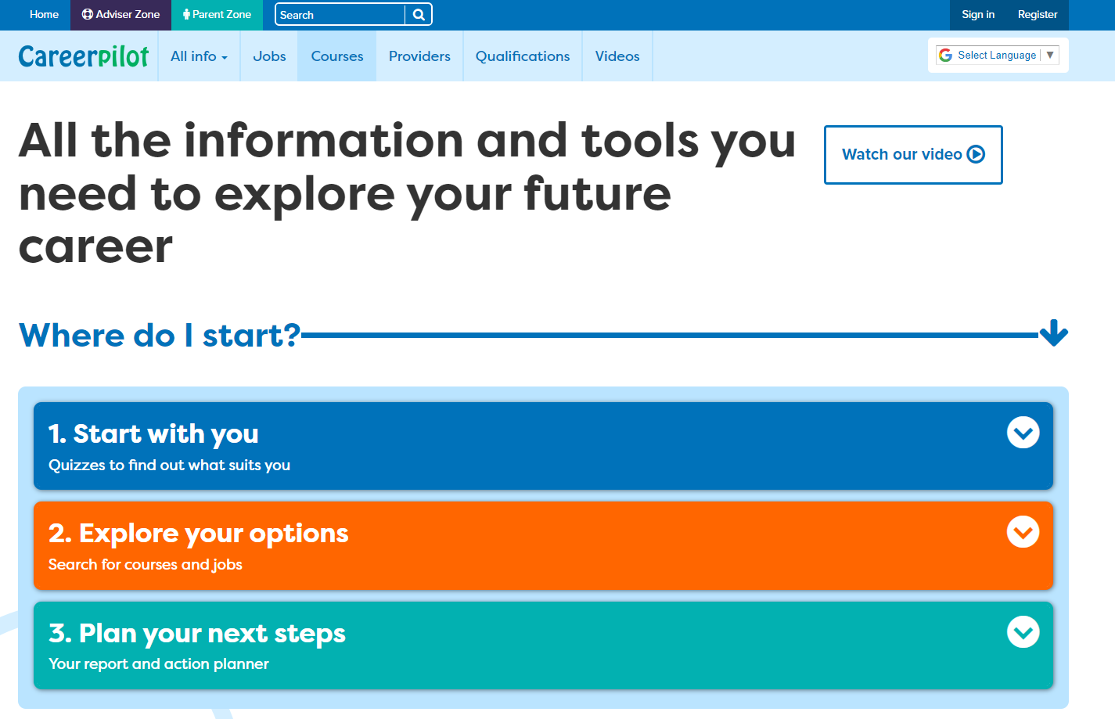
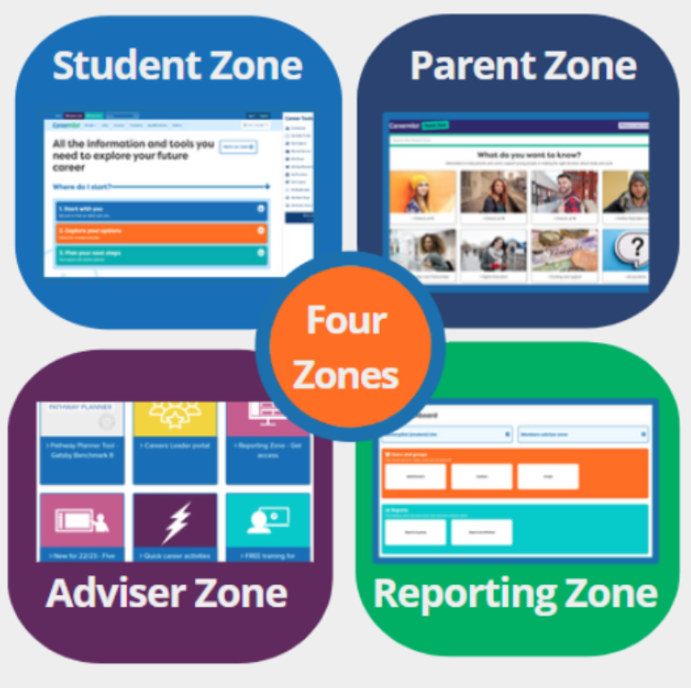

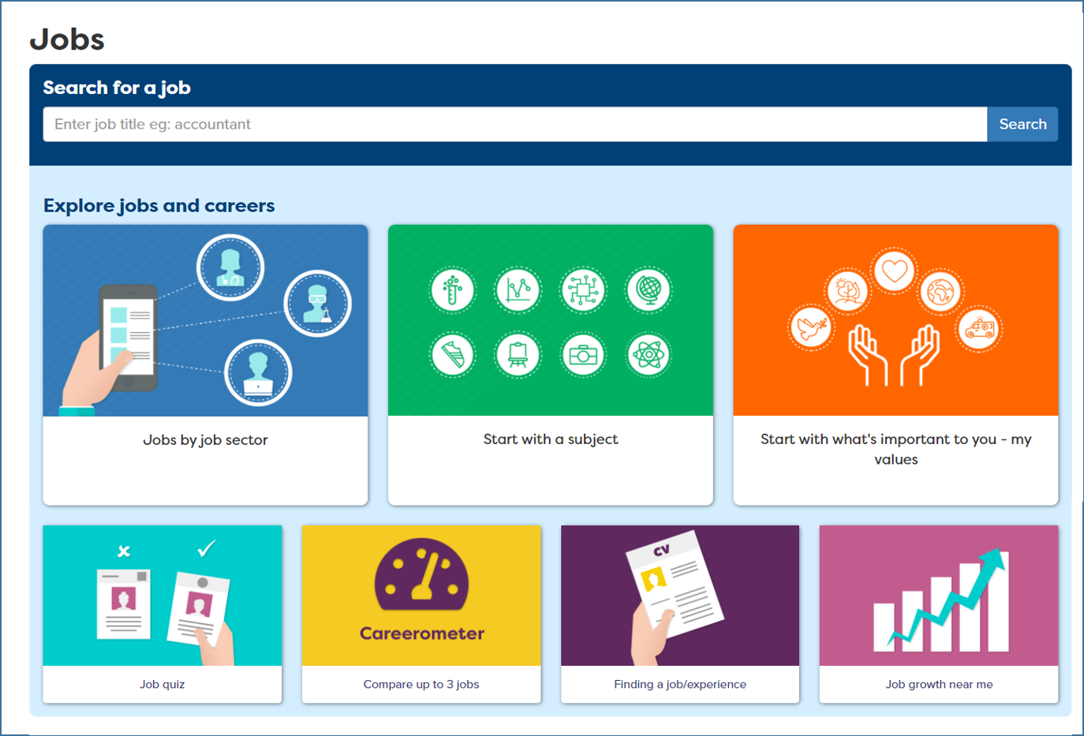


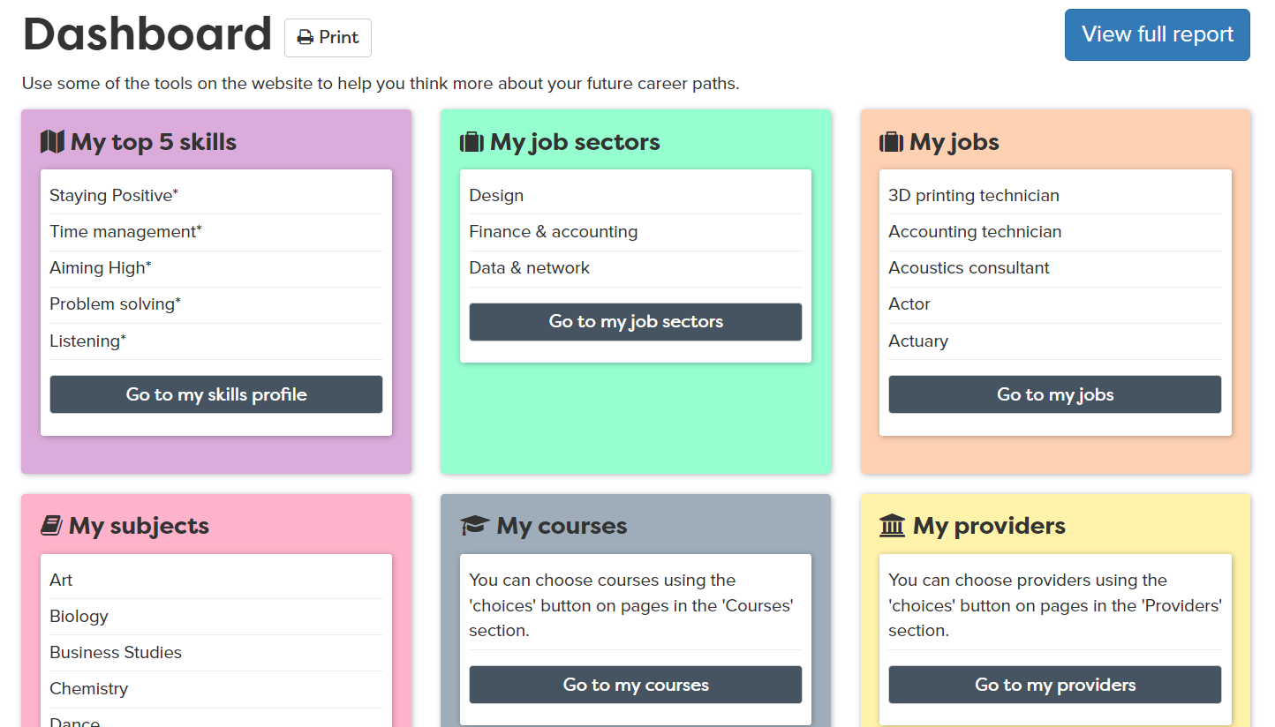

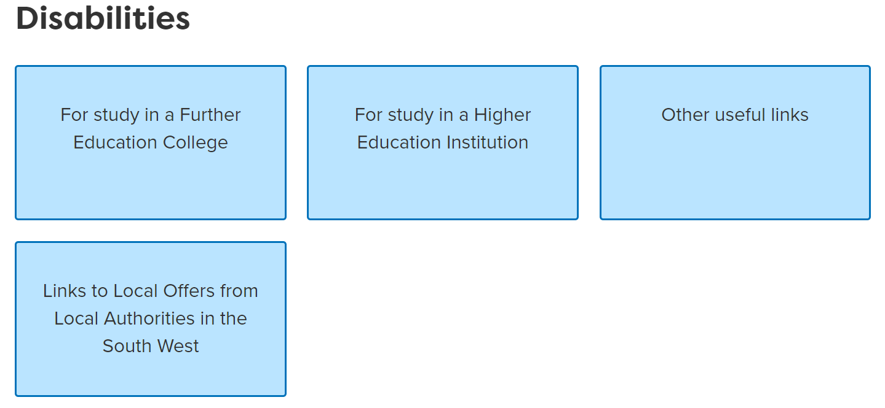
Mapped to Gatsby
Welcome Checklist
SEND Schools
2024-25
Gatsby Benchmark | Careerpilot sections | How Careerpilot helps SEND schools meet the Gatsby Benchmarks
A stable careers programme |  | The suite of Careerpilot tools can help implement a stable careers programme for SEND students. The Careerpilot website provides information and advice to young people about all the different pathways, written by professional career advisers. The Adviser Zone has lesson plans, videos and resources to help schools plan and deliver a programme of careers education including 5 week careers programmes for every year group and 20 minute activities for tutor time. Some may need to be adapted for the SEND audience. Many Careerpilot resources are presented visually e.g the job quiz, and there are over 1000 videos about jobs and qualifications. The Parent Zone helps parents and carers get answers to career-related questions.
Learning from career and labour market information |  | Students can start looking for jobs from different starting points, by completing a job quiz, the Buzz personality quiz, by their strengths and values, or through a subject they love. The values section has entry points for people with some SEND needs showing job sectors and companies which are looking for their specific talents. The Careerpilot site includes non-stereotypical videos and information on 19 job sectors with over 800+ job profiles, which include national and regional labour market information. The Course Search provides up to date access to LMI about degrees and apprenticeship vacancies. The Careerpilot Hot Jobs section, in the Adviser Zone, offers posters, images and activities, that you can use to show students and parents the jobs that are predicted to grow, with key data.
Addressing the needs of each pupil |  | Career Tools enable registered students to complete a range of activities which will help them learn more about themselves and their choices. Students can explore and choose job sectors, qualifications, etc. and create a Career Tools Report, useful preparation for an EHCP meeting, especially at key points of progression. The site has links to all SEND local offers in the Southwest and in some of the Southeast. A section on ‘SEND’ provides key information about progression for students with a disability moving to college or uni.
See other maps: How Careerpilot can be mentioned for Compass

Slide 2
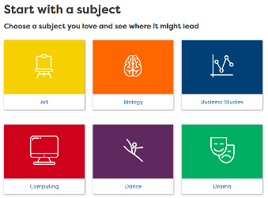

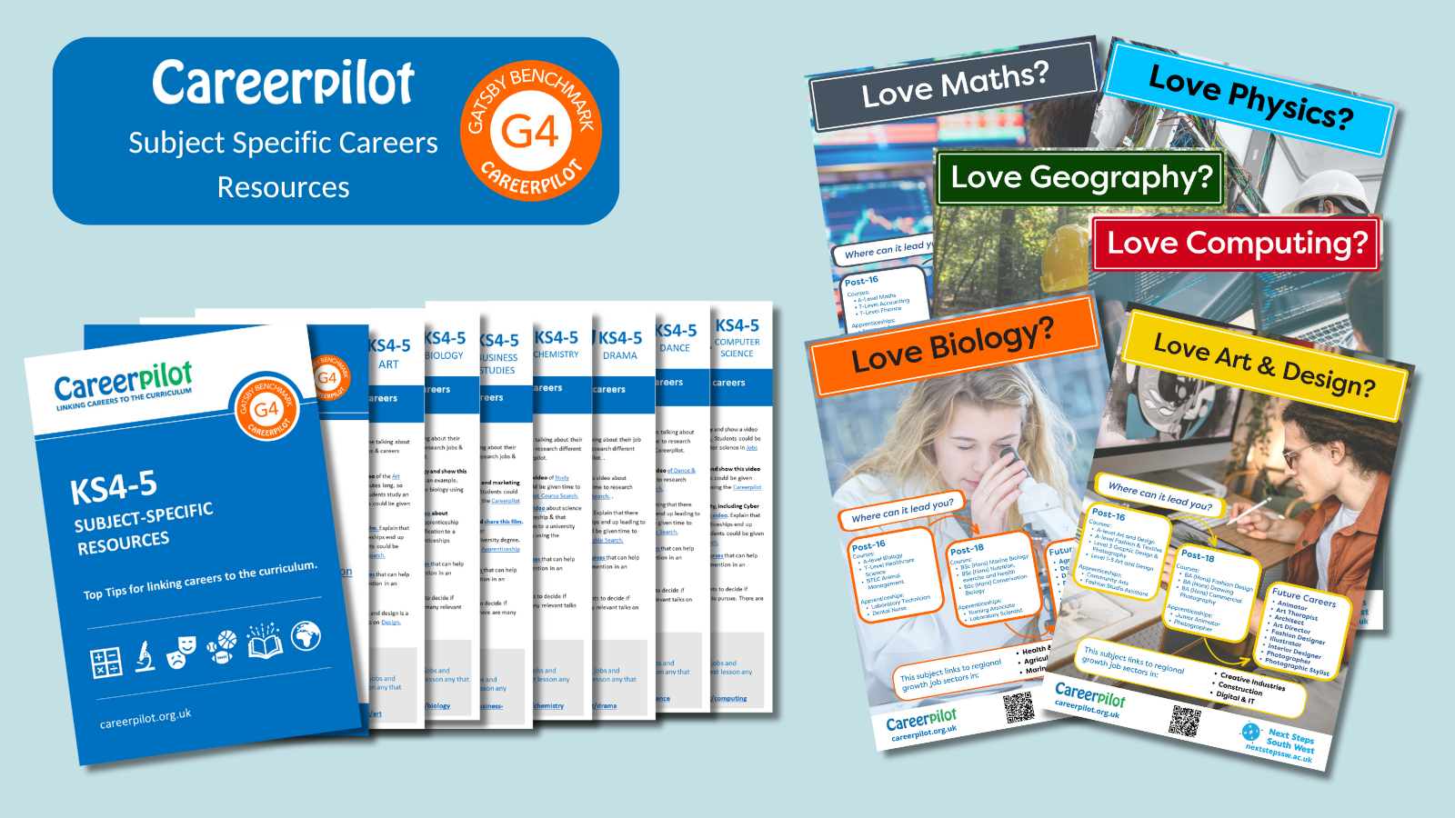
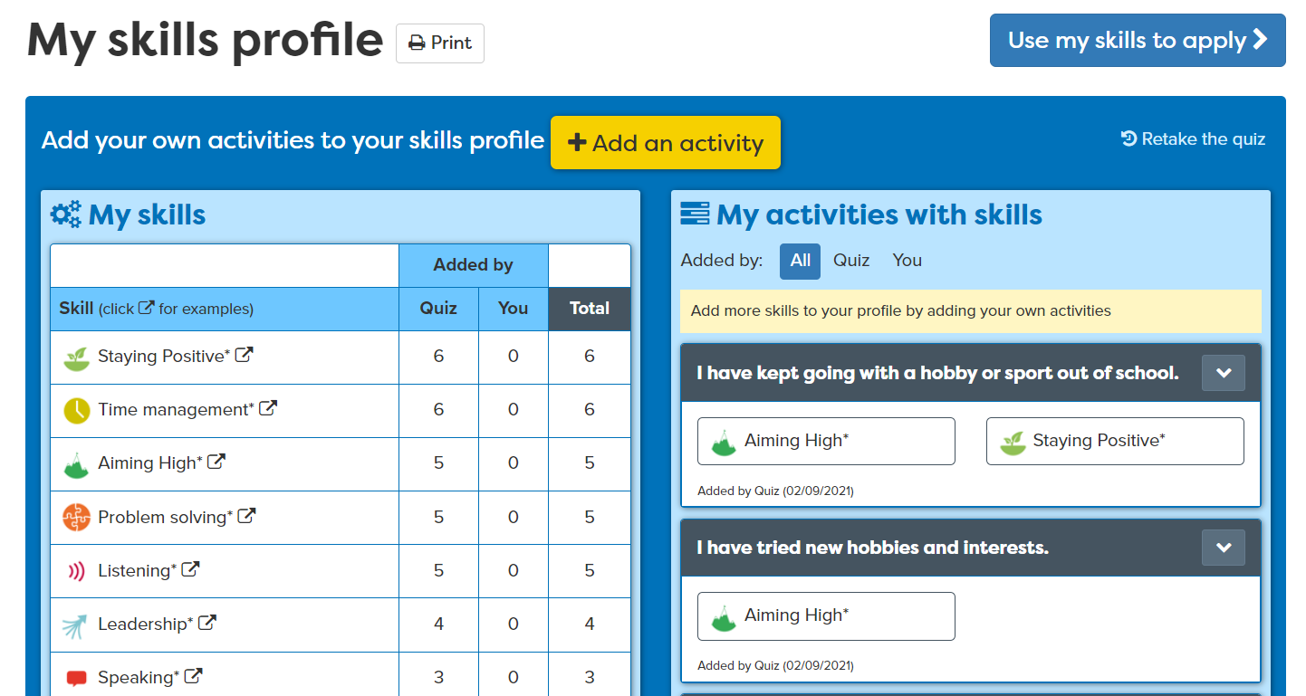

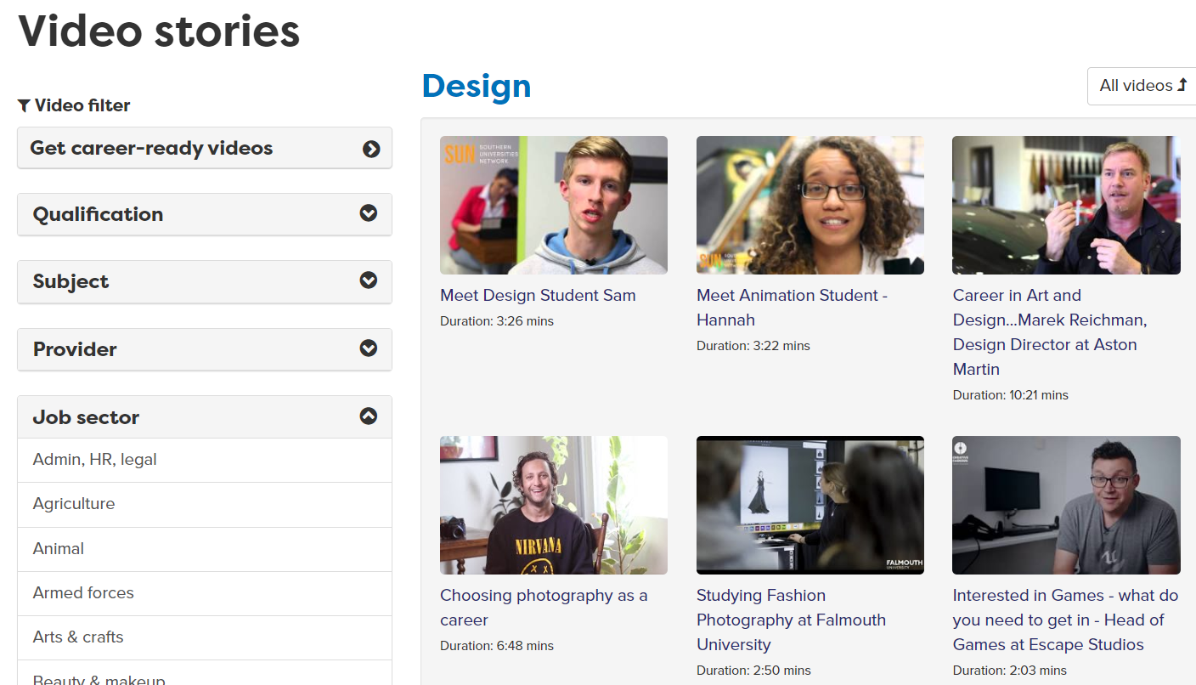




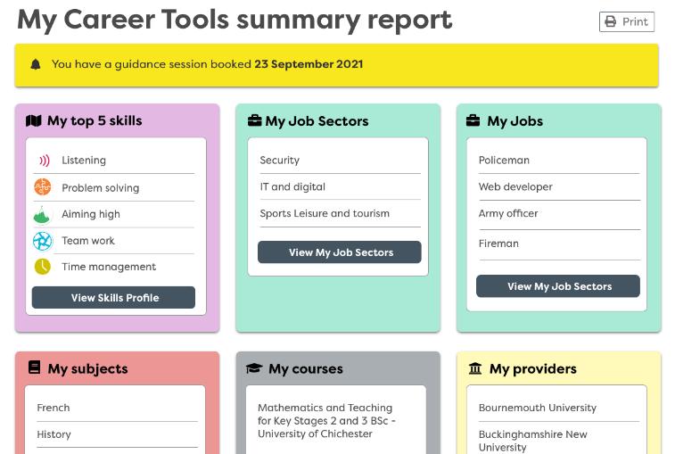

Gatsby Benchmark | Careerpilot sections | How Careerpilot helps schools meet the Gatsby Benchmarks
Linking curriculum learning to careers |  | ‘Start with a subject’ shows where a favourite subject could lead, giving sample jobs, apprenticeships, college and degree courses. The site has information on 19 job sectors, 57 sub-sectors and over 800+ job profiles, including Green Jobs. There are video stories showing routes into a range of jobs, many of which are non-stereotypical and can be searched by subject. We also have Resources for Subject Teachers in the Adviser Zone including subject posters and top tips for linking to careers.
Learning from encounters with employers and employees |  | The site has over 1000 video stories of people talking about their job roles and routes. The Skills Profile enables students to record WEX, employer and FE/HE encounters and what skills they have learnt from these activities - which are added to their Skills Profile which they can use when applying or writing personal statements. Careers staff can use the Reporting Zone reports to plan encounters to meet students’ needs using information about students’ job sector interests.
Experiences of work |  | Careerpilot has a section to help students plan for work experience, which includes ideas for virtual work experience. There are 800+ job profiles to help students get information about the role, expected skills, entry requirements and LMI. Students can complete the Skills Profile as part of planning for work experience so they have a list of their skills they can talk about at interview, and where they can record their experience and skills developed through work placements. Access a recorded video lesson to help Y10 prepare for work experience.
Encounters with further and higher education |  | Careerpilot has detailed information about ALL study and training routes at age 13/14, 16 and 18. A Qualification Planner helps map a route through the levels. Students can use the Course Search to find courses and apprenticeship vacancies and Find a Provider has links to schools, colleges, universities and training providers. The site has lots of videos from FE/HE students talking about their study and our partner universities post free opportunities for students in the South West.
Personal Guidance |  | Careerpilot can help students prepare for guidance interviews and for EHCP meetings if they complete the Career Tools. This will create their personalised career report which they can choose to share with parents and other supporting professionals. Guidance advisers can use the report to learn about the students interests and plans and the adviser can record reports and actions at the end of the session.

