Slide 1

Careerpilot is closing. This resource is only available to use until 23rd October 2026.
Preparing for Post 16
Lesson 1: Getting ready for post 16 options
This lesson can be delivered through a video recording

Slide 2
Recorded video of lesson 1
Right click to play the video icon above or copy and paste the link below in a new tab to view:
https://youtu.be/0-0BcwweIQM
Notes:
The Career Development Institute has developed a careers framework that shows the skills everybody needs to have to manage their future career.
This slide shows the students which of the career learning areas (CDI) that this lesson links to.
You can also share the structure of the session with students.

Slide 3






Getting Career-ready
Introduction and warm up activity – 20 mins
You will see how your post 16 choices fit with future jobs and you career
Careerpilot Activities 25 mins
You will make a plan and develop a pathway into your future
Wrap-up
5 mins
Notes:
The Career Development Institute has developed a careers framework that shows the skills everybody needs to have to manage their future career.
This slide shows the students which of the career learning areas (CDI) that this lesson links to.
You can also share the structure of the session with students.

Slide 4

Warm up activity
You have won the lottery!
The prize is….

Slide 5

A holiday in one of these places
Barbados
Australia
Which one will you choose?
South Africa
Belgium
England
Notes:
Think which one they want as their prize, they don’t have to say

Slide 6
Just found out more detail…
Explore ALL the information before you decide
Barbados
Beach ranger
Australia
Sheep-shearing
South Africa
Picking grapes
Which place do you want to go now?
Belgium
Testing chocolate
England
Glastonbury tickets
Notes:
Knowing the detail can make all the difference and that’s the same with choosing your career options, you need to know the detail, not just ‘I am going to go to college/sixth form’ but which course, where will it take you, etc.

Slide 7

What is a career?
A career is an individual's journey through life, learning and work.
A job is something you might do to earn money as part of your career journey. There are lots of different job sectors you could work in, from finance, to art and design, to working with animals.
Y11 – the big things
Explore all options and firm up what you will do at the end of Y11
Get the best GCSEs you can
Notes:
Explain what a career is and that jobs are part of their career journey (and they might have lots of them)
The key things related to careers that Y10 will be focusing on

Slide 8




Where are future jobs going to be?
Medical, Health Science and Care
IT and Digital Technology
Engineering and Construction
Environmental (Green Jobs)
This is Labour Market Information (LMI)
Be in the know to know where to go
Notes:
With new technology and science developments there will be a growth in jobs needed in many industry sectors including:
Medical and Health – we will continue to need more medical scientists, researchers, doctors, nurses and health care workers
IT and Digital – we will need more data analysts, technology researchers and AI developers
Engineering and construction - we will need more people to design and build the new buildings of the future – architects, electricians, energy engineers
Environmental jobs– we need lot of people to do jobs that help protect our planet like ecologists, foresters and environmental advisers

Slide 9





Get ready for your future career
https://www.youtube.com/watch?v=OWZxyyK6OuA
Notes:
Why is careers important and what can you do NOW!
Show video

Slide 10
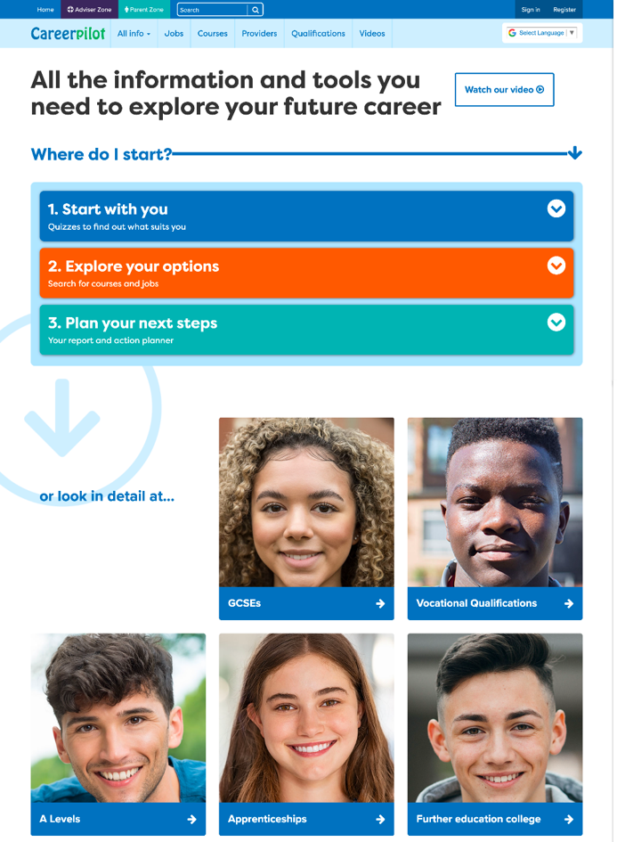
Introducing Careerpilot
Jobs, courses, qualification planner, videos
Quizzes, tools – 3 stages to help you decide
Future qualifications and pathways
careerpilot.org.uk
Notes:
Careerpilot is a website that you can use for free. It has lots of information and tools to help you to start to think about future career ideas and pathways.
The website is built around 3 stages:
Start with you – with quizzes to find out more about what might suit you
Explore your options – where you can search for courses and jobs
Plan your next steps – where you can build a report and plan some actions.

Slide 11

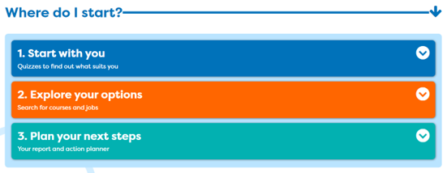
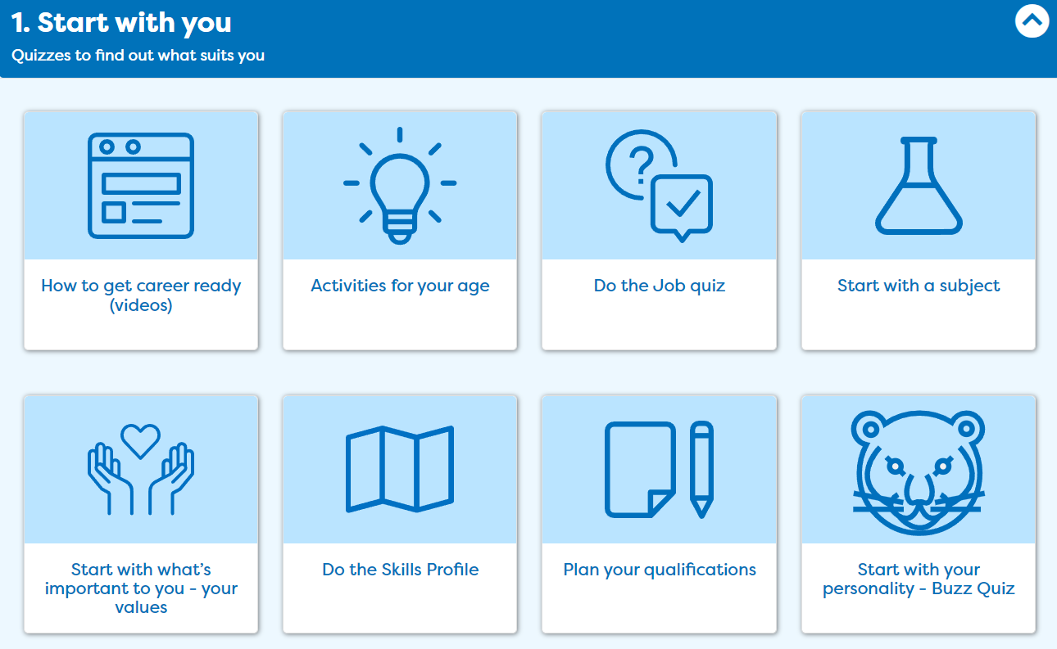
One place for all your careers information.
Get Ready For Your Future Career
Notes:
In this session you will be using ‘Start with you’ to get ideas of what jobs might suit you in the future

Slide 12

One place for all your careers information.
Get Ready For Your Future Career
Volunteering
Cadets
Duke of Edinburgh
GCSEs
Youth Groups
Don’t drop them!
Great for your CV
Sports Teams
Performing Arts
Notes:
Yes your number 1 priority needs to be your GCSE but don’t give up anything that will be useful for a future job/course/CV.

Slide 13

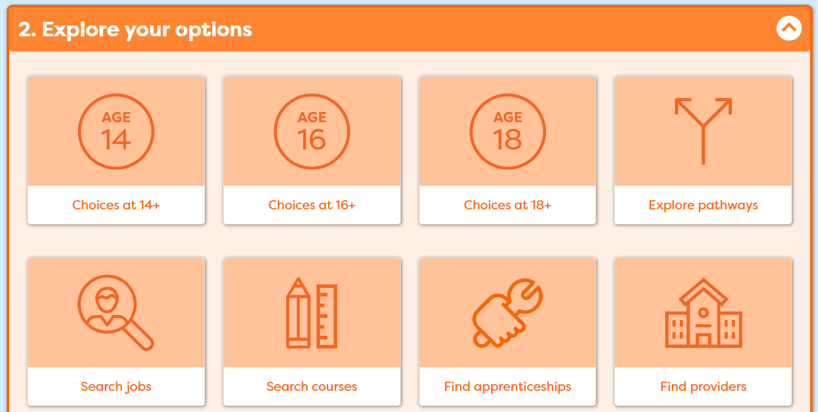
One place for all your careers information.
Get Ready For Your Future Career
Today
Notes:
Today focused on your options.

Slide 14


One place for all your careers information.
Get Ready For Your Future Career
Parents/family
Career advisers
Teachers
Careerpilot
Notes:
When they are back as a group. Talk about supporters and see if they can suggest any others. Tell them the name of the school careers adviser.

Slide 15
Pathways after Y11
What pathways can I choose at the end of Y11?
Academic
Vocational/Technical
Work-based - Apprenticeship
Mostly in a 6th Form or 6th Form College
Mostly in a
local college
Mostly in a workplace
Notes:
Ask them to say what pathways they can do at 16.

Slide 16






Different routes in
Academic
Technical/Vocational
Apprenticeship
Degree Achieved
Degree Year 2
HND
Foundation Degree Y2
Higher Apprenticeship
Degree Year 1
HNC
Foundation Degree Y1
Higher Apprenticeship
A levels
T LEVEL other Level 3 - BTEC/OCR
Advanced Apprenticeship
5 x GCSEs 4 - 9
T Level Foundation and other Level 2
Intermediate Apprenticeship
GCSEs 1 - 3
Notes:
Explain that there are three pathways but in all pathways there are levels of quals. Level 2 is getting 5 GCSEs grade 4-1.
Show them the other levels and make the point that all pathways can lead to a degree.
The bit of the qualification ladder we are mainly talking about today is their choices after GCSEs
There are many ways to achieve the same careers (although for some there are very set routes, like doctor, vet, etc. so they need to check)
Both Lucy and Leon are nurses
Lucy did a BTEC in health and Social Care after GCSEs and then did a degree.
Leon did A levels and then started work in a hospital as a porter. He was offered a health care apprenticeship and achieved his degree through this route.
A common pathway into nursing and paramedic is through working in a hospital and then being given the opportunity for further training.

Slide 17
One place for all your careers information.
Choosing options – what to think about
What grades are you likely to get at GCSE (esp. English and maths)?
How do you like to learn e.g. by doing, by studying?
Some people start with what they want to do in the future (course/job) and look at what they need to do to get there.
Some people start with a subject they like and focus in later.
There are lots of ways of getting to the same future job.
Notes:
What you need to think about

Slide 18
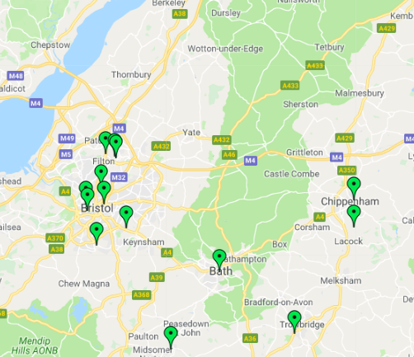
Vocational Pathway
Vocational courses are about a job area
e.g General – Btec/OCR, Specific - Tech Levels
Colleges offer lots of vocational courses at lots of levels. Schools offer some too.
Some colleges offer A levels, some don’t. Students can resit their Maths & English GCSEs at college.
Many Level 3 vocational courses require 4 x GCSEs at Level 4+ (check this).
Example courses:
Level 2 - Accounts
Level 1 and 2 - Animal care and management
Level 1 and 2 – Health and Social Care
Level 1,2 and 3 – Plumbing
Level 3 T Level – Digital design
Level 1, 2 and 3 - Sports
Get UCAS points for each, which can get you onto a higher level course
Notes:
Key facts about vocational:
Colleges offer lots of vocational courses, some offer quite specialist courses like boat building, agriculture. Most do not offer GCSE resits, GCSEs or A Levels. However, in some areas of the South of England schools do not have 6th Forms and colleges are the providers for A levels (you might want to adapt this slide to suit your area). All colleges offer support for students who do not get Grade 4 or above in maths and English at GCSE.

Slide 19

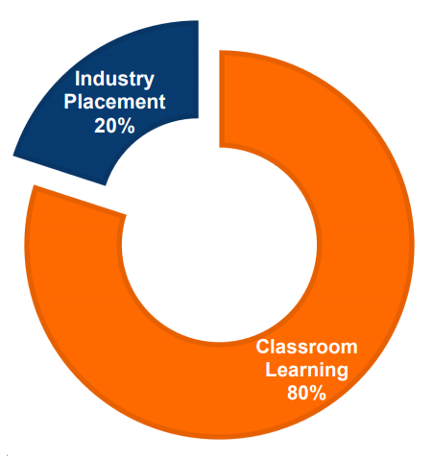
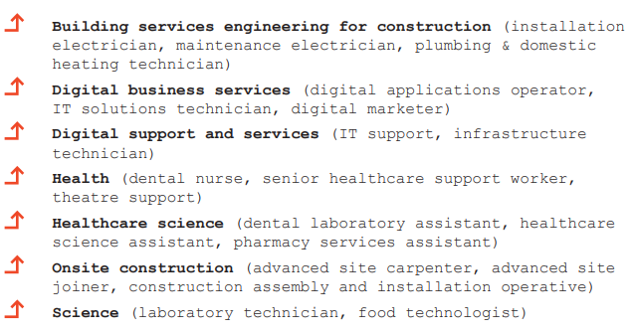
One place for all your careers information.
Vocational Pathway: T Levels
Will train you to do a specific job
Mostly in colleges
1 T-Level equivalent to 3 A Levels
Get UCAS points which can get you onto a higher-level course
Notes:
T Levels are fairly new and are offered in colleges.
They are equivalent to 3 A Levels

Slide 20



Work-based Pathway – Apprenticeships
Higher/Degree Apprenticeship
£6.40 per hour – (but some employers pay more)
Higher/Degree Apprenticeship
Learn by doing the job, in the workplace
Higher/Degree Apprenticeship
Advanced Apprenticeship
Need to find one like finding a job
Intermediate Apprenticeship
Notes:
Explain will be looking at how to find an apprenticeship later in session

Slide 21

One place for all your careers information.
Academic Pathway – A-levels
A Levels
Other Voc Quals
Usually take 3 or 4
Related to a job area
AS levels – in some schools
Small (=1 A Level)
Extended Project Qualification
Large (=2 or 3 A Levels)
L3 Core Maths
Get UCAS points for each, which can get you onto a higher level course
Notes:
A Levels – Key facts

Slide 22
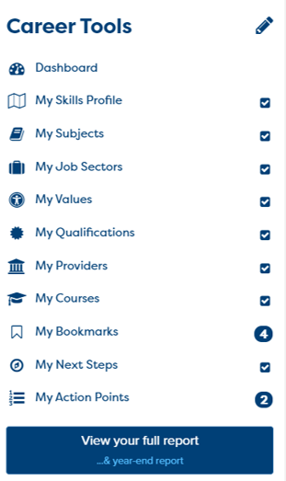

One place for all your careers information.
Now build your report in Career Tools
Register/sign in
Build your report
If you have registered before then sign in
Notes:
You will using Careerpilot to explore all your options, register (or sign in if you have used it before)
Then you can build your report and have a record of all your career choices and plans

Slide 23
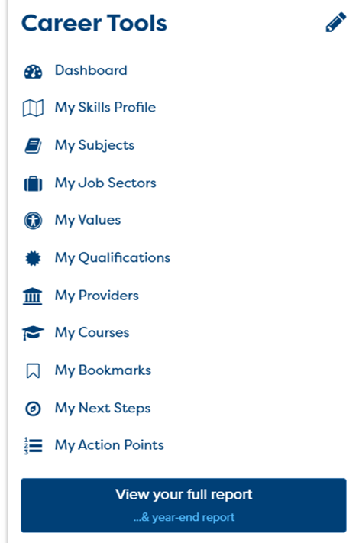
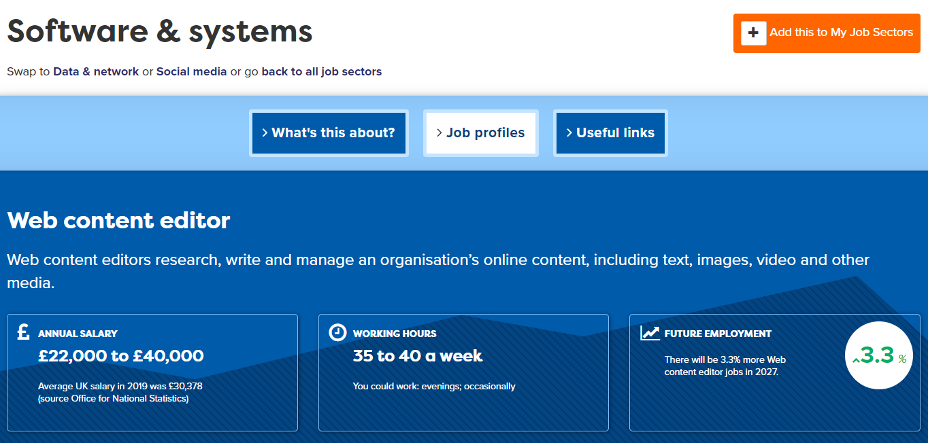
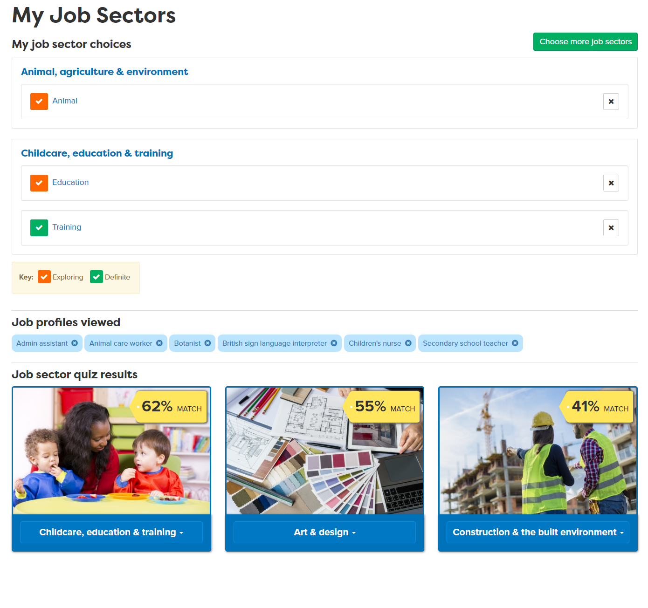
Use your Career Tools
Notes:
Encourage students to go to their Career Tools via the home page and click on My Job Sectors to see their chosen sectors and the job profiles they have viewed.
Explain this will be saved for them to revisit at a later date and they can add more or change their choices as they go through school.

Slide 24
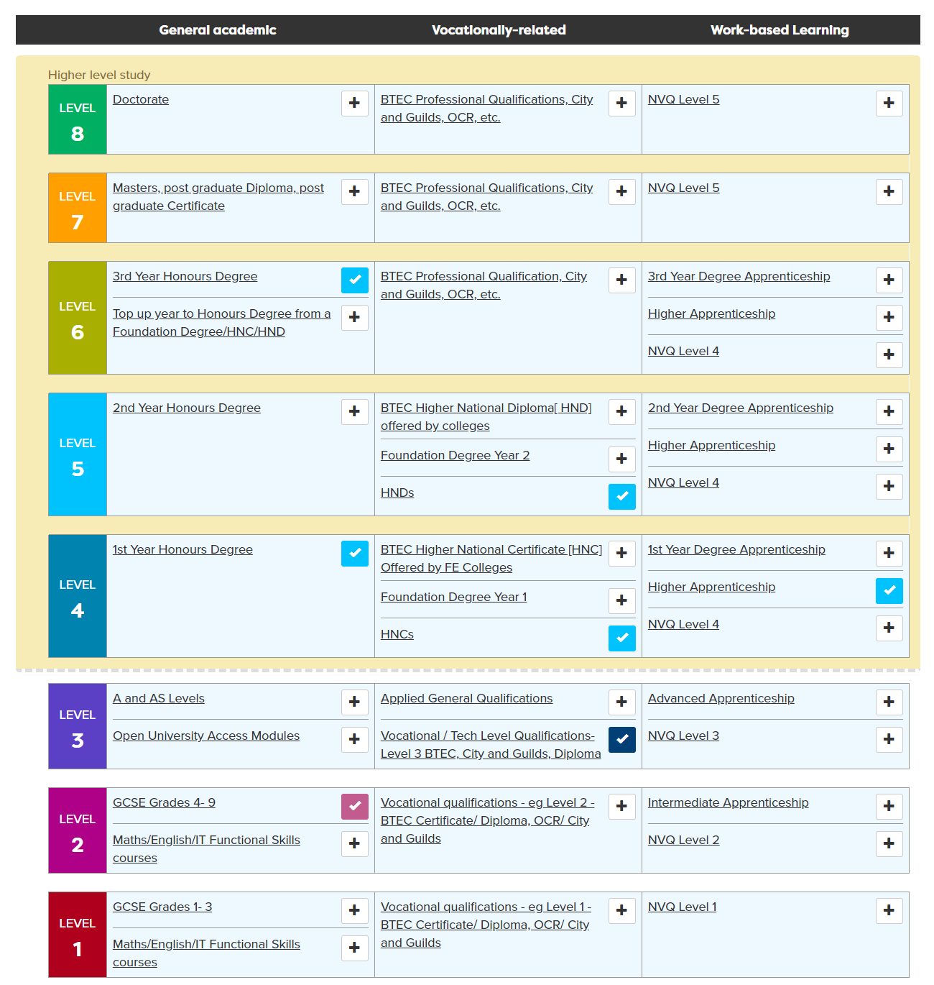
Add your present and future qualifications
Add/update your subjects and predicted grades
It is important to know your grades as this might affect your choices at 16 - but the good news is you have time to make them even better!
Notes:
Then they can add the qualifications they might be thinking of doing to the Qualifications planner. When they have added some on the ladder, in My Quals they can add their subjects and predicted grades. It is important to know grades as this might affect your choices at 16 but the good news is you have a whole year to make them even better!

Slide 25

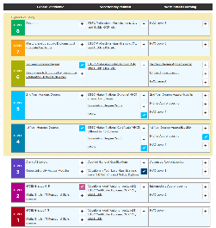
In today’s lesson you will…
25 mins
Register/sign in to Careerpilot
2. Know yourself use ‘Start with you’
3. Add/update your qualifications to ‘My qualifications’
4. Consider routes at 16 and explore options
careerpilot.org.uk
Notes:
Students can get started on the activities shown – flex the time to allow for the wrap up.

Slide 26


Pathways at 16: Which are you interested in?
Academic
Technical/Vocational
Work-based
A levels
General
T Levels (L 3)
Apprenticeships
Studying subjects in detail
General about a sector e.g. Health and social care
Trained to do a job e.g. digital design
Trained to do a job in the workplace. Will get paid.
TASK: Working in pairs, discuss the pathways you are interested in and why you think they will suit you.
Speak clearly and in a way that is engaging for your audience
Listen carefully while your partner is talking
and ask questions to find out more
5 mins
Notes:
Who is thinking about XX as first choice, second choice?
Speaking Step 11 - Speaking engagingly: I communicate in a way that is engaging for my audience
Listening Step 8 – Questioning: I ask open questions to understand more

Slide 27
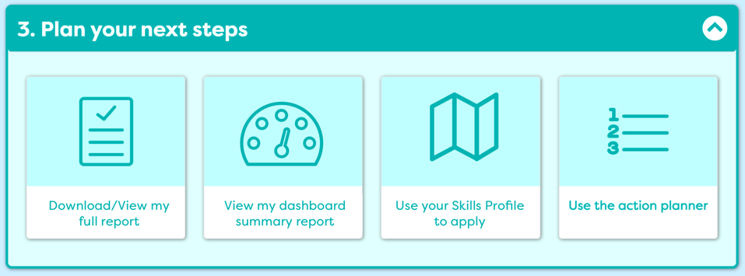
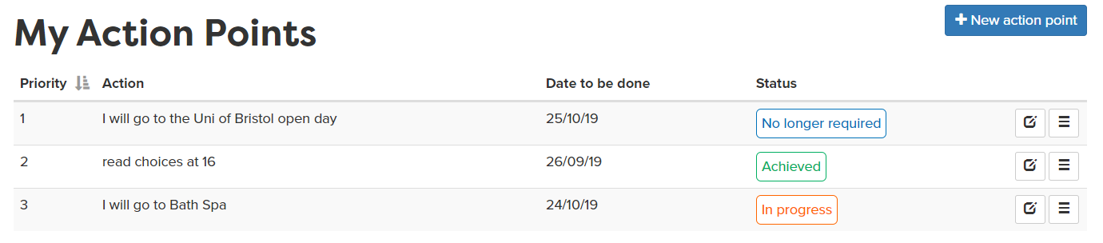
Plan your next steps
Notes:
They could, in their own time go back to Careerpilot and do any other activities, including setting an action point of something they could be doing to help them plan for the end of Y11.

Slide 28
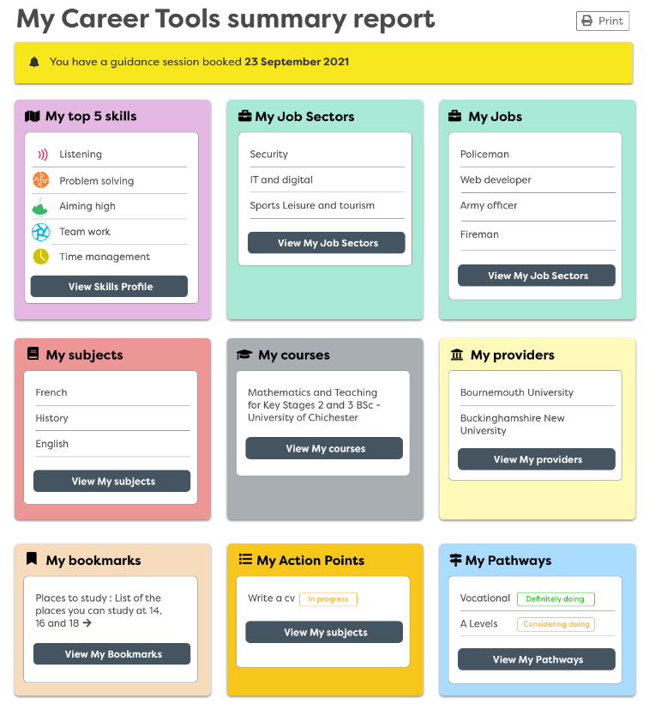
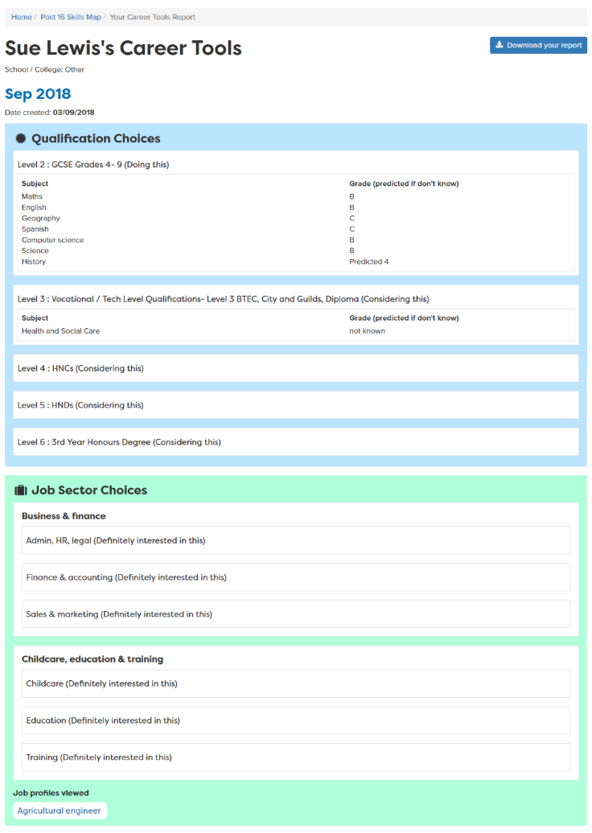
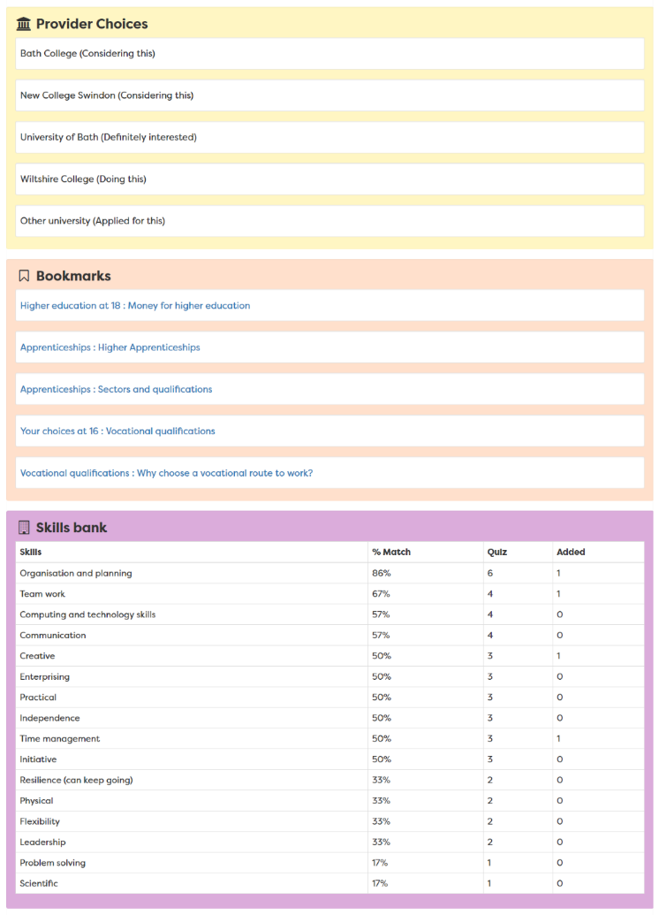
View your report
Report moves up each year
Notes:
A slide to show the report that is created once the career tools have been completed – moves up with them each year in school

Slide 29

Getting Career-ready
You saw how your post 16 choices fit with future jobs and you career
You started to make a plan and develop a pathway into your future
Notes:
The Career Development Institute has developed a careers framework that shows the skills everybody needs to have to manage their future career.
This slide shows the students which of the career learning areas (CDI) that this lesson links to.
You can also share the structure of the session with students.

