Slide 1


careerpilot.org.uk
Careerpilot is closing. This resource is only available to use until 23rd October 2026.
This lesson can be delivered through a video recording
Preparing for post 18 options
Lesson 1: Getting ready for post 18 options
Notes:
A video recording of this lesson is available to play from the front with prompts to pause for students to complete activities. See next slide for link.

Slide 2
Recorded video of lesson 1
Right click to play the video icon above or copy and paste the link below in a new tab to view:
https://youtu.be/ZY3MIBfgQFs
Notes:
The Career Development Institute has developed a careers framework that shows the skills everybody needs to have to manage their future career.
This slide shows the students which of the career learning areas (CDI) that this lesson links to.
You can also share the structure of the session with students.

Slide 3






Getting Career-ready
Introduction
25 mins
You will see how your post 18 choices fit with future jobs and your career
Careerpilot Activities 25 mins
You will actively be planning, prioritising and setting targets for your future
Wrap up
10 mins
Notes:
The Career Development Institute has developed a careers framework that shows the skills everybody needs to have to manage their future career.
This slide shows the students which of the career learning areas (CDI) that this lesson links to.
You can also share the structure of the session with students.

Slide 4

What is a career?
A career is an individual's journey through life, learning and work.
A job is something you might do to earn money as part of your career journey. There are lots of different job sectors you could work in, from finance, to art and design, to working with animals.
Y12/13 – the big things
Explore all post 18 options in detail
See what options align with your future plans
Get the best qualifications you can
Notes:
Explain what a career is and that jobs are part of their career journey (and they might have lots of them).
Emphasis the big career things that Y12/13 will need to be considering

Slide 5

Exploring motivations
What do you want from a future job?
What drives you?
Write down your top 3, here are a few ideas or use your own
You can use what drives you (your values) to help you find a course/career.
Notes:
They can write down their top three (recognize it is sometimes hard to have just three). They don’t need to tell you what they have chosen but make the point that what drives you (your values) can help you look for courses and careers.

Slide 6
Career planning is changing
Careers in the past
Careers in the future?
Notes:
In the past there was more of a staircase approach to jobs, start at one step and move up. Now careers are ‘squiggly’ as we don’t know for sure where jobs will be as tech advances and people might have to retrain, etc.

Slide 7




Where are future jobs going to be?
Medical, Health Science and Care
IT and Digital Technology
Engineering and Construction
Environmental (Green Jobs)
This is Labour Market Information (LMI)
Be in the know to know where to go
Notes:
With new technology and science developments there will be lots of brand-new jobs for people to do and a growth in jobs in many industry sectors including these sectors.

Slide 8

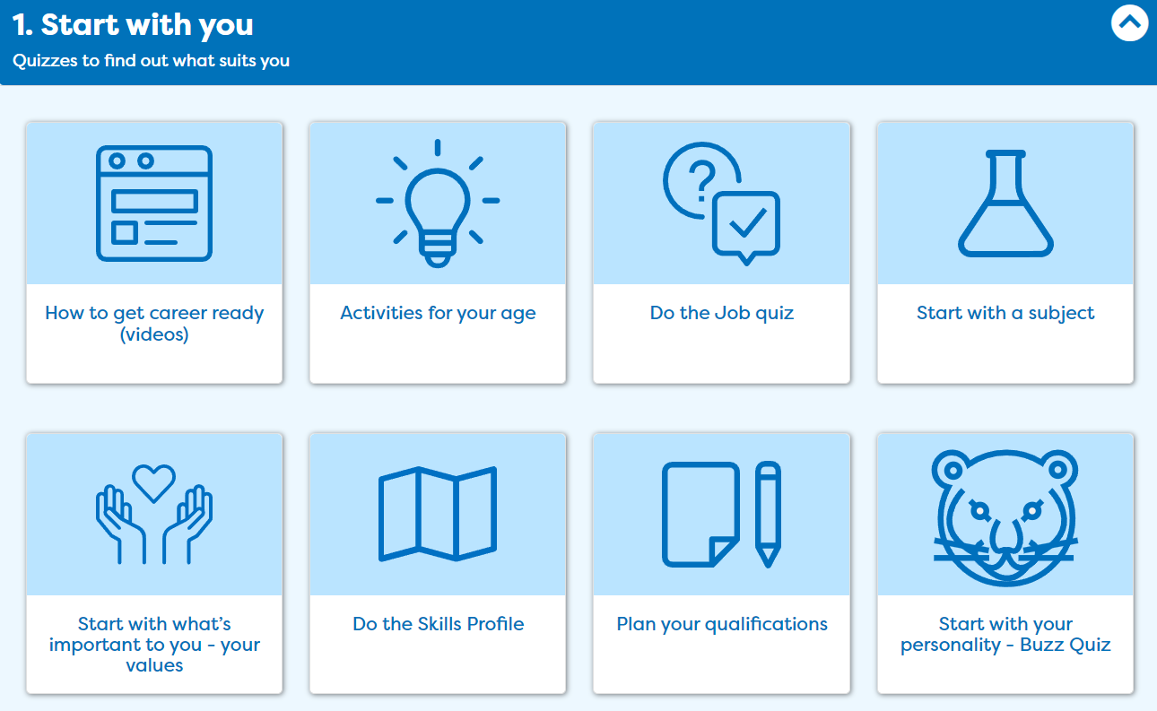
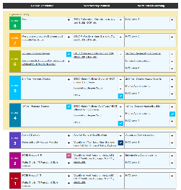

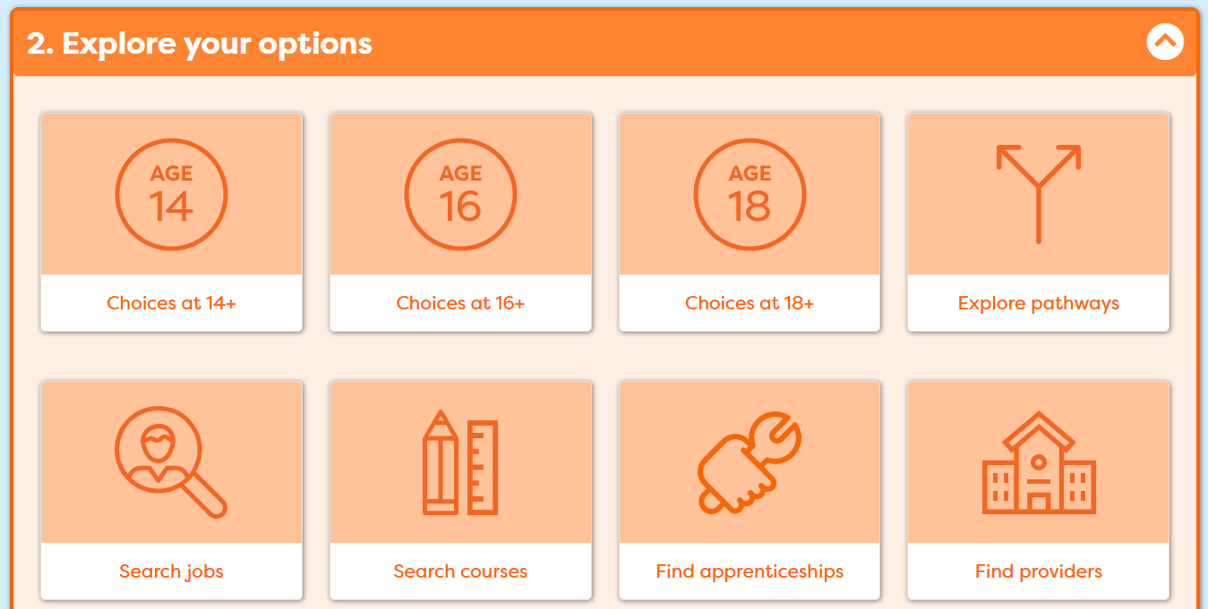
In today’s lesson you will…
Register/sign in to Careerpilot
2. Confirm what drives you ‘Start with you’
3. Add your qualifications to ‘My qualifications’
4. Consider routes at 18 and explore options
Notes:
Explain to students what activities they will be doing shortly on Careerpilot.
Use the following slides to explain how to complete these activities before getting started….

Slide 9





Get ready for your future career
https://www.youtube.com/watch?v=OWZxyyK6OuA
Notes:
Show the video (3 mins). If they have seen it before set them a challenge to remember the 4 thing the video recommends they can do now to manage their career

Slide 10
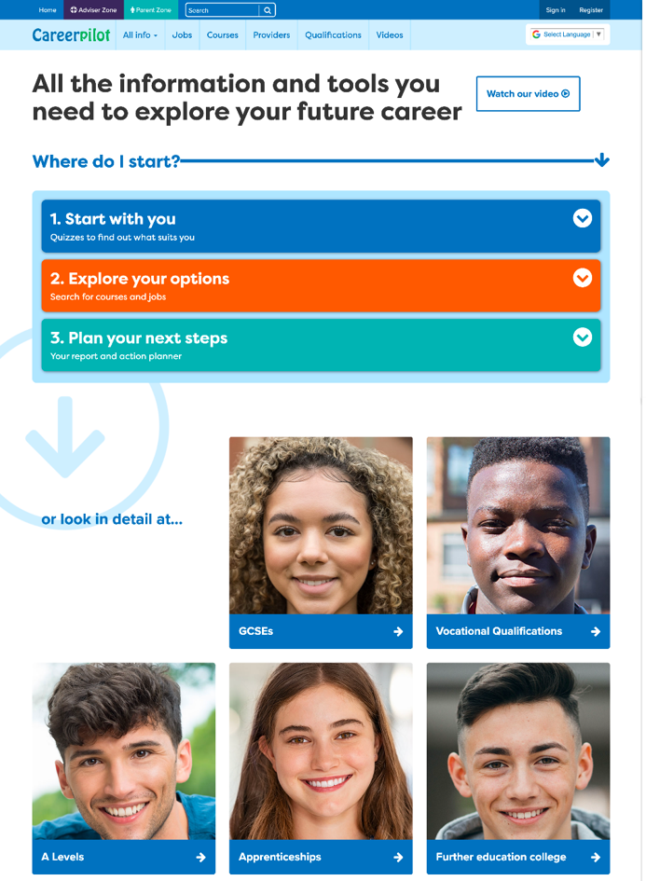
Careerpilot – all you need in one place
Jobs, courses, qualification planner, videos
Quizzes, tools – 3 stages to help you decide
Future qualifications and pathways
careerpilot.org.uk
Notes:
Careerpilot is a website that you can use for free. It has lots of information and tools to help you to start to think about future career ideas and pathways.
The website is built around 3 stages:
Start with you – with quizzes to find out more about what might suit you
Explore your options – where you can search for courses and jobs
Plan your next steps – where you can build a report and plan some actions.
They might well have used it before in KS3 and 4

Slide 11

One place for all your careers information.
Build your report in the Career Tools
1. Register/sign in 2. Build you report
Notes:
You will be using Careerpilot to explore all your options, register (or sign in if you have used it before)
Then you can build your report and have a record of all your career choices and plans

Slide 12

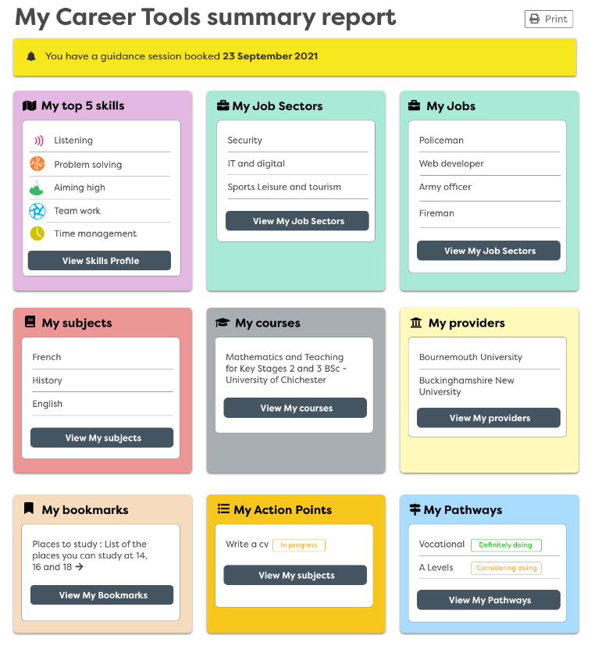
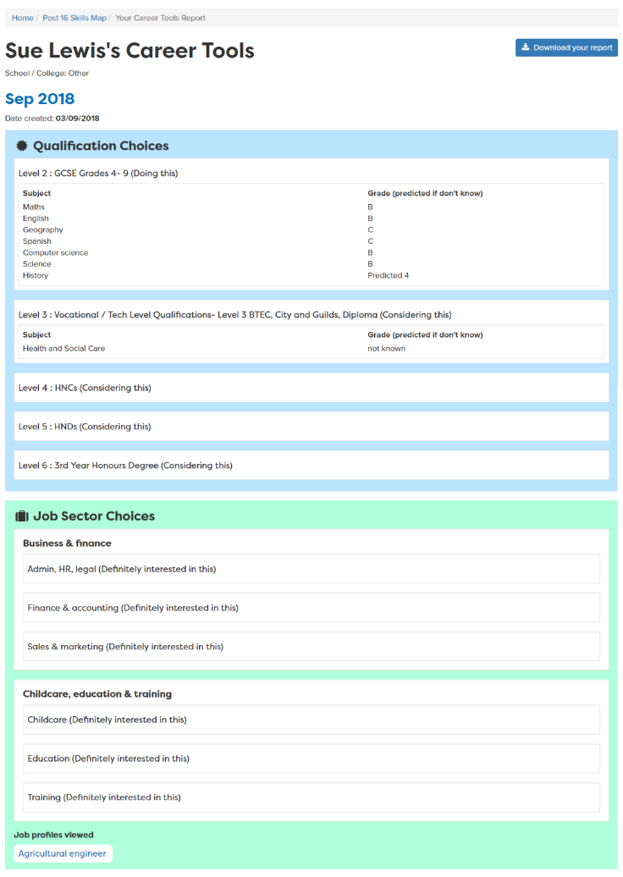
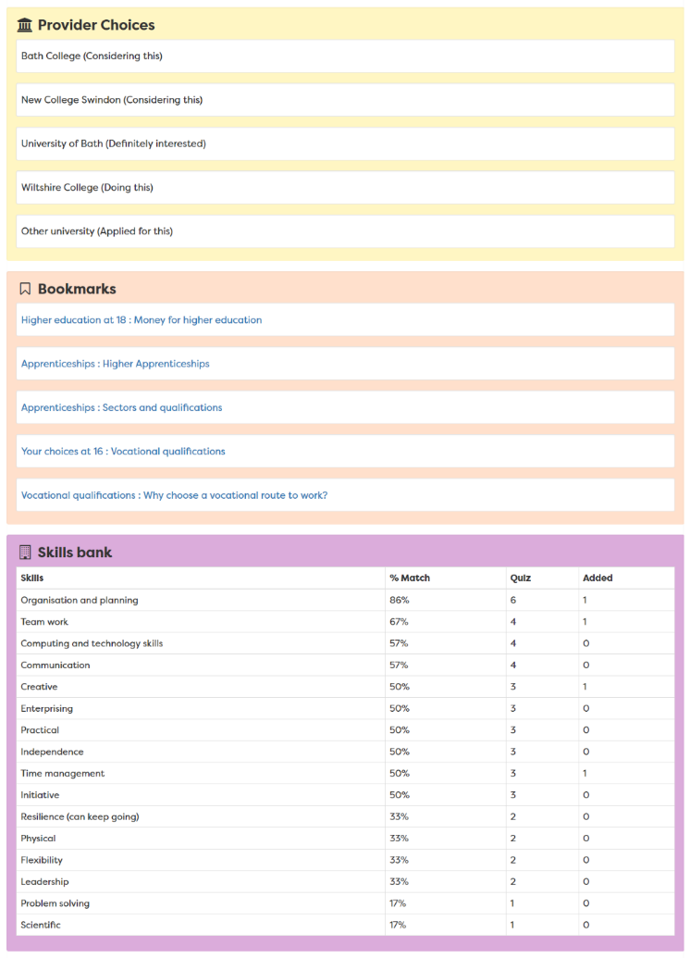
Report moves up each year
Notes:
A slide to show the report that is created once the career tools have been completed – moves up with them each year in school
Students can access their report until they are 20

Slide 13

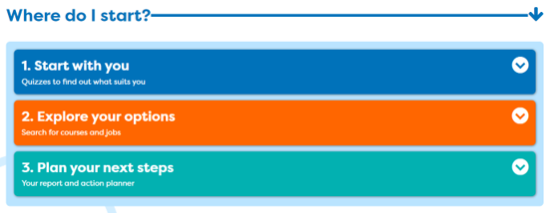
One place for all your careers information.
Notes:
Start by exploring ‘Start with you’ or redoing things you did previously to see what has changed.
You will add you post Y12 subjects to ‘My quals’ and make sure you added your GCSE actual results.

Slide 14
One place for all your careers information.
Future Planning
What I want from life
Post 18 – After Y13/college
Jobs I would like
5 mins
Notes:
It is important to tie career decisions into what you want from life.
Students draw the 3 circles as above and then write in their thought to date about each one. The last box is about what’s important to them – Kids, having a house, preventing climate change

Slide 15

One place for all your careers information.
Get ready for your future career
Work Experience
Cadets
Duke of Edinburgh
A Levels/
T Levels/BTECs
Youth Groups
Don’t drop them!
Great for your CV
Sports Teams
Performing Arts
Notes:
Yes your number 1 priority needs to be you’re A Levels or other Level 3 Qualification but don’t give up anything that will be useful for a future job/course/CV.

Slide 16

Today
Notes:
Today focused on your options.

Slide 17
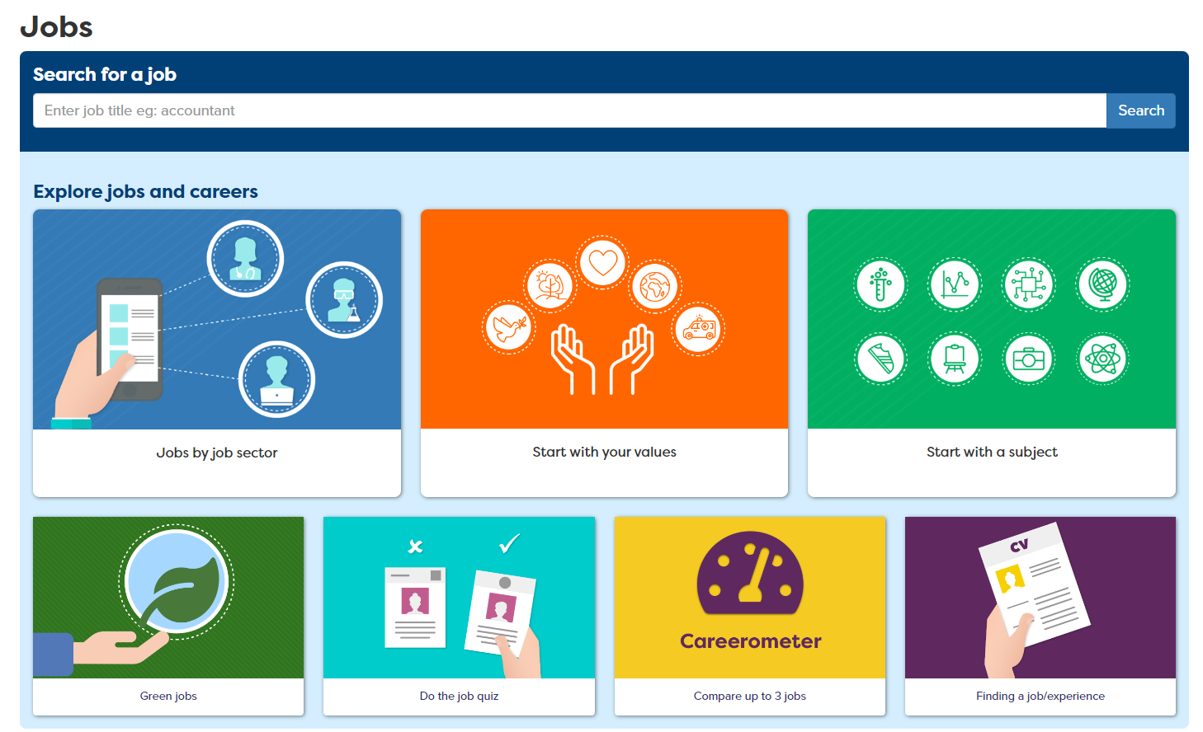
One place for all your careers information.
What will get you to where you want to go?
Notes:
If you know what job you want to do in the future you can see what routes you can take into it.
Choose a job

Slide 18
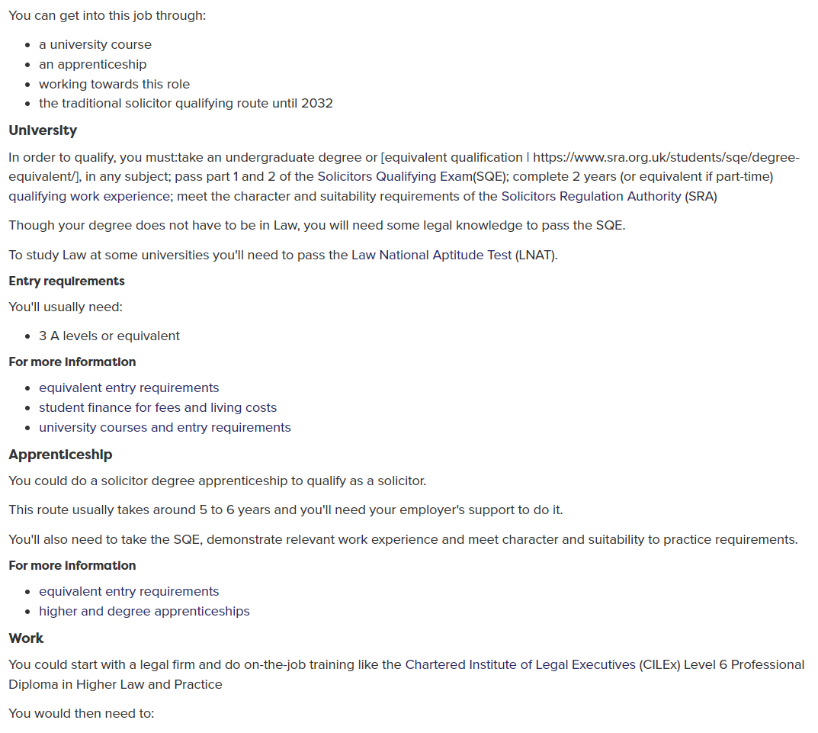
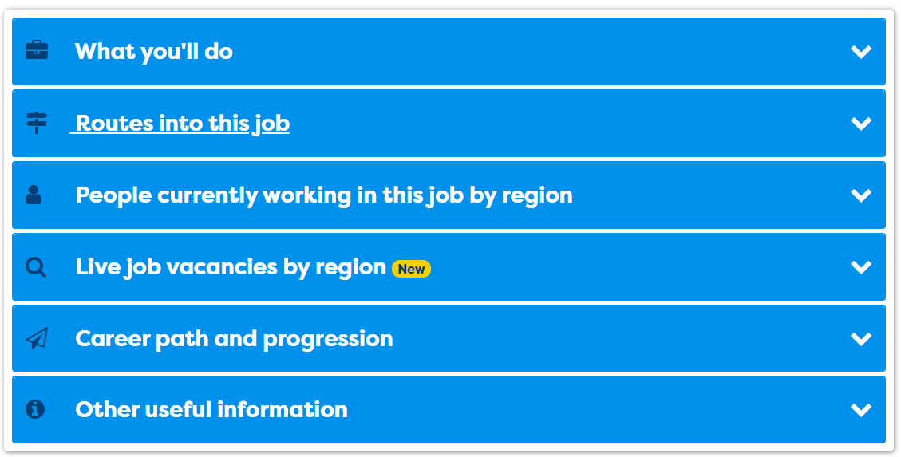
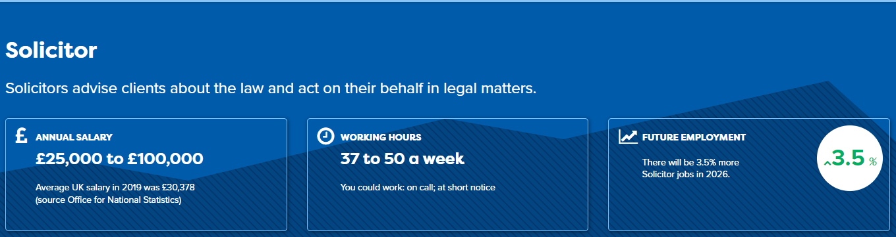
One place for all your careers information.
What will get you to where you want to go?
Notes:
Every profile has lots of details about the job – LMI and what routes can be taken.

Slide 19






Gap Year
Get a job
Academic
Technical/Vocational
Apprenticeship
Degree Achieved
Degree Year 2
HND
Foundation Degree Y2
Higher Apprenticeship
Degree Year 1
HNC
Foundation Degree Y1
Higher Apprenticeship
A levels
BTEC/OCR General or T Level
Advanced Apprenticeship
5 x GCSEs 4 - 9
BTEC/OCR Level 2
Intermediate Apprenticeship
GCSEs 1 - 3
Notes:
Need also to consider the next qual you will do.
Explain that there are three pathways but in all pathways there are levels of quals.
Make the point that all pathways can lead to a degree.
The bit of the qualification ladder we are mainly talking about today is their choices after Level 2 or 3

Slide 20
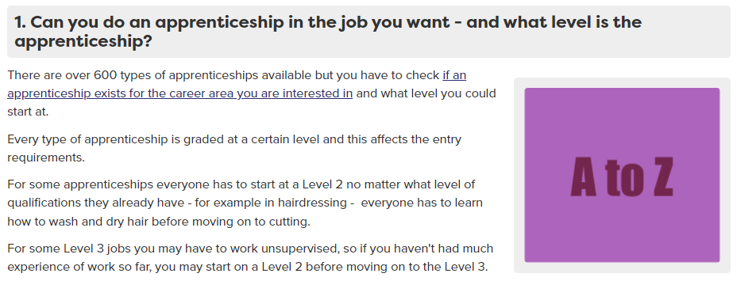
Degree or apprenticeship?
Nurse
Dentist
Medical Doctor
Can be competitive –as anyone of any age can apply for an apprenticeship
Degree
Degree
Degree
Apprenticeship
Apprenticeship – new 2023
Notes:
Ask what qualification do they need to become….
Is it a degree, apprenticeship or both?
See answers. The Medical doctor is a bit of a trick question as this will be a new apprenticeship in 2023.
Can see an A-Z of available apprenticeships on Careerpilot – in the ‘finding an apprenticeship’ section. Make the point that even if one exists they still have to find a vacancy. Careerpilot has links to vacancy sites too.

Slide 21



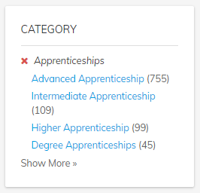

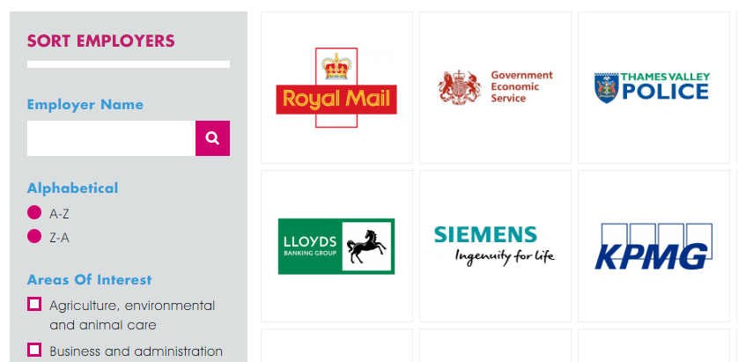
One place for all your careers information.
Interested in apprenticeships?
Higher/Degree Apprenticeship
You might have to start at a lower level or go sideways
Higher/Degree Apprenticeship
Higher/Degree Apprenticeship
Advanced Apprenticeship
Intermediate Apprenticeship
Notes:
Make point that Higher and Degree apps are great but they are competitive. Need sometimes to start at level lower than you have. There are other places to look, like Not Going to Uni.
There are a lot more Advanced Apps available
Search for vacancies on Careerpilot

Slide 22
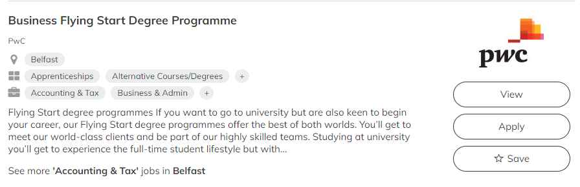


One place for all your careers information.
Interested in employer sponsored degree?
Check the small print and what you are committing to!
Notes:
There are also employers who will sponsor you as you do your degree.

Slide 23


Interested in Higher Education in a college?
Often lower grades needed.
Degree in 3rd year
Business
Computing
Design
Education
Engineering
Environment
Social care
Construction
Law
Media
Finance
Psychology
Science
Social Sciences
HND
Foundation Degree Y2
HNC
Foundation Degree Y1
Often lower fees than a university.
A Foundation Degree is a degree combining both academic and vocational qualifications.
Notes:
Another option you can consider is to do higher level qualifications through your local college.
They offer a range of qualifications at level 4 and above depending on the college and the courses will vary depending on their specialisms and the local demand.
They either offer HNC/HNDs – which are higher level BTEC courses or Foundation degrees which combine academic and vocational qualifications.
It is possible after a level 5 to top up one of these qualifications to get a full degree either at college or a university. All of the courses that are offered by a college are vocational – so job related.
The fees can be less than university and the course may suit you if you know what you want to do and would like to stay close to home.
Some HNC/Ds and FD are now also badged as Higher Technical Quals, providing good progression routes from T Levels

Slide 24

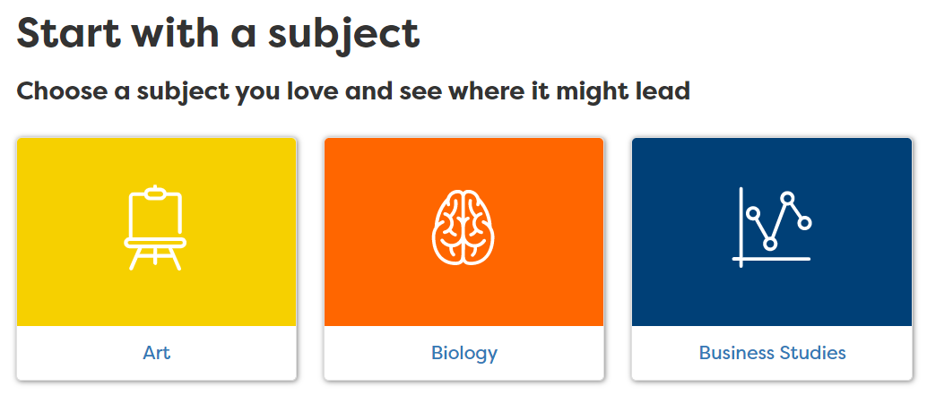
Thinking Uni? 1000s of courses, 130 unis
1. Decide which course
2. Find and compare
Values/interests can help you choose
Courses with the same name can be quite different
Start with a job and work back
What UCAS tariff points will you have? (56 = A*, 48 =A, B =40)
Accommodation costs, student satisfaction, etc.
Go to a local Uni and save costs or consider college/ Open University.
Notes:
Who is thinking about uni?
Here are a few key things when deciding.
Can start with a job or start with a subject as employers are keen for people with any sort of degree subject.

Slide 25
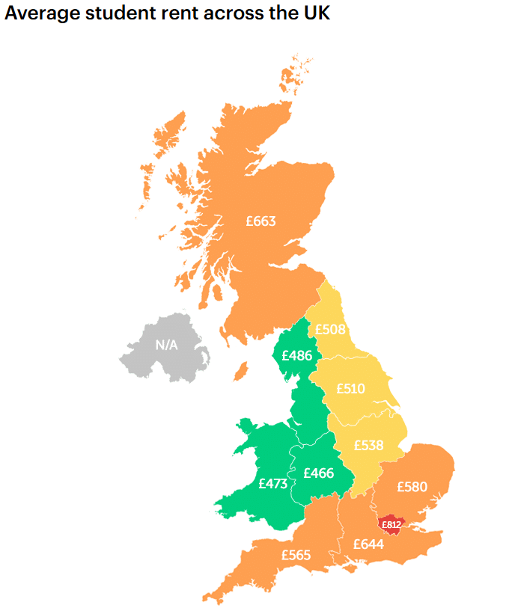

Explore the details
Average student rent across the UK
What is the average
student rent?
Does the rent include bills, WIFI?
Notes:
Ask students to write down what they think the average rent is.
Put hands up if think:
Under £500
Over £500
Need to know more than just about the course costs.
Rent varies across the UK with London being the most expensive region (though maintenance loans are higher in London)

Slide 26
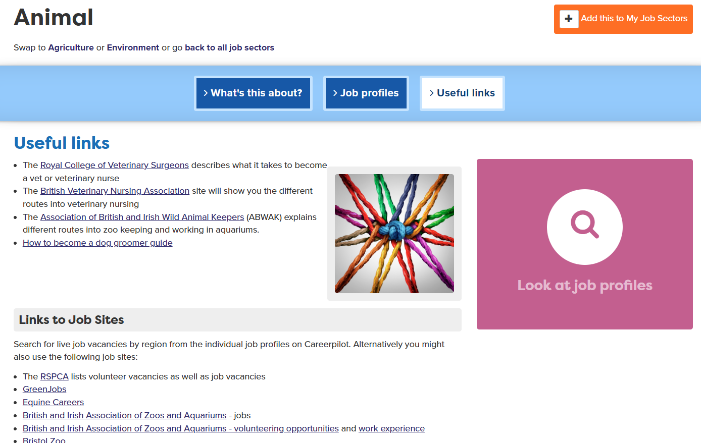
Thinking about work and training?
Notes:
Careerpilot has info on these pathways and every job sector has links to employer websites to find out more and also to search vacancies.

Slide 27
One place for all your careers information.
Top Tips
If you are thinking of applying for an apprenticeship:
Plan A
Apply for Uni by January
Plan B
Look for an apprenticeship as vacancies for September often come out after January
Notes:
They can always decline their uni place later if they get a great apprenticeship opportunity.

Slide 28
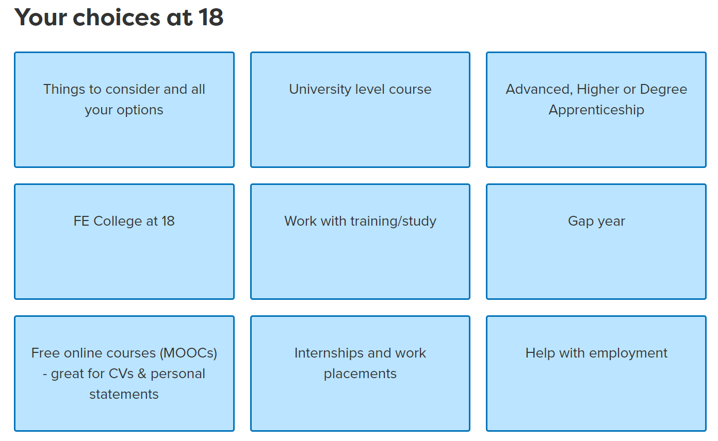
One place for all your careers information.
Careerpilot has all the information
Notes:
Careerpilot has lots of information about options, including links to other sites which offer good information.
MOOC – Massive Open Online Courses are free and are a short, online intro to subjects – looks great on your CV or personal statement but also great way to find out more about a subject.

Slide 29

Now it about you – explore your options
1
3
careerpilot.org.uk
2
4
20 mins
Notes:
Give the students 20 – 25 minutes exploring Careerpilot after explaining task. Make sure they sign into Careerpilot.
These are the sections we will be focusing on today. Use any of these sections to help you get an idea of yourself and your options and to help you think about what you will do after Y13 and into the future. Remember to tag things you like as you find them.

Slide 30


One place for all your careers information.
Get ready for your future career
Parents/family
Career advisers
Teachers Head of 6th Form
Careerpilot
Notes:
When they are back as a group. Talk about supporters and see if they can suggest any others. Tell them the name of the school careers adviser.

Slide 31
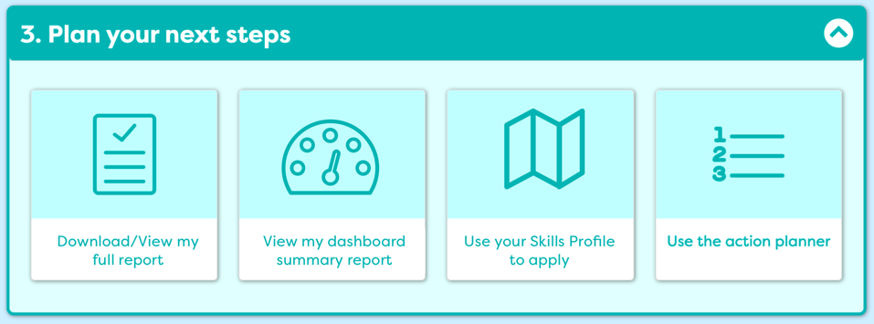
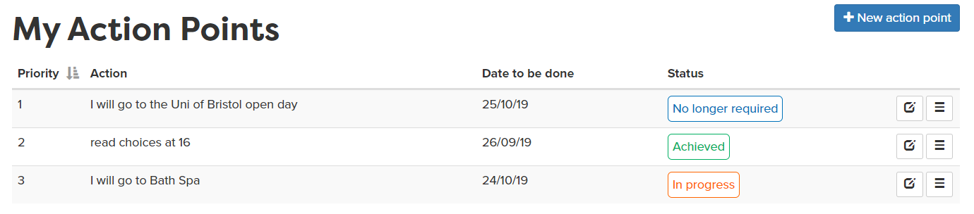
Write an action point
5 mins
Notes:
They should write one or two action points of things they will do now to move on their career.

Slide 32
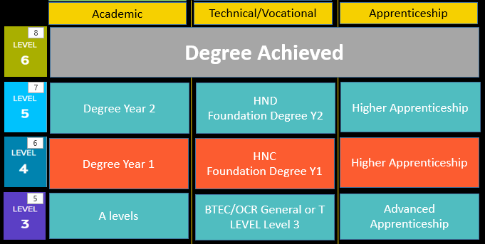
Wrap-up – In pairs
Pathways at 18: Which are you interested in?
5 mins
Notes:
Ask who is interested in Academic, Voc, work based.
Get students to write down their chosen pathways as A, B C
Ask who wants to stay in the area, who wants to go further
In pairs share what they looked at and what they are thinking of

Slide 33
Getting Career-ready – did you?
Seen how your post 18 choices fit with future jobs and your career
Started to make a plan and develop a pathway for your future
Notes:
The Career Development Institute has developed a careers framework that shows the skills everybody needs to have to manage their future career.
This slide shows the students which of the career learning areas (CDI) that this lesson links to.
You can also share the structure of the session with students.

