Slide 1




Delivery Notes
Before session 1, ask school to ‘whitelist’ careerpilot.org.uk
All students to have own computer with Internet access.
Deliverer to have whiteboard for presentation.
Timings | Slides | Activity | Notes | Key tasks
20 mins | 1 - 11 | Setting the scene |  | Yes
20 mins | 12 - 16 | Thinking about WEX and finding one to apply to | Workbook | Yes
15 mins | 17 - 21 | Exploring your skills and matching to a job | Workbook | Yes
5 mins | 22 - 24 | Wrap-up
After session 1, send school summary of what covered and Digital Postcard for session 1 to send to each student. Remind the school of what you need for session 2 – each student to be able to download template

Slide 2


Specially designed to help you develop your skills and explore and plan your future work experience placement
Session 1
Exploring YOU and work experience opportunities and YOUR skills.
Investigate and Explore
Session 2
Having what YOU need to apply for and have a great work experience
Apply
and Demonstrate

Slide 3


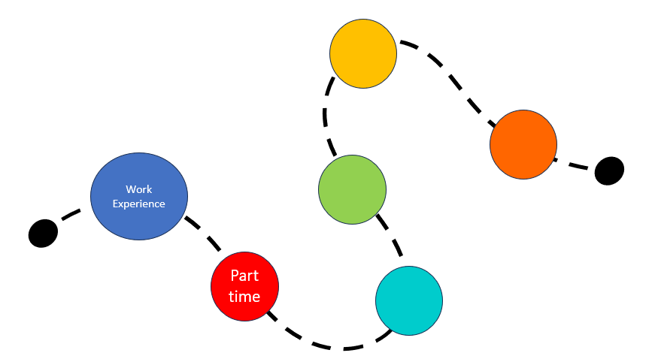

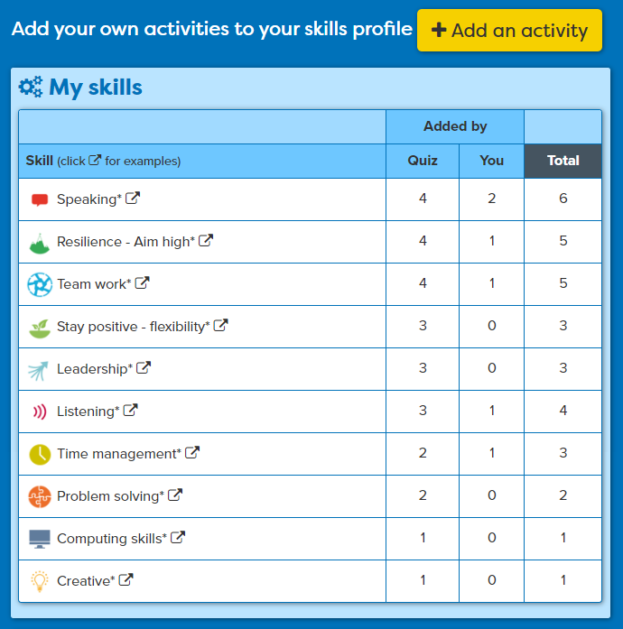
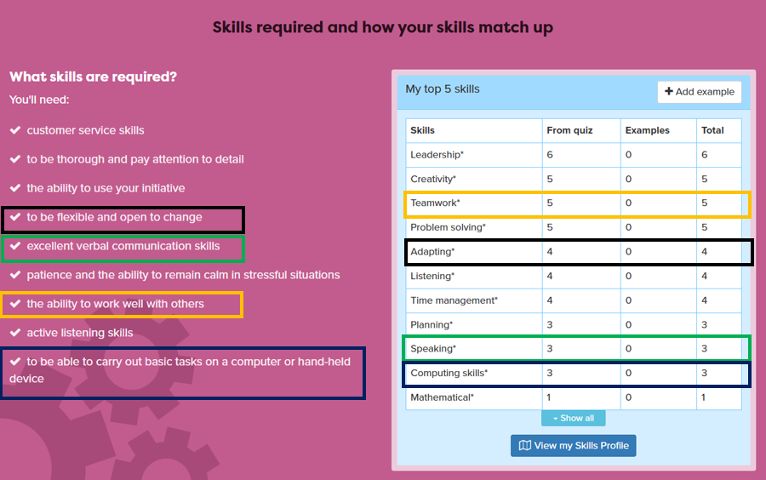
In this session you will:
1
  Understand the benefits of work experience and how it fits with YOUR career journey
2
Explore local companies that might offer work experience placement opportunities
3
  Recognise the essential workplace skills you have and match them to a job role
careerpilot.org.uk
Notes:
Three key things to be covered in this session

Slide 4






What do you want in your future life?
?
What do we all need to get the things we want from life?
Notes:
Just say ‘Have you thought about what you want to get from future life?’ they don’t have to say but just making point that we all have ambitions.

Slide 5


What different places can people work?
Office
Workshop
Home
In a hospital
Outdoors
Digital nomad
Notes:
Explain that what we all need to be able to do the things we want is usually funds, and we get them from having a job. Loads of different types of jobs. But that is not the only thing we get from working. See if they can come up with some ideas like:
Job satisfaction
Meet new people
Learn new things
Gives us purpose
Enjoy leisure time more as have contrast.

Slide 6

What is a career?
A career is an individual's journey through life, learning and work.
It is all about YOU!
Work Experience
Part time
Throughout your career you may have many jobs.
Notes:
WEX first stage on career journey

Slide 7

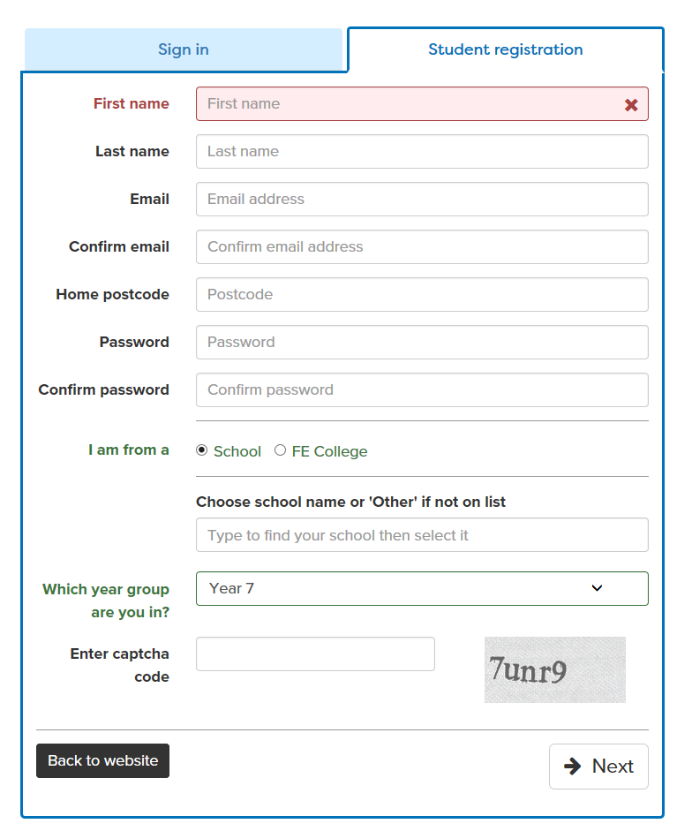
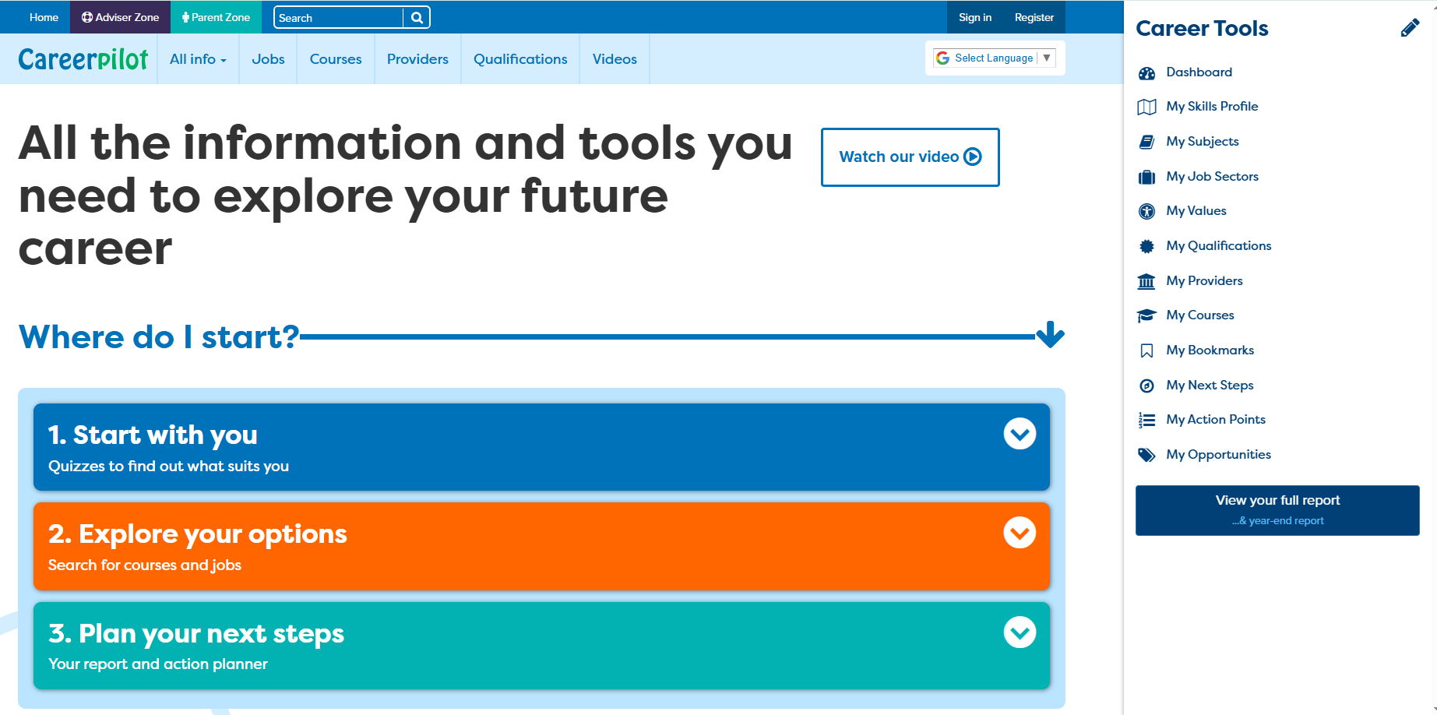
A website to help with your career
careerpilot.org.uk
Notes:
They should only set up new account of they do not have one already, otherwise they should ‘sign in’. They can do ‘forgotten password’ from the sign in screen. They must use the same email they used to register and go to that email address to pick up the new password link.

Slide 8
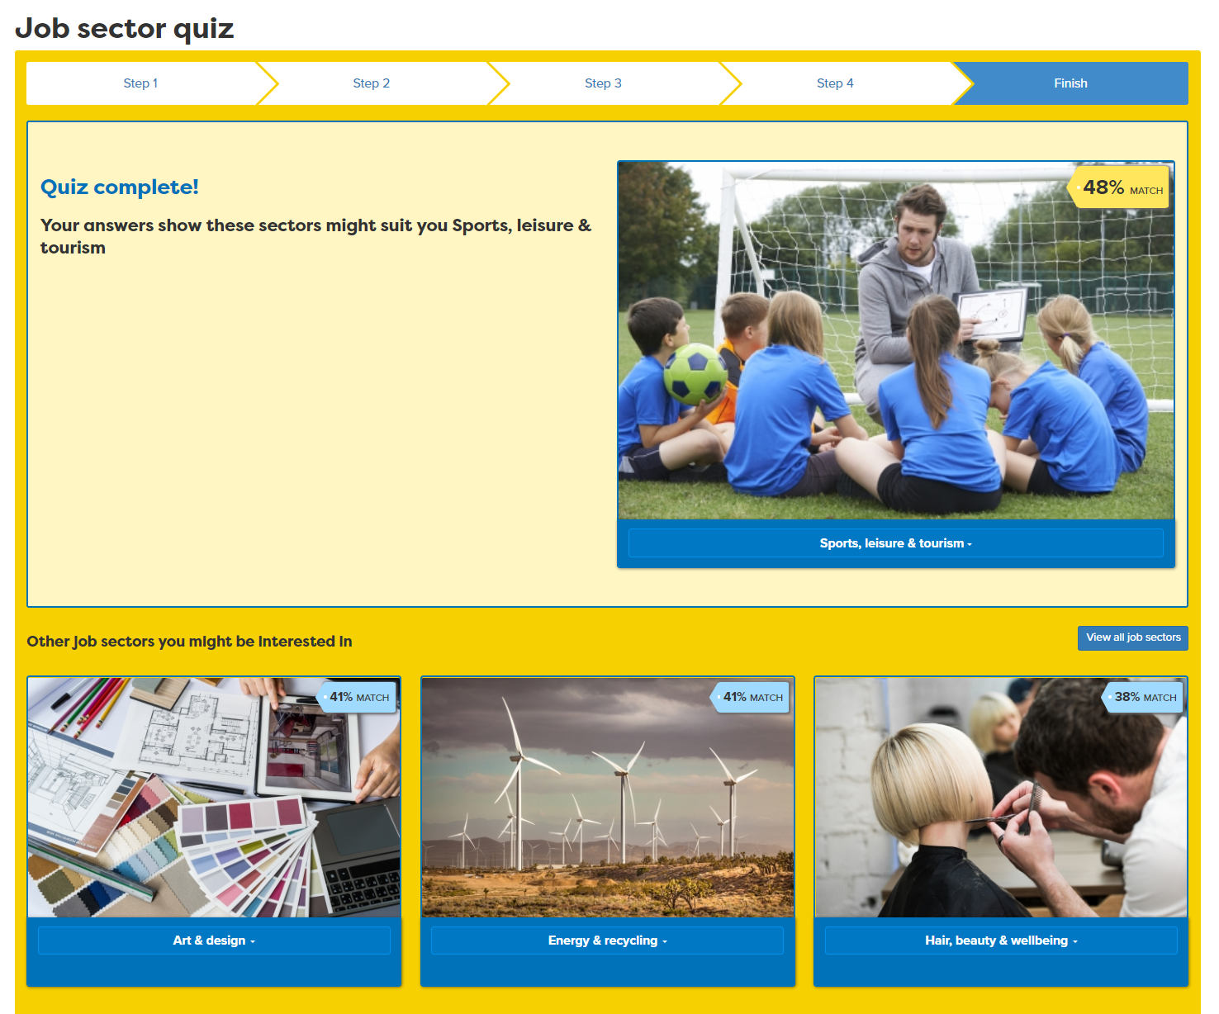
Looking at Careerpilot reports

Slide 9
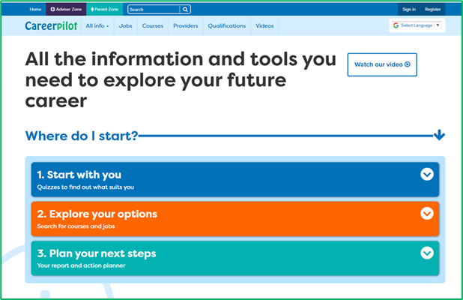
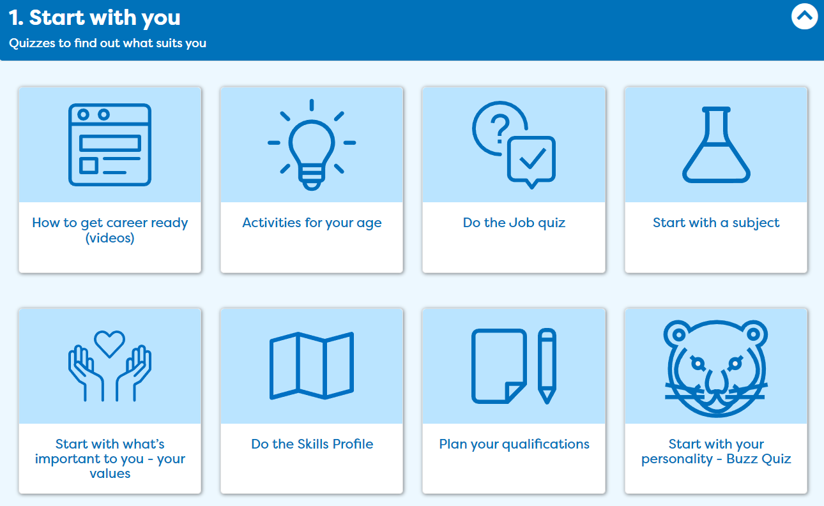
What sort of personality do you have?

Slide 10
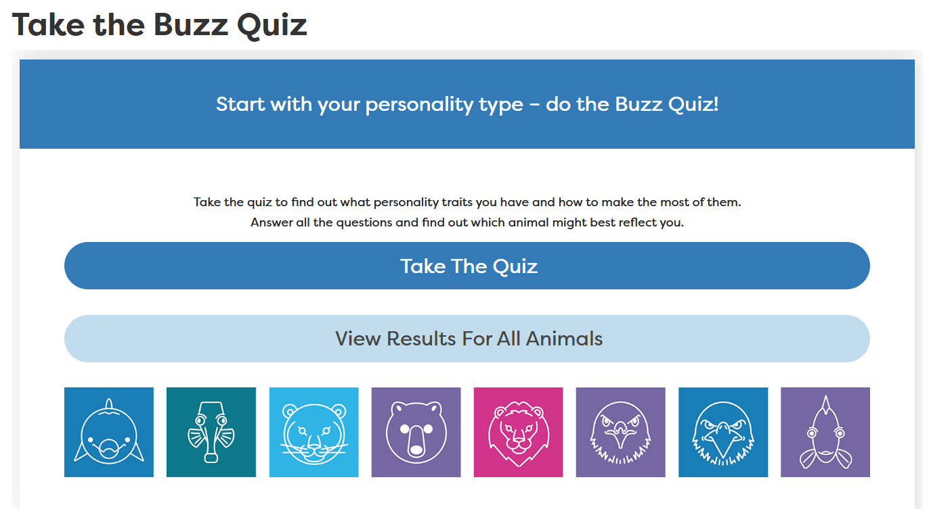
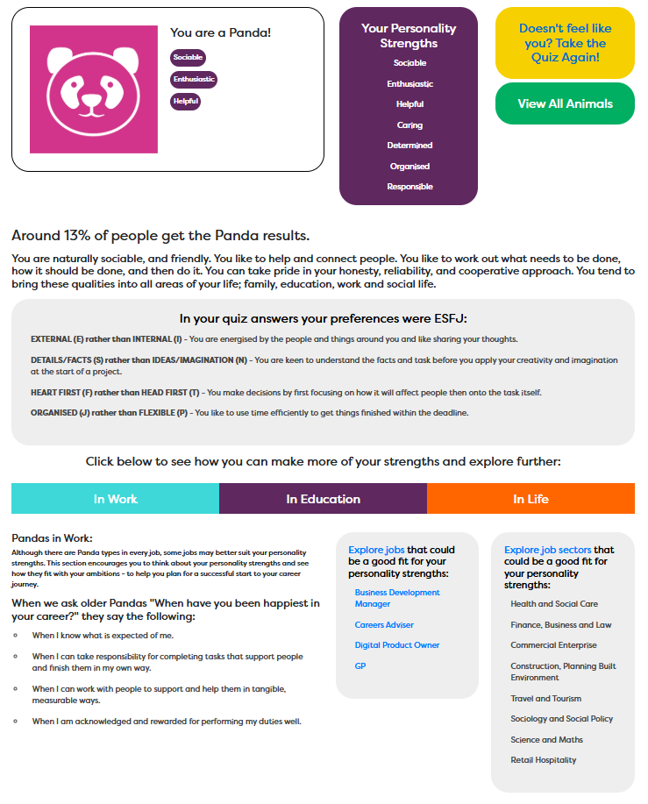
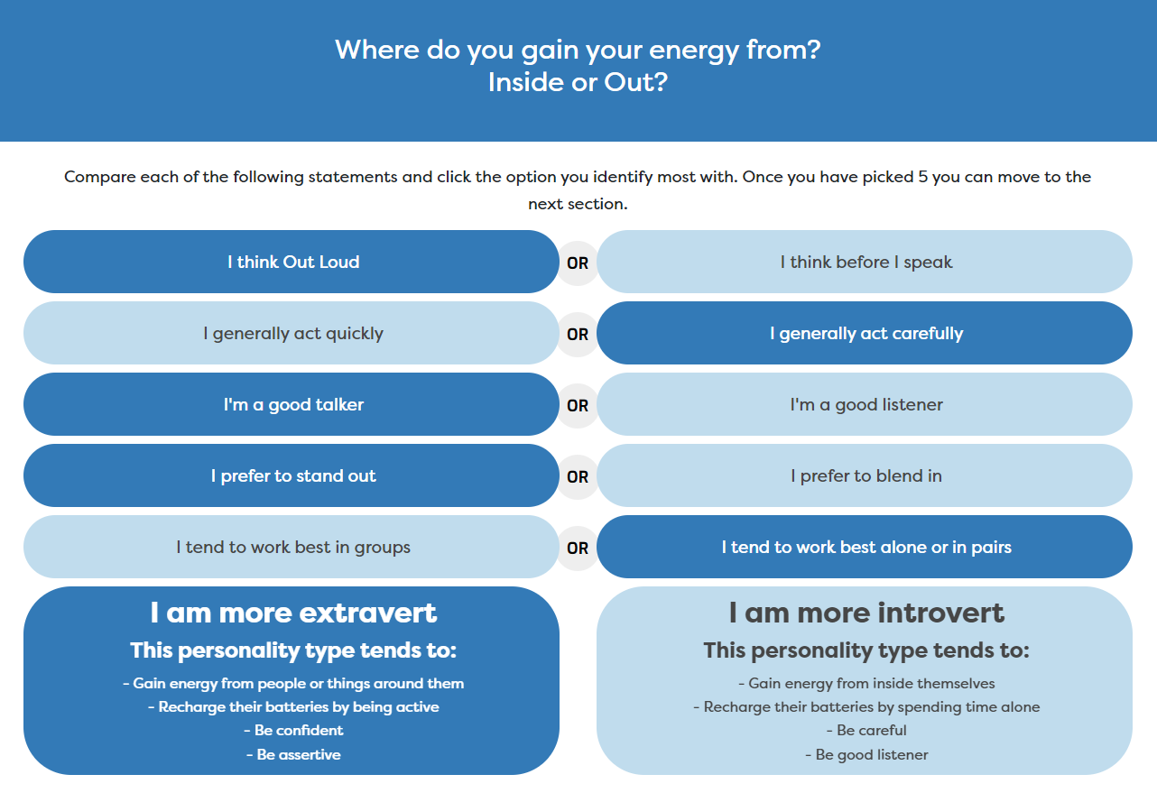
We all have different types of personality traits, what are yours?

Slide 11
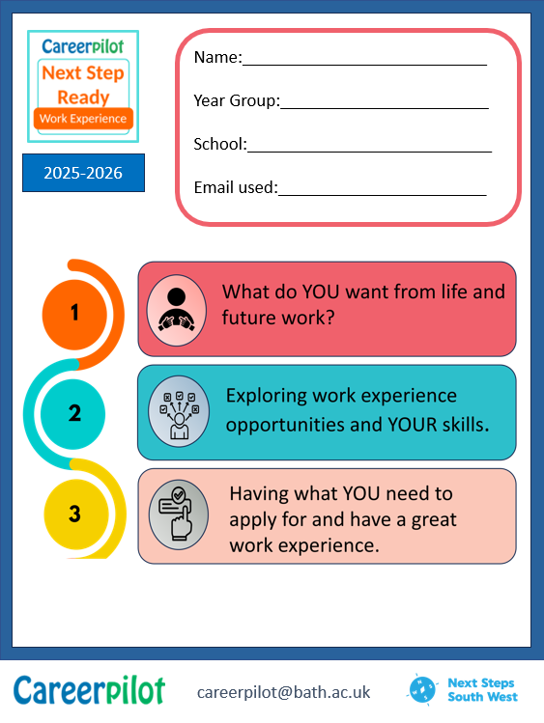
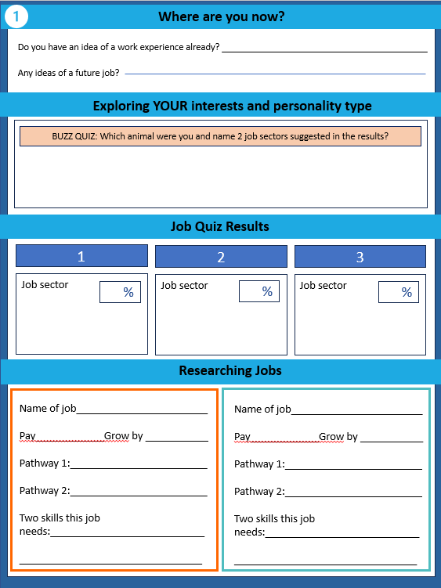

Workbook

Slide 12
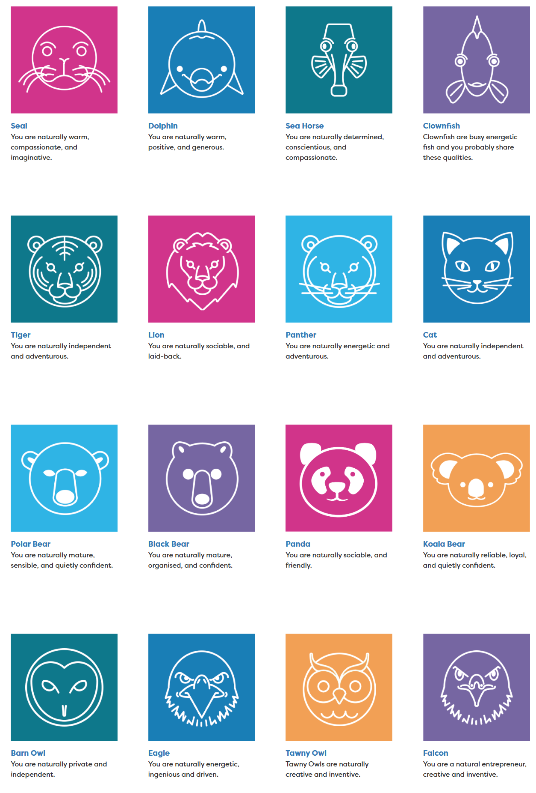

Feedback on your results
Your community/country/the world needs people of all types and people interested in all job sectors.
Notes:
Just ask a few people to put up hands if they were this animal, were recommended this job sector.
Mention that they are building skills as they go through the lessons.

Slide 13




What was their first job?
Taylor Swift: Singer, songwriter, musician
Beyonce – American singer
Harry Styles – Singer
Hair salon floor sweeper
Worked in a bakery
Christmas Tree Farm
Where you start your working life is not always where you end up!
Notes:
See if they know who they are and what they did as a first job.

Slide 14
Why do work experience?
To find out about a company
To learn/practice skills
To try out a job role
To be seen as a future worker
Is this the sort of job I like?
What skills will I need to do it?
What is the best way to talk to a boss?
Notes:
Could show video here (as on last slide)
Can ask them for ideas but to be quick just go through them in overview

Slide 15






Work experience can help with your career choices
Y10 Work Experience
Choosing post 16
Choosing post 18
Notes:
Will be diving into more detail about WEX in session 2 but in summary WEX can help you with future choices about qualifications as well as jobs.

Slide 16

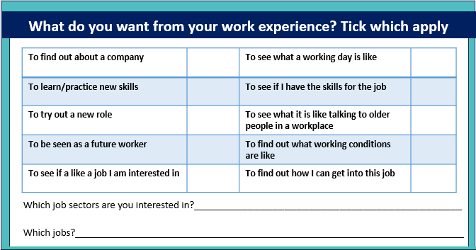
Which sectors/jobs are you interested in for work experience?
Write down a few things you want to get from YOUR work experience
And which job sectors and jobs you are interested in for work experience
Notes:
In workbook – what do they want to get from WEX. Tick as many as they want. Add a sector and even a job they are thinking of for WEX.

Slide 17
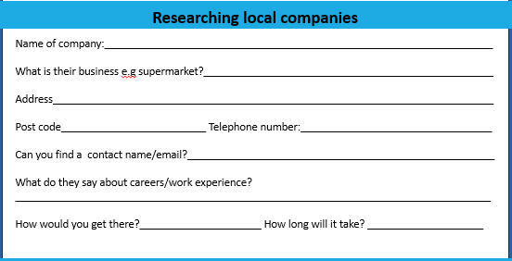
Use the school list of possible placements
  Choose one to apply to and write down the details in your workbook
10 mins

Slide 18

Focus on skills and what you have to offer
Essential in ANY job
Some jobs need other technical skills
IT Skills
Practical
Scientific
Physical
Notes:
Explain the 8 essential skills.
Mention that some jobs also require additional tech skills.
The 8 are the ones we are focusing on.

Slide 19
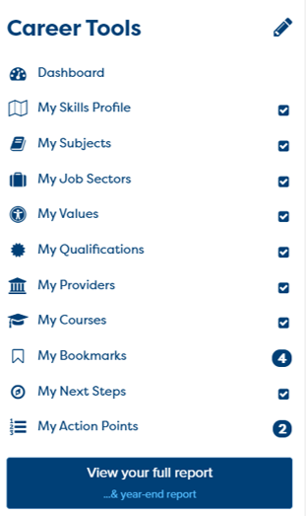
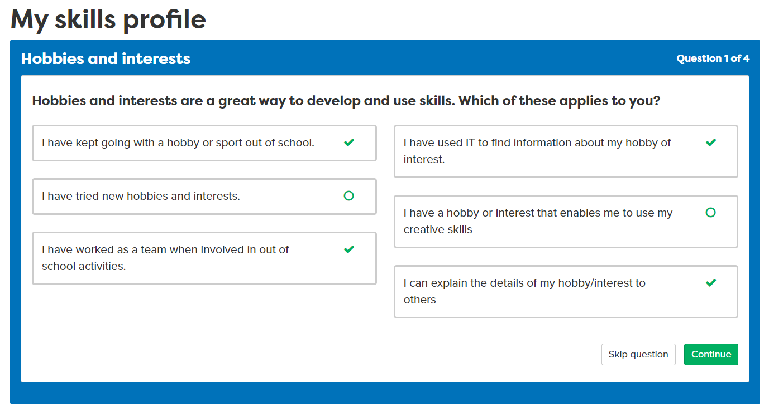
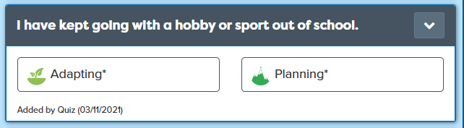
What skills do you have already?
Notes:
Even if done before want them to do this again so the list is up to date.

Slide 20
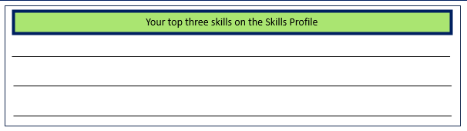
What skills have you got already?
Today: Add at least 1 or 2 of your examples
Add your own examples
All your skills are ‘banked’ for later when you want to apply

Slide 21
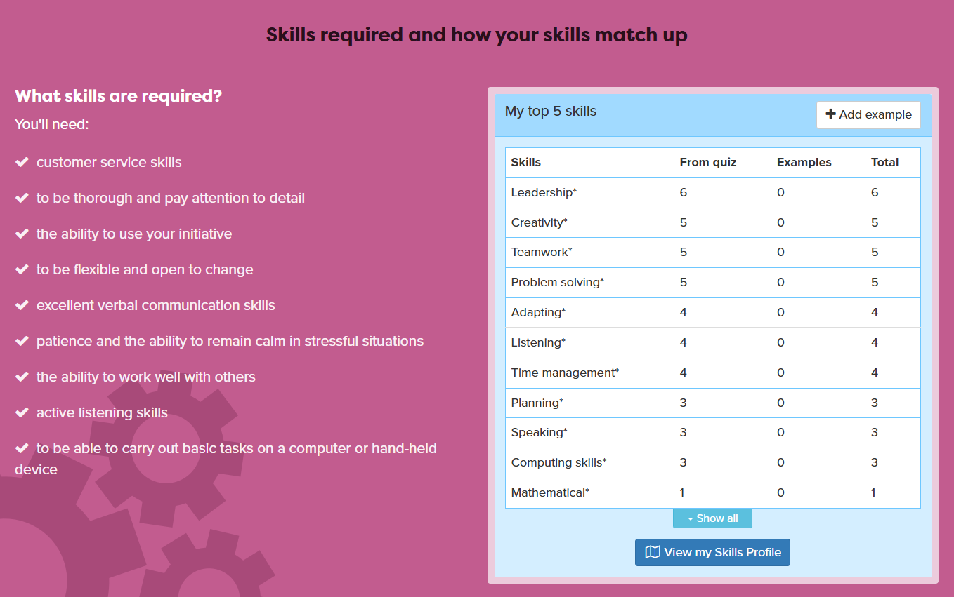
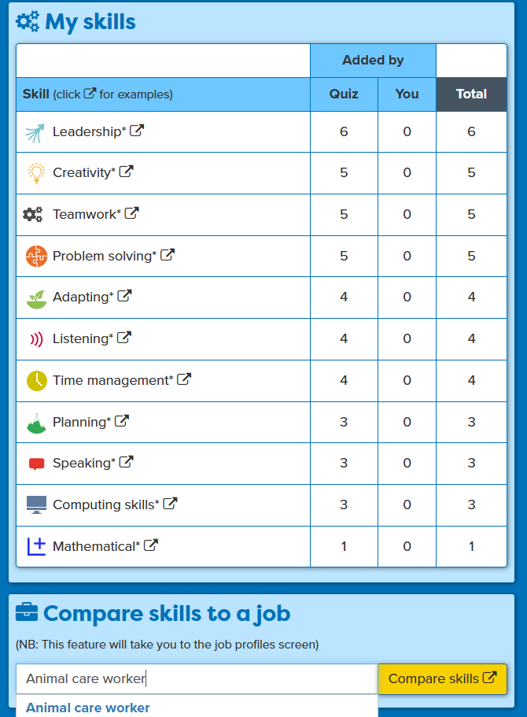
Matching your skills to a job
Notes:
Student puts in nearest job role that matches with their WEX. When they open job profile on pink bit will show skills job requires alongside their own. The language employers use might be a bit different so need to make that point e.g communication rather than speaking and listening.
In workbook write down three or four skills they have and the job wants.

Slide 22
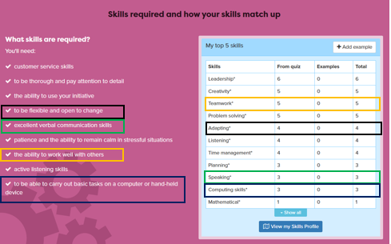
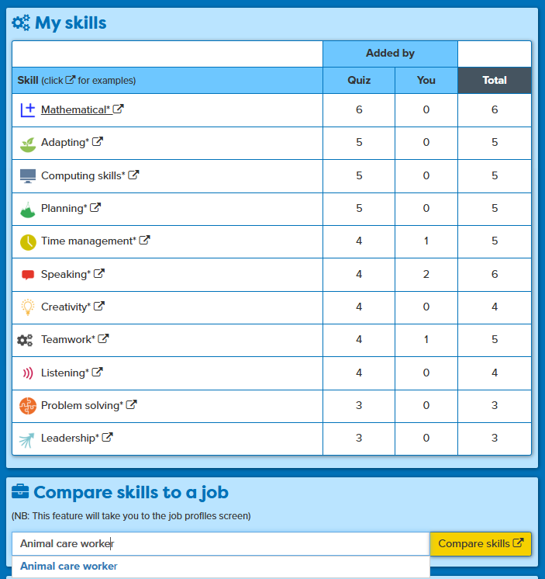
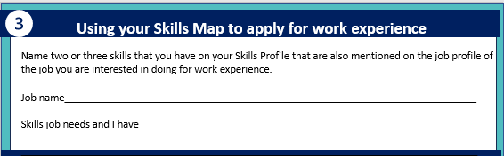
Find three skills the job needs that you have examples of
2
10 mins
3
1
3
Notes:
Summary of the task,

Slide 23
In this session you cpmpleted:
1
  Understand the benefits of work experience and how it fits with YOUR career journey
2
Explore local companies that might offer work experience placement opportunities
3
  Recognise the essential workplace skills you have and match them to a job role
careerpilot.org.uk
Notes:
Three key things to be covered in this session

Slide 24
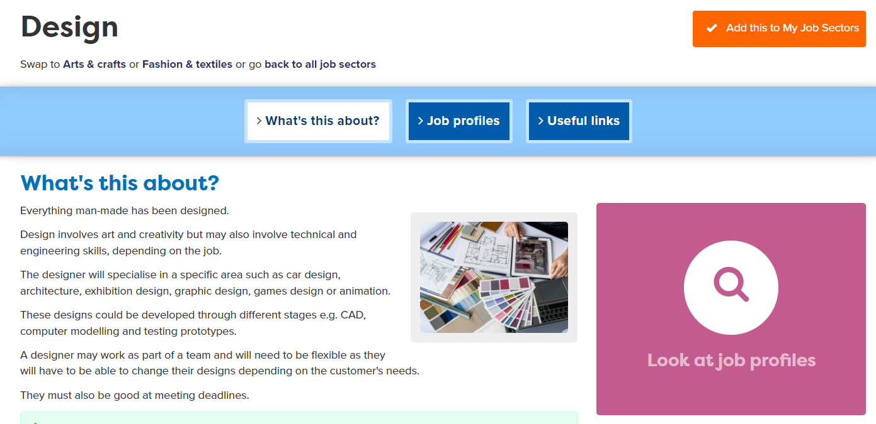
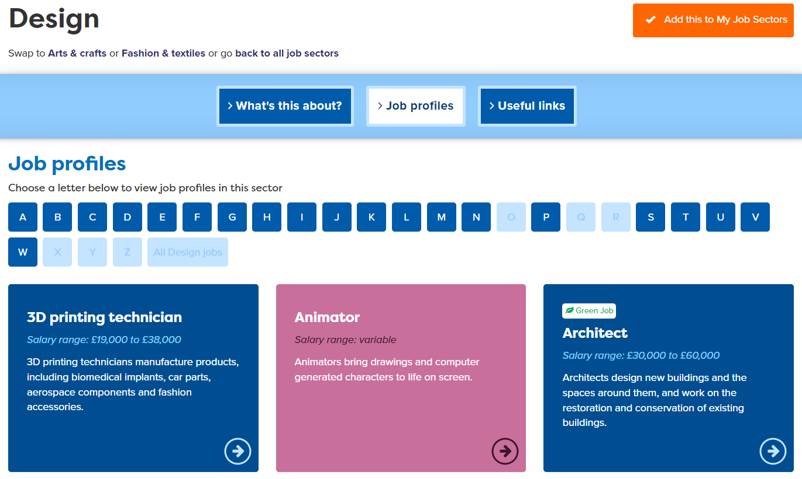
Exploring Jobs
Notes:
Show how there will be lots of jobs, some they will know a bit about but some might be completely new.

Slide 25
Exploring Jobs
Notes:
Show how there will be lots of jobs, some they will know a bit about but some might be completely new.

Slide 26
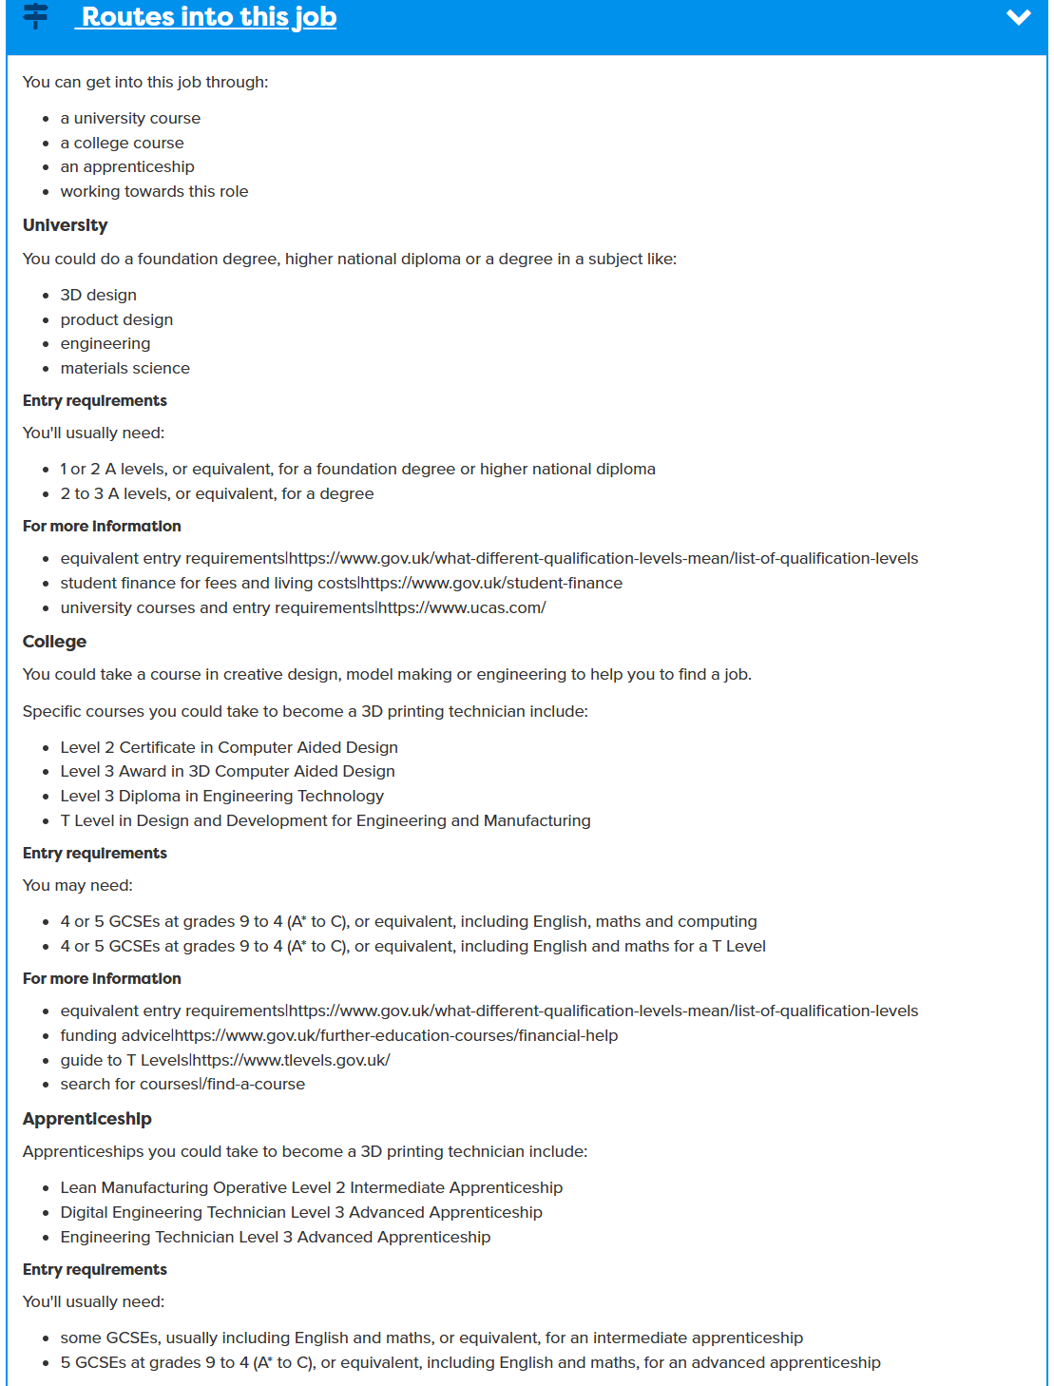
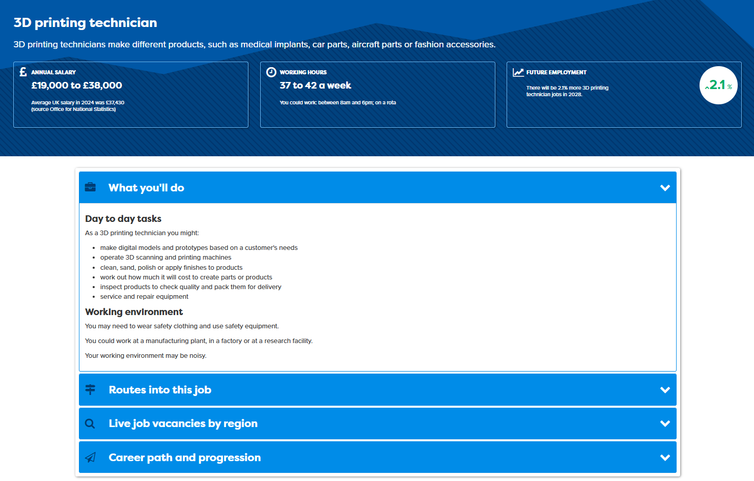
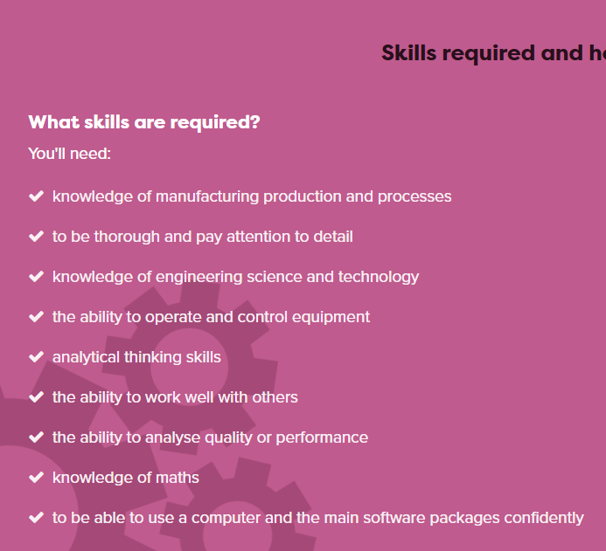
Researching jobs
Look at 2 jobs
Notes:
Explain job profile, salary, grow by, pathways, and further down on pink background, skills

Slide 27
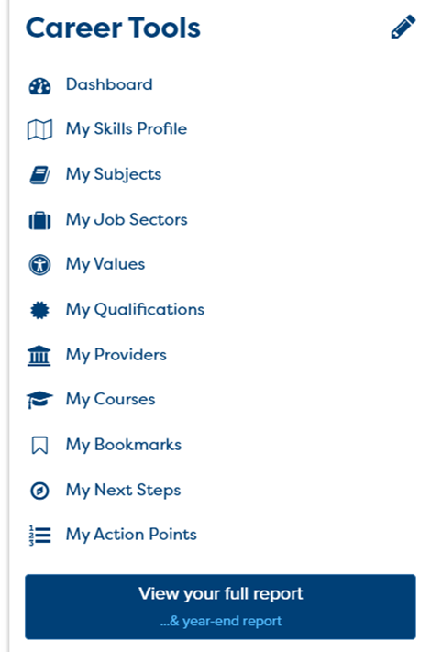
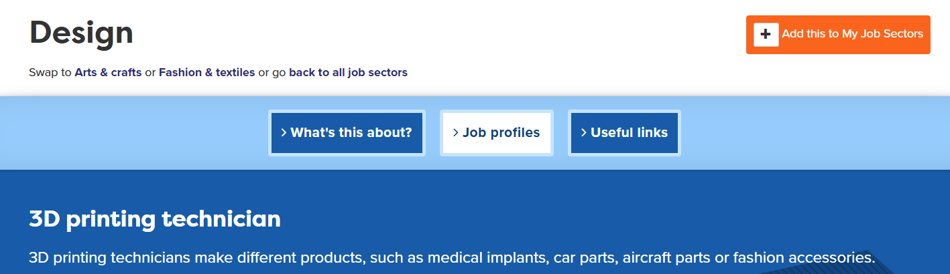
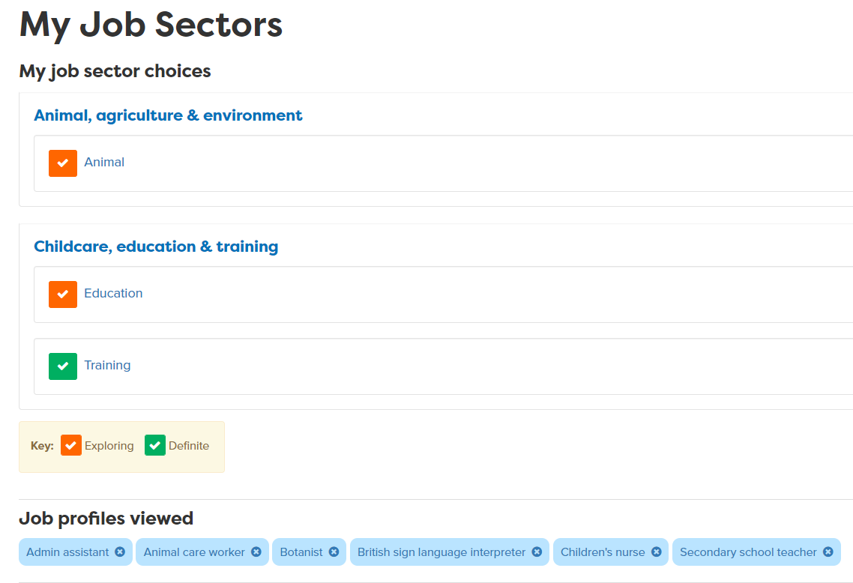
Add any job sectors you like to your Career Tools

Slide 28

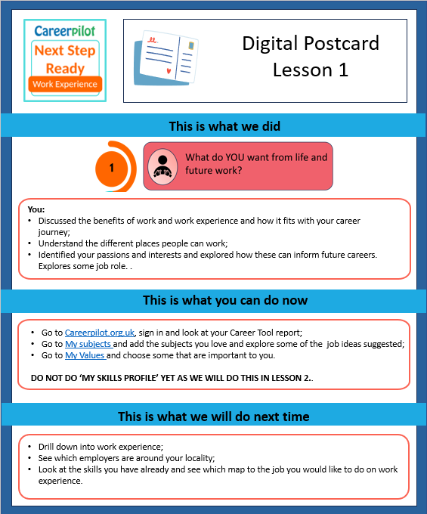
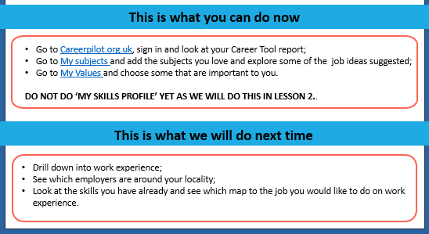
What now?
LESSON 2
Next session: Tuesday June 2nd
careerpilot.org.uk
Notes:
Please send digital postcard to main link teacher and ask them to send to the students

Slide 29
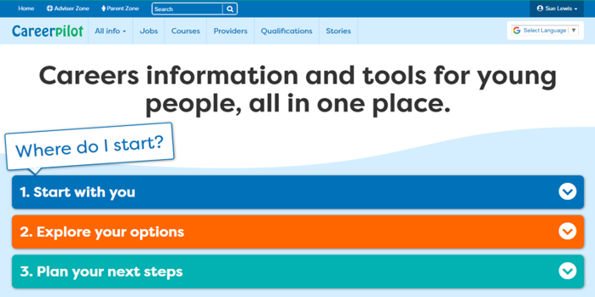
What would you like from a future job?

Slide 30
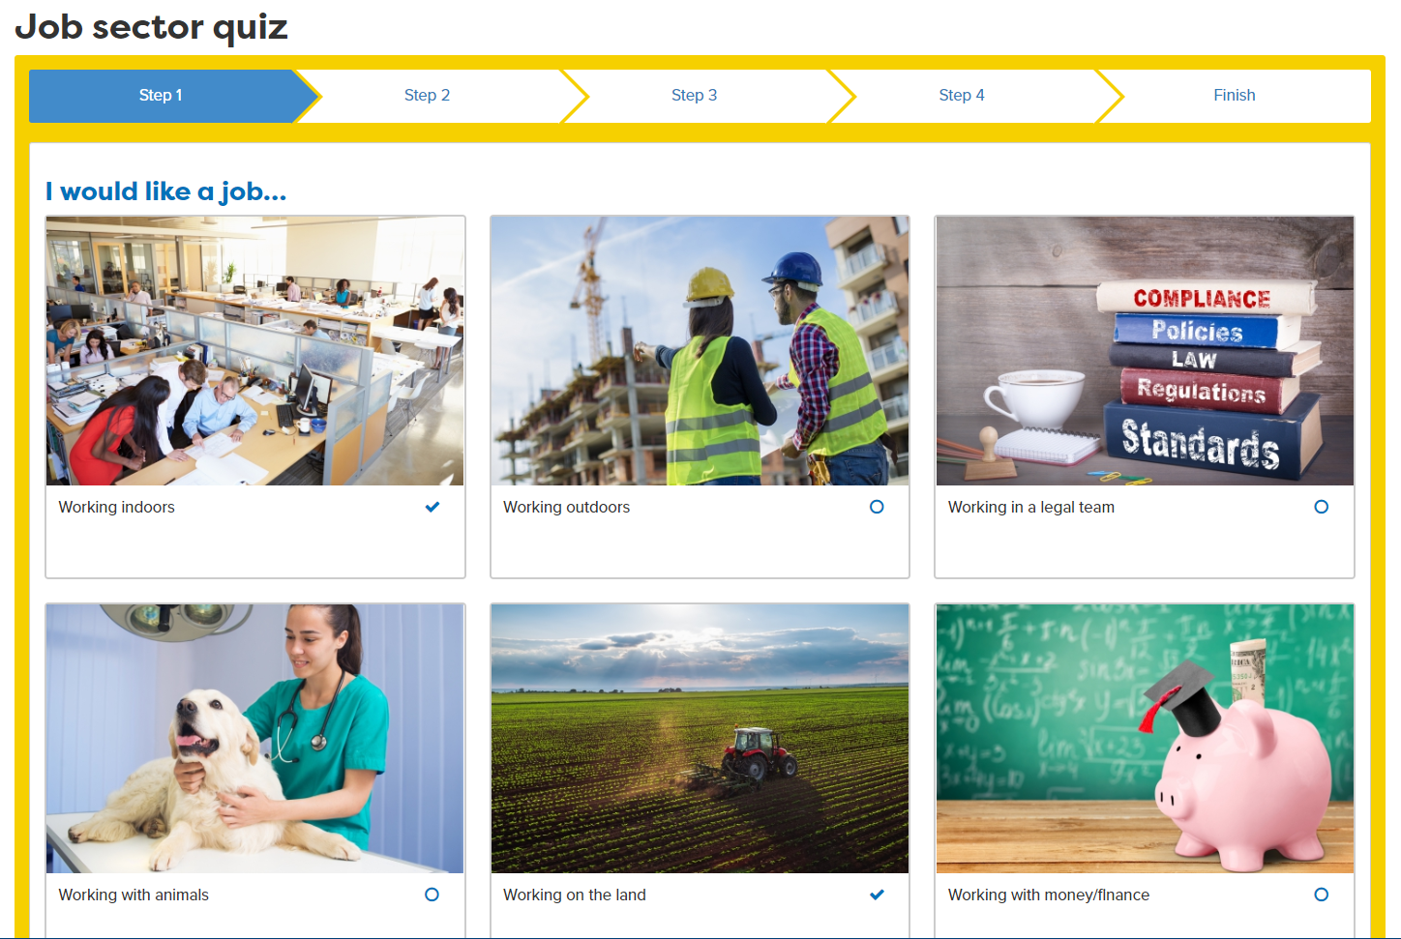
Click on any pictures that match what you want

