Slide 1


Careerpilot is closing. This resource is only available to use until 23rd October 2026.
Know Your KS4 Options
Lesson 1:
Choosing your Key Stage 4 options
This lesson can be delivered through a video recording

Slide 2
Recorded video of lesson 1
Right click to play the video above or copy and paste in a new tab to view:
https://youtu.be/o_A4RCrsOVU
Please prepare for this recorded lesson by opening videos on slide 6 and slide 17 in a separate tab to play when prompted.

Slide 3






Getting Career-ready
Introduction and warm up activity – 10 mins
You will know what a qualification is and start to prepare for choosing your GCSEs
Careerpilot Activities 20-30 mins
You will be aware of key stage 4 choices and where subjects can lead
Paired activity
5-15 mins
Notes:
The Career Development Institute has developed a careers framework that shows the skills everybody needs to have to manage their future career.
This slide shows the students which of the career learning areas (CDI) that this lesson links to.
You can also share the structure of the session with students.

Slide 4

What is a career?
A career is an individual's journey through life, learning and work.
A job is something you might do to earn money as part of your career journey. Many jobs require you to have specific learning, skills and qualifications.
Notes:
Ask students if they know what a career means?
Encourage students to explain what is meant by the word career then reveal the answer.
Ask students to share it they have any idea about what sort of job or work they might like to do one day?

Slide 5




What subjects would be useful for these jobs?
Do you know which subjects you might want to study?
3 mins
Notes:
In pairs ask them to think of the school subjects that will be useful in one or two of these jobs.
Dentist – D&T, science
Nurse – Science, English, maths
Architect – maths, physics, art
Outdoor instructor – PE, geography

Slide 6

Key points about Key Stage 4 options
Watch a video on choosing your GCSE options:
www.bbc.co.uk/bitesize/articles/zrjh92p
Notes:
Watch a video on choosing your GCSE options:
www.bbc.co.uk/bitesize/articles/zrjh92p
Open this link to view video in a separate tab.

Slide 7






One place for all your careers information.
Qualifications
Academic
Technical/Vocational
Apprenticeships
Degree Achieved
Degree Year 2
HND
Foundation Degree Y2
Higher Apprenticeship
Degree Year 1
HNC
Foundation Degree Y1
Higher Apprenticeship
A levels
BTEC/OCR NEW T LEVEL Level 3
Advanced Apprenticeship
5 x GCSEs 4 - 9
BTEC/OCR Level 2
Intermediate Apprenticeship
GCSEs 1 - 3
Notes:
Explain there are three pathways, level of quals from 1 -8.
Deferent quals. But they are choosing GCSE’s which are the first stage of the quals ladder.

Slide 8
The KS4 Qualifications – what’s on offer?
GCSEs - GENERAL
VOCATIONAL
Can you name some of the GCSE subjects your school offers?
Does your school offer any alternative vocational courses (related to a job area)?
Which subjects are compulsory – you have to do them?
5-10 mins
TASK: Using the list you made as a class, make YOUR own list of YOUR top 8 subjects and then mark you favourite 3 with a *
Notes:
As a whole group see if you can name the subjects you can do at your school for GCSE
See if they know of any vocational courses on offer (teachers help the students if you know and they don’t) Maybe show list of their choices at end
Which are compulsory? Circle them - English, maths, science.
TASK - Using the list students can make a list of their top 8 subjects and then mark their favourite 3 with a *

Slide 9
Good idea to consider these things
If you want a job or career in science or engineering, then do double or triple science
If you want a job working abroad or you would like to travel, a language is really useful
If you want to study a subject in sixth form or college then don’t drop it for Year 10 e.g. you want to do Art A Level don’t drop art at GCSE
Notes:
Explain that as they are general, not choosing one doesn’t close down your options but there are a few things to bear in mind

Slide 10
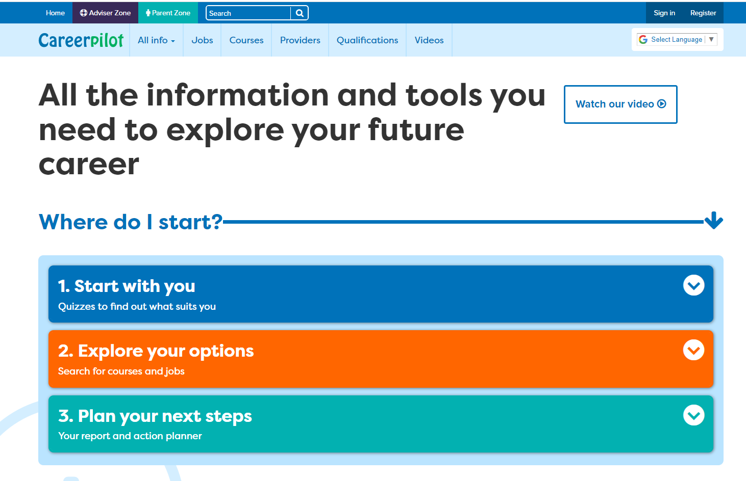
Introducing Careerpilot
Sign in to Careerpilot at school or any time at home to explore ideas for your future career.
You keep your Careerpilot account until you are 20!
Jobs, courses, qualification planner, videos
Quizzes, tools
Future qualifications and pathways
careerpilot.org.uk
Notes:
Careerpilot is a website that you can use for free. It has lots of information and tools to help you to start to think about future career ideas and pathways and to get to know yourself, your skills, interests and strengths better.
The website is built around 3 stages:
Start with you – with quizzes to find out more about yourself and what jobs might suit you
Explore your options – where you can search for courses and jobs
Plan your next steps – where you can build a report and plan some actions.

Slide 11
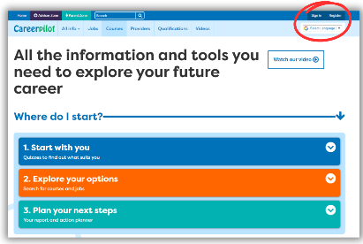

In today’s lesson you will…
Register or sign in to Careerpilot
Click on ‘Start With You’ then ‘Start with Subject’ and explore your top three subjects to see where they could lead.
Notes:
Explain to students what activities they will be doing shortly on Careerpilot.
Use the following slides 11-16 to explain how to complete these activities before getting started….

Slide 12

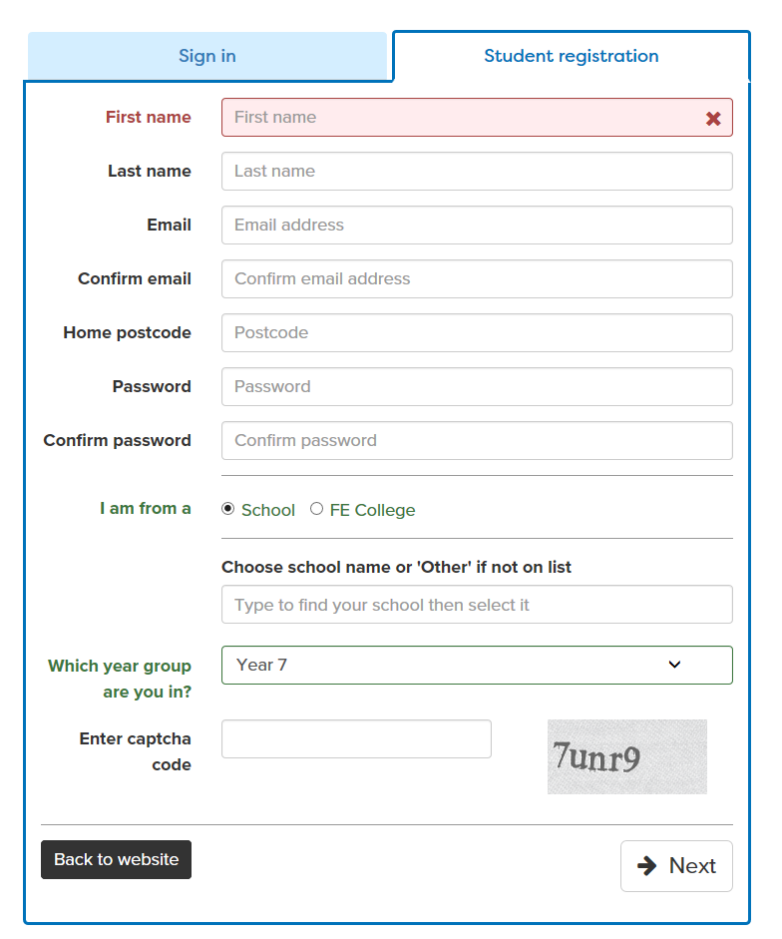
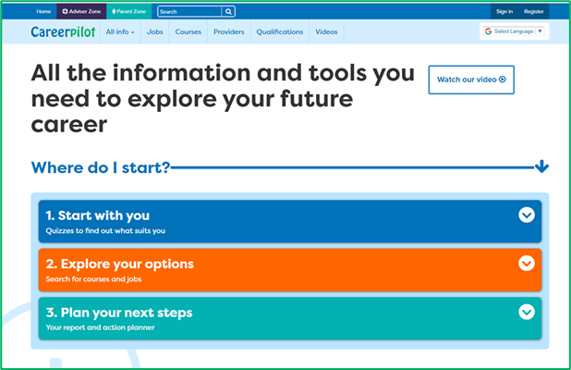
Register or sign in to Careerpilot
If you have registered before – sign in
Notes:
Show students that if they are new to Careerpilot, they need to register to use the website.
They must click on the ‘Register’ button in the top right corner to open up a short registration form that takes a few minutes to complete.
Remind students to use their school email address to register and to click on your school from the drop down list.
Students that have already registered just need to log in with their email and password.

Slide 13
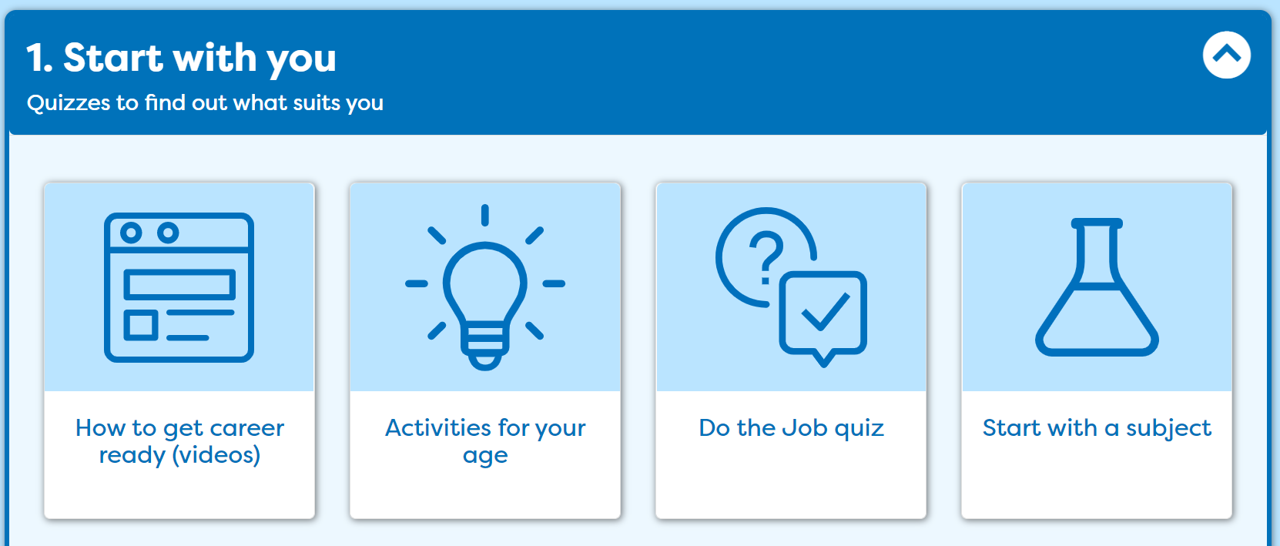
Explore subjects

Slide 14

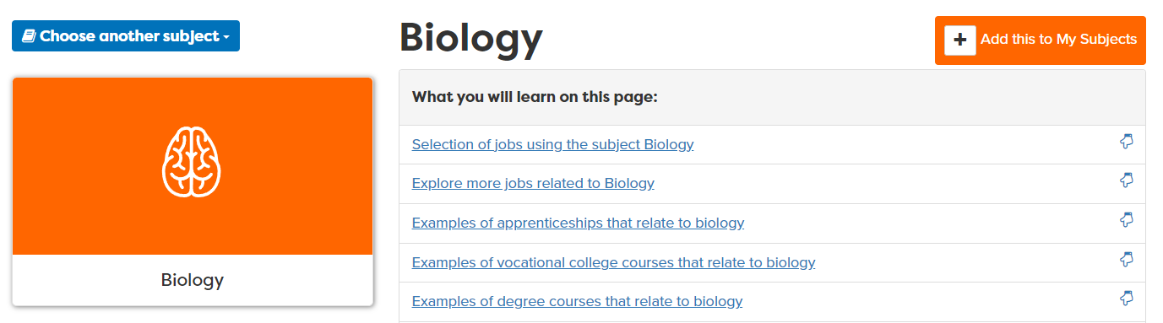
Choosing subjects
In ‘Start with a Subject’, you can look at different subjects and see what jobs they may lead on to in the future.
Look at your top 3 subjects from your list and save them.
Write down three jobs that each subject can lead on to.
Notes:
Students can use their list of subjects they are interested in as a starting point for exploring where they might lead and recording 3 jobs that each can lead onto. They could look at the job profile by clicking on the link if there is time.

Slide 15
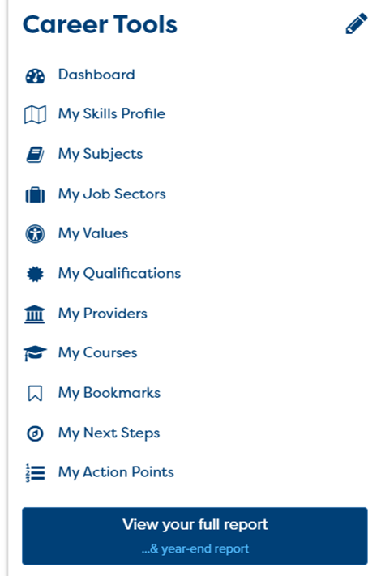
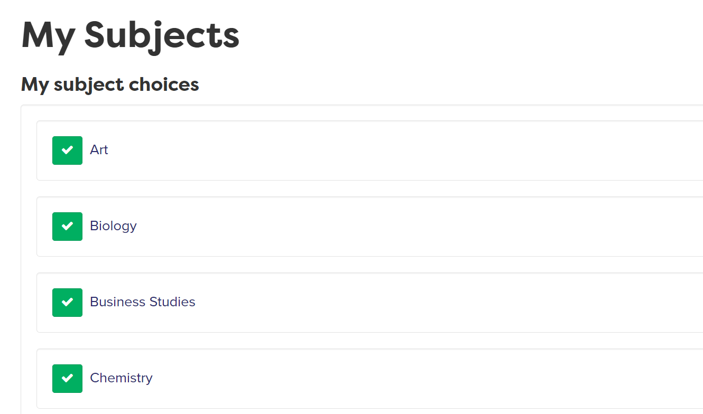
Using your Career Tools
Go to the home page and select ‘Career Tools’ at top right of home page.
Click on ‘My Subjects’ to see those you’ve ‘tagged’. You can click them to see all the information, at any time (or change them)
Notes:
Encourage students to go to their Career Tools via the home page and click on My Job Sectors to see their chosen sectors and the job profiles they have viewed.
Explain this will be saved for them to revisit at a later date and they can add more or change their choices as they go through school.

Slide 16


In today’s lesson you will…
Register or sign in to Careerpilot
2. Click on ‘Start With You’ then ‘Start with Subject’ and explore your top three subjects and see where they can lead – don’t forget to ‘tag’ them.
Make a note of 3 jobs that each could lead on to.
3. Go to your ‘Career Tools’ to check you have saved all the subjects you are interested in.
20 mins
Notes:
Explain to students what activities they will be doing shortly on Careerpilot.
Use the following slides 11-16 to explain how to complete these activities before getting started….

Slide 17

What to avoid when choosing options
3 mins
https://youtu.be/DsLfssAa1OY
Notes:
Good video to show:
What you wouldn’t do when choosing your options – i.e. choose them because you like the teacher, your friend is doing it, your parents told you to, you think it will be easy.
Video does mention Grade A – C so make sure to mention that means 4-9 in new grades

Slide 18


In pairs, write down all the things you have learnt about your Key Stage 4 options
Think about what you’ve learnt and order your points to be understood.
Listen carefully while your partner speaks and make notes to record important information
For example:
How many subjects do you usually study?
What vocational courses does my school offer?
What are the three compulsory subject?
What should you not do when choosing your options?
X
X
X
5 mins
Notes:
Students can make a note of any course or jobs of interest that are related to subjects they are interested in.
This activity can support students to build the following skills steps:
Step 6 Listening - Note-taking: I record important information
Step 4 Speaking: Organising thoughts: I order my points to be understood

Slide 19
Getting Career-ready
You know what a qualification is and start to prepare for choosing your GCSEs
TODAY
You are aware of key stage 4 choices and where subjects can lead

