Slide 1


careerpilot.org.uk
Careerpilot is closing. This resource is only available to use until 23rd October 2026.
5 Week Careers Programme
Year 7 - Exploring jobs

Slide 2
Teacher Overview: Year 7
This 5-week careers programme for Year 7 aims to support students to:
Develop their career skills for life, learning and work
Prepare them for the next career decisions they will have to make.
Lessons have been developed by the Careerpilot Team – all are qualified career advisers and teachers.
The programme contains all you need to deliver 5 x 50–60-minute lessons, or the first lesson can be delivered as a standalone session. All lessons use a PowerPoint presentation, with notes to explain screens. The first lesson has been pre-recorded as a video lesson with a member of the Careerpilot Team virtually delivering the session and providing instruction to the facilitating should you wish to use this delivery option.
Lesson 1, 4 and 5 require all students to have individual access to Careerpilot to register and use information and tools offered through the site to help build their career report. Careerpilot can be accessed through a pc, tablet or phone at www.careerpilot.org.uk
Lesson 2-3 can either be delivered with or without student online access, using Careerpilot for online tasks where possible, or through use of adapted offline tasks if individual computer/phone access is not available.
To provide feedback or ask a question contact:
careerpilot@bath.ac.uk

Slide 3



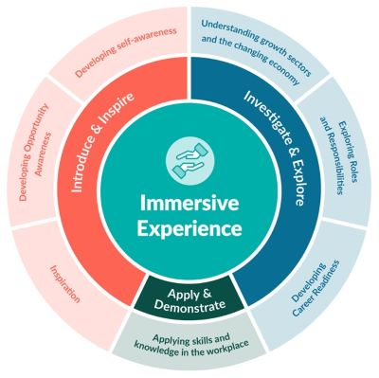



The Year 7 careers lessons are mapped to:
CDI Framework and career development skills
Gatsby Benchmarks
See the big picture by paying attention to how the economy, politics and society connect with your own life and career.
www.gatsbybenchmarks.org.uk/
The Equalex Framework to support preparation for Modern Work Experience
Manage your career actively, make the most of opportunities and learn from setbacks.
Explore the full range of possibilities open to you and learn about recruitment processes and the culture of different workplaces.
Grow throughout life by learning and reflecting on yourself, your background, and your strengths.
Introduce & Inspire
www.thecdi.net/write/Framework/CDI_86-Framework-Guidance_in_Secondary_Schools-webFINAL.pdf
www.careersandenterprise.co.uk/modern-work-experience/equalex-for-educators/
https://www.careerpilot.org.uk/skills-profile/activities
Skills Builder Universal Framework 2.0
www.skillsbuilder.org/universal-framework
Notes:
These lessons have been developed to support students to build their career development skills, as identified by the CDI Career Development Famework. Each lesson identifies two outcomes linked to the CDI framework.
The lessons will support meeting Gatsby Benchmark 1, 2, 3, 4 and 6 and also support the Equalex Framework for preparing students for Modern Work Experience as they ‘Introduce & Inspire’ students about the world of work.
The lessons provide opportunities for students to practice their essential skills as identified in the Skills Builder Framework 2.0 - www.skillsbuilder.org/universal-framework/
The relevant skills steps are identified in the teacher notes in relevant activities, with reflection questions and prompts for discussion with students as part of the plenary.

Slide 4
Lesson Overview – Year 7
Lesson 1: Introducing Careerpilot
Students register on Careerpilot and complete a jobs quiz to research future job ideas.
All students will need access to Careerpilot for this first lesson.
Lesson 2: Jobs of the future
Students look at how jobs will change in the future using LMI to look at job growth.
Alternative offline task option for students without individual access to Careerpilot.
See slide 35 to print poster resources for offline activity. All students will need paper and pens.
Lesson 3: Green jobs
Students learn what green jobs are and where the job opportunities are.
Alternative task options for students with or without individual access to Careerpilot.
All students need paper and pens.
Lesson 4: Jobs by subject
Students use ‘Start with a Subject’ to explore career paths related to a favourite subject.
All students will need individual online access to Careerpilot, paper and pens.
Lesson 5: Careerpilot quiz
Students take part in a quiz to reinforce the content of the last four lessons.
All students require paired online access to Careerpilot, paper and pens.
Notes:
Use this page to navigate directly to the relevant lesson.

Slide 5

Careerpilot is closing. This resource is only available to use until 23rd October 2026.
Year 7 - Exploring Jobs
Lesson 1: Introducing Careerpilot
There is a recorded version of this lesson
Notes:
Lesson 1 – Introducing Year 7 to Careerpilot to explore jobs.

Slide 6


Getting Career-ready
You will understand that a career is a journey and will start looking towards what you might like to do in the future.
Introduction and warm up activity – 10-15 mins
Careerpilot Activities 20-30 mins
You will explore different job sectors and start to think about what aspects of a job you might be interested in.
Presentations
10-15 mins
Notes:
The Career Development Institute has developed a careers framework that shows the skills everybody needs to have to manage their future career.
This slide shows the students which of the career learning areas (CDI) that this lesson 1 links to.
You can also share the structure of the session with students.

Slide 7
What is a career?
A career is an individual's journey through life, learning and work.
A job is something you might do to earn money as part of your career journey. There are lots of different job sectors you could work in, from finance, to art and design, to working with animals.
Notes:
Ask students if they know what a career means?
Encourage students to explain what is meant by the word career then reveal the answer.
Ask students to share if they have any idea about what sort of job they might like to do one day?

Slide 8




Exploring jobs
Working in groups or pairs, you have 5 minutes to try to think of a different job for every letter of the alphabet.
Write the job titles down in order...
A – Actor
B – Banker
C – Chef
5 mins
Notes:
Students must work in pairs to write down job titles for each letter of the alphabet.
They have 5 minutes to work together.
When the time is up, work as a class to quickly go through the letters of the alphabet getting students to contribute ideas for each letter.
Use the following slide to help with any letters that are missing.
Students can build their Teamwork skill at Step 7: Contributing: I contribute to group activity

Slide 9
Jobs you might have picked….
A - Actor
B - Baker
C - Chef
D - Dancer
E - Electrician
F - Farmer
G - Gardener
H - Hotel Manager
I - Insurance Salesperson
J - Jewellery Designer-Maker
K - Kitchen Fitter
L - Librarian
M - Musician
N - Nurse
O - Optician
P - Paramedic
Q - Quantity Surveyor
R – Recycled Metals Worker
S – Sports Coach
T - Teacher
U – User Researcher
V - Vlogger
W – Web designer
X - X-Ray Technician
Y - Youth Worker
Z - Zookeeper
Notes:
Extension:
Class discussion opportunities around what the job title means, what would people do if they did this job? Does anyone know anyone who does the different jobs listed?
Use Careerpilot to research the jobs further as a class: https://www.careerpilot.org.uk/job-sectors

Slide 10
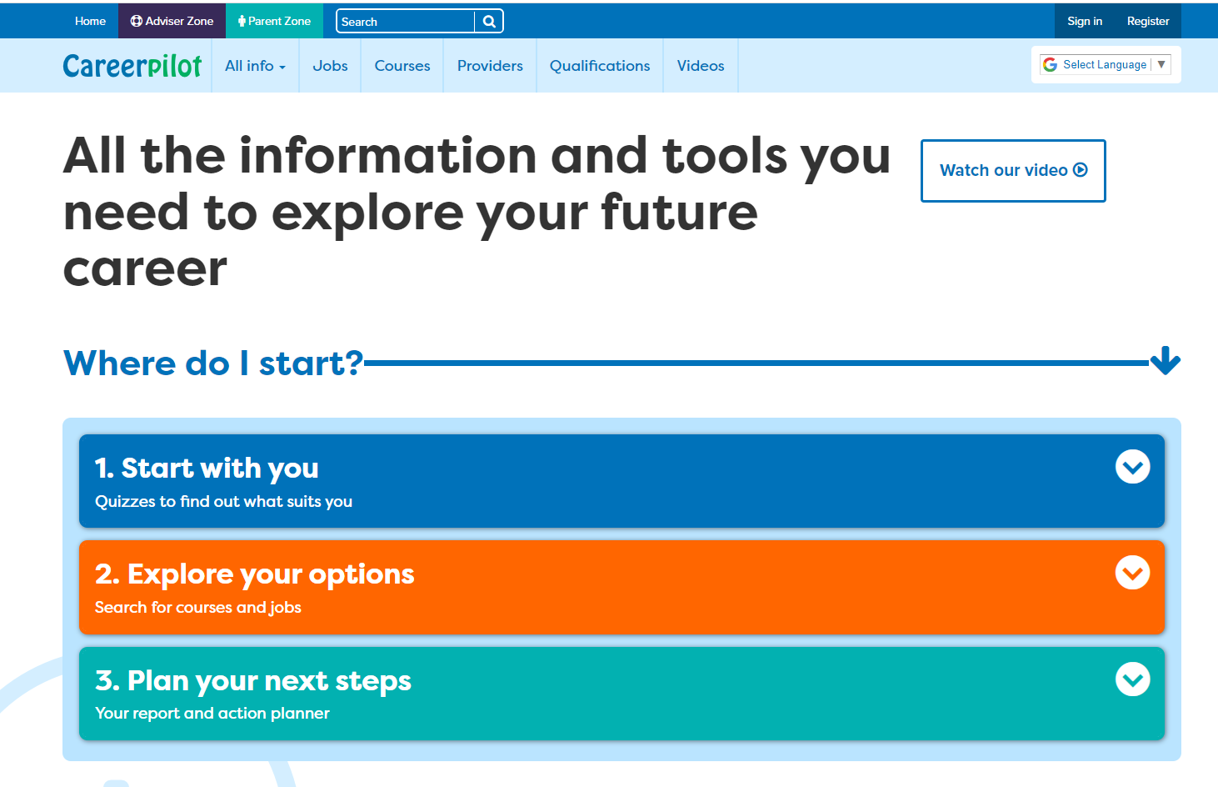
Introducing Careerpilot
Jobs, courses, qualification planner, videos
Quizzes, tools
Future qualifications and pathways
careerpilot.org.uk
Notes:
Careerpilot is a website that you can use for free. It has lots of information and tools to help you to start to think about future career ideas and pathways.
The website is built around 3 stages:
Start with you – with quizzes to find out more about what might suit you
Explore your options – where you can search for courses and jobs
Plan your next steps – where you can build a report and plan some actions.

Slide 11
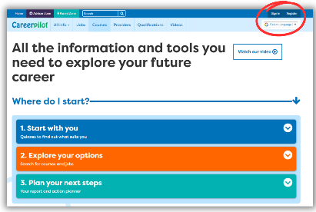


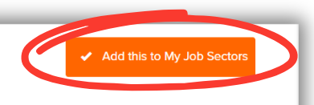
In today’s lesson you will…
Register on Careerpilot
2. Complete the Job Sector Quiz
3. Explore some Job Sectors and look at job profiles
4. Tag 2 Job Sectors you are interested in
Notes:
Explain to students what activities they will be doing shortly on Careerpilot.
Use the following slides 13-19 to explain how to complete these activities before getting started….

Slide 12
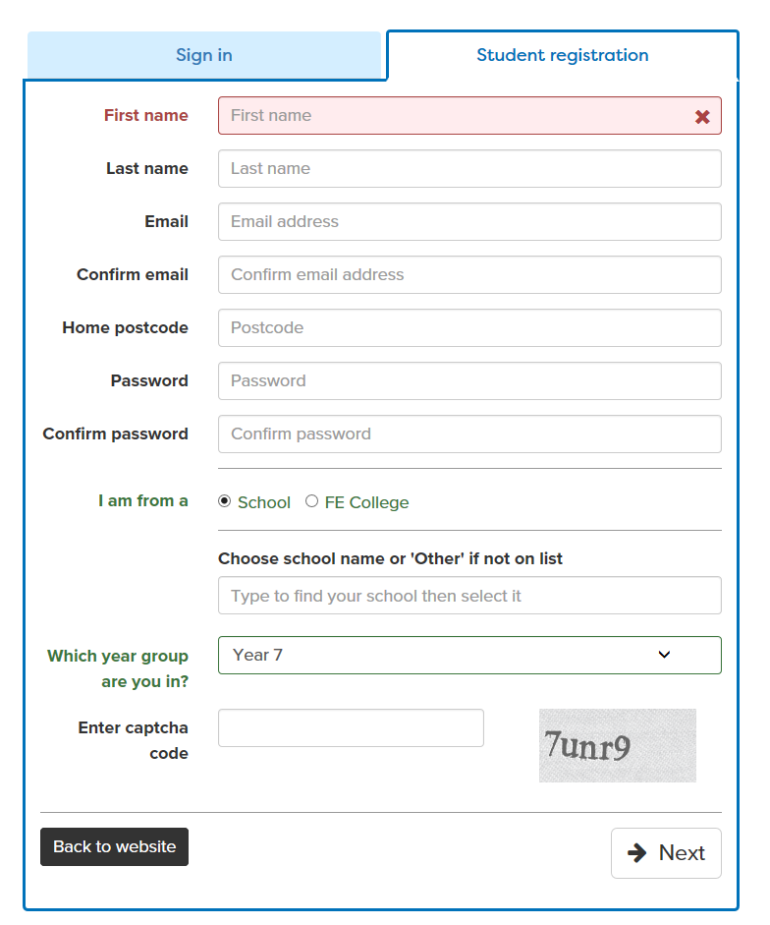

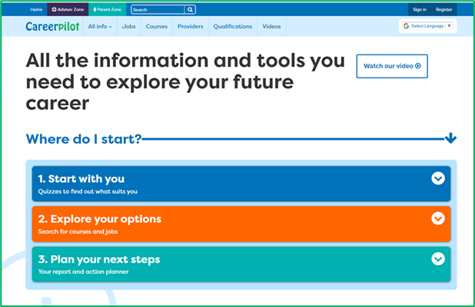
Register or sign in to Careerpilot
If you have registered before – sign in
Notes:
Show students that if they are new to Careerpilot, they need to register to use the website.
They must click on the ‘Register’ button in the top right corner to open up a short registration form that takes a few minutes to complete.
Remind students to use their school email address to register and to click on your school from the drop down list.
Students that have already registered just need to log in with their email and password.

Slide 13
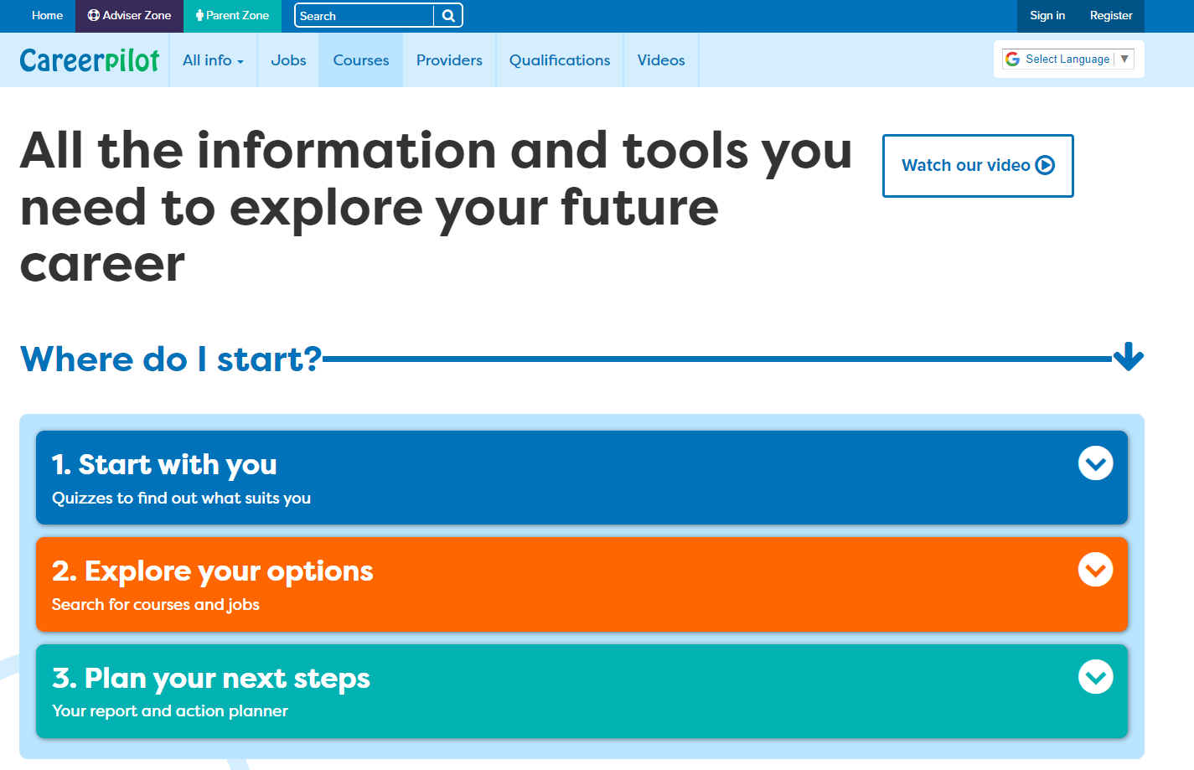
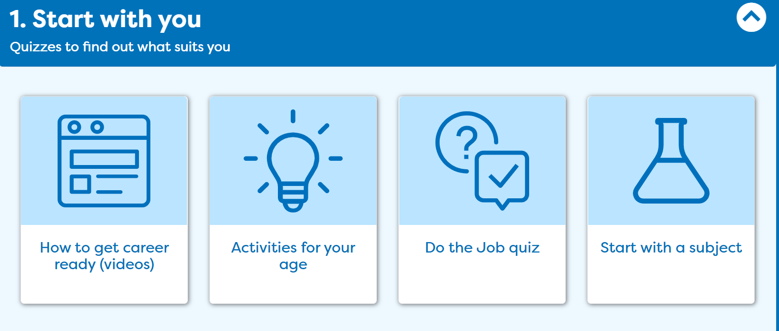
Complete the Job Sector Quiz.
Notes:
Once registered students need to go to ‘Start with you’ on the home page and click on ‘Quizzes to get started’ then click on the Careerpilot Job Sector Quiz.

Slide 14
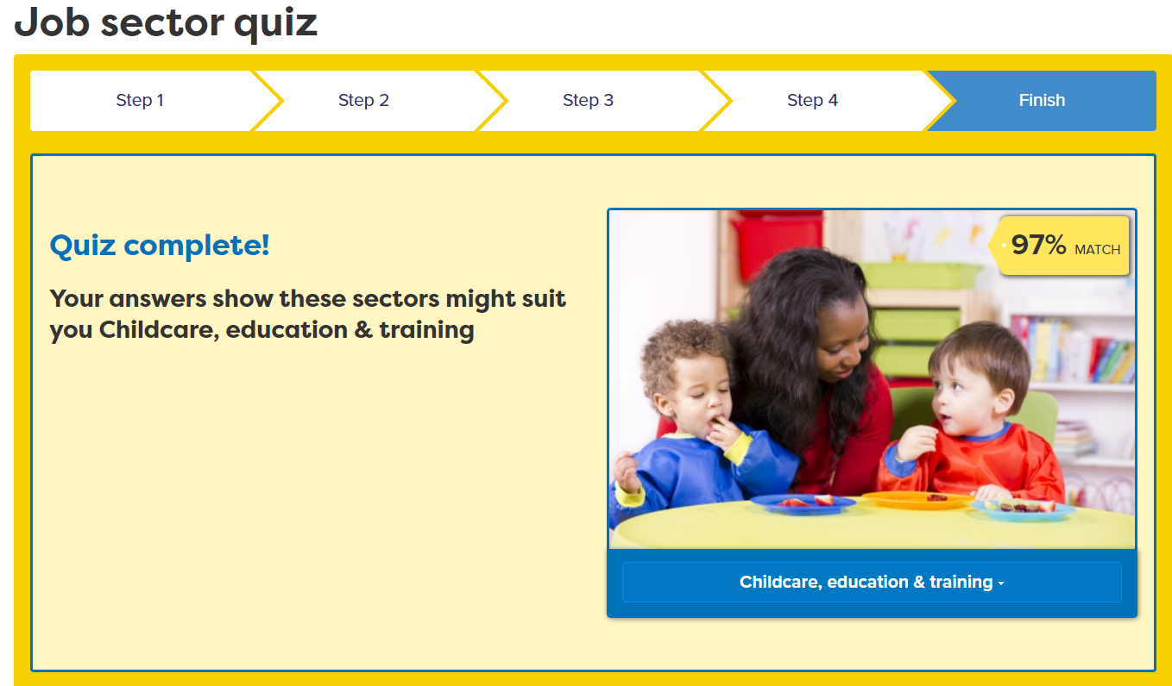

Explore Job Sectors and Job Profiles
Notes:
Students can explore some of the job sectors the quiz matches them with.
They can also click on ‘View all job sectors’ to explore other job sectors not in their quiz results.

Slide 15
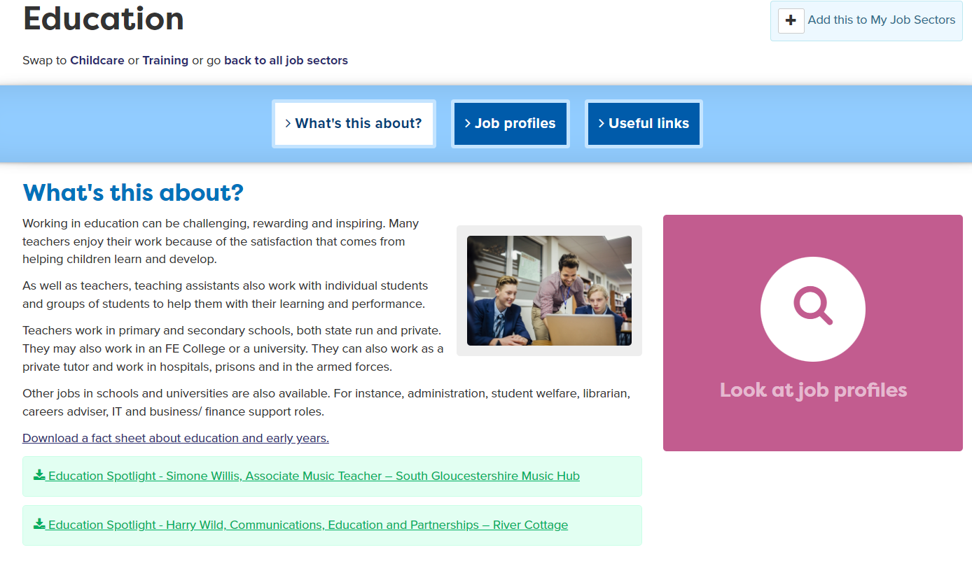
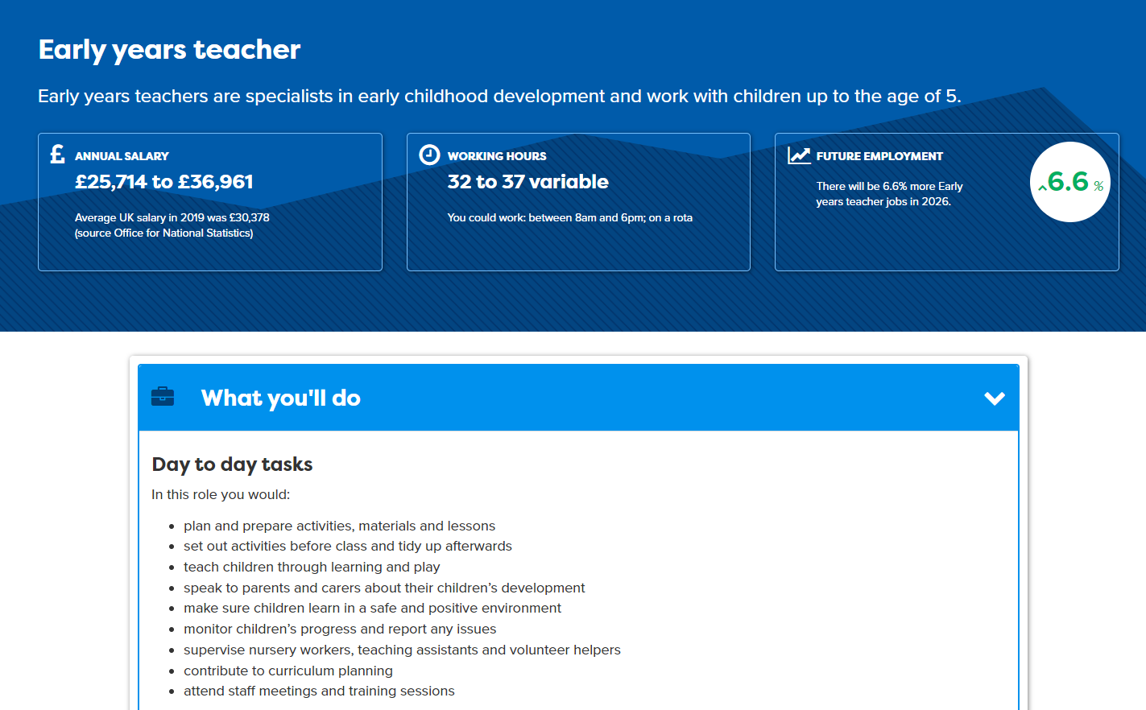
Notes:
In every sector students can look at ‘what’s this about’ and also see lots of ‘job profiles’.
Each job profile shows information about the job, including salaries and day to day tasks.
Check understanding about ‘salary’. Explain to students that the annual salary is the amount of money you could earn in a year doing this job if you work full time (5 days a week). Students can compare the job salary to the ‘Average UK Salary’ of approximately £30,000.
Day to day tasks shows what you would actually be doing for this job.
Students should explore some jobs and look at what’s involved, comparing salaries of different jobs.
Extension: Students may wish to take notes about any jobs that are of interest, noting salary and day to day tasks.

Slide 16
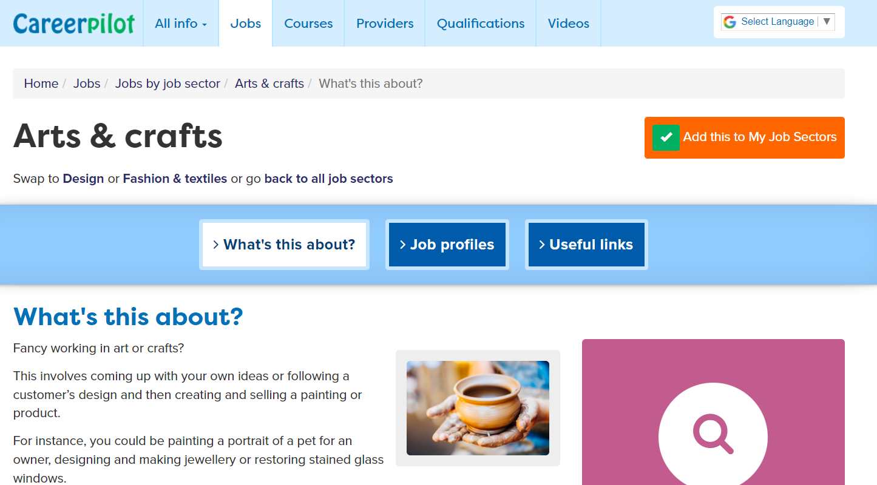
Tag 2 job sectors you’re interested in
Notes:
Their task is to pick two job sectors they are interested in (they can have more) and click ‘Add this to My Job Sectors’ to save in their Career Tools.

Slide 17
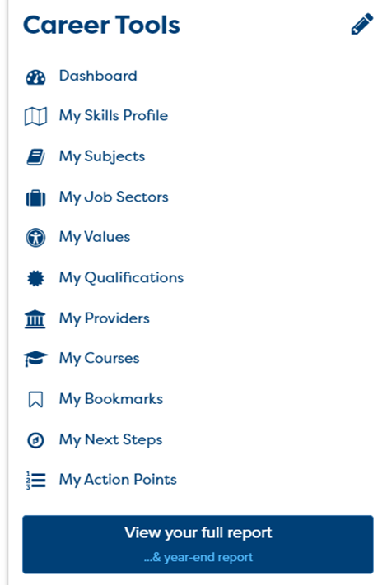
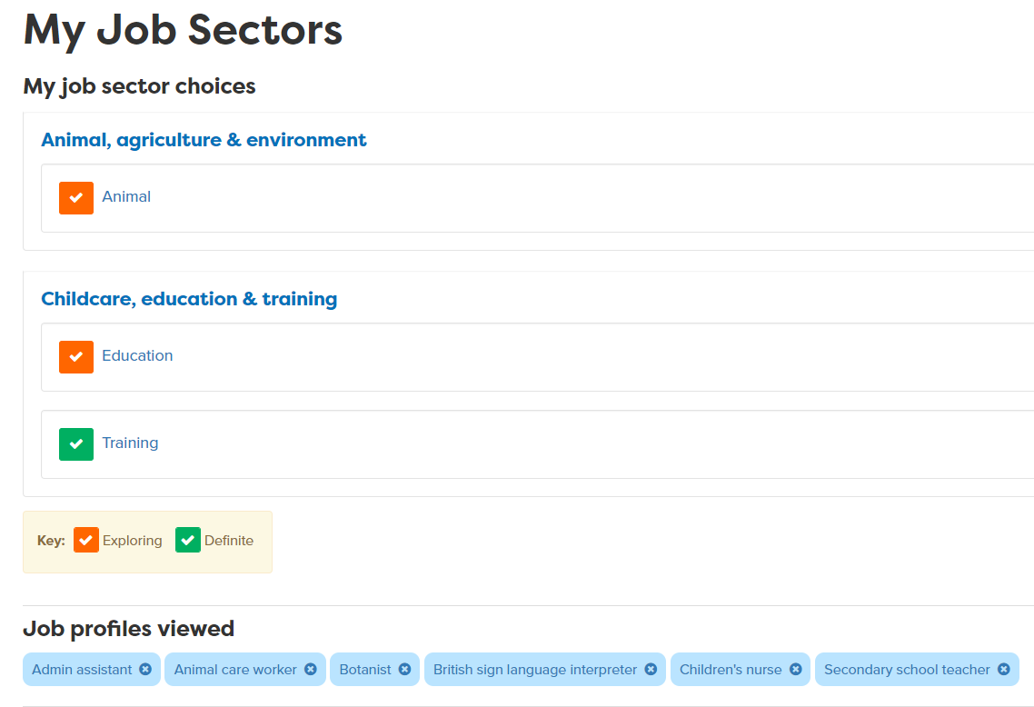
Using your Career Tools
Go to the home page and select Career Tools at top right of home page.
Click on My Job Sectors to see those you tagged and job profiles you viewed.
Notes:
Encourage students to go to their Career Tools via the home page and click on My Job Sectors to see their chosen sectors and the job profiles they have viewed.
Explain this will be saved for them to revisit at a later date and they can add more or change their choices as they go through school.

Slide 18
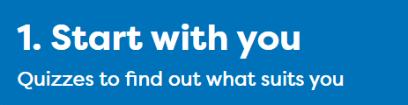
Careerpilot Task
20 mins
Register on Careerpilot
2. Complete the Job Sector Quiz
3. Explore some Job Sectors and look at job profiles
4. Tag 2 Job Sectors you are interested in
Notes:
Explain to students what activities they will be doing shortly on Careerpilot.
Use the following slides 13-19 to explain how to complete these activities before getting started….

Slide 19


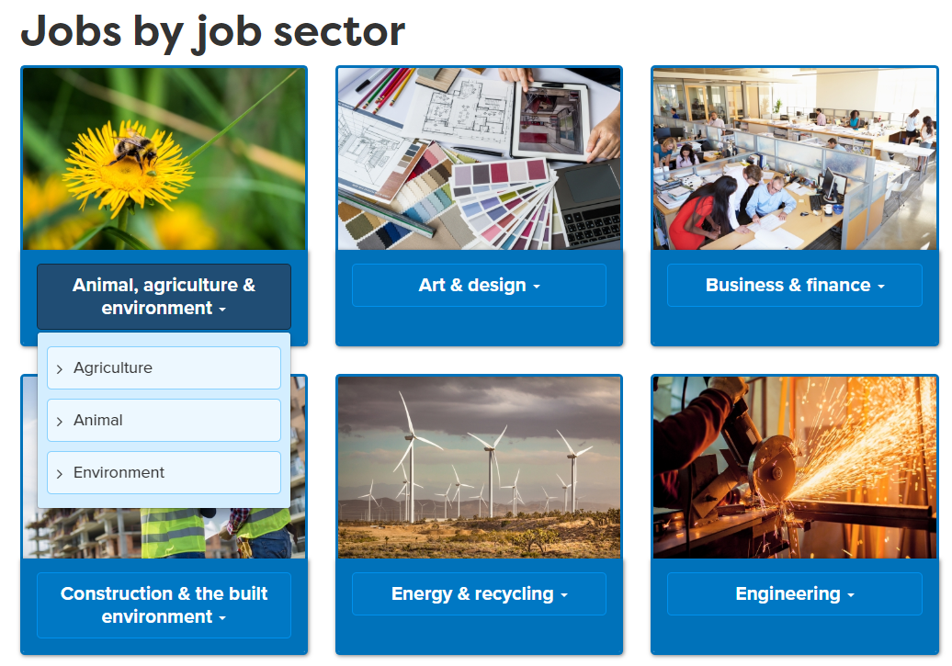
Sharing what you found out
Take it in turns to tell each other about the Job Sectors you explored and any Job Profiles you found that interest you and why.
When you speak, talk clearly so everyone can hear you.
When listening to someone else is talking, show you are listening by looking at them.
5 mins
Notes:
Ask students to now take it in turns to show and tell a partner about the job sectors they have saved, including about any jobs they viewed that sounded interesting. Students can compare the salaries of the jobs they found and talk about what aspects of the day to day tasks they think looked interesting and why.
This activity will support students to practice the following essential skills:
Step 7 Listening: Active Listening: I show I am paying attention
Step 2 Speaking: Discussing together: I communicate clearly in a small group
Ask students if they feel they have demonstrated these skill steps as part of this activity.
If time, ask students to feed back on their partner’s chosen jobs or job sectors to the whole class.

Slide 20
Getting Career-ready
TODAY
You understand that a career is a journey and have started to look towards what you might like to do in the future.
You explored different job sectors and started to think about what aspects of a job you might be interested in.
Notes:
LAST SLIDE OF LESSON 1
Reflect on the aims of the session and how they can help students to start to get Career-ready.
Check understanding of what ‘career’ means with class.
Ask for hands up from students if they feel they have started to think about some job sectors they might be interested in.

Slide 21

Careerpilot is closing. This resource is only available to use until 23rd October 2026.
Exploring Jobs
Lesson 2: Jobs of the Future
Notes:
The Career Development Institute have a new framework which shows that everybody, young and old, needs to have the skills to do these 6 things if they are going to be able to manage their future careers.
In this session we will be helping you develop the skills for these three.
This is what we will be doing.

Slide 22
Getting Career-ready
Introduction and warm up activity – 10-15 mins
You will explore how developments in technology and science are changing jobs of the future.
Task
10-30 mins
You will understand what Labour Market Intelligence (LMI) is and how it can be used to predict which jobs may grow in the future.
Presentations
10-15 mins
Notes:
The Career Development Institute has developed a careers framework that shows the skills everybody needs to have to manage their future career.
This slide shows the students which of the career learning areas (CDI) that this lesson 1 links to.
You can also share the structure of the session with students.

Slide 23

What are the jobs of the future?
Technology and science are developing fast to improve our lives in so many ways. As the world changes, the jobs people do will change too. When you are adults, you may be doing jobs that don’t even exist yet!

Slide 24

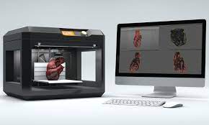
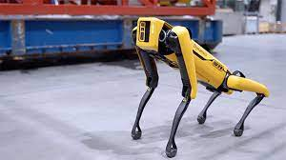

The growth in automation
Notes:
Automation is where technology is used to produce and deliver goods and services with less need for humans. Lots of jobs are changing or disappearing, as a result.
For example the new Amazon Go store has no tills and few staff as computers can tell what people are buying and charge them automatically.
3D printers can create objects from flat plans automatically. Robots have replaced the jobs of people in some workplaces like warehouses, and we even have the first driverless cars!

Slide 25




How might jobs change in the future?
Notes:
Class discussion: Ask the students what jobs are the images showing – then discuss how technology might change these jobs in the future.
Technology makes many jobs easier but could mean some jobs will change or are not needed at all!
Computers make it easier for students to learn on their own from home. Could teachers be replaced by robots?? What would be good or bad about that?
In shops, people can pay using their phones and may not always need a person to serve them. Could a robot provide customer service as good as a human could??
Farmers are using technology to look at data to help plan what they grow and when to get the best harvest. Could they have automatic driverless tractors?? Is this a good idea?
Could robots replace people working in a warehouse – what jobs might robots be able to do to help humans?

Slide 26




Where are future jobs going to be?
Medical, Health Science and Care
IT and Digital Technology
Engineering and Construction
Environmental (Green Jobs)
Notes:
With new technology and science developments there will be a growth in jobs needed in many industry sectors including:
Medical and Health – we will continue to need more medical scientists, researchers, doctors, nurses and health care workers
IT and Digital – we will need more data analysts, technology researchers and AI developers
Engineering and construction - we will need more people to design and build the new buildings of the future – architects, electricians, energy engineers
Environmental jobs– we need lot of people to do jobs that help protect our planet like ecologists, foresters and environmental advisers

Slide 27
What is LMI?
LMI stands for Labour Market Information.
LMI can tell you about different jobs, what you might earn (the salary), skills and qualifications needed and if a job is predicted to grow in the future or not.

Slide 28
Student Tasks
If the students have access to a computer each or in pairs continue with this presentation, looking at slides 30-34
If students DO NOT have access to a computer, print off Hot Job posters to show to students and go to slide 35.

Slide 29


Careerpilot Task
Log in to Careerpilot
2. Go to Job Sectors and look at different job profiles
3. Work in pairs to use LMI to find 3 jobs that are predicted to grow in the future (there will be more of these jobs) and 3 that will decline (there will be less of them).
4. Work together to create a poster to show the jobs that are set to grow vs decline
Notes:
Explain to the students what activities they will be doing shortly on Careerpilot. The next two slides explain the task in more details.

Slide 30
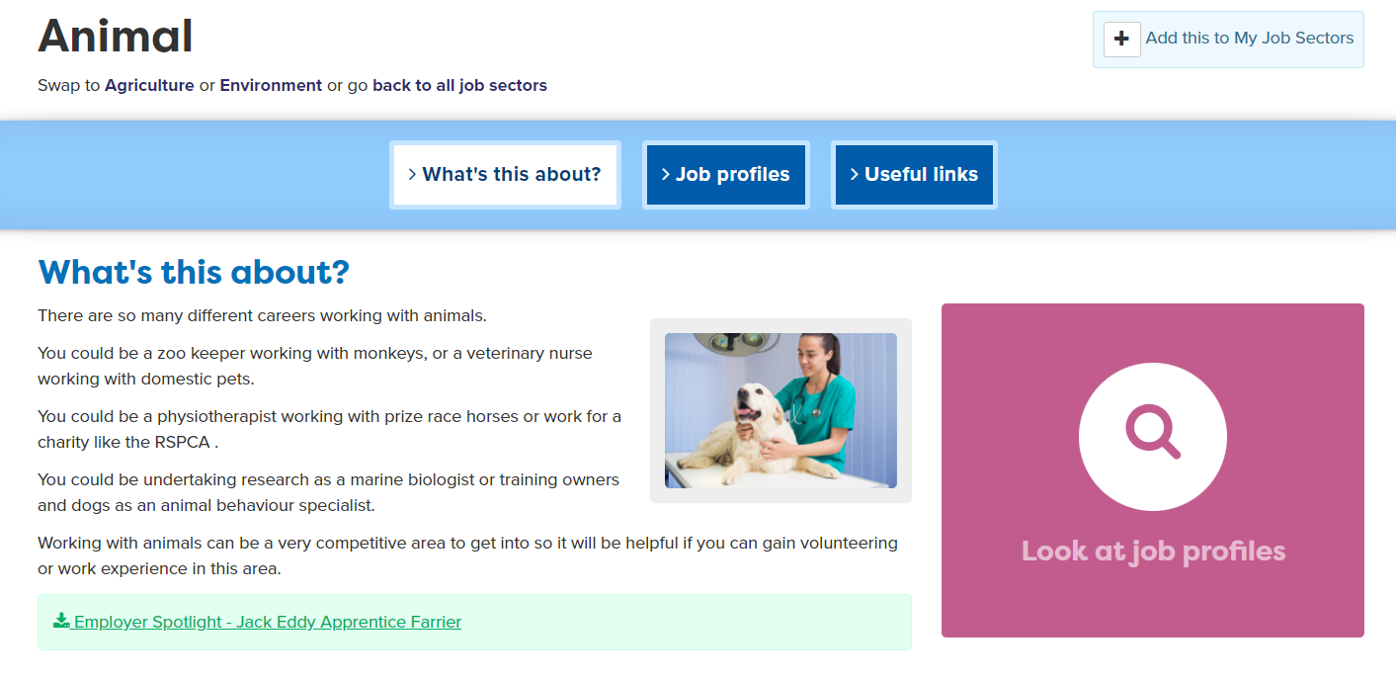
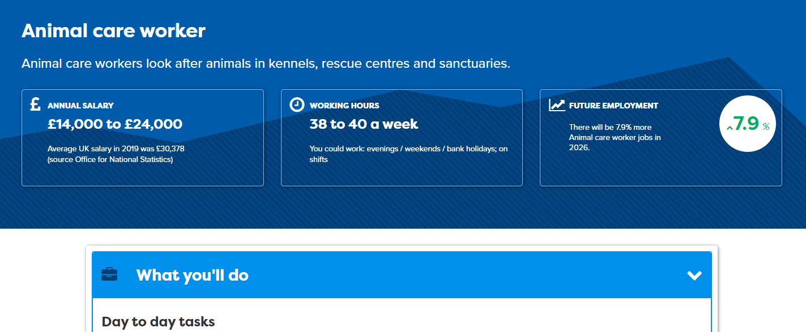
Task 1: Use Careerpilot to look at LMI
Notes:
Show students how they can explore LMI using Careerpilot, as every job profile gives information about the salary, working hours and if the job is set to grow or decline over the next few years.
Open separate tab to show Careerpilot Jobs Search - https://www.careerpilot.org.uk/job-sectors
Model how to look for a job and see the information in the job profile.

Slide 31

Task 2: Create a poster
In pairs, create a poster to show the jobs that you think are set to grow or decline. You may add pictures and colour to make it stand out.
Notes:
Where there is no individual access to computers for students, this activity can be used as an alternative. You may search up some of the jobs
Students can build the Teamwork skill at step 7: I contribute to group decision making, whilst recognising the value of others' ideas

Slide 32
Careerpilot Task
Log in to Careerpilot
2. Go to Job Sectors and look at different job profiles
3. Work in pairs to use LMI to find three jobs that are predicted to grow in the future (there will be more of these jobs in coming years) and three that will decline (there will be less of them).
30 mins
4. Work together to create a poster to show the jobs that are set to grow vs decline
Notes:
Explain to the students what activities they will be doing shortly on Careerpilot. They have 30 minutes to complete these tasks.
Students can build their Teamwork skill at step 4: I work well with others by supporting them if I can do so

Slide 33
Paired presentations
Take it in turns in your pairs to share your findings with the rest of the class. You may share your poster if you created one.
Show you are listening by using open questions to deepen your understanding
Speak engagingly by using facts and examples to support your points
5 mins
Click here for final slide.
Notes:
This activity can support students to build the following skills steps:
Step 7 Listening: I show I am listening by using open questions to deepen my understanding
Step 7 Speaking: I speak engagingly by using facts and examples to support my points
Reflection questions
What is the difference between open and closed questions? Can you give any examples of the difference?
How can you use open questions to support being a better listener?
Did you use examples to support your points?

Slide 34

Using Labour Market Information
5 mins
Notes:
Careerpilot job profiles can give you lots of useful labour market information to find out more about if a job is set to grow over the coming years or is set to decline.
This is an example of a job that is set to grow by 4% by 2026, so this means there will be more of these jobs. This job is in the IT and Digital job sector.
Teachers - You may log in to Careerpilot to print off some Hot Jobs posters and images showing jobs predicted to grow for students to look at on their tables from here:
https://www.careerpilot.org.uk/adviser-zone/hot-jobs-resources-free-gatsby-benchmark-2
Alternatively open a new tab and explore sample of job profiles with students from the front here: https://www.careerpilot.org.uk/job-sectors/sectors
Look at and discuss the Future Employment information within the job profile.

Slide 35
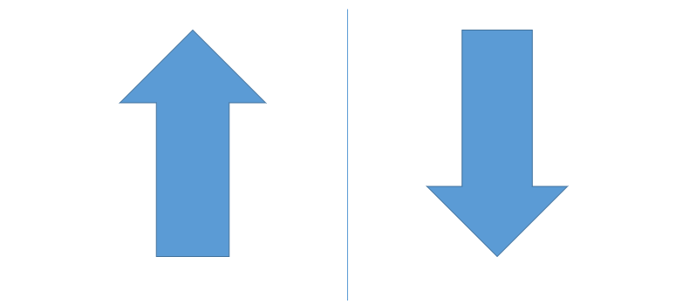
Task 1: Create a poster
Working in pairs, think back to the earlier slides and discuss 3 jobs you think are likely to grow in the UK and 3 jobs you think will decline and why you think this.
Create a poster to show the jobs that you think are set to grow or decline. You may add pictures and colour to make it stand out.
20 mins
Notes:
Give students time to discuss jobs that may grow or decline over the coming years and why.
Discuss how the recent covid pandemic and climate change, along with developments in technology and automation have impacted on the jobs landscape.

Slide 36
Paired presentations
Take it in turns in your pairs to share your findings with the rest of the class. You may share your poster if you created one.
Show you are listening by using open questions to deepen your understanding
Speak engagingly by using facts and examples to support your points
5 mins
Click here for final slide.
Notes:
This activity can support students to build the following skills steps:
Step 7 Listening: I show I am listening by using open questions to deepen my understanding
Step 7 Speaking: I speak engagingly by using facts and examples to support my points
Reflection questions
What is the difference between open and closed questions? Can you give any examples of the difference?
How can you use open questions to support being a better listener?
Did you use examples to support your points?

Slide 37
Getting Career-ready
TODAY
You have explored how developments in technology and science are changing jobs of the future.
You know what Labour Market Intelligence (LMI) is and how it can be used to predict which jobs may grow in the future.
Notes:
LAST SLIDE OF LESSON 2
Reflect on the aims of the session and how they can help students to start to get Career-ready.
Check understanding of what ‘LMI’ means with class.
Ask for hands up from students if they feel they now know how to use LMI to find out which jobs are set to grow or decline in the future.

Slide 38

Careerpilot is closing. This resource is only available to use until 23rd October 2026.
Exploring Jobs
Lesson 3: Green Jobs

Slide 39
Getting Career-ready
Introduction and warm up activity – 10-15 mins
You will know what ‘green jobs’ are.
You will explore the relationship between careers and the natural environment.
Careerpilot Activities 20-30 mins
You will understand what Labour Market Intelligence (LMI) is and how it can be used to find out more about different jobs.
Presentations
5-15 mins
Notes:
The Career Development Institute has developed a careers framework that shows the skills everybody needs to have to manage their future career.
This slide shows the students which of the career learning areas (CDI) that this lesson 1 links to.
You can also share the structure of the session with students.

Slide 40

What are Green Jobs?
Green Jobs are those involved in producing goods or services that help to protect the environment and look after our natural resources.
Click here to watch a short video about green jobs:
5 mins
Notes:
Show the students the short video to explain What is a Green Job’. Click enable content if prompted to access the video.
Alternatively copy and paste this link into a new tab on your browser:
https://www.youtube.com/watch?v=2uHdj6d1rSs
Ask students at the end of the video if they can remember any of the green jobs mentioned in the video.

Slide 41

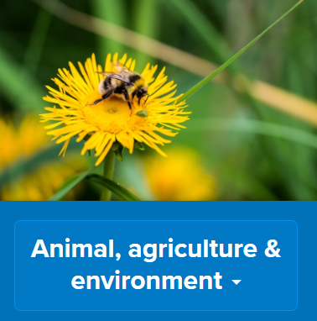



Where are Green Jobs?
There are lots of green jobs involved in:
Green Jobs can be found in many job sectors including:
Notes:
Discuss with students which Job Sectors are worth looking at when looking for green jobs that help to protect our planet.

Slide 42
Student Tasks
If students have access to a computer each or in pairs, continue with this presentation, looking at slides 44-48 and then jump to slide 51 to end session
If students DO NOT have access to a computer, go to slide 49.

Slide 43
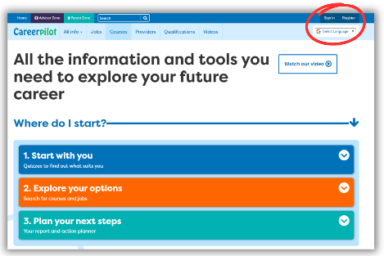

In today’s lesson you will…
Log in to Careerpilot
2. Go to Jobs and click on Green Jobs
3. Work in pairs to explore some Green Job profiles and find out:
What are the day to day tasks?
What are the different routes in to this job?
Is the job likely to grow or decline over the coming years?
4. Make notes on what you find out about 3 different Green Jobs – this could be written or made into a poster.
Notes:
Explain to students what activities they will be doing shortly on Careerpilot then take them through the next couple of slides to explain the task.
Students can build the Teamwork skill at step 7: I contribute to group decision making, whilst recognising the value of others' ideas

Slide 44
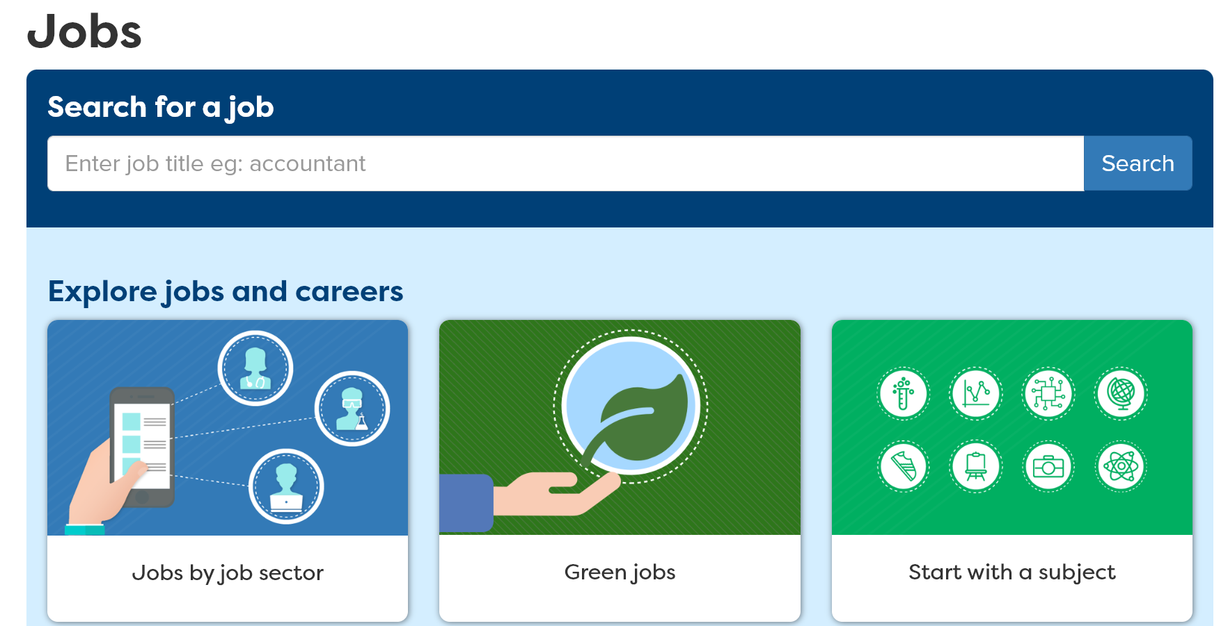
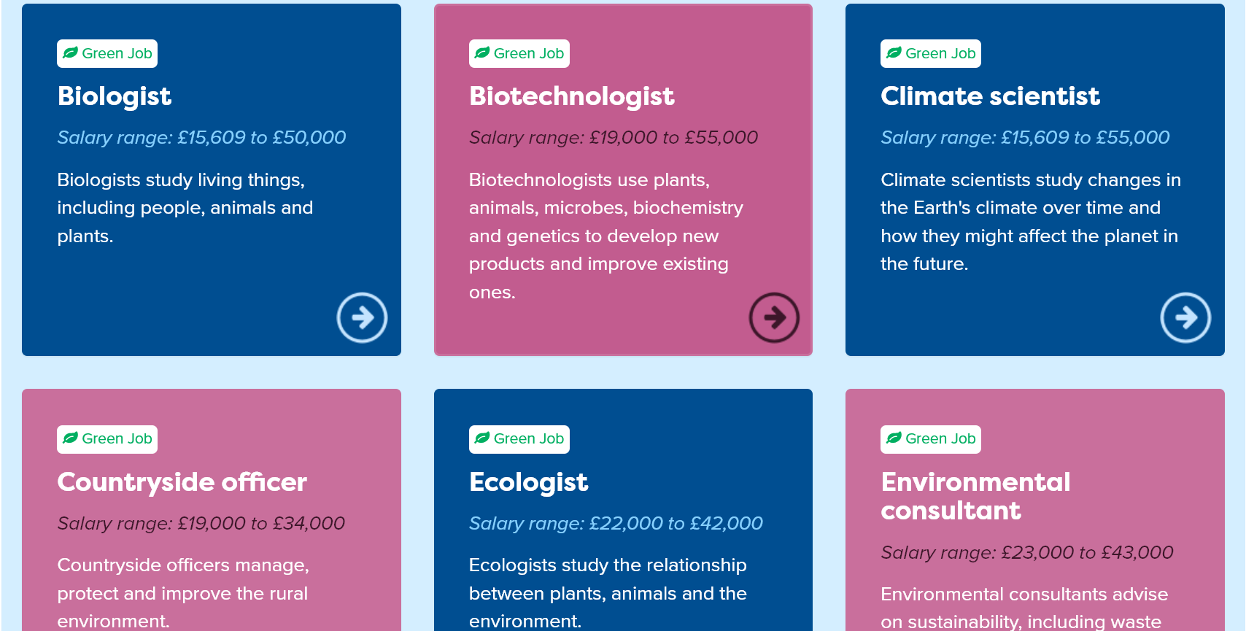
Use Careerpilot to look for Green Jobs
Notes:
Students can find out more about Green Jobs by using Careerpilot.
Some green jobs are listed in the Jobs section, by clicking on Green Jobs as well as in some of job sectors discussed previously.

Slide 45
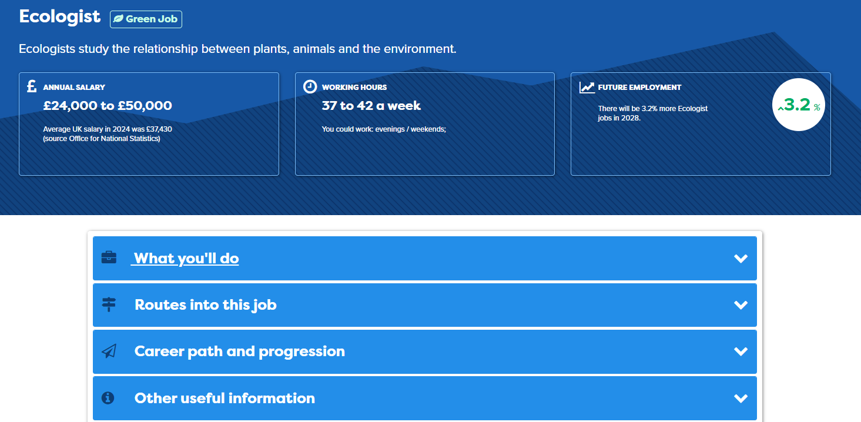
Use Green Job LMI
Notes:
Students can use the Labour Market Information in Job profiles to find out more about different Green Jobs.
Show students how they can find out what they could earn (the salary), how to get into the job – different courses or apprenticeships, even how many people are employed in this job by region.

Slide 46
Careerpilot Task
30 mins
Log in to Careerpilot
2. Go to Jobs and click on Green Jobs
3. Work in pairs to explore some Green Job profiles and find out:
What are the day to day tasks?
What are the different routes in to this job?
Is the job likely to grow or decline over the coming years?
4. Make notes on what you find out about 3 different Green Jobs – this could be written or made into a poster.
Notes:
Explain to students what activities they will be doing shortly on Careerpilot then take them through the next couple of slides to explain the task.
Students can build the Teamwork skill at step 7: I contribute to group decision making, whilst recognising the value of others' ideas

Slide 47
Paired presentations
Take it in turns in your pairs to share what you have found out about 3 Green Jobs with the rest of the class.
Speak engagingly by using facts and examples to support your points:
    What are the day-to-day tasks?
    What are the different routes in?
    Is the job likely to grow or decline over the coming years?
Show you are listening by using open questions to deepen your understanding
10 mins
Click here for next slide
Notes:
This activity can support students to build the following skills steps:
Step 7 Listening: I show I am listening by using open questions to deepen my understanding
Step 7 Speaking: I speak engagingly by using facts and examples to support my points
Reflection questions
Did you ask open questions to support your understanding?
Did you use examples to support your points?

Slide 48
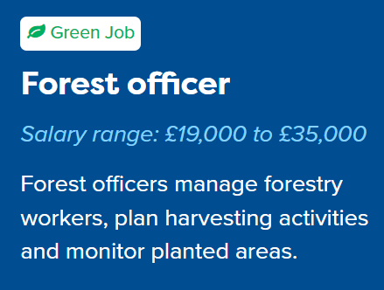


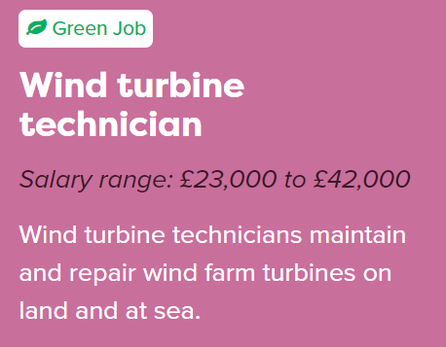
Where are the Green Jobs?
Can you think of any green jobs you might find in the job sectors below? Remember, green jobs are those involved in producing goods or services that help to protect the environment and look after our natural resources.
5 mins
Notes:
Give students 5 minutes for students to talk in pairs about examples of green jobs in each of the four sectors before revealing an example for each.
Discuss how they are green jobs – how do they help to protect our environment and prevent climate change.

Slide 49
Task: Create a mind map
Working in pairs, create a mind map of as many green jobs as you can that may help to protect our environment.
GREEN JOBS
Electric Car Engineer
Green Energy
Green Transport
15 mins
Solar panel fitter
Wind turbine installer
Notes:
Where there is no individual access to computers for students, this activity can be used as an alternative. You may support students to think about green jobs they saw in the video at the start of the lesson, or think about jobs needed to improve our homes, transport, and energy. Or those that protect trees, wildlife, oceans. Or prevent pollution, support recycling, avoid waste

Slide 50
Paired presentations
Take it in turns in your pairs to share your mind maps with the rest of the class.
Speak engagingly by using facts and examples to support your points:
        Which green jobs did you think about?
        How are they green jobs?
10 mins
Notes:
Discuss as a class some of the ideas for green jobs identified by students. You may look up more examples to build on their ideas by opening Careerpilot in a new tab: https://www.careerpilot.org.uk/job-sectors/green-jobs
This activity can support students to build the following skills steps:
Step 8 Speaking - Using facts: I speak engagingly by using facts and examples to support my communication

Slide 51
Getting Career-ready
TODAY
You now know what ‘green jobs’ are.
You have explored the relationship between careers and the natural environment.
You now understand what Labour Market Intelligence (LMI) is and how it can be used to find out more about different jobs.
Notes:
LAST SLIDE OF LESSON 3
Reflect on the aims of the session and how they can help students to start to get Career-ready.
Check understanding of what ‘Green Jobs’ means with class.
Ask for hands up from students if they feel they now know how to use LMI to find more about different jobs they are interested in.

Slide 52
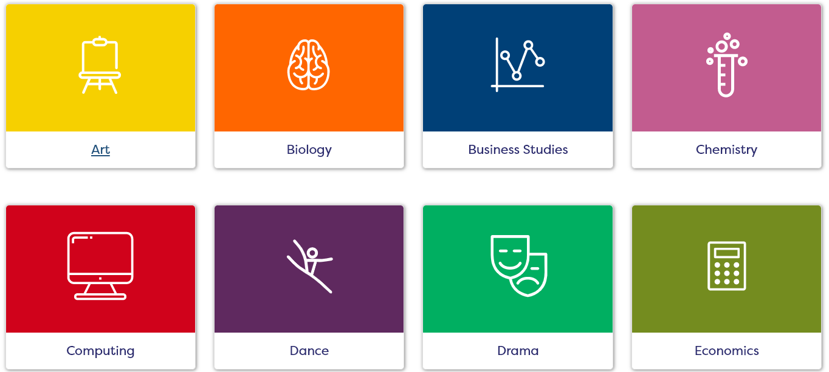
Exploring Jobs
Lesson 4: Start with a Subject

Slide 53
Getting Career-ready
Introduction and warm up activity – 10-15 mins
You will consider your strengths and interests and explore where they could lead.
Careerpilot Activities 20-30 mins
You will be aware of the range of possible jobs related to your favourite subjects.
Presentations
5-15 mins
Notes:
The Career Development Institute has developed a careers framework that shows the skills everybody needs to have to manage their future career.
This slide shows the students which of the career learning areas (CDI) that this lesson 1 links to.
You can also share the structure of the session with students.

Slide 54

Start with a Subject
Do you have a subject that you enjoy and that you feel you do well in at school? It could be any subject, from Art to PE to Maths.
Have you wondered if there might be a job you could one day do related to your favourite subject?

Slide 55
What is your favourite subject?
You have 5 minutes to write down your favourite subject in the middle of the page, then think of 3 jobs you could do one day that might use this subject and write them down around the subject.
Art
Photographer
Artist
Fashion Designer
5 mins
Notes:
Students work on their own to think of a favourite subject and a few jobs they can think of that relate to this job.
Record as a spider diagram/mind map.

Slide 56
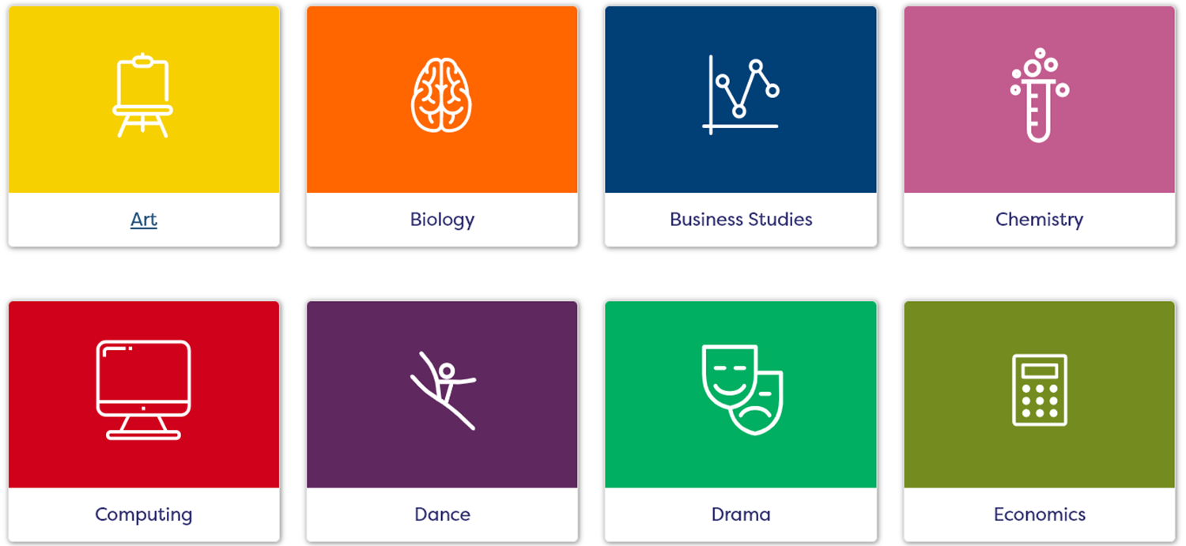
Using Careerpilot to search for jobs
On Careerpilot you can choose any favourite subject and see what courses or jobs it could lead on to in the future.
Notes:
Show the students the Real Cool Futures video showing ‘green careers’.
Ask students at the end of the video if they can remember any of the jobs that were highlighted - Innovation Executive at EDF energy, Recycling Liaison Officer, Customer Services, Solar Panel Fitter, Communications Officer, Operations Manager etc.

Slide 57

Careerpilot Task
Log in to Careerpilot
2. Go to ‘Start with you’ and click on ‘Start with a
Subject’
3. Find a favourite subject from the list and look at the list of related jobs. Can you add some more related job titles to your own diagram?
Look at the job profiles to find out more about the day to day tasks of each job.
Look at some of the video stories to find out more from people who do these jobs.
30 mins
Notes:
Explain to students what activities they will be doing shortly on Careerpilot.
Extension: Any students that finish early could be asked to look at another favourite subject and create a second diagram with related jobs around another subject.
Students can build the Teamwork skill at step 7: I contribute to group decision making, whilst recognising the value of others' ideas

Slide 58
Sharing what you found
Working in pairs, take it in turns to talk through what you found out today.
    Speak engagingly by using facts and examples
    What is your favourite subject?
    Which jobs have you found related to that subject?
    Are there any jobs you might like to do one day?
Show you are listening by using open questions to deepen your understanding
10 mins
Notes:
This activity can support students to build the following skills steps:
Step 8 Listening – Questioning: I ask open questions to understand more
Step 8 Speaking – Using facts: I speak engagingly by using facts and examples to support my communication
Reflection questions
Did you ask open questions to support your understanding?
Did you use examples to support your points?

Slide 59
Getting Career-ready
You have thought about your strengths and interests and explore where they could lead.
TODAY
You are now aware of the range of possible jobs related to your favourite subjects.

Slide 60
Careerpilot is closing. This resource is only available to use until 23rd October 2026.
Exploring Jobs
Lesson 5: Careerpilot Quiz

Slide 61
Getting Career-ready
Class Discussion
What is a career?
What is LMI?
How and why are jobs changing?
What are Green Jobs?
10 mins
Notes:
A career is an individual's journey through life, learning and work.
LMI is Labour Market Information – information about jobs, what you might earn, if the job is predicted to grow or not etc.
Some jobs are changing due to developments in new technology – some jobs may not be needed as much, but others may be needed more.
Green Jobs are those involved in producing goods or services that help to protect the natural environment and look after our planet.

Slide 62
Careerpilot Quiz
Log in to Careerpilot and work in pairs to find the answers to the following questions:
1. What is the average salary for a hospital doctor?
2. What qualifications do you need to be an Early Years Teacher?
3. Are there likely to be more or less farmers needed in the future? What percentage growth or decline is there?
40 mins
4. Name 3 different Green Jobs?
5. What does a motorsport engineer do?
6. Find 3 jobs where the average salary is over £50,000
Notes:
Explain to students what activities they will be doing shortly on Careerpilot.
Students need to work in pairs to find and record the answer to each of the questions above.
Extension question: Find the highest paid job on Careerpilot!
Students can build their Teamwork skill at Step 7: I contribute to group decision making, whilst recognising the value of others' ideas

Slide 63
Careerpilot Quiz Answers
What is the average salary for a hospital doctor?
https://www.careerpilot.org.uk/job-sectors/medical/job-profile/hospital-doctor
2. What qualifications do you need to be an Early Years teacher? https://www.careerpilot.org.uk/job-sectors/childcare/job-profile/early-years-teacher
3. Are there likely to be more or less farmers needed in the future?
https://www.careerpilot.org.uk/job-sectors/agriculture/job-profile/farmer
4. Name 3 different Green Jobs?
https://www.careerpilot.org.uk/job-sectors/green-jobs
5. What does a motorsport engineer do?
https://www.careerpilot.org.uk/job-sectors/engineering-design/job-profile/motorsport-engineer
6. Find 3 jobs where the average salary is over £50,000
https://www.careerpilot.org.uk/job-sectors/stem/job-profile/airline-pilot
https://www.careerpilot.org.uk/job-sectors/law/job-profile/barrister
https://www.careerpilot.org.uk/job-sectors/design-planning/job-profile/civil-engineer
Notes:
Use the URLs to support students to find the answers to the questions on Careerpilot where needed.

Slide 64

Getting Career-ready
You know how developments in technology and science are changing jobs and know what ‘green jobs’ are.
Over the last 5 lessons
You understand that a career is a journey and have started to look towards what you might like to do in the future.
You have considered your strengths and interests and explored where they could lead.
You are aware of the range of possible jobs related to your favourite subjects and can use LMI to find out more about them.
Notes:
The Career Development Institute has developed a careers framework that shows the skills everybody needs to have to manage their future career.
This slide shows the students which of the career learning areas (CDI) that this lesson 1 links to.
You can also share the structure of the session with students.

