Slide 1
Session 3
careerpilot.org.uk
What inspires you?
Look at Jobs and courses
Make a plan

Slide 2
What you will get from this lesson
You will:
Think about your strengths as a learner;
Explore more jobs and courses;
Think about your next step plan;
Do a quiz using Careerpilot.
Notes:
The Career Development Institute has developed a careers framework that shows the skills everybody needs to have to manage their future career.
This slide shows the students which of the career learning areas (CDI) that this lesson 1 links to.
You can also share the structure of the session with students.

Slide 3
Reminder – We have explored
Skills you have
Pathways you could take
Jobs you might like
Courses you could do
But what does it take to be a successful learner?
Notes:
Explain to students what activities they will be doing shortly on Careerpilot.
Use the following slides 11-15 to explain how to complete these activities before getting started….

Slide 4
What makes a successful learner?
Can take responsibility for their own learning
Question everything to make sure they understand
Are driven by what interests them
Where are you now?
Which are your strongest?
Which one will you work on?
Can keep going through challenges
Are determined to succeed
Exercise their minds and their bodies
Know how and when to ask for help
Can learn from their mistakes
Notes:
Show students that if they are new to Careerpilot, they need to register to use the website.
They must click on the ‘Register’ button in the top right corner to open up a short registration form that takes a few minutes to complete.
Remind students to use their school email address to register and to click on your school from the drop down list.
Students that have already registered just need to log in with their email and password.

Slide 5
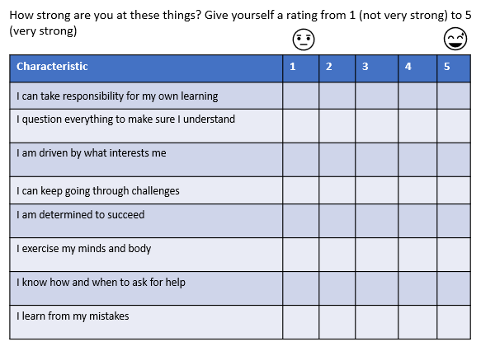
Do 4 things today
1
Quiz – Successful Learner
10 mins
2
Explore more jobs/courses on Careerpilot
15 mins
3
Do a quiz in pairs using Careerpilot
20 mins
Notes:
Encourage students to go to their Career Tools via the home page and select Career Tools at top right of home page.
Click on My Skills Profile to see your results or view skills on the Dashboard.
Explain this will be saved for them to revisit at a later date and they can add more or change their choices as they go through school.

Slide 6
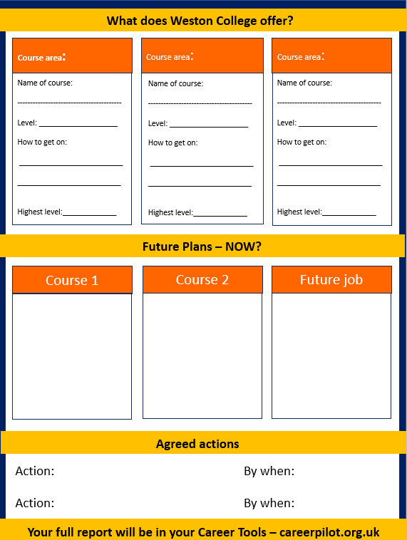
Do 4 things today
4
Have a short one to one conversation about your plans
Notes:
Encourage students to go to their Career Tools via the home page and select Career Tools at top right of home page.
Click on My Skills Profile to see your results or view skills on the Dashboard.
Explain this will be saved for them to revisit at a later date and they can add more or change their choices as they go through school.

Slide 7
Careerpilot Quiz in pairs
Log in to Careerpilot and find the answer to the following questions:
1. What is the highest level of qualification shown in the Qualification Planner?
20 mins
2. Name 3 different types of Level 3 qualifications
3. Name 3 job sectors
4. What qualifications do you need to become an software engineer?
5. Find 2 courses through degree search from BS23 2AL.
6. How many apprenticeships in business, 30 miles from BS24 2AL
Notes:
Explain to students what activities they will be doing shortly on Careerpilot.
Students can work individually or in pairs to find the answers. Students to make a note of the answers.

Slide 8
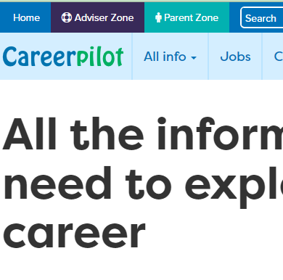
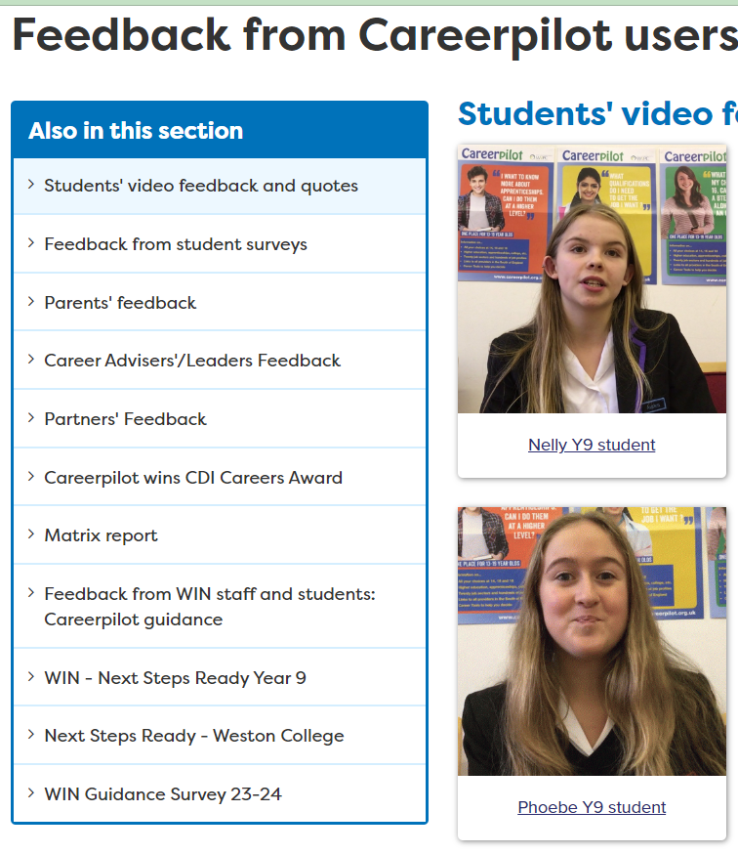
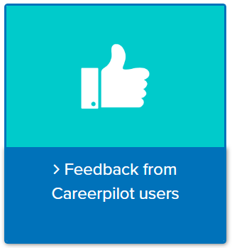
End Quiz

Slide 9
End Quiz
5 mins

Slide 10
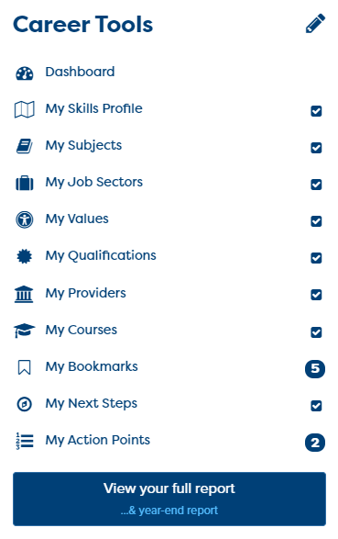
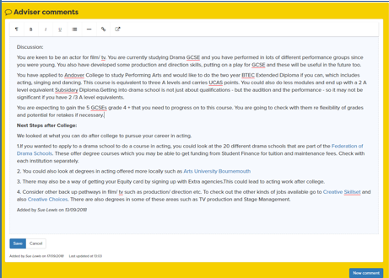
What next?
You can use your Careerpilot account until you are 20

Slide 11
You have been amazing!
Good luck with your future plans
Hope you feel…
Notes:
Can leave out of short of time

