Slide 1




KS4: Offline Careers Activities
Exploring Jobs and Careers
Careerpilot is closing. This resource is only available to use until 23rd October 2026.
careerpilot.org.uk
1

Slide 2
KS4: Offline Careers Activities
Exploring Jobs and Careers
  This set of short offline activities can be completed with a class in tutor time or as a warm up for a careers lesson.
  Each activity is designed to take 15-20 minutes to include some exploration of Careerpilot from the front.
  When opening any links, right click on the link and select 'open link in new tab' to ease navigation back to the activities.
  No individual student access to a computer required for this lesson, although students can log in to Careerpilot as a follow up activity.
  Click on the activity below to access the relevant slide.
Jobs of the Future
Students guess which jobs are 'Hot Jobs' that are predicted to grow over the coming years.
Degree or not a Degree?
Students are given a range of degrees and have to decide if they are a real course or a fake.
Routes In
Students work with others to consider different pathways into specific jobs.
Skills, Skills, Skills
Students watch a video of someone talking about their job and consider the different skills needed for this work.
careerpilot.org.uk
2
2

Slide 3

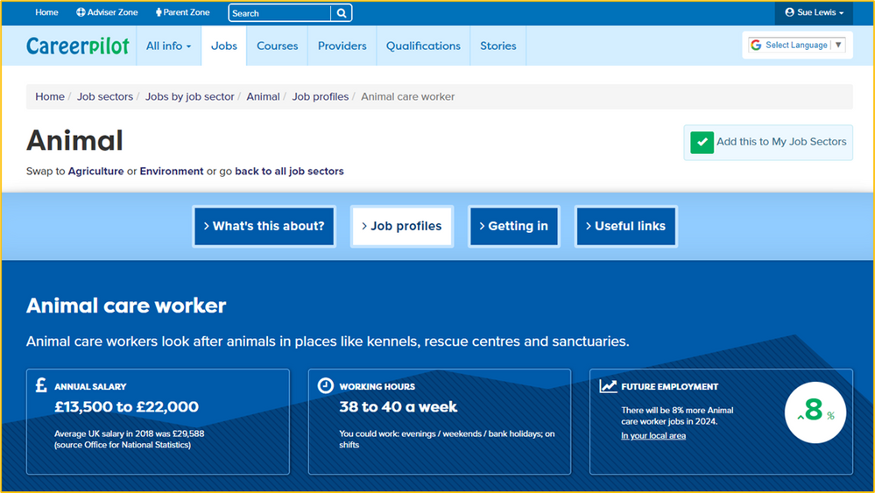
KS4: Jobs of the Future
Teacher
Notes
Careerpilot - Exploring jobs and careers
This activity introduces a range of 'Hot Jobs' that are predicted to grow over the coming years. Discuss why certain jobs may be growing or in decline - you might talk about automation and technology and climate change as potential factors effecting the jobs market.
Playing Jobs of the Future:
  Students work in pairs or individually
  The teacher reads out a job title from the list on slide 4 and the student/pairs have to write the job down and draw an arrow up or down next to it to show if they think the job is predicted to grow or decline within the next few years.
  Students can also use thumbs up or down to show the class if they think it is predicted to grow or decline.
  The teacher then reveals the answer by opening the Careerpilot Job Profile from links.
  A point is scored for each correct guess and the winning pair/individuals are the ones with the most points.
Extension:
Students can register or log in to Careerpilot as a follow up to explore job profiles in the Jobs section to find out more and can bookmark individual jobs and save them in their Career Tools.
Click here for
next slide
careerpilot.org.uk
3
3

Slide 4
KS4: Jobs of the Future
Climate Scientist | Florist | Blacksmith
Computer Games Developer | Postperson | Environmental Consultant
Domestic Energy Assessor | Nurse | Offshore Drilling Worker
Cyber Intelligence Officer | Family Support Worker | Locksmith
Make-up Artist | Counsellor | Pet Behaviour Consultant
careerpilot.org.uk
4
4

Slide 5
KS4: Degree or Not a Degree?
Teacher
Notes
Careerpilot - Exploring jobs and careers
This activity explores some different degree courses that could be studied at university to show the range available. Introduce this session by discussing what a degree course is. You can look at the different levels of qualifications, and vocational and academic pathways, using the qualifications ladder on Careerpilot.
Playing Degree or Not a Degree:
  Students work in a group or pairs
  The teacher shows the six different degree course names on slide 6.
  Students then have to discuss with others and guess if the degrees are real ones you can study at university of if they are fake.
  The teacher then reveals the answers on slides 6-11 and discusses alternative courses where appropriate.
  The winning group / individual is the one that scores the highest number of points.
Extension:
Students can register or log in to Careerpilot as a follow up to explore the Courses section to find out more about different degrees and universities. They can bookmark individual courses to save them in 'My Courses' in their Career Tools.
Click here for
next slide
careerpilot.org.uk
5
5

Slide 6
KS4: Degree or Not a Degree?
Degree Course
Cake Design
Wildlife Conservation
Festival Management
Vlogging
Football Science
Animal Behaviour
Real
or
Fake?
Click here for
next slide
careerpilot.org.uk
6
6

Slide 7
KS4: Degree or Not a Degree?
Degree Course | Fake or Real? | Example of where can you study this course
Cake Design | Fake | Not available as a degree, but you could look at college courses such as Level 2 Certificate in Sugarcraft, Level 2 Certificate in Professional Cake Decoration or Level 3 Diploma in General Patisserie and Confectionary
Wildlife Conservation
Festival Management
Vlogging
Football Science
Animal Behaviour
Click here for
next slide
careerpilot.org.uk
7
7

Slide 8
KS4: Degree or Not a Degree?
Degree Course | Fake or Real? | Example of where can you study this course
Cake Design | Fake | Not available as a degree, but you could look at college courses such as Level 2 Certificate in Sugarcraft, Level 2 Certificate in Professional Cake Decoration or Level 3 Diploma in General Patisserie and Confectionary
Wildlife Conservation | Real | Bath Spa University
Festival Management
Vlogging
Football Science
Animal Behaviour
Click here for
next slide
careerpilot.org.uk
8
8

Slide 9
KS4: Degree or Not a Degree?
Degree Course | Fake or Real? | Example of where can you study this course
Cake Design | Fake | Not available as a degree, but you could look at college courses such as Level 2 Certificate in Sugarcraft, Level 2 Certificate in Professional Cake Decoration or Level 3 Diploma in General Patisserie and Confectionary
Wildlife Conservation | Real | Bath Spa University
Festival Management | Real | Falmouth University
Vlogging
Football Science
Animal Behaviour
Click here for
next slide
careerpilot.org.uk
9
9

Slide 10
KS4: Degree or Not a Degree?
Degree Course | Fake or Real? | Example of where can you study this course
Cake Design | Fake | Not available as a degree, but you could look at college courses such as Level 2 Certificate in Sugarcraft, Level 2 Certificate in Professional Cake Decoration or Level 3 Diploma in General Patisserie and Confectionary
Wildlife Conservation | Real | Bath Spa University
Festival Management | Real | Falmouth University
Vlogging | Fake | Not available specifically as a degree, but you could look at college courses such as Level 1 Award In Video Editing and Production for Creative Media Industries, Level 2 Certificate in Creative Digital Media or Level 3 Diploma in Digital Content Production. Vlogging may be covered in more general Film and Media Degree Courses.
Football Science
Animal Behaviour
Click here for
next slide
careerpilot.org.uk
1
10

Slide 11
KS4: Degree or Not a Degree?
Degree Course | Fake or Real? | Example of where can you study this course
Cake Design | Fake | Not available as a degree, but you could look at college courses such as Level 2 Certificate in Sugarcraft, Level 2 Certificate in Professional Cake Decoration or Level 3 Diploma in General Patisserie and Confectionary
Wildlife Conservation | Real | Bath Spa University
Festival Management | Real | Falmouth University
Vlogging | Fake | Not available as a degree, but you could look at college courses such as Level 1 Award In Video Editing and Production for Creative Media Industries, Level 2 Certificate in Creative Digital Media or Level 3 Diploma in Digital Content Production
Football Science | Real | Plymouth Marjon University
Animal Behaviour
Click here for
next slide
careerpilot.org.uk
11

Slide 12
KS4: Degree or Not a Degree?
Degree Course | Fake or Real? | Example of where can you study this course
Cake Design | Fake | Not available as a degree, but you could look at college courses such as Level 2 Certificate in Sugarcraft, Level 2 Certificate in Professional Cake Decoration or Level 3 Diploma in General Patisserie and Confectionary
Wildlife Conservation | Real | Bath Spa University
Festival Management | Real | Falmouth University
Vlogging | Fake | Not available as a degree, but you could look at college courses such as Level 1 Award In Video Editing and Production for Creative Media Industries, Level 2 Certificate in Creative Digital Media or Level 3 Diploma in Digital Content Production
Football Science | Real | Plymouth Marjon University
Animal Behaviour | Real | University of Exeter
careerpilot.org.uk
12

Slide 13
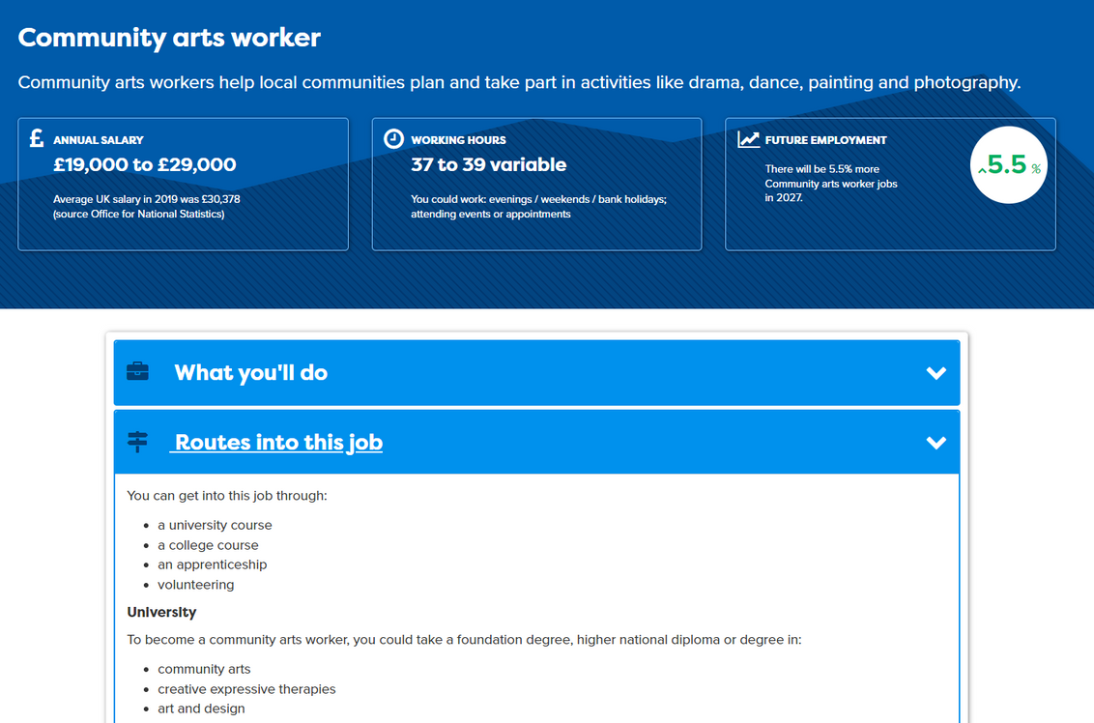
KS4: Routes In
Teacher
Notes
Careerpilot - Exploring jobs and careers
This activity explores the different pathways that you could take to work in a number of Hot Jobs. You can use this activity to discuss difference between different level of qualifications and vocational and academic routes using the qualifications ladder on Careerpilot.
Playing Routes In:
  Students work in a groups or pairs with a pen and paper per group
  Working together, students have 10 minutes to draw the table on slide 14 and discuss each job one at a time and the ‘routes in’ to the career. Do you think you need a university degree? Could you do an apprenticeship?
  The teacher can then use the Job Profiles on Careerpilot to look together at the possible ‘routes in’.
  Mark one point for each correct answer.
  The winning group is the one that scores the highest number of points.
Extension:
Students could use Careerpilot as a follow up to research jobs they are interested in and explore the routes in. The Job Sectors part of the site has information on 800+ jobs and if students register with Careerpilot their favourites can be bookmarked & saved within their Career Tools.
Click here for
next slide
careerpilot.org.uk
13

Slide 14
KS4: Routes In
Job | Do you need to study a degree at university to do this job? | Could you do an apprenticeship to get into this job?
Hospital Doctor
Landscaper
Community Arts Worker
Aerospace Engineer
Dental Technician
Animal Care Worker
careerpilot.org.uk
14

Slide 15
KS4: Skills, Skills, Skills
Teacher
Notes
Careerpilot - Exploring jobs and careers
This activity encourages students to think about the different skills needed to do different jobs. Please use one or more of the videos from Careerpilot to introduce the job and to prompt discussion on the skills that may be needed. You may use the Essential Skills needed for any job on slide 15 as a prompt, as well as encouraging students to think about more specific technical skills.
Playing 'How many jobs':
  Students can work in pairs or as a group
  Each pair or group is given an A3 piece of paper
  Students are shown a video clip from opposite to hear from someone talking about their job
  Students should make a note of the job title, then discuss and write down any skills needed for that particular role.
Extension:
Students can log in or register with Careerpilot to complete the Skills Profile to explore their own skills and build a bank of examples of where they have developed the skills to share in applications for study or work.
Wind Turbine Engineer | Computer Games Developer
Train Driver | Hotel Receptionist
Click here for
next slide
careerpilot.org.uk
15

Slide 16

KS4: Skills, Skills, Skills
careerpilot.org.uk
16

