Slide 1
Session 1
careerpilot.org.uk
What inspires you?
Look at Jobs and courses
Sue Lewis
Ruth Thomas
University of Bath
Make a plan

Slide 2
What you will get from this lesson
You will:
What is a career;
Consider your next career step;
Think about your skills;
Think about job sectors that might suit you

Slide 3
What is a career?
A career is an individual's journey through life, learning and work.
It is all about YOU!
Throughout your career you will have many jobs

Slide 4
Why is this important?
https://www.youtube.com/watch?v=OWZxyyK6OuA
Notes:
Ask students if they know what a career means?
Encourage students to explain what is meant by the word career then reveal the answer.
Ask students to share it they have any idea about what sort of job or work they might like to do one day?

Slide 5
Getting to know you
Tell the group one thing you really like to do – in college or out of college

Slide 6
What’s next on your career journey?
ESOL Course
Level 1
Level 2
Level 3
Level 4+
In the UK you have to be in education or training until you are 18
Notes:
Ask students if they know what a career means?
Encourage students to explain what is meant by the word career then reveal the answer.
Ask students to share it they have any idea about what sort of job or work they might like to do one day?

Slide 7
The bigger picture - Qualification Pathways
Academic
Vocational
Work-based
Degree Achieved
Degree Year 2
HND
Foundation Degree Y2
Higher Apprenticeship
Degree Year 1
HNC
Foundation Degree Y1
Higher Apprenticeship
A levels
BTEC/ OCR /T LEVEL Level 3
Advanced Apprenticeship
English and Maths Grade 4 and above
BTEC/OCR Level 2
Intermediate Apprenticeship
5 x GCSEs 4 - 9
GCSEs 1 - 3

Slide 8
Focus on YOUR next step
Your next decision
What course?
Apprenticeship?
What job?
ESOL
B
A
Notes:
Ask students if they know what a career means?
Encourage students to explain what is meant by the word career then reveal the answer.
Ask students to share it they have any idea about what sort of job or work they might like to do one day?

Slide 9
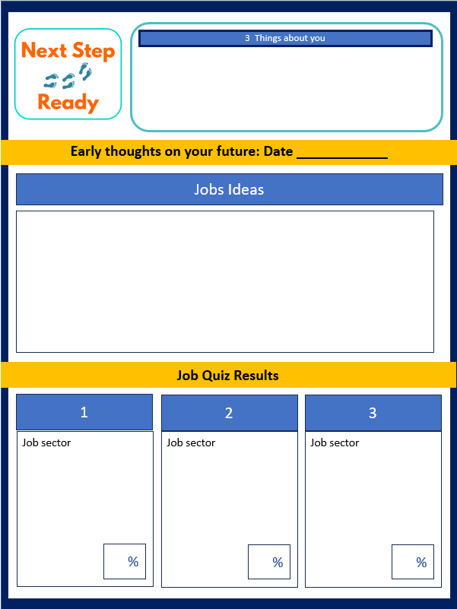
Do you have any job ideas already?
5 mins

Slide 10
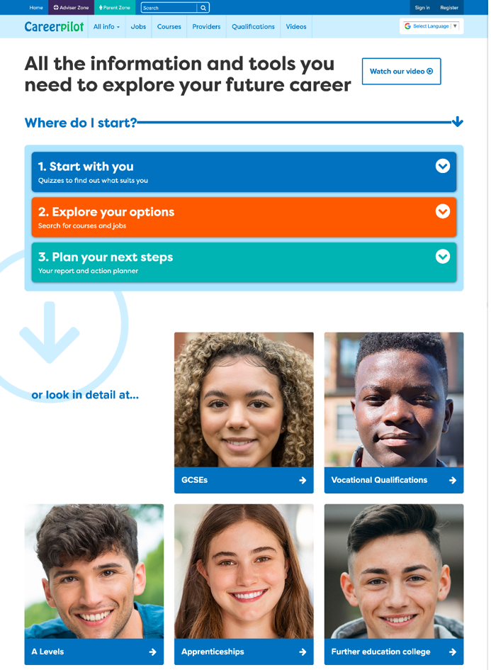
Introducing Careerpilot
Jobs, courses, qualification planner, videos
Quizzes, tools – 3 stages to help you decide
Future qualifications and pathways
careerpilot.org.uk
Notes:
Careerpilot is a website that you can use for free. It has lots of information and tools to help you to start to think about future career ideas and pathways.
The website is built around 3 stages:
Start with you – with quizzes to find out more about what might suit you
Explore your options – where you can search for courses and jobs
Plan your next steps – where you can build a report and plan some actions.

Slide 11
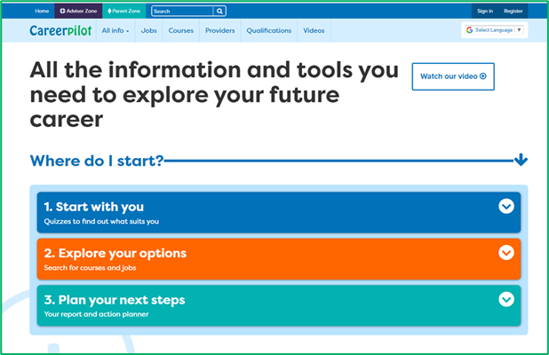
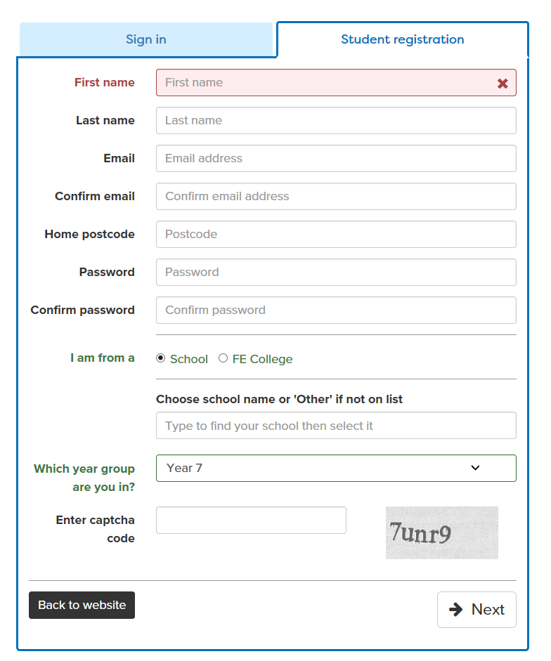
Register or sign in to Careerpilot
careerpilot.org.uk
If you have registered before – sign in
Notes:
Show students that if they are new to Careerpilot, they need to register to use the website.
They must click on the ‘Register’ button in the top right corner to open up a short registration form that takes a few minutes to complete.
Remind students to use their school email address to register and to click on your school from the drop down list.
Students that have already registered just need to log in with their email and password.

Slide 12
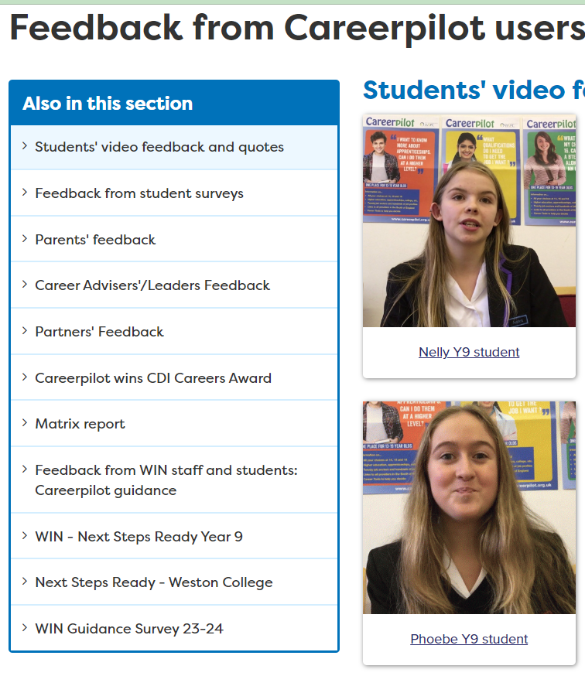
Starting Points

Slide 13
Starting Points

Slide 14
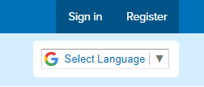
Getting started
1. Register or sign in
careerpilot.org.uk.
2. Do the starter quiz
3. Add your details to your workbook
10 mins
Notes:
Students can use their list subjects and those they are interested in as a starting point for exploring where they might lead.

Slide 15
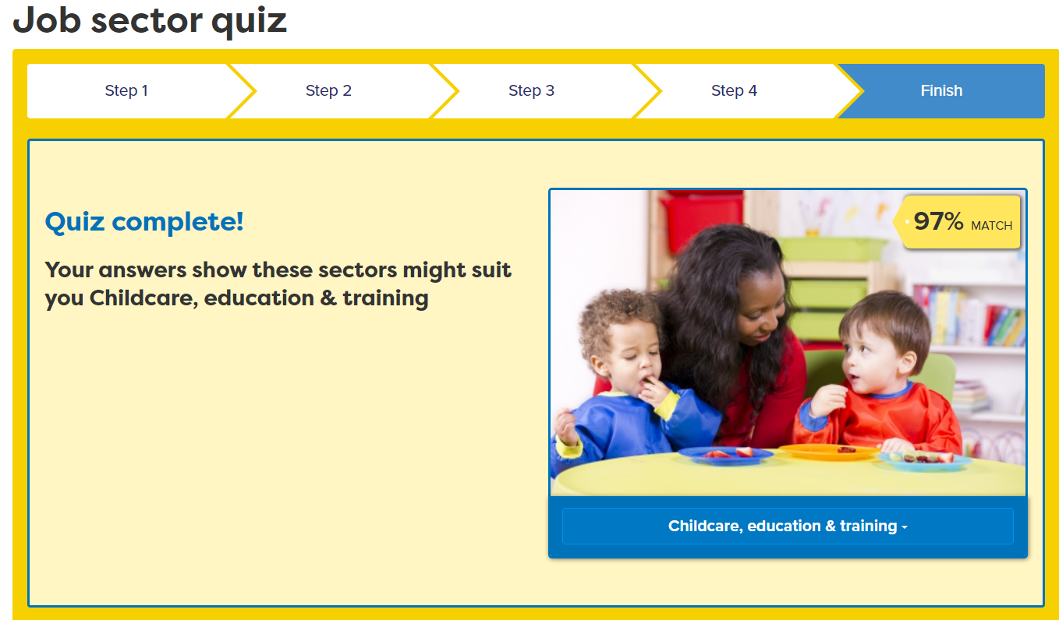
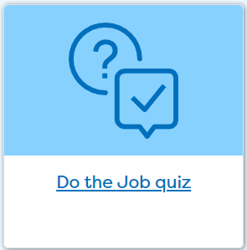
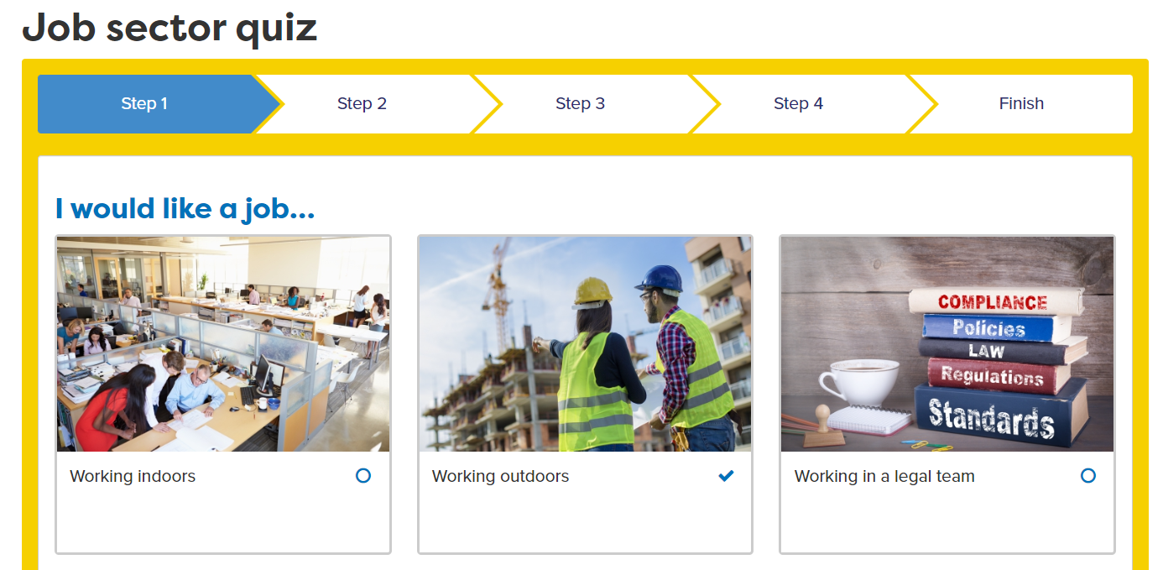
Explore job sectors
Notes:
Ask students to complete the job sector quiz – if they have previously completed it they can look at answers they gave before and review if still relevant and overwrite if necessary.

Slide 16
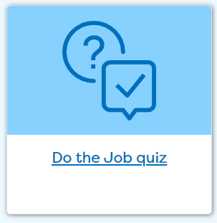
Careerpilot Tasks
1. Click on ‘Start With You’ then do the Jobs Quiz
2. Add the top three job sectors your results map to.
10 mins
Notes:
Explain to students what activities they will be doing shortly on Careerpilot.
Use the following slides 11-16 to explain how to complete these activities before getting started….

Slide 17
The Essential Skills
Other skills some jobs need
IT Skills
Practical
Scientific
Physical
Notes:
Class discussion – what skills did students come up with?
These eight skills have been identified by employers as being essential to any job. They are people skills, so are all about how you communicate with others, how you manage yourself and come up with new ideas.
You can see them as four pairs of skills:
Communication skills - Listening and Speaking
Creative Problem Solving skills - Problem Solving and Creativity
Self-management skills - Staying Positive and Aiming High
Inter-personal skills - Leadership and Teamwork

Slide 18
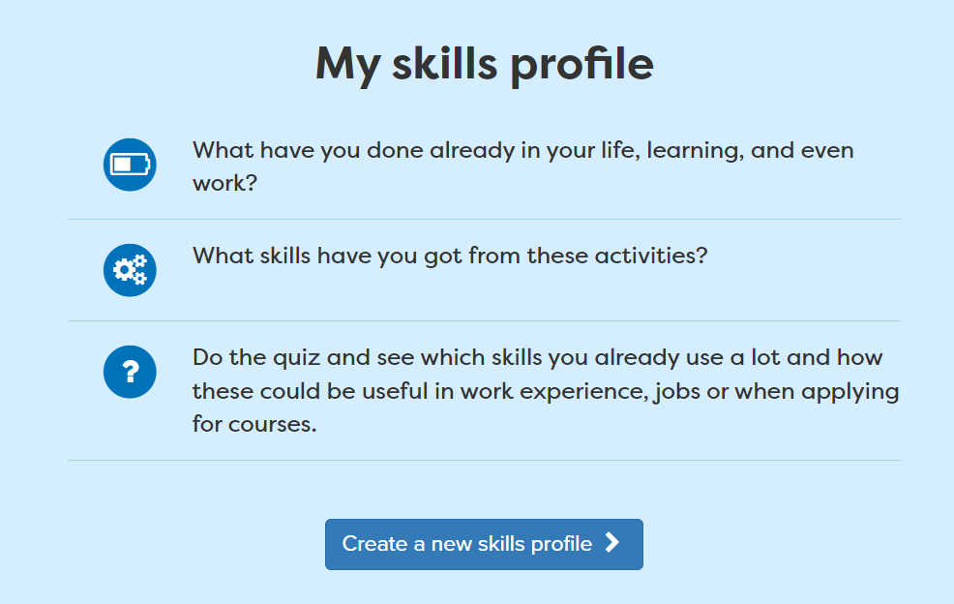
Add activities
Jan 2024
Notes:
Students can add activities that they have completed where they have been building their skills.
For example, they may take part in a club outside of school where they use Teamwork skills.

Slide 19
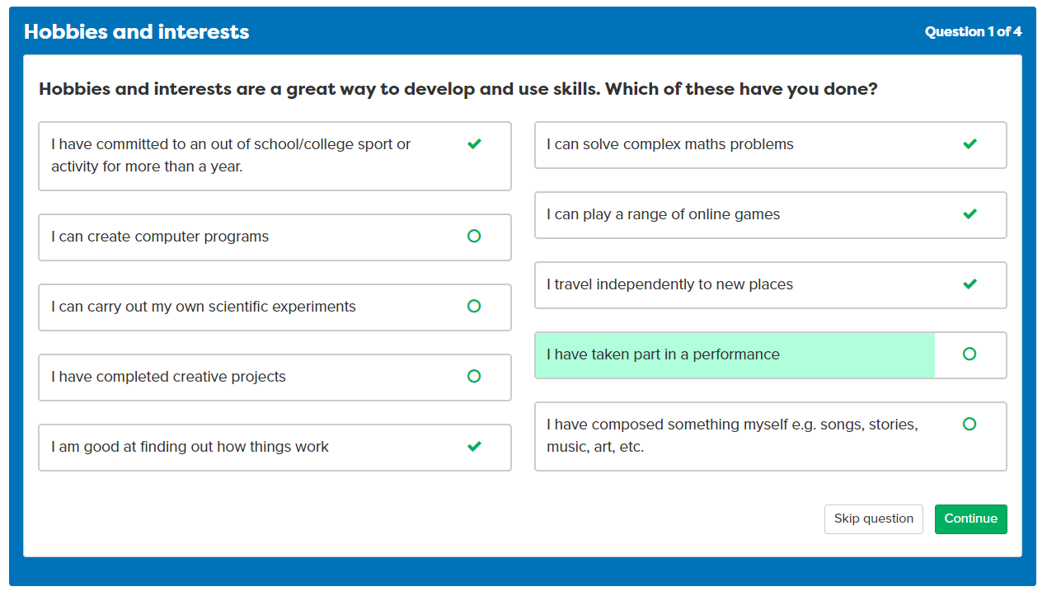
Complete the Skills Profile
Notes:
Students can add activities that they have completed where they have been building their skills.
For example, they may take part in a club outside of school where they use Teamwork skills.

Slide 20
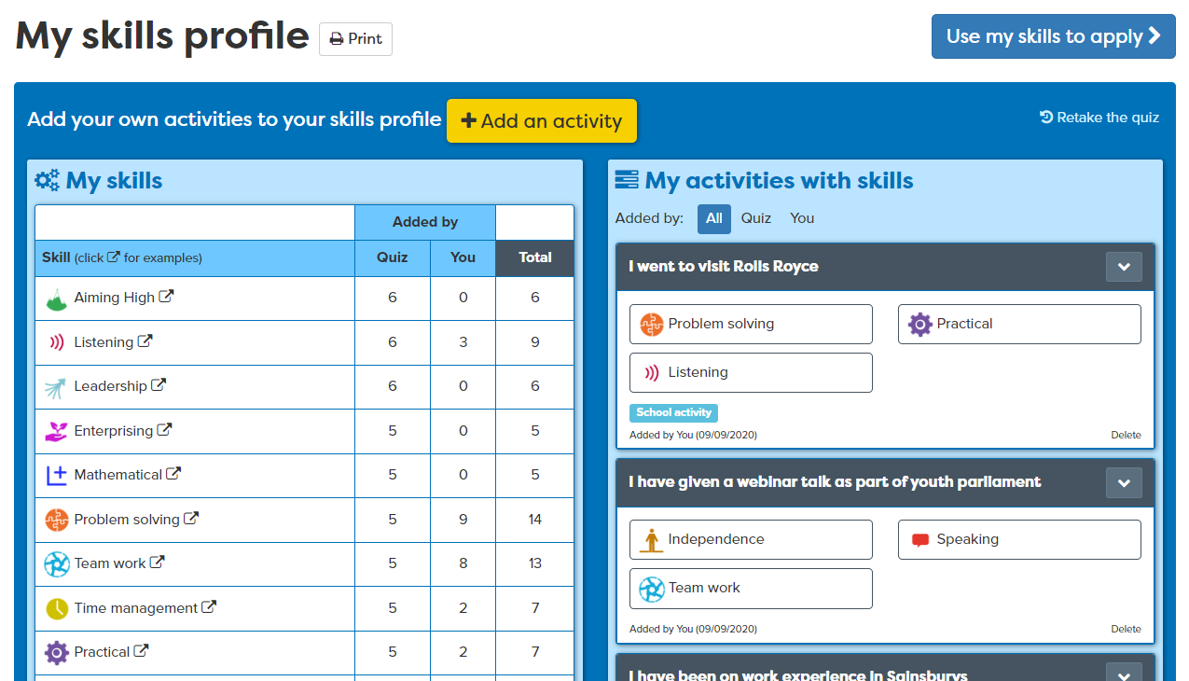
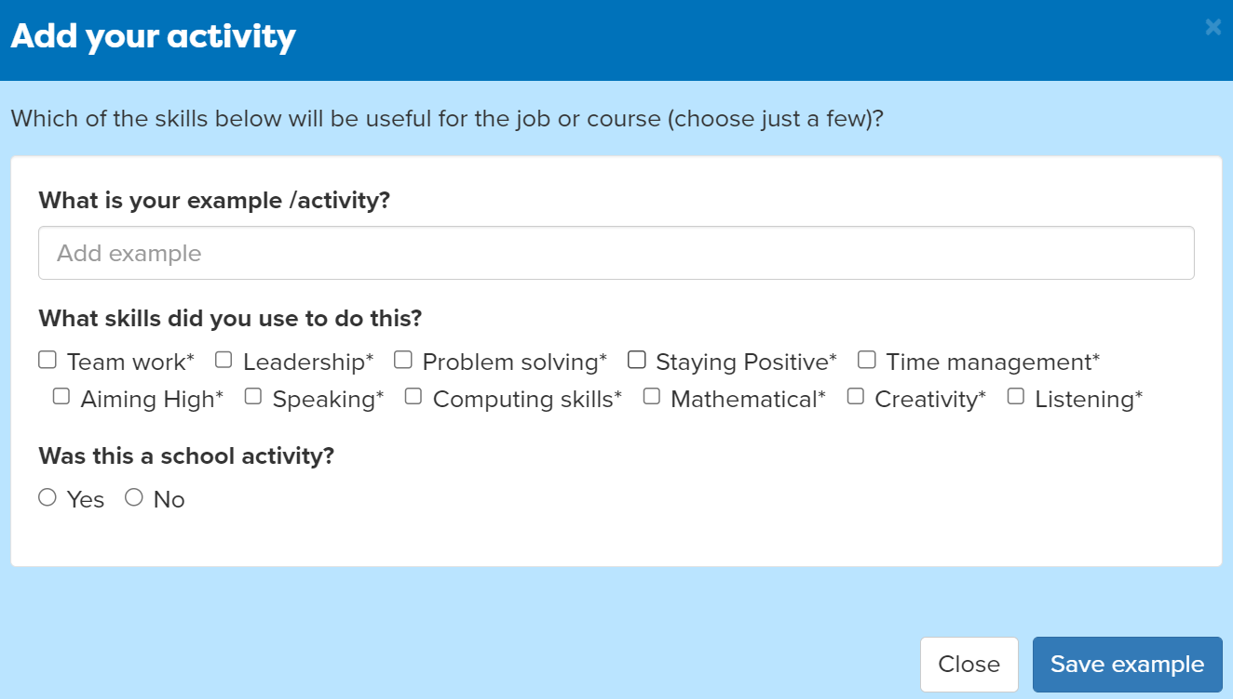
Complete the Skills Profile
Notes:
Students can add activities that they have completed where they have been building their skills.
For example, they may take part in a club outside of school where they use Teamwork skills.

Slide 21
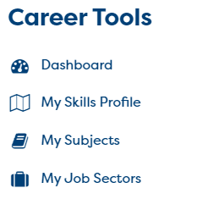
Your Skills Tasks
Click on ‘Start With You’ then ‘Do the Skills Profile’. Add an example of your own.
10 mins
Go to your Career Tools to see your Skills Profile results
Notes:
Explain to students what activities they will be doing shortly on Careerpilot.
Use the following slides 11-16 to explain how to complete these activities before getting started….

Slide 22
Thinking about jobs – in small groups
How many jobs can you think of in:
Sports Club
Supermarket
10 mins
Train Station
Notes:
The Career Development Institute has developed a careers framework that shows the skills everybody needs to have to manage their future career.
This slide shows the students which of the career learning areas (CDI) that this lesson 1 links to.
You can also share the structure of the session with students.

Slide 23
Discussing your interests
Tell the group one thing you have learnt about:
Job sectors that might suit you.
Skills you are already using

Slide 24
Feedback on lesson
Rate these things:
I know more about the job sectors that could suit me
I know more about the skills I have
Write a number from 1-10 (best)
:
Digital Postcard:
What we did and what you could do now
careerpilot.org.uk

Slide 25
careerpilot.org.uk
What inspires you?
Look at Jobs and courses
Make a plan

