Slide 1



Post 16 options and Work Experience
Lesson 2: Work experience - why do it, what to think about and what have you got to offer?

Slide 2


Recorded video of lesson 1
https://youtu.be/YUugDc3tYjM
Right click to play the video above or copy and paste in a new tab to view:

Slide 3






Getting Career-ready
Introduction and warm up activity – 15 mins
You will recognise the value of trying new things
Careerpilot Activities 25 mins
You will reflect on the meaning of work
Wrap-up
10 mins
Notes:
The Career Development Institute has developed a careers framework that shows the skills everybody needs to have to manage their future career.
This slide shows the students which of the career learning areas (CDI) that this lesson links to.
You can also share the structure of the session with students.

Slide 4



What was their first job?
Taylor Swift: Singer, songwriter, musician
Beyonce – Singer
Harry Styles – Singer
Christmas Tree Farm
Hair salon floor sweeper
Worked in a bakery
Where you start your working life is not always where you end up!
Notes:
Quick starter activity to show that you are likely do a range of different jobs in your lifetime. Work experience helps students to find out what work is like and to try out something which interests them.
Ask students if they know who each celebrity is and what job they are famous for, then click to reveal.
Ask students to guess a job they did before they were famous then click to reveal one at a time.
Taylor Swift worked on a Christmas Tree Farm picking bugs off plants

Slide 5
Why do people work?
Working in pairs, come up with some ideas about why people go to work. To get paid is only one reason for working!
Share your ideas and listen to your partner’s contributions.
You may want to make notes of your ideas.
Why do people work?
5 mins
Notes:
Students have 5 mins to work in pairs to think about what different people get from work
Ideas to feed into discussion:
Satisfaction
Challenge
Power
Money
Reason to get up in morning
This activity supports students to practice Step 7 Teamworking – Contributing: I contribute to a group activity

Slide 6





Work experience can help career choices
Y10 Work Experience
Choosing post 16
Choosing post 18
Notes:
WEX can help you make decisions about your future courses and work

Slide 7
One place for all your careers information.
Why do Work Experience?
To find out about a company
To learn/practice skills
To try out a job role
To be seen as a future worker
Notes:
Ask the class – why WEX is important?

Slide 8
Work Experience can help answer….
Is this the sort of job I like?
What skills will I need to do it?
What is the best way to talk to a boss?
Do I like the working conditions?
Could I do this job every day?
How could I get into this job?
Write down a few things you want to get from YOUR work experience
Notes:
Pause the video for students to write down what they want to get from their WEX

Slide 9

Work experience – reality check
What jobs can I realistically do as a Year 10?
Nursery worker
Supermarket
Engineer
Office worker
Doctor
Computer programmer
Whatever work experience you get it will help you practice and develop your skills
Notes:
Ask the students to identify which are likely to be offered to a Year 10. Explain there are lots of great opportunities but because of rules/Health & Safety, some job roles might not be available as work experience for an under 16-year-old. However, they may be able to get experience in a related role.
They will be developing skills wherever they go and be in a work role for maybe the first time.

Slide 10





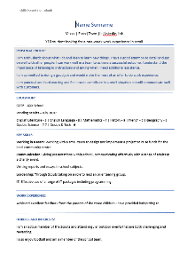
Get the most out of work experience
Think about a job sector or job you would like to try
Think about what you have to offer – your skills and interests
Look for a placement
Have a CV ready to show your employer or talk about
Notes:
Lesson 1 you did the job quiz to see sectors that might suit you.

Slide 11
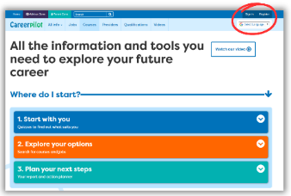
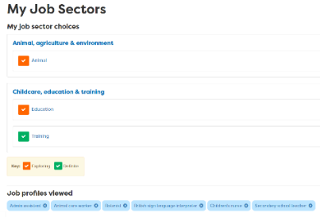


In today’s lesson you will…
Register/sign in to Careerpilot
2. Go to ‘My Job sectors’ and remind yourself
of the ones you liked – any good for work experience?
3. Complete the values task and think about what’s
important to you in a job (add to My Values)
4. Assess/update your skills using the ‘Skills Profile’.
Add your own examples
careerpilot.org.uk
Notes:
Explain to students what activities they will be doing shortly on Careerpilot.
Use the following slides to explain how to complete these activities before getting started….

Slide 12
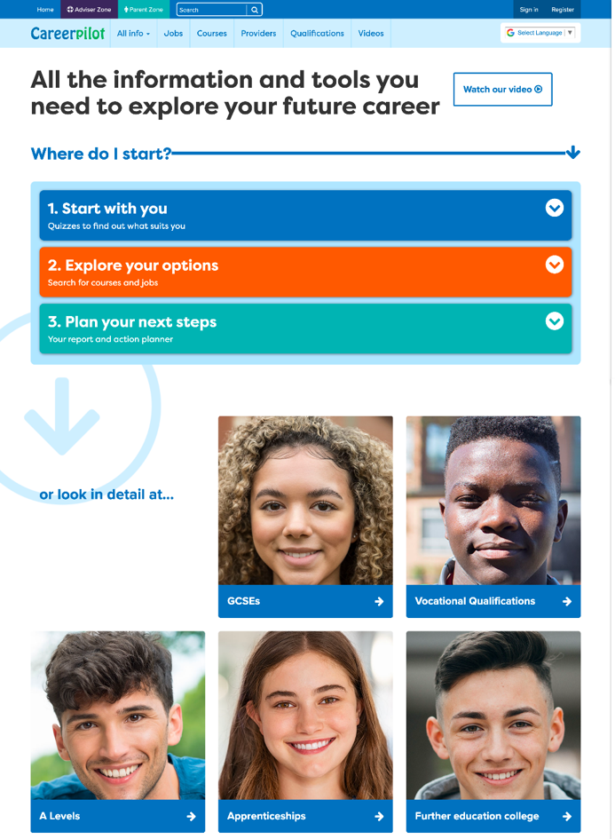
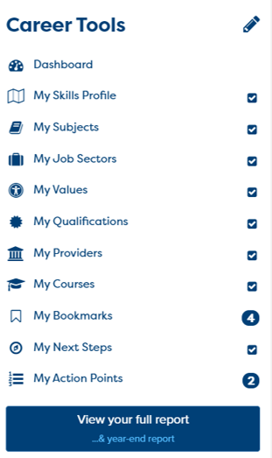

One place for all your careers information.
Log in to Careerpilot
Register/sign in
Notes:
You will using Careerpilot to explore all your options, register (or sign in if you have used it before)
Then you can build your report and have a record of all your career choices and plans

Slide 13
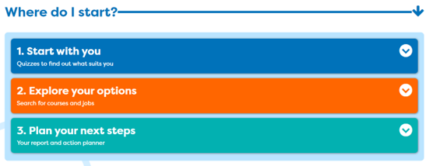
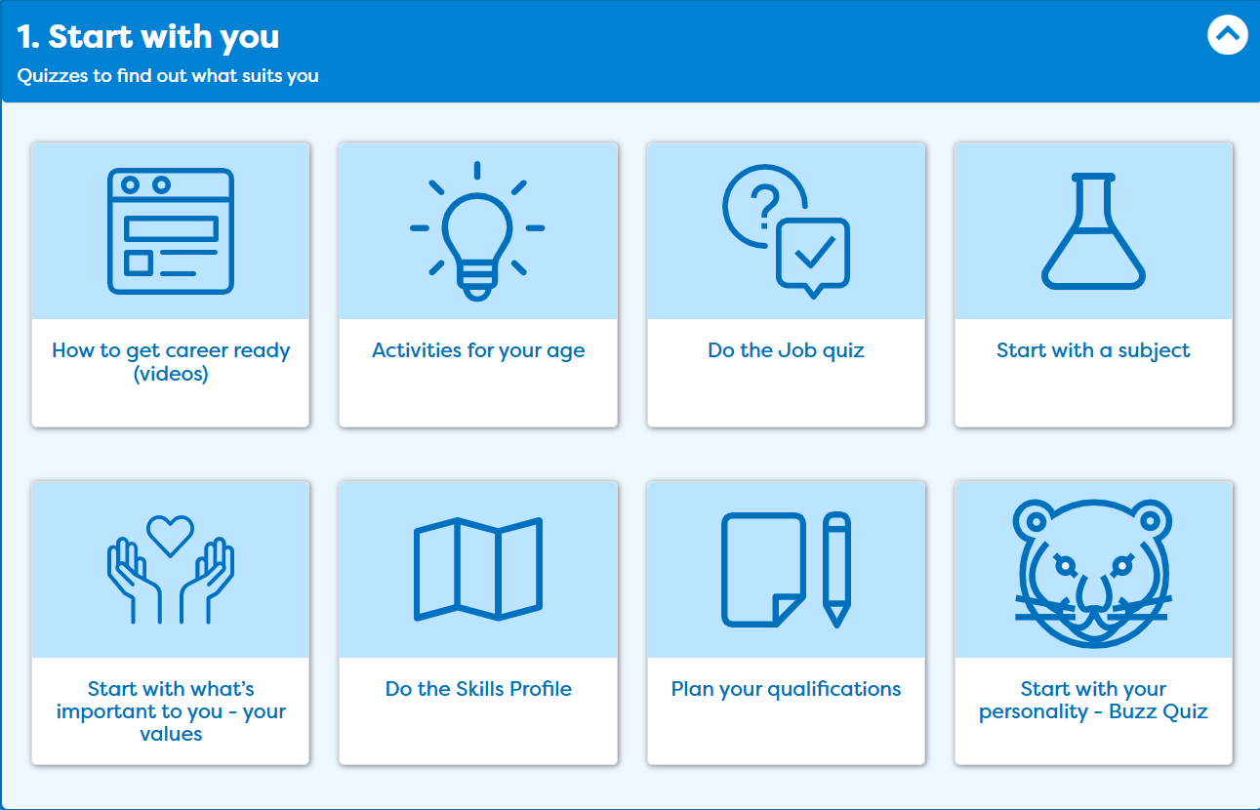
One place for all your careers information.
Think about what you have to offer
Notes:
In ‘Start with you’ these are the activities will be doing today. I am going to show you what you need to do.

Slide 14

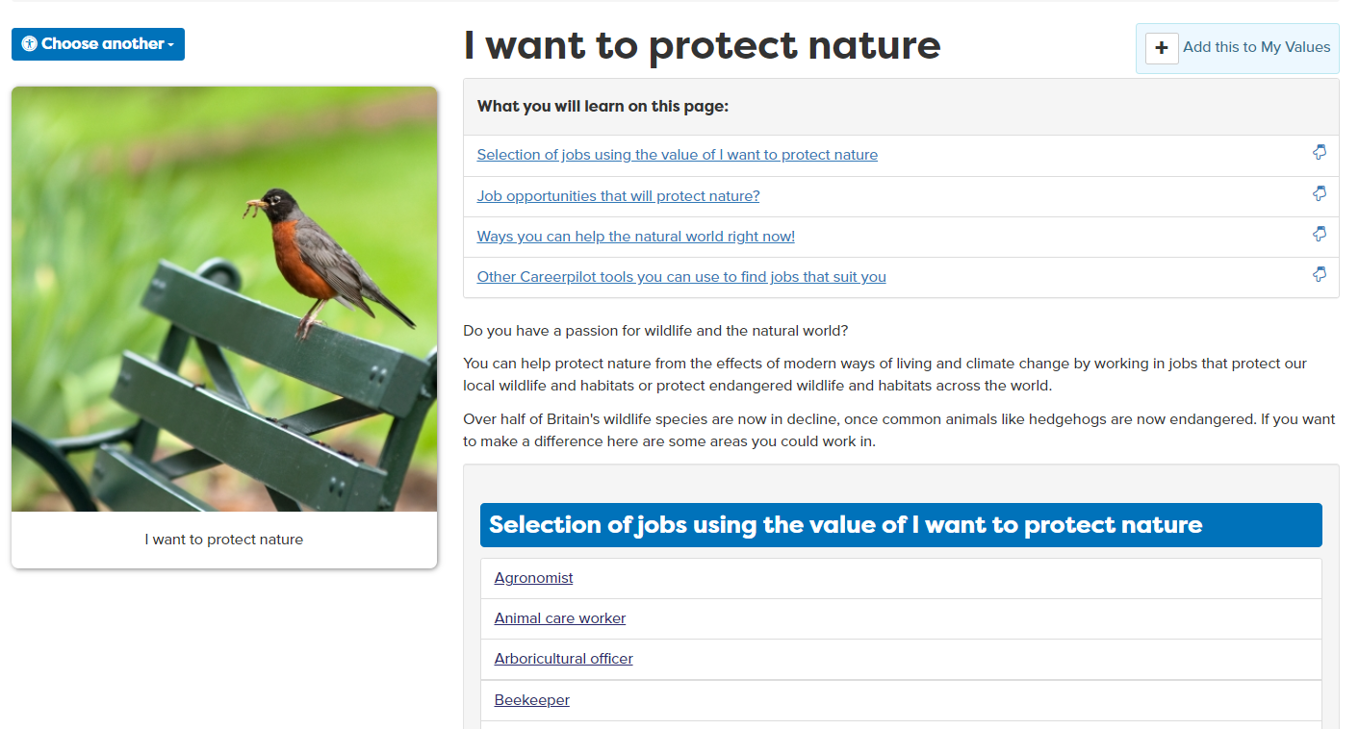
What’s important to you in future work?
Notes:
In ‘Start with you’ these are the activities will be doing today. I am going to show you what you need to do.

Slide 15

The Essential Skills
Other skills some jobs need
IT Skills
Practical
Scientific
Physical
Notes:
Reminder
These eight skills have been identified by employers as being essential to any job. They are people skills, so are all about how you communicate with others, how you manage yourself and come up with new ideas.
You can see them as four pairs of skills:
Communication skills - Listening and Speaking
Creative Problem Solving skills - Problem Solving and Creativity
Self-management skills – Adapting and Planning
Collaboration skills - Leadership and Teamwork

Slide 16
One place for all your careers information.
Think about what you have to offer
Notes:
In ‘Start with you’ these are the activities will be doing today. I am going to show you what you need to do.

Slide 17
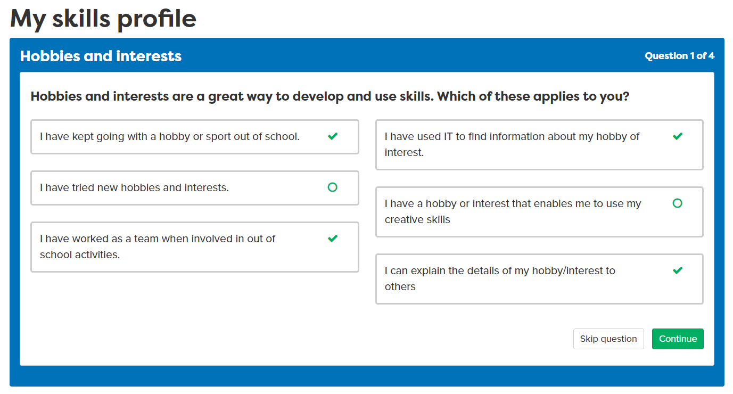
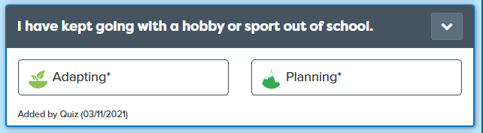
What are your skill strengths?
Notes:
First we will do the Skills Profile, if you have done it before retake the quiz to see if things have changed.

Slide 18
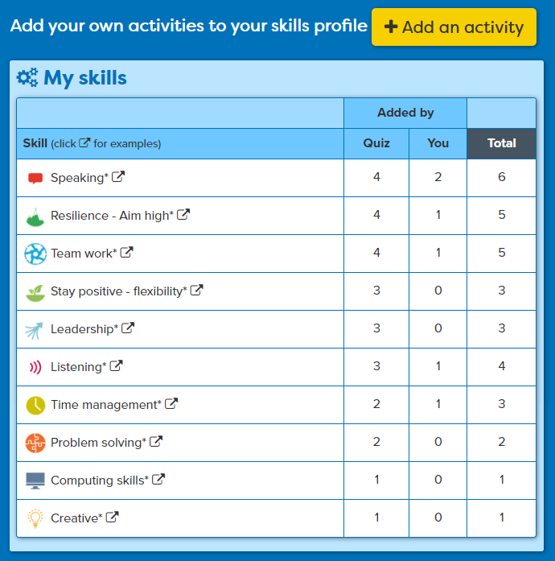
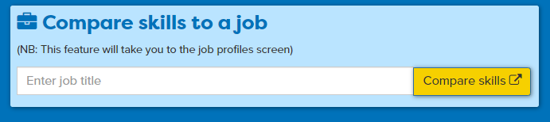
Add your own examples
Today: Add at least 2 examples
Useful for work experience
All your skills are ‘banked’ for later when you want to apply
See how YOUR skills compare to a job
Notes:
All their skills will be put in the Skills Bank, they should add at least two examples of their own in the lesson but keep going back to add things over time. The Skills Banks can then be used when they come to apply.
Useful when you are applying for WEX to mention your skills.

Slide 19
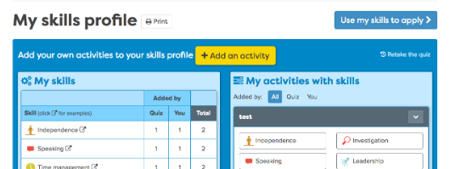
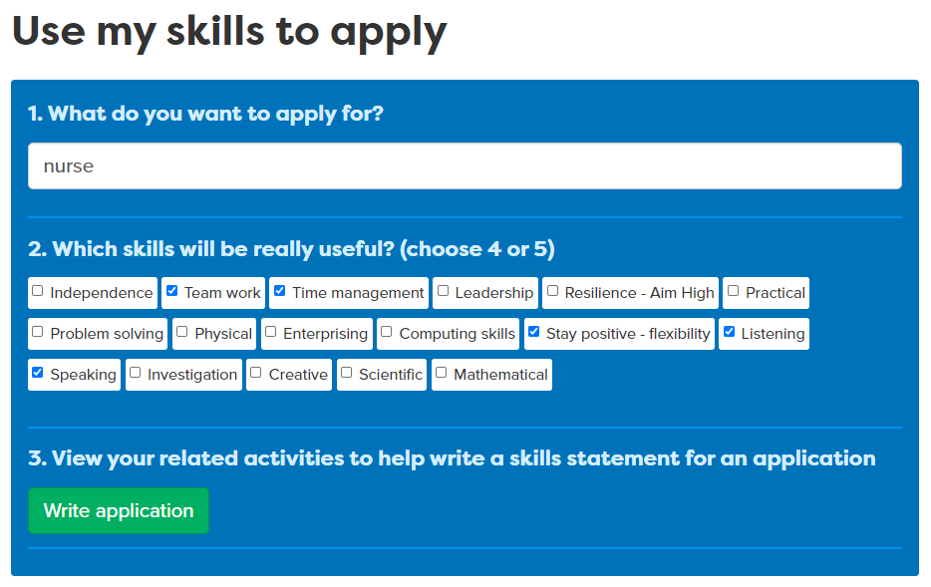
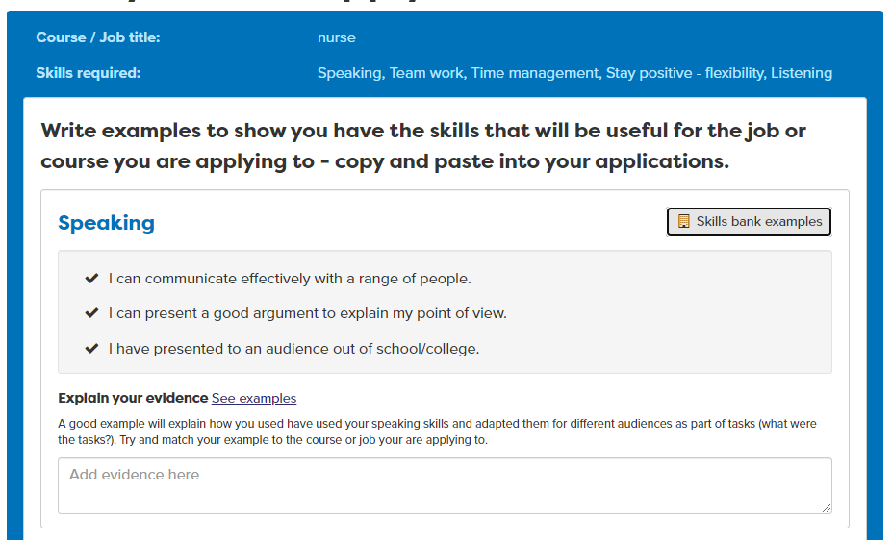
Use your skills when you apply
Notes:
Students can use the skills profile to apply for jobs but adding the information to their CVS and personal statement using our tool above. You can use this in employer CV work shops – B5, applying for work experience BM6 and college or university places – BM7.

Slide 20
Task to complete on Careerpilot
25 mins
Register/sign in to Careerpilot
2. Go to ‘My Job sectors’ and remind yourself
of the ones you liked – any good for work experience?
3. Complete the values task and think about what’s
important to you in a job (add to My Values)
4. Assess/update your skills using the ‘Skills Profile’.
Add your own examples
careerpilot.org.uk
Notes:
Pause video for students to complete tasks on Careerpilot – use the previous slides as needed to guide them through the activities

Slide 21




Wrap-up
Working in pairs – tell your partner:
A job sector you would like to do work experience in
A value that is important to you
A job or qualification you might like to do in the future
    Speak clearly and use facts and examples to explain your choices
  Listen carefully and summarise what you’ve heard to show your understanding.
5 mins
Notes:
Students have 5 mins to work in pairs to share their research and ideas.
If time could ask the class to put hands up about which job sectors/quals they are interested in.
This activity supports students to practice:
Step 8 Speaking – Using Facts: I use facts and examples to support my communication
Step 8 Listening – Summarising: I summarise or rephrase what I learnt

Slide 22

Getting Career-ready – did you?
Recognise the value of trying new things
Reflect on the meaning of work
Next session: Work experience – how to find one
Notes:
The Career Development Institute has developed a careers framework that shows the skills everybody needs to have to manage their future career.
This slide shows the students which of the career learning areas (CDI) that this lesson links to.
You can also share the structure of the session with students.

