Slide 1


Careerpilot is closing. This resource is only available to use until 23rd October 2026.
This lesson can be delivered through a video recording
Know Yourself, Know Your Skills
Lesson 1:
Know Yourself
Notes:
The Career Development Institute have a new framework which shows that everybody, young and old, needs to have the skills to do these 6 things if they are going to be able to manage their future careers.
In this session we will be helping you develop the skills for these three.
This is what we will be doing.

Slide 2
Pre-recorded Lesson
Copy and paste link below or control/right click image above to open video recording in a new tab:
https://youtu.be/gt624kt2wM4
Notes:
You can deliver this lesson using the following PowerPoint slides with accompanying notes or can use this pre-recorded lesson and pause when prompted for students to complete the activities.

Slide 3






Getting Career-ready
Introduction and warm up activity – 10-15 mins
You will complete a personality quiz to find out your personality type.
Careerpilot Activities 20-30 mins
You will use your personality profile to explore jobs and courses that may suit you.
Presentations
5-15 mins
Notes:
The Career Development Institute has developed a careers framework that shows the skills everybody needs to have to manage their future career.
This slide shows the students which of the career learning areas (CDI) that this lesson 1 links to.
You can also share the structure of the session with students.

Slide 4
What is a personality?
Your personality is what makes you special and different from everyone else. It's how you think, feel, and act. It's what makes you laugh, cry, or get excited. Everyone has a different personality, and that's what makes the world so interesting!
TASK:
Can you think of 10 words that describe how people may feel or act? These are called personality traits.
For example, people may be kind, thoughtful, funny…..
5 mins
Notes:
Help students to brainstorm different words that describe how they may feel or act. Explain that these words are like building blocks for our personalities. Everyone has a mix of these qualities and that is what makes us special and unique.

Slide 5

Personality types at work
A personality type is like a big group of people who share similar personality traits. They won’t be the same, but they may be more likely to act or feel in a certain way.
In work, some personality types love to be part of a busy team, while others prefer to work alone. Some prefer to detailed tasks, while others like to look at the bigger picture.
Our personality type can mean we are better suited to certain jobs or careers that will make the most of our personality and strengths.

Slide 6
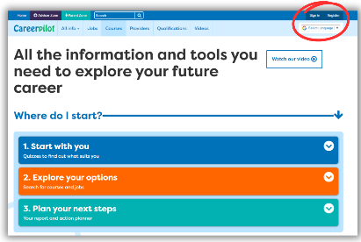
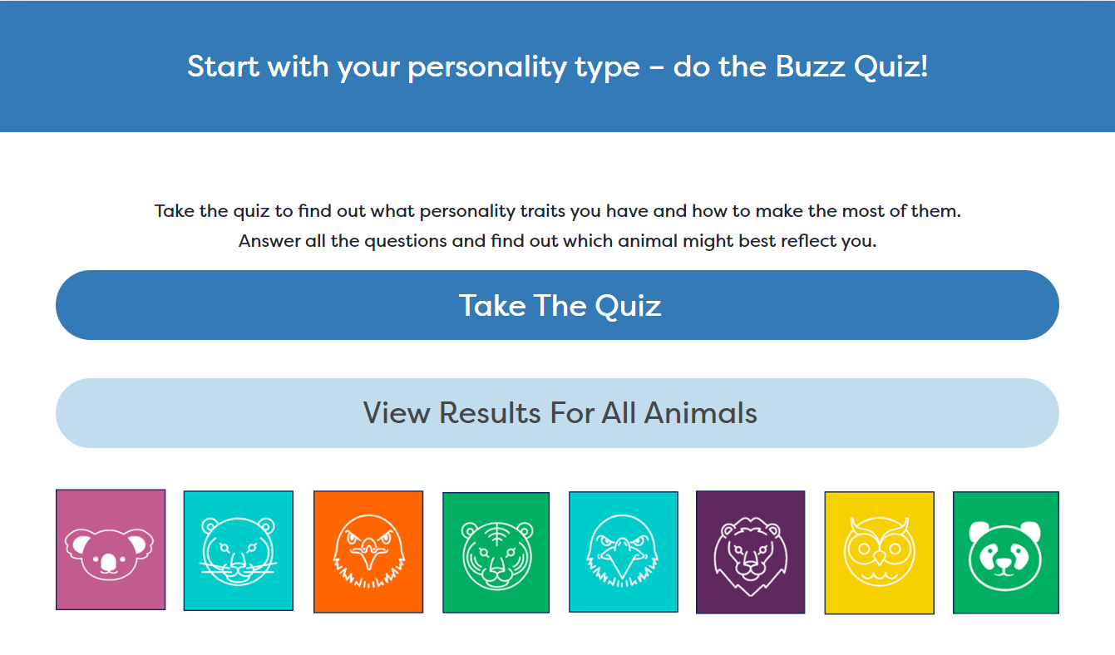

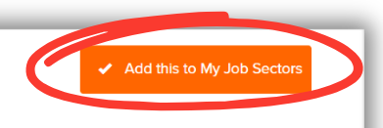
In today’s lesson you will…
Register or sign in to Careerpilot
2. Complete the Buzz Personality Quiz to discover your personality type. Make a note of your animal.
3. Explore job sectors that could be a good fit for your personality strengths
4. Save 2 job sectors that are of interest to your Career Tools.
Notes:
Explain to students what activities they will be doing shortly on Careerpilot.
Use the following slides 11-15 to explain how to complete these activities before getting started….

Slide 7
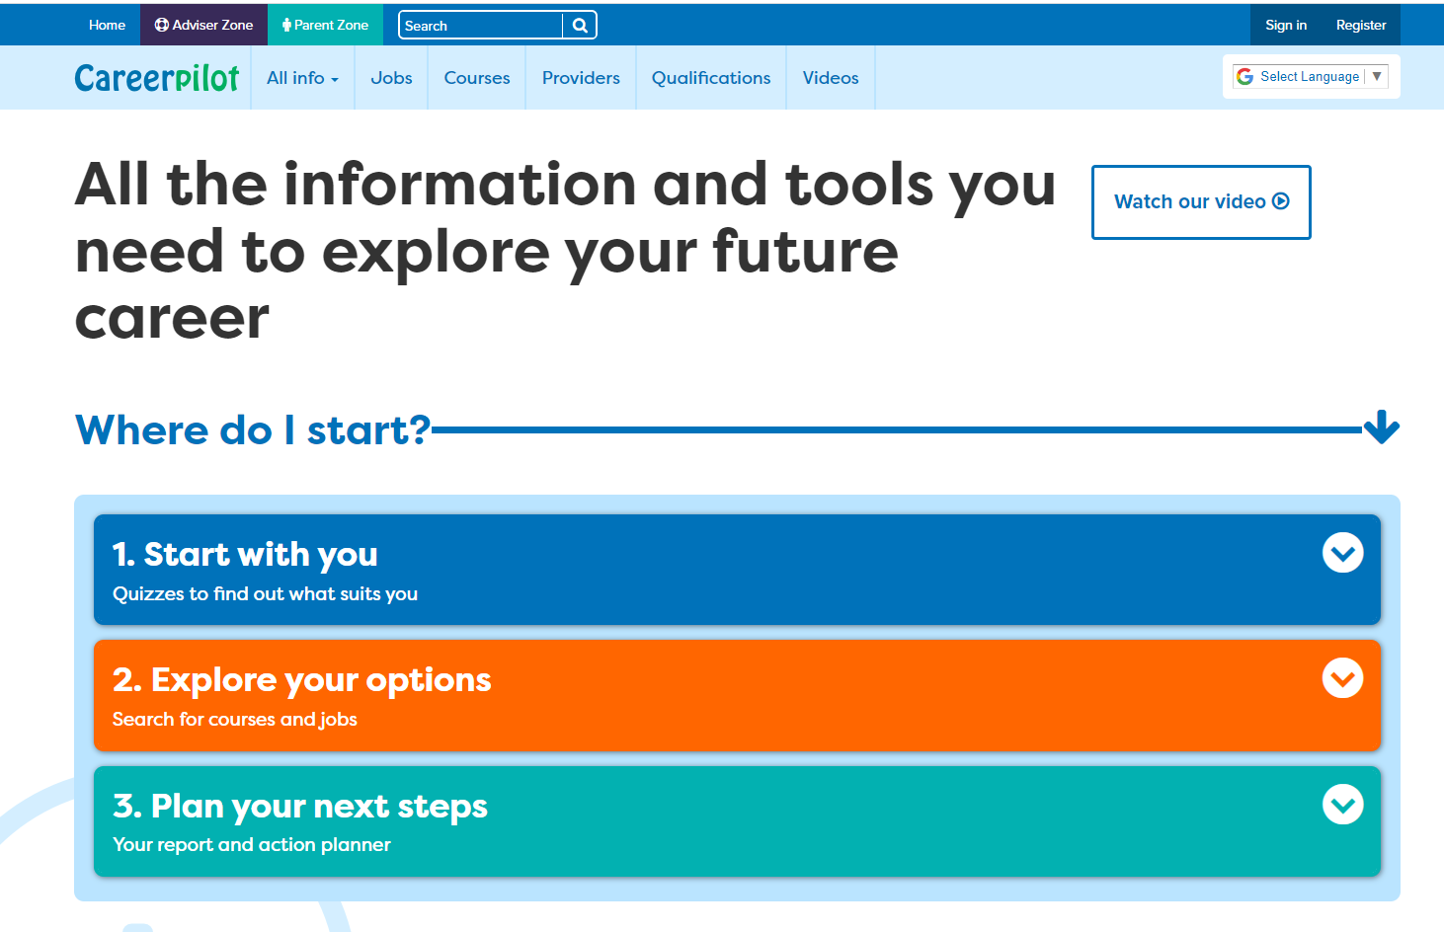
Introducing Careerpilot
Sign in to Careerpilot at school or any time at home to explore ideas for your future career.
You keep your Careerpilot account until you are 20!
Jobs, courses, qualification planner, videos
Quizzes, tools – 3 stages to help you decide
Future qualifications and pathways
careerpilot.org.uk
Notes:
Careerpilot is a website that you can use for free. It has lots of information and tools to help you to start to think about future career ideas and pathways and to get to know yourself, your skills, interests and strengths better.
The website is built around 3 stages:
Start with you – with quizzes to find out more about yourself and what jobs might suit you
Explore your options – where you can search for courses and jobs
Plan your next steps – where you can build a report and plan some actions.

Slide 8
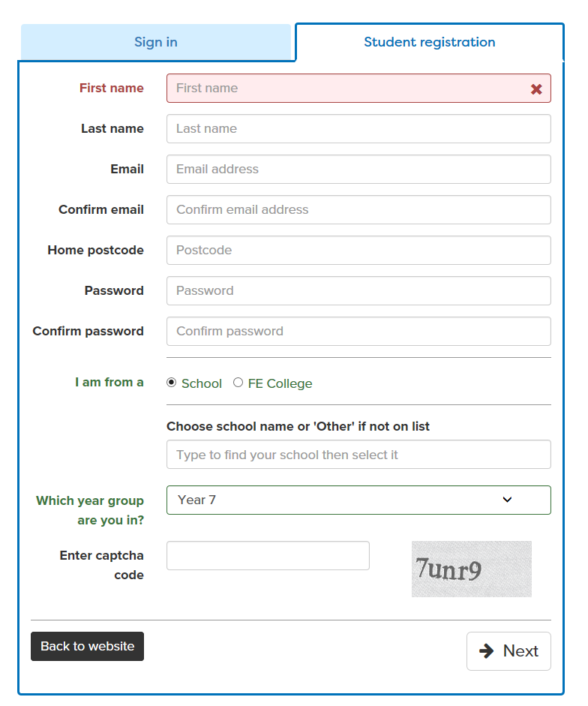

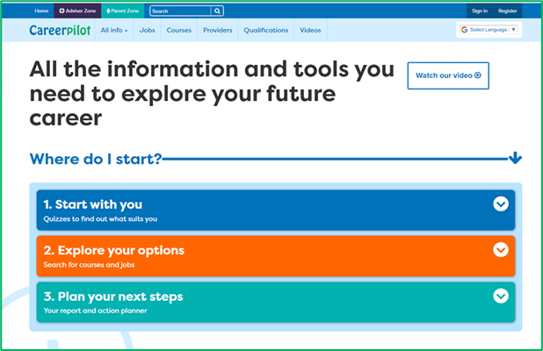
Register or sign in to Careerpilot
If you have registered before – sign in
Notes:
Show students that if they are new to Careerpilot, they need to register to use the website.
They must click on the ‘Register’ button in the top right corner to open up a short registration form that takes a few minutes to complete.
Remind students to use their school email address to register and to click on your school from the drop down list.
Students that have already registered just need to log in with their email and password.

Slide 9
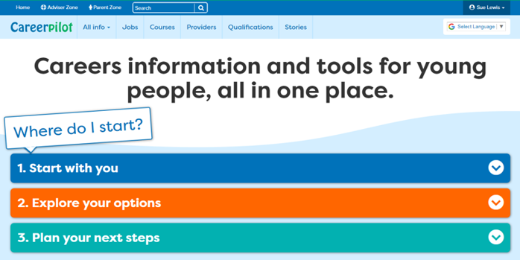
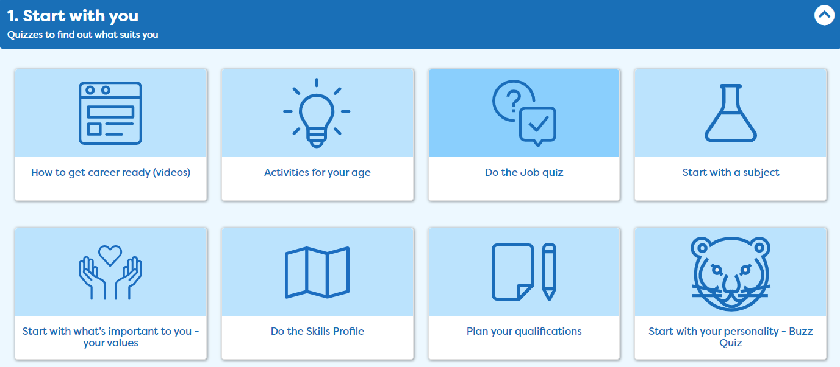
Complete the Buzz Quiz
Notes:
Once registered students need to go to ‘Start with you’ on the home page and click on ‘Start with your personality – Buzz Quiz’.

Slide 10
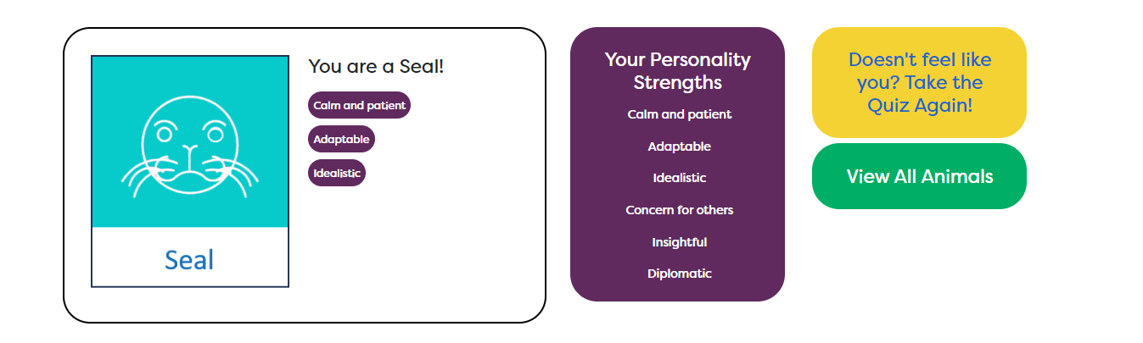
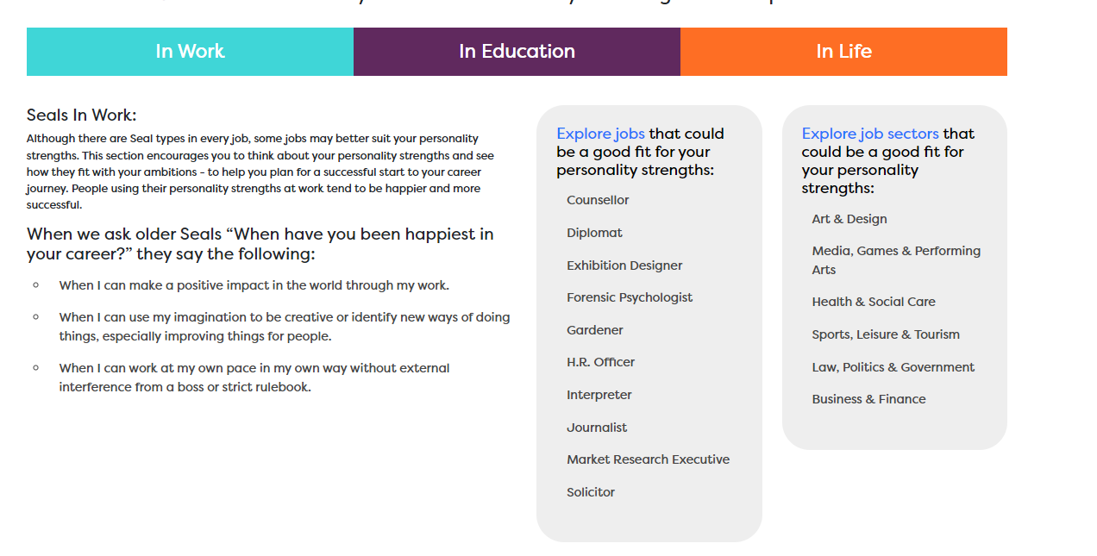
Find out what animal you are
Notes:
Find out what animal you are and explore job sectors that may suit you on Careerpilot.

Slide 11
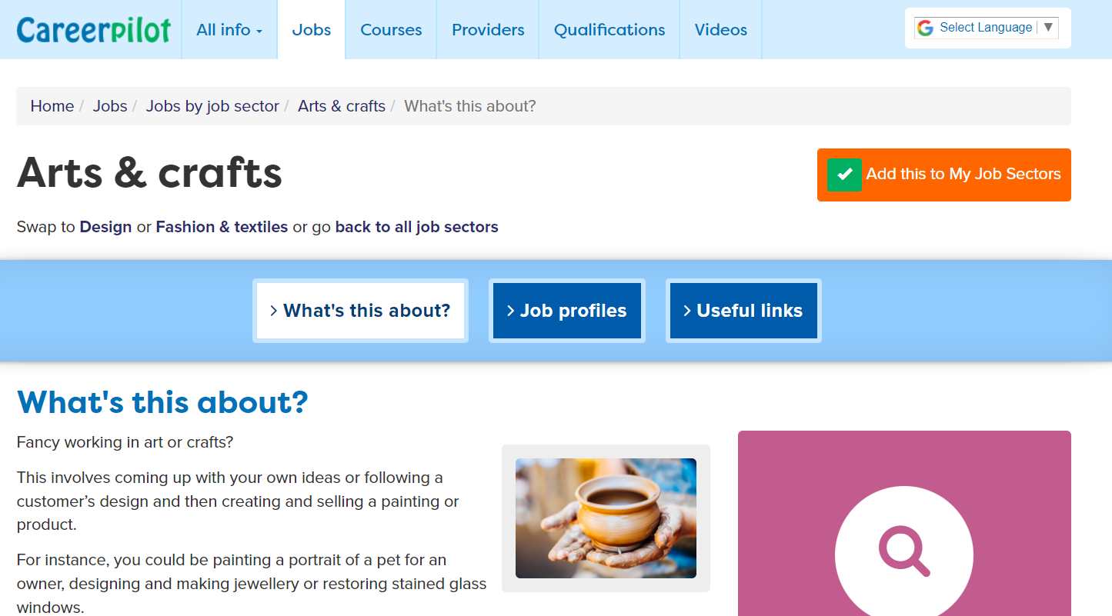
Tag 2 job sectors you’re interested in
Notes:
Students can pick two job sectors they are interested in (they can have more) and click ‘Add this to My Job Sectors’ to save in their Career Tools.

Slide 12
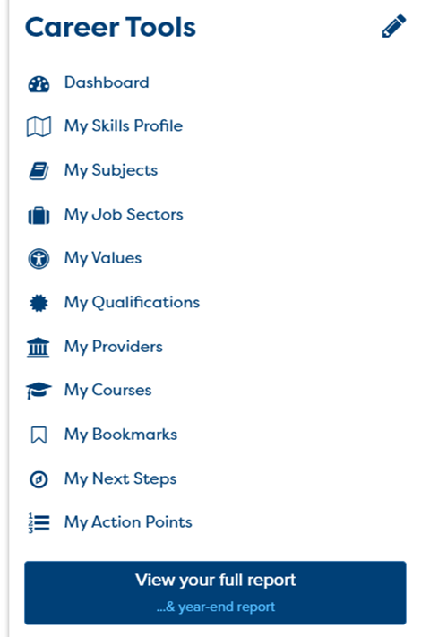
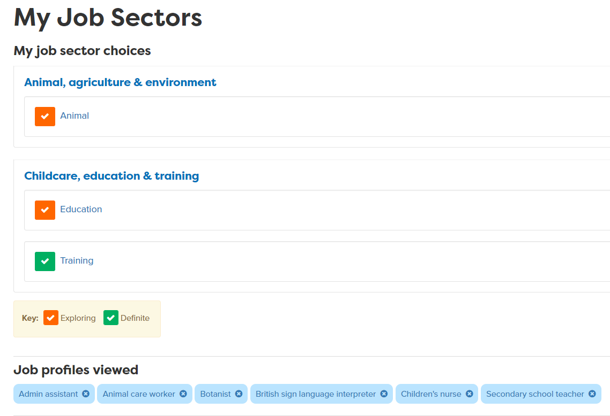
Use your Career Tools
Go to the home page and select Career Tools at top right of home page.
Click on My Job Sectors to see those you tagged and job profiles you viewed.
Notes:
Encourage students to go to their Career Tools via the home page and click on My Job Sectors to see their chosen sectors and the job profiles they have viewed.
Explain this will be saved for them to revisit at a later date and they can add more or change their choices as they go through school.

Slide 13

Careerpilot Task
20 mins
Register or sign in to Careerpilot
2. Go to Start with You. Then choose the Buzz Personality Quiz to discover your personality type. Make a note of your animal.
3. Explore job sectors that could be a good fit for your personality strengths
4. Save 2 job sectors that are of interest to your Career Tools.
Notes:
Explain to the students what activities they will be doing shortly on Careerpilot.

Slide 14


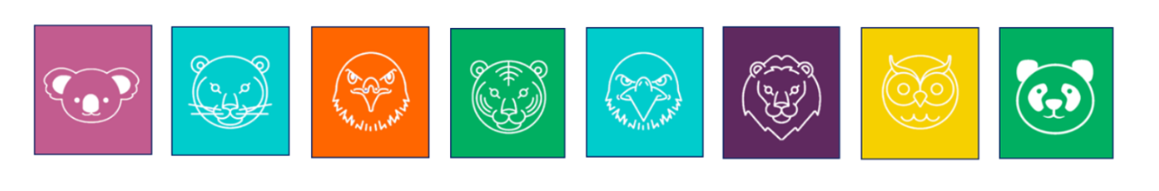
Sharing your personality type
With a partner, take it in turns to talk about your animal personality type and what jobs you found that were interesting to you.
Speak clearly
Show your partner you are paying attention while they speak
5 mins
Notes:
Give students time to talk in pairs about their skill strength.
This activity support students to develop the following skills:
Step 7 Speaking – Expressing self: I use tone, expression and gesture to be understood
Step 7 Listening – Active listening: I show I paying attention
Ask the students for feedback on how they feel they or a partner have demonstrated these skills steps.

Slide 15
Getting Career-ready
You completed a personality quiz to find out your personality type.
TODAY
You used your personality profile to explore jobs and courses that may suit you.
Notes:
The Career Development Institute has developed a careers framework that shows the skills everybody needs to have to manage their future career.
This slide shows the students which of the career learning areas (CDI) that this lesson 1 links to.
You can also share the structure of the session with students.

