Slide 1


careerpilot.org.uk
Careerpilot is closing. This resource is only available to use until 23rd October 2026.
5 Week Careers Programme
Year 8/9 – Know Your KS4 Options

Slide 2
Teacher Overview: Year 9
This 5-week careers programme aims to support students to:
Develop their career skills for life learning and work
Prepare them for the next career decisions they will have to make.
Lessons have been developed by the Careerpilot Team – all are qualified career advisers and teachers.
The programme contains all you need to deliver 5 x 50-60 minute lessons, or the first lesson can be delivered as a standalone session. All lessons use a Power Point presentation, with notes to explain screens. The first lesson has been pre-recorded as a video lesson with a member of the Careerpilot Team virtually delivering the session and providing instruction to the facilitating teacher and the students should you wish to use this delivery option.
Lesson 1, 4 and 5 require all students to have individual access to Careerpilot to register and use the wealth of information and tools offered through the site to help build their career report.
Careerpilot can be accessed through a pc, tablet or phone at www.careerpilot.org.uk
Lesson 2-3 can either be delivered with or without student online access, using Careerpilot for online tasks where possible, or through use of adapted offline tasks if individual computer/phone access is not available.
To provide feedback or ask a question contact:
careerpilot@bath.ac.uk

Slide 3



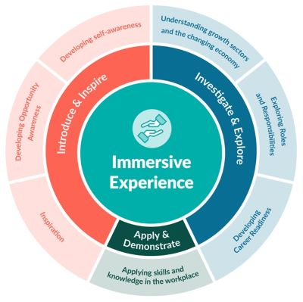



The Year 7 careers lessons are mapped to:
CDI Framework and career development skills
Gatsby Benchmarks
See the big picture by paying attention to how the economy, politics and society connect with your own life and career.
www.gatsbybenchmarks.org.uk/
The Equalex Framework to support preparation for Modern Work Experience
Manage your career actively, make the most of opportunities and learn from setbacks.
Explore the full range of possibilities open to you and learn about recruitment processes and the culture of different workplaces.
Grow throughout life by learning and reflecting on yourself, your background, and your strengths.
Introduce & Inspire
Investigate & Explore
www.thecdi.net/write/Framework/CDI_86-Framework-Guidance_in_Secondary_Schools-webFINAL.pdf
www.careersandenterprise.co.uk/modern-work-experience/equalex-for-educators/
https://www.careerpilot.org.uk/skills-profile/activities
Skills Builder Universal Framework 2.0
www.skillsbuilder.org/universal-framework
Notes:
These lessons have been developed to support students to build their career development skills, as identified by the CDI Career Development Famework. Each lesson identifies two outcomes linked to the CDI framework.
The lessons will support meeting Gatsby Benchmark 1, 2, 3, 4 and 6 and support the Equalex Framework for preparing students for Modern Work Experience as they ‘Introduce & Inspire’ students about the world of work and ‘Investigate & Explore’ jobs and careers.
The lessons provide opportunities for students to practice their essential skills as identified in the Skills Builder Framework 2.0 - www.skillsbuilder.org/universal-framework/
The relevant skills steps are identified in the teacher notes in relevant activities, with reflection questions and prompts for discussion with students as part of the plenary.

Slide 4
Lesson Overview – Year 9
Lesson 1: Choosing your Key Stage 4 options
Students explore the KS4 options and start thinking how to choose .
All students will need access to Careerpilot for this first lesson.
Lesson 2: GCSEs and how they fit with your future
Students consider how to choose subjects and research where subjects might lead.
Alternative task options for students with or without individual access to Careerpilot.
All students need paper and pens.
Lesson 3: Start with a Job
Students research jobs and look at the different routes into them.
Alternative task options for students with or without individual access to Careerpilot. All students need paper and pens. Teachers need to print Hot Jobs posters for task from Adviser Zone for task with no student computer access.
Lesson 4: Building your Skills
Students consider the importance of building their skills alongside their qualifications.
Alternative task options for students with or without individual access to Careerpilot.
All students need paper and pens.
Lesson 5: Careerpilot quiz
Students take part in a quiz to reinforce the content of the last four lessons.
All students require paired online access to Careerpilot, paper and pens.
Notes:
Use this page to navigate directly to the relevant lesson.

Slide 5


Careerpilot is closing. This resource is only available to use until 23rd October 2026.
Know Your KS4 Options
Lesson 1:
Choosing your Key Stage 4 options
This lesson can be delivered through a video recording

Slide 6


Getting Career-ready
Introduction and warm up activity – 10 mins
You will know what a qualification is and start to prepare for choosing your GCSEs
Careerpilot Activities 20-30 mins
You will be aware of key stage 4 choices and where subjects can lead
Paired activity
5-15 mins
Notes:
The Career Development Institute has developed a careers framework that shows the skills everybody needs to have to manage their future career.
This slide shows the students which of the career learning areas (CDI) that this lesson links to.
You can also share the structure of the session with students.

Slide 7

What is a career?
A career is an individual's journey through life, learning and work.
A job is something you might do to earn money as part of your career journey. Many jobs require you to have specific learning, skills and qualifications.
Notes:
Ask students if they know what a career means?
Encourage students to explain what is meant by the word career then reveal the answer.
Ask students to share it they have any idea about what sort of job or work they might like to do one day?

Slide 8




What subjects would be useful for these jobs?
Do you know which subjects you might want to study?
3 mins
Notes:
In pairs ask them to think of the school subjects that will be useful in one or two of these jobs.
Dentist – D&T, science
Nurse – Science, English, maths
Architect – maths, physics, art
Outdoor instructor – PE, geography

Slide 9

Key points about Key Stage 4 options
Watch a video on choosing your GCSE options:
www.bbc.co.uk/bitesize/articles/zrjh92p
Notes:
Watch a video on choosing your GCSE options:
www.bbc.co.uk/bitesize/articles/zrjh92p
Open this link to view video in a separate tab.

Slide 10






One place for all your careers information.
Qualifications
Academic
Technical/Vocational
Apprenticeships
Degree Achieved
Degree Year 2
HND
Foundation Degree Y2
Higher Apprenticeship
Degree Year 1
HNC
Foundation Degree Y1
Higher Apprenticeship
A levels
BTEC/OCR NEW T LEVEL Level 3
Advanced Apprenticeship
5 x GCSEs 4 - 9
BTEC/OCR Level 2
Intermediate Apprenticeship
GCSEs 1 - 3
Notes:
Explain there are three pathways, level of quals from 1 -8.
Deferent quals. But they are choosing GCSE’s which are the first stage of the quals ladder.

Slide 11
The KS4 Qualifications – what’s on offer?
GCSEs - GENERAL
VOCATIONAL
Can you name some of the GCSE subjects your school offers?
Does your school offer any alternative vocational courses (related to a job area)?
Which subjects are compulsory – you have to do them?
5-10 mins
TASK: Using the list you made as a class, make YOUR own list of YOUR top 8 subjects and then mark you favourite 3 with a *
Notes:
As a whole group see if you can name the subjects you can do at your school for GCSE
See if they know of any vocational courses on offer (teachers help the students if you know and they don’t) Maybe show list of their choices at end
Which are compulsory? Circle them - English, maths, science.
TASK - Using the list students can make a list of their top 8 subjects and then mark their favourite 3 with a *

Slide 12
Good idea to consider these things
If you want a job or career in science or engineering, then do double or triple science
If you want a job working abroad or you would like to travel, a language is really useful
If you want to study a subject in sixth form or college then don’t drop it for Year 10 e.g. you want to do Art A Level don’t drop art at GCSE
Notes:
Explain that as they are general, not choosing one doesn’t close down your options but there are a few things to bear in mind

Slide 13
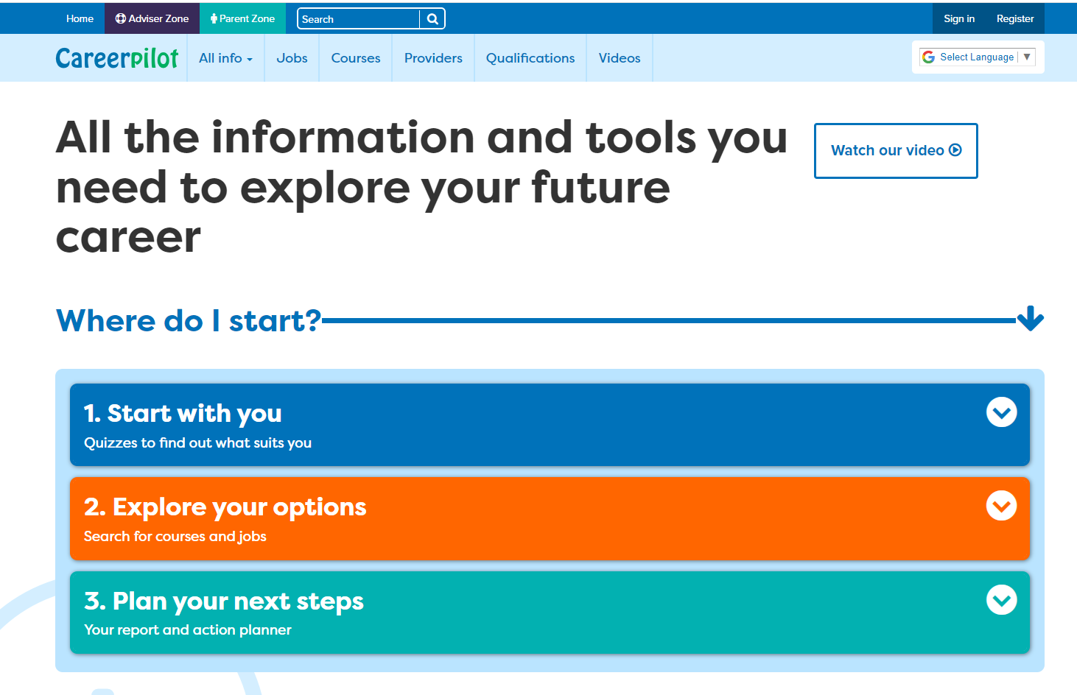
Introducing Careerpilot
Sign in to Careerpilot at school or any time at home to explore ideas for your future career.
You keep your Careerpilot account until you are 20!
Jobs, courses, qualification planner, videos
Quizzes, tools
Future qualifications and pathways
careerpilot.org.uk
Notes:
Careerpilot is a website that you can use for free. It has lots of information and tools to help you to start to think about future career ideas and pathways and to get to know yourself, your skills, interests and strengths better.
The website is built around 3 stages:
Start with you – with quizzes to find out more about yourself and what jobs might suit you
Explore your options – where you can search for courses and jobs
Plan your next steps – where you can build a report and plan some actions.

Slide 14
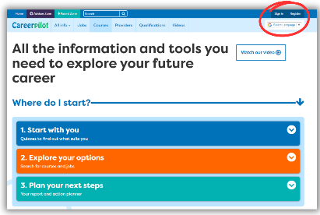

In today’s lesson you will…
Register or sign in to Careerpilot
Click on ‘Start With You’ then ‘Start with Subject’ and explore your top three subjects to see where they could lead.
Notes:
Explain to students what activities they will be doing shortly on Careerpilot.
Use the following slides 11-16 to explain how to complete these activities before getting started….

Slide 15

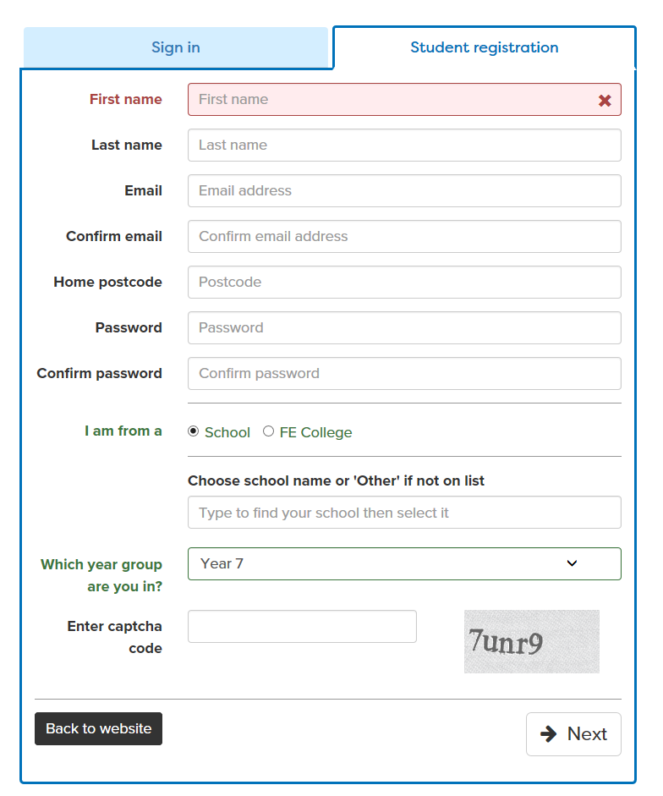
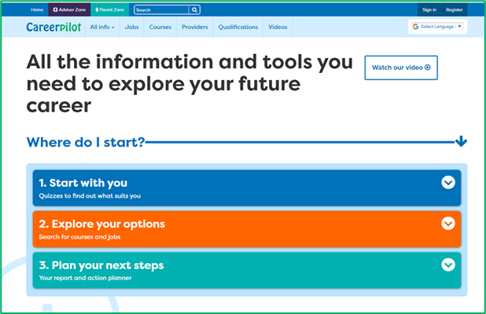
Register or sign in to Careerpilot
If you have registered before – sign in
Notes:
Show students that if they are new to Careerpilot, they need to register to use the website.
They must click on the ‘Register’ button in the top right corner to open up a short registration form that takes a few minutes to complete.
Remind students to use their school email address to register and to click on your school from the drop down list.
Students that have already registered just need to log in with their email and password.

Slide 16
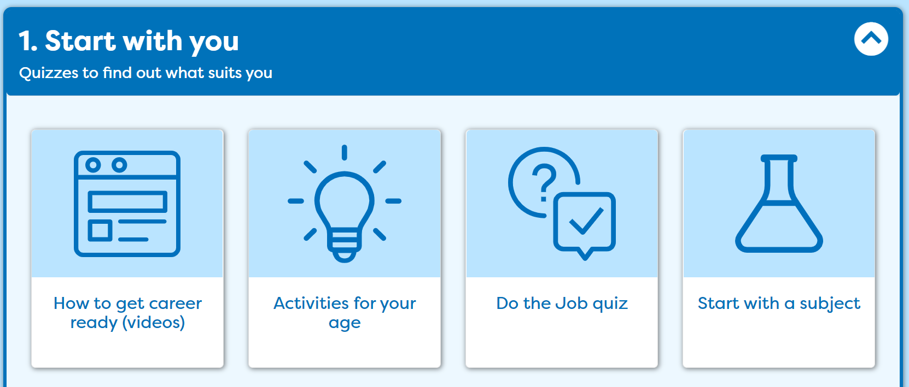
Explore subjects

Slide 17
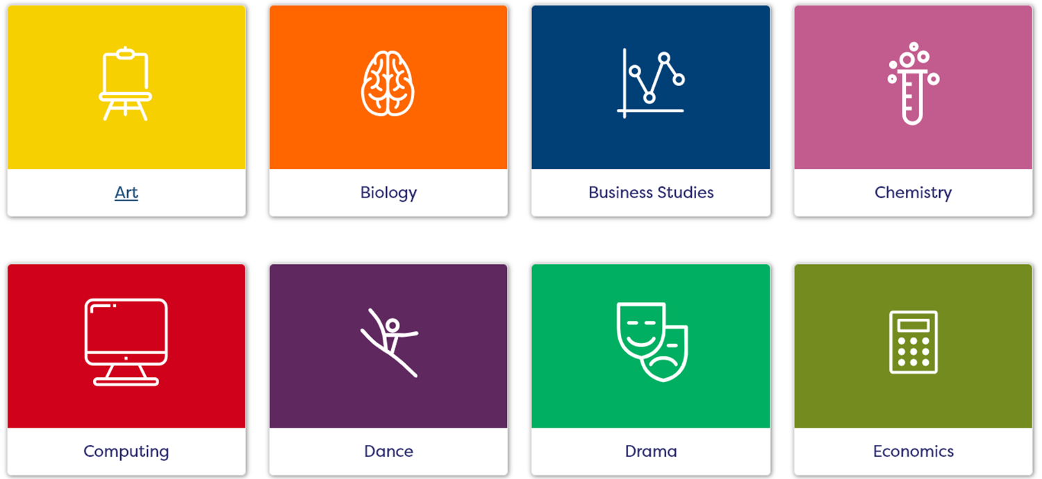
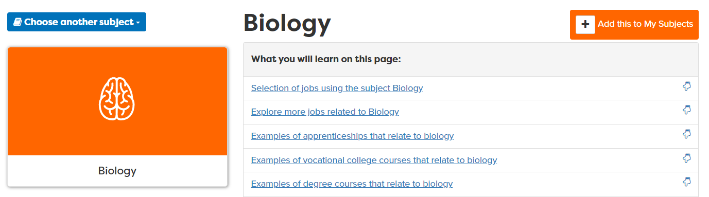
Choosing subjects
In ‘Start with a Subject’, you can look at different subjects and see what jobs they may lead on to in the future.
Look at your top 3 subjects from your list and save them.
Write down three jobs that each subject can lead on to.
Notes:
Students can use their list of subjects they are interested in as a starting point for exploring where they might lead and recording 3 jobs that each can lead onto. They could look at the job profile by clicking on the link if there is time.

Slide 18
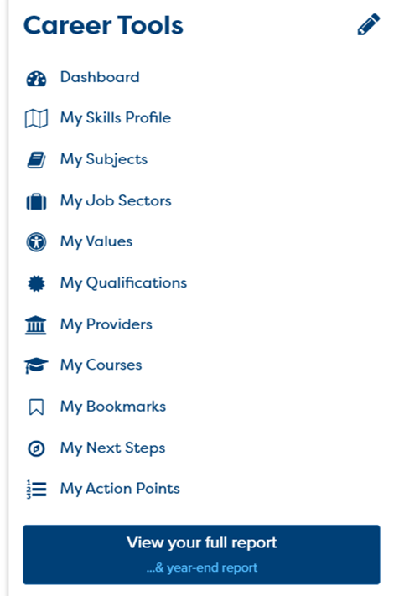
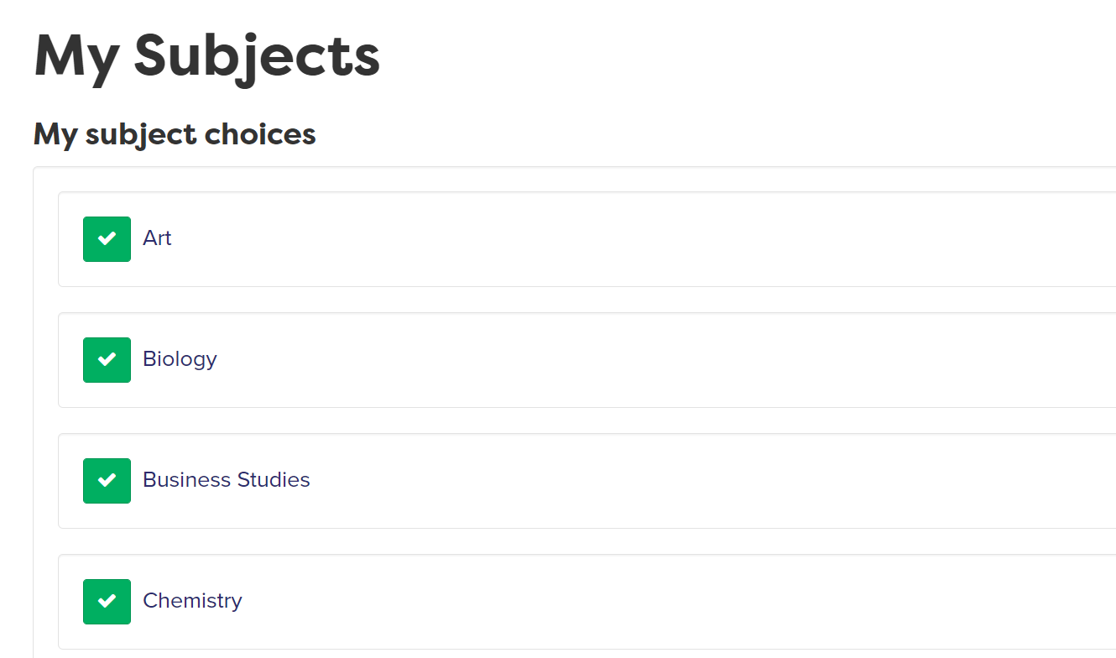
Using your Career Tools
Go to the home page and select ‘Career Tools’ at top right of home page.
Click on ‘My Subjects’ to see those you’ve ‘tagged’. You can click them to see all the information, at any time (or change them)
Notes:
Encourage students to go to their Career Tools via the home page and click on My Job Sectors to see their chosen sectors and the job profiles they have viewed.
Explain this will be saved for them to revisit at a later date and they can add more or change their choices as they go through school.

Slide 19


In today’s lesson you will…
Register or sign in to Careerpilot
2. Click on ‘Start With You’ then ‘Start with Subject’ and explore your top three subjects and see where they can lead – don’t forget to ‘tag’ them.
Make a note of 3 jobs that each could lead on to.
3. Go to your ‘Career Tools’ to check you have saved all the subjects you are interested in.
20 mins
Notes:
Explain to students what activities they will be doing shortly on Careerpilot.
Use the following slides 11-16 to explain how to complete these activities before getting started….

Slide 20

What to avoid when choosing options
3 mins
https://youtu.be/DsLfssAa1OY
Notes:
Good video to show:
What you wouldn’t do when choosing your options – i.e. choose them because you like the teacher, your friend is doing it, your parents told you to, you think it will be easy.
Video does mention Grade A – C so make sure to mention that means 4-9 in new grades

Slide 21


In pairs, write down all the things you have learnt about your Key Stage 4 options
Think about what you’ve learnt and order your points to be understood.
Listen carefully while your partner speaks and make notes to record important information
For example:
How many subjects do you usually study?
What vocational courses does my school offer?
What are the three compulsory subject?
What should you not do when choosing your options?
X
X
X
5 mins
Notes:
Students can make a note of any course or jobs of interest that are related to subjects they are interested in.
This activity can support students to build the following skills steps:
Step 6 Listening - Note-taking: I record important information
Step 4 Speaking: Organising thoughts: I order my points to be understood

Slide 22
Getting Career-ready
You know what a qualification is and start to prepare for choosing your GCSEs
TODAY
You are aware of key stage 4 choices and where subjects can lead

Slide 23
Careerpilot is closing. This resource is only available to use until 23rd October 2026.
Know Your Options
Lesson 2: GCSEs and how they fit with your future

Slide 24
Getting Career-ready
Introduction and warm up activity – 10 mins
You will see how GCSEs fit with your future career choices
Careerpilot Activities 20-30 mins
You will be aware that learning, skills and qualifications are important for your career
Presentations
5-10 mins
Notes:
The Career Development Institute has developed a careers framework that shows the skills everybody needs to have to manage their future career.
This slide shows the students which of the career learning areas (CDI) that this lesson links to.
You can also share the structure of the session with students.

Slide 25
Choosing subjects
Last lesson you made a list of subjects you wanted to do in Key Stage 4 and looked at jobs some could lead on to.

Slide 26

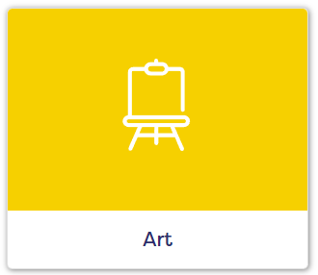

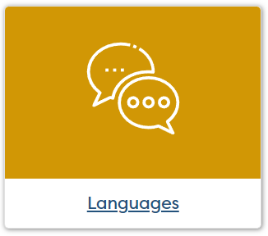
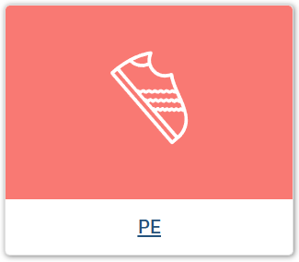
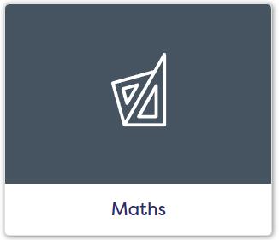
In pairs – chose a subject and come up with as many jobs as you can think of that this subject could be useful for – in 5 minutes!
5 mins
Notes:
In pairs students have 5 minutes to come up with the names of as many jobs they can think of for one of the subjects.
Find out which pair has the mostly. Look on the Careerpilot and show them some of the others for one or two subjects.
https://careerpilot.org.uk/job-sectors/subjects
5 mins task, 5 mins follow-up

Slide 27
In today’s lesson you will…
Start thinking about your future after GCSEs
2. Know more about qualifications after GCSEs
Think about job sectors you may like and about what pathways and qualifications you might need
Notes:
Explain to students what activities they will be doing shortly on Careerpilot.
Use the following slides to explain how to complete these activities before getting started….

Slide 28
GCSEs and your future
GCSEs
Post 16 – After Y11
Post 18 – After Y13/college
Jobs I would like
What I want from life
10 mins
Notes:
Students draw the 4 circles as above and then write in their thoughts to date about each one. The last box is about what’s important to them – kids, having a house, preventing climate change
Make the point that it is fine not to know at this stage but if they have got ideas they can put them in.

Slide 29
One place for all your careers information.
Qualifications
Academic
Technical/Vocational
Apprenticeships
Degree Achieved
Degree Year 2
HND
Foundation Degree Y2
Higher Apprenticeship
Degree Year 1
HNC
Foundation Degree Y1
Higher Apprenticeship
A levels
BTEC/OCR NEW T LEVEL Level 3
Advanced Apprenticeship
5 x GCSEs 4 - 9
BTEC/OCR Level 2
Intermediate Apprenticeship
GCSEs 1 - 3
Notes:
Explain there are three pathways, level of quals from 1 -8.
Deferent quals. But they are choosing GCSE’s which are the first stage of the quals ladder.

Slide 30
Student Tasks
If students have access to a computer each or in pairs continue with this presentation, looking at slides 31 – 37 and end lesson with slide 45
If students DO NOT have access to a computer, go to slide 38 to end.

Slide 31
Make a grid like this (for online task)
 | Job 1 | Job 2 | Job 3
Name of job
What pathways can you take e.g. degree, college, etc
What GCSEs grades do you need?
5 mins
Notes:
Alternatively, students can explore jobs by starting with a subject again and seeing where it might lead.

Slide 32
Register or sign in to Careerpilot
If you have registered before – sign in
Notes:
Show students that if they are new to Careerpilot, they need to register to use the website.
They must click on the ‘Register’ button in the top right corner to open up a short registration form that takes a few minutes to complete.
Remind students to use their school email address to register and to click on your school from the drop down list.
Students that have already registered just need to log in with their email and password.

Slide 33
Explore job sectors
Go to ‘Start with you’ on the homepage and select ‘Do the Job Quiz’
Review your answers if you have completed this previously.
Notes:
Ask students to complete the job sector quiz – if they have previously completed it they can look at answers they gave before and review if still relevant and overwrite if necessary.

Slide 34
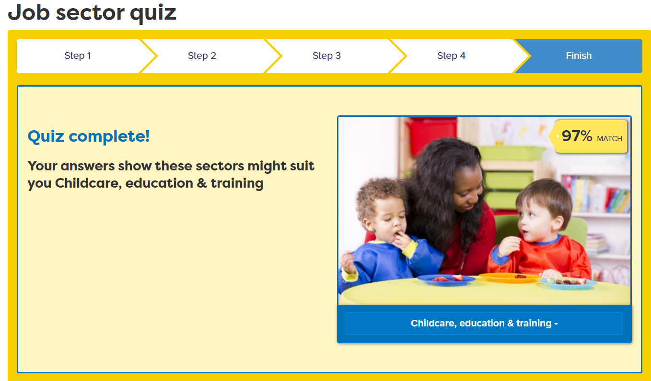


Explore Job Sectors and Job Profiles
Go to a job sector the job quiz suggested to you.
Click on ‘Job Profiles’.
Notes:
Students can explore some of the job sectors the quiz matches them with.
They can also click on ‘View all job sectors’ to explore other job sectors not in their quiz results.
From here students can explore job profiles and see the routes in and subjects that are useful for the job.

Slide 35
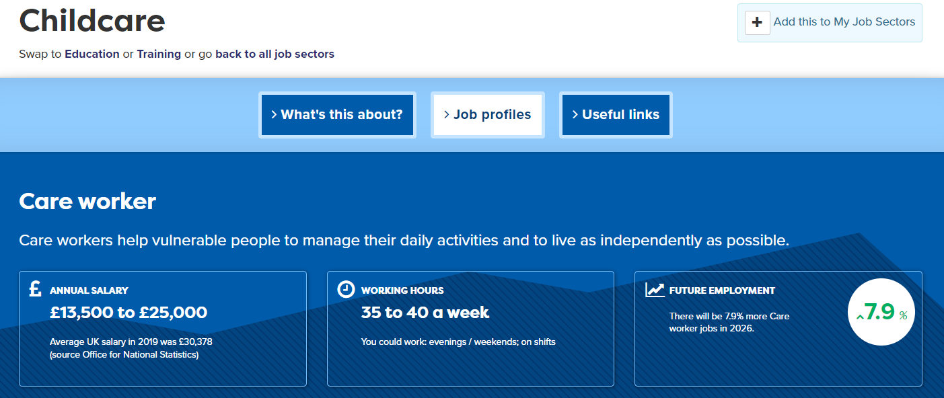
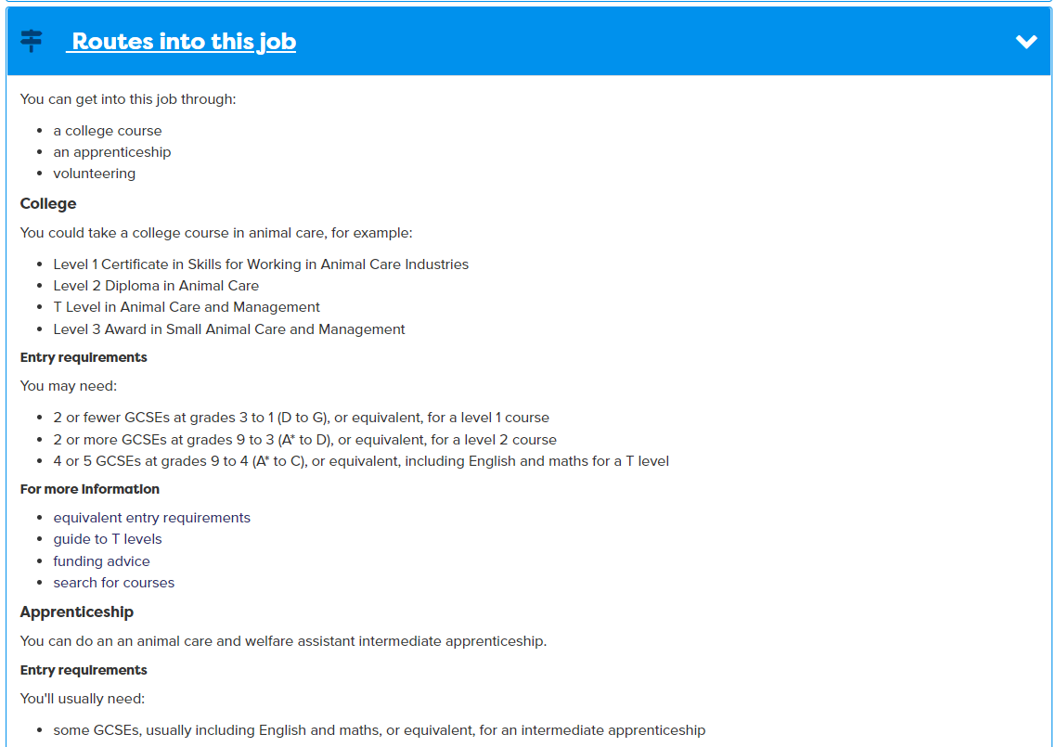
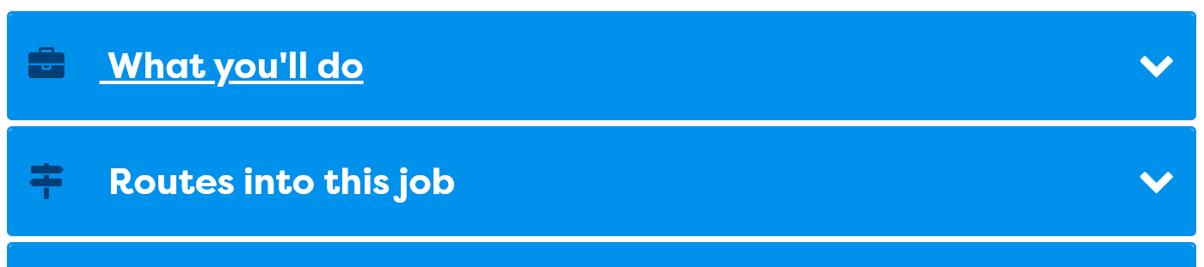
Explore and tag related job sectors
Notes:
When students find jobs of interest, encourage them to tag the job sector to add to their Career Tools.

Slide 36

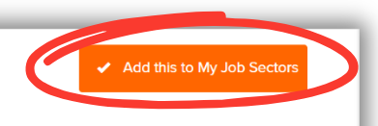
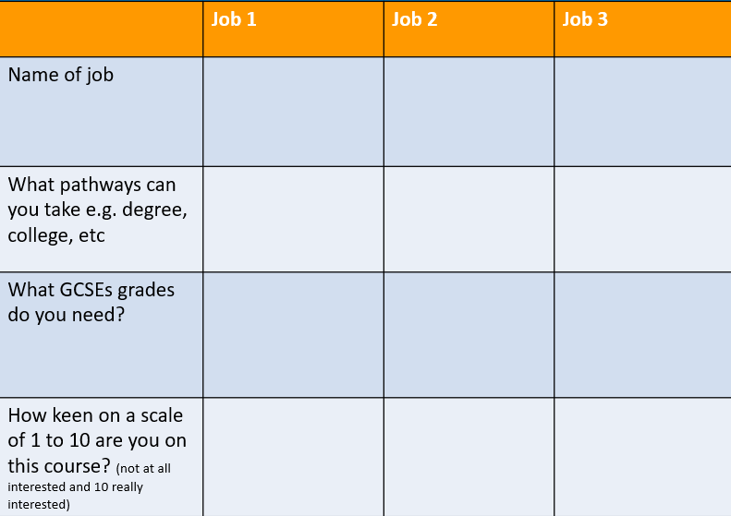
In today’s lesson you will…
Register or sign in to Careerpilot
Click on ‘Start with you’ then complete the
‘Job Sector Quiz’ and explore job profiles within suggested sectors.
3. Explore jobs profiles and tag any job sectors you’re interested in to save in your Career Tools
For 3 jobs add information to your grid
25 mins
Notes:
Explain to students what activities they will be doing shortly on Careerpilot.
Use the following slides to explain how to complete these activities before getting started….

Slide 37
Sharing with others after online task
With a partner, take it in turns to talk about the job sectors the quiz suggested to you and the jobs you looked at.
Speak clearly and use facts and examples.
Listen carefully while your partner speaks and show you are listening by summarising what you heard.
5 mins
Notes:
This activity supports developing the Speaking and Listening skills at the following steps in the Skills Builder Framework
Speaking Step 8 – Using facts: I use facts and examples to support my communication
Listening Step 9 – Summarising: I summarise or rephrase what I learnt

Slide 38
Make a grid like this and fill it in (offline task)
 | 1 e.g. English | 2 | 3
Name of subject
Think of 2 jobs this subject could lead on to | 1
 | 2
What pathways do you think you can take e.g. degree, college, apprenticeship (it could be all 3) | 1
 | 2
15 mins
Homework: Go to Careerpilot.org.uk and then to ‘Jobs’, search for the jobs on your grid and see if you are right
Notes:
Students might not know much about different routes so it would be good to show them some extras for job profiles on Careerpilot. Search for the name of a job here https://careerpilot.org.uk/job-sectors
And drill down to a ;job profile’ go to the ‘Routes in’ and see what qualifications might be needed. Point out any mention of the GCSE grades needed.
Teachers do this for a few jobs.

Slide 39

Task 2
Working individually or in pairs, create a poster to promote a GCSE subject to others for a school display.
What are the great things about this subject? What jobs can it lead on to? Why should students choose this?
Make your poster bright and attractive and use persuasive language.
You need English for every job!
Develop your communication skills
Interpret texts
Become confident at sharing ideas
20 mins

Slide 40
Sharing with others
In pairs or to the class, take it in turns to share your poster and talk about why you have chosen the subject, why it is a good GCSE choice and how it can support your future career.
Speak clearly and use the poster as a visual aid to support your points. Remember you are selling your subject!
Listen carefully while your partner speaks and think about how they use tone to persuade you.
5 mins
Notes:
This activity supports developing the Speaking and Listening skills at the following steps in the Skills Builder Framework
Speaking Step 9 – Sharing Visuals: I use images, charts or diagrams when it helps my communication
Listening Step 10 – Recognising tone: I recognize tone of communication

Slide 41
Getting Career-ready
You have seen how GCSEs fit with your future career choices
TODAY
You are aware that learning, skills and qualifications are important for your career

Slide 42
Careerpilot is closing. This resource is only available to use until 23rd October 2026.
Know Your Options
Lesson 3: Start with a Job

Slide 43
Getting Career-ready
Introduction and warm up activity – 10-15 mins
You will be aware of the range of different jobs and where they will grow
Task 20 mins
You will imagine different possibilities for yourself in your career.
Presentations
10-15 mins
Notes:
The Career Development Institute has developed a careers framework that shows the skills everybody needs to have to manage their future career.
This slide shows the students which of the career learning areas (CDI) that this lesson links to.
You can also share the structure of the session with students.
Please note this lesson focuses on the qualifications required for different jobs, building on the focus on skills in Year 8.

Slide 44
Qualification Levels
There are different routes you can take to get the qualifications you need to do a job you are interested in.
Academic
Vocational/Technical
Apprenticeships
Degree Achieved
Degree Year 2
HND
Foundation Degree Y2
Higher Apprenticeship
Degree Year 1
HNC
Foundation Degree Y1
Higher Apprenticeship
A levels
BTEC/OCR T Level Level 3
Advanced Apprenticeship
GCSEs 4 - 9
BTEC/OCR Level 2
Intermediate Apprenticeship
GCSEs 1 - 3
Notes:
Check understanding of qualification levels. Explain that there are three qualification pathways to get to employment – the academic route, vocational route or work-based route.
In Key Stage 4 students will work towards Level 1 and 2 academic and vocational qualifications in school. Level 2 is getting 5 GCSEs grade 4-9.
Show them the other levels and make the point that all pathways can lead to a degree.
Different jobs require you to have a minimum level of qualifications.

Slide 45

Warm up activity
What qualifications do you think you would need to become a nurse?
You need to study at degree level either at university OR on an apprenticeship
You will need 4-5 GCSEs, including English, Maths and Science at grades 4+
You need 2 or 3 A-Levels including a science, OR a Level 3 Diploma or T-Level in Health and Social Care or Nursing

Slide 46

Sami is a
Warehouse Manager
Warehouse Manager
Salary: £23,000-£34,000
Leah is a Warehouse Manager
Academic
Vocational
Work-based
Degree Achieved
Degree Year 2
HND
Foundation Degree Y2
Higher Apprenticeship
Degree Year 1
HNC
Foundation Degree Y1
Higher Apprenticeship
A levels
BTEC/OCR T Level Level 3
Advanced Apprenticeship
GCSEs 4 - 9
BTEC/OCR Level 2
Intermediate Apprenticeship
GCSEs 1 - 3
Notes:
There are many ways to achieve the same careers (although for some there are very set routes, like doctor, vet, etc. so they need to check)
Both Sami and Leah are working as Warehouse Managers.
Sami did a Level 3 Diploma in Warehouse Operations, then went on to university to get a Degree in Supply Chain Management with a work placement before getting a job as a Warehouse Manager.
Leah did a Level 3 Advanced Apprenticeship in Business Administration then went straight into employment and worked her way up to Warehouse Manager after a couple of years in the workplace.

Slide 47
What is LMI?
LMI stands for Labour Market Information - information about the jobs market.
LMI can tell you about different jobs and the skills and qualifications required to be able to do the job.

Slide 48
Student Tasks
If the students have access to a computer each or in pairs, continue with this presentation, looking at slides 49 – 53 and then go to slide 55 for final task.
If students DO NOT have access to a computer, go to slide 54 and continue to end.

Slide 49



In today’s lesson you will…
Have a reminder of different qualifications and routes
2. Go to Job Sectors and look at 3 different job profiles
3. Look at what LMI (Labour market information) the job shows eg. is it going to grow, how much will you earn, etc.
4. Create a table to show what you find out about each job.
Notes:
Explain to students what activities they will be doing in this lesson

Slide 50
Register or sign in to Careerpilot
If you have registered before – sign in
Notes:
Show students that if they are new to Careerpilot, they need to register to use the website.
They must click on the ‘Register’ button in the top right corner to open up a short registration form that takes a few minutes to complete.
Remind students to use their school email address to register and to click on your school from the drop down list.
Students that have already registered just need to log in with their email and password.

Slide 51
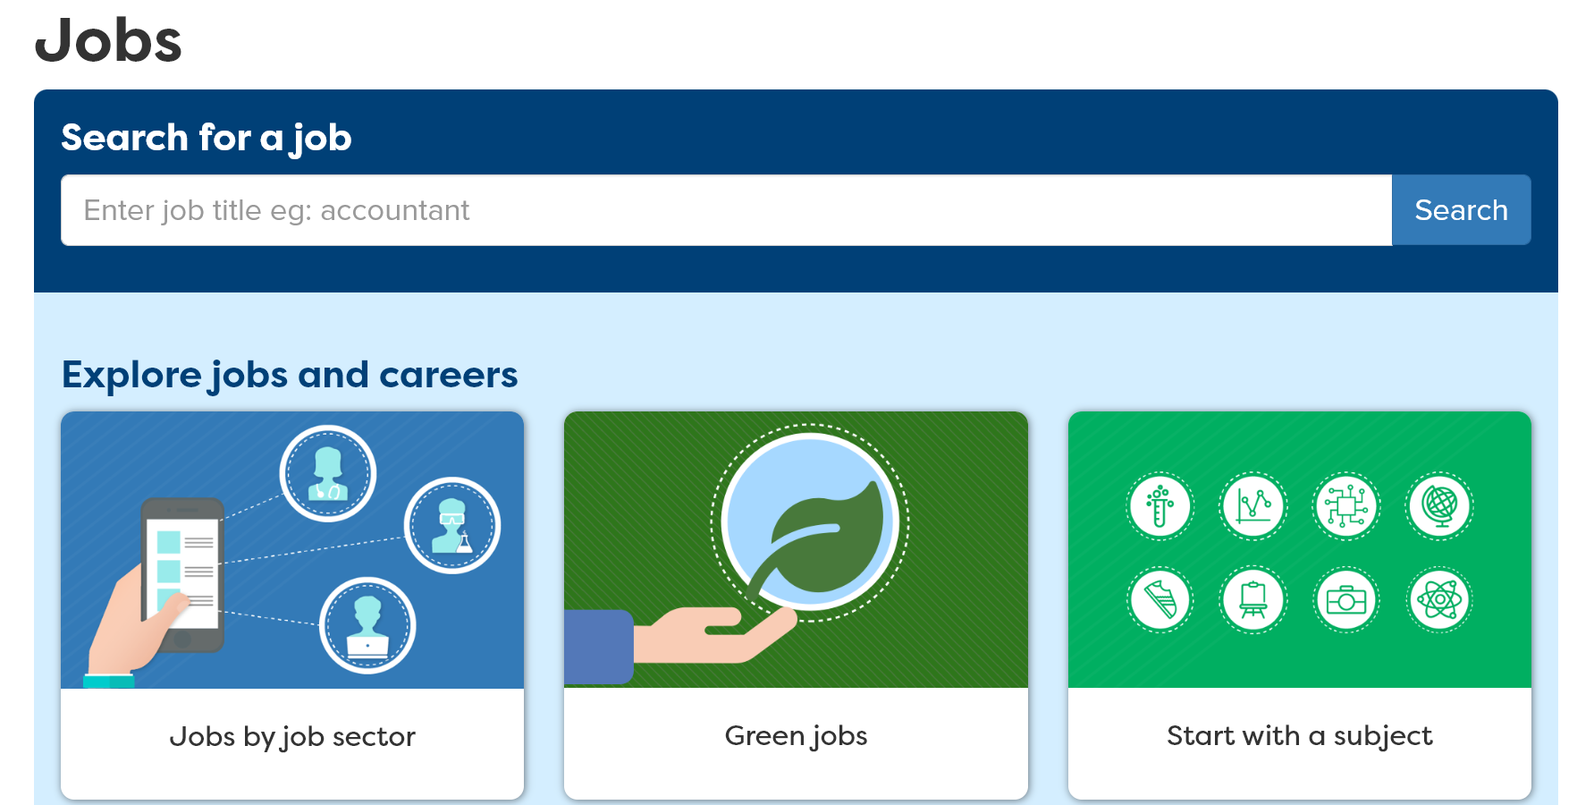

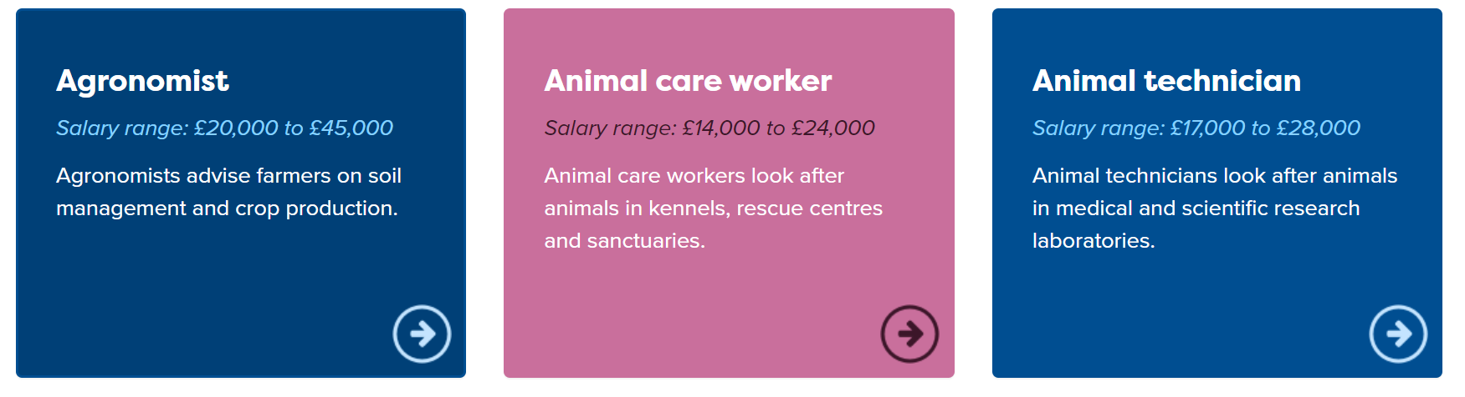
Using Careerpilot to look at jobs
Notes:
Students can find out more about Green Jobs by using Careerpilot.
Some green jobs are listed in the Jobs section, by clicking on Green Jobs.

Slide 52
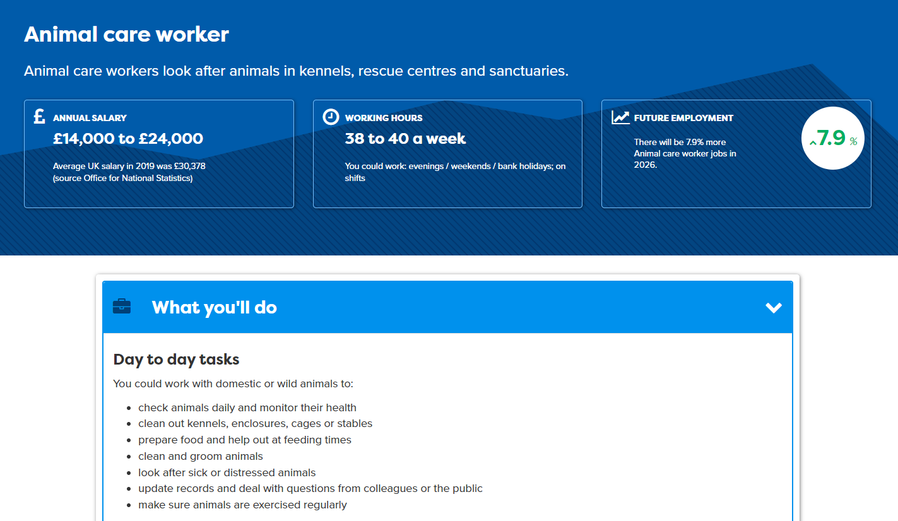
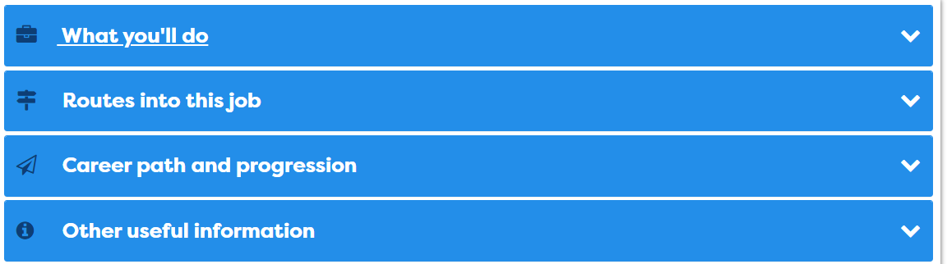
Using Careerpilot to look at LMI
Notes:
Students to can explore LMI using Careerpilot, as every job profile gives information about the salary, working hours and if the job is set to grow or decline over the next few years. Also what the different routes are into the job and the qualifications needed.

Slide 53
Careerpilot Task
Log in to Careerpilot
2. Go to ‘Jobs’ and look at 3 different job profiles
3. Use the information on the job profile to look at:
Whether it will grow or not
What are the routes into this role
20 mins
4. Create a table or poster to show what you found out about each job.
Click here for the next slide
Notes:
Recap to students what activities they now need to complete on Careerpilot.
Ask a few to tell you which of the jobs they looked at will grow more.
Also, ask where in the country is the best place to look for that job (bar graph shows this on each job profile) Maybe show this for some jobs by going to https://careerpilot.org.uk/job-sectors and looking at a job profile

Slide 54

Task
Look at the job profiles provided. Pick 3 jobs of interest and use the labour market information on the profiles and make a note of
What you would do in this job
The routes to get there
Relevant subjects
20 mins
Notes:
Log in to Careerpilot to print off a selection of Hot Jobs posters for students to look at – there are sets of posters for Green Jobs, Digital and IT and NHS jobs. You may share them on tables or displayed on the wall.
https://www.careerpilot.org.uk/adviser-zone/hot-jobs-resources
You may support students to find out more about some of the jobs by searching for them on the Careerpilot job search to bring up the more detailed job profiles: Careerpilot : Jobs
Extension task – Students could think of three more jobs of interest to research on Careerpilot as homework.

Slide 55
Sharing with others
With a partner, take it in turns to talk about jobs you have researched and what you found out about them
  Speak clearly and think about using tone, expression and gesture to engage listeners using your poster/table as a visual aid.
Listen carefully while your partner speaks and show you are listening by summarising what you heard.
10 mins
Notes:
This activity can support students to build the following skills steps:
Step 8 Listening - Summarising: I show I am listening by summarising or rephrasing what I have heard
Step 9 Speaking – Speaking engagingly: I communicate in a way that is engaging for my audience

Slide 56
Getting Career-ready
You are aware of the range of different jobs and where they will grow
TODAY
You have imagined different possibilities for yourself in your career.

Slide 57
Careerpilot is closing. This resource is only available to use until 23rd October 2026.
Know Your Options
Lesson 3: Building Your Skills

Slide 58
Getting Career-ready
Introduction and warm up activity – 10-15 mins
You will complete or update your skills profile.
You will talk about your skills strengths and interests with others in your class.
Careerpilot Activities 20-30 mins
You will recognise the importance of building skills alongside qualifications for your career.
Presentations
5-15 mins
Notes:
The Career Development Institute has developed a careers framework that shows the skills everybody needs to have to manage their future career.
This slide shows the students which of the career learning areas (CDI) that this lesson links to.
You can also share the structure of the session with students.

Slide 59
What skills do we need for work?
Alongside your GCSE qualifications you also need to keep developing certain skills for a successful career.
Some technical skills will be specific to a job, like computer skills to work in IT or food preparation skills to work in catering, but there are also some essential skills that are needed by everybody, for any job.

Slide 60




Skills Warm-up
Working in pairs, you have 5 minutes to try to think of as many different skills that you may need for the world of work.
Which skills do you think are essential skills that everyone needs for any job?
5 mins
Notes:
Students must work in pairs to write down as many skills as they can that may be needed for work.
They have 5 minutes to work together and to list, draw or create a mind map of skills on paper.
Ask them to circle skill they think are essential for every job.

Slide 61






The Essential Skills
Notes:
Class discussion – what skills did students come up with?
There are eight skills that have been identified by employers as being essential to any job. They are people skills, so are all about how you communicate with others, how you manage yourself and come up with new ideas.
Communication:
Listening - Receiving, retaining and processing of information
Speaking - Transmitting information or ideas
Creative Problem Solving:
Creativity – Using imagination and generating new ideas
Problem Solving – Finding solutions to problems
Self-management:
Planning – Setting goals and designing routes to achieve them
Adapting- overcoming challenges and setbacks to achieve goals
Collaboration:
Teamwork - Working cooperatively with others to achieve a shared goal
Leadership - Supporting, encouraging and motivating others to achieve a shared goal

Slide 62
Student Tasks
If the students have access to a computer each or in pairs, continue with this presentation, from slide 63-69 and come back to slide 72 for final 10 minute task
If students DO NOT have access to a computer, go to slide 70 to end.

Slide 63


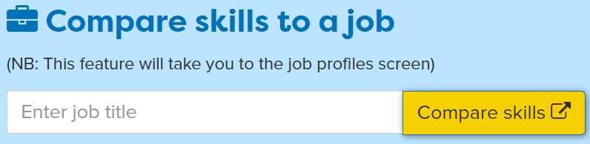
In today’s lesson you will…
Register or sign in to Careerpilot
Complete or update your Skills Profile
3. Add 2 new activities where you have developed your skills
4. Compare your skills with those needed for 3 different jobs
Notes:
Explain to students what activities they will be doing shortly on Careerpilot.
Use the following slides to explain how to complete these activities before getting started….

Slide 64
Register or sign in to Careerpilot
If you have registered before – sign in
Notes:
Show students that if they are new to Careerpilot, they need to register to use the website.
They must click on the ‘Register’ button in the top right corner to open up a short registration form that takes a few minutes to complete.
Remind students to use their school email address to register and to click on your school from the drop down list.
Students that have already registered just need to log in with their email and password.

Slide 65

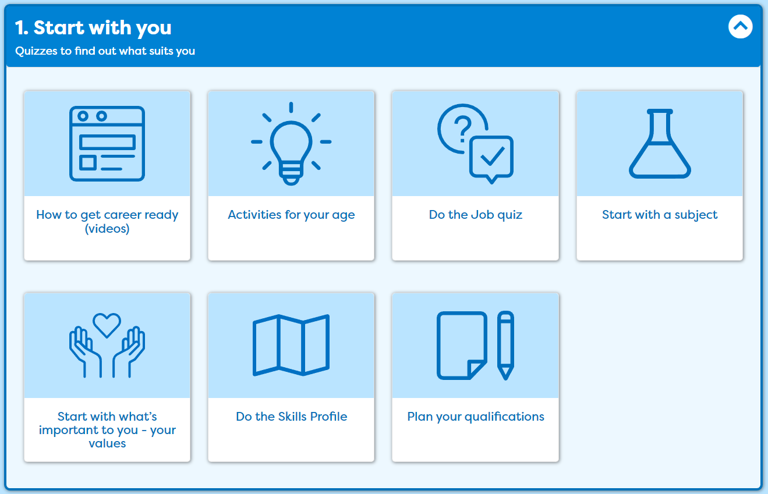
Complete or update your Skills Profile
Notes:
Once registered students need to go to ‘Start with you’ on the home page and click on ‘Do the Skills Profile’.
Students will need to complete the skill profile quiz to identify skills they have already started to develop.

Slide 66
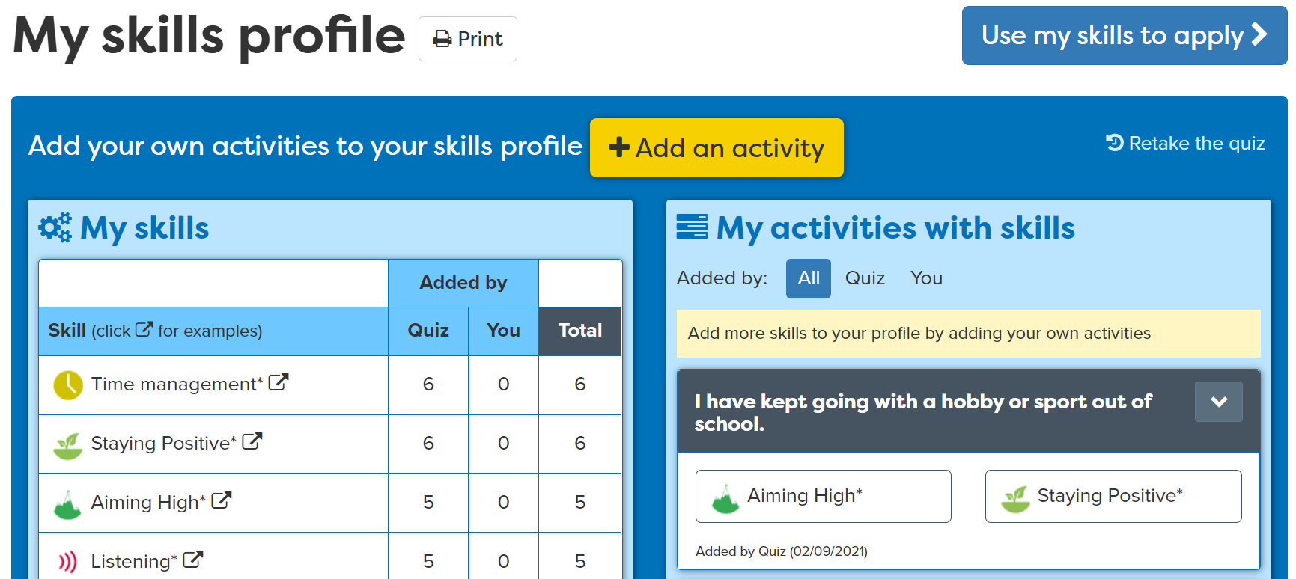
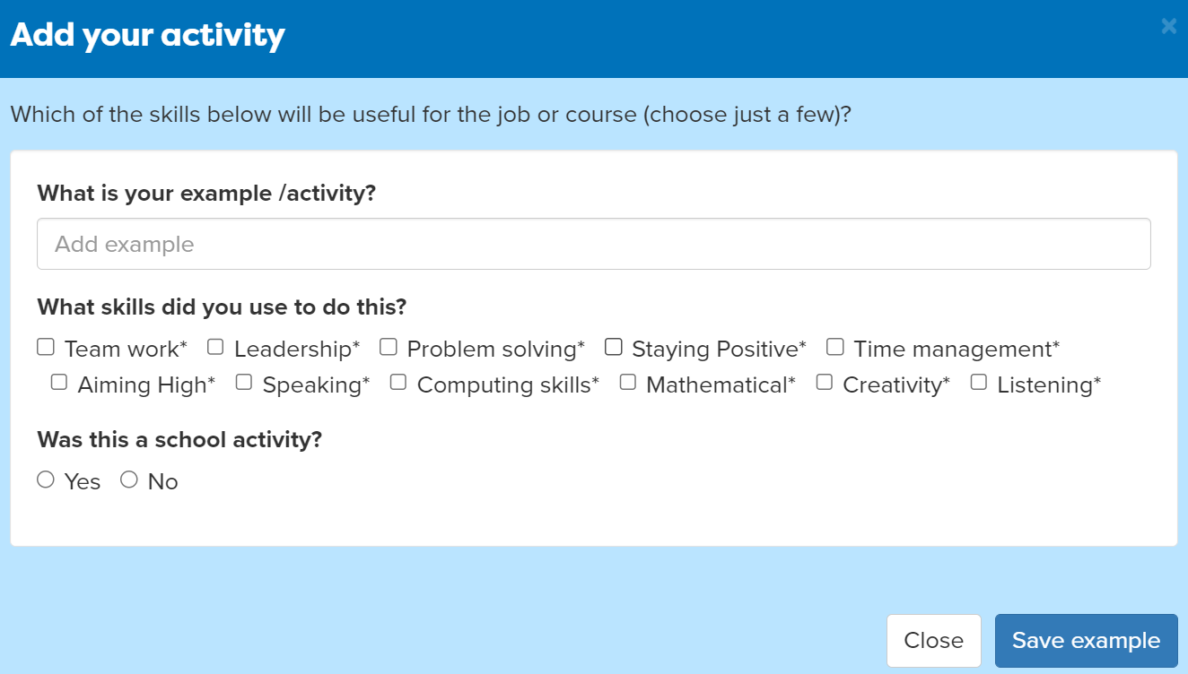
Add activities
Notes:
Students can add activities that they have completed where they have been building their skills.
For example, they may take part in a club outside of school where they use Teamwork skills.

Slide 67
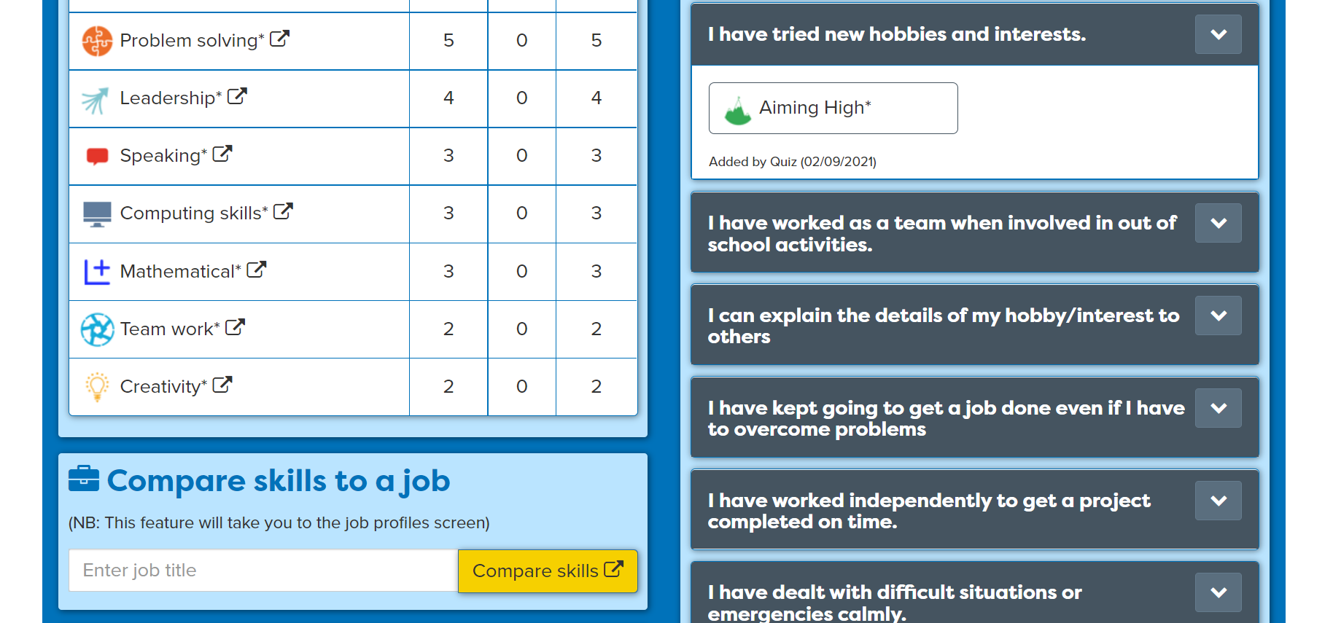
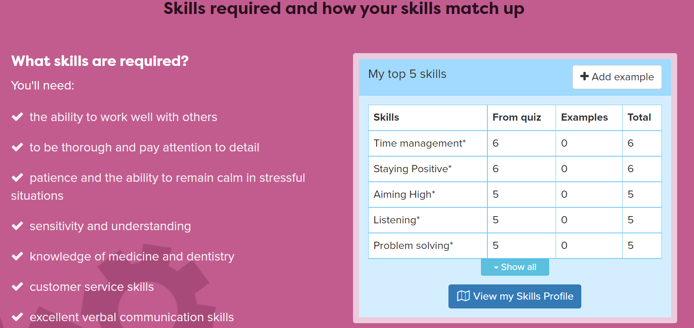
Compare your skills with a job
Notes:
Students can compare their own skills with those needed for 3 different jobs. Are there skills they need to develop further?
This will open the job profile so they can find out more about the job they’ve selected.
Extension: Students may wish to take notes about any jobs that are of interest, noting salary and day to day tasks.

Slide 68
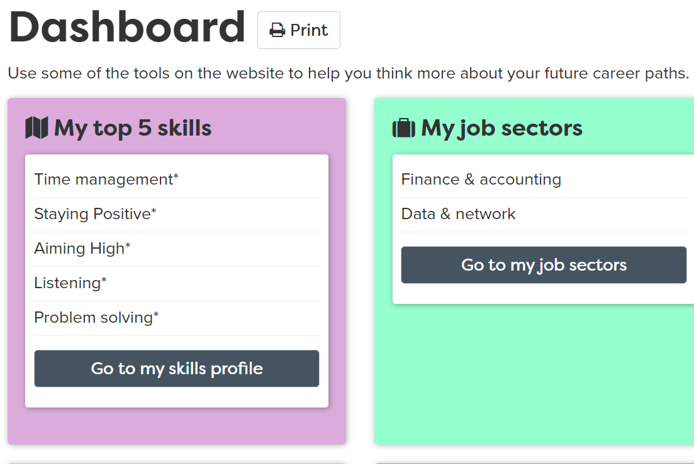
Using your Career Tools
Notes:
Encourage students to go to their Career Tools via the home page and select Career Tools at top right of home page.
Click on My Skills Profile to see your results or view skills on the Dashboard.
Explain this will be saved for them to revisit at a later date and they can add more or change their choices as they go through school.

Slide 69
Careerpilot Task
20 mins
Register or sign in to Careerpilot
2. Complete or update your Skills Profile
3. Add 2 new activities where you have developed your skills
4. Compare your skills with those needed for 3 different jobs
Click here for next slide
Notes:
Reminder of activities for students to work through with timings.

Slide 70
Individual Task
Your name
School clubs
Activities out of school
Subjects taking
Create a mind map that is all about you. It needs to have your name in the centre and should show the following:
Subjects you are currently taking
School clubs you take part in.
Any hobbies or activities you have outside of school – could include gaming, baking, reading, using social media, caring duties within the family, helping neighbours etc.
15 mins
Notes:
You may need to model how to draw a mindmap for students and come up with a few examples to get students thinking – consider school activities, outside school hobbies and clubs, helping with family members, babysitting etc.

Slide 71

Individual Task
Draw out a table with each of the eight essential skills and using your mindmap, think about where you have opportunities to build these skills, both in school and outside of school.
Write down at least two examples for each skill.
Which two skills do you think are your skills strengths?
15 mins
Essential Skill | Example
Teamwork | Playing in the local football team
 | Taking part in the school play
Notes:
You may need to come up with a few more examples to get students thinking – consider school activities, outside school hobbies and clubs, helping with family members, babysitting etc.

Slide 72
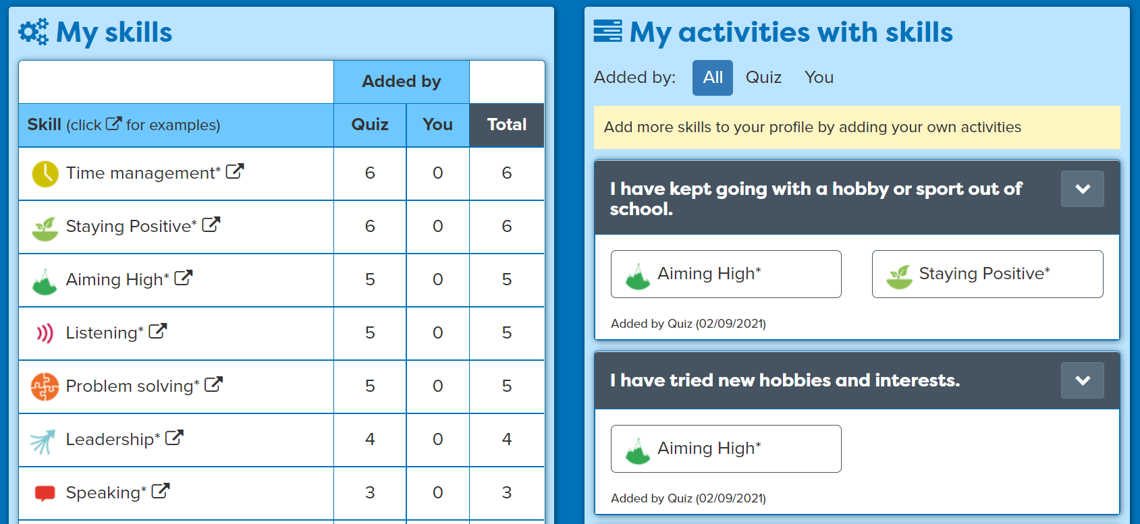
Sharing your skills
With a partner, take it in turns to talk about your skills strengths.
Speak clearly and show some examples of where you have been building skills.
Listen carefully while your partner speaks and show you are listening by summarising what you heard.
10 mins
Notes:
This activity can support students to build the following skills steps:
Step 8 Listening - Summarising: I show I am listening by summarising or rephrasing what I have heard
Step 8 Speaking - Using facts: I use facts and examples to support my communication

Slide 73
Getting Career-ready
You have completed a skills profile and know your skills strengths and areas to develop.
You can talk about your skills strengths with others in your class.
TODAY
You recognise the need to build skills alongside qualifications for your career.
Notes:
Ask class to list the eight essential skills.
Communication skills - Listening and Speaking
Creative Problem Solving skills - Problem Solving and Creativity
Self-management skills - Staying Positive and Aiming High
Inter-personal skills - Leadership and Teamwork
Ask class to put hands up if they have completed the skills profile and know their current skills strengths.

Slide 74
Careerpilot is closing. This resource is only available to use until 23rd October 2026.
Know Your KS4 Options
Lesson 5: Careerpilot Quiz

Slide 75
Warm-up
As a class can you list all of the subject choices you have at your school for Key Stage 4.
5 mins
Notes:
Use the whiteboard to capture subjects from class discussion – you may want to refer to your school website to show students where they can view their subject choices.

Slide 76

Careerpilot Quiz
Log in to Careerpilot and find the answer to the following questions:
1. What is the highest level of qualification shown in the Qualification Planner?
2. Name 3 different Level 3 qualifications
3. Name 3 compulsory subjects you have to study at GCSE
4. What qualifications do you need to become a Police Officer?
30 mins
5. Name 3 jobs that relate to the subject Maths.
6. Name 3 degree courses that relate to the subject PE.
Notes:
Explain to students what activities they will be doing shortly on Careerpilot.
Students can work individually or in pairs to find the answers. Students to make a note of the answers.

Slide 77
Careerpilot Quiz
What is the highest level of qualification shown in the Qualification Planner?
https://www.careerpilot.org.uk/qualifications
2. Name 3 different level 3 qualifications
https://www.careerpilot.org.uk/qualifications
3. Name 3 compulsory subjects you have to study at GCSE
https://www.careerpilot.org.uk/information/your-choices-at-14/choosing-gcses-compulsory-and-optional
4. What qualifications do you need to become a Police Officer?
https://www.careerpilot.org.uk/job-sectors/law/job-profile/police-officer
5. Name 3 jobs that relate to the subject Maths.
https://www.careerpilot.org.uk/job-sectors/subject/maths
6. Name 3 degree courses that relate to the subject PE.
https://www.careerpilot.org.uk/job-sectors/subject/pe
Notes:
Ask students to share the answers and use the links to work through finding any of the answers together on Careerpilot.

Slide 78
Getting Career-ready
You have started to prepare for choosing your GCSEs
You have imagined different possibilities for yourself in your career.
You recognise the need to build skills alongside qualifications for your career.
Over the last 5 lessons
You are aware that learning, skills and qualifications are important for your career
You have completed a skills profile and know your own skills strengths.
You have talked about your own strengths with others in your class.
You are aware of the range of different jobs and that many require specific learning, skills and minimum qualifications and have used LMI to research them.
Notes:
Ask students to put their hands up if they have a better idea of what subjects they are going to choose for GCSEs since these lessons
Ask for a few examples of jobs students are interested in and if they know what qualifications they would need to do them.

